Slide 1
Civil War

Slide 2
Other Names
The War between the states
The War of Secession
The War for Southern Independence
The War of Northern Aggression

Slide 3
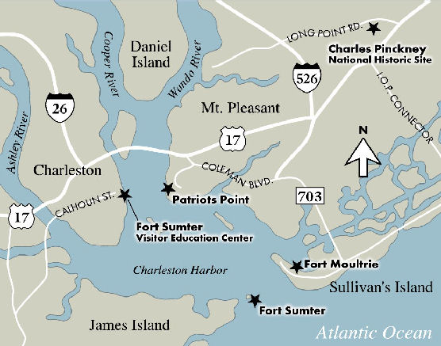
Boiling Point
Soon after secession begins..
  South seizes most federal bases
  Ft. Sumter still help by Union
  South cuts supplies to fort in 1864
Lincoln takes office and is forced to make a decision…
  Order retreat of troops and thus recognize legitimacy of secession
  - or-
  2. Fire on the blockade and be held responsible for starting war

Slide 4
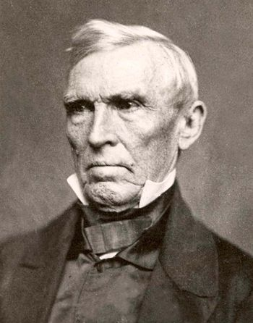
Attempts to Compromise
Crittenden Compromise
  Called for revival of Missouri Compromise line
  Republicans Refuse
    determined to prevent expansion of slavery
  Finally, Compromises cannot save the country

Slide 5
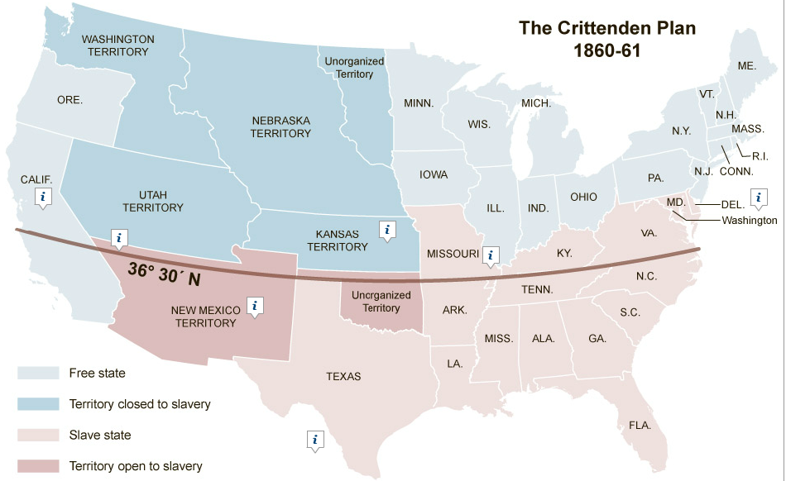

Slide 6
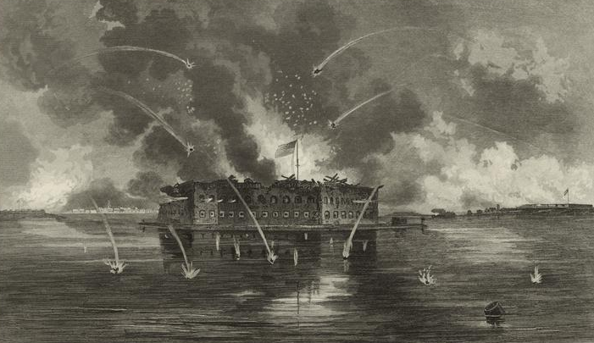
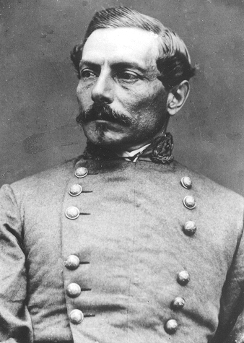
Fort Sumter
Lincoln decides to send “supplies” in to the fort
Forces Beauregard (Confederate General) to fire first shots
A day after the bombardment ended, the Union Surrenders
No one dies during the actual bombardment
Soon after “battle,” VA, Kent., Tenn., and N.C. secede

Slide 7
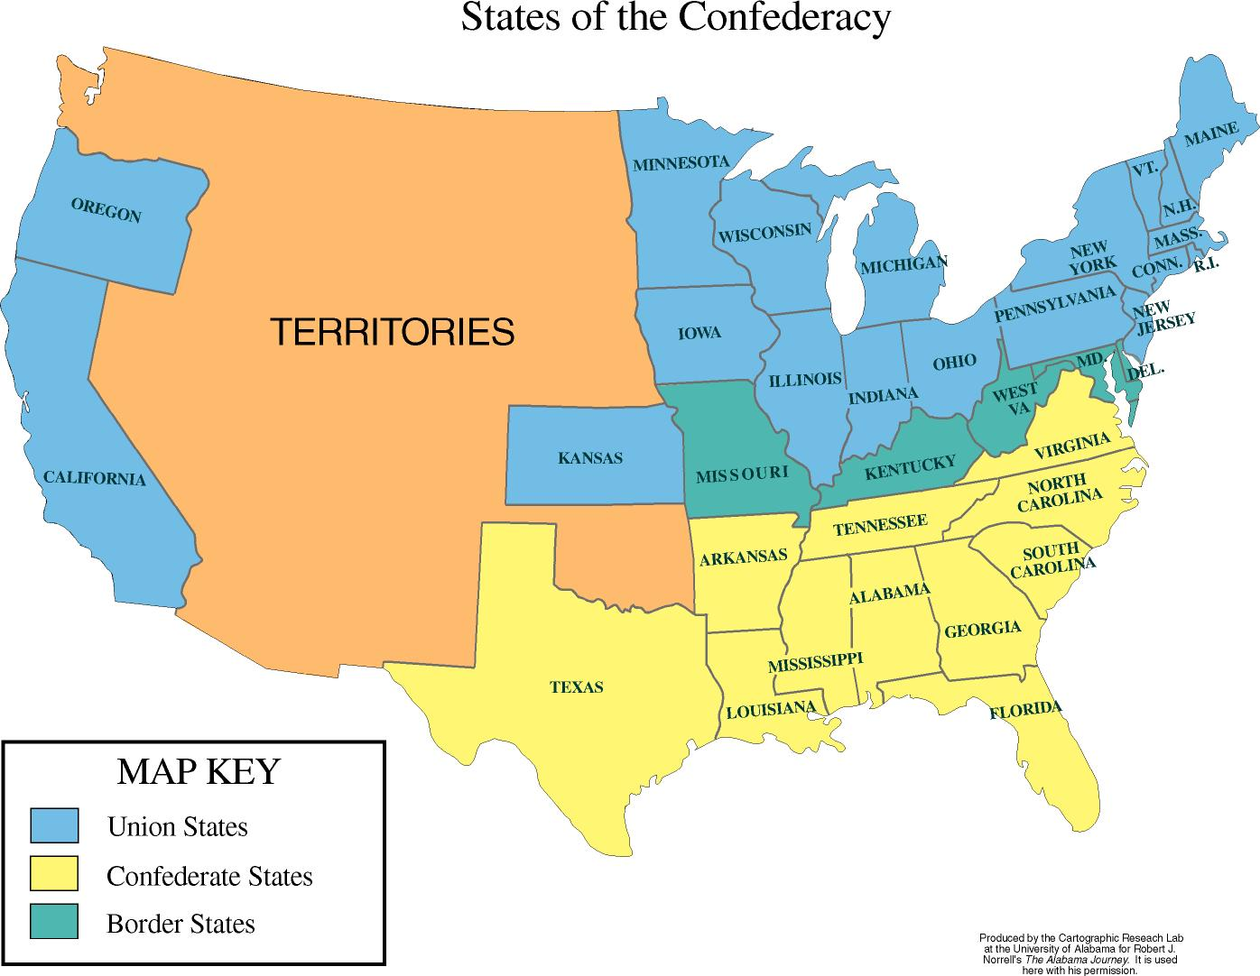

Slide 8
The Opposing Sides
Northern Advantages
Population
Transportation
Navy
Communication
Industry
Southern Advantages
Defensive War
Knowledge of Terrain
Public Support
Military Leadership
*Support from Europe*

Slide 9
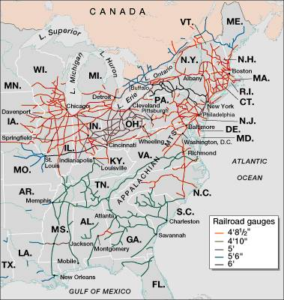

Slide 10
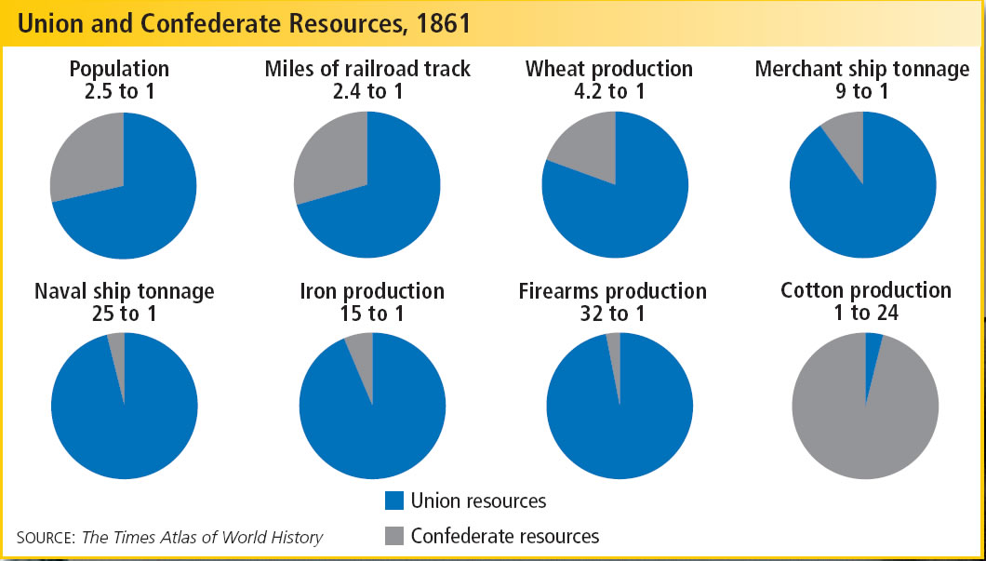

Slide 11
Mobilization

Slide 12
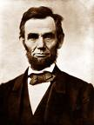
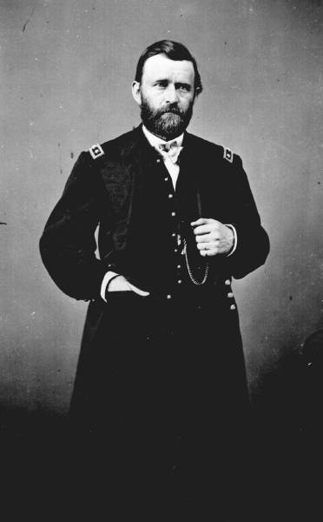
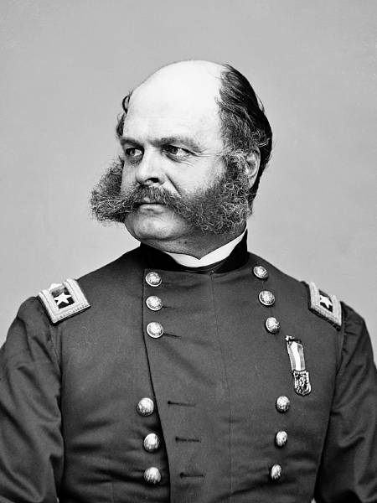
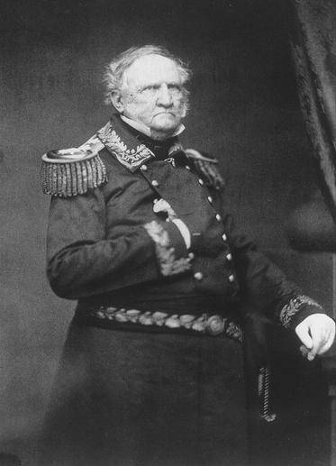
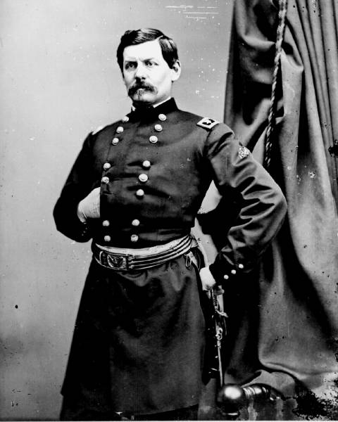
Union Leadership
Abraham Lincoln
  Stretches Presidential power throughout the war
    No Declaration of War
        Argues domestic insurrection does not need congressional approval
    Suspends Habeas Corpus
        Uses to imprison “Copperheads”
    Seizes telegraph offices and railroads
    Ignores Dred Scott Decision
        Confiscates/Frees Slaves

Slide 13
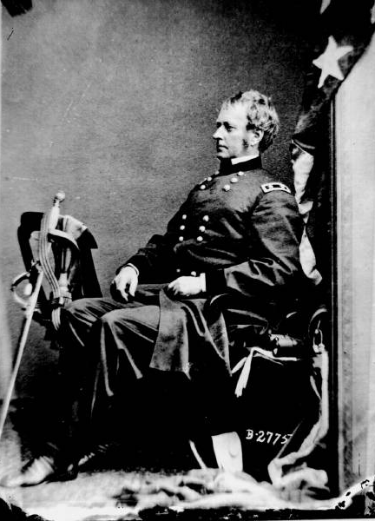
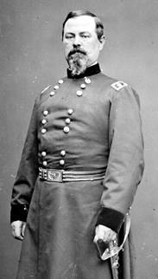
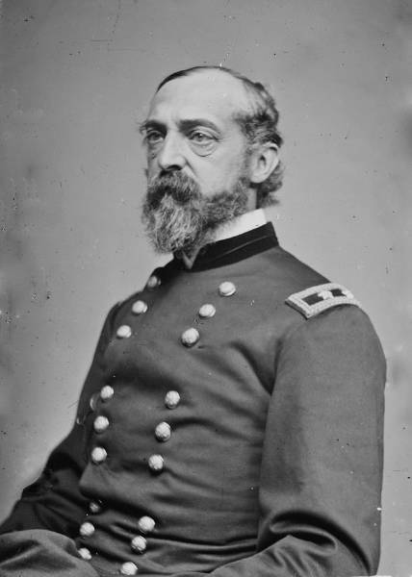
Lincoln’s Generals
Winfield Scott
Joseph Hooker
Irwin McDowell
George McClellan
George Meade
Ambrose Burnside
Ulysses S. Grant

Slide 14
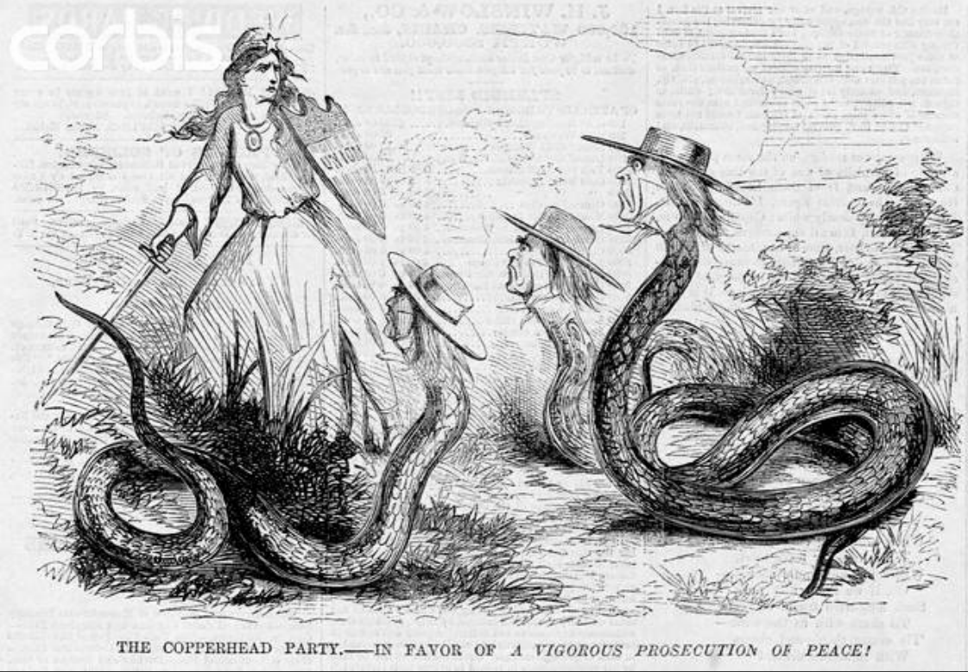

Slide 15
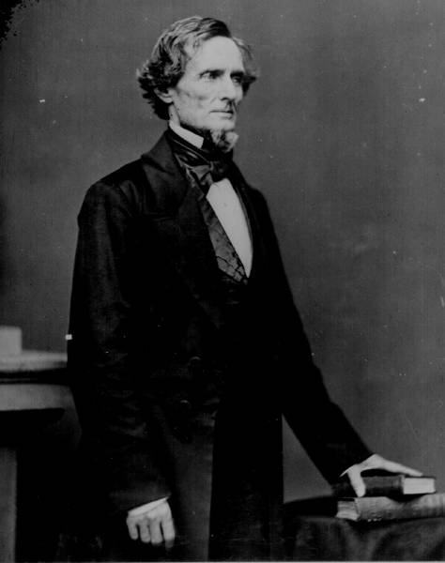
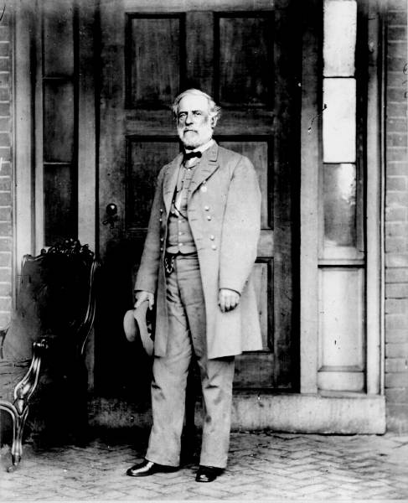
Confederate Leadership
Confederate Constitution
  Similar to U.S.
  Exceptions
    Sovereignty of States
    Slavery sanctioned
Leadership
  Jefferson Davis – President
  Alexander Stephens – VP
  6 year terms

Slide 16
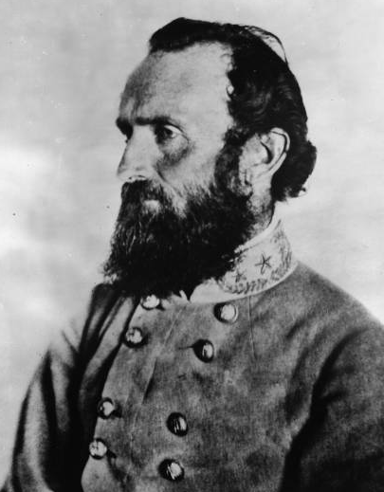
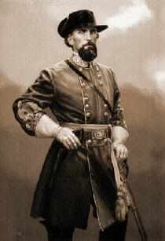
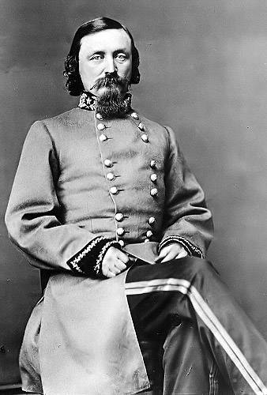
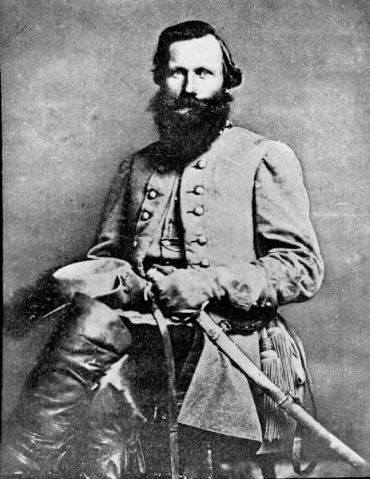
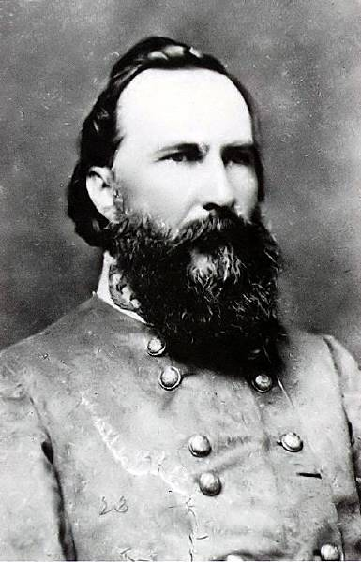
The Confederate Generals – Advantage
“Stonewall” Jackson
Nathan Bedford Forrest
George Pickett
Jeb Stuart
James Longstreet
Robert E. Lee

Slide 17
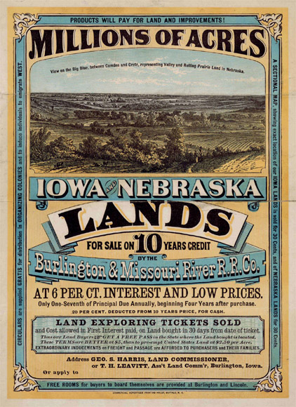
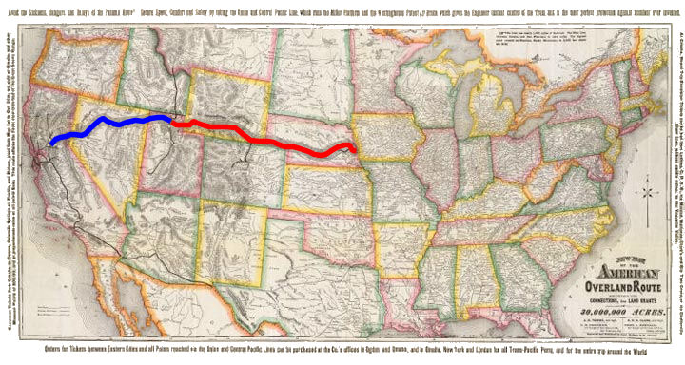
Northern only Congress
Homestead Act
  160 acres for small fee
Morrill Act
  Public land given to states
  Used for Universities
Raise Tariffs
Transcontinental R.R. Funding
  Union Pacific and Central Pacific
Re charter National Bank

Slide 18
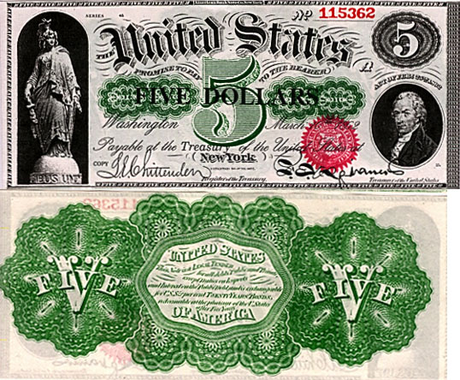
Financing War - Union
Taxes
  Unpopular and unsuccessful
Paper Currency
  “Greenbacks”
  Result = Inflation
    80%
Loans
  $400 Billion in Bonds
  $2.6 Billion borrowed from banks

Slide 19
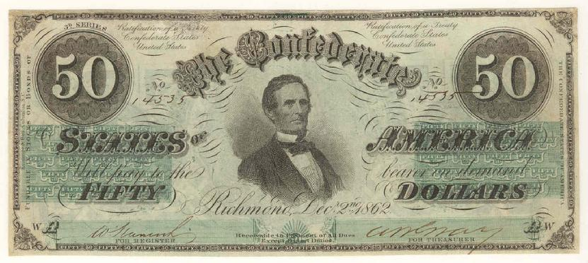
Financing War - Confederacy
Income Tax
  Unpopular and unsuccessful
Paper Currency
  Print $1.5 Billion
  Result = Hyper Inflation
    5000– 6000% Inflation

Slide 20
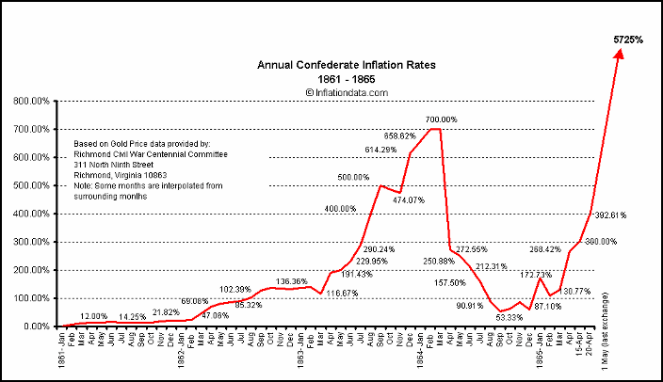

Slide 21
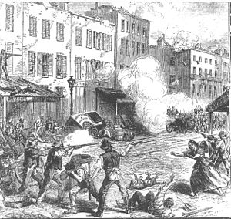
Raising Army - Union
Primarily Volunteer
  500,000
  3 year terms
Conscription (1863)
  20 – 35 yrs
  $300 opt out
  Able to find/hire replacement
  Leads to NYC Draft Riots

Slide 22
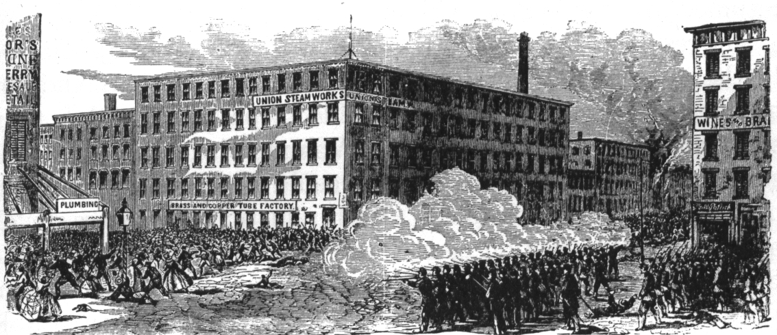

Slide 23
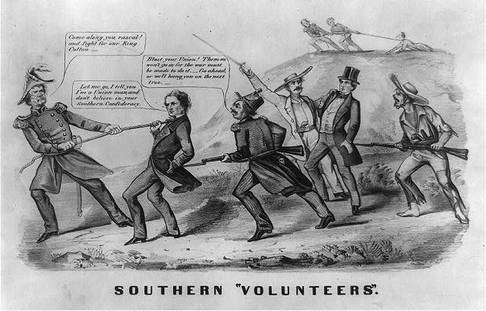
Raising Army – Confederacy
Primarily Volunteer
Conscription (1862)
  18 to 35 yrs
  500,000 drafted

Slide 24
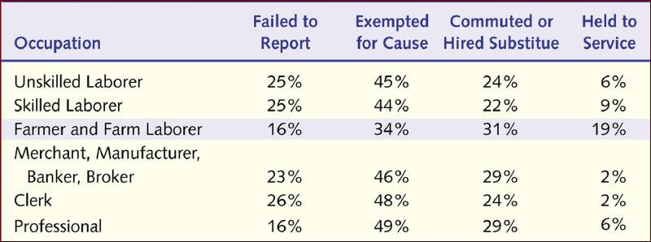
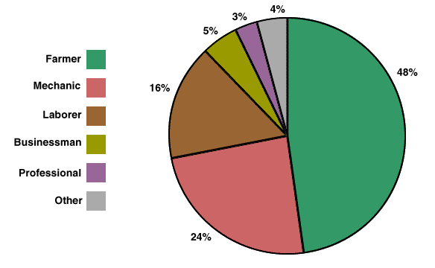

Slide 25
European Involvement
Mainly France and Great Britain
Declare Neutrality
  Angers North and South
Trent Affair
  Union captures British Vessel transporting Confederate officials to Europe
  North furious
Alabama Crisis
  Confederates supporters in Britain build vessel for South
  Ship (Alabama) destroys 66 Union vessels

Slide 26
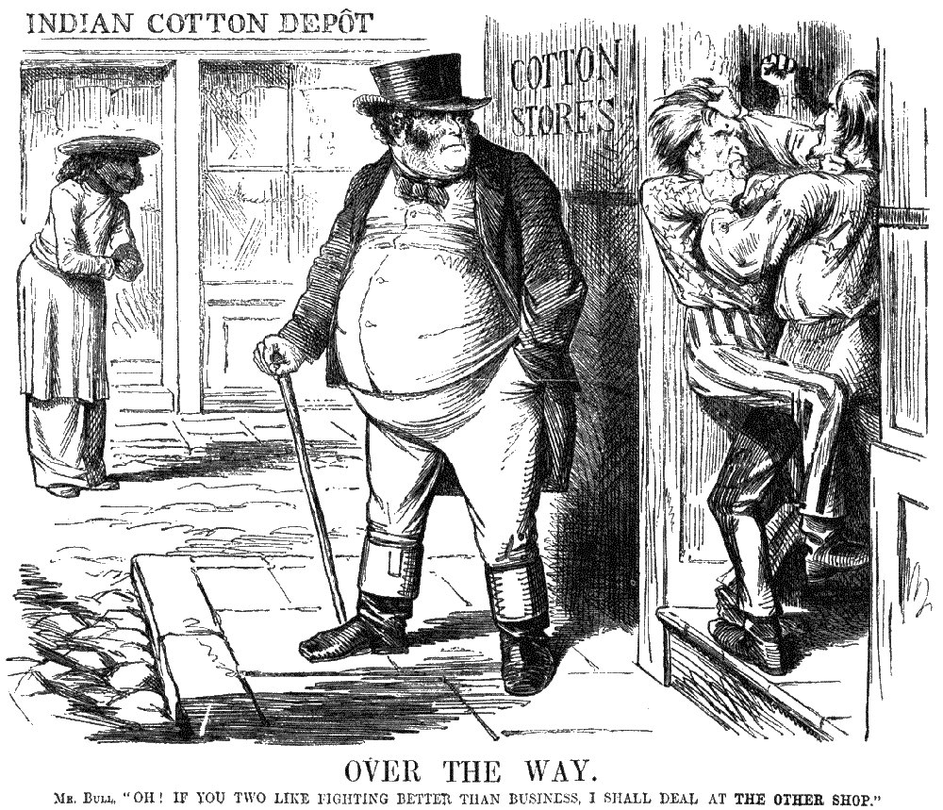

Slide 27
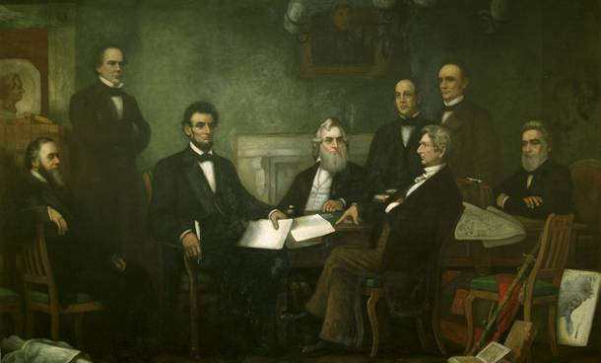
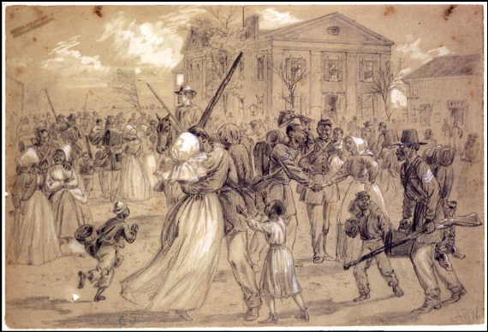
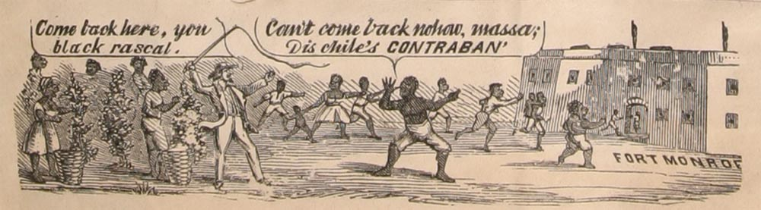
Emancipation
First proposed by Radical Republicans
  Thaddeus Stevens and Charles Sumner
Confiscation Acts
  1861 – Freed slaves used to support war effort
  1862 – Freed slaves of any Confed. supporters
    Allowed use in Union Military

Slide 28
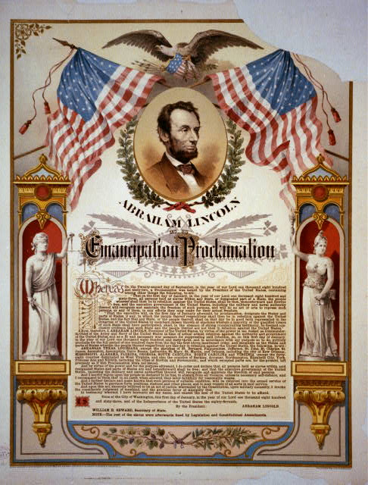
Emancipation
Emancipation Proclamation
(Jan 1, 1863)
  After “Victory” at Antietam
  Frees slaves – (Confederate States only)
  War becomes “moral struggle”
  Prevents Europe from getting involved
    Large Anti Slavery movement in Britain
    France wont join if Britain doesn’t lead
    Both find cotton elsewhere (India and Egypt)

Slide 29
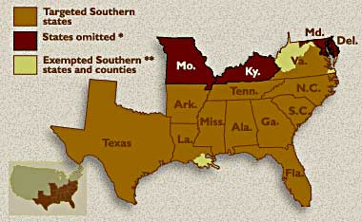

Slide 30
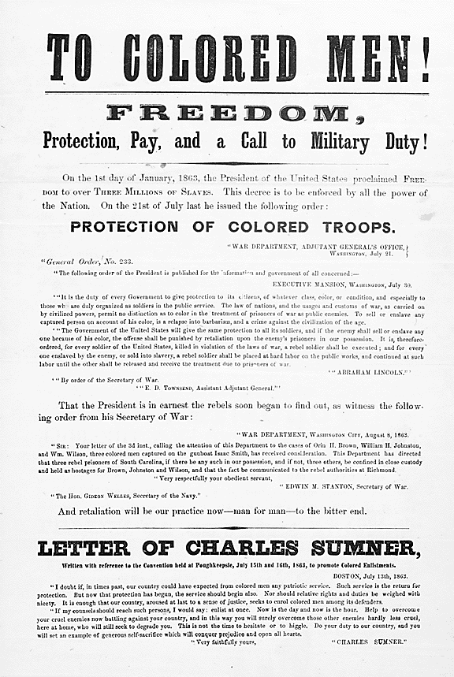
African Americans - Union
Men
179,000 serve in Military
Primarily Manual Labor
Higher Mortality Rate
54th Regiment
  16 Medals of Honor
Women
Volunteered-
  Nurses, Scouts, Spies
  Harriet Tubman

Slide 31
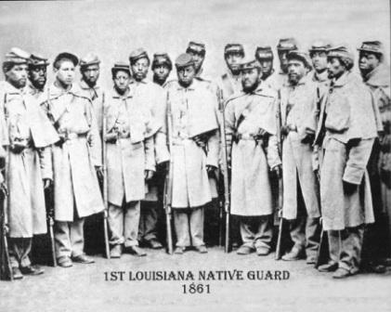
African Americans - Confederacy
Many escaped to North
Joined Union military
300,000 drafted
  Rarely used in battle

Slide 32
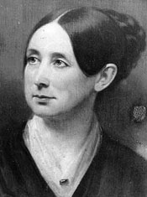
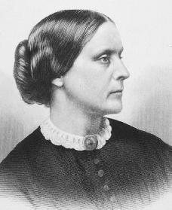
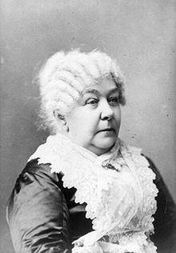
Women - Union
Medicine
  Clara Barton – Founds Red Cross 1881
  U.S. Sanitary Commission
    Volunteer Nurses
    Dorothea Dix
Abolition and Suffrage
  Women use war to support both issues
  National Women's Loyal League
    Elizabeth C. Stanton
    Susan B. Anthony

Slide 33
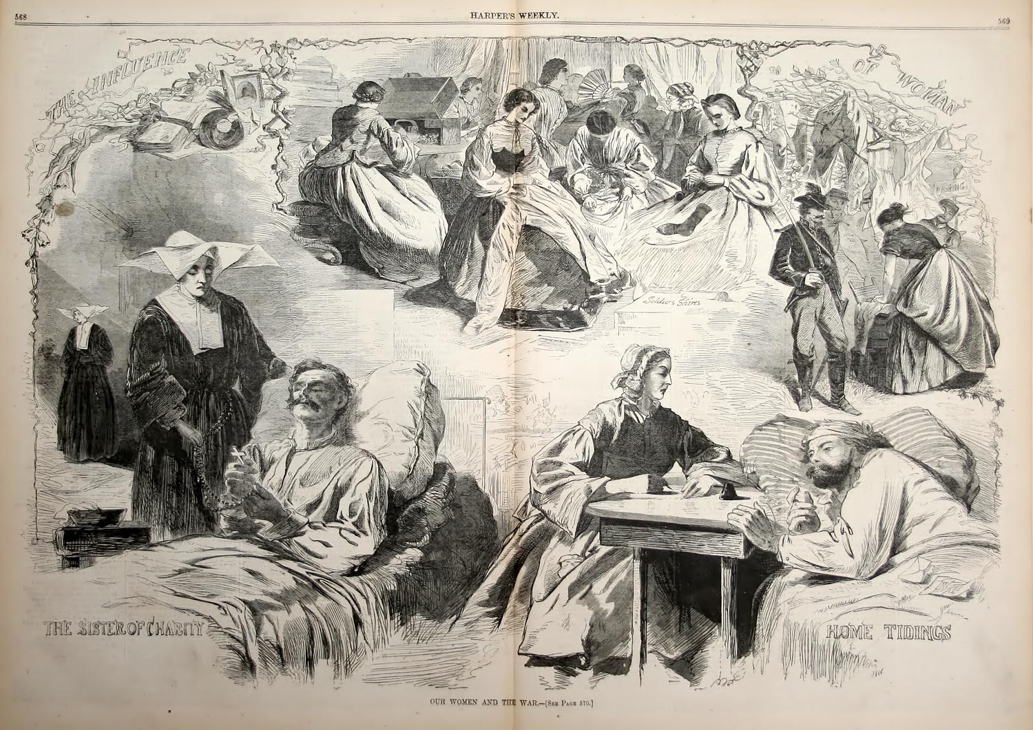

Slide 34
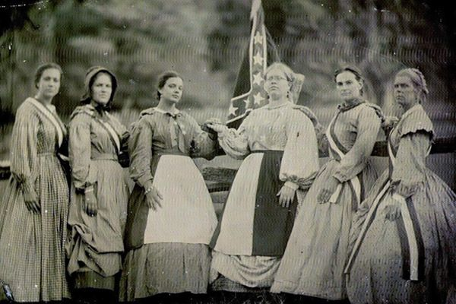
White Women – Confederacy
Outnumber men by 1865
Forced to fill jobs vacated by men

Slide 35
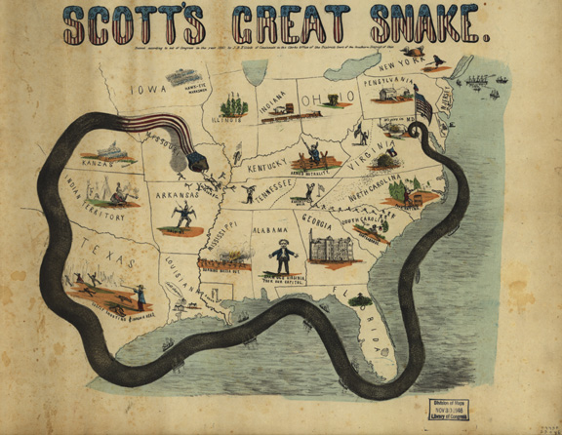
The Battles

Slide 36
The Union
Advantages
Big population
Industrialized: produce more ammunition, arms, medical supplies
Larger railroad network
Small, well-organized navy
Established government
Leadership of Lincoln
Disadvantages
Must travel farther to reach battles
Fighting in enemy territory
Difficult to find good military leader

Slide 37
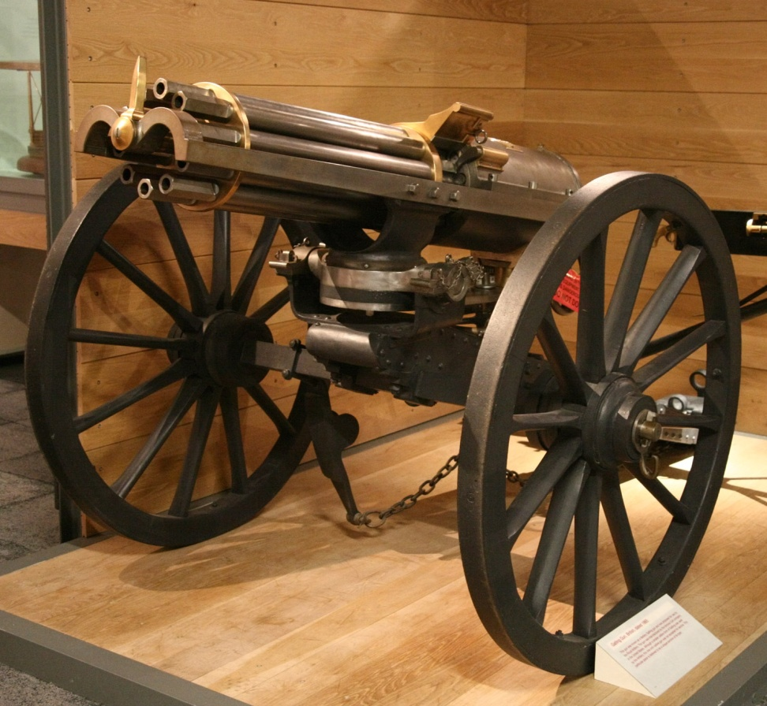
New Weapons
Rifles
  More accurate
  Breech Loading
    Load in the back
Gatlin Gun
Minie ball
Destructive bullet

Slide 38
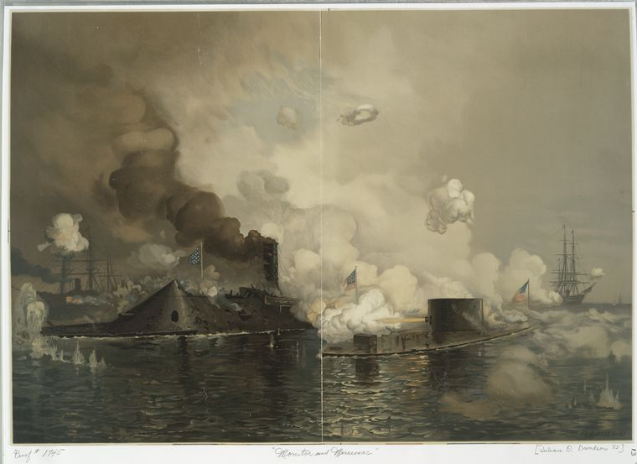
Sea Warfare
Ironclads
  Steam-propelled warship covered by iron
  Monitor (Union)
  Merrimac (Rebel)
CSS Virginia and USS Monitor
Notes:
The ironclad was developed as a result of the vulnerability of wooden warships to explosive or incendiary shells

Slide 39

First metal ships in world!

Slide 40
Military Strategies
Union
Anaconda Plan
Idea to coil around the South and squeeze it to death (like a snake)
Naval Blockade
Get control of the Miss. River to split Confederacy in two
Confederacy
Do enough damage to break Union’s will to fight
Get military support from Britain and France (they rely heavily on southern cotton)

Slide 41

First Battle of Bull Run aka First Manassas
July 21, 1861
First major battle of the Civil War
North hoped to take Richmond and bring end to war
Richmond

Slide 42


Slide 43
1st Bull Run
Two very inexperienced armies met in VA
Reinforcements turned the tide in favor of the South on the third day
Union soldiers retreated in chaos
Picnic lunches were disturbed as DC society people had gathered for lunches near the battlefield

Slide 44

Reaction to Bull Run
Confederates first victory
Many Southerners think war is over
Lincoln called for volunteers
General George McClellan Chosen to lead Union Army

Slide 45

Battle of Antietam
“Bloodiest Single Day of the War”

Slide 46


Slide 47


Slide 48


Slide 49


Slide 50


Battle of Antietam
“Bloodiest Single Day of the War”
September 17, 1862
23,000 killed or wounded in one day!

Slide 51
Impact of Antietam
September 17, 1862
Union Army wins first major battle in over 1 year
Allowed Lincoln to announce the Emancipation Proclamation
Discouraged England and France from joining the war on the Confederate side
Caused Lincoln to fire McClellan

Slide 52

Im going to be delicate about this…. you are absolutely terrible at your job. Pretty much anybody else in the entire world could do a better job than you.. I honestly think a little tiny infant child could take your job and we would be better off… a small dog would actually be a better general than you…
Im not exaaacctly sure what youre trying to say here..

Slide 53

Battle of Vicksburg

Slide 54

The Battle of Vicksburg
Lincoln appoints Ulysses Grant as the head of the entire Union Army
Anaconda Plan depended on gaining control of the Mississippi River
Vicksburg placed under siege (totally surrounded)
  -Surrender on Jul 4th, 1863
Result: Confederacy split in two!

Slide 55


Slide 56

Gettysburg
Gettysburg

Slide 57

Battle of Gettysburg, July 1, 1863
General Lee coming out of a major victory in Chancellorsville, Va.
Lee decides to invade Union territory
  Hopes to draw attention away from Vicksburg
  Hopes another victory will cause Northern support for war to decline.

Slide 58

Battle of Gettysburg, July 1-3, 1863
Turning Point of the War- in favor of North! – the South is pushed back and never again advances into the North
Gettysburg Address: Lincoln gives a famous speech honoring all those who died and reminding Northerners what they were fighting for.

Slide 59

Gettysburg Casualties

Slide 60

Gettysburg Address
4 months after actual battle
these dead shall not have died in vain -- that this nation, under God, shall have a new birth of freedom -- and that government of the people, by the people, for the people, shall not perish from the earth.
        Abe Lincoln

Slide 61

Sherman’s March

Slide 62

Sherman’s March
1864 “March to the Sea”
  TN to Savannah, GA
Total War:
  strike military and civilian targets, destroy materials & crops, destroy railroads and factories, break people’s will to continue fighting
News of success in 1864 helps Lincoln win election over McClellan

Slide 63

Election of 1864
Lincoln v. McClellan

Slide 64


The Peace Movement: Copperheads
Clement Vallandigham

Slide 65

1864 Copperhead Campaign Poster

Slide 66


Surrender at
Appomattox Court House

Slide 67

The Progress of War: 1861-1865

Slide 68

Over 618,000 military deaths during Civil War.

Slide 69

Civil War Casualties
in Comparison to Other Wars

Slide 70


Slide 71
Rank | War | Years | Deaths | Deaths per Day | Deaths per Population
1 | American Civil War | 1861–1865 | 625,000 | 599 | 1.988% (1860)
2 | World War II | 1941–1945 | 405,399 | 416 | 0.307% (1940)
3 | World War I | 1917–1918 | 116,516 | 279 | 0.110% (1920)
4 | Vietnam War | 1955–1975 | 58,151 | 26 | 0.03% (1970)
5 | Korean War | 1950–1953 | 36,516 | 45 | 0.02% (1950)
6 | American Revolutionary War | 1775–1783 | 25,000 | 11 | 0.899% (1780)
7 | War of 1812 | 1812–1815 | 20,000 | 31 | 0.345% (1810)
8 | Mexican–American War | 1846–1848 | 13,283 | 29 | 0.057% (1850)
9 | War on Terror | 2001–present | 5,491 | 2 | 0.002% (2010)
10 | Philippine–American War | 1899–1913 | 4,196 | 1 | 0.006% (1900)

Slide 72
EFFECTS OF CIVIL WAR
Abolition of slavery (13th Amendment)
Increased power to fed. gov't – killed the issue of states rights
U.S. now an industrial nation
Western lands increasingly opened to settlement
South was economically and physically devastated, w/ the plantation system crippled...thus Reconstruction (rebuilding the U.S.) - but a deep hatred of the North remained...
4 million freed African Americans

