Slide 1
Warm-Up
On a piece of paper in your binder answer the question below:
What are some responsibilities that citizens should do?

Slide 2

American Citizenship

Slide 3

What Does it Mean to be an American Citizen?

Slide 4
What is Civics?
Civics- the study of the duties and rights of citizens
Citizens- members of the community what owe loyalty to a government and gain protection from that government
To have an effective government = citizens need to know their rights and responsibilities

Slide 5
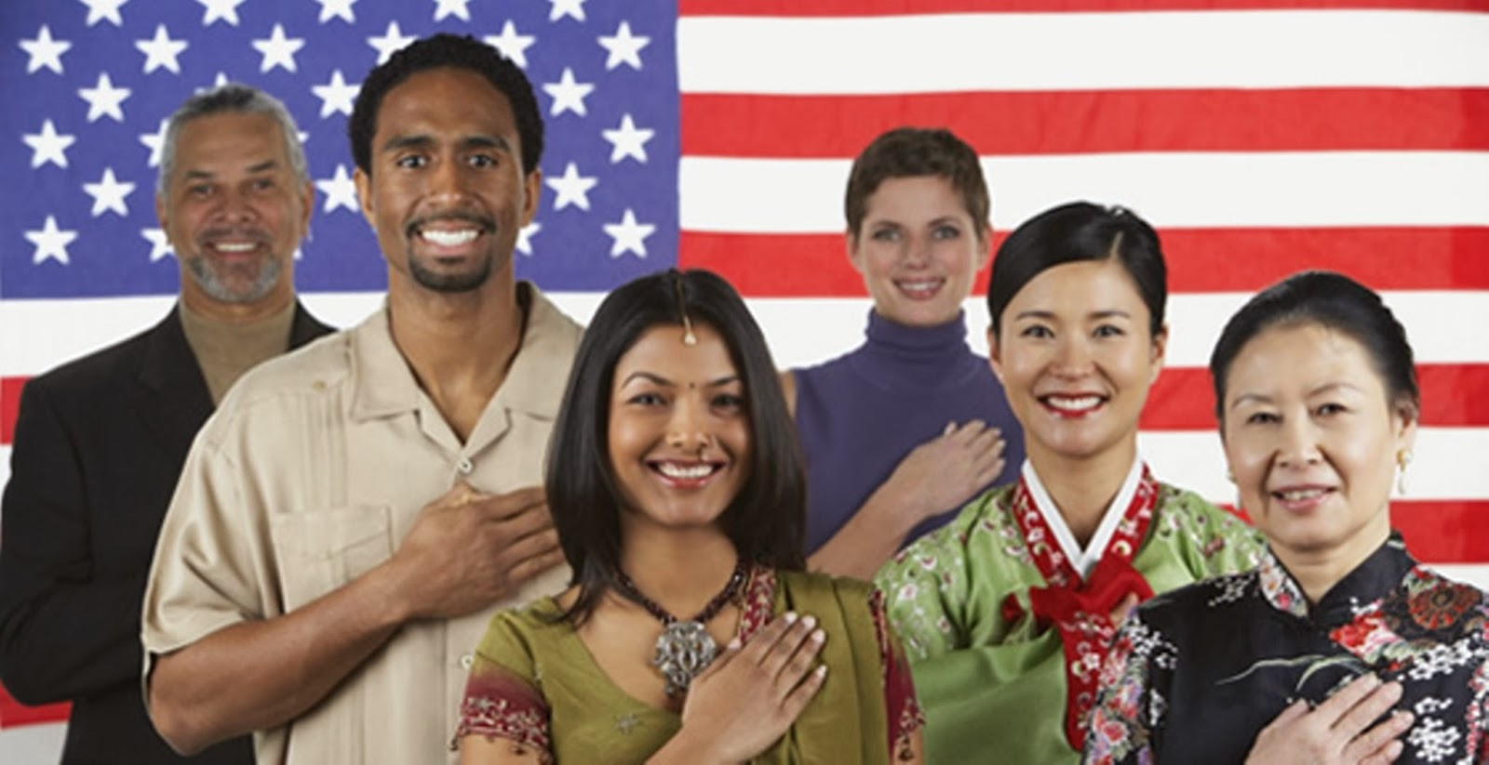
How do you become a citizen?
There are two ways to become an American citizen according to Section 1 Article 2 in US Constitution:
By Birth
Or, by Naturalization

Slide 6

By Birth
There are 2 ways to be born an American citizen:
You must be born in America, or a territory or other possession controlled by American
One or more of your parents must be an American citizen

Slide 7
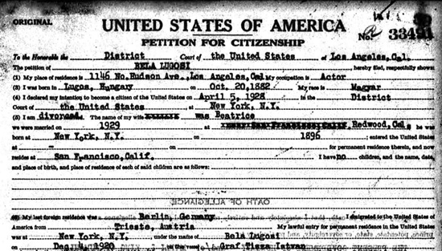
Naturalization is the process were a foreigner can gain citizenship by fulfilling the guidelines established by Congress
These guidelines can be found in the Immigration and Nationality Act of 1965
This Act set the guidelines for who can become a citizen, and how to do it

Slide 8

Naturalization Process
You must be eligible for Naturalization:
  18 years old, permanent resident for 5 years,
  must be able to read, write, and speak English
  Show understanding of US civics
  Be of good moral character

Slide 9
Naturalization Process
Work with an attorney to fill out an application, and pay the $400 fee
Attend an interview and answer questions about your application and background
Take an English and Civics test
Take the Oath of Allegiance

Slide 10
Citizenship Test
Go to this link: https://my.uscis.gov/prep/test/civics
Scroll to the bottom of the page and click on “Start Practice Test”
Answer the questions and complete the test

Slide 11
Congratulations, you are now a US citizen!

Slide 12
How to Lose Citizenship
1. Expatriation- give allegiance to another country
  Someone who becomes a naturalized citizen of another country
2. Denaturalization- if lied on their citizenship application
  May be deported
3. Convicted of certain crimes- treason, taking part in a rebellion, or trying to overthrow the government by violent means can cause loss of citizenship

Slide 13
Natural Rights & Bill of Rights
Life, Liberty, & Pursuit of Happiness
  Rights granted to all people by “nature or God” that can’t be denied or restricted by govt
Bill of Rights
  1st 10 amendments in the US Constitution that protected citizens’ rights

Slide 14
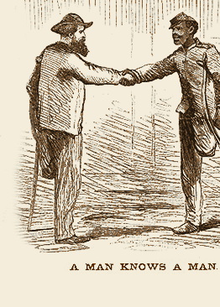
Civil Rights
Civil Rights: Rights that are guaranteed to all American citizens without discrimination
Protection of Civil Rights was originally left to the states until the Civil War
13th Amendment: Outlawed the slavery
14th Amendment: Granted full Citizenship to African-Americans, stated the government couldn’t take a citizen’s life, liberty, or property without due process, and that everyone would be given equal protection under the law

Slide 15
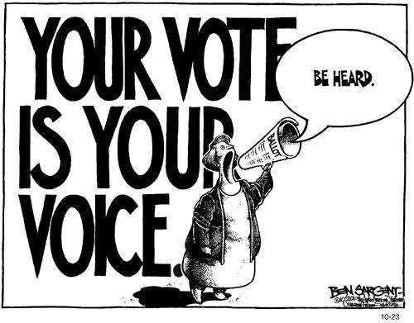
Voting Rights
Every American Citizen 18 and over has the right to vote
Voting allows citizens to fully participate in the government
States were originally allowed to decide who would vote
15th Amendment: No person can be denied the right to vote based on race
17th Amendment: Citizens can vote for their state’s US Senators

Slide 16
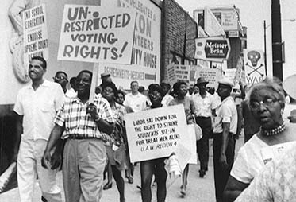
More Voting Rights!!!!
19th Amendment: Women gained the right to vote
24th Amendment: Declared the voting poll tax unlawful and Unconstitutional
26th Amendment: Lowered the voting age to 18

Slide 17
Crash Course: Civil Rights and Liberties
https://www.youtube.com/watch?v=kbwsF-A2sTg&index=23&list=PL8dPuuaLjXtOfse2ncvffeelTrqvhrz8H

Slide 18
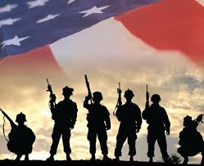
Duties of a Citizen
Duties of Citizenship: actions that American are required by law to perform
Obeying the Law
Attending School-Receiving an Education
Paying Taxes
Serving in the Armed Forces: Draft, Registration
Appearing in Court/Jury Duty

Slide 19
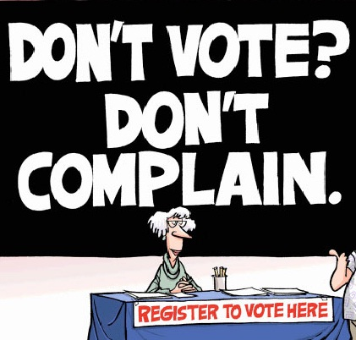
Responsibilities: Actions that aren’t required by law, but are important to the success of the nation and well-being of the people
Responsibilities include:
Voting: Preserves the ideal of consent of the governed
Being informed on government activities and programs

Slide 20

Responsibilities Continued
Taking Part in the Government
Helping Your Community
  Volunteering
  What are ways to volunteer in your community?
Respecting and Protecting Other’s Rights

