Slide 1
Charcoal

Slide 2
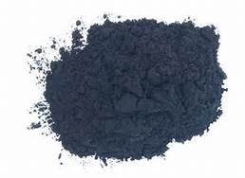
Powder Charcoal
Powder charcoal is used to:
Create tonal values
Usually over larger surfaces
Easily erases
Can be darkened
by adding layers.

Slide 3
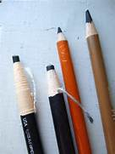
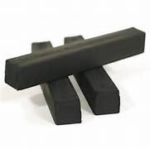
Compressed Charcoal
Powdered with gum binder
Round or square sticks
Charcoal pencils

Slide 4
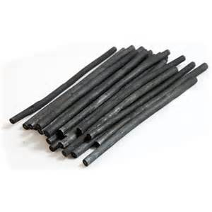
Vine charcoal
Vine charcoal is willow or linden/Tilia twigs burnt into:
Soft
Medium
Hard consistencies

Slide 5
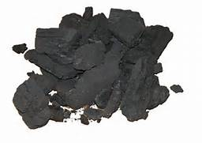
Pure Charcoal
Very soft
Very dark tones
Very messy!

Slide 6
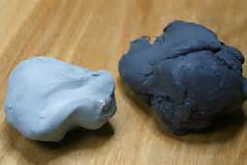
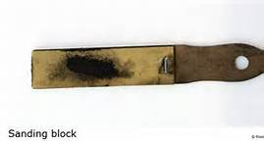
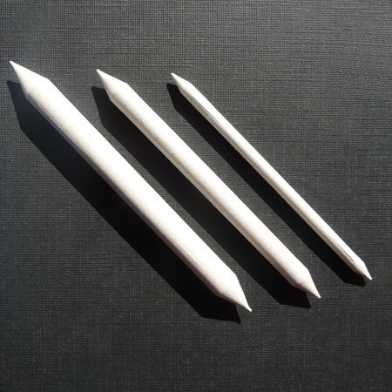
Accessories
Kneaded eraser
(any eraser)
Tortillions
(blending stump)
Sandpaper block

Slide 7
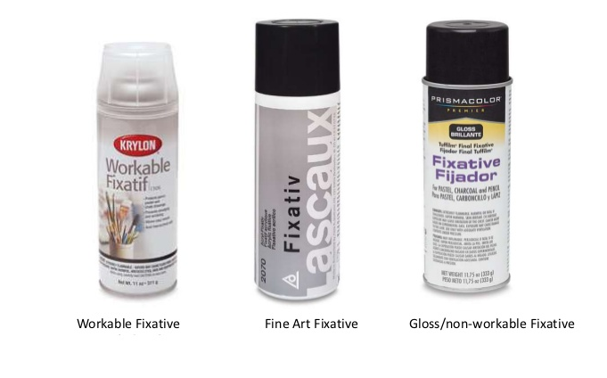
Fixatives

Slide 8
Portraits and sketches by the Masters

Slide 9
Old Masters
Early Renaissance (rebirth of ancient traditions)
High Renaissance (exceptional artistic production)
Baroque (exaggerated motion, dramatic)

Slide 10
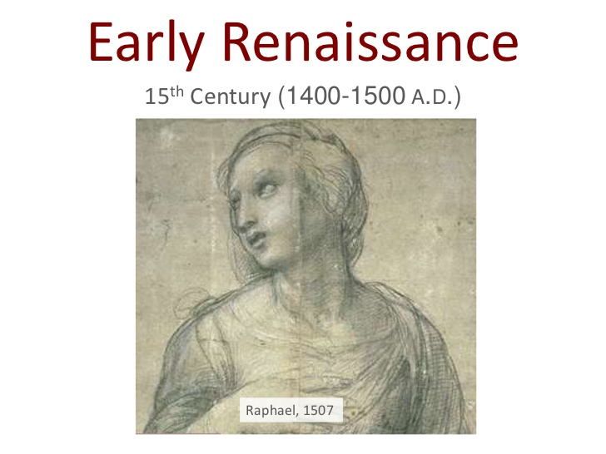
Early Renaissance
15th Century (1400-1500 A.D.)
RAPHAEL, 1507

Slide 11
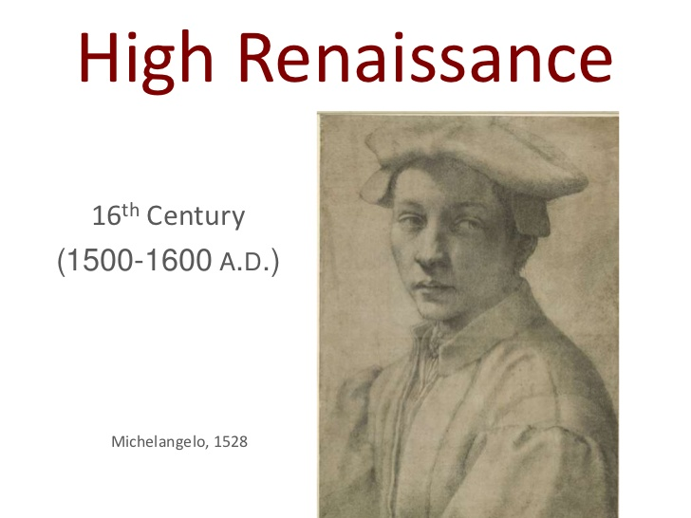
High Renaissance
16th Century (1500- 1600 A.D.)
Michelangelo, 1528

Slide 12
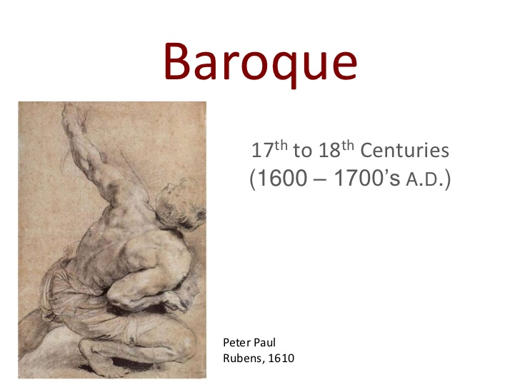
17th to 18th Centuries
(1600- 1700’s A.D.)
Peter Paul Rubens, 1610

Slide 13
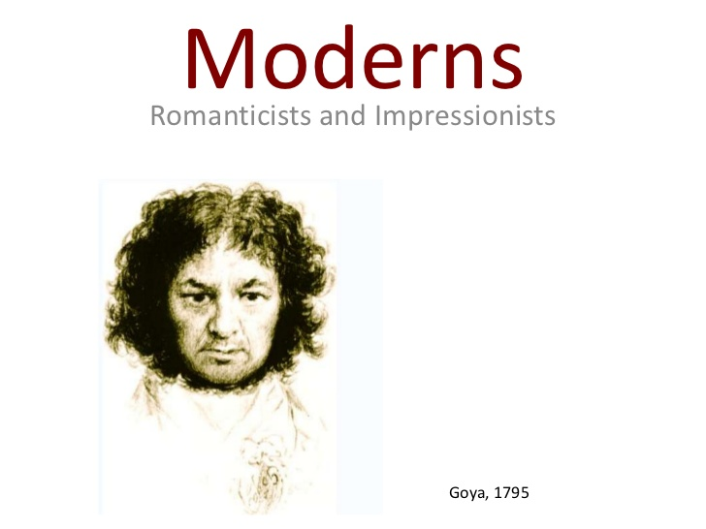
Romanticists and Impressionists
Strong emotion, emphasis on apprehension, horror and terror emotions
Brush strokes, open composition, ordinary subject matter
Goya, 1795

Slide 14
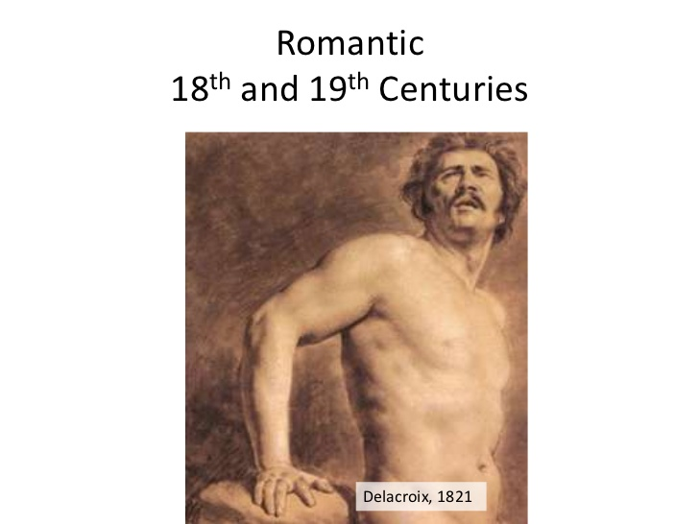
Romantic
18th and 19th Centuries
Delacroix, 1821

Slide 15
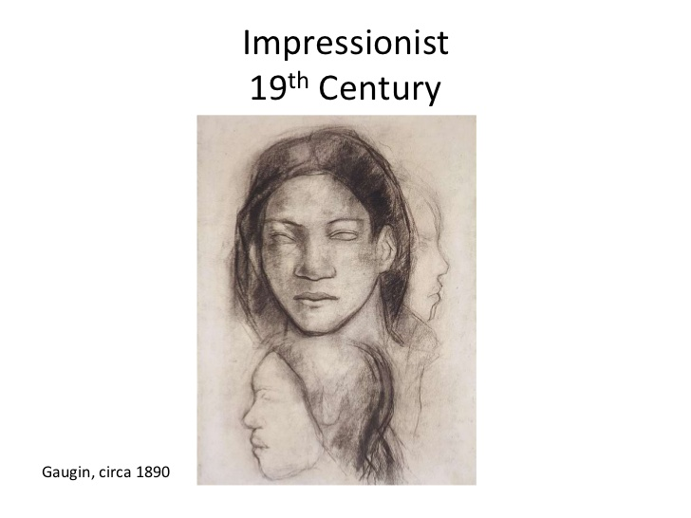
Impressionist
19th Century
Gaugin, circa 1890

Slide 16
Getting Started
Clear drawing surface
  Layout paper
    Tape along the sides to the board
Have drawing supplies ready
  Charcoal, kneaded eraser, blending stump
  Paper towels may be used for blending large areas.

Slide 17
Step by Step
Sketch the composition lightly
Make adjustments to proportions and perspectives
Add mid-tones with smooth or textured marks while maintaining whiteness where desired
Emphasize shadows by adding darker marks
Blend
Refine shadows and light
Use eraser to lighten areas
Layer charcoal for darker values

