Slide 1
Chapters 9 & 10 Extensions
Stella Diaz

Slide 2

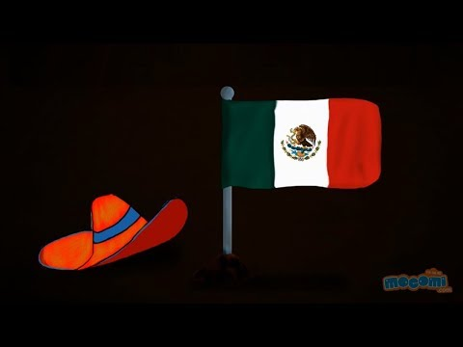
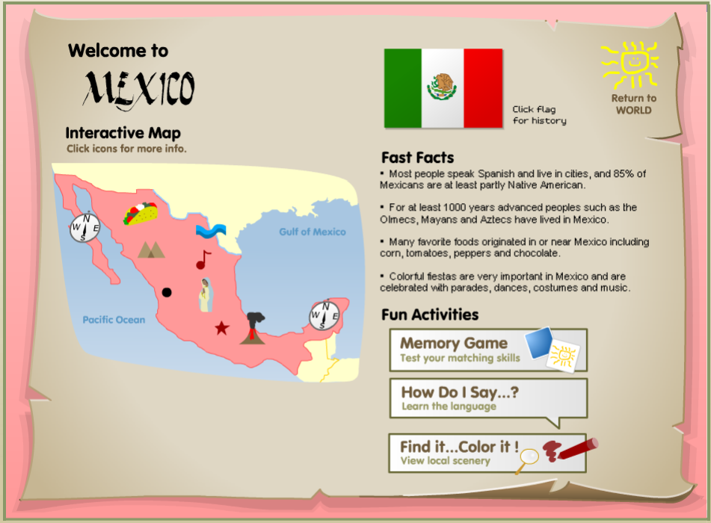
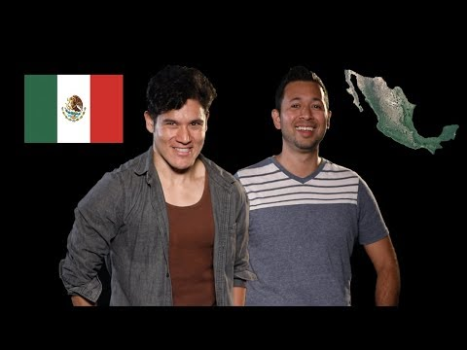

Mexico!
México!
!
Since Stella moved away from Mexico when she only a baby, she realizes she doesn’t know much at all about the country of her heritage. Take some time to learn a little about this country.

Slide 3
Mexico!
México!
!
Add four new facts you learned into the boxes.

Slide 4
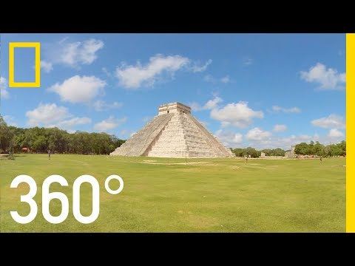
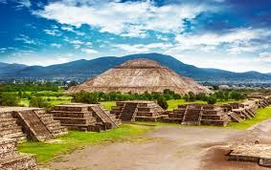
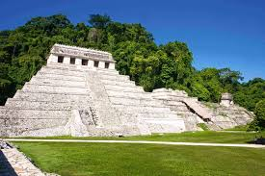

See Ancient Mexican Ruins in 360!
The Aztecs, Incas and Mayans were three of the ancient civilizations who inhabited what is now Mexico as long as 1,800 years ago! Get an up close look by viewing famous ruins in 360°!
Chichen Itza
Teotihuacan
Palenque
Teachers:
You may want to visit these sites as a class rather than keep the slide in the hyperdoc for students.
View More!
“Mexico: Land of the Aztecs” in 360Cities

