Slide 1
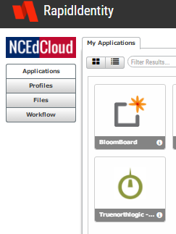
Changing Student passwords
Login to Teacher IAM account.
Select Profiles to the left of screen

Slide 2
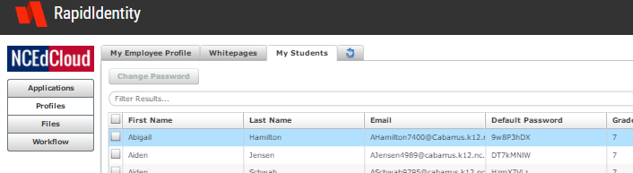
Changing student passwords
Select the “My students” tab
Check student
Select “Change password”

Slide 3
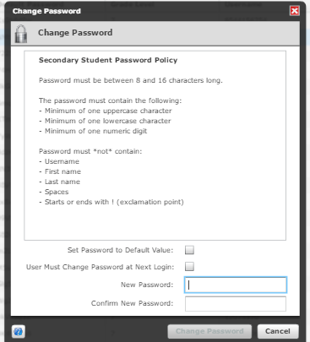
Changing student password

