Slide 1
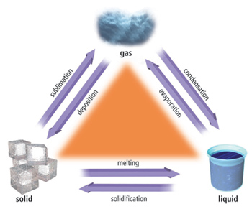
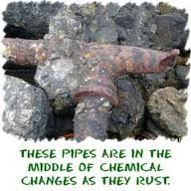
Physical and Chemical
Changes in Matter
5.P.2.3—Summarize properties of original materials, and the new material formed, to demonstrate that a change has occurred

Slide 2
Changes in Matter
Matter can have two main changes.
Physical
Chemical

Slide 3
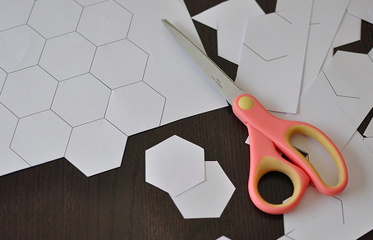
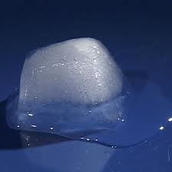
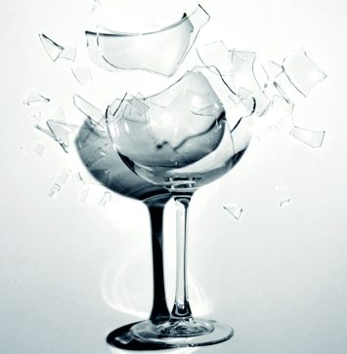
Physical Changes in Matter
Matter can change shape and state.
During a physical change, the identity of a substance is not changed.
Examples:
A broken glass is still glass
Ice melted is still water
Cut up paper is still paper
** All can be returned to their original state.

Slide 4
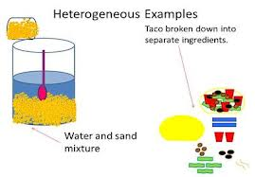
Other Ways Physical Changes Occur
Cuts
Tears
Folds
Written on
Matter changing states
Breaks
Mixtures—contains two or more pure substances that are mixed together. They do not join chemically. Examples: lemonade, sand and water.

Slide 5
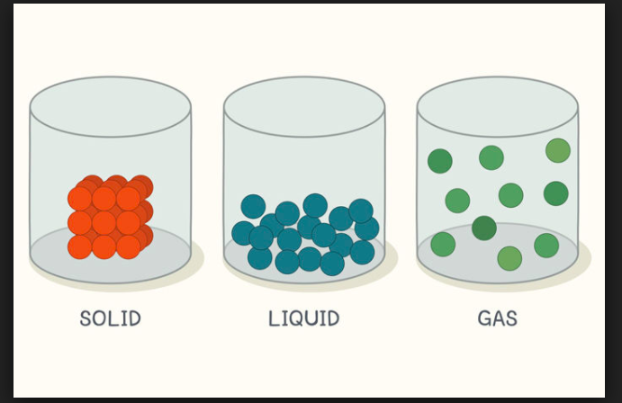
Law of Conservation of Matter
The law of conservation of matter states that matter cannot be created nor destroyed. Matter can change states, but one cannot create new matter.

Slide 6
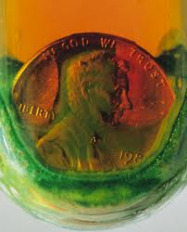
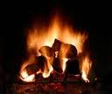

Chemical Changes in Matter
During a chemical change, new substances are formed.
The new substances may be elements or compounds and they have different properties from the original substance.
Examples: Wood burning, penny rusting, and fireworks.
All are new substances and cannot be returned to their original state.

Slide 7
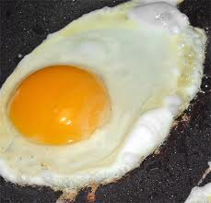
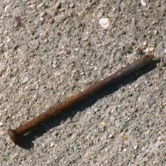
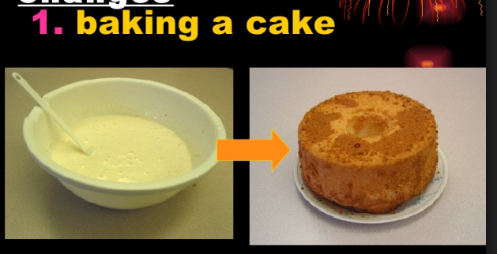
Chemical Reactions
New matter is formed through:
  Burning
  Rusting
  Cooking

Slide 8
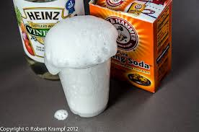
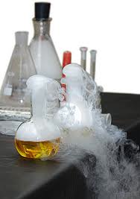
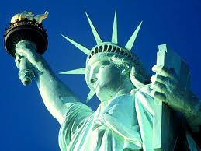
Identifying Chemical Changes
A change in color, burning, and production of a gas are some ways you can tell a chemical change has occurred.

Slide 9
Review Sites
http://www.fossweb.com/modulesK-2/SolidsandLiquids/activities/changeit.html
http://www.wacona.com/words/matter/
http://studyjams.scholastic.com/studyjams/jams/science/matter/changes-of-matter.htm
http://www.learninggamesforkids.com/changes-in-matter-games.html
http://www.chem4kids.com/files/matter_chemphys.html

