Slide 1
Cell Organelle Project
A menu

Slide 2
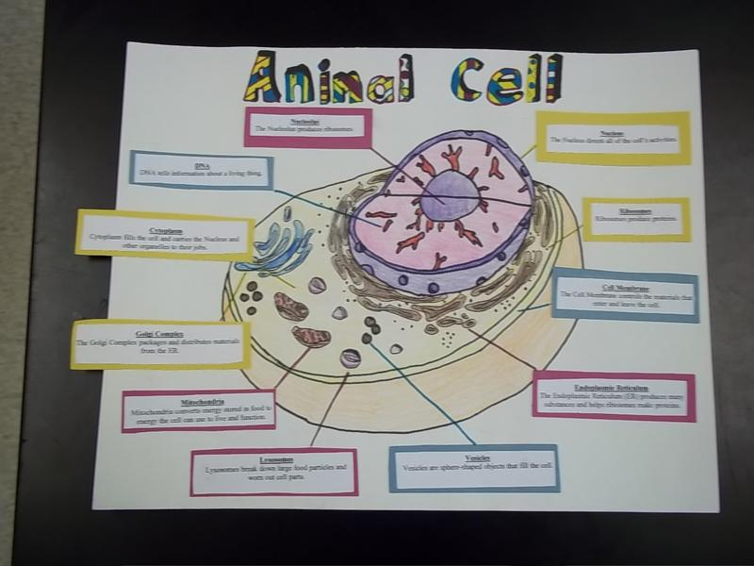
A Poster

Slide 3
Write & Perform an original song/rap
https://www.youtube.com/watch?v=wMOj2GExBrQ

Slide 4

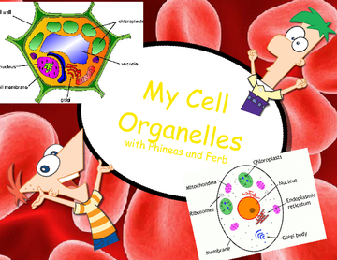
Write a children’s book

Slide 5
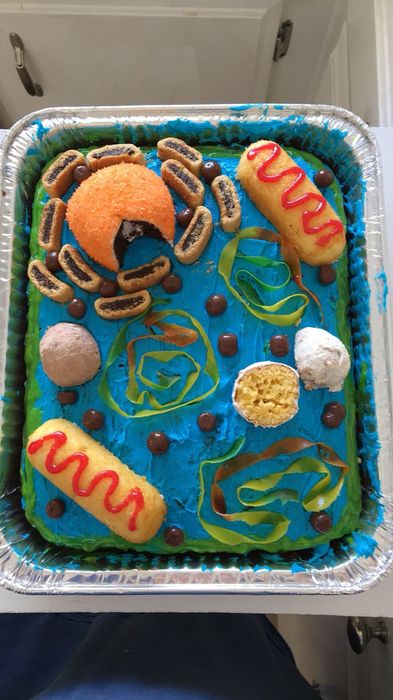
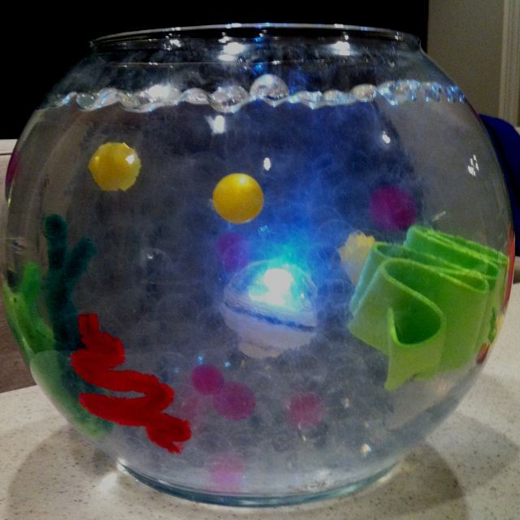
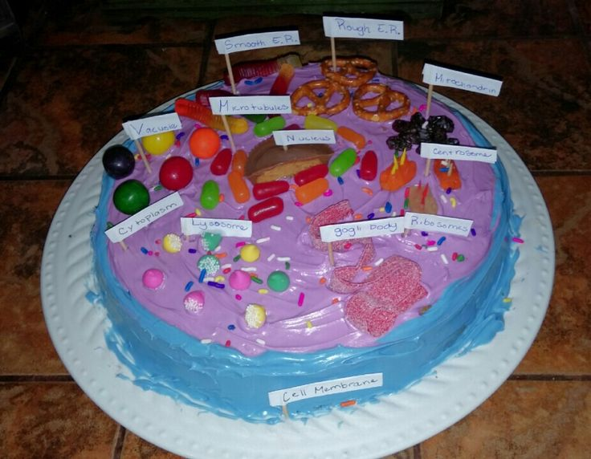
Edible Cell

Slide 6
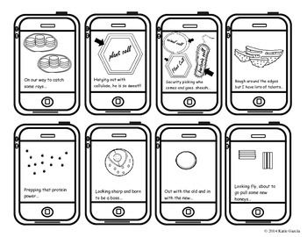
A set of cell-fie flash cards

Slide 7
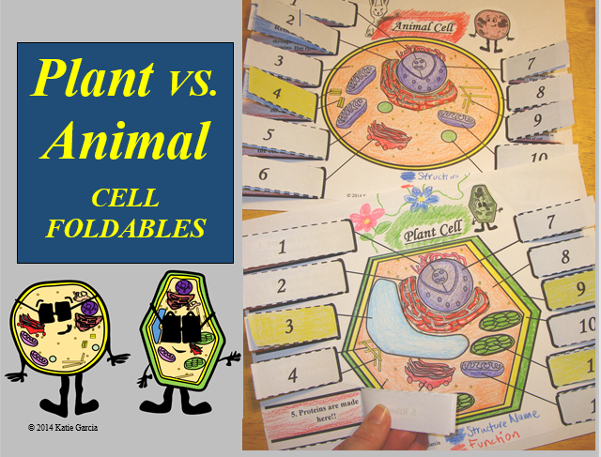
A pair of 3 layer foldables

Slide 8
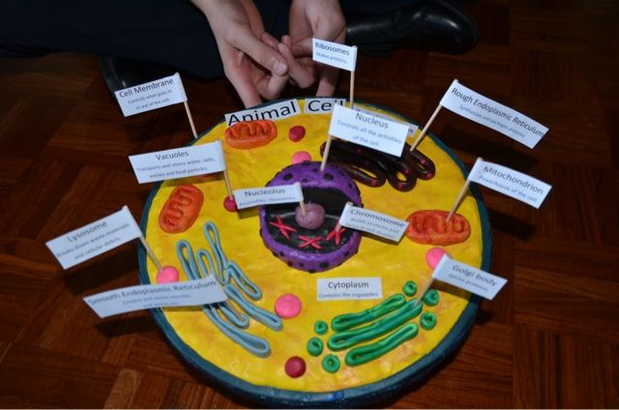
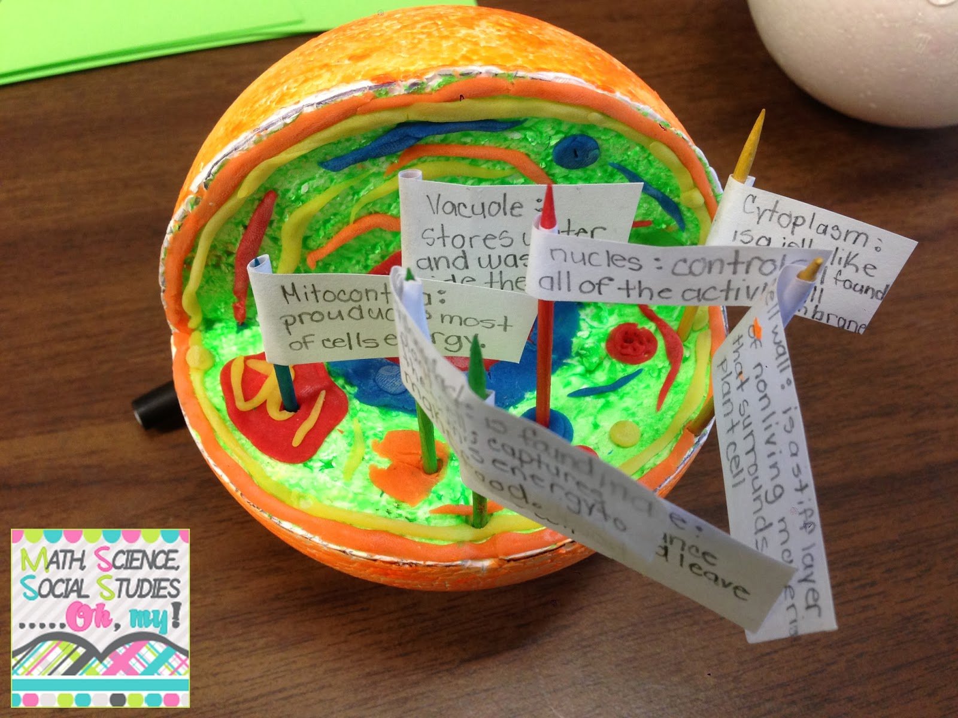
3-Dimensional Cells

Slide 9
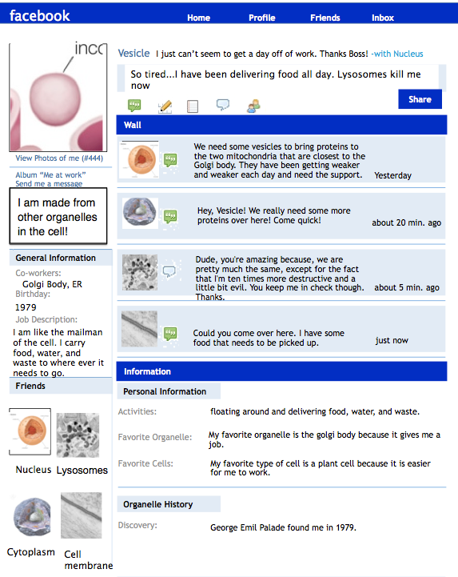
Cell Organelle Facebook page

Slide 10
Poster
Write and Perform an original song/rap
Write a children’s book
Edible cell
A set of cell-fie flashcards
A pair of 3 layer foldables
3-Dimensional cells
Cell Organelle Facebook page

