Slide 1
“When a reporter asked whether white people could join the OAAU, Malcolm X said, "Definitely not." Then he added, "If John Brown were still alive, we might accept him.“

Slide 2
The Antebellum
Presidents:
Part 3

Slide 3
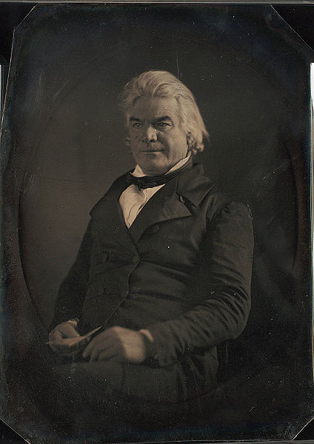
Andrew P. Butler
1796 – 1857
Senator from South Carolina
Co-author of the Kansas-Nebraska Act
Butler was a strong, outspoken supporter of slavery
Butler was verbally attacked in the Senate in 1856 by abolitionist Senator Charles Sumner of Massachusetts over Butler’s support of slavery

Slide 4
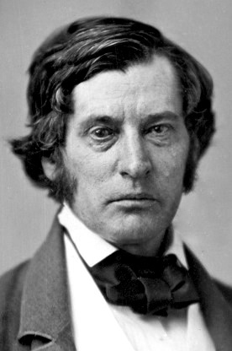
Charles Sumner
1811 – 1874
Senator from Massachusetts
Opposed the Fugitive Slave Act and the Kansas-Nebraska Act
In May 1856, Sumner delivered a 3-hour “Crime Against Kansas” speech, which made personal attacks against Sen. Butler, including making fun of Butler’s speech which had been impaired from a stroke

Slide 5
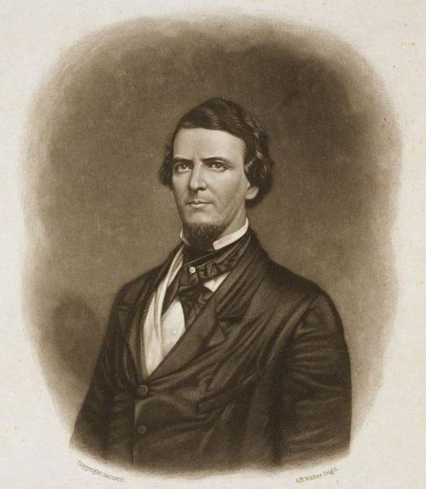
Preston Brooks
1819 – 1857
Representative from South Carolina
Nephew of Andrew Butler
Enraged by Sumner’s attacks, Brooks decided to act to defend the honor of his disabled uncle and of the state of South Carolina
Brooks first considered challenging Sumner to a duel but decided that was too much of an honor and doubted Sumner would even accept the challenge anyway

Slide 6
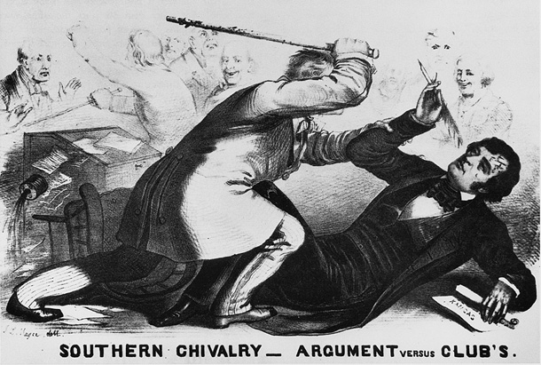
The Sumner-Brooks Incident
May 22, 1856
Brooks attacked Sumner with a cane on the floor of the Senate, savagely beating him until the cane broke
Sumner took 3 years to recover from his injuries
Dozens of proud Southerners sent Brooks new canes in support
Brooks would resign his seat and be fined $300 for assault, but went otherwise unpunished (he did, however, die the next year from the flu)

Slide 7
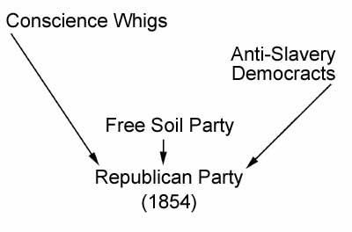
The Republican Party
Founded in 1854 by a mixture of former Whigs, Free Soilers, and anti-slavery Democrats
Direct response to the Kansas-Nebraska Act
Number one goal became to contain the spread of slavery to the South and not allow it to spread to new states or territories

Slide 8
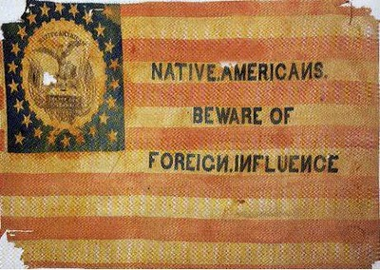
The “Know-Nothings”
The American Party
Nativist party that opposed immigration and was fiercely anti-Catholic
Initially successful, but short-lived since its members were divided over slavery

Slide 9
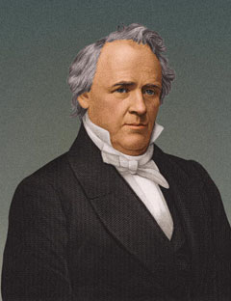
James Buchanan
1791 – 1868
15th President (1857-61)
Only unmarried President
Believed that South could only be kept in the Union through concessions and compromise, but this infuriated Northern supporters
Failed to successfully deal with increasingly violent sectionalism

Slide 10
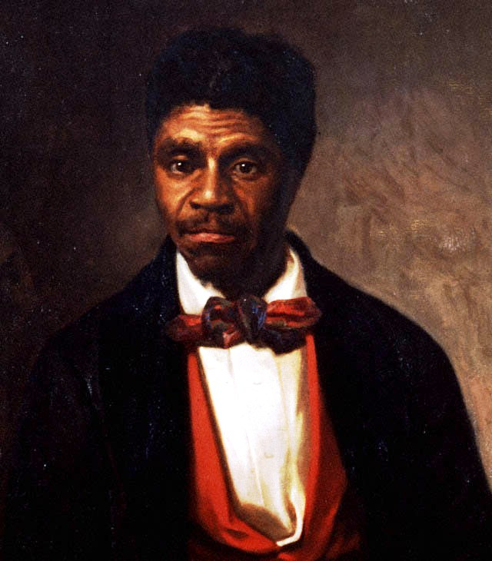
Dred Scott
1799 – 1858
Slave who sued for his freedom on the grounds that his master, an Army officer, had carried him into states and territories where slavery was illegal
Was given freedom by his owner in 1857 after Scott had lost his case in the Supreme Court

Slide 11
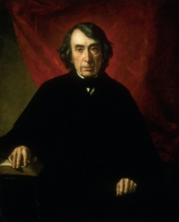
The Dred Scott Decision
1857
Dred Scott v. Sandford
Southern-dominated Supreme Court under Chief Justice Roger Taney ruled that since persons of African ancestry were not citizens of the U.S. but were instead private property, they were not protected by U.S. laws and could not sue in U.S. courts
The Court also overturned the Missouri Compromise as unconstitutional, ruling that Congress could not pass laws that denied citizens their right to private property (slaves) without “due process” (5th Amendment)

Slide 12
Lincoln vs Douglas
Was Lincoln really a racist?

Slide 13
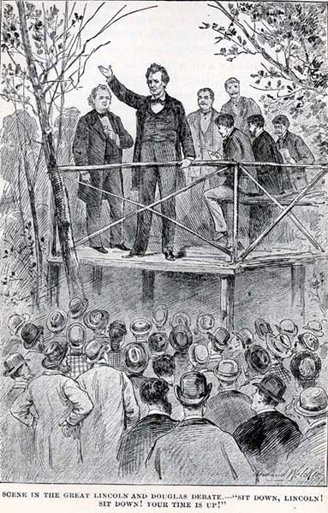
The Lincoln-Douglas Debates
1858
Republicans ran Abraham Lincoln against Democrat Stephen Douglas for U.S. Senate in Illinois
The 2 men participated in a series of public debates centered on slavery
Lincoln opposed the spread of slavery, Douglas promoted popular sovereignty
Douglas argued the Freeport Doctrine – that the Dred Scott decision was correct, but that states wanting to keep slavery out only needed to refuse to pass any laws which would enable slavery
Douglas won re-election, but Lincoln won national attention for himself & the Republican Party

Slide 14
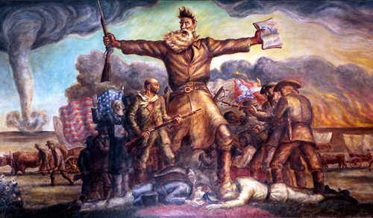

Slide 15
John Brown & Harper’s Ferry

Slide 16
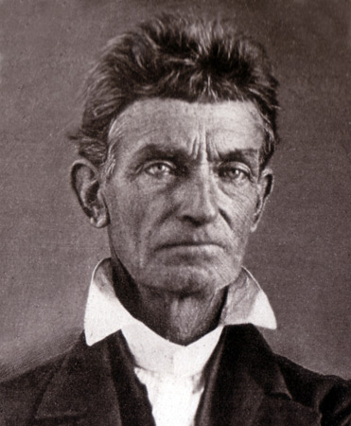
John Brown
1800 – 1859
Businessman who experienced bankruptcy, the death of his wife and a number of his children before becoming an ardent abolitionist
Moved to Kansas in 1856 and participated in the murder of 5 pro-slavery settlers (The Pottawatomie Massacre) and the more organized fighting between abolitionist and pro-slavery forces
When fighting died down in Kansas, Brown returned east

Slide 17
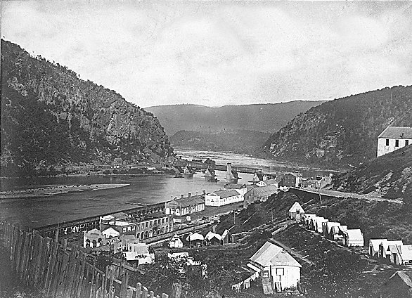

Slide 18
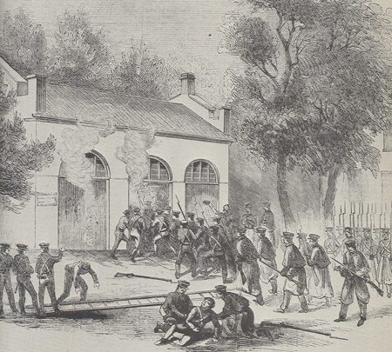
John Brown’s Raid on Harper’s Ferry
Oct. 16-18, 1859
Brown mounted an attack on the federal armory at Harper’s Ferry, VA in an effort to seize weapons with which to arm slaves and start a rebellion
Brown took the armory, but local slaves did not rebel and no support came
Brown’s forces were defeated by U.S. Marines led by Col. Robert E. Lee and Brown was captured, tried and hung for treason

Slide 19
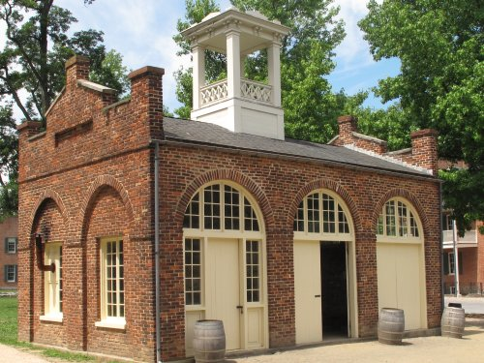

Slide 20
"I, John Brown, am now quite certain that the crimes of this guilty land can never be purged away but with blood.“
—John Brown's last words, written on a note handed to a guard just before his hanging

Slide 21
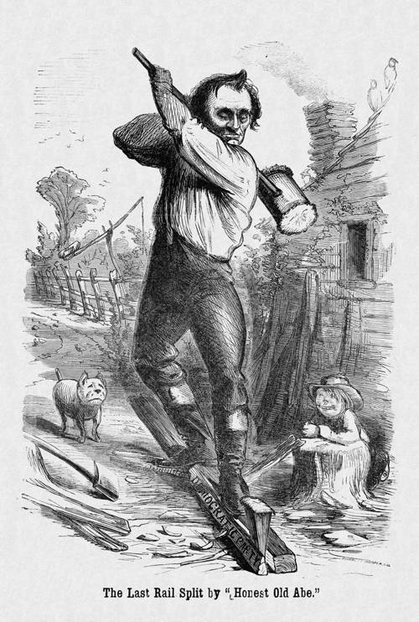
South Turns Against the Republicans
After John Brown’s Raid, Southerners became convinced that abolitionists were determined to destroy the Southern way of life
The Republican Party was closely tied to the abolitionist cause
Southern leaders vowed that they would rather dissolve the Union than tolerate a Republican-led government

Slide 22
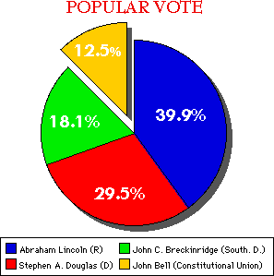
The Election of 1860
Democratic Party Split
Northern Democrats who favored popular sovereignty nominated Stephen Douglas
Southern Democrats who demanded federal protection of slavery nominated John Breckinridge
Republicans nominated Abraham Lincoln
Former Whigs created the Constitutional Party, which argued that the Union could still be preserved through upholding the Constitution, and nominated John Bell

Slide 23
We, therefore, the People of South Carolina, by our delegates in Convention assembled, appealing to the Supreme Judge of the world for the rectitude of our intentions, have solemnly declared that the Union heretofore existing between this State and the other States of North America, is dissolved, and that the State of South Carolina has resumed her position among the nations of the world, as a separate and independent State; with full power to levy war, conclude peace, contract alliances, establish commerce, and to do all other acts and things which independent States may of right do.

Slide 24
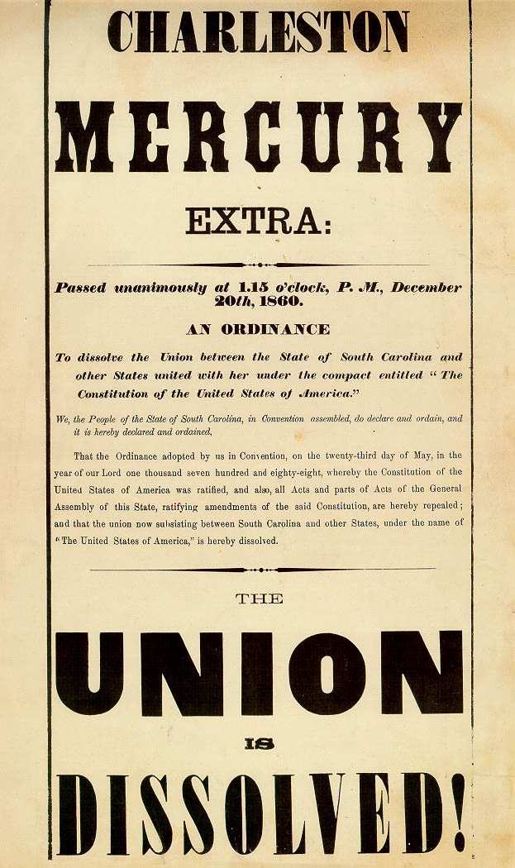
South Carolina Secedes
When Lincoln won the election, the South was outraged
On Dec. 20, 1860, South Carolina seceded from the Union
President Buchanan declared secession to be illegal but hesitated to use military force to stop it
U.S. forces in South Carolina retreated to the safety of Ft. Sumter in Charleston Harbor
South Carolina was quickly followed in secession by Mississippi, Florida, Alabama, Georgia, Louisiana, and Texas

Slide 25
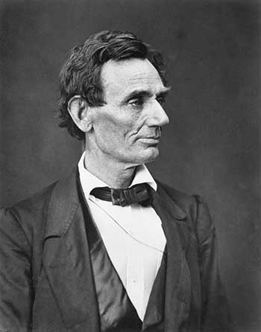
Abraham Lincoln
1809 – 1865
16th President (1861-65)
Republican
His election prompted the South to secede; Lincoln had to decide whether to let them leave the U.S. or use military force to make them stay – he chose to fight
Although anti-slavery, Lincoln was willing to offer protections for Southern slavery to keep the Union whole

Slide 26
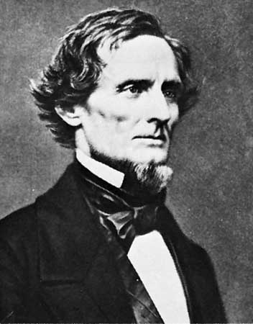
Jefferson Davis
Feb. 1861: Secessionist states declared themselves to be an independent nation, the Confederate States of America
The Confederates wrote a new constitution and elected former Mississippi senator Jefferson Davis as their President

Slide 27
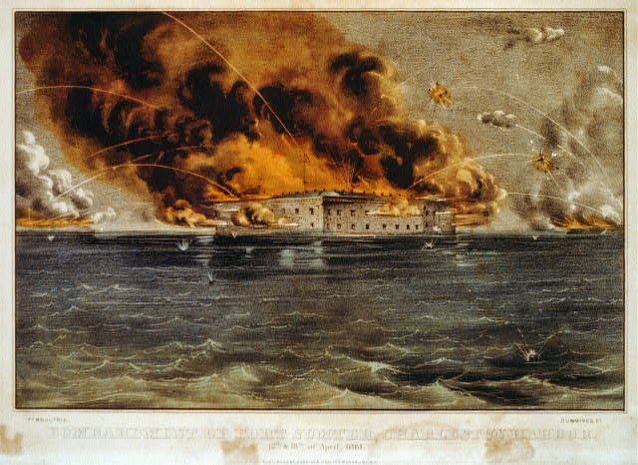
Ft. Sumter
April 1861: Lincoln announced that he intended to reinforce and resupply the Union troops at Ft. Sumter
The South demanded that Ft. Sumter surrender; when the fort refused, it was bombarded with cannon-fire for 33 hours (this marks the official beginning of the U.S. Civil War)
April 13, 1861: Ft. Sumter surrendered to South

Slide 28
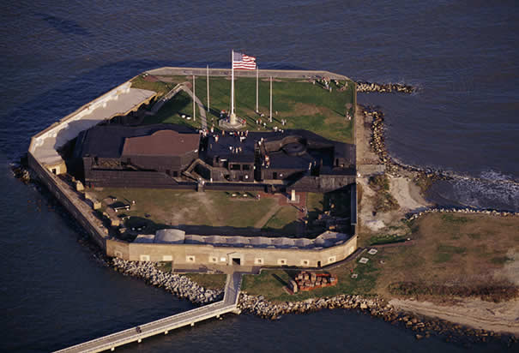

Slide 29
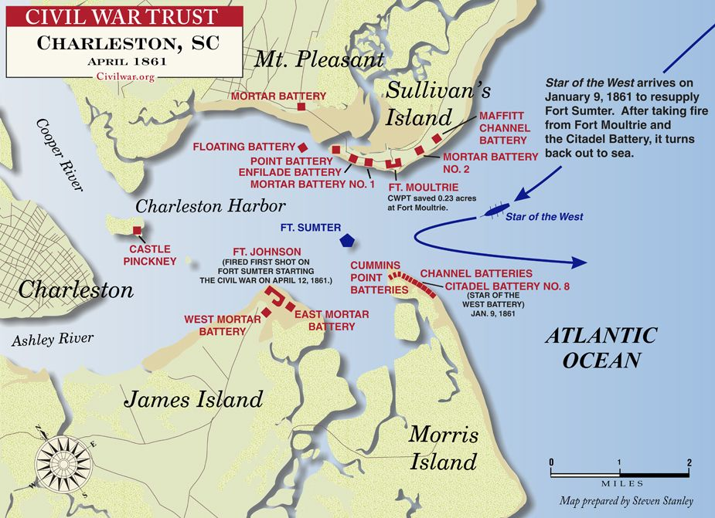

Slide 30
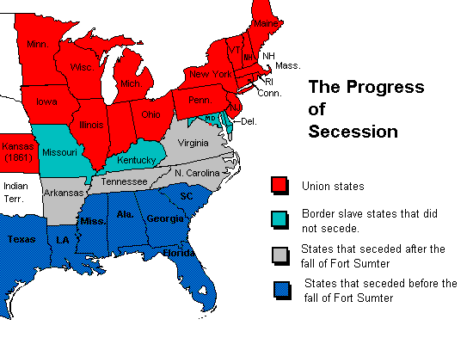
The Upper South Secedes
Lincoln began to build an army to fight the secessionist
This prompted states in the “Upper South” to secede in support of the Confederacy
Virginia, Arkansas, North Carolina, & Tennessee all left the Union to join the Confederacy

Slide 31
The Border States Must Decide
Lincoln needed the remaining 4 slave states (Delaware, Maryland, Kentucky, and Missouri) to stay in the Union
Delaware freely committed to the North, even voting to abolish slavery
Lincoln imposed martial law in Maryland (in order to protect Washington D.C.)
Kentucky sided with the North after Confederate forces invaded the state
Missouri voted to stay with the North

Slide 32

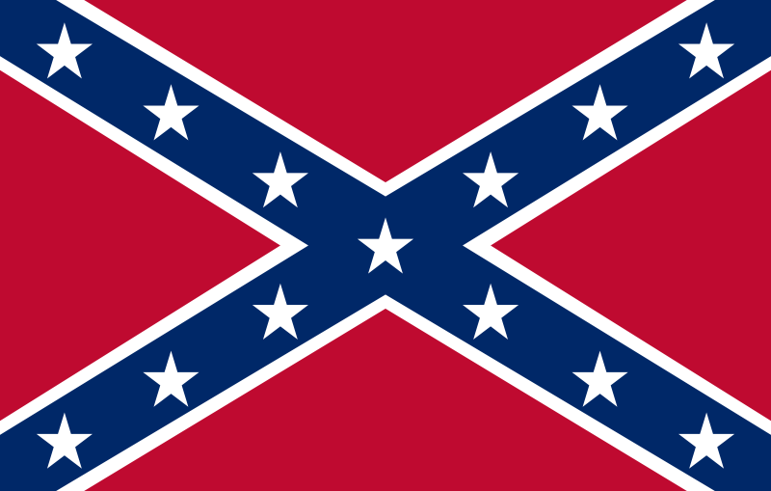
The Confederate States of America
NOT THIS -----→
←-----THIS

Slide 33
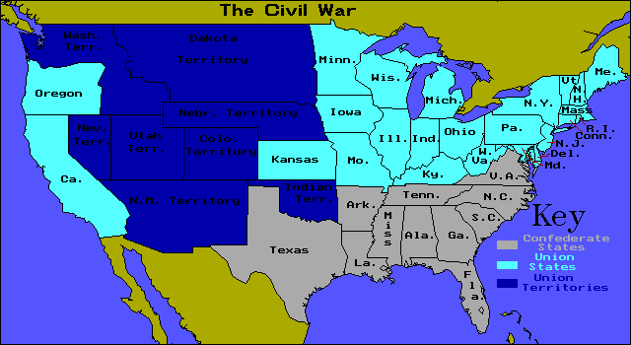
North vs. South

Slide 34
Was John Brown a Hero or a Terrorist?

