Slide 1
Causes of The Civil War:
Part 1

Slide 2
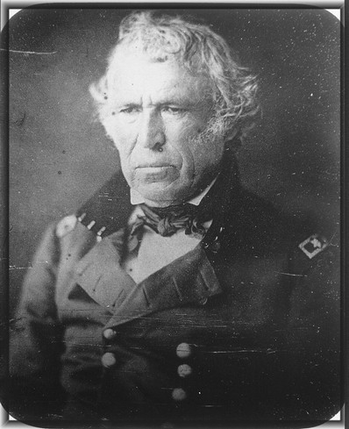
The Mexican War (1846-48)
In response to Mexico’s refusal to receive Slidell, Polk ordered U.S. troops under the command of Gen. Zachary Taylor to secure the Texas border at the Rio Grande
Mexico considered this an invasion of Mexican territory and an act of war
The Mexican army attacked Taylor’s forces, leading the U.S. to declare war on May 13, 1846
Gen. Zachary Taylor

Slide 3
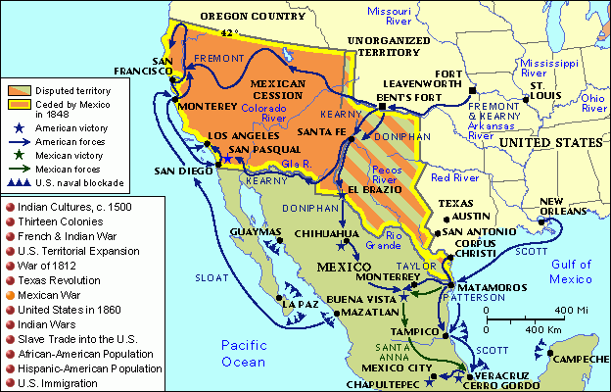
The Mexican War (1846-48)

Slide 4
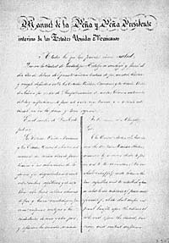
Treaty of Guadalupe-Hidalgo
The war lasted for two very bloody years before Mexico finally surrendered after U.S. forces captured Mexico City
The two sides signed the Treaty of Guadalupe-Hidalgo in February 1848
Mexico ceded 500,000 sq. miles of territory (California, Utah, Arizona, Nevada, New Mexico)
Mexico accepted Rio Grande as southern border of Texas
In return, the U.S. paid Mexico $15 million and assumed $3.25 million in debts Mexico owed to American citizens

Slide 5
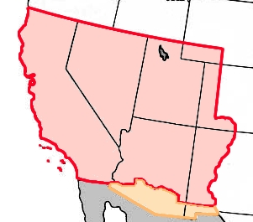
The Mexican Cession

Slide 6
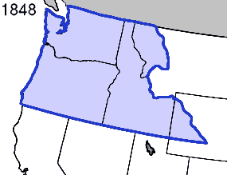
Annexation of Oregon
June 1846
In the end, Britain and the U.S. peacefully resolved their dispute over where the boundary should lie between the U.S. and Canada in the Oregon Territory, splitting the region along the 49th degree of latitude
President Polk hoped that adding the slave-free Oregon Territory would balance the addition of pro-slavery territories in Texas and the Mexican Cession

Slide 7
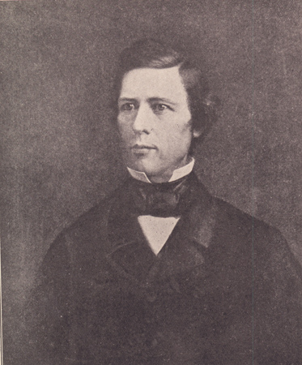
The Wilmot Proviso
The Wilmot Proviso was proposed in 1846 by Rep. David Wilmot of Pennsylvania; he argued for a complete ban on slavery in any new territories the U.S. might acquire from Mexico
Sen. John C. Calhoun of South Carolina countered that the states own U.S. territories in common and Congress holds no authority to ban slavery in the territories
The U.S. Senate refused to vote on the Wilmot Proviso, but its proposal angered slavery supporters across the South
David Wilmot

Slide 8
The question of slavery in the territories will become a major long term cause of the Civil War
-Southerners begin to defend slavery

Slide 9
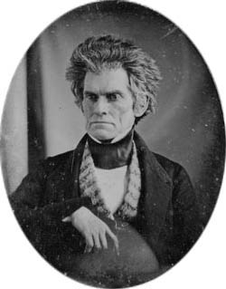
Hardening Attitudes About Slavery
John Calhoun even began to argue that slavery was not a “necessary evil” as had long been the South’s stance, but rather it was a “positive good” because white slave owners provided care for their slaves and introduced them to Christianity, thereby saving their souls
John C. Calhoun

Slide 10
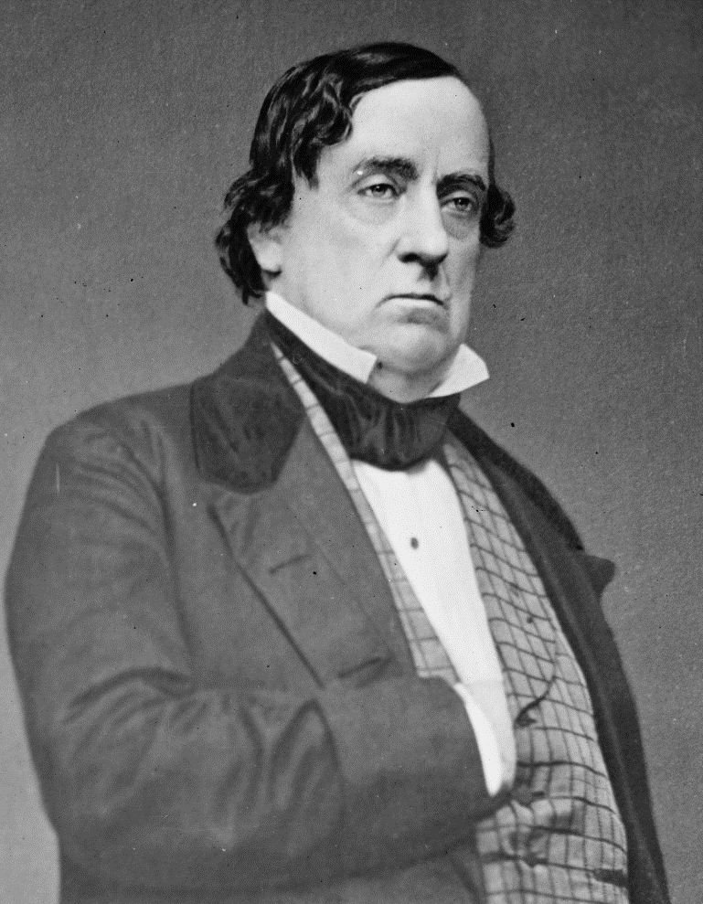
“Popular Sovereignty”
Idea proposed by Sen. Lewis Cass of Michigan
Citizens of each new territory should be allowed to decide for themselves on whether to allow slavery there, rather than the federal government making a decision
Cass’s idea became popular because it kept Congress from having to make any decision about slavery
Lewis Cass

Slide 11
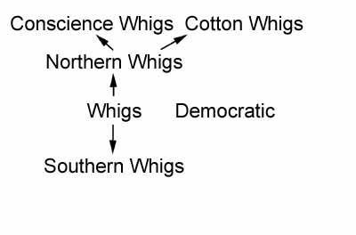
Split in the Whig Party
The slavery issue began to divide Whigs from the North into “Conscience Whigs” who opposed slavery and “Cotton Whigs” who supported slavery because Southern cotton fed their northern textile factories

Slide 12
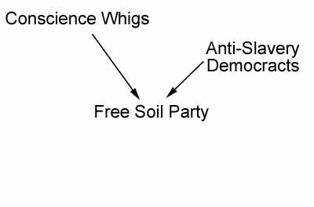
Rise of the Free Soil Party
After pro-slavery Zachary Taylor became the Whig nominee for president in 1848, Conscience Whigs quit the Whig Party and joined themselves with northern anti-slavery Democrats
This new party was called the Free Soil Party (they opposed expanding slavery to the “free soil” of the West).

Slide 13
Zachary Taylor
1784 – 1850
12th President (1849–50)
“Old Rough and Ready”
Slave owner, but believed slavery wouldn’t work in the West because of the climate
A hero of the Mexican War, Taylor had never held an elected office before being elected president
Died in office from an intestinal illness

Slide 14
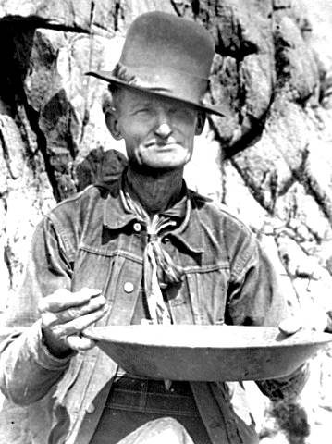
Gold Rush of 1849
Gold was discovered in Sutter’s Mill, California in 1848
This led to a surge of 80,000 new settlers (called ’49ers) who flooded California in 1849, hoping to get rich quick
This growth in population led California to quickly apply for statehood, but as a free state, rather than a slave state

Slide 15
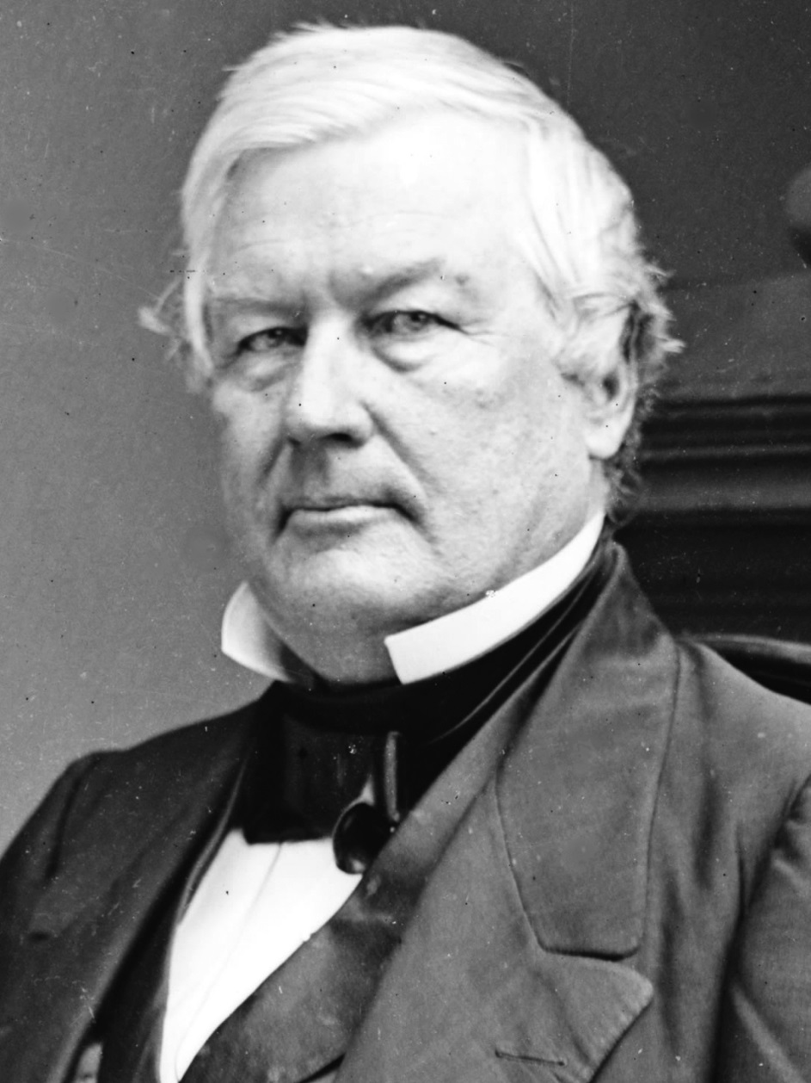
Millard Fillmore
1800 – 1874
13th President (1850-53)
Whig (later switched to the American, or “Know Nothing” Party after leaving office)
Fillmore opposed slavery, but believed that it was necessary to protect it in order to keep the South happy and the Union whole
Endorsed the Compromise of 1850 and signed it into law
Was not nominated for president by the Whigs in 1852

Slide 16
California has applied for free Statehood. What will need to happen to keep the union together?

Slide 17
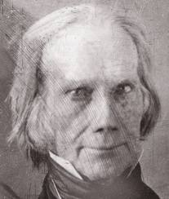
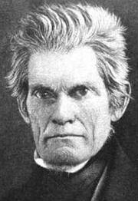
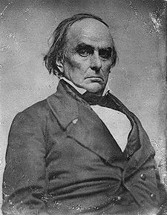
The Compromise of 1850
When California asked to join the Union as a free state, Congress hesitated because their entry would upset the balance between free and slave states in the Senate
Henry Clay of Kentucky, working with Stephen Douglas of Illinois, proposed a series of compromises between North and South that would allow California to join the Union
Clay’s plan was opposed by John C. Calhoun of South Carolina, but supported by the powerful Daniel Webster of Massachusetts

Slide 18
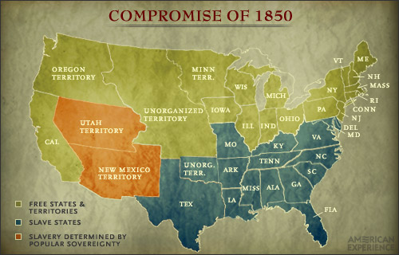
The Compromise of 1850
5 separate bills were pushed through Congress by Clay, Douglas, and Webster over the opposition of Calhoun:
1) California was admitted as a free state
2) The slave trade (but not slave ownership) was banned in Washington D.C.
3) The New Mexico Territory and Utah Territory were created and would be allowed to decide the slavery issue for themselves (popular sovereignty)
4) Texas was paid $10 million in return for giving up its claims to lands in the New Mexico Territory
5) The Fugitive Slave Act forced the return of runaway slaves

Slide 19
Compromise of 1850
Northerners got:
Southerners got:
California was admitted as a free state
New Mexico won territory from Texas, limiting Texas’ size (and spread of slavery)
The slave trade in Washington D.C. was banned
“Popular sovereignty”: each future state would get to decide for itself on slavery
Texas’ debts to southerners would be paid off
Slave ownership in Washington D.C. remained legal
Congress would not be allowed to interfere in the domestic slave trade
Strong Fugitive slave laws allowed southerners to recover runaway slaves in the north

Slide 20
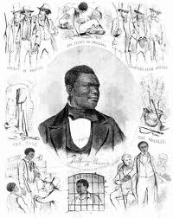
The Fugitive Slave Act
Law enforcement anywhere in the U.S. were required to arrest runaway slaves and return them to their owners
Anyone harboring a fugitive slave or refusing to help apprehend one was subject to fine and prison
Slaves were identified solely by the word of their owner or the owner’s representative and those accused of being a runaway received no trial
As a result, any free black was in danger – all it took was a claim that they were a runaway and they were arrested and sent into slavery

Slide 21
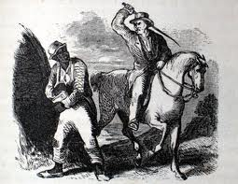
Uncle Tom’s Cabin
Novel written by Harriet Beecher Stowe
Published in 1852, the novel was written in direct response to the Fugitive Slave Act
Uncle Tom Sold 300,000 copies in its first year of publication
The novel brought the suffering of slaves to life for many readers and helped increase the abolitionist ranks
President Lincoln would later credit Uncle Tom’s Cabin with being one of the causes of the Civil War

Slide 22
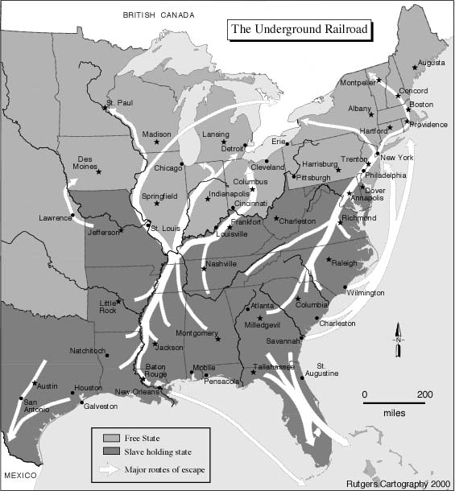
The Underground Railroad
Abolitionists organized a network of individuals who helped hide and move runaway slaves
The Underground Railroad moved thousands of slaves to freedom in Canada, since just getting them into the North was no longer sufficient due to the Fugitive Slave Act
These people risked imprisonment and lynching (hanging without a trial) to help these slaves escape

Slide 23
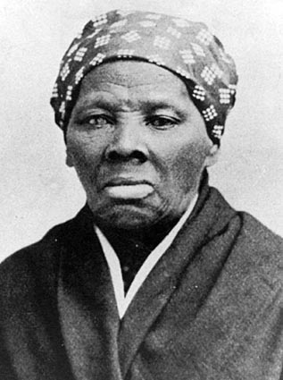
Harriet Tubman
1820 – 1913
The most famous of the “conductors” on the Underground Railroad
Tubman was an escaped slave who risked herself by returning to the South over and over to guide runaways along the Underground Railroad, despite being an epileptic herself
Later worked as a spy for the Union Army during the Civil War and as a women’s rights activist following the Civil War

Slide 24
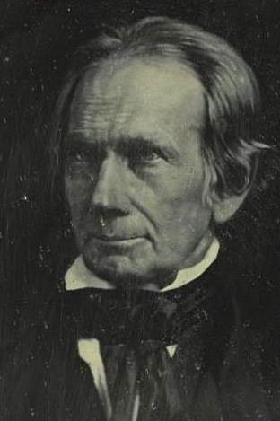
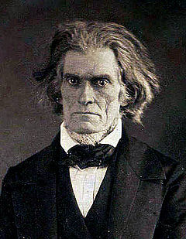
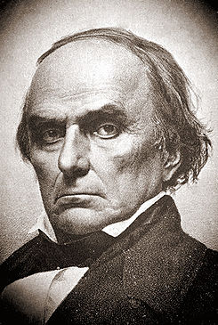
A Changing of the Guard
John C. Calhoun died at age 68 in 1850 after 39 years of serving in Washington
Henry Clay died at age 75 in 1852 after 46 years of serving in Washington
Daniel Webster died at age 70 after 39 years of serving in Washington
The deaths of these longtime Congressional leaders left a younger, angrier generation of Senators to debate the slavery issue; these new leaders proved less willing to strike compromises

Slide 25
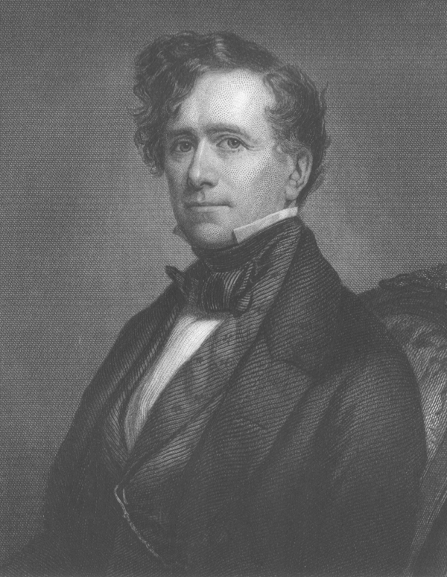
Franklin Pierce
1804 – 1869
14th President (1853-1857)
Democrat
Due to scandal and his support of the Kansas-Nebraska Act, Pierce was not nominated for a second term by his party in 1856

Slide 26
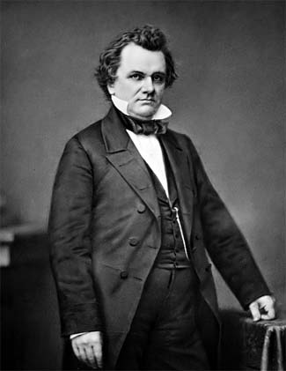
Stephen A. Douglas
1813 – 1861
Senator from Illinois nicknamed the “Little Giant”
Helped draft the Compromise of 1850 and was the author of the Kansas-Nebraska Act
Douglas was a strong believer in democracy and the will of the people – so he supported the idea of using popular sovereignty to decide the slavery issue

Slide 27
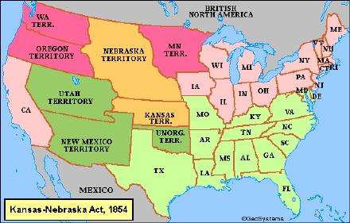
The Kansas-Nebraska Act
Passed in 1854
Act of Congress which created two new territories out of the Great Plains – Kansas and Nebraska
The act repealed the Missouri Compromise and allowed the 2 new territories to exercise popular sovereignty to decide the issue of slavery

Slide 28
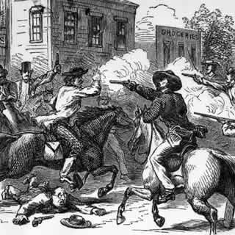
“Bleeding Kansas”
Settlers moving into the Kansas Territory from Missouri brought their slaves with them
The New England Emigrant Aid Company began organizing and equipping northern settlers to move to Kansas and oppose slavery
Both sides were armed and willing to fight and periods of serious violence ensued

Slide 29
Was Abraham Lincoln A Racist?

Slide 30
Attitudes on Slavery: Research
Why did Abolitionists oppose slavery? Provide at least two specific examples. Cite your sources.
How did Southerners attempt to defend the institution of slavery? Provide at least two specific examples? Cite your sources.
If YOU were an Abolitionist in 1850, explain why YOU would oppose the institution of slavery? Be specific
100 words minimum

