Slide 1
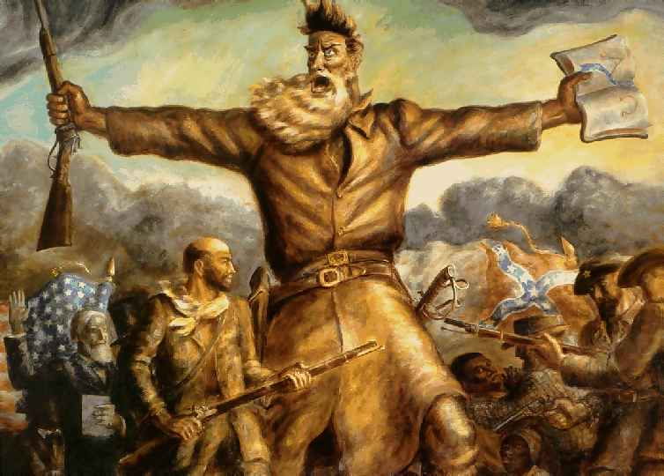
The Divisive Politics of Slavery

Slide 2
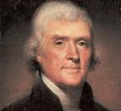
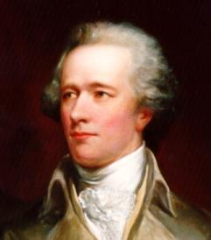
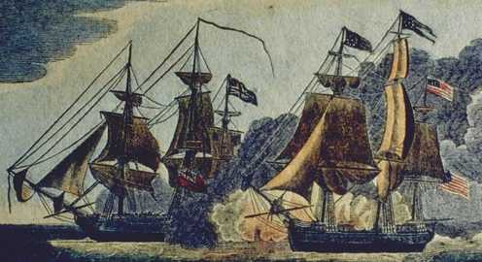
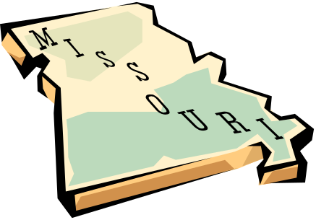

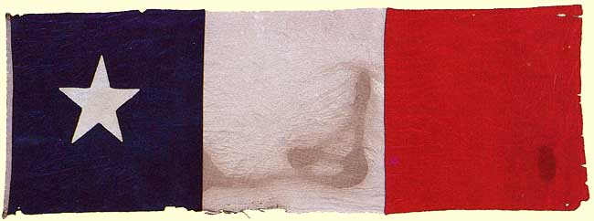
Sectionalism Prior to 1850
Federalists vs. Democratic Republicans
Hamilton’s Economic Plan 1790
War of 1812
Missouri Compromise 1820
Nullification Crisis 1832
Annexation of Texas

Slide 3
North | South
Industrialized | Agricultural
Railroads | Few Railroads
Small towns become cities | Mostly Rural
Immigrants become industrial workers | Few immigrants - Small farms and plantations
Fear expansion of slavery | Slaves as a source of labor

Slide 4
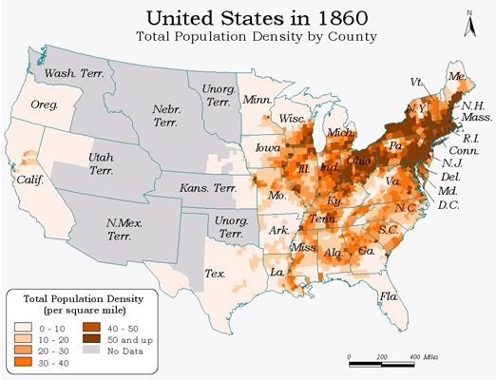

Slide 5
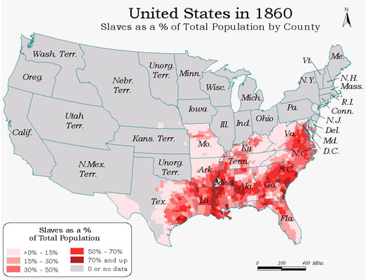
3 states over 50%
slaves

Slide 6
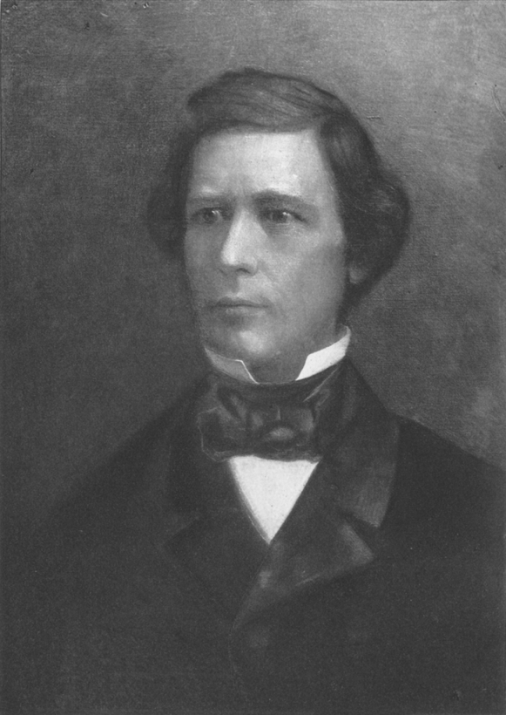
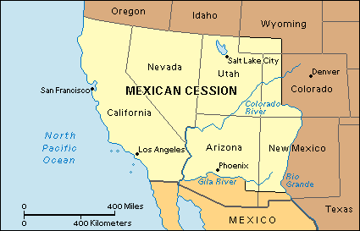
The Wilmot Proviso
Proposed by Northern Congressmen
Goal – Declare slavery illegal in territory gained from Mexico
Effect – Never passes and angers southerners

Slide 7
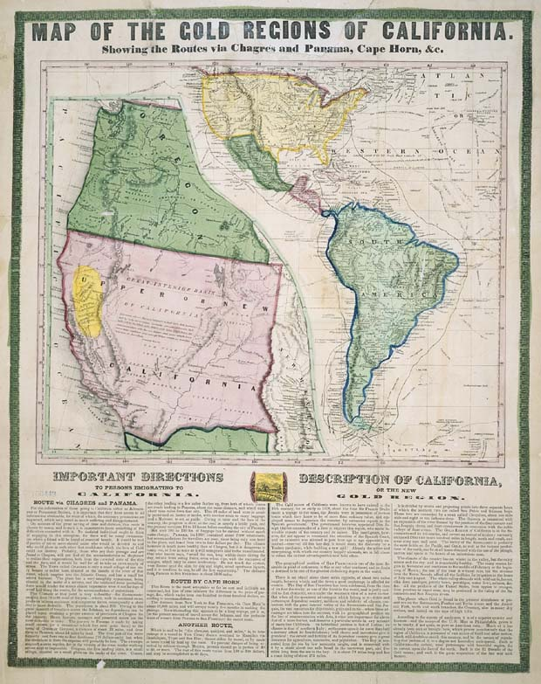
Statehood for California
Cause:
  Population increase due to 1849 Gold Rush
Question:
  Will California be admitted as a free or slave state
* President Taylor insists on California become a Free state. * Refuses to compromise

Slide 8
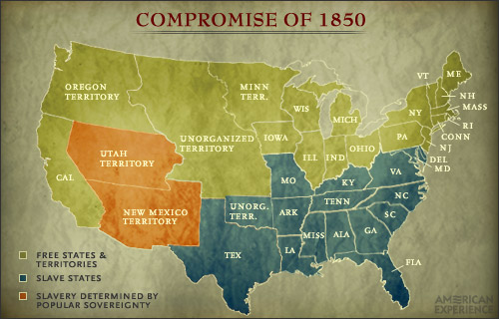
Compromise of 1850
Southerners threaten secession… again.
Zachary Taylor unexpectedly dies
Henry Clay offers Compromise of 1850

Slide 9
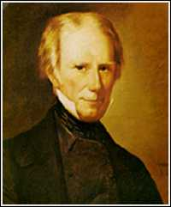
Terms of the Compromise
1. California = free state
2. Stronger fugitive slave laws
3. Sell of slaves banned in Washington D.C
4. Popular sovereignty in NM and Utah
- Residents of territory decide on slavery
You know you can’t say no to this face

Slide 10
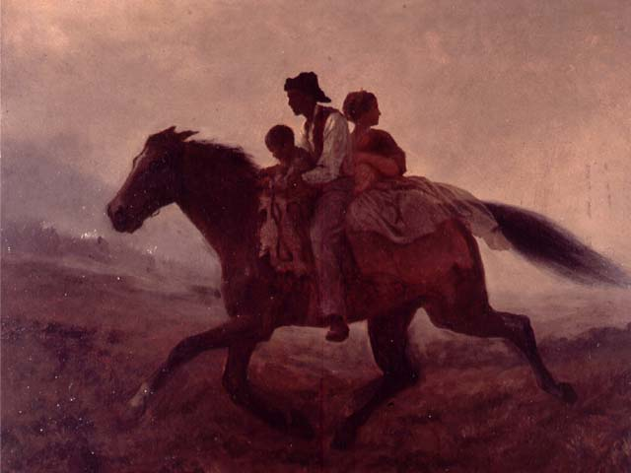
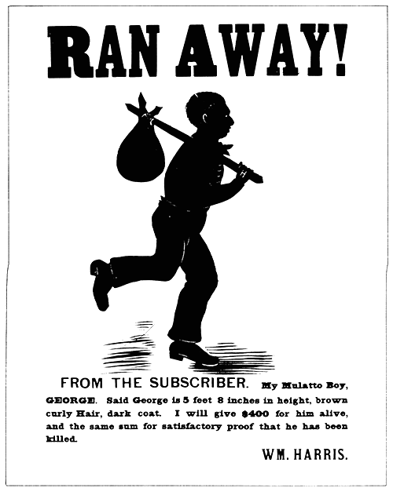
FUGITIVE SLAVE ACT
No warrant necessary
Judges paid more to rule in favor of slave holder/bounty hunters
Northerners now REQUIRED to assist in the return of run away slaves

Slide 11
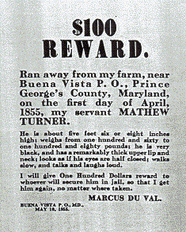
Reward poster for runaway slave

Slide 12
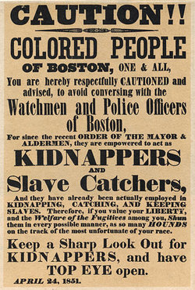
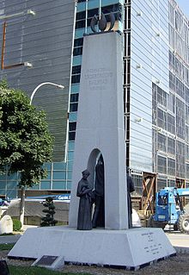
The Fugitive Slave Act brought the issue of slavery to the North
Northerners sent fugitives to Canada

Slide 13
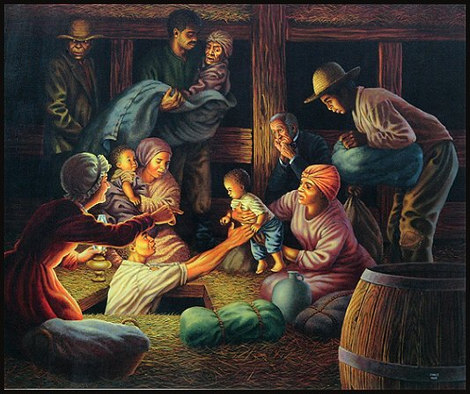
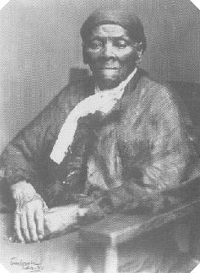

Fugitive Slaves & The Underground Railroad
Harriet Tubman & The Underground Railroad
- 19 trips to the South
- helped 300 slaves to freedom
Estimated that around 1000 slaves escaped per year.

Slide 14
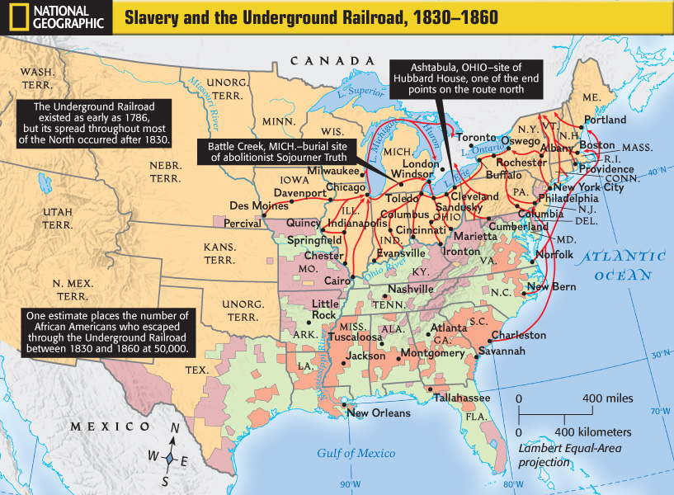

Slide 15
http://www.history.com/topics/kansas-nebraska-act/videos#harriet-tubman-and-the-underground-railroad

Slide 16
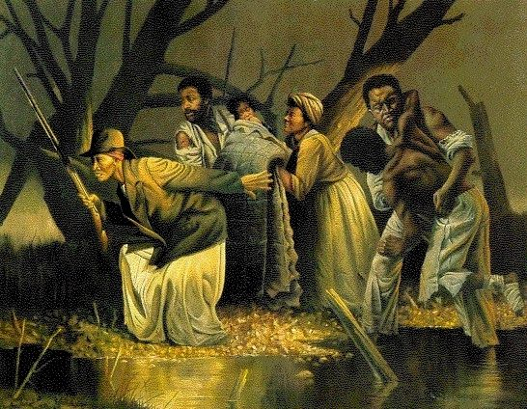

Slide 18
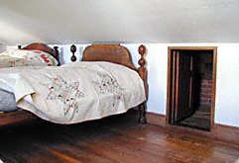
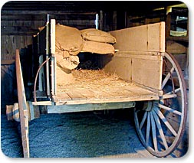
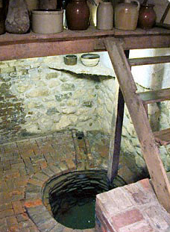
THE UNDERGROUND RAILROAD – hiding places

Slide 19
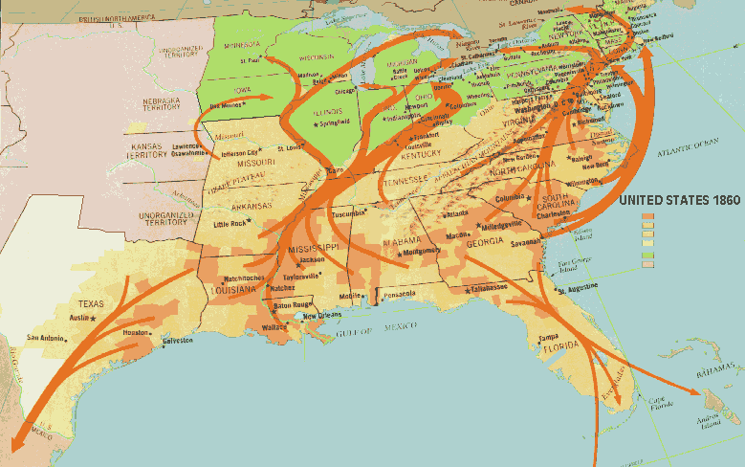
THE UNDERGROUND RAILROAD

Slide 20
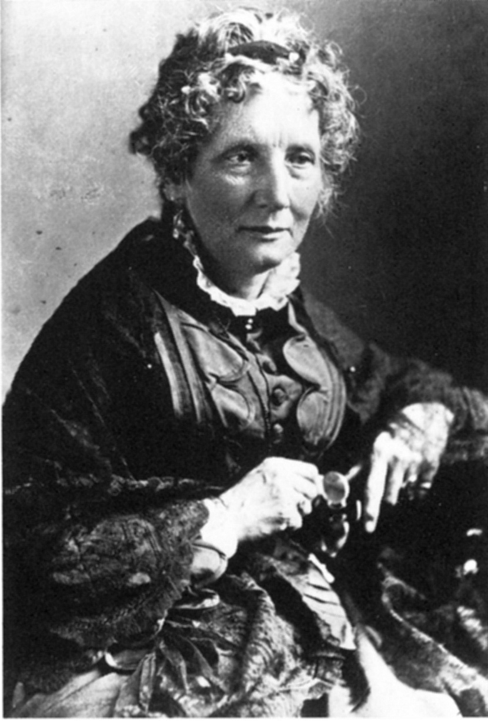
Uncle Tom’s Cabin - 1852
Written by Harriet Beecher Stowe
Sold 1,000,000 copies in 2 yrs.
South says book gives
slavery a false picture
Book shows slavery as
a moral problem

Slide 21
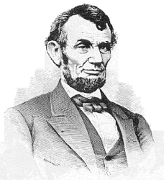
President Lincoln once met her and supposedly said "So this is the little lady who started this great war."

Slide 22
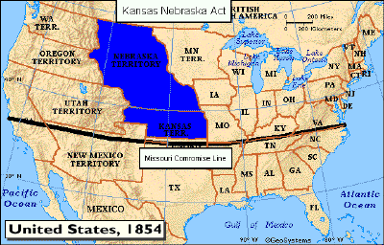
The Kansas-Nebraska Act
Introduced by Stephen A. Douglas
Turn the territory into two
  Kansas & Nebraska
Legality of slavery chosen by people
  Popular sovereignty
  Would repeal the Missouri Compromise
Northern View:
Worried this would turn territory into slave states
Southern View:
90% of congressmen voted in favor of the law
Leads to the creation of the Republican Party

Slide 23
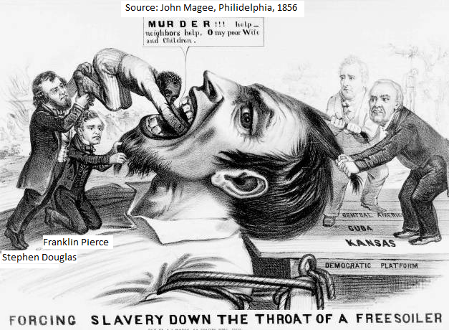
James Buchanan

Slide 24
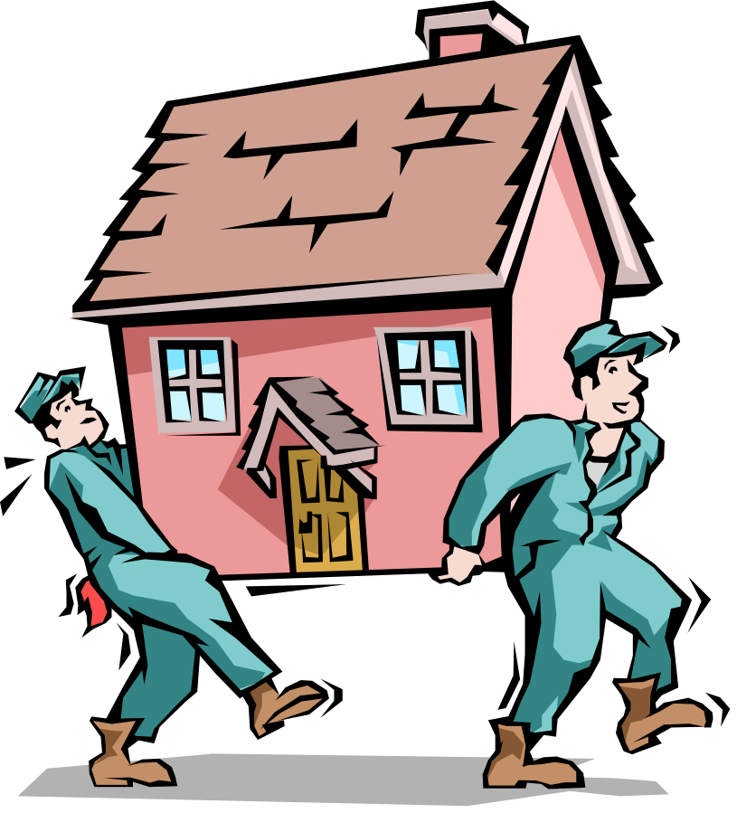
Result:
People from surrounding states (primarily abolitionists) flock to Kansas to vote
“Border Ruffians”
“Jayhawkers”
Kansas should be a slave state
You’re a real jerk. It should be a free state

Slide 25
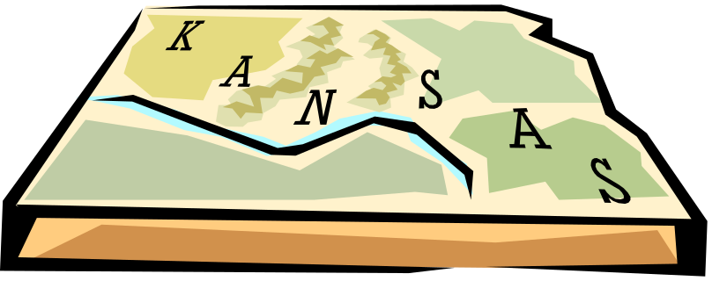
BLEEDING
KANSAS
Many people voted illegally and fights break out in Kansas - this becomes known as “BLEEDING KANSAS”
An attack on Lawrence becomes known as the “Sack of Lawrence”

Slide 26
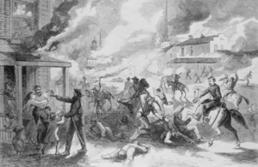
Bleeding Kansas
Thousands of Pro Slavery and Anti Slavery Americans rush to Kansas to cast their votes
Leads to several instances of violence, destruction of property and murder

Slide 27
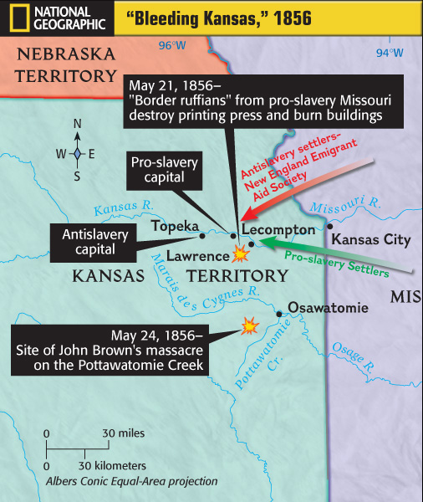
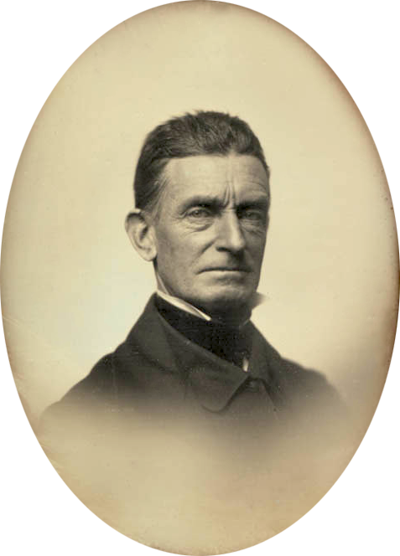

Slide 28
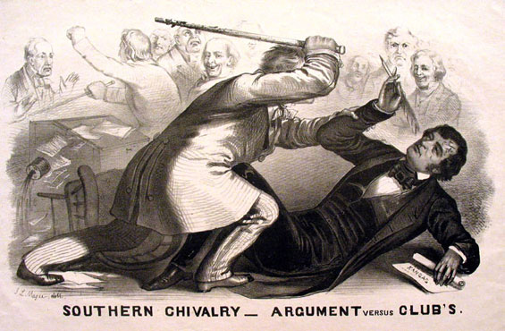
Violence in the Senate
Northern Congressman (Sumner) speaks out against (and makes fun of) the southern way of live and use of slaves.
A Southern Congressman (Brooks) attacks Sumner the next day, beating him until his cane snapped in half

Slide 29
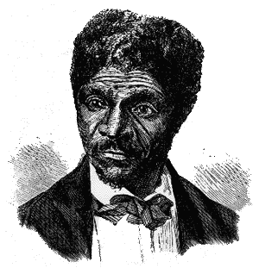
Dred Scott Case
Issue
  A slave (Dred Scott) was moved into a “free” territory
  When his owner died, he sued for his freedom
Questions to be answered
  Can a slave sue?
Ruling
  A slave is property and, therefore, cannot sue
  It is unconstitutional to ever make property (slaves) illegal
  Missouri Compromise?

Slide 30
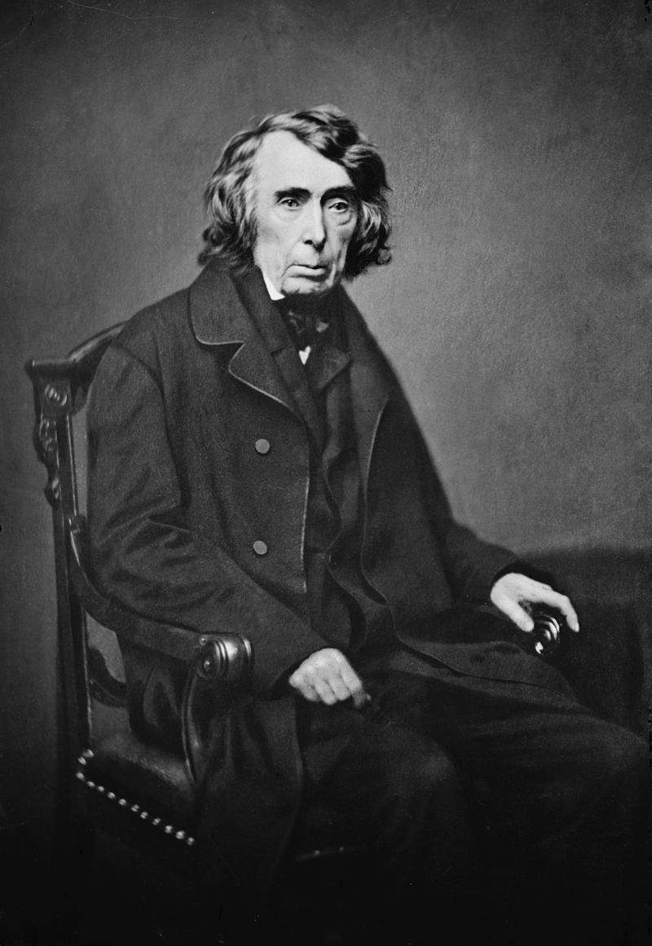
Roger B Taney
“They had for more than a century before been regarded as beings of an inferior order, and altogether unfit to associate with the white race, either in social or political relations; and so far inferior, that they had no rights which the white man was bound to respect; and that the negro might justly and lawfully be reduced to slavery for his benefit.”

Slide 31
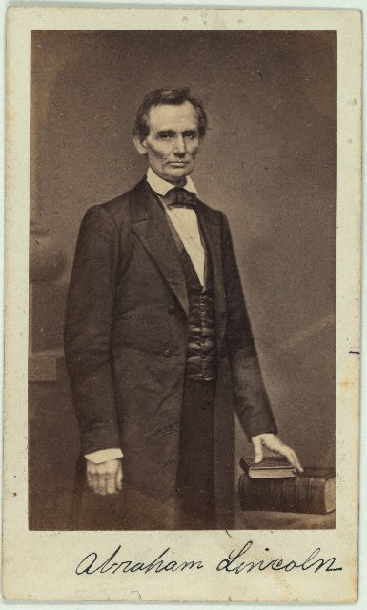
ABRAHAM LINCOLN –
Born poor in Kentucky
Little formal education
Became successful lawyer
Beliefs on slavery led him into politics
*Also established vampire killer

Slide 32
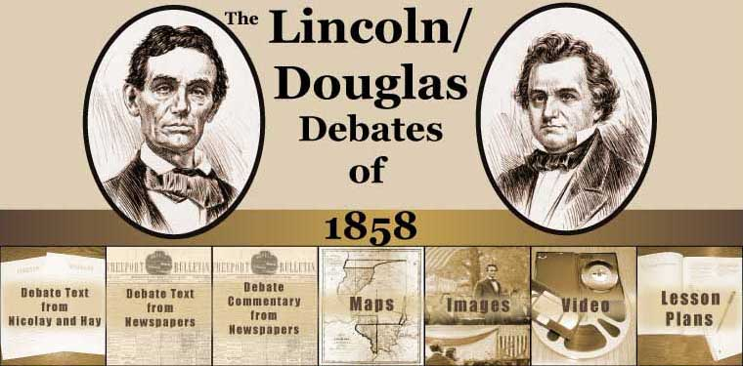
Lincoln-Douglas Debates - 1858
Both are running for Illinois Senate
Both have very different opinions on Slavery
Lincoln Douglas
Slavery should Issue should be
not spread! decided by each state

Slide 33
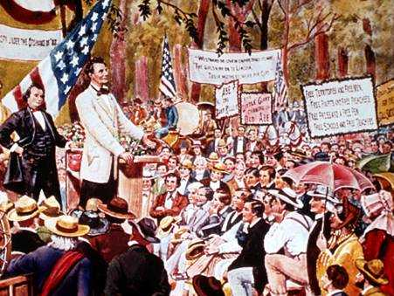

Slide 34
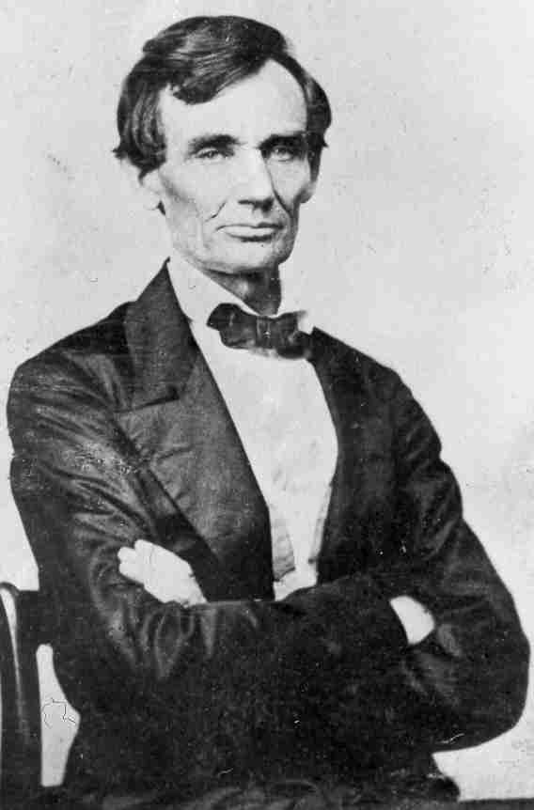
Douglas wins the election for the Illinois Senate
But….
Lincoln shows he has the potential to win an office in the future

Slide 35
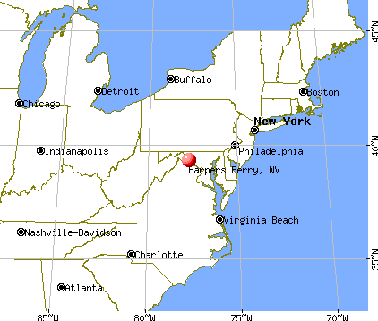
HARPER’S FERRY – a

Slide 36
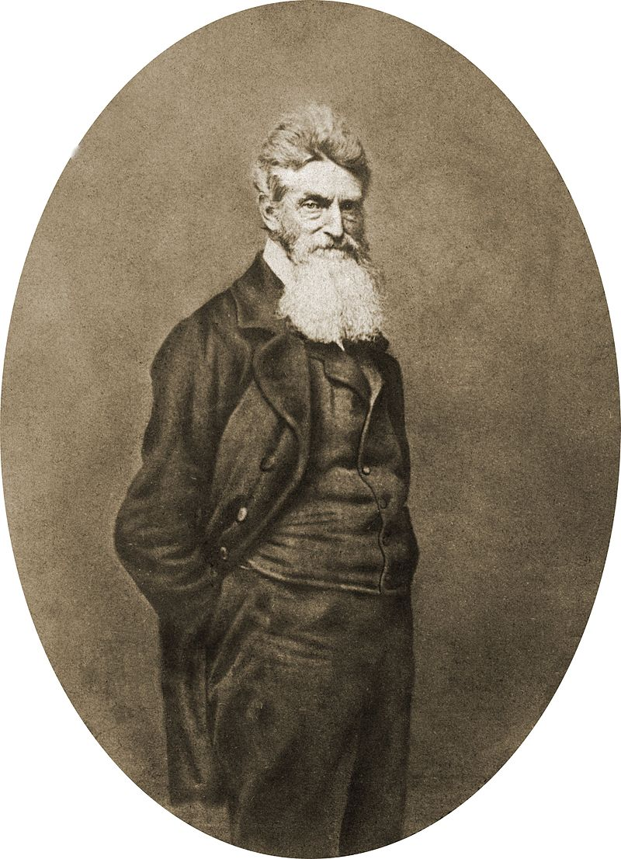
John Brown’s Plan
Organize a large group of slaves and abolitionists
Raid the Federal Arsenal in Harpers Ferry
Lead Revolution into the south freeing slaves along the way

Slide 37
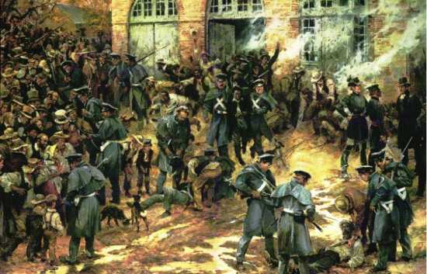
JOHN BROWN’S ATTACK AT HARPER’S FERRY

Slide 38
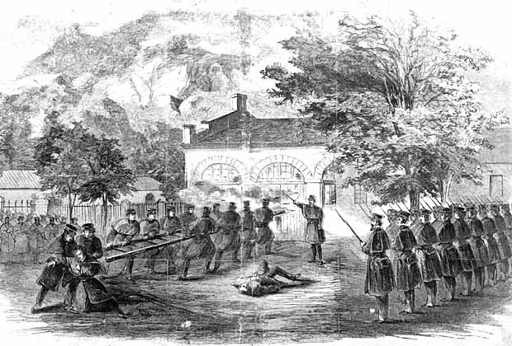
Results
John Brown’s plan fails
Of the 20 men (16 white, 4 black) 10 are killed
John Brown is arrested, put on trial, and executed for treason
North South
Views him as a Martyr Views him as a terrorist

Slide 39
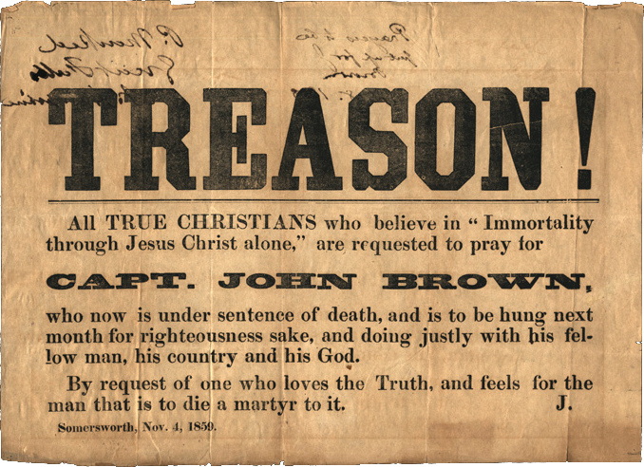

Slide 40
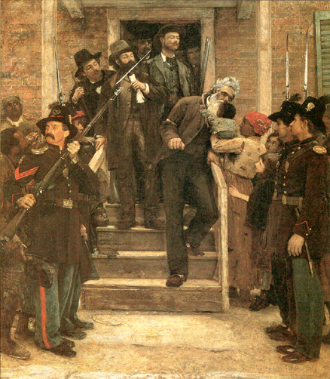
LAST MOMENTS OF JOHN BROWN
http://www.history.com/topics/bleeding-kansas/videos#john-browns-last-speech

Slide 41
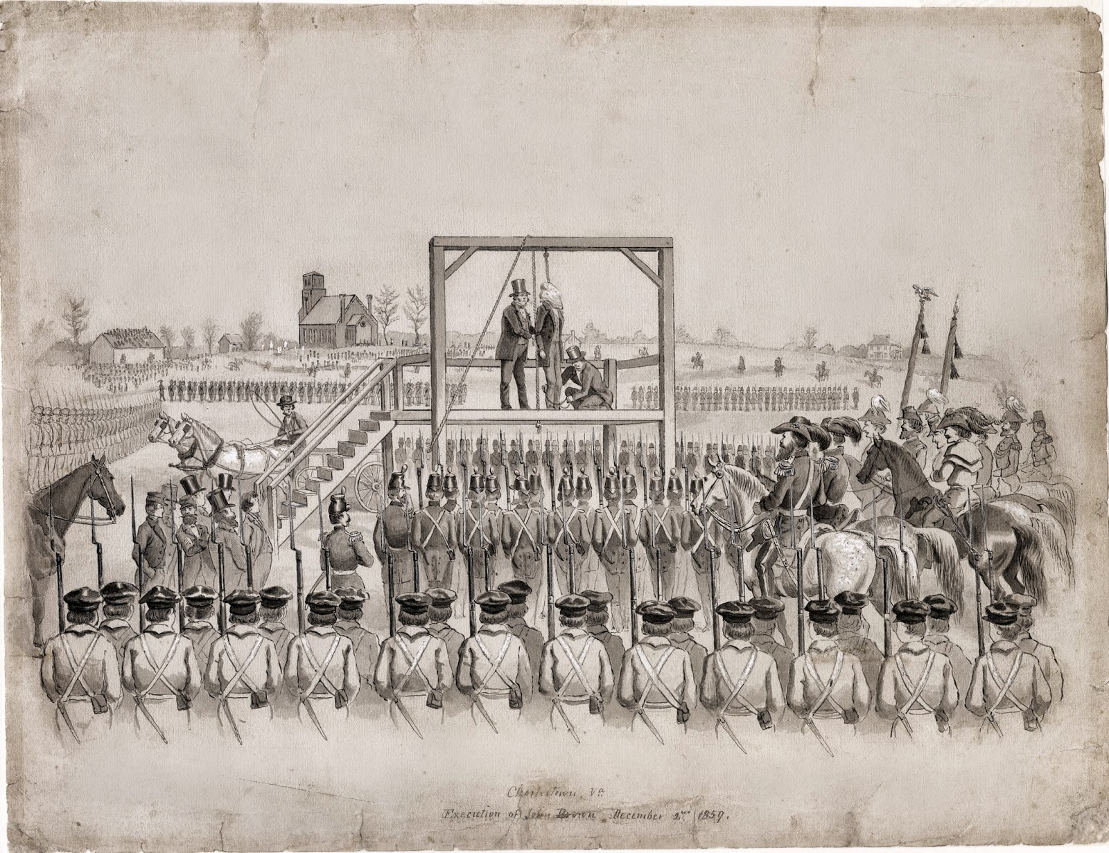

Slide 42
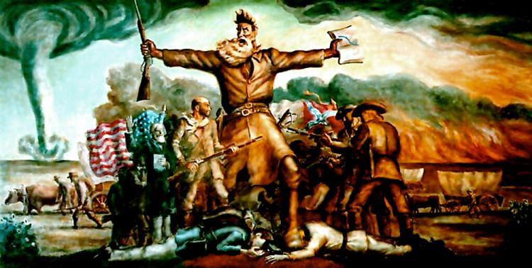
JOHN BROWN
"His zeal in the cause of my race was far greater than mine—it was as the burning sun to my taper light—mine was bounded by time, his stretched away to the boundless shores of eternity. I could live for the slave, but he could die for him.“
- Frederick Douglass

Slide 43


Election of 1860
Democrats could not agree on how slavery would be explained in their PLATFORM

Slide 44
ELECTION OF 1860
Republicans – Abraham Lincoln
Southern Dems – John Breckinridge
Northern Dems – Stephen Douglas
Constitutional Union – John Bell

Slide 45


Slide 46

http://mailbox.univie.ac.at/kurt.mayer/graphics/LincolnElectl.jpg

Slide 47

PRESIDENTIAL ELECTION OF 1860
http://www.multied.com/PageMill_Images/image31.gif

Slide 48

http://www.giltroy.com/Courseweb/pres1860.gif

Slide 49

Lincoln wins many votes in the North and since the North has a larger population he wins the election
http://www.wildwestweb.net/cwleaders/Abraham%20Lincoln.jpg

Slide 50


The South is afraid that Lincoln will now try to abolish slavery in the United States

Slide 51

SECEDE – to withdraw from the Union, split with the country
South Carolina becomes the first to secede on December 20, 1860

Slide 52

In the next six weeks more states secede: Mississippi, Florida, Alabama, Georgia, Louisiana and Texas

Slide 53

These states form their own country – THE CONFEDERATE STATES OF AMERICA

Slide 54

JEFFERSON DAVIS is elected president of the Confederate States of America
http://www.military.com/pics/davis1.jpg

Slide 55

Northerners felt that secession was unconstitutional and the South did NOT have the right to leave
X

Slide 56

Lincoln becomes the 16th president in March of 1861

Slide 57


Slide 58

Lincoln tells the South he does not accept their secession

Slide 59

Fort Sumter

Slide 60

THE END

