Slide 1
Cardiovascular System
(Or Circulatory System)

Slide 2
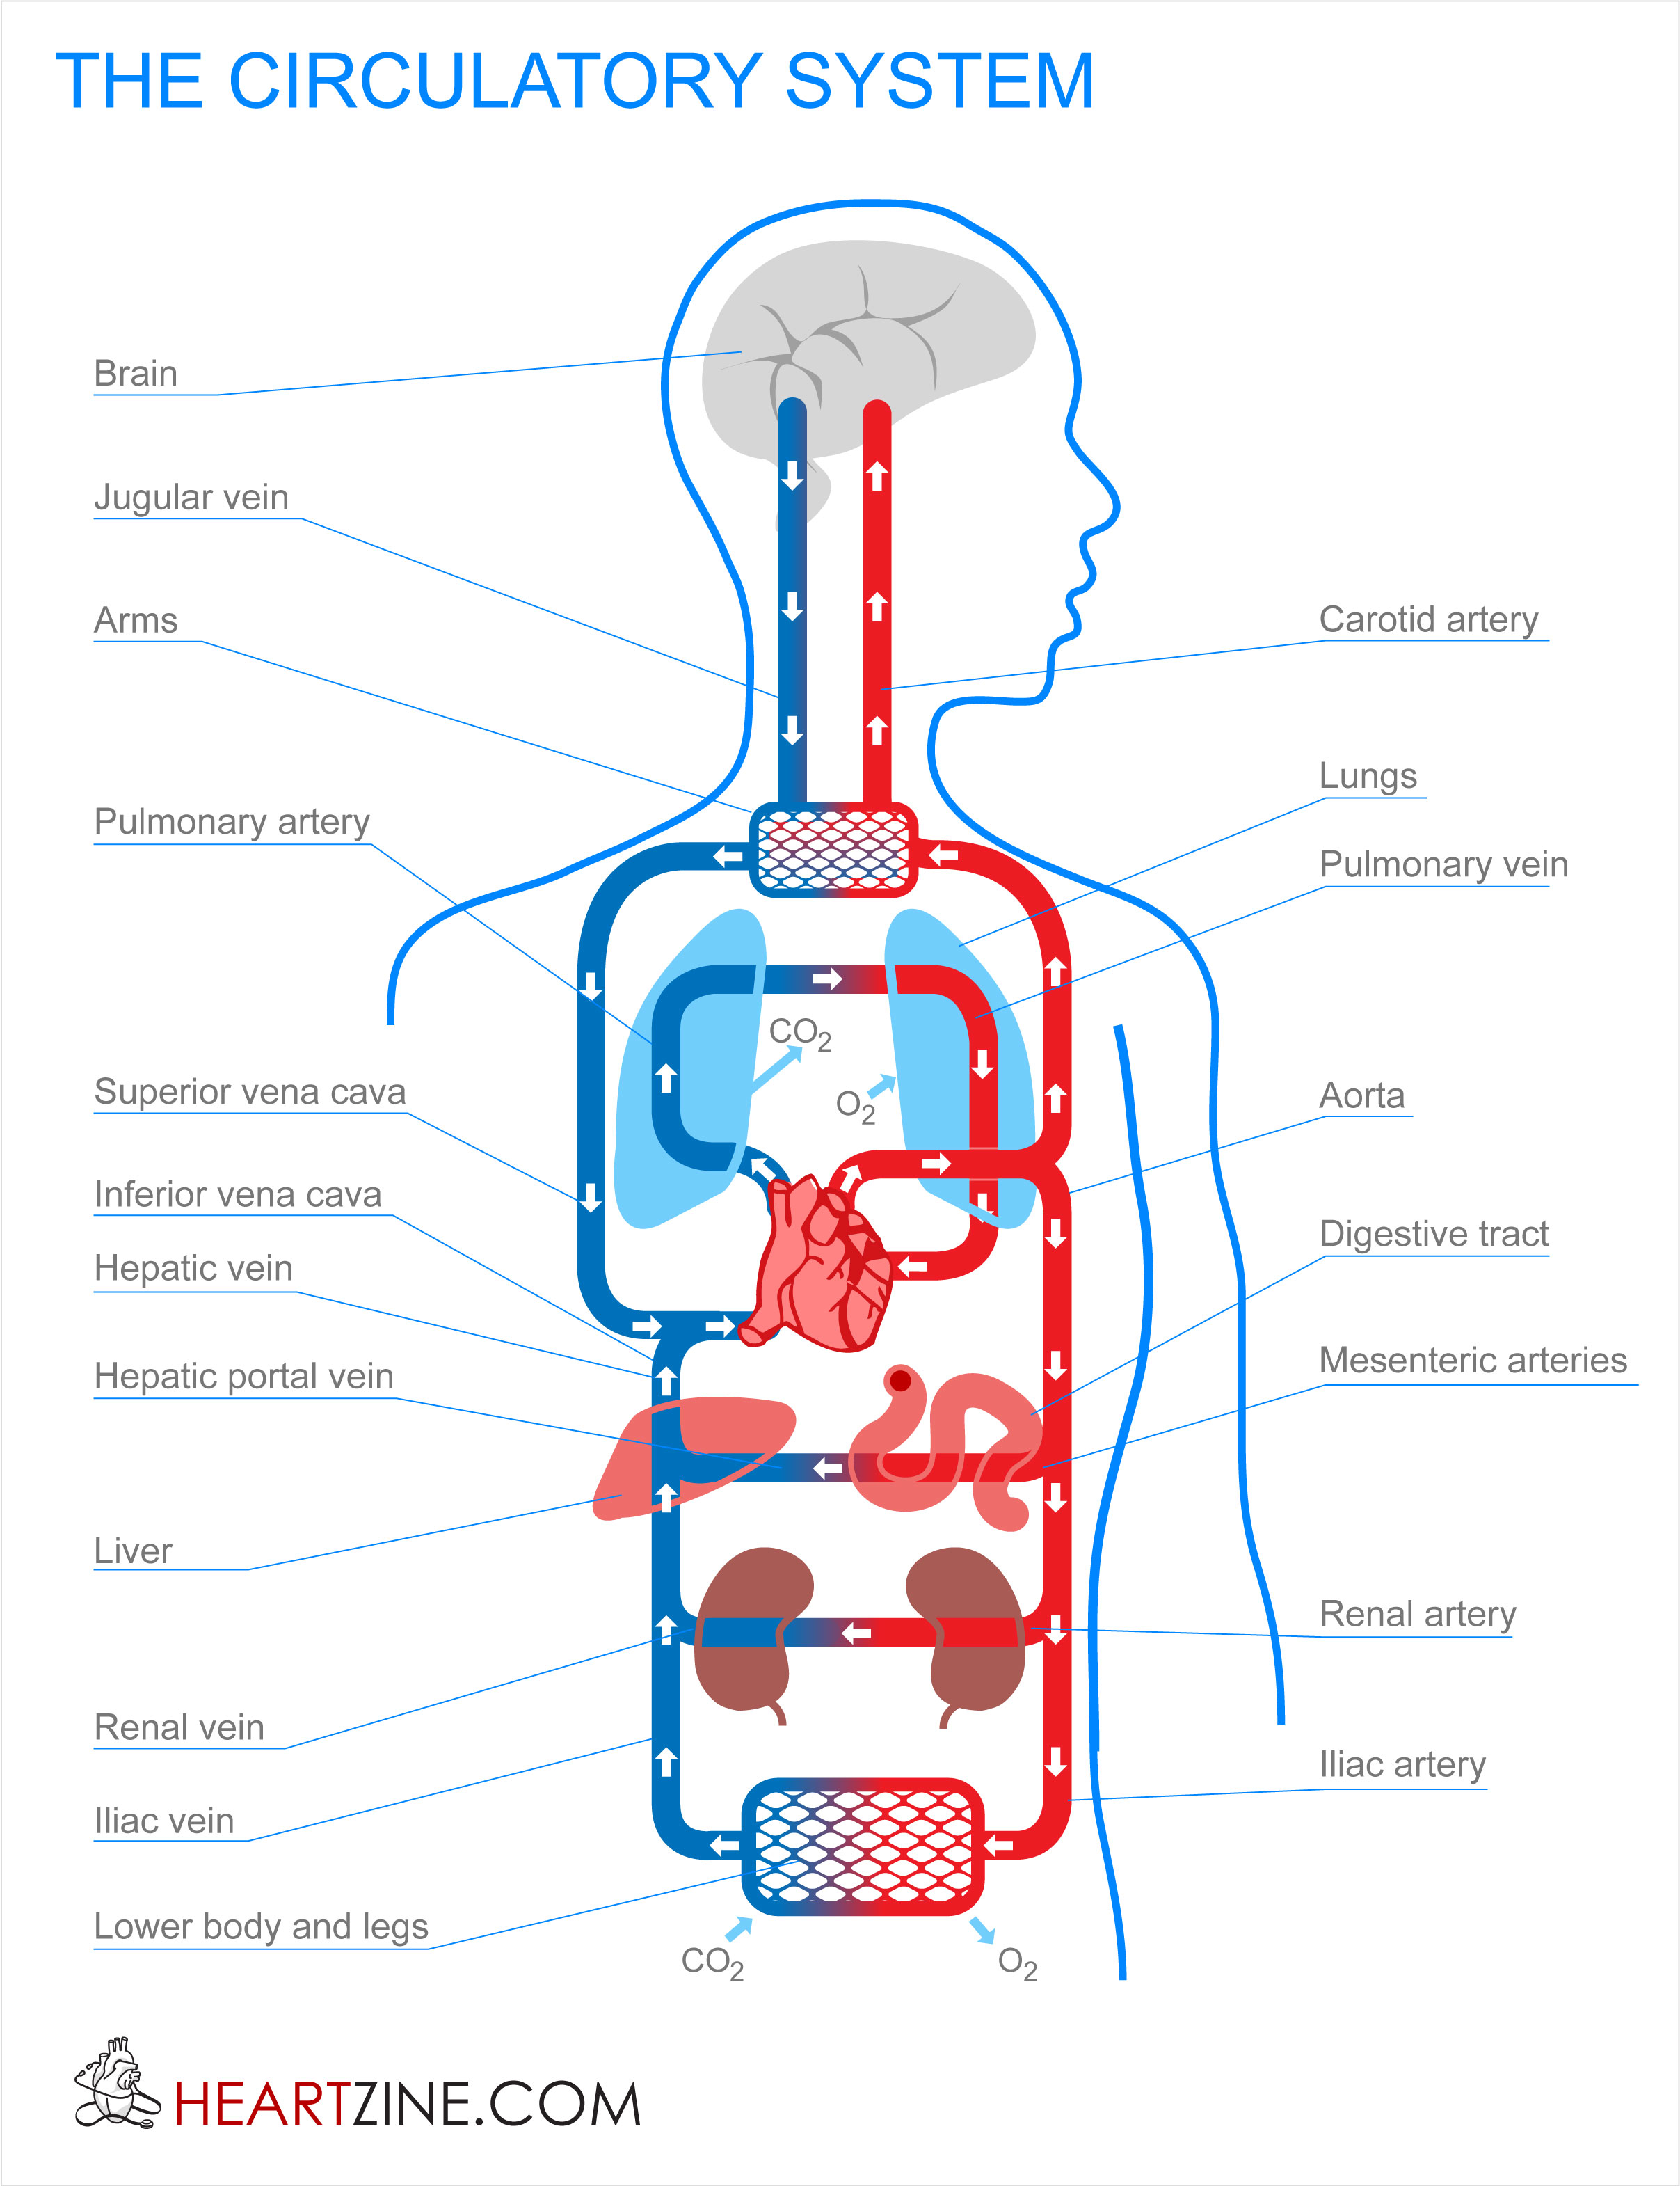
Purpose of the System
The purpose of this system is to transport oxygen and blood throughout the tissues in the body and remove waste products from the body.

Slide 3
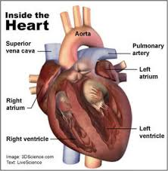
Organs in the System
The heart is the primary organ in this system. It pumps blood throughout the body through arteries and veins.
Also included in this system:
Arteries
Veins
Blood vessels and blood
Lungs *also part of respiratory system

Slide 4
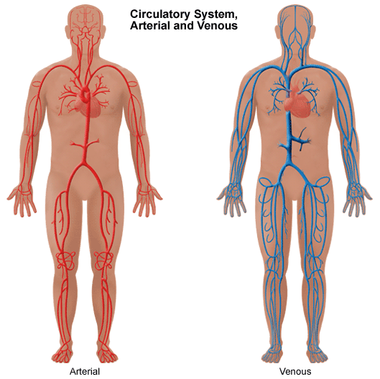
Arteries
Channels like flexible pipes that take the blood and oxygen from the lungs to the cells of the body.

Slide 5
Veins
Channels that take blood filled with carbon dioxide back to the heart and lungs.
Send blood through the lungs to get oxygen and leave the carbon dioxide, then through the liver and kidneys to leave other wastes.

Slide 6
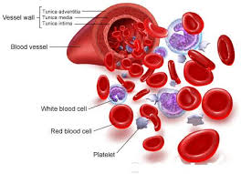
What does blood do for our body?
Besides taking oxygen to the body’s cells, the blood also helps to take food in the form of sugar and proteins to the cells.
As the blood flows throughout the body, it helps keep it warm.

Slide 7
Review
Brain Pop (see Mrs. Nelson for the password)
Study Jams
Khan Academy Circulatory System
Heart and Circulatory System

