Slide 1
Journal-
A reformer is someone who fights for a change in society. What qualities do you think reformers must have in order to succeed in their causes? Can you name any past or present reformers?
Answer in complete sentences.

Slide 2
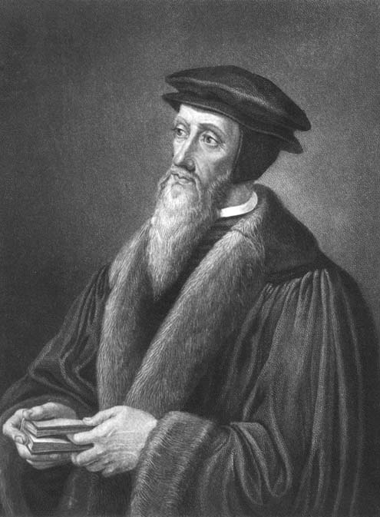
Calvinism
Founder: John Calvin
Influenced by Martin Luther (only authority is the Bible)
Started in Geneva, Switzerland

Slide 3
Basic Philosophy:
Predestination - "Since God is all-knowing, He has known since the beginning who will be saved." It is the duty of those chosen few to rule society as God directed.
Example City: Geneva - Calvin set regulations for everyone in the city.
Theocracy - Government controlled by religious leaders

Slide 4

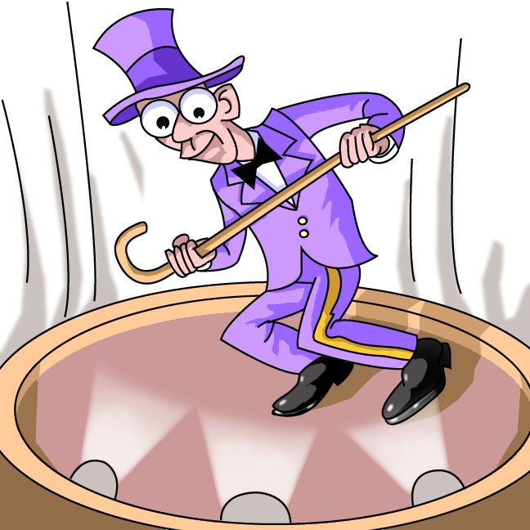
Regulations
Everyone attended church and classes in religion daily.
No brightly colored clothing!
No fighting, swearing, drinking, gambling, card-playing or dancing!

Slide 5
Punishment for breaking the rules
imprisonment
excommunication
banishment from the city
execution.

Slide 6
Calvinism influenced Europe.
It spread to the Netherlands, Scotland, and small communities in Europe.
The ideas influenced both Presbyterian and Baptist churches.

Slide 7
Henry VIII
Church of England

Slide 8
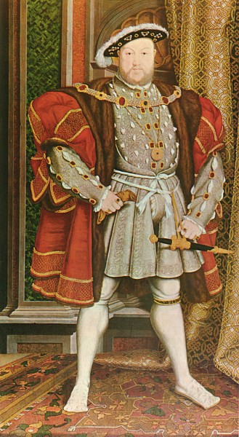
Henry VIII
Physical Appearance: Beard, Large, Traditional Dress
Hobbies: Tennis, Joust, Music, Discussions about Religion & Science

Slide 9
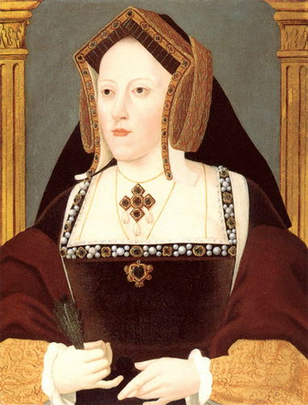
1st Wife:
Catherine of Aragon
Child: Mary - Became known as "Bloody Mary" (Catholic)
No Healthy Male Heir!

Slide 10
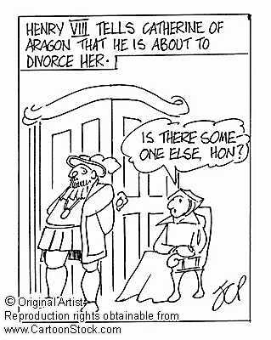
Henry requested an annulment so that he could remarry and have a healthy son...
The Pope said NO!

Slide 11
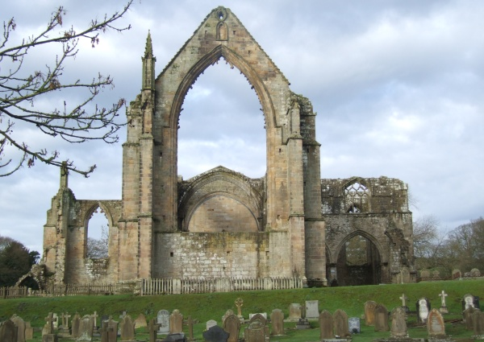
Henry creates his own church - the Church of England (Anglican Church) - and gave himself a divorce!
Henry_s_Divorce_and_Anne_s_Coronation_asf.asf

Slide 12
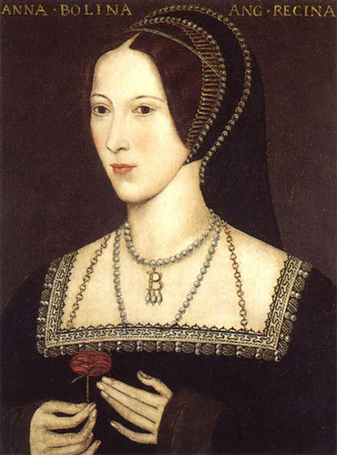
2nd Wife:
Anne Boleyn
Child: Elizabeth - Ruled England 44 years!
She was beheaded after false accusations of adultery.

Slide 13
1534 -
Act of Supremacy: separated the Church of England from Rome and Henry is named the head of the church.
He closed the monasteries and took the Roman Catholic Church's land and money for himself.

Slide 14
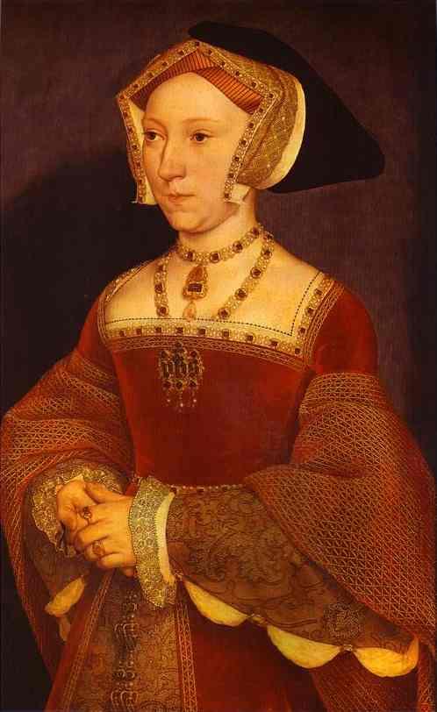
3rd Wife:
Jane Seymour
Child:
Edward - died at 16
Died

Slide 15
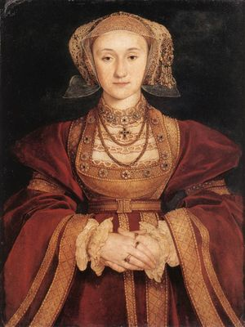
4th Wife:
Anne of Cleves
So UGLY she was sent away!

Slide 16
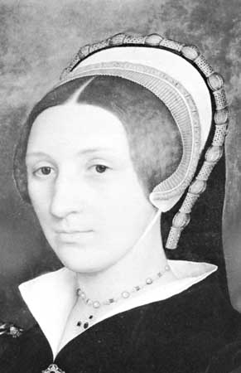
5th Wife:
Catherine Howard
She was beheaded after a charge of adultery.

Slide 17
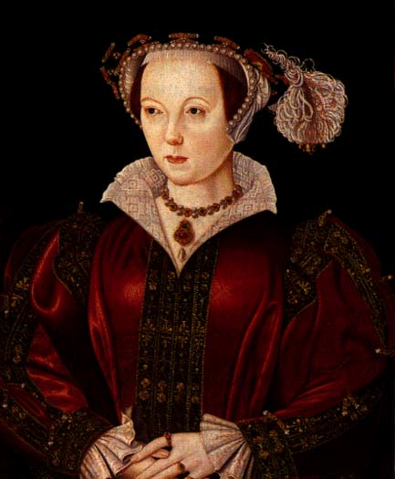
6th Wife:
Catherine Paar
She took care of Henry until he died.

Slide 18
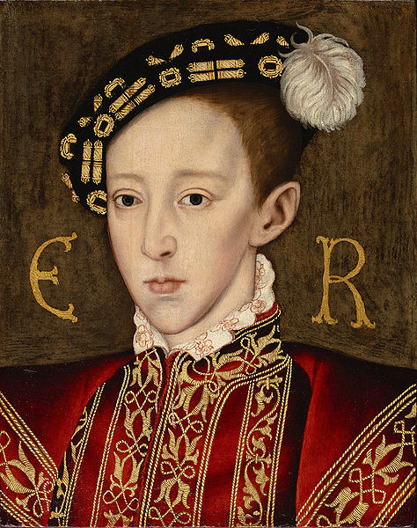
Edward VI
Served as king 1547- 1553
Succeed by Lady Jane Gray for 9 days.

Slide 19
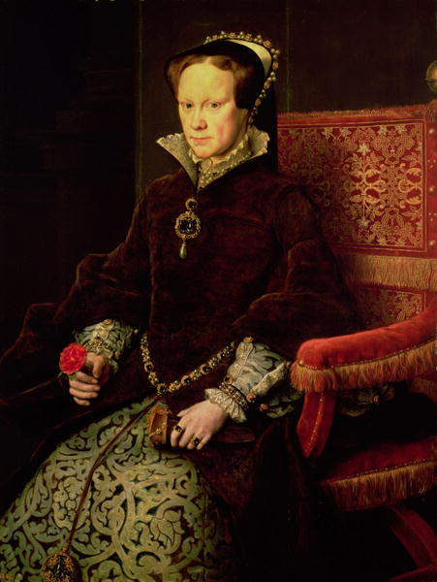
Mary I
r. 1553-1558
"Bloody Mary"
Committed to bringing Catholicism back to England
Wife of Spanish King Philip II

Slide 20
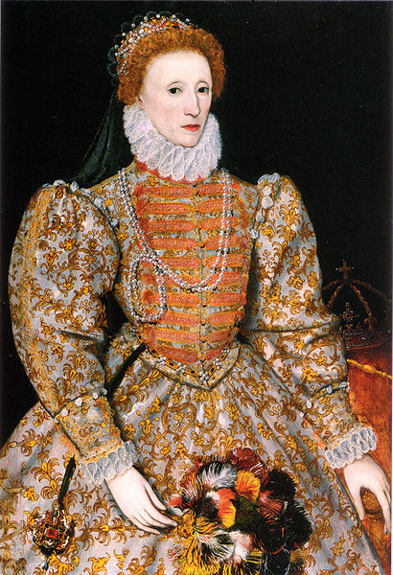
Elizabeth I
r. 1558 - 1603
Protestant
Her 44 years on the throne provided welcome stability for the kingdom and helped forge a sense of national identity.

Slide 21

Reformation Map Assignment
Use the map on page 497 to answer the following questions.
1. Where was the center of the Calvinist Movement?
2. What countries are the main centers of Calvinism?
3. What countries are the main centers for Lutheranism?
4. What countries are the main centers of Catholicism?
5. Where is Protestantism stronger, Southern or Northern Europe?

Slide 23
Attachments
Henry_s_Divorce_and_Anne_s_Coronation_asf.asf

