Slide 1

7th Grade Social Studies Common Final Exam (CFE) Jeopardy Review Game
Notes:
1

Slide 2

Common Final Exam Jeopardy Review Game
ERA 6 – Interaction & Change
ERA 7 – Revolution & Empire
ERA 8 – Global Conflict
ERA 9 – The Emerging Modern World
Document & Map Analysis
$100
$100
$100
$100
$100
$200
$200
$200
$200
$200
$300
$300
$300
$300
$300
$400
$400
$400
$400
$400
$500
$500
$500
$500
$500

Slide 3
$100 Question from ERA 6
The greatest invention of the last millennium and a cause for the Renaissance, Reformation, and Scientific Revolution was…

Slide 4
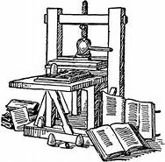
$100 Answer from ERA 6
The Printing Press

Slide 5
$200 Question from ERA 6
How did the invention of the printing press have an impact on the Reformation?

Slide 6
$200 Answer from ERA 6
Spread of ideas and beliefs
New translations of the Bible in the vernacular
More books and literate society
Lead to questioning of previous beliefs

Slide 7
$300 Question from ERA 6
This refers to the exchange of ideas, foods, and diseases between the Old World and the New World.

Slide 8
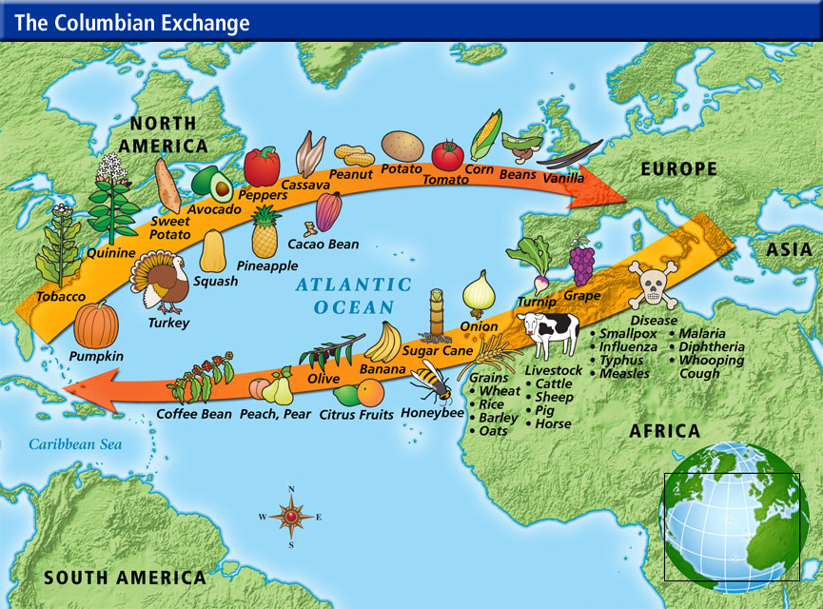
$300 Answer from ERA 6
The Columbian Exchange

Slide 9
$400 Question from ERA 6
A direct effect of the Columbian Exchange was the spread of religion and language. This is known as…

Slide 10

$400 Answer from ERA 6
Cultural Diffusion

Slide 11
$500 Question from ERA 6
The Native American population dropped drastically during the years of 1500-1700s. This was due to a disease introduced by the Spanish explorers known as…

Slide 12
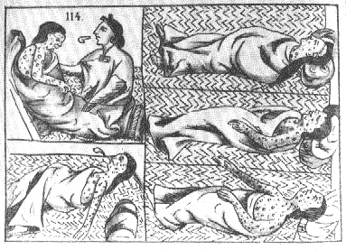
$500 Answer from ERA 6
Small Pox

Slide 13
$600 Question from ERA 6
What role do the colonies play for the mother country in the economic policy of mercantilism?

Slide 14
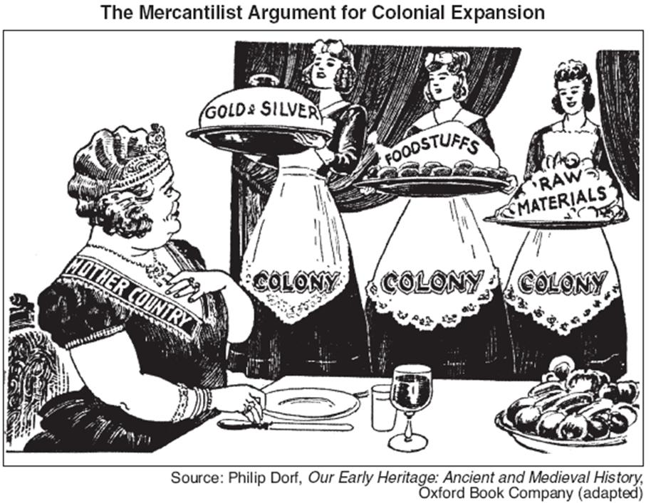
$600 Answer from ERA 6
A source of raw materials for the developed country’s industry.

Slide 15
$700 Question from ERA 6
Martin Luther protested against many Catholic Church abuses including the selling of indulgences by posting the ________ ____________ on the door of the Catholic Church in Wittenberg, Germany.

Slide 16
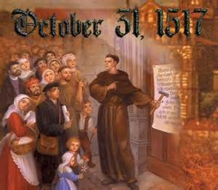
$700 Answer from ERA 6
95 Thesis

Slide 17
$100 Question from ERA 7
The absolutist idea that kings/queens have been sent by God to rule their nation.
Notes:
17

Slide 18
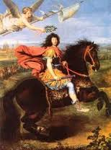
$100 Answer from ERA 7
Divine Right of Kings
Notes:
18

Slide 19
$200 Question from ERA 7
This enlightenment figure believed that having an absolute monarch was the best form of government.
Notes:
19

Slide 20
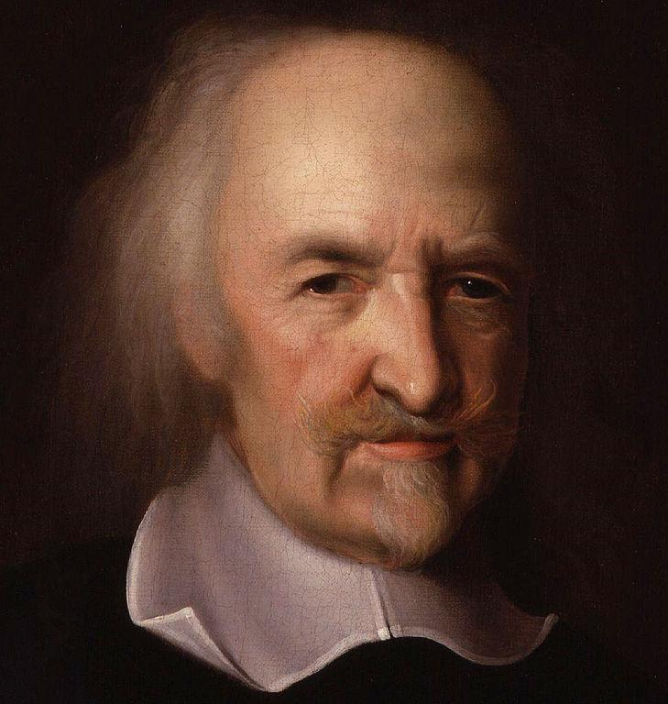
$200 Answer from ERA 7
Thomas Hobbes
Notes:
20

Slide 21
$300 Question from ERA 7
The United States Declaration of Independence and the French Declaration of the Rights of Man and of Citizen was influenced by which English Enlightenment philosopher?
Notes:
21

Slide 22
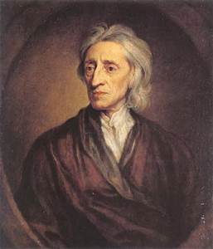
$300 Answer from ERA 7
John Locke
Notes:
22

Slide 23
$400 Question from ERA 7
How did the use of new machinery affect the production of goods during the industrial revolution?

Slide 24

$400 Answer from ERA 7
Goods were produced:
Faster
Cheaper
In larger numbers
Notes:
24

Slide 25
$500 Question from ERA 7
As a result of the industrial revolution, more people moved to big cities. This big city growth is referred to as ________________.
Notes:
25

Slide 26
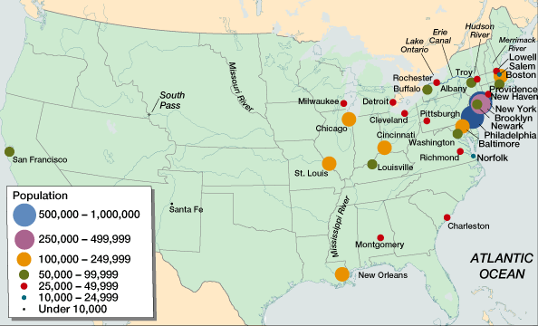
$100 Answer from ERA 7
Urbanization
Notes:
26

Slide 27
$600 Question from ERA 7
This economic system lets business owners set their own hourly wages, allows for high profits, and no government intervention.
Notes:
27

Slide 28
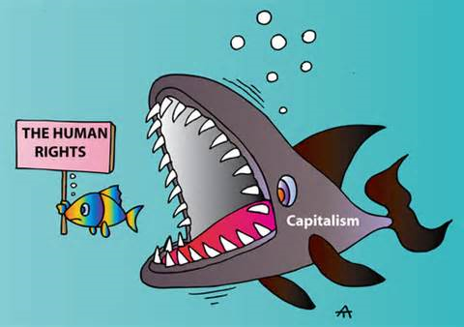
$600 Answer from ERA 7
Market Economy
Notes:
28

Slide 29
$700 Question from ERA 7
This type of economic system involves direct trade, no competition, and relies on customs and traditions.
Notes:
29

Slide 30
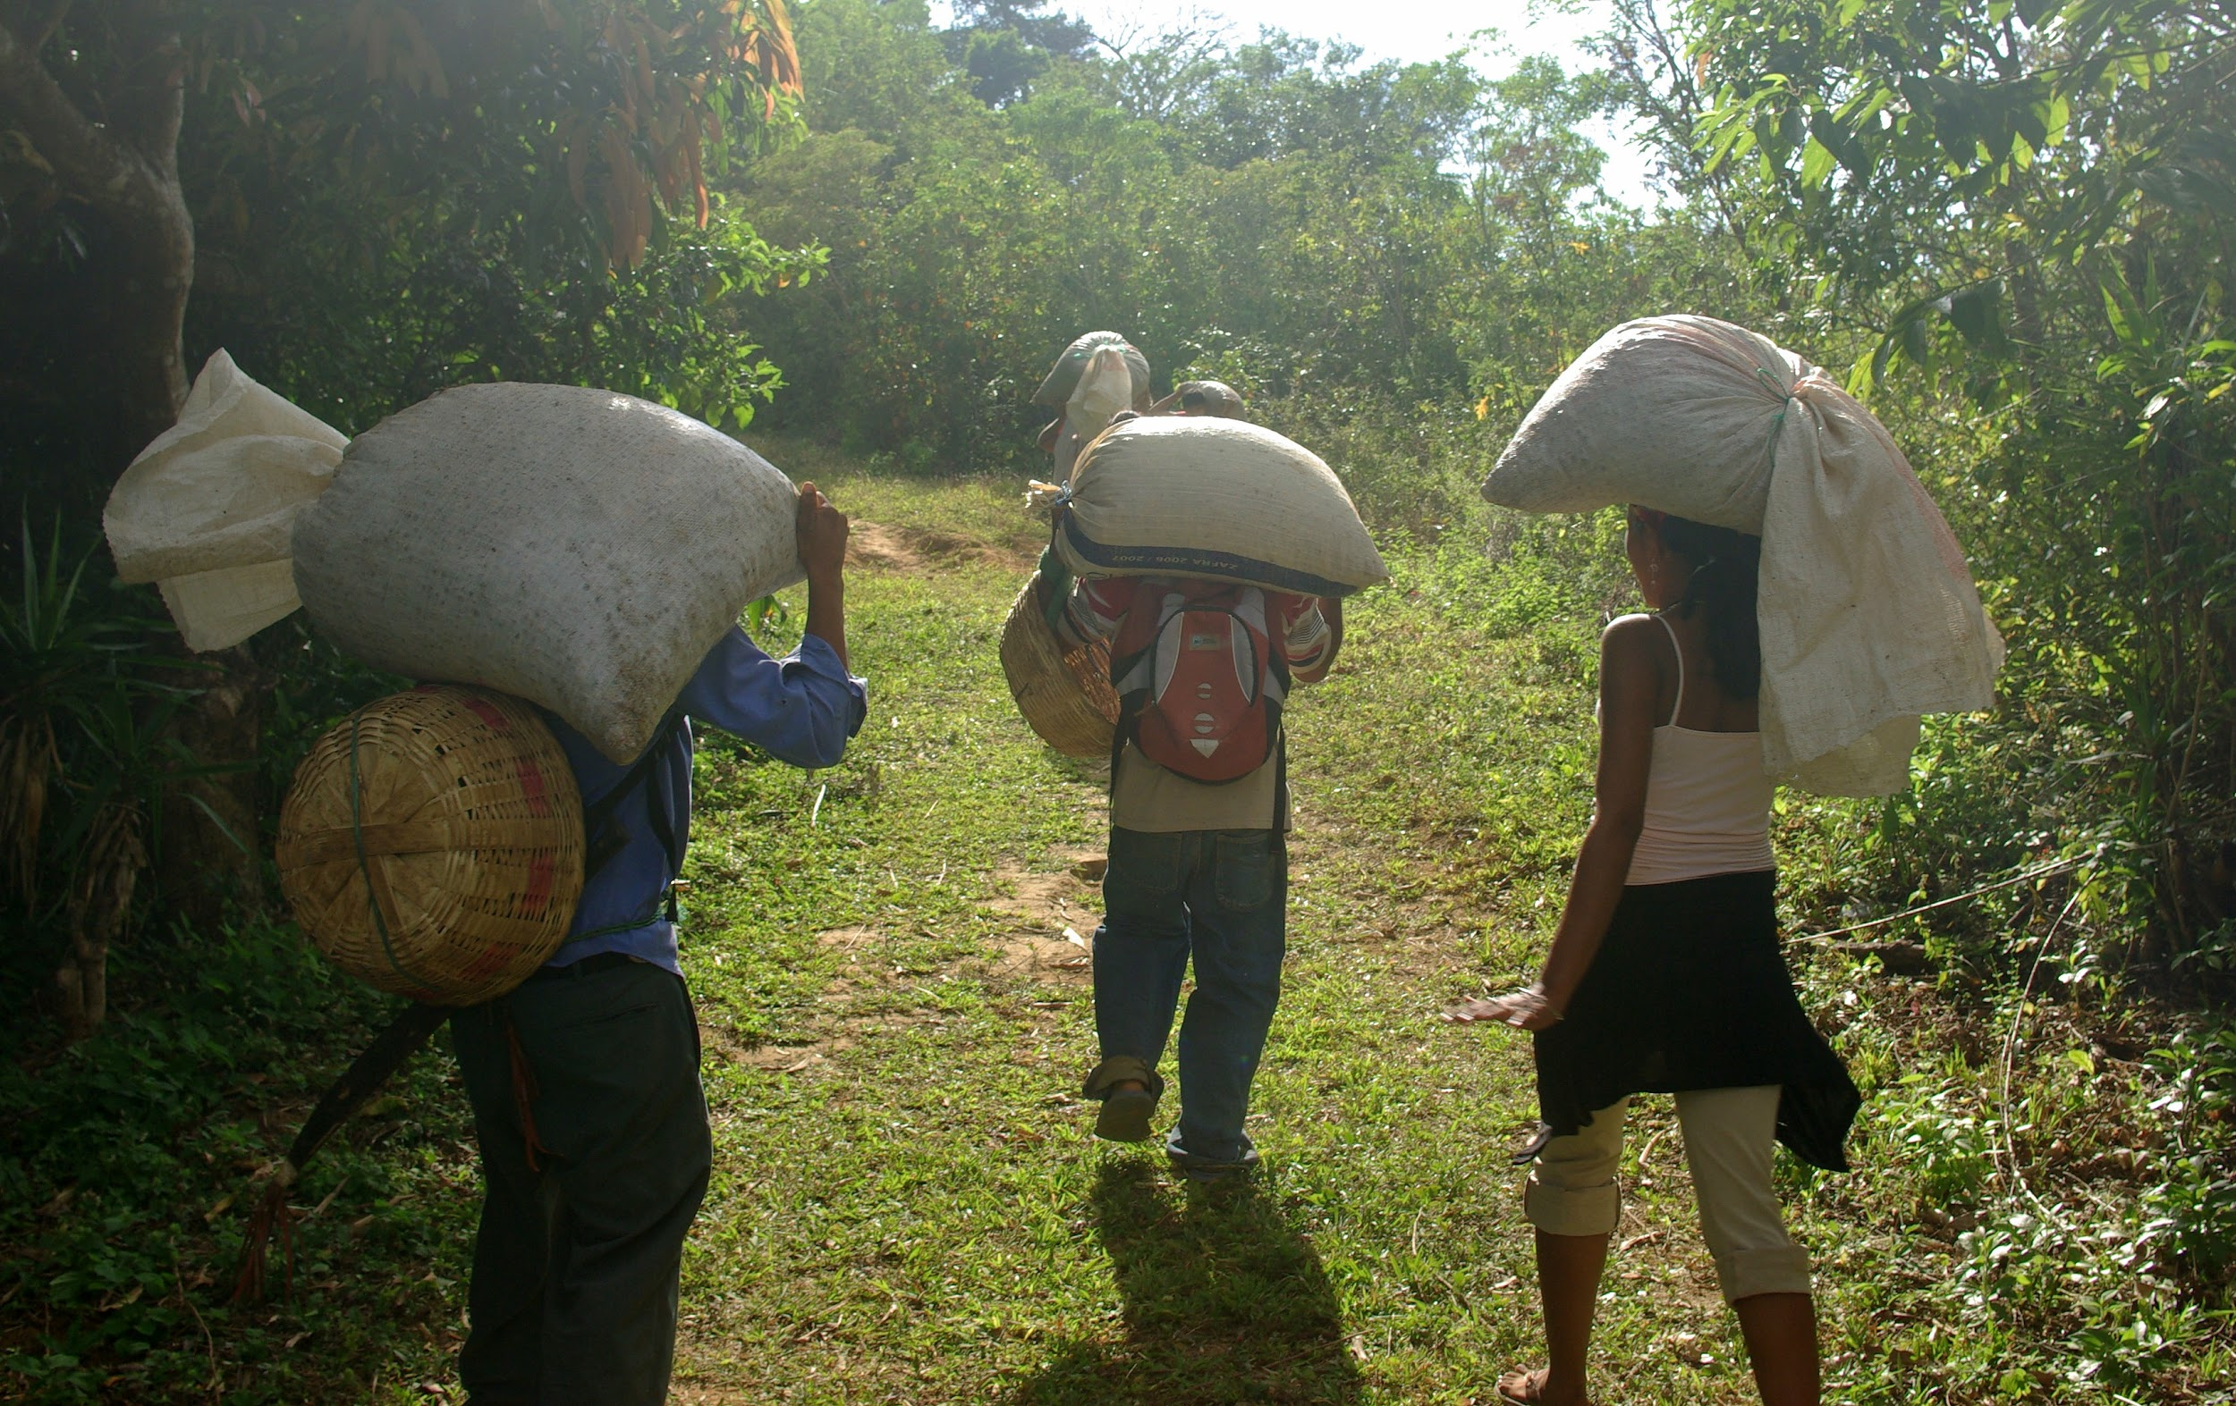
$700 Answer from ERA 7
Traditional Economy
Notes:
30

Slide 31
$800 Question from ERA 7
This economic system allows the government to control the factors of production, set working conditions, and the prices of goods.
Notes:
31

Slide 32
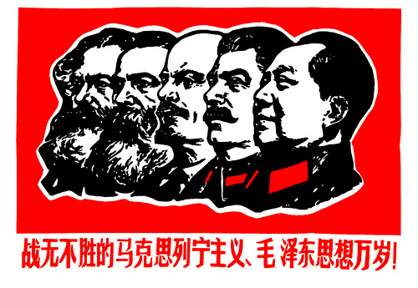
$800 Answer from ERA 7
Command Economy
Notes:
32

Slide 33
$900 Question from ERA 7
What economic system is being described below?:
Individuals can own businesses and set prices based on demand of goods.
Business owners must pay a governmentally mandated minimum wage to their workers.
Business owners must follow governmentally mandated regulations on disposal of waste, sanitation, etc.
Notes:
33

Slide 34
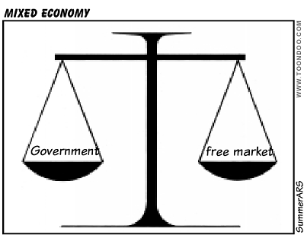
$900 Answer from ERA 7
Mixed
Economy
Notes:
34

Slide 35
$1000 Question from ERA 7
This was the gathering of European leaders in 1885 to divide the continent of Africa into European control.
Notes:
35

Slide 36
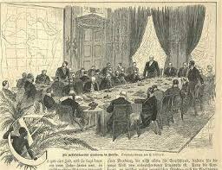
$1000 Answer from ERA 7
The Berlin Conference
Notes:
36

Slide 37
$1100 Question from ERA 7
How has modern/present Africa been impacted by the Age of Imperialism?
Notes:
37

Slide 38
$1100 Answer from ERA 7
Present day boundaries have been set based on European colonization
Loss of economic resources.
Unstable governments and societies.
Notes:
38

Slide 39
$100 Question from ERA 8
Two reasons why the U.S. became
involved in World War I.

Slide 40
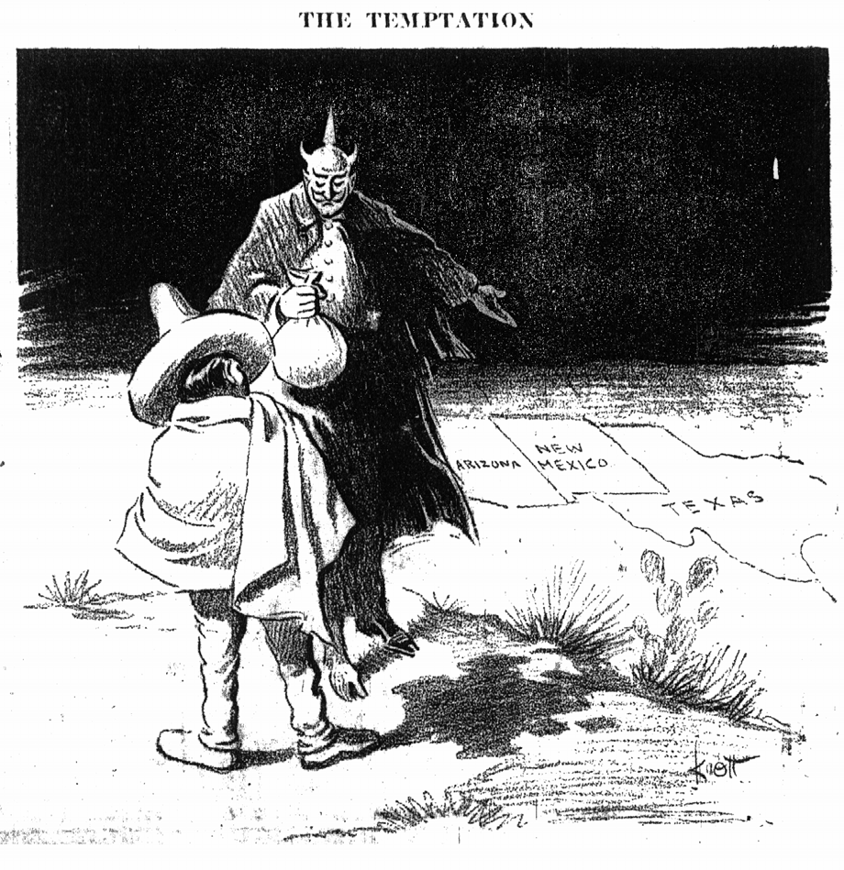
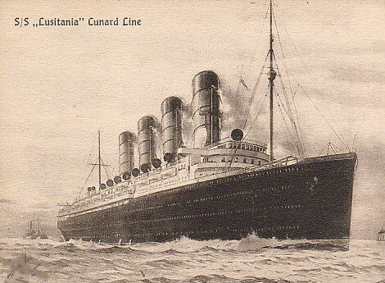
$100 Answer from ERA 8
Zimmerman Telegraph (note)
Sinking of the Lusitania

Slide 41
$200 Question from ERA 8
The new weaponry and technology used in WWI was made possible because of the
_______________ _______________.

Slide 42
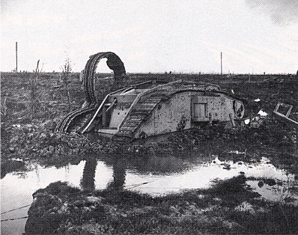
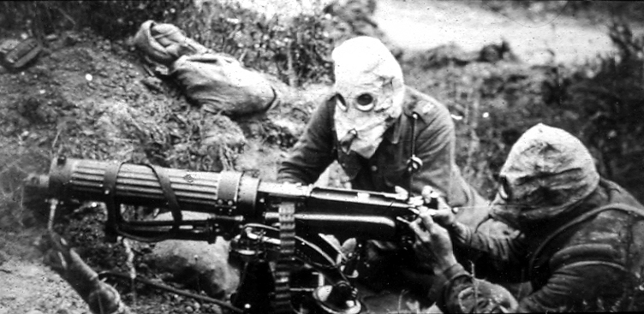
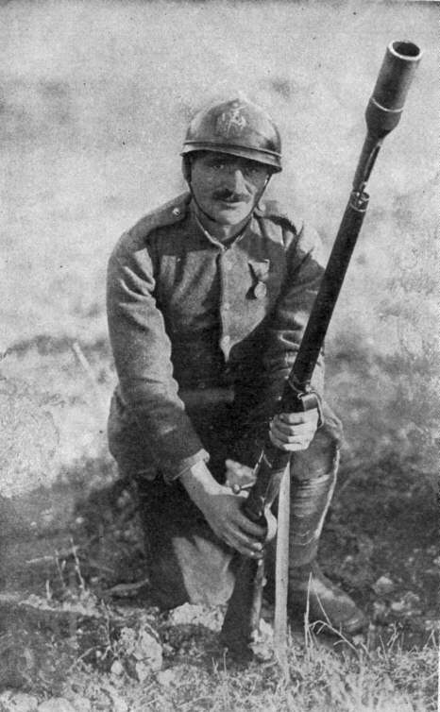
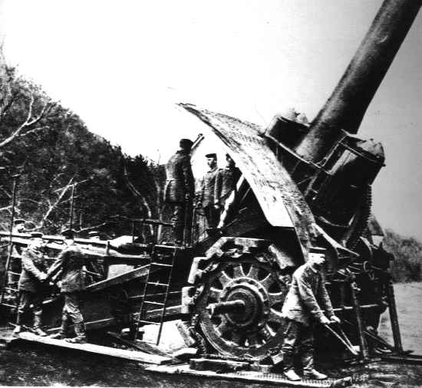
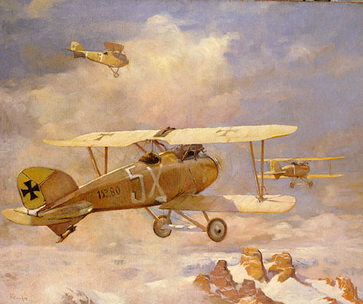
$200 Answer from ERA 8
Industrial Revolution.

Slide 43
$300 Question from ERA 8
The name of the document that ended World War I was the
_____________ of _____________

Slide 44
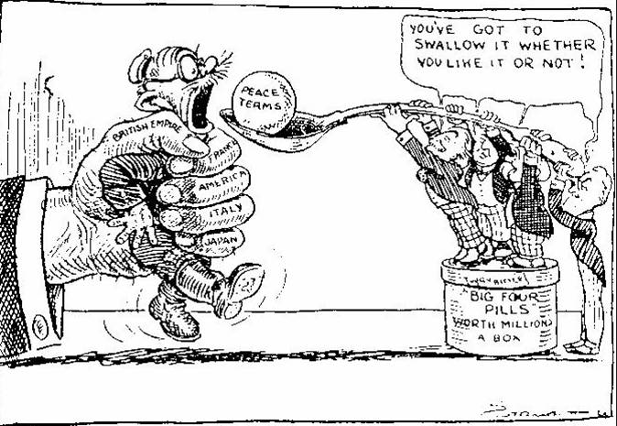
$300 Answer from ERA 8
Treaty of Versailles

Slide 45
$400 Question from ERA 8
Name both reasons the League of Nations failed to keep peace in the world.

Slide 46
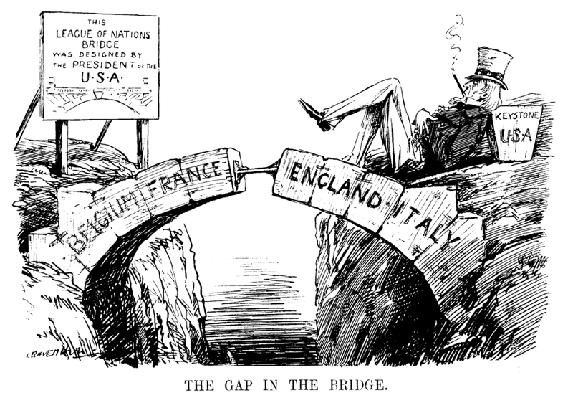
$400 Answer from ERA 8
Lack of support from world powers (U.S.A., Soviet Union, and Japan)
No military force to back it’s policies

Slide 47
$500 Question from ERA 8
Censorship of the press, mass arrest, and/or secret police are most characteristic of what form of government?

Slide 48
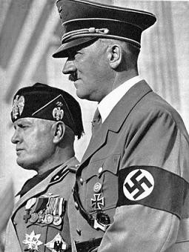
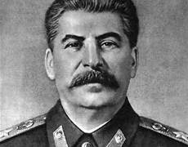
$500 Answer from ERA 8
Totalitarian
Dictatorships

Slide 49
$500 Question from ERA 8
Native people losing their culture, customs, languages, and religions due to being taking over by a more powerful country is usually caused by the policy of _________________________.

Slide 50
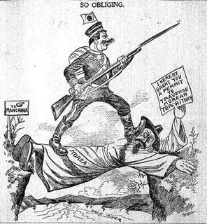
$500 Answer from ERA 8
Imperialism

Slide 51
$600 Question from ERA 8
Giving into the demands of an enemy in an effort to avoid war/conflict is known as ___________________.

Slide 52
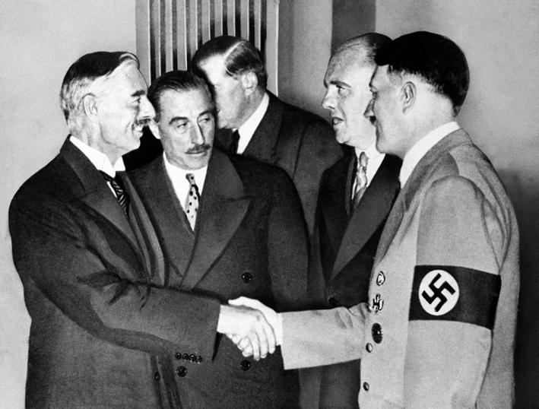
$600 Answer from ERA 8
Appeasement

Slide 53
$100 Question from ERA 9
These two countries rose up as the world’s super powers after World War II and dominated the world’s politics for the next 50 years.

Slide 54
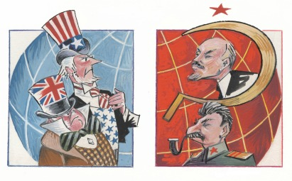
$100 Answer from ERA 9
The United States and the Soviet Union

Slide 55
$200 Question from ERA 9
This world peace-keeping organization was formed after World War II to settle disputes between member countries.

Slide 56

$200 Answer from ERA 9
The United Nations

Slide 57
$300 Question from ERA 9
This man-made structure divided East and West Berlin into 2 different political sections.

Slide 58
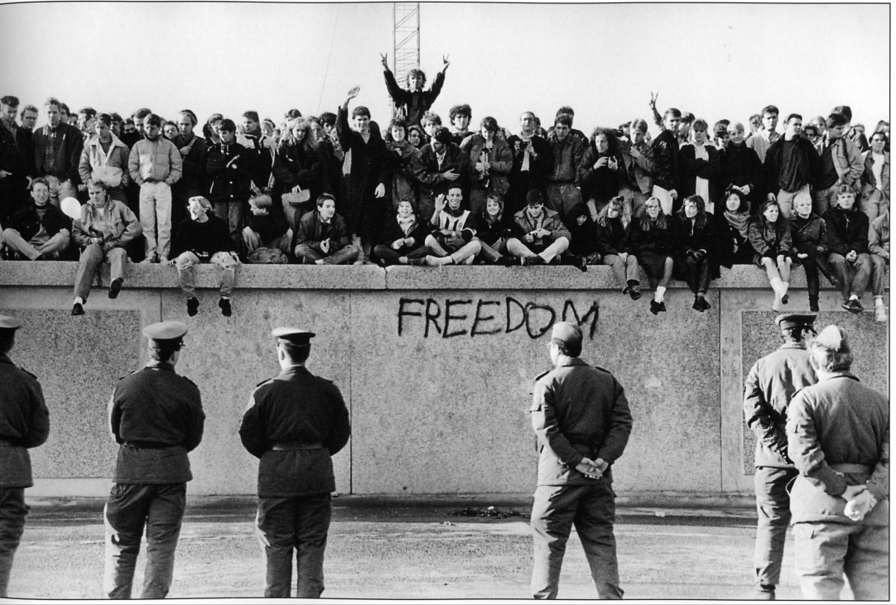
$300 Answer from ERA 9
The Berlin Wall

Slide 59
$400 Question from ERA 9
The United States’ policy of keeping the Soviet Union from influencing/taking over other countries in the world.

Slide 60
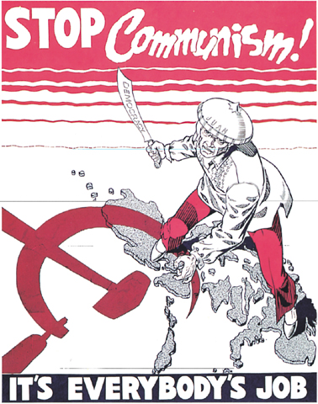
$400 Answer from ERA 9
containment

Slide 61
$500 Question from ERA 9
This negative effect of economic progress occurs when trees are cut down and enviormental habitats are lost.

Slide 62
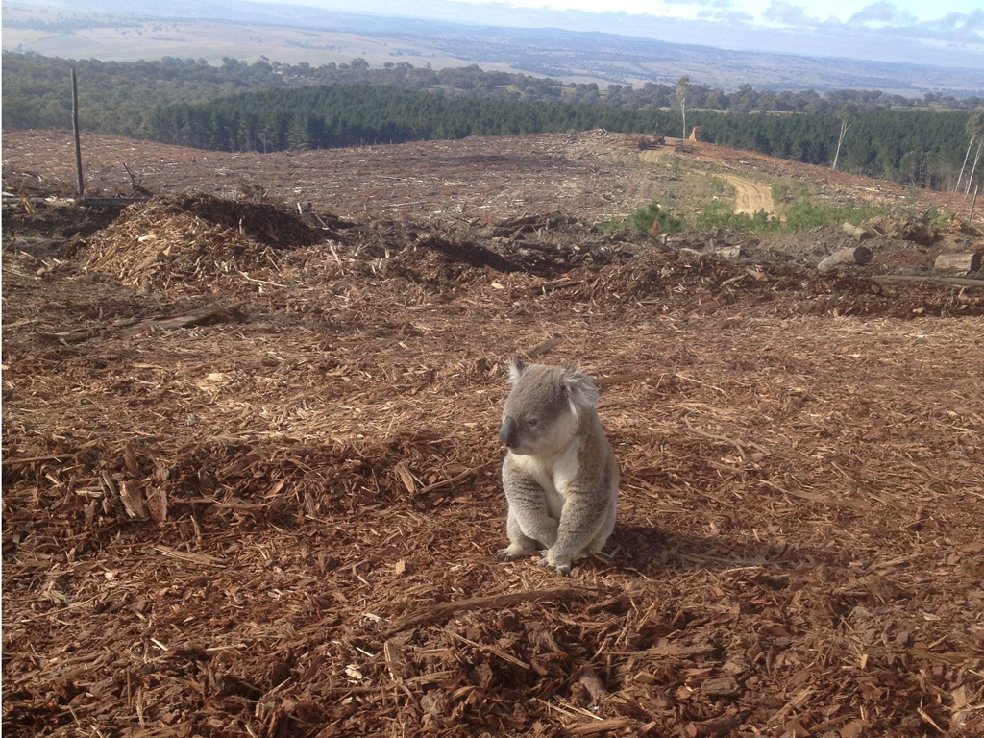
$500 Answer from ERA 9
deforestation

Slide 63
$600 Question from ERA 9
This negative effect of economic progress refers to the rising temperature of the globe due to the lose of the ozone layer.

Slide 64
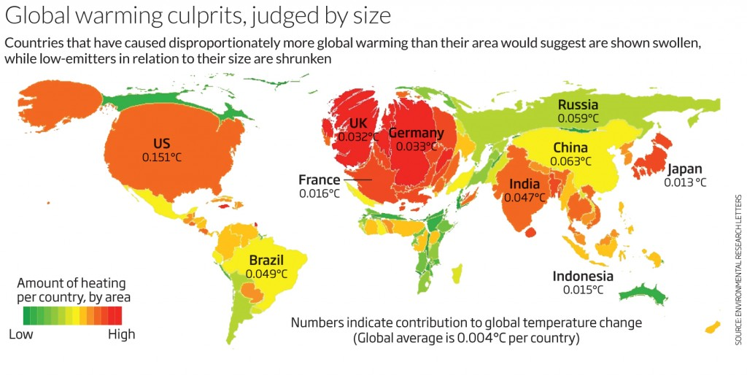
$600 Answer from ERA 9
global warming

Slide 65
$700 Question from ERA 9
The process of bringing the world together through the use of technology and communication. This has led to economic progress for much of the world.

Slide 66

$700 Answer from ERA 9
globalization

Slide 67
$800 Question from ERA 9
This organization consists of 8 countries that owns 80% of the world’s oil reserves and controls the prices of oil in the world.

Slide 68
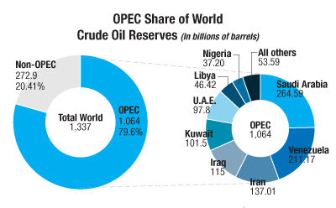
$800 Answer from ERA 9
OPEC

Slide 69
$900 Question from ERA 9
When putting together a budget, you must look at both your ___________ & _____________.

Slide 70

$900 Answer from ERA 9
income & expenses

Slide 71
$1000 Question from ERA 9
The 2 types of expenses included in budgeting are ___________ & ________________.

Slide 72
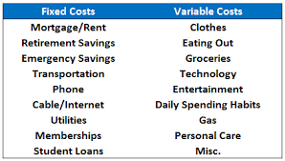
$1000 Answer from ERA 9
fixed & variable

Slide 73
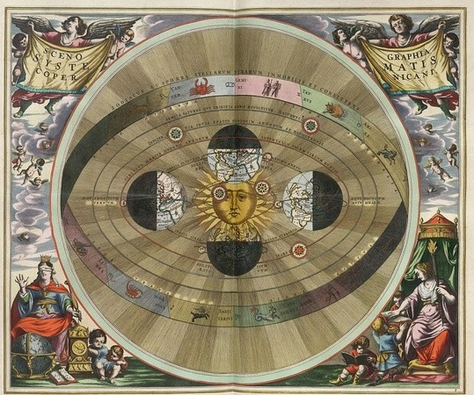
$100 Question from Documents & Maps
What model of the universe is pictured?

Slide 74
$100 Answer from Documents & Maps
Helio-centrism model of the Universe.

Slide 75
$200 Question from Documents & Maps
According to the map, where did the majority of slaves go during the years of the Triangular Trade Route?
Map

Slide 76
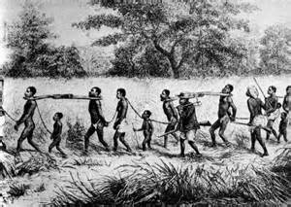
$200 Answer from Documents & Maps
Brazil, South America

Slide 77
$300 Question from Documents & Maps
One cause of the French Revolution was the unfair societal system in place. The 3rd Estate of French society paid 90% of the French ____________.
Notes:
77

Slide 78
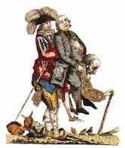
$300 Answer from Documents & Maps
Taxes
Notes:
78

Slide 79
$400 Question from Documents & Maps
Montesquieu believed in that government should be separated, so no one person/branch has too much power. This is known as...
Notes:
79

Slide 80
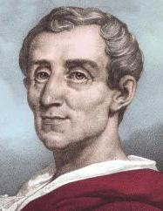
$400 Question from Documents & Maps
Separation of Powers/Balance of Power
Notes:
80

