Slide 1
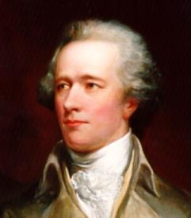
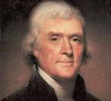
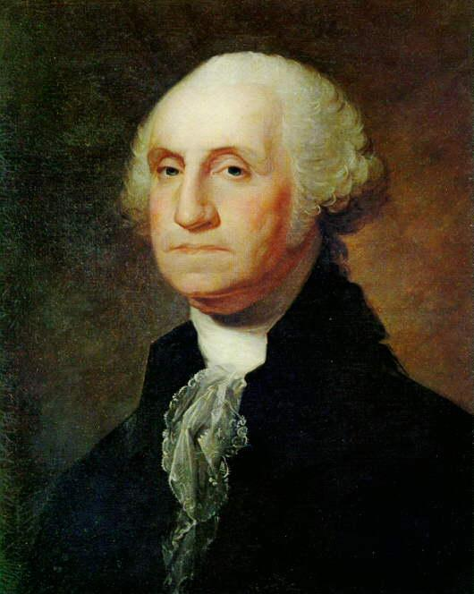
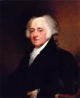
Beginning a New Nation

Slide 2
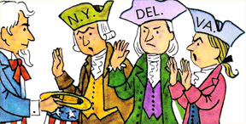
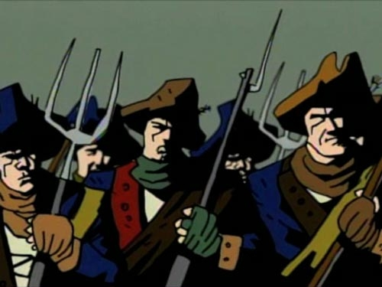
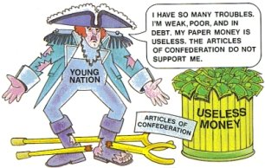
Shay’s Rebellion
Massachusetts farmers refuse to pay taxes
The Articles of Confederation don’t give the National government the power to tax or enforce state laws
Proves that we need a new, stronger constitution

Slide 3
“Fixing” the Government
Alexander Hamilton
  Leading supporter – Stronger central govt
  Calls for meeting in Philadelphia
    Shays Rebellion convinces most states to send a rep.
Constitutional Convention
  55 men
  Avg age – 44 yrs
  Wealthy and Educated
  Led by G. Wash.

Slide 4
Choosing Sides

Slide 5
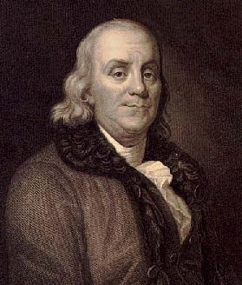
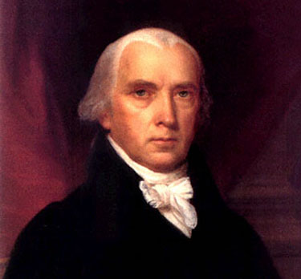
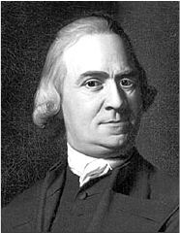
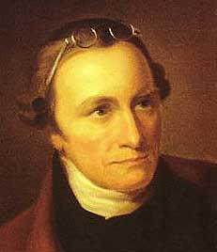
Federalists vs. Anti Federalists
“Federalists”
  PRO – Constitution
  PRO – Strong Central Govt
    Washington
    B. Franklin
    Hamilton
    Madison
  Federalist Papers - Written to argue IN FAVOR of the C
Anti – Federalists
  Worried that the C would give the government too much power
  Demanded a Bill of Rights
    P. Henry
    S. Adams

Slide 6
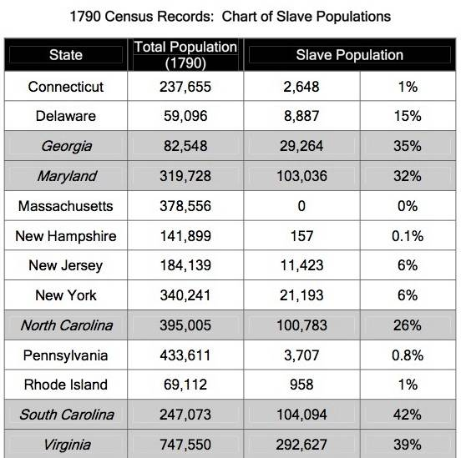
Issue of Representation
  Virginia Plan
    James Madison
    Representation Based on Population
  New Jersey Plan
    William Patterson
    Equal Representation
      Like Articles of Confederation
What about slavery?
Should slaves count towards population?

Slide 7
Compromises

Slide 8
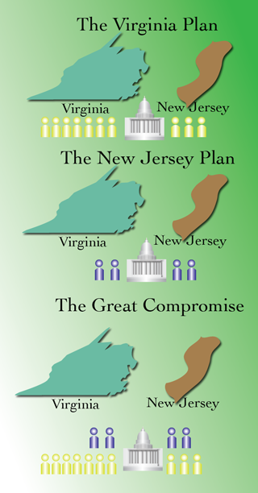
Compromises
Great Compromise
  Bi Cameral Legislature
    House of Representatives
      Based on population
      Chosen by Direct Election
    Senate
      Each state gets 2
      Chosen by State Legislators
3/5th Compromise
  3 out of every 5 slaves counts as one person for both representation and taxation

Slide 9
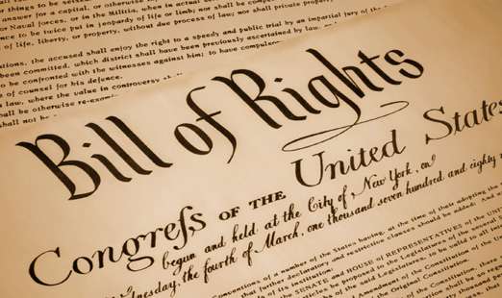
Compromises
Bill of Rights
  Added to convince Anti-Federalists to ratify
  First 10 Amendments

Slide 10
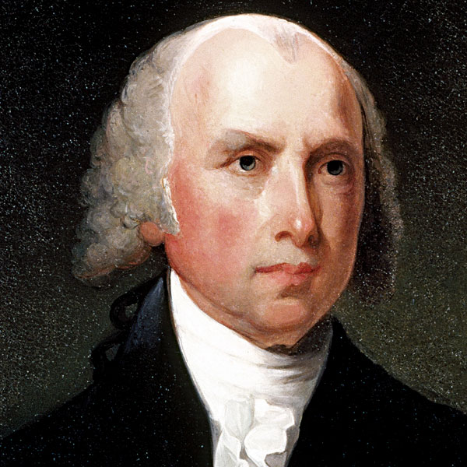
Basics of the Constitution
Written by James Madison
Federalism
  Division of power b/w State and Fed govt
    Expressed (Enumerated) Powers
      Powers of the National Govt
    Concurrent Powers
      Powers shared
    Reserved Powers
      Powers “reserved” for the states

Slide 11
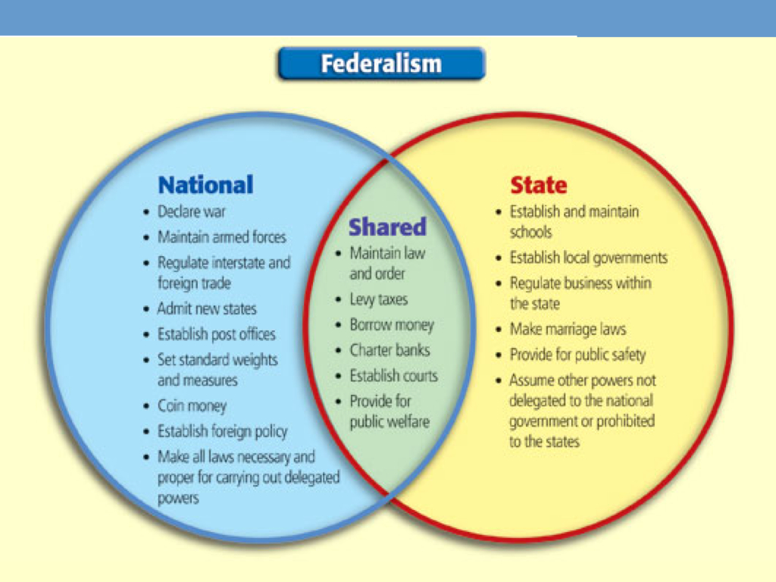

Slide 12
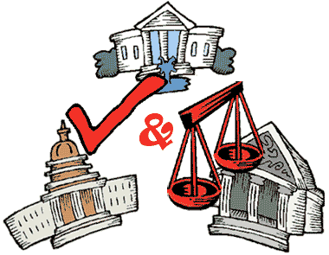
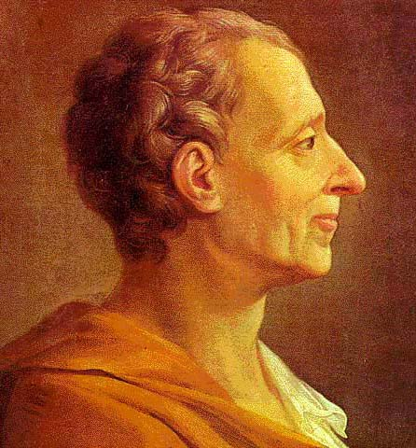
Basics of the Constitution
Separation of power
  Idea supported by Montesquieu
  3 branches “check & balance” each other

Slide 13
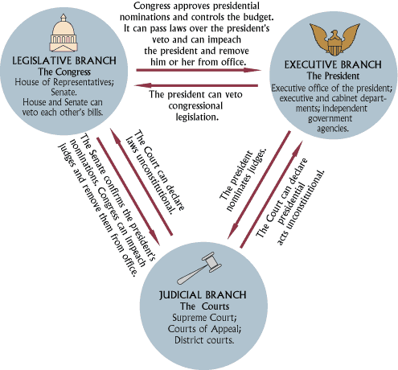

Slide 14
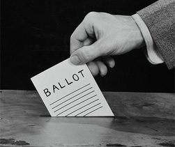
Basics of the Constitution
Popular Sovereignty
  Power goes through the people
  But… power must be regulated
    Shays Rebellion
      Shows what happens when people have too much power
    Senate
      Originally NOT elected by the people
    Electoral College
      Technically, the people do not directly choose the President
    Federal Courts
      Judges not Elected by the people

Slide 15
Breakdown of the Constitution
Preamble
  Article I – Legislative
    How we make laws
  Article II – Executive
    How we enforce laws
  Article III – Judicial
    How we interpret laws
  Article IV – States
    Explains the relationship b/w states and National Govt
  Article V – Amendments
    How the Constitution can be changed
  Article VI – Supremacy Clause
    This is THE supreme law of the land
  Article VII – Ratification
    Explains how the states will ratify (accept) the C

Slide 16
Basics of the Constitution
Bill of Rights
  Drafted by congress after ratification
  10 Amendments (9 Limit Govt)
Supreme Court
  Vague Wording
    Judiciary Act of 1789
      6 Justices
      13 District Courts
Executive Departments
  Congress Creates 3
  War, Treasury, State

Slide 17
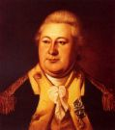
The First Cabinet
Secretary of the State
Secretary of the Treasury
Secretary of War

Slide 18
Early Political Parties
Federalists
  Control govt for 12 years
  Hamilton
    Believed stable govt = strong elite ruling class
    Strives to make this group happy
Republicans
  aka: Dem-Reps, Jeffersonian Reps
  Formed due to fear of Federalist gaining too much power
  Jefferson
    Believed in “Yeomen Farmer”
    Supported Fr. Revolution

Slide 19
Lingering Problem
$

Slide 20
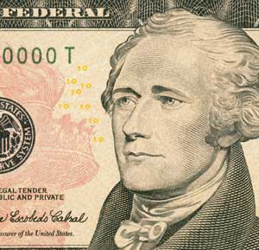
Hamilton's Economic Plan-1790
Plan to reduce National Debt
  Want to…
    Pay back rich investors with Bonds
    Consolidate National Debt
      Rich more willing to Lend
      Wont let govt fail
    Raise $
      Excise Tax on Alcohol
      Prot. Tariff
    National Bank
      Give Loans
      Hold Fed $ from taxes
      Be center for US Banking System
Jefferson vs. Hamilton

Slide 21
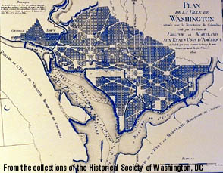
This South opposed the plan as they had paid off most of their debts.
Compromise→ South would accept plan nations capital moved to southern state.
The plan worked and the bill was passed in 1790

Slide 22
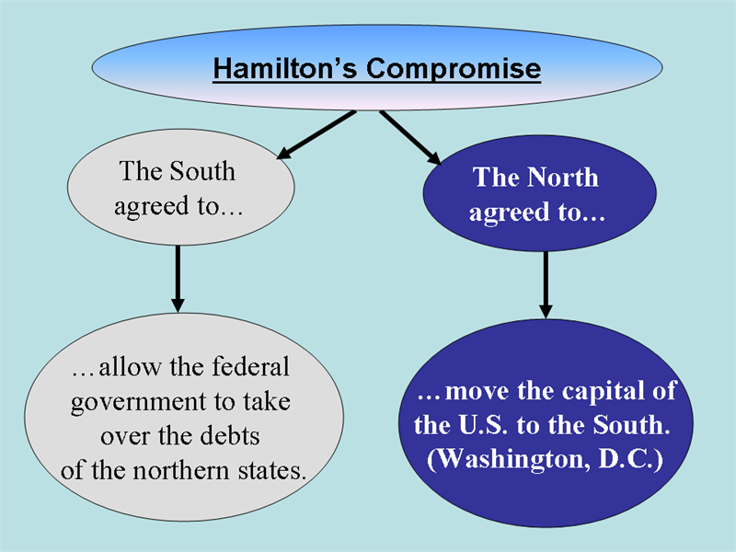

Slide 23
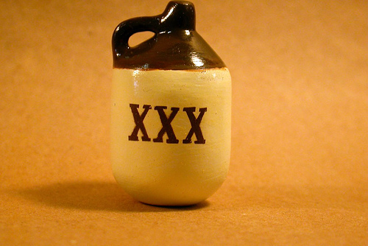
Whiskey Rebellion -
Penn. Manufactures despise excise tax and refuse to pay
Washington and Hamilton rode with 15000 militiamen to enforce the tax
First example of the power of the new Federal Government on American soil

Slide 24
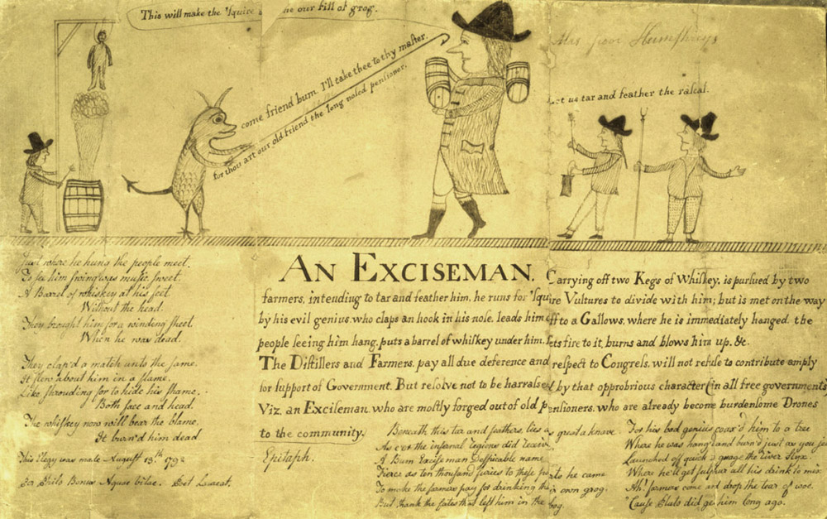

Slide 25
New Problem : French Revolution
- Who should we help?
French | British
Democratic Republicans (Jefferson) | Federalists (Hamilton)
Honor the Treaty of 1778 (Does it still apply?) | Federalists want to re-open Trade Relationship
They helped us in American Revolution | Don’t want another war with Brits

Slide 26
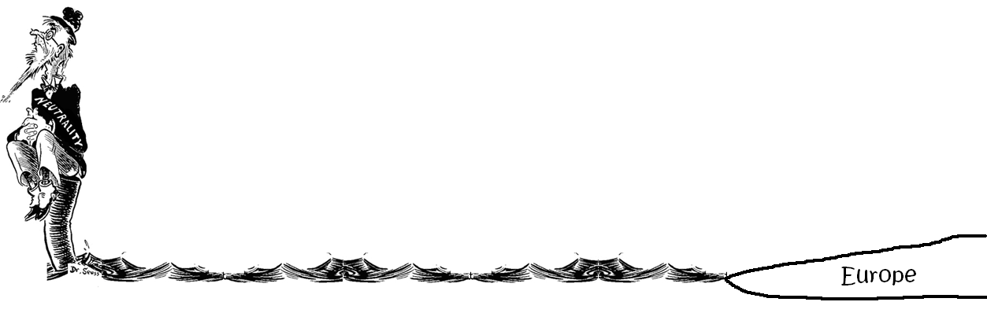
So what do we do?
Proclamation of Neutrality 1793
  Washington decides to declare Neutrality and keep America out of it.
  Angers Both Sides
  Begins Impressments

Slide 27
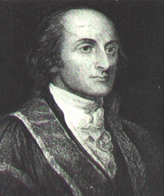
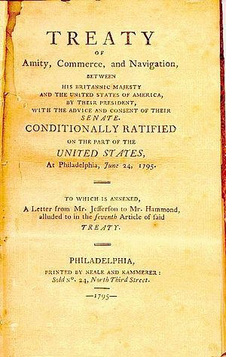
Jay’s Treaty (aka Treaty of London)- 1794
  John Jay – Designed by Hamilton
  Supposed to
    End British Impressments (250 Ships taken)
    Ensure Trading Relationship
    Order Brits to leave NW Territory
    Demand Compensation for freed slaves
  Agreement
    Reestablished Trade Relationship (Most favored Nation Status)
    Some Brits leave NW territory
      Others continue fur trading in this area.
  Prevents War, but…
  Angers French
  Angers Dem-Reps & Southerners
    Shows MAJOR split of the parties

Slide 28
Democratic Republican Response
Damn John Jay!
Damn everyone that won't damn John Jay!
Damn every one that won't put lights in his window and sit up all night damning John Jay!

Slide 29
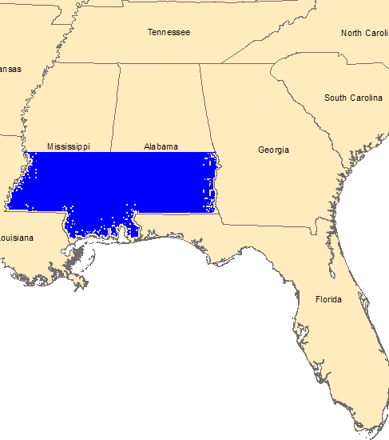
Pinckney’s Treaty - 1795
(aka Treaty of San Lorenzo)
Treaty with Spain
  Spain sides with French
  Scared of U.S. Brit alliance
US Gets
  land claims east of Miss. other than Florida
  Access to use Mississippi River for trade
  Protection From FL N.A.
Spain gets
  Defined boundary for Florida

Slide 30
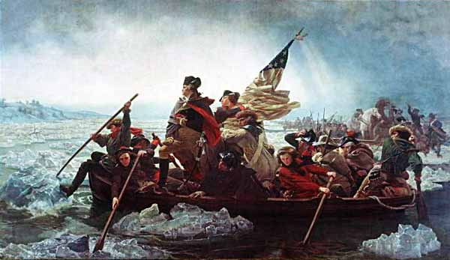
George Washington’s Farewell Address Advice
Avoid political divisions into parties
Avoid alliances with other countries

Slide 31
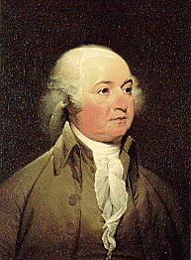
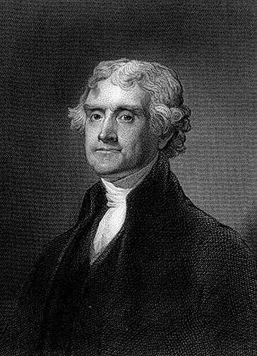
Downfall of Federalists
Election of 1796
V
E
R
S
U
S
Federalist
John Adams
Democratic-Republican
Thomas Jefferson

Slide 32
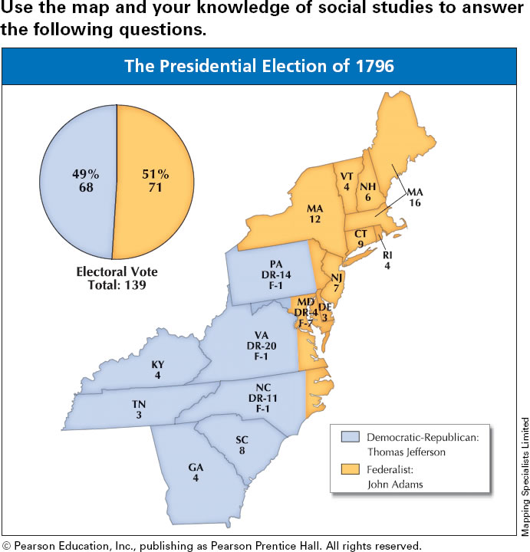




Progress Monitoring Transparency: Section 2
PM
TRANSPARENCY
Progress Monitoring Transparency
Which area of the country voted for Adams?
Which area of the country voted for Jefferson?
What does this show us about America in 1796?
Notes:
Answer
C
A

Slide 33
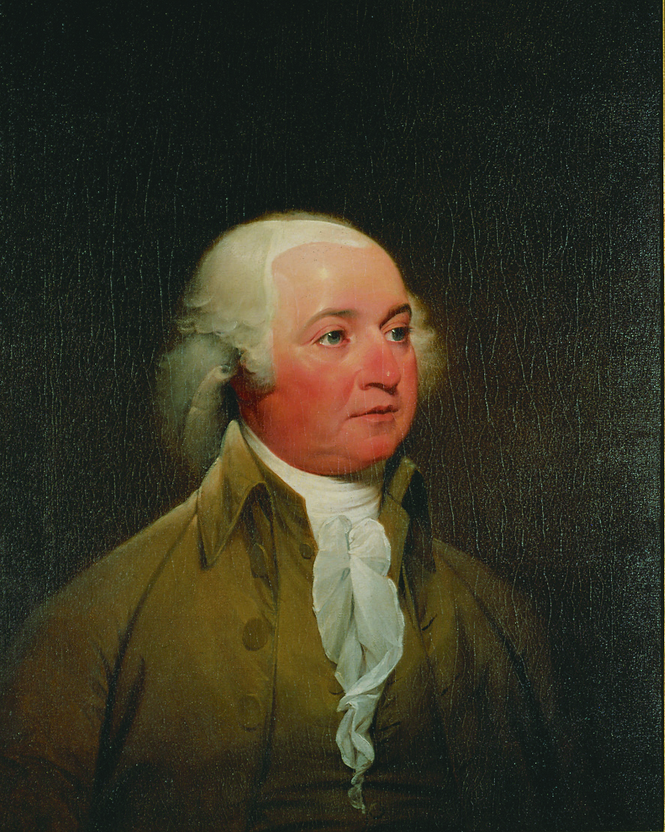
Adams is Prez, Jefferson is Vice Prez
Electoral Votes:
Adams - - 71 votes
Jefferson - - 68 votes
The Constitution stated that the runner up in the presidential election would be named vice president.
What problems might this present?

Slide 34
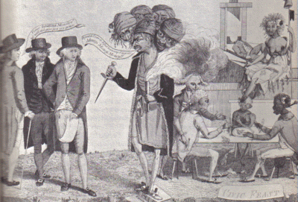
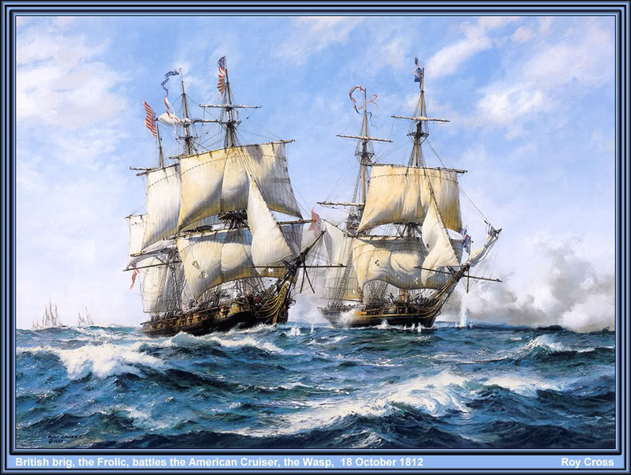
X, Y, Z Affair - 1797
Adams Attempt to end French Impressments
  Send J. Marshall, E. Gerry, and Pinckney
    Intend on meeting Talleyrand (Foreign Minister)
French officials (X, Y, and Z) ask for loan and bribe to end impessmets
  Sets off Anti French Movement
  US prepares for war
  Leads to Creation of Dept of Navy
  Quasi War
Issue not resolved until 1800
  Adams and Napoleon (1st Consul)
***Show Video***

Slide 35
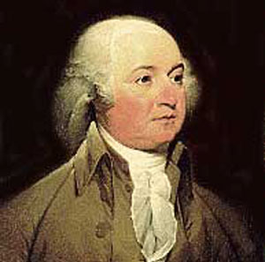
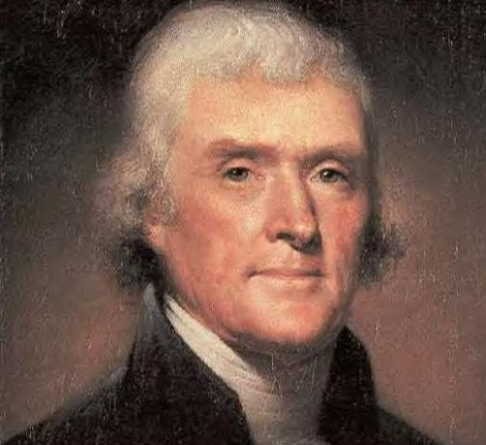
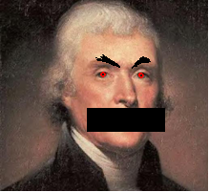
Alien and Sedition Acts - 1798
Federalists looking to quiet opposition party
Alien- allowed the president to deport or jail any ‘undesirable’ alien
    No one actually deported
Sedition- censored citizens talking bad about American policies.
    Only 10 arrested
Makes Adams look horrible

Slide 36
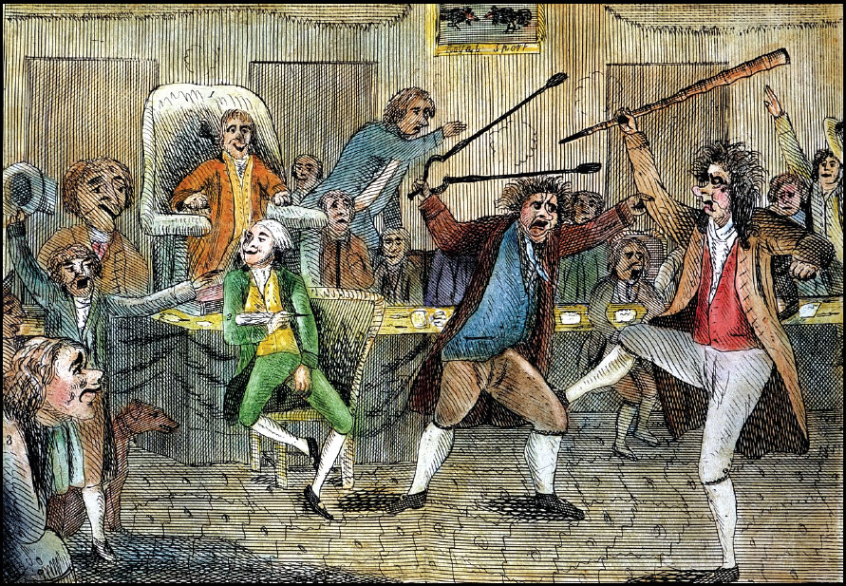
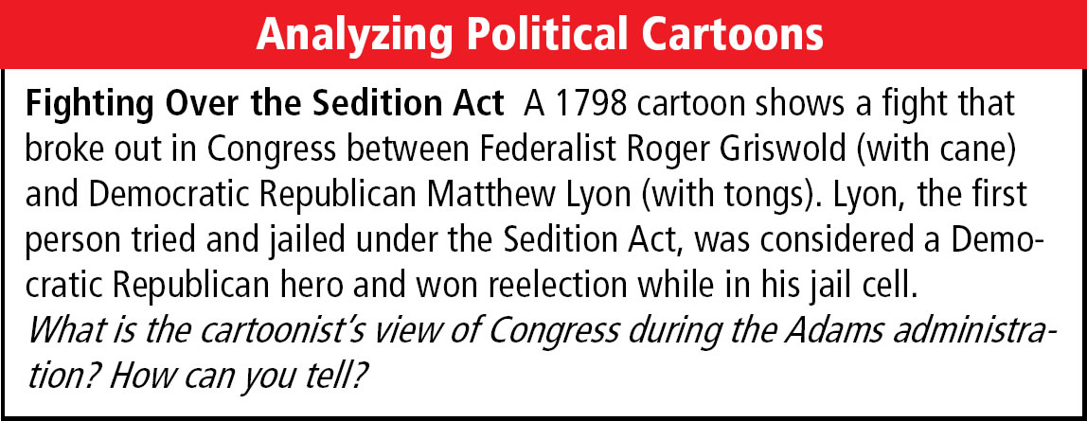
Political Cartoons: Fighting Over the Sedition Act
ANALYZE
Political Cartoons: Fighting Over the Sedition Act

Slide 37
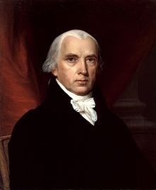
  Virginia and Kentucky Resolutions- 1798
  Led by Jefferson (secretly) and Madison, these states opposed the acts and proposed the idea of Nullification.
  With this power, states would be able to deem an act of congress as unconstitutional.
  Nullification never “Legal”
  This showed the ever growing “states rights” argument.

Slide 38
Election of 1800
“The Revolution of 1800”
V
E
R
S
U
S
Democratic-Republican T. Jefferson
Federalist John Adams
Significance: Shows a peaceful transfer of power between political parties (Federalist to Demoncratic-Republican)

Slide 39
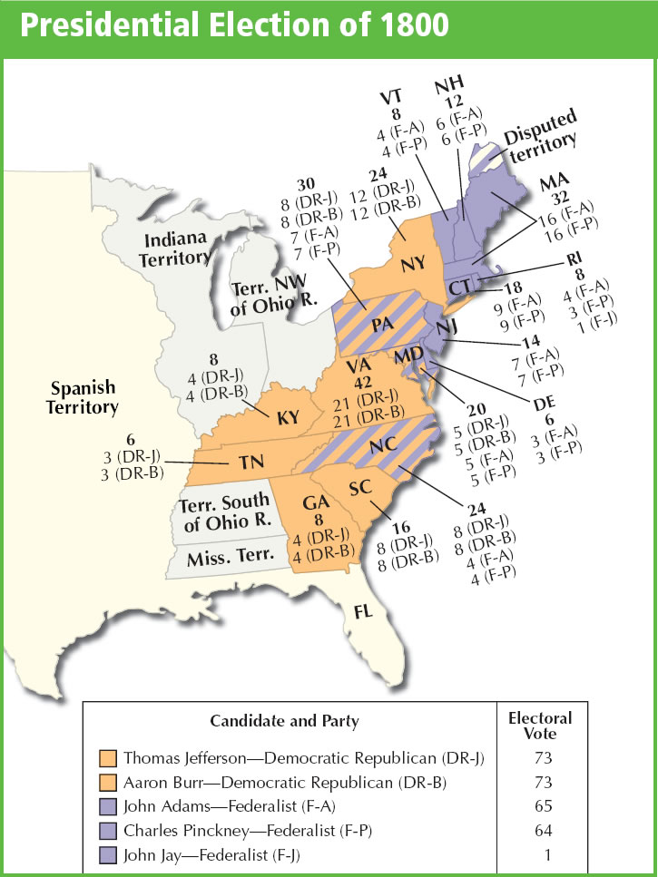
The Election of 1800
Jefferson and Aaron Burr are tied
Jefferson is selected by Hamilton (Leader of the House of Representatives) to be President

Slide 40
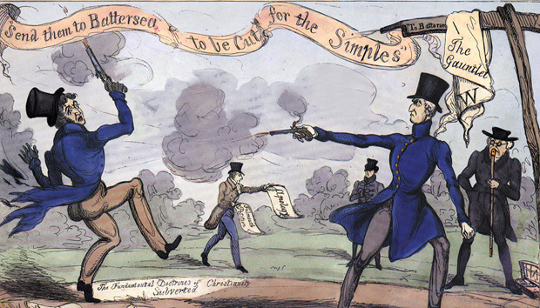
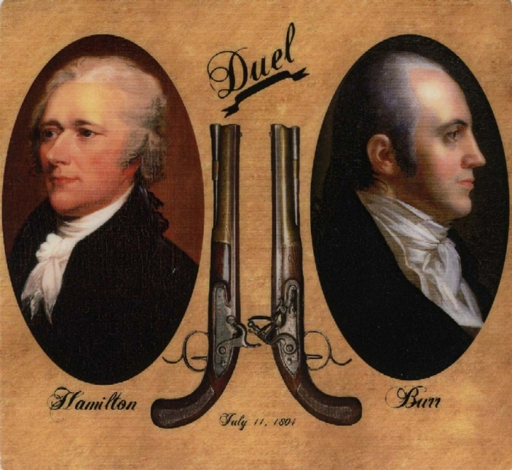
Aaron Burr challenges Alexander Hamilton to a duel after the Election. Burr kills Hamilton in a duel in 1804.

Slide 41

Federalist’s Last Act
Judiciary Act of 1801
  Federalists lose…
    Presidency
    Control of Congress
  Want to maintain control of Judicial Branch
    Act reduced SC by one Justice
    Increases # of Federal Judges
    “Midnight Judges”
  What does this lead to?

