Slide 1
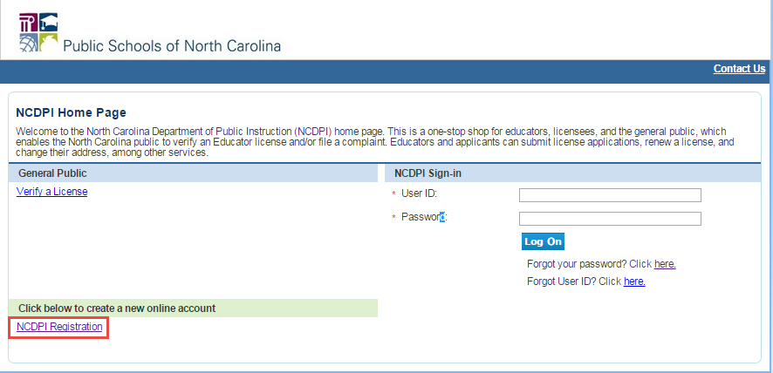
1. To register in the system, the educator will click on the NCDPI Registration link on the log-in page.

Slide 2
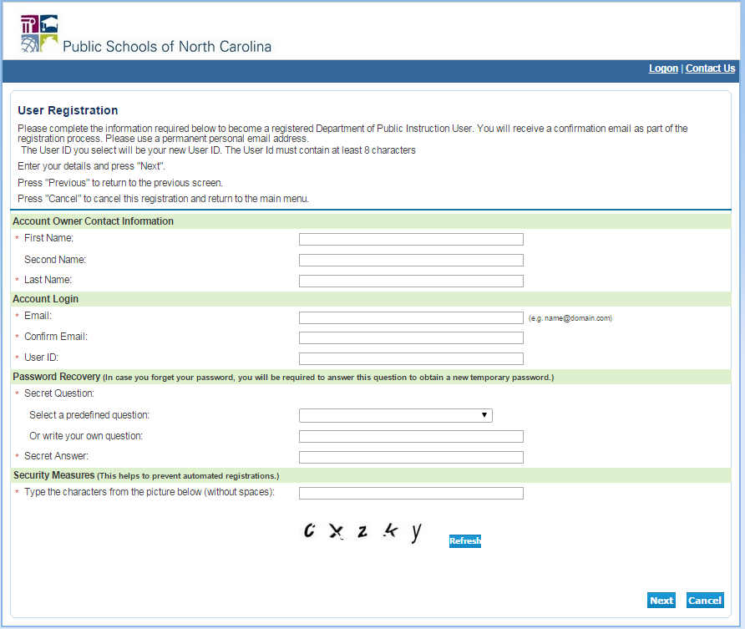
2. The educator will enter and submit his or her unique account information. After submitting this information, the educator will receive an email with a temporary password. On the first login, he or she will need to change his or her password.

Slide 3
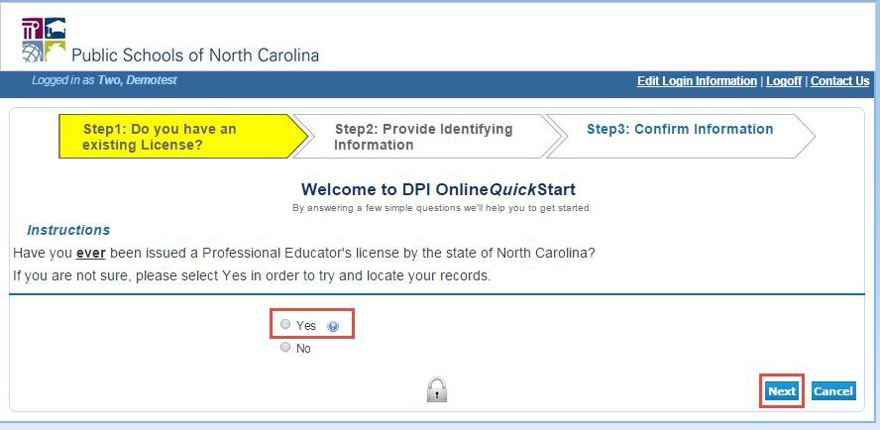
3. After changing his or her password, the educator will see the onboarding screen, which will guide him or her through the process of adding his or her license to his or her online account.

Slide 4
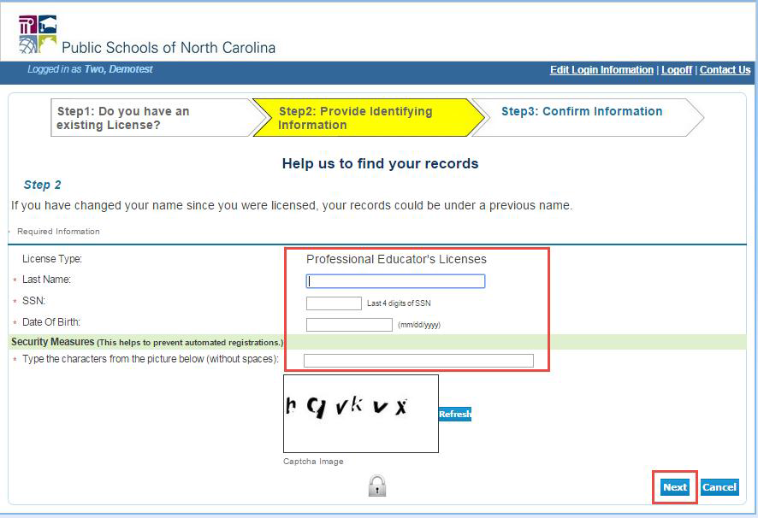

Slide 5
