Slide 1
Nutrition Education
Physical Education

Slide 2
Think, Pair, Share
What is the most serious public health issue today?

Slide 3
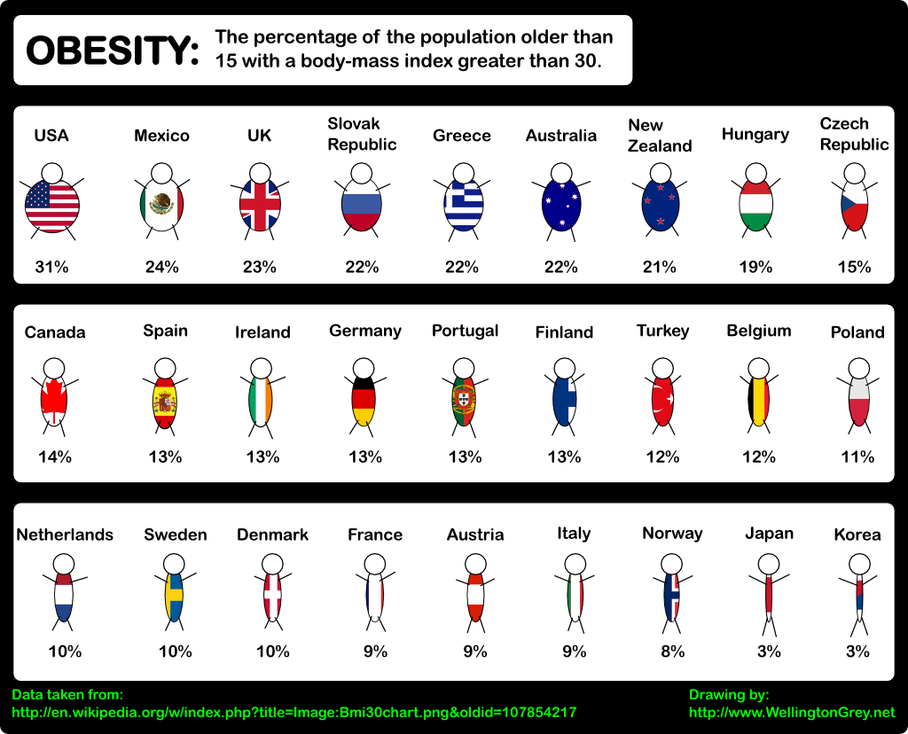

Slide 4
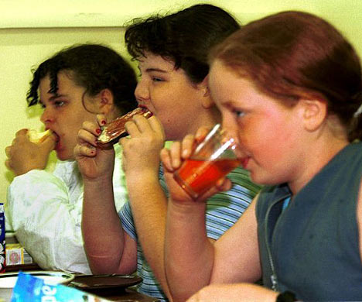
Children and Youth
17% of children/youth ages 2-19 are obese.

Slide 5
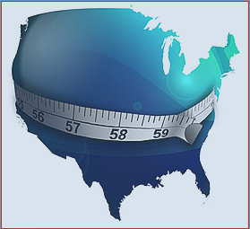
BMI
Rise in America

Slide 6
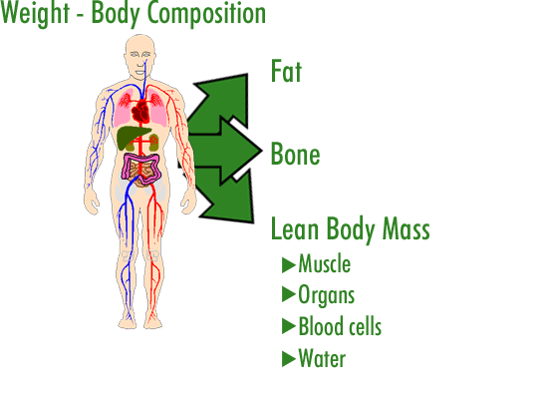
BMI
What is it?
Body Mass Index (BMI)
→ A formula that includes height and weight to measure a person’s lean-to-fat composition.
Body Composition
Refers to the percentages of fat, and fat-free mass (muscle and bone) in the body.
Healthy Goal:
Low fat percentage and higher fat-free mass percentage

Slide 7
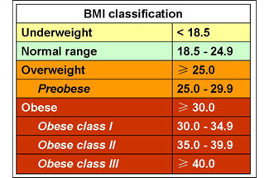
BMI % Classifications:

Slide 8
Calculating Your BMI:
Weight(lb) / [Height (in)]^2 X 703
-For example: (Weight=150 lbs. Height= 5’5” (65”)
Calculation→ [150/(65)^2]x 703 = 24.96

Slide 9
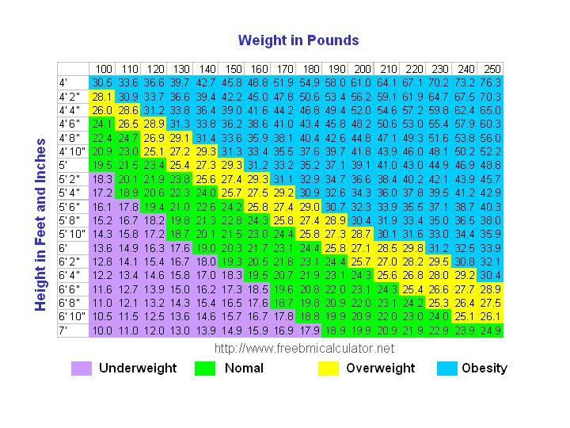
-BMI is a reliable indicator of body fatness for most children and teens.
-Inexpensive and easy-to-perform method.
-BMI does not measure body fat directly.

Slide 10
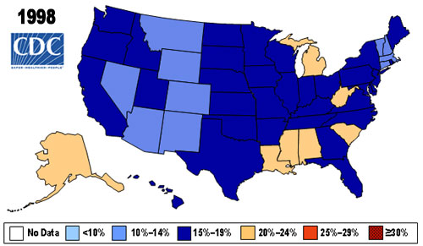

Slide 11
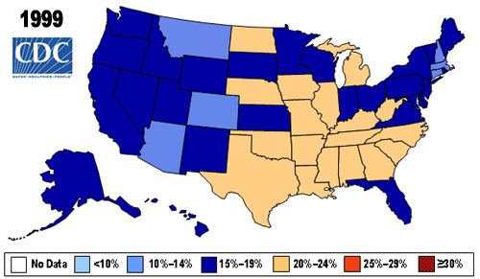

Slide 12
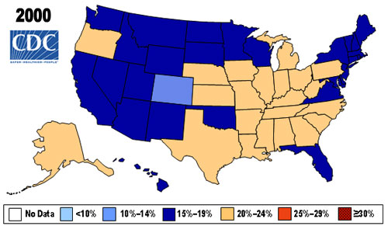

Slide 13
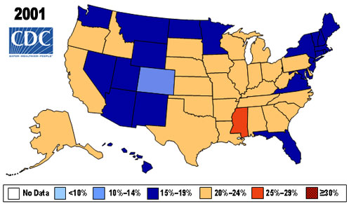

Slide 14
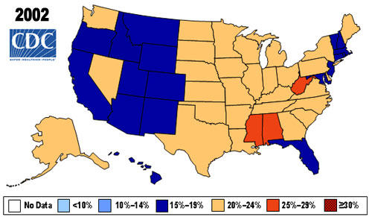

Slide 15
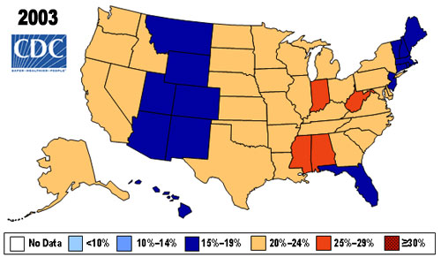

Slide 16
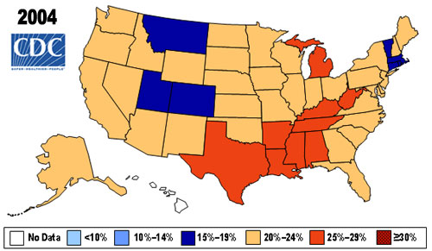

Slide 17
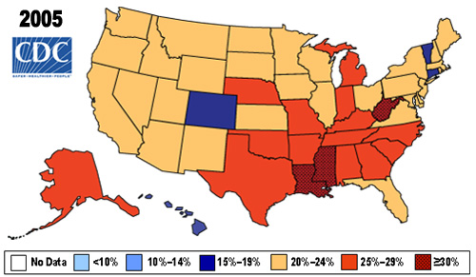

Slide 18
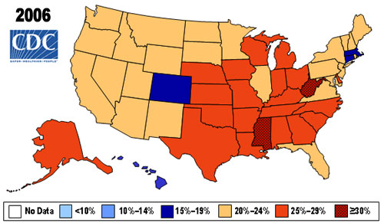

Slide 19
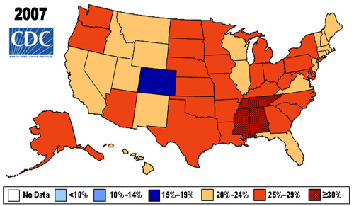

Slide 20
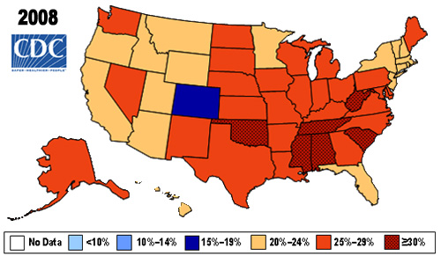

Slide 21
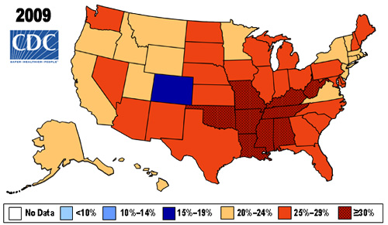

Slide 22
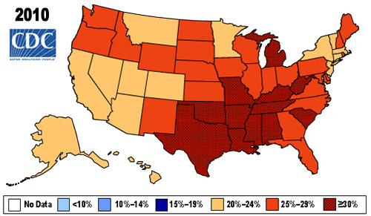

Slide 23
Prevalence* of Self-Reported Obesity Among U.S. Adults by State and Territory, BRFSS, 2011
*Prevalence estimates reflect BRFSS methodological changes started in 2011. These estimates should not be compared to prevalence estimates before 2011.
WA
MT
ND
ME
OR
MN
VT
NH
ID
SD
WI
NY
MA
WY
MI
RI
IA
PA
CT
NV
NE
NJ
UT
IL
IN
OH
DE
CO
KS
WV
VA
MD
CA
MO
KY
DC
TN
NC
AZ
OK
AR
SC
NM
MS
AL
GA
AK
TX
LA
FL
HI
GUAM
PR
15%–<20% 20%–<25% 25%–<30% 30%–<35% ≥35%

Slide 24
Prevalence* of Self-Reported Obesity Among U.S. Adults by State and Territory, BRFSS, 2012
*Prevalence estimates reflect BRFSS methodological changes started in 2011. These estimates should not be compared to prevalence estimates before 2011.
WA
MT
ND
ME
OR
MN
VT
NH
ID
SD
WI
NY
MA
WY
MI
RI
IA
PA
CT
NV
NE
NJ
UT
IL
IN
OH
DE
CO
KS
WV
VA
MD
CA
MO
KY
DC
TN
NC
AZ
OK
AR
SC
NM
MS
AL
GA
AK
TX
LA
FL
HI
GUAM
PR
15%–<20% 20%–<25% 25%–<30% 30%–<35% ≥35%

Slide 25
Prevalence* of Self-Reported Obesity Among U.S. Adults by State and Territory, BRFSS, 2013
*Prevalence estimates reflect BRFSS methodological changes started in 2011. These estimates should not be compared to prevalence estimates before 2011.
WA
MT
ND
ME
OR
MN
VT
NH
ID
SD
WI
NY
MA
WY
MI
RI
IA
PA
CT
NV
NE
NJ
UT
IL
IN
OH
DE
CO
KS
WV
VA
MD
CA
MO
KY
DC
TN
NC
AZ
OK
AR
SC
NM
MS
AL
GA
AK
TX
LA
FL
HI
GUAM
PR
15%–<20% 20%–<25% 25%–<30% 30%–<35% ≥35%

Slide 26
Calculate your BMI
Use the BMI tool on the CDC.gov website to determine your BMI.
-Go to http://apps.nccd.cdc.gov/dnpabmi/
-Put in your information and record your BMI percentage.
-Then compare your percent measure to standards for underweight, normal weight, overweight, or obese.

Slide 27
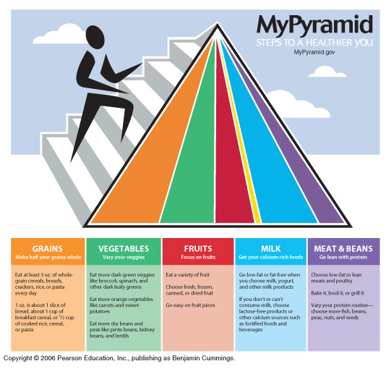
My Pyramid -- Outdated Logo

Slide 28
MyPlate – Current Logo

