Slide 1
BALLET HISTORY
DANCE

Slide 2
ORIGINS OF DANCE
Dance has began as far back as cave paintings, Egyptian hieroglyphics, descriptions of ancient Olympic games, and Old Testament references.
The HEARTBEAT offered a melody for stamping feet and breathing.
DANCE IN THE MIDDLE AGES: 1450
Spain’s baile de los seises (dance of the six) performed at Corpus Christi services with boys is still performed today. Costumes wore out and secretly patched.
Carole- a basic form of folk dance where chains were made that included a leader who led hand-linked dancers in circles and lines. (maypole dance- dance of fertility).
Danseomania and danse macabre- people dancing until they collapsed or died of exhaustion.
Court dances: joglars (jugglers) and minstrels.

Slide 3
RENAISSANCE ERA
Both in Italy and France. 1500’s
The Italians developed basic ideas to measure dance: keeping time, ability to memorize, use of space, posture, use of footwork, graceful movements.
The French: Catherine de Medici: Great-granddaughter of Lorenzo the Magnificent. Huge supporter of ballet.
Ballet Comiques, Ballet Masquerades, Equestrian Ballets.

Slide 4
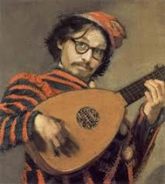
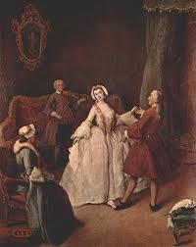
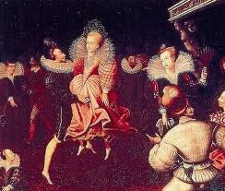
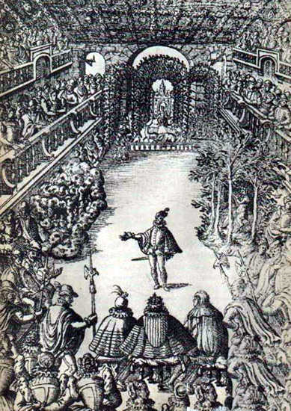
RENAISSANCE ERA

Slide 5
BAROQUE BALLET
Mid 1600’s still in France
LOUIS XIV: Ballet Royal De La Nuit. Le Roy En Soleil.
Danse d’ecole: schooled dancing that followed time-honored and strict rules for executing specific poses and steps. Also known as Classical Ballet. This was the start of professional ballet.
Ballet d’action: where the dancers conveyed the dramatic plot during distinct sections of dance based on conventional steps and a robust amount of pantomime and gesture.

Slide 6
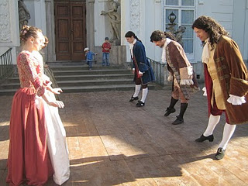
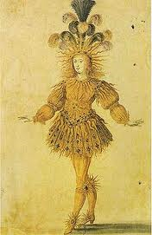
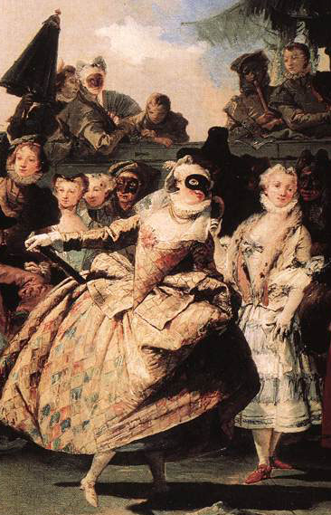
BAROQUE BALLET

Slide 7
CLASSICAL BALLET
Jean Georges Noverre: (1727-1810) entered the Opera Comique as a professional dancer. He choreographed ballets and taught many famous ballerinas such as Marie Antoinette.

Slide 8
ROMANTIC ERA
1800’s: Based on emotion and individualism.
Gothic Folklore: wilis and sylphs.
The 2 greatest ballets of this era: La Sylphide and Giselle.
1880: first commercial blocked shoes were introduced. The first pointe shoes were heel-less, square-tipped, satin slippers.
For the first time in the history of dance, the female presence superseded that of the male.
Flying devices used, trap doors, and music.
Marie Taglioni: her father choreographed La Sylphide and she was prima ballerina.
Carlotta Grisi and Fanny Essler: argument between who wore the first pointe shoes and who was the better dancer.

Slide 9
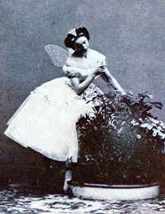
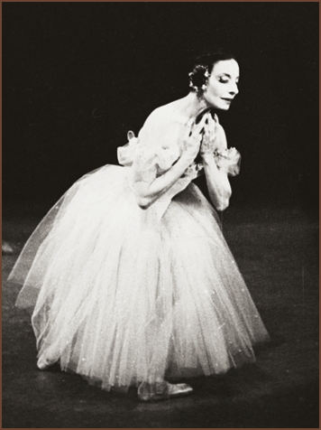
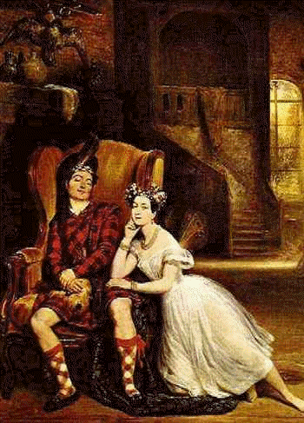
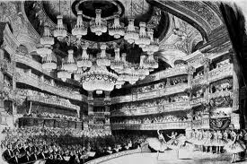
ROMANTIC ERA

Slide 10

La Slyphide
http://www.youtube.com/watch?v=l7xkcl0I6zA

Slide 11

GISELLE
http://www.youtube.com/watch?v=n9T-ftsUc2o&feature=related

Slide 12
RUSSIAN BALLET
Harles-Louis Didelot: Father of Russian Ballet. Flying machines.
Marius Petipa( 1818-1910): Collaborated with Tchaikovsky to make The Sleeping Beauty and collaborated with Ivanov to make Swan Lake.
Sergei Diaghilev: Formed the Ballet Russes.
Ballet Russes performed in America in New York, January 1916.
Dance grew to great heights with the influence of Avant-Garde and Neoclassicism that it quickly spread to many different countries such as Canada, Australia, Scandinavia, Switzerland, and beyond.

Slide 13
Bibliography
Lee, Carol. Ballet in Western Culture. 2002. Routledge.
Youtube.com video. http://www.youtube.com/watch?v=l7xkcl0I6zA
Youtube.com video. http://www.youtube.com/watch?v=n9T-ftsUc2o&feature=related

