Slide 1
Atmosphere
6th Grade PBL
Colonizing another planet

Slide 2
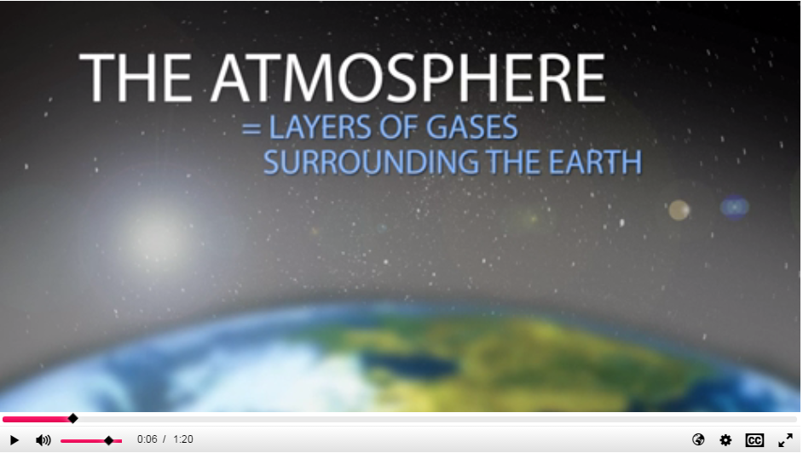
Atmosphere
All the planets in our solar system, and some of its smaller bodies too, have an outer layer of gas we call the atmosphere. The atmosphere usually sits atop a denser, rocky crust or planetary core. Atmospheres can extend thousands of kilometers into space. On Earth, it is this envelope that allows organisms to live. Atmospheric ozone protects us from ultraviolet radiation. CO₂ and other gases trap heat and keep the surface warm enough for life to thrive. Oxygen has allowed life to evolve.
The atmospheres of at least the inner planets has evolved since they formed. This is the clearest for Earth. The Earth’s original atmosphere was probably like Venus in composition, consisting of carbon dioxide and nitrogen. The evolution of photosynthesis converted carbon dioxide in the Earth’s atmosphere to oxygen, increasing the amount of O₂ in it from initial 0.01% to its current 22% level.

Slide 3
What does this mean for your colony?
Use the chart on the next page to figure out what the atmosphere is like for your planet.
Fill in the information on your Note-taking Sheet.

Slide 4
Planet | Carbon Dioxide | Nitrogen | Oxygen | Argon | Methane | Sodium | Hydrogen | Helium | Other
Mercury |  |  | 42% |  |  | 22% | 22% | 6% | 8%
Venus | 96% | 4%
Mars | 95% | 2.7% |  | 1.6% |  |  |  |  | 0.7%
Jupiter |  |  |  |  |  |  | 89.8% | 10.2%
Saturn |  |  |  |  |  |  | 96.3% | 3.2% | 0.5%
Uranus |  |  |  |  | 2.3% |  | 82.5% | 15.2%
Neptune |  |  |  |  | 1.0% |  | 80% | 19%
Titan |  | 97% |  |  | 2% |  |  |  | 1%

Slide 5
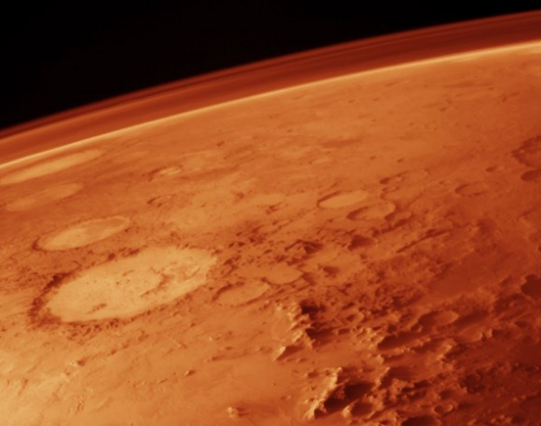
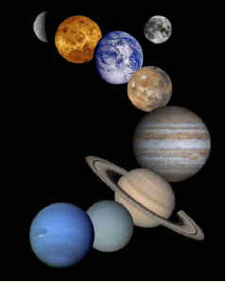
Check out these two articles for more information

Slide 6
Does Your Atmosphere help support life?
How does your atmosphere compare to Earth’s atmosphere?
What affect does this have on us if we colonize there?
  Would we have breathable air?
  Would plants be able to grow?
  What would stop the solar radiation?

Slide 7
How could we fix this?
As a team, brainstorm ways to address the issues that make your planet inhabitable.
Some links to look at:
Protecting Astronauts from Solar Radiation
Making Oxygen on Mars

