Slide 1
The Country’s First Governemnt

Slide 2
Bell Ringer
What do you know about the Articles of Confederation?
Why is a written constitution important?

Slide 3
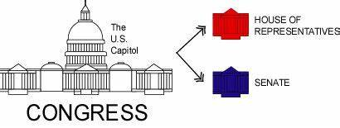
State Constitutions
New Hampshire= 1st colony to organize a state
  Set up a constitution
State Governments
  State constitutions had similar laws
  Bicameral
  Governor
  Bill of Rights

Slide 4

What led to the Articles of Confederation?
1770s- Americans were breaking away from British rule
Great Britain’s actions led to colonists’ resentment toward monarchy
Feared a strong central power/government

Slide 5
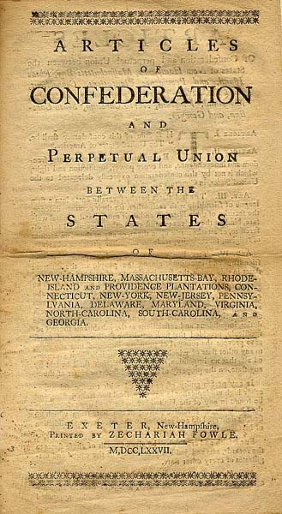
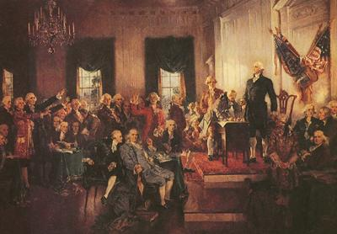
Articles of Confederation
1781- ratified Articles of Confederation
1st Constitution of U.S.
Confederation-group of individual state governments that unite for common purpose
One-house legislature
Each state had one vote
Legislature called Confederation Congress

Slide 6
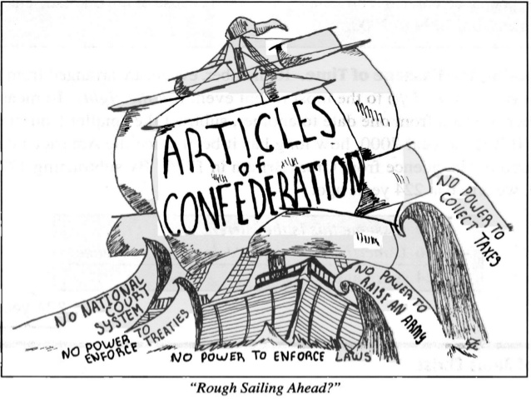
Weaknesses of Articles of Confederation
National govt couldn’t impose/collect taxes
No national currency
No national court system
No executive branch

Slide 7
Weakness of Article of Confederation
Congress couldn’t regulate foreign trade
Congress couldn’t enforce laws
Approval of 9 states to pass laws
Articles couldn’t be changed without agreement of all 13 states

Slide 8
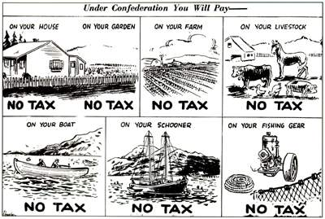
Result of Articles of Confederation
Weak national government
Government short of money
States printed their own money
Difficult trading with other countries

Slide 9
Result of Articles of Confederation
States couldn’t settle disputes among themselves
Government depended on states for law enforcement
Difficult to enact/enforce laws
No practical way to change the powers of government

Slide 10
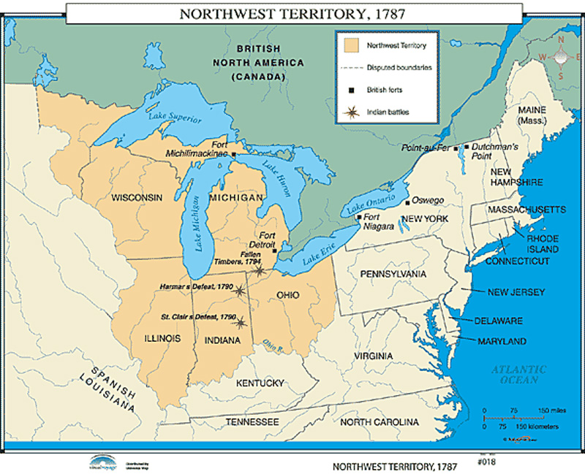
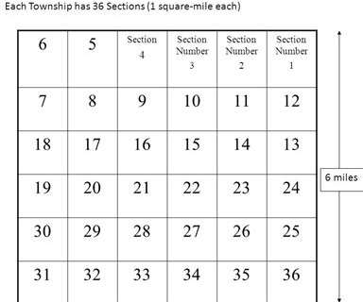
Northwest Ordinances
Ordinances- a law, usually of a city or county
Ordinance of 1785
  Set up plan for surveying land
  Described how western lands would be sold
  Divided land into townships 6 mile sq then divided into 36 sections (1 sq. mile)
Northwest Ordinance (1787)
  Set up government for Northwest Territory
  Plan for admitting new states to the Union
  Slavery outlawed in Northwest Territory
  Used as a model for government in new territories

Slide 11
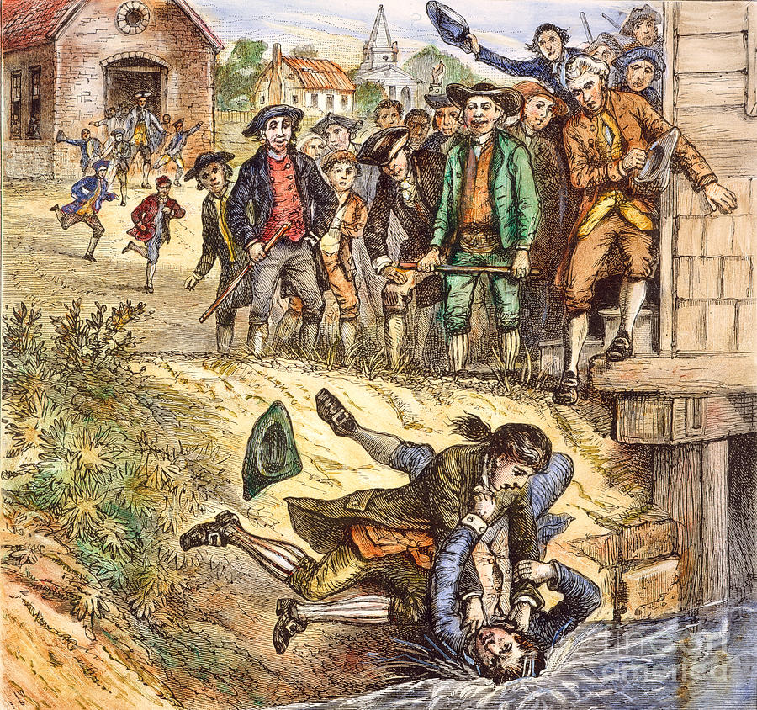
Disgruntled Farmers
Confederation Congress had lot of debt
  Couldn’t collect taxes
  Borrowed money for American Revolution
State govt have debt as well
Resulted in heavy taxes
Trade slowed & loss of jobs
Farmers couldn’t sell crops -> went into debt
  Possibly lost land

Slide 12
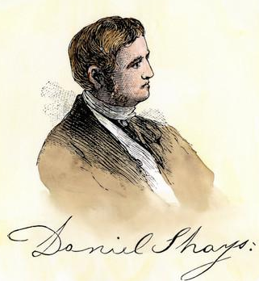
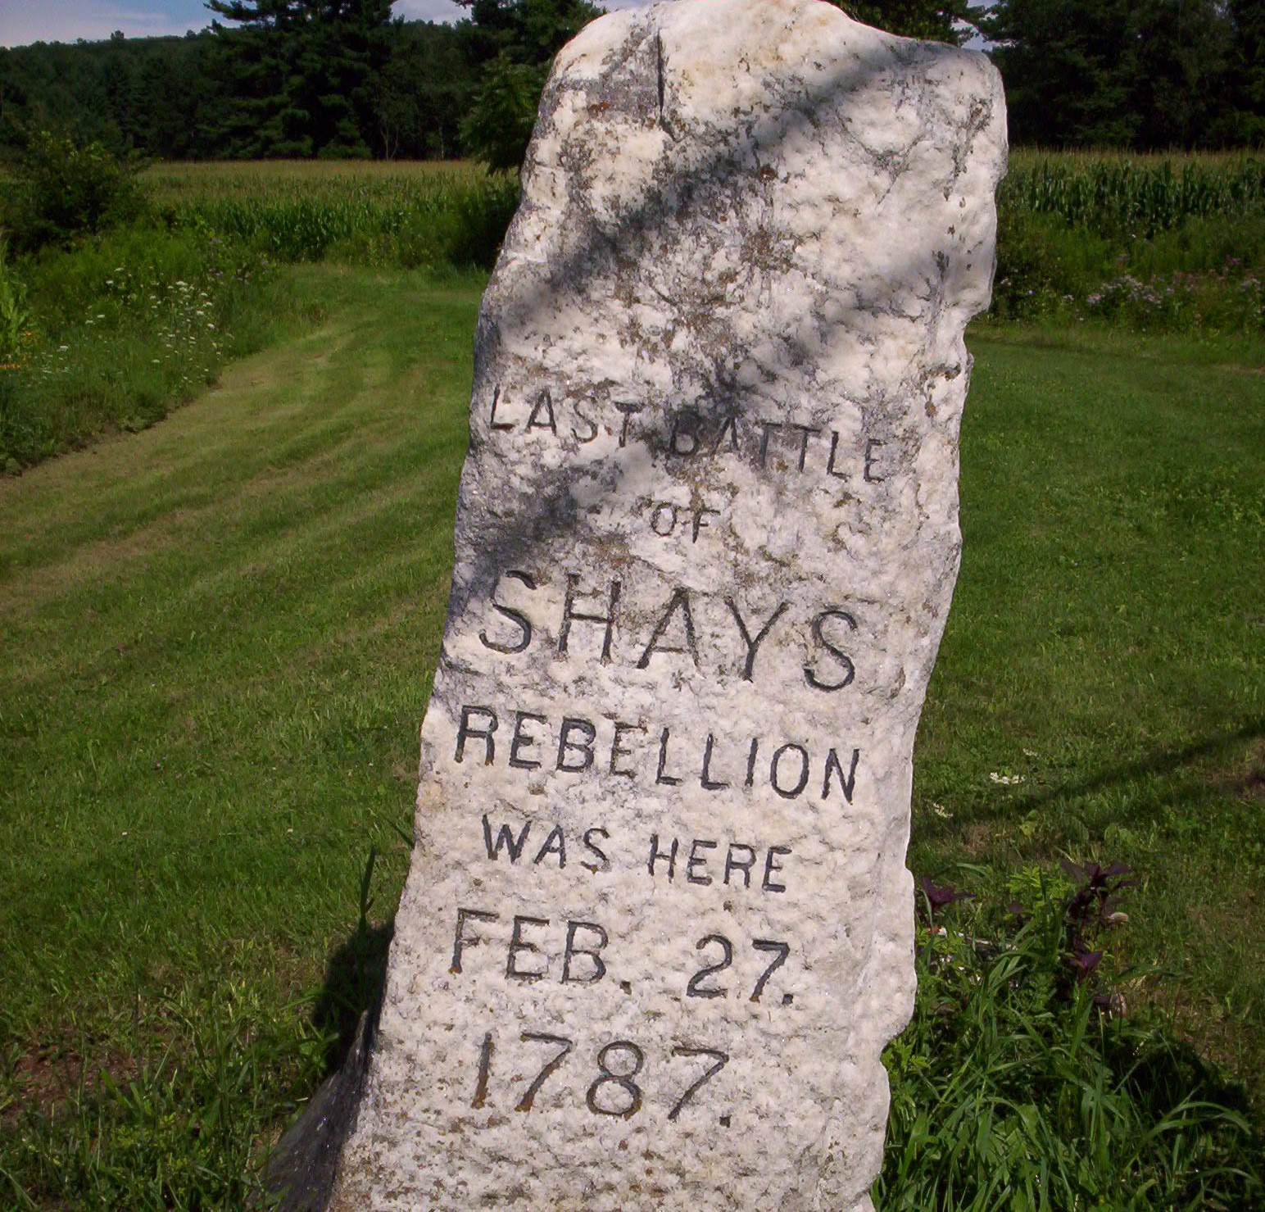
Shays’ Rebellion (January 1787)
1786-1787-> riots broke out
Farmer uprising led by Daniel Shays
  Shays owed money because of taxes
  Courts threatened to take his farm
Shays led 1,2000 protestors in attack on federal arsenal
  Including some African Americans
Quickly stopped by U.S. troops

Slide 13
Aftermath of Shays’ Rebellion
Showed the need of reform
Delegates began working towards revising government
What would our country look like if we were still under the Articles of Confederation?

