Slide 1
Journal-
What motivates people to explore the unknown? What can we assume about an explorer's character and personality?

Slide 2
Exploration
What is it?
Always Present
Sometimes Present
Never Present
Examples:
Nonexamples:
Tie Down a Definition:

Slide 3
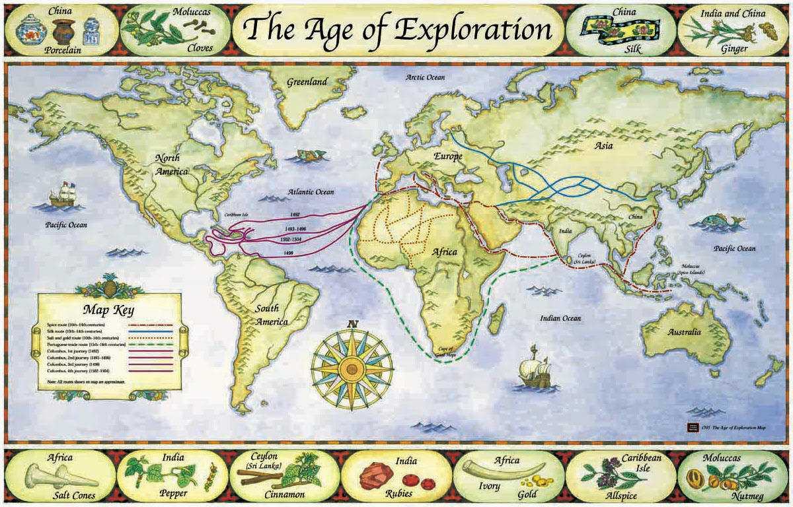
Where did Europeans explore?

Slide 4
New World
Ancient Latin American Civilizations

Slide 5
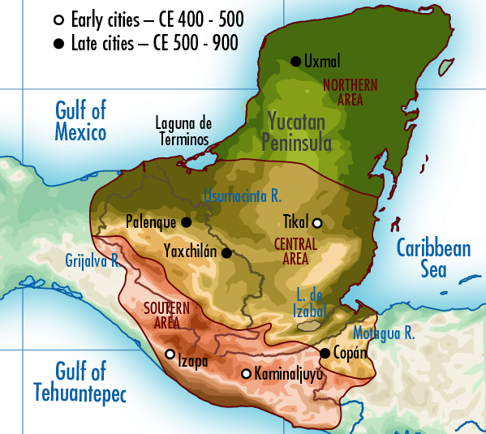
I. Mayans ( Height: 300-900)
A. Location: Guatemala
Great City: Tikal

Slide 6
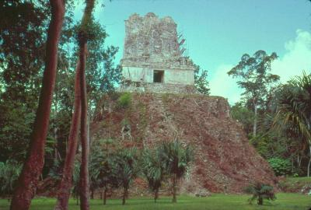
B. Achievements
• Solar & Sacred Calendars (365 days)
- Long Count
• System of writing: Glyphs (500 signs)
- Palenque: collection of Mayan glyphs
- Popul Vuh
• Astronomy
• Pyramids (to the gods)
• Built 80 Independent Cities

Slide 7
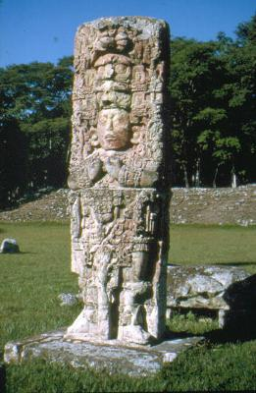
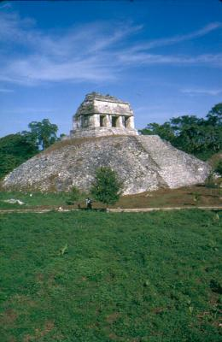
C. Society
Rulers
Priests
Warriors
Commoners
Slaves

Slide 8
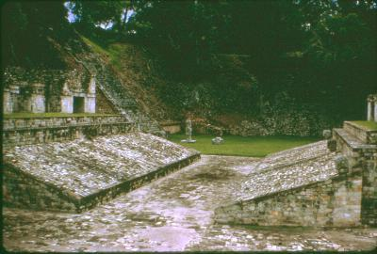
D. Religion - Polytheistic
• Pyramids used for rituals and sacrifices
• Priests pierced tongues and ears for blood offerings for rain
• Cut out hearts
• Threw spears at victim’s chest
• Fling heart into a sacred well for the offering
Mayan Hand Ball Court

Slide 9
Warm Up -
There have been several civilizations to disappear from without a trace: the Lost Colony at Roanoke, Royal Cities of the Maya, the unfound lost city of Atlantis.
What do you think motivated the people of these civilizations to "just walk away" as the video said yesterday?

Slide 10
Journal: “Royal City of the Maya”
National Geographic August 2003
1. Why did Stephen Houston return to Piedras Negras?
2. How long did the village of Piedras Negras thrive before it collapsed?
3. What challenge did Houston’s team have to overcome in order to begin their project in 1997?
4. How was Houston able to date many of the artifacts he found?
5. How big did the population of Piedras Negras grow to be?
6. What conclusion did Houston come to about what happened to the village of Piedras Negras?

Slide 12
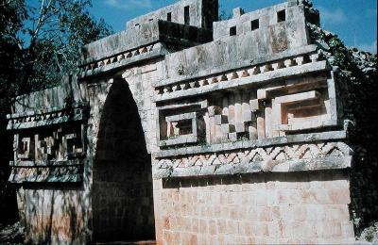
E. Decline
• Unknown- Abandoned Cities
Turn to page 449. List reasons historians hypothesize for the decline and fall of the Maya.

Slide 13
Incan Mummies
Turn to page 464-465 in your text.
Read Social History:Incan Mummies and analyze the pictures provided.
1. What do Incan mummification practices suggest about Incan culture?
2. How is the practice of human sacrifice different with the Inca than what we've seen with the Maya?
3. Why do you think mummification is not a common practice in the United States today?

Slide 14
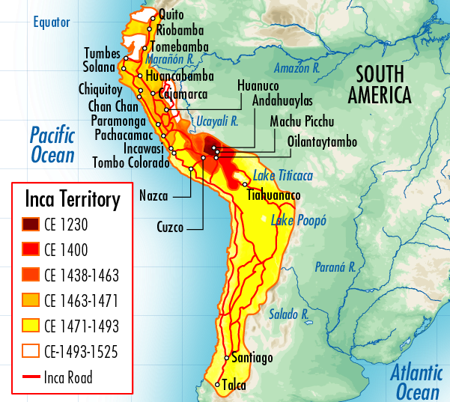
II. Incas (1100-1533)
A. Location: Peru
Great City: Cuzco

Slide 15
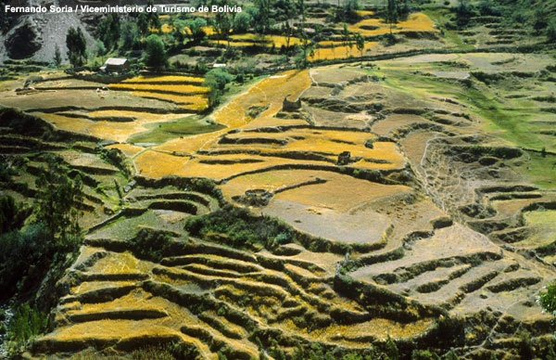
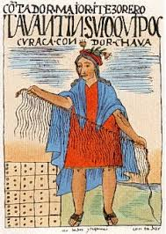
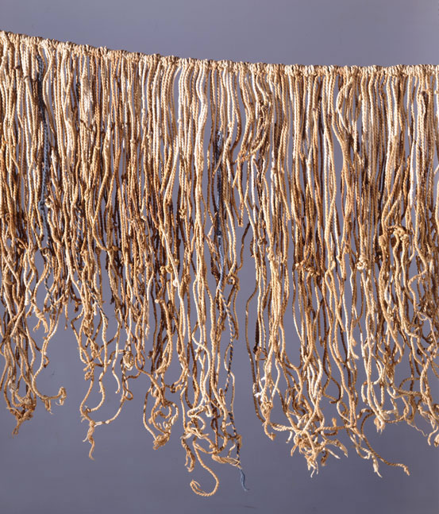
B. Achievements
• Terrace Farming
• 10,000 miles of stone highway
Quechua Spoken
Language
Quipu - system of knotted
strings, record keeping

Slide 16
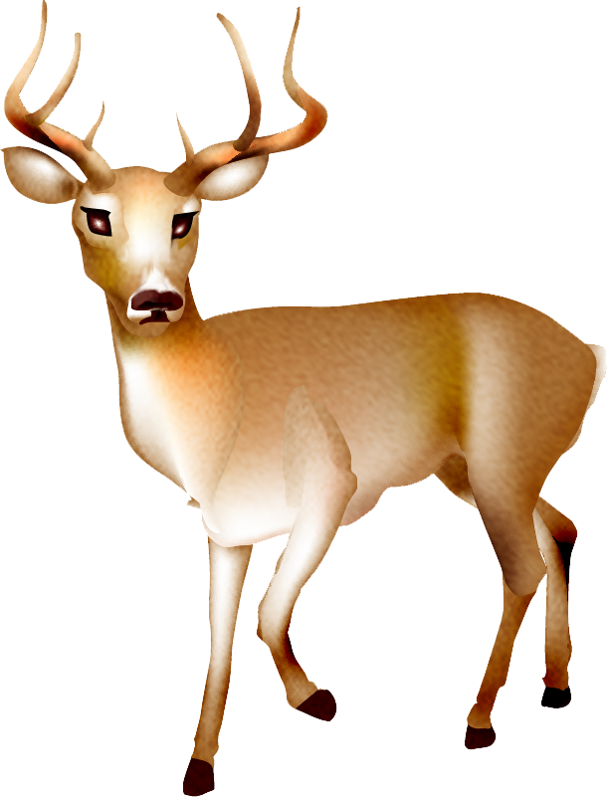
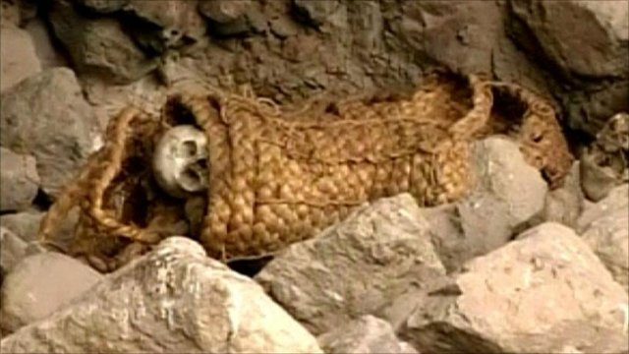
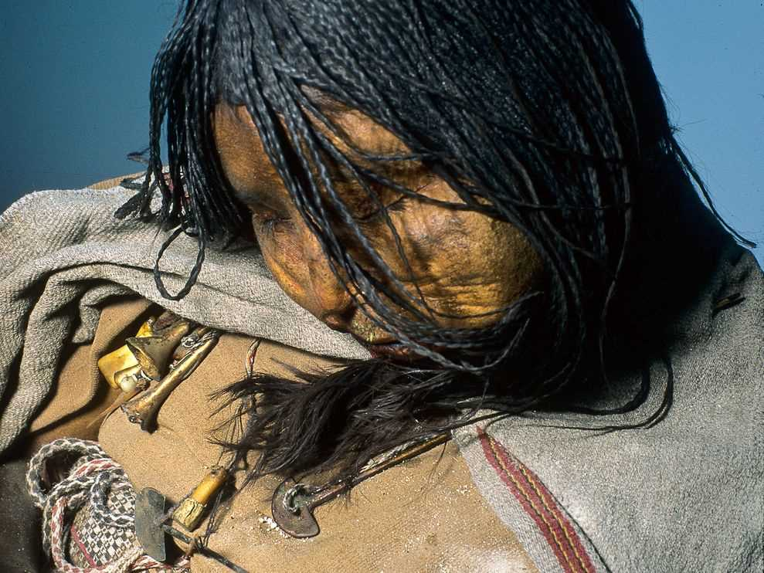
C. Religion
• Emperor- direct descendant of the gods
• Animal sacrifices
Mummification

Slide 17

D. Laws
• Rape: dropping a heavy stone on a man’s shoulders
• 2nd offense: Death!
• Disobedience- 3rd offense: Death!
• Lying- 2nd offense: Death

Slide 18
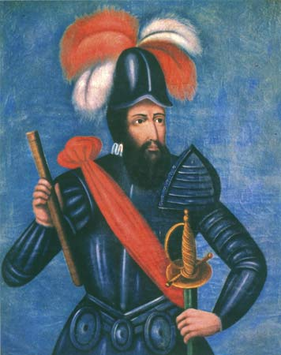
E. Decline
• 1533-Pizarro a Spanish explorer/conquistador
Spanish conquer by
kidnapping Atahualpa for
ransom, then kill him.
His troops march on Cuzco.

Slide 19
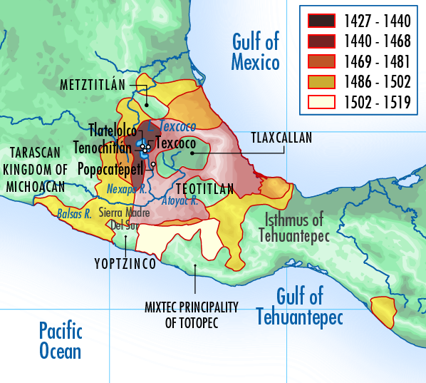
III. Aztecs (1325-1521)
A. Location: Mexico
Great City: Tenochtitlan

Slide 20
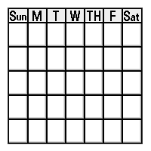
B. Achievements:
• Calendar
• System of Writing
What else are the Aztec known for?
Use your textbook page 455 "Tenochtitlan: A Planned City" to complete the list.

Slide 21

C. Laws Against: Adultery, Drunkenness, Witchcraft, Treason, Stealing
• All crimes are punished by death- stoning, strangulation, or sacrifice.

Slide 22
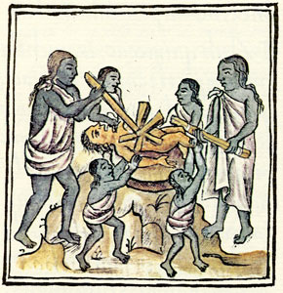
D. Religion
Major Gods:
• Sun God- Quetzalcoatl "Feathered Serpent"
• God of War and Sun- Huitzilopochtli
• Believed the Gods needed human blood to survive ... offered a fresh human heart!
• 30,000 people sacrificed a year!
• Fire God Ceremony was most gruesome

Slide 23
E. Society
Read "Nobles Rule Aztec Society" on page 454-455. Complete the social hierarchy based on your understanding of the text.

Slide 24
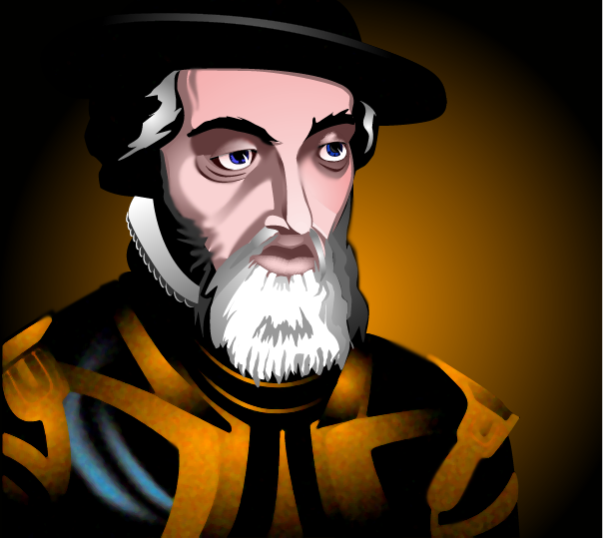
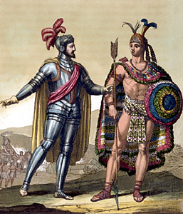
F. Decline
• Cortes a Spanish Explorer/
Conquistador
Cortes takes Aztec gold tribute, kidnaps Montezuma, and uses enemy tribes of the Aztec to march on their empire.
Hernan Cortes and Montezuma

Slide 25
New World News
Directions: Create a newspaper for ONE of the New World Civilizations consisting of 5 articles/sections using the planning guide provided. Ideas for topics are included. Your newspaper should contain:
- A title that indicates which New World Civilization you've selected.
- A Date for "publication"
- 5 completed sections of your template
- Color and Creativity!

Slide 26
Age of Exploration
What were the motivations for European exploration?
Read the document provided and answer the accompanying questions. On your Post-it, based on your document, answer the question: Why did people explore? If you have more than one reason get additional Post-its from the front table. Stick your Post-it here.

