Slide 1
The Ancient
Egyptians

Slide 2
Introduction of Ancient Egypt
Originally called “Kemet” – Black Land
Given the name “Egypt” by the Greeks!

Slide 3
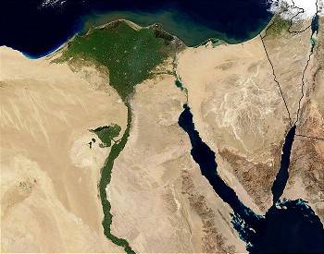
A View of Egypt by Satellite
How does geography impact civilization?

Slide 4
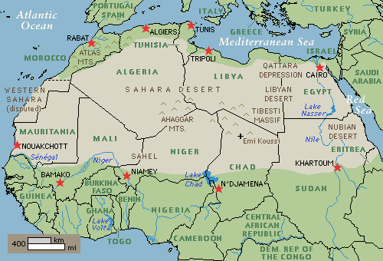
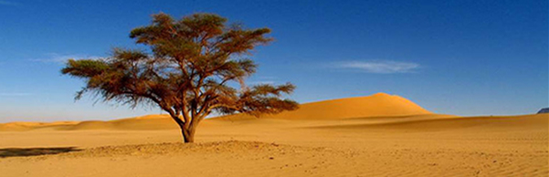
Geography
Sahara Desert – barrier to invasions

Slide 5
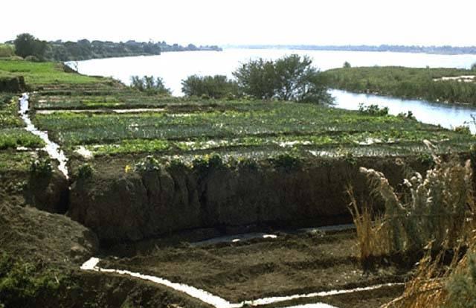
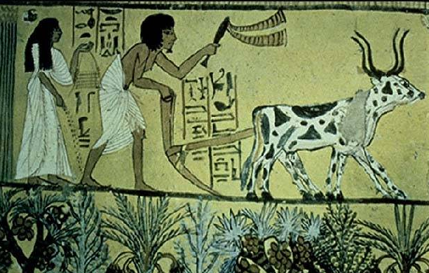
The Fertile Nile Valley
Nile River – location of settlements

Slide 6
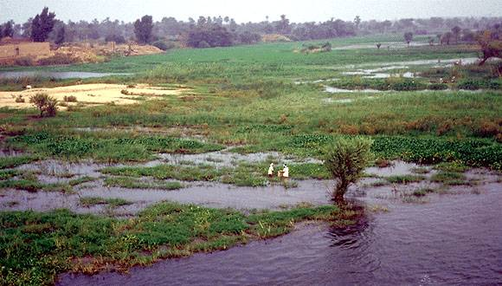
The Annual Flooding of the Nile

Slide 7
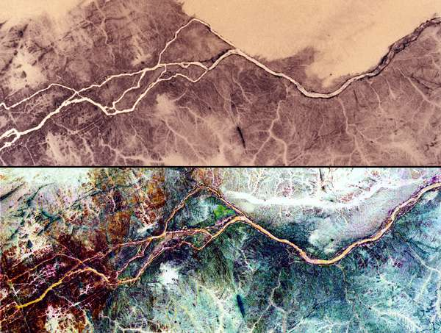
Cataracts – blocked passage along the Nile – the last 650 miles can be navigated by boats
NASA Image

Slide 8

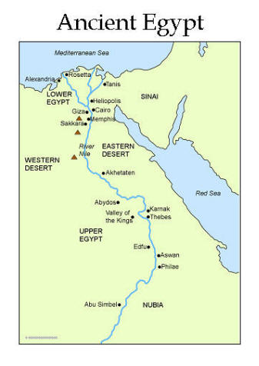

  Upstream : Lotus is the symbol of Upper Egypt
  Delta Region : Papyrus is the symbol of Lower Egypt
  East bank of the Nile River- location of temples. Why?
  West bank of the Nile River- location of tombs. Why?

Slide 9
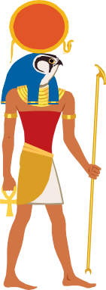
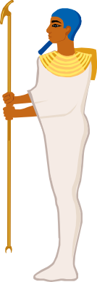
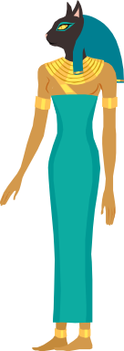
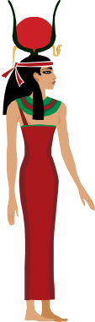
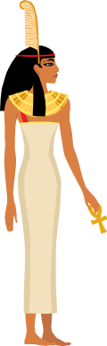
Religion
  Greatest influence on daily lives!
  Prepared for afterlife – mummification rituals
  Polytheistic – gods/goddesses

Slide 10
People

Slide 11
Article-Egypt: Gift of the Nile
Read the article provided.
Answer the included questions for thought on the back of the article on a CLEAN sheet of notebook paper.
Please do NOT write on the article.

Slide 12
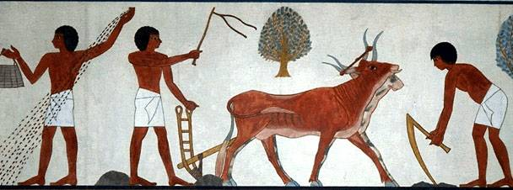
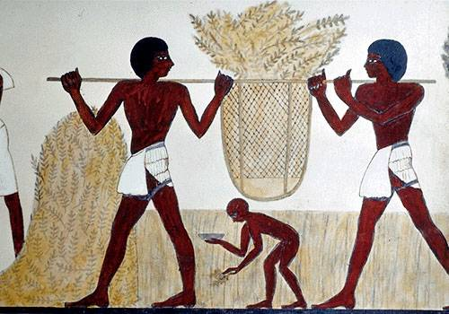
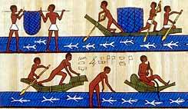
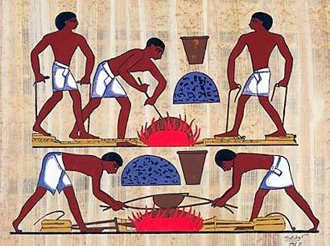
Scenes of Ancient Egyptian
Daily Life
Based on the images, how would you assume Egyptians spent most of their time?

Slide 13
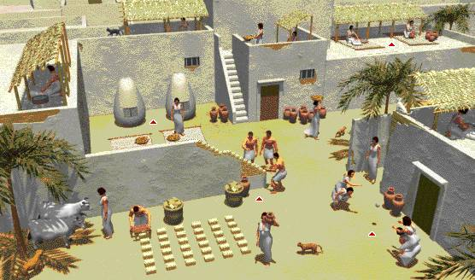
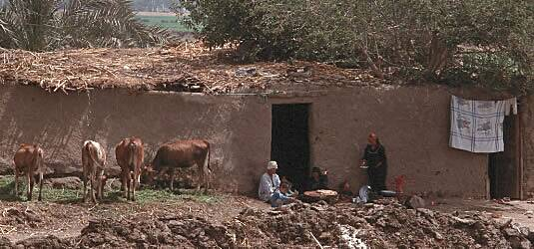
Ancient Egyptian Housing
Middle Class Homes
Peasant Homes

Slide 14
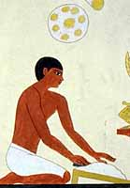
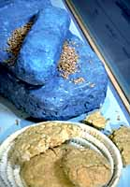
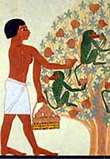
Making Ancient Egyptian Beer

Slide 15
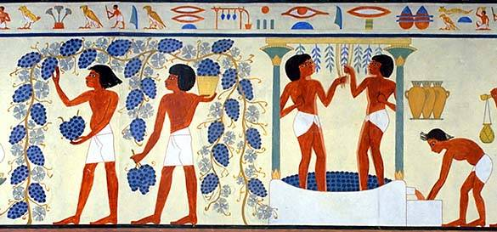
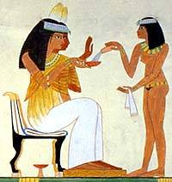
Making Ancient Egyptian Wine

Slide 16
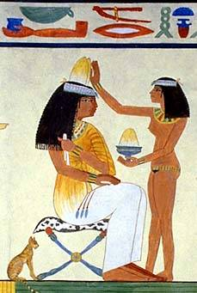
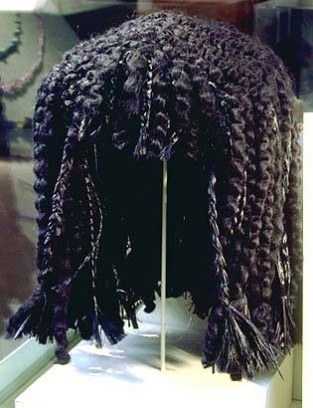
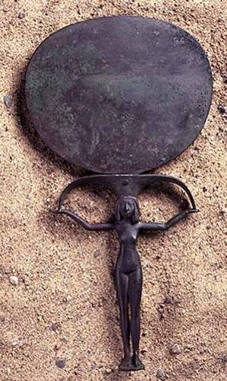
An Egyptian Woman’s “Must-Haves”
Mirror
Perfume
Wigs

Slide 17
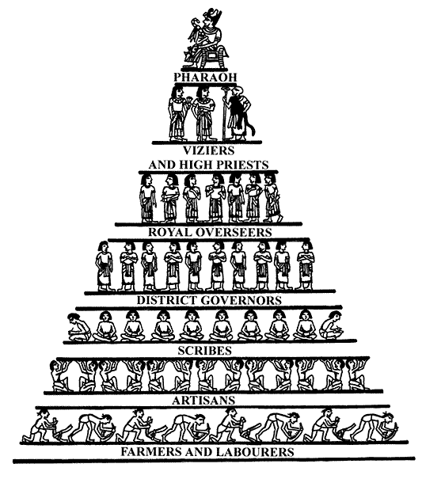
Egyptian Social Hierarchy

Slide 18
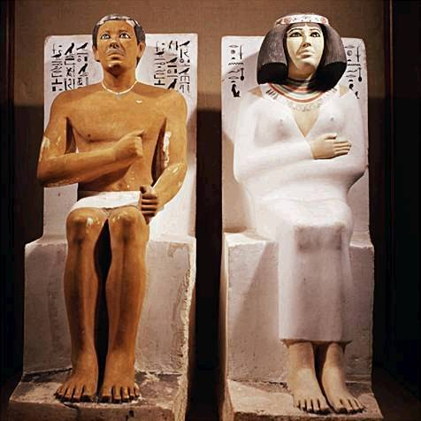
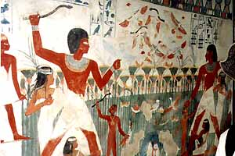
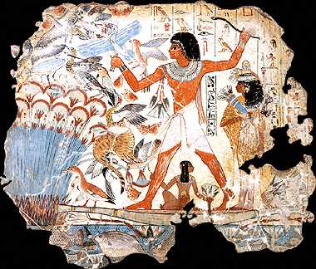
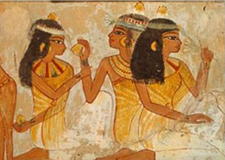
Egyptian Nobility

Slide 19
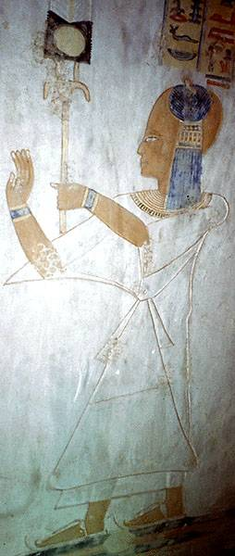
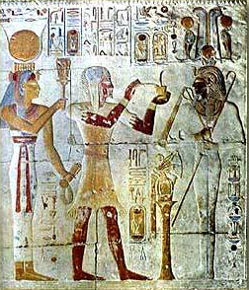
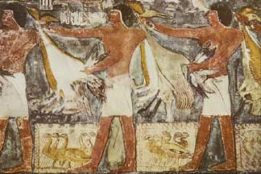
Egyptian Priestly Class

Slide 20
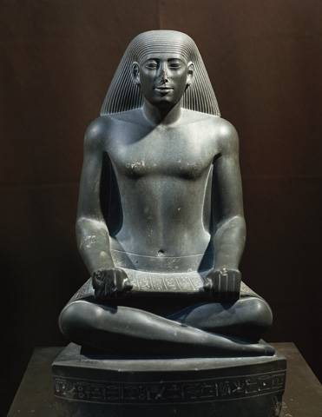
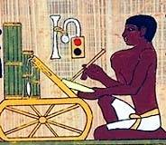
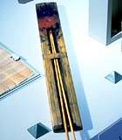
Egyptian Scribe

Slide 21
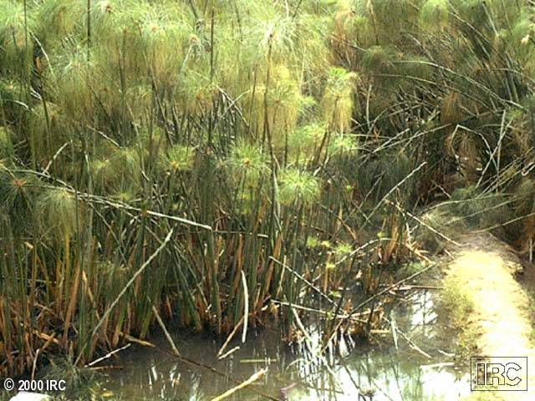
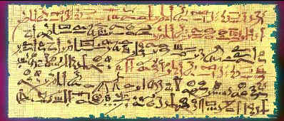
Papyrus → Paper
Hieratic Scroll Piece
Papyrus Plant

Slide 22







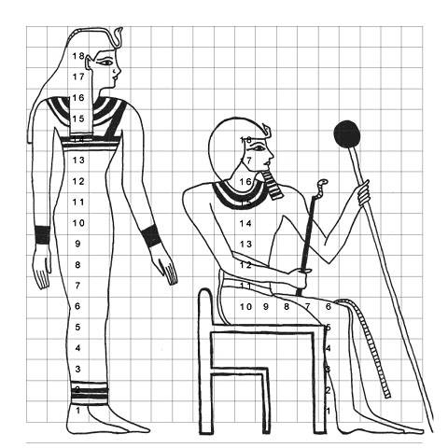

Egyptian Math & Draftsmenship
1 | 10 | 100 | 1000 | 10,000 | 100,000 | 1,000,000
What number is this?

Slide 23
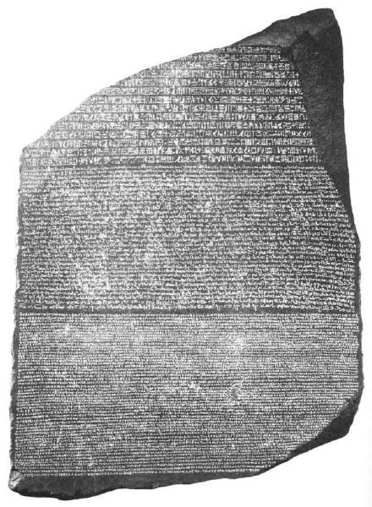
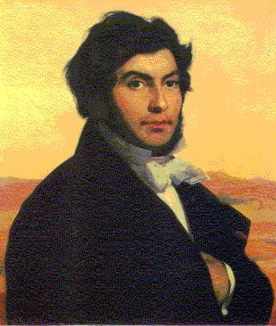
Champollion & the Rosetta Stone

Slide 24
Ancient Egyptian History
Periods | Time Frame
Nile Culture Begins | 3900 B. C. E.
Archaic | 3100 – 2650 B. C. E.
Old Kingdom | 2650 – 2134 B. C. E.
Middle Kingdom | 2040 – 1640 B. C. E.
New Kingdom | 1550 – 1070 B. C. E.
Late Period | 750 – 332 B. C. E.
Greek Ptolemaic Era | 332 – 30 B. C. E.
Roman Period | 30 B. C. E. – 395 C. E.

Slide 25
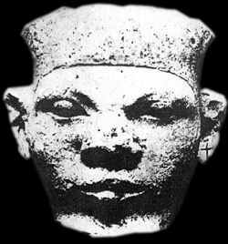
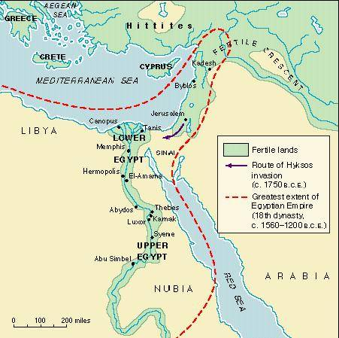



Menes: Unifier of Upper & Lower Egypt
c. 3100 B. C. E. ?
Founded the 1st Dynasty

Slide 26
Timeline of Ancient Egypt
3100 BC – Egypt was united under Menes who founded the 1st Dynasty
2700 BC – Beginning of the Old Kingdom or Age of Pyramids
2100 BC – Beginning of the Middle Kingdom or the Age of the Nobles
1700 BC – Egypt is conquered by the Hyksos.
1580 BC – Egyptians drive out the Hyksos.
1570 BC – Beginning of the New Kingdom.
1500 BC – Egyptian Empire reaches its height.

Slide 27
1380 BC – Reign of Akhenaten begins. He tries to change the religion of the land to that of one god, Aten, the sun.
1361 BC – The Reign of Tutankhamen begins. He restores the old gods.
1352 BC – Death of Tutankhamen.
1304 BC – Regin of Ramses II, great warrior against the Hittites.
1085 BC – The Period of Decline begins.
669 BC – Assyrians invade Egypt.
525 BC – Persians drive the Assyrians out and take over Egypt.
332 BC – Alexander the Great invades Egypt.
31 BC – The army of the last queen of Egypt, Cleopatra, is defeated at Actium. Egypt becomes a province of Rome.

Slide 28
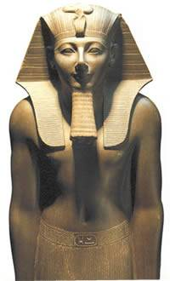
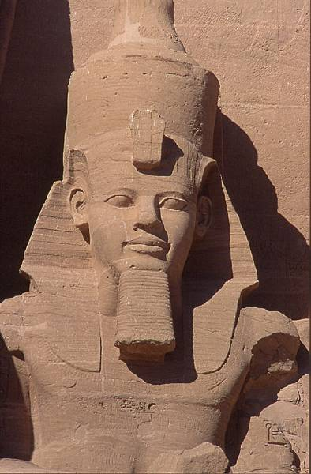
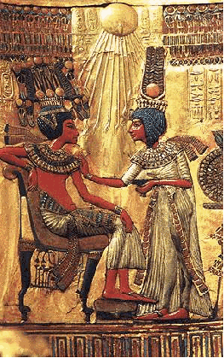
Some Famous Egyptian Pharaohs
Tutankhamon
1336-1327 B. C. E.
Thutmose III
1504-1450 B. C. E.
Ramses II
1279-1212 B. C. E.

Slide 29
Famous Egyptian Pharaohs
Take the next 5 minutes to research your assigned pharaoh using classroom materials and digital resources.
Identify each of the following:
Dates of reign as pharaoh
Accomplishments or achievements
Working with your classmates, fill out your pharaoh chart completely.

Slide 30
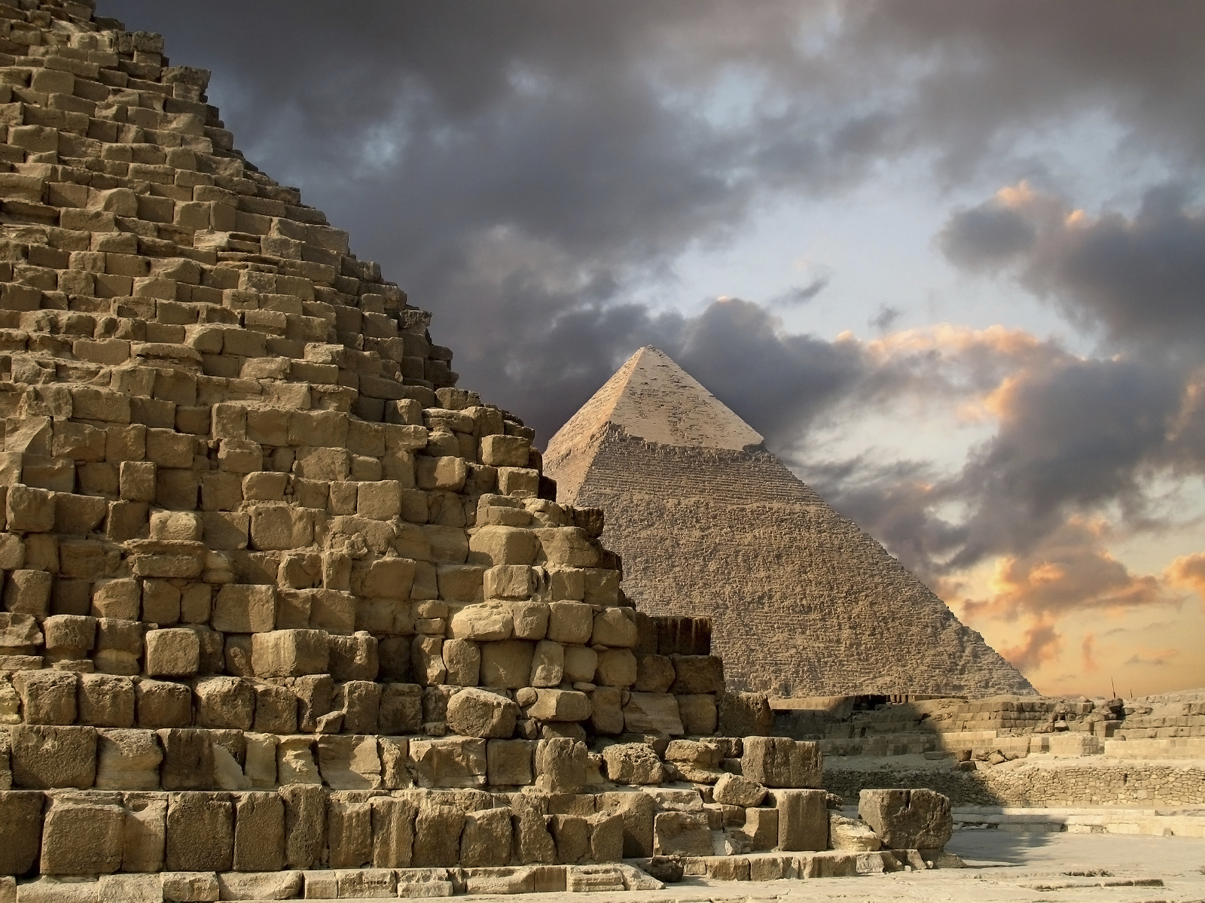
Architecture
  Most recognized aspect of Ancient Egypt
  “Bigger was better!” – reflected the importance of their religion
  Pyramids, Sphinx, Abu Simbel

Slide 31
Pyramids

Slide 32
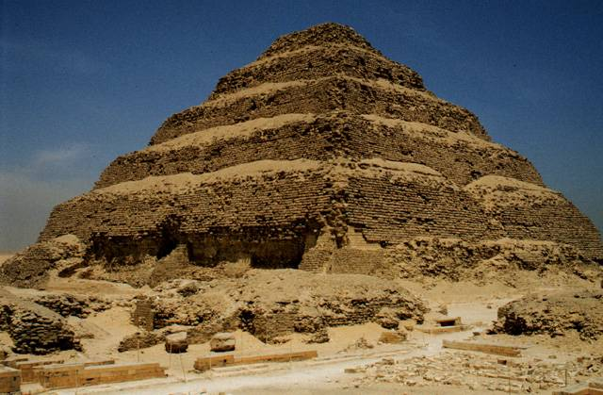
Stepped Pyramid at Saqqara

Slide 33

“Bent” Pyramid of King Sneferu

Slide 34


Giza Pyramid Complex

Slide 35
Most famous- Three pyramids at Giza
Built for Khufu, Chephren, and Mycerinus around 2500 BC
Largest is the Great Pyramid
  756 feet on each side
  450 feet high (45 stories)
  2 million stones
  13 acres (8 football fields)
Entrance is oriented toward the east (why?)
Built during the annual flood when no other work was possible
They have survived because their shape is resistant to wind erosion

Slide 36

Plan of the Great Pyramid
of Khufu

Slide 37

The Valley of the Kings

Slide 38

Archaeologist, Howard Carter (1922)

Slide 39

Entrance to King “Tut’s” Tomb

Slide 40

King Tutankhamon’s Death Mask
1336-1327 B. C. E.

Slide 41




King Tutankhamon

Slide 42

King Tutankhamun’s Tomb

Slide 43




Treasures From Tut’s Tomb

Slide 44




Shabtis: The Pharaoh’s Servants
in the Afterlife

Slide 45


The Sphinx

Slide 46


  Located at Giza
  240 feet long; 66 feet high
  Body of a lion and a head of a man (thought to be Chephren)
  Theories on damage to the nose:
        Napoleon
        Show it was not sacred
        Erosion

Slide 47


Abu Simbel:
Monument to Ramses II
1279-1213 B. C. E.

Slide 48

Who Are These Strange People?

Slide 49


Obelisks
  Towering structures that reach towards the sun (ex. Washington Monument)
  Made out of a single limestone block and decorated with hieroglyphics
  Many are no longer on Egyptian soil (Paris, NYC, London)

Slide 50
Egyptian architecture is in danger of disappearing forever. Why?
Aswan High Dam- increased rainfall and increased humidity
  Water is a great enemy of stone
Population growth- in 10 years Cairo’s population has doubled
  Monuments are no longer isolated
Failed restoration attempts- adding chemicals that are actually speeding up destruction

Slide 51
Mummification

Slide 52


Preparations for the Underworld
ANUBIS weighs the dead person’s heart against a feather.
Priests protected your KA, or soul-spirit

Slide 53

Materials Used in Mummification
1. Linen 6. Natron
2. Sawdust 7. Onion
3. Lichen 8. Nile Mud
4. Beeswax 9. Linen Pads
5. Resin 10. Frankinsense

Slide 54



Preparation for
the Afterlife

Slide 55




Egyptian Mummies
Seti I
1291-1278 B. C. E.
Ramses II
1279-1212 B. C. E.
Queen Tiye, wife of Amenhotep II
1210-1200 B. C. E.

Slide 56


Journey to the Underworld
The dead travel on the “Solar Bark.”
A boat for the journey is provided for a dead pharaoh in his tomb.

Slide 57

Egyptian Book of the Dead

Slide 58

The Final Judgement
Anubis Horus Osiris

