Slide 1
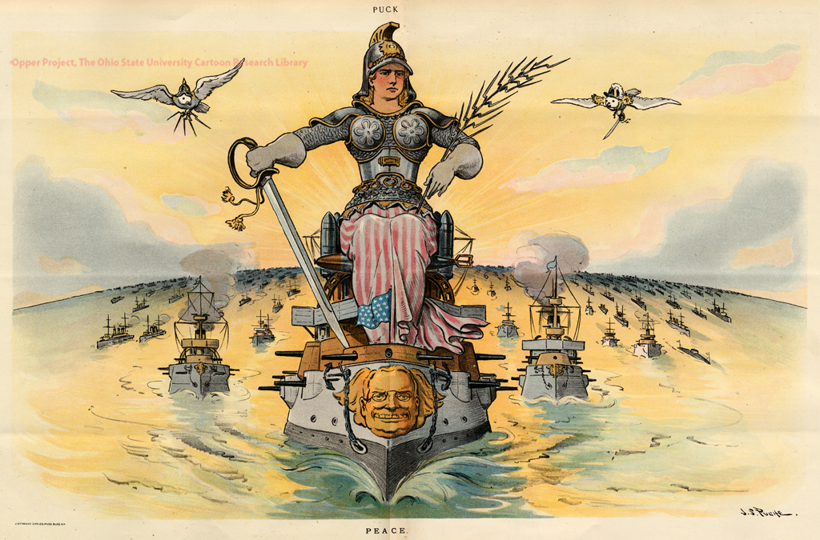
America’s Global Reach
American Imperialism & World War I

Slide 2
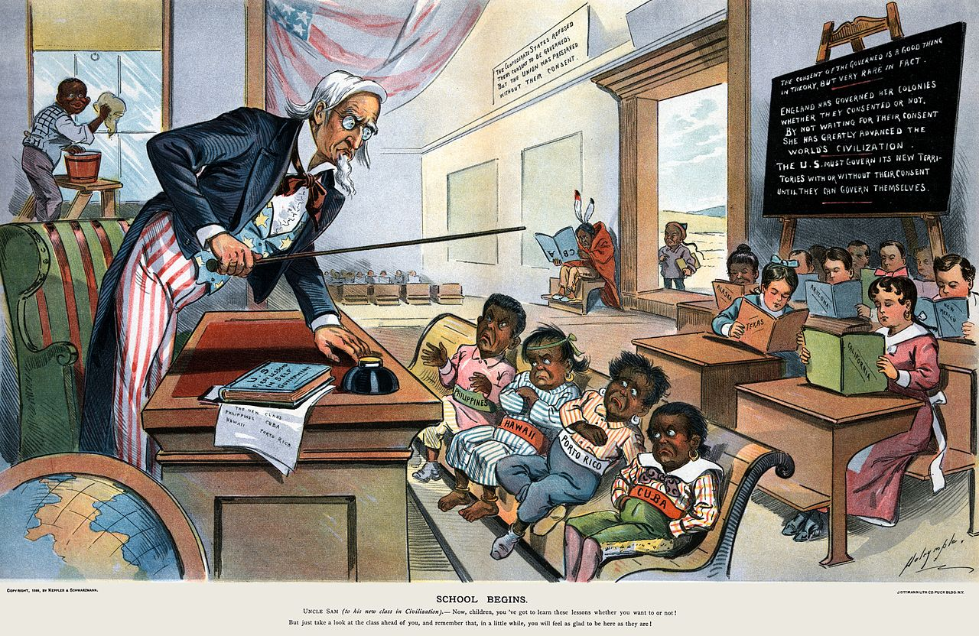
September 12 Warm-Up
List three observations about this picture.

Slide 3
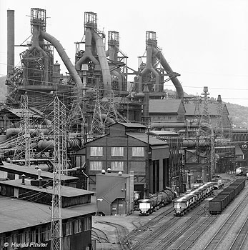
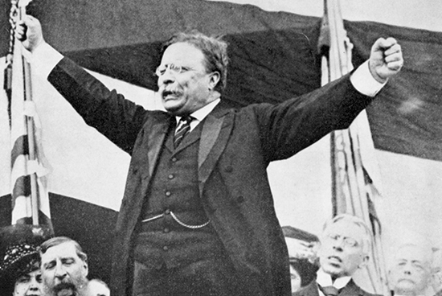
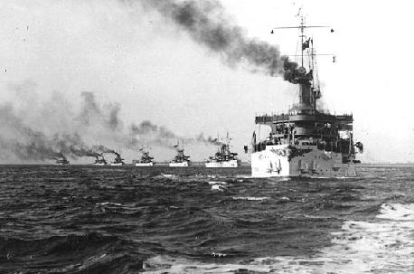
The “Civilized”
Industrialized/Strong Economy
Strong Leader/Government
Powerful Military

Slide 4
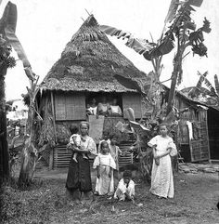
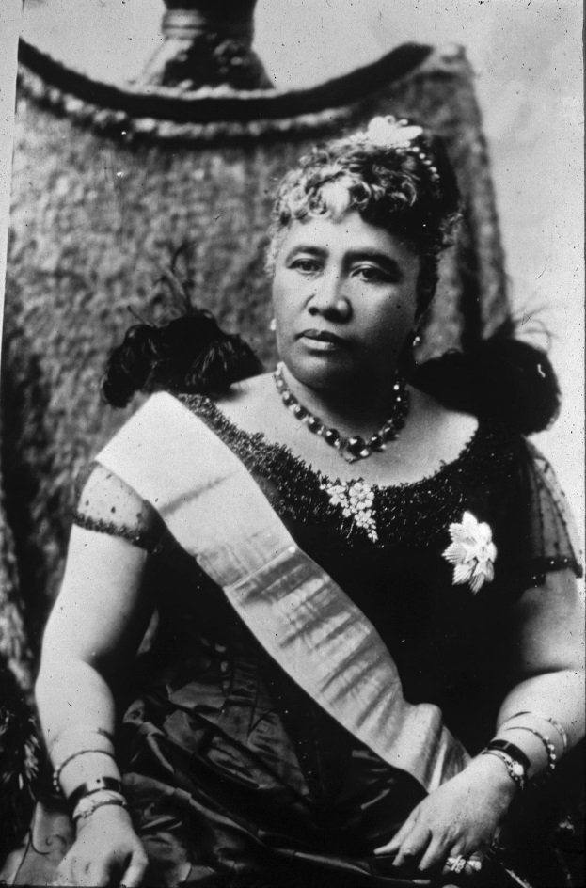
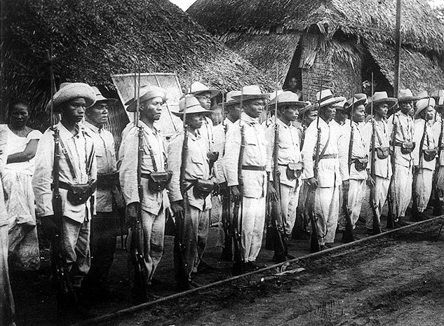
The “Uncivilized”
Little industry/Agricultural
Weak Government/Leader
Limited Military Power

Slide 5

Why did America
join the Imperialist
club at the end
of the 1800s?

Slide 6
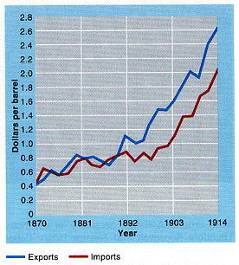
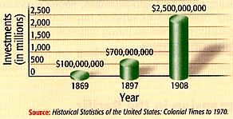

Economic Interests
U.S Foreign Investments: 1869-1908
U.S. Imports & Exports: 1870-1914

Slide 7
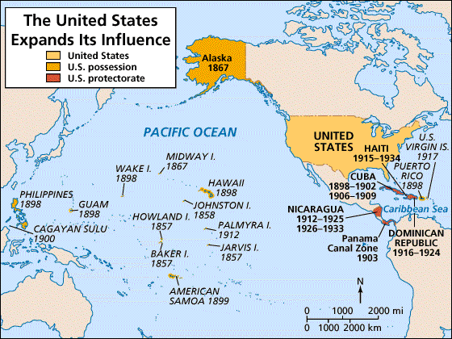
Military/Strategic Interests
Alfred T. Mahan → The Influence of Sea Power on History: 1660-1783

Slide 8
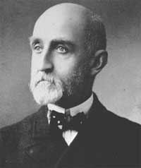
Military/Strategic Interests
Admiral Alfred T. Mahan
    “The Influence of Sea Power on the World”
    Argued that control of the sea was key to world dominance
    Large Navy = $ and Power
US builds 5th largest navy by 1898
3rd largest by 1900
Notes:
Other nations were increasing their global military strength and the U.S. needed to catch up
Read by the major world powers and helped stimulate the naval race
US built 9 steel-hulled cruisers between 1883-1890

Slide 9
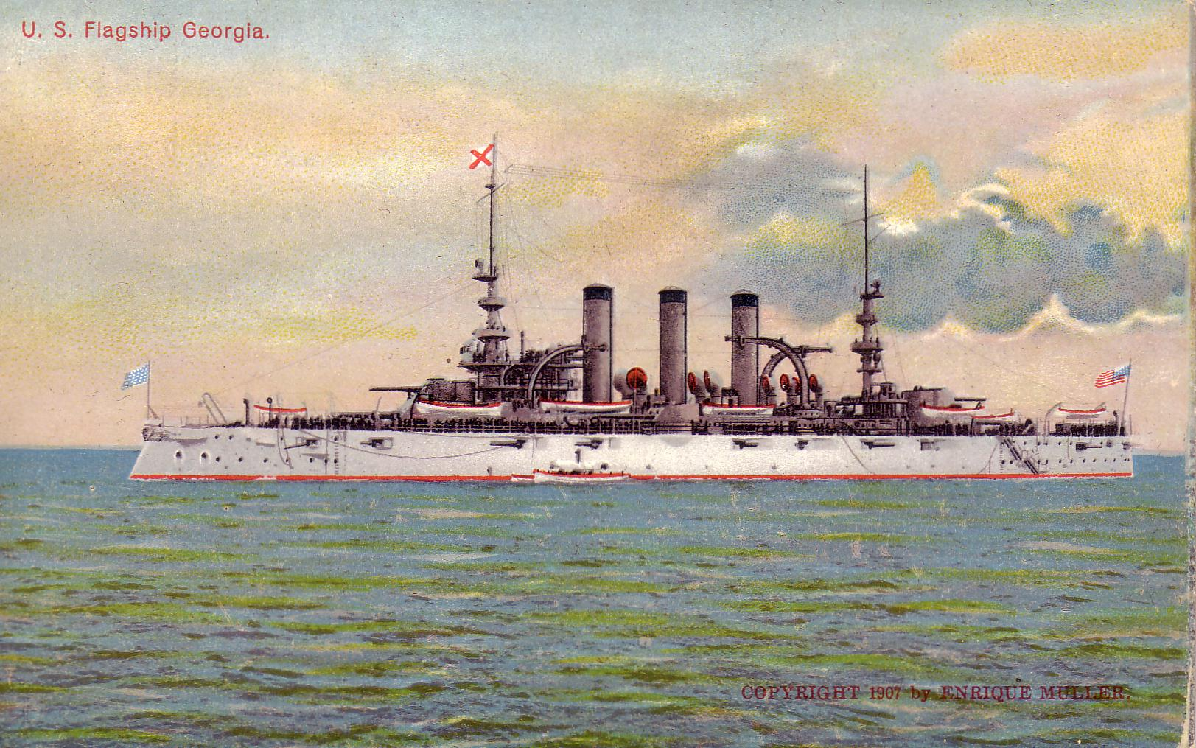
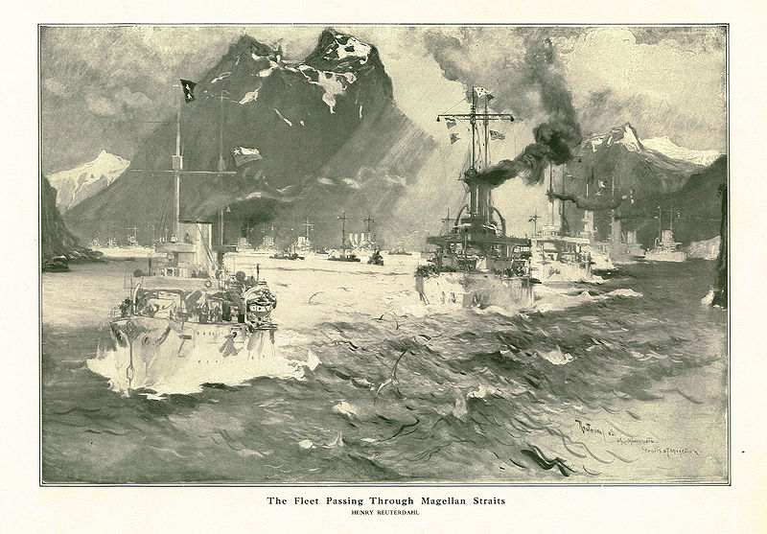
The Great White Fleet
US fleet (16 ships) sent out to show the US naval strength around the world (T.R.)
  Circumnavigated the world
  Enforced treaties & protected overseas holdings
America became the 3rd largest navy by 1900
    1. Britain
    2. Germany
    3. U.S.
    4. Japan

Slide 10
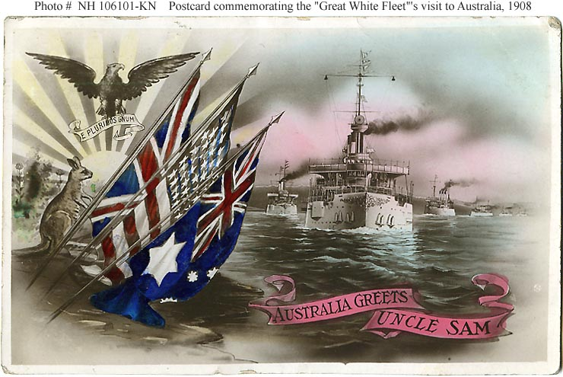
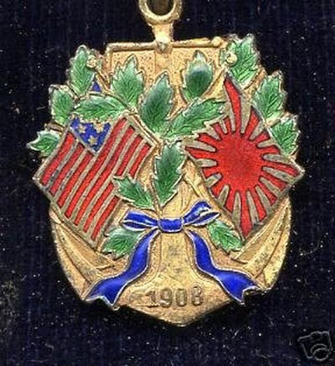
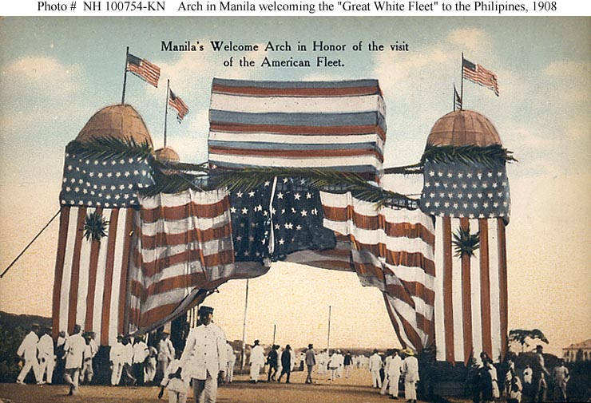
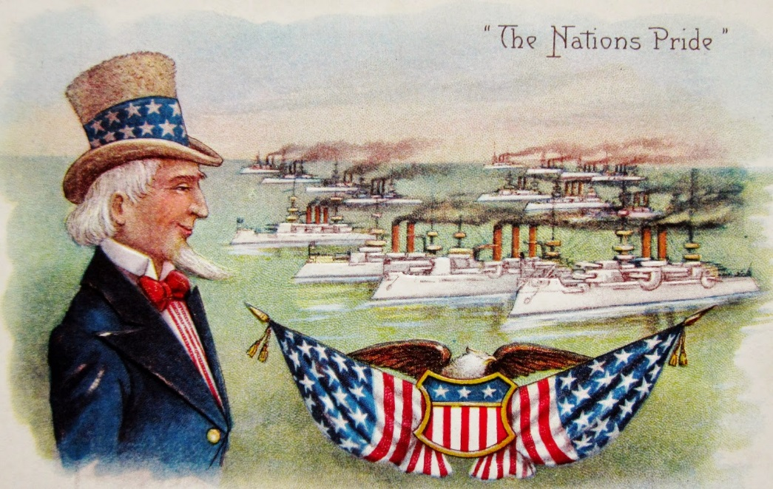
The great white fleet: 1907

Slide 11
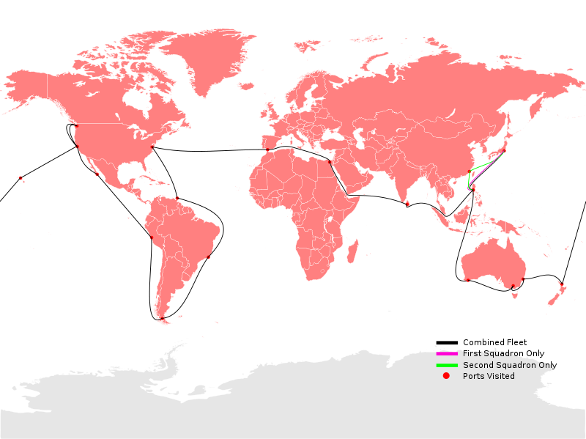

Slide 12

Religious Interests

Slide 13

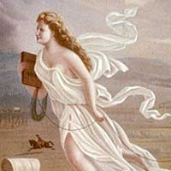
The Frontier Thesis

Slide 14
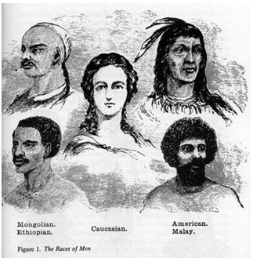
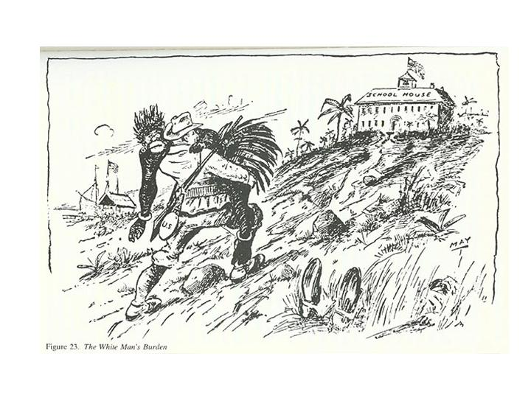
Social Darwinism
The Hierarchy
of Race
What does Cultural Superiority mean?

Slide 15
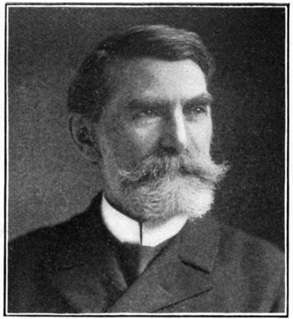
Social Darwinism
Josiah Strong
  Our Country: Its Possible Future and It’s Present Crisis
  Belief that “Anglo Saxons” should spread Christianity to “savage” groups around the world.
  Suggested that there was a “competition” amongst the races.

Slide 16
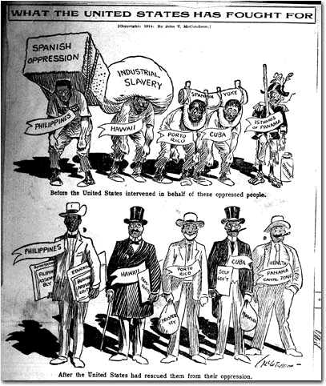
Take up the White Man’s burden—
Send forth the best ye breed—
Go send your sons to exile
To serve your captives' need
To wait in heavy harness
On fluttered folk and wild—
Your new-caught, sullen peoples,
Half devil and half child

Slide 17
Japan

Slide 18
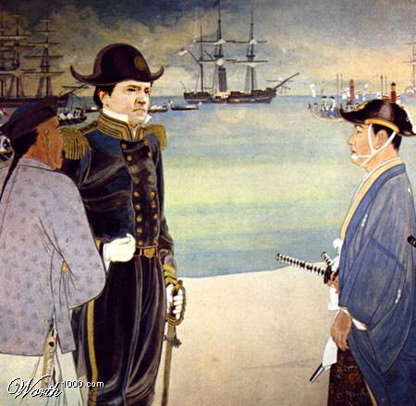
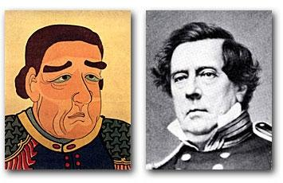
Commodore Matthew Perry “Opens Up” Japan: 1853
The Japanese View of Commodore Perry

Slide 19
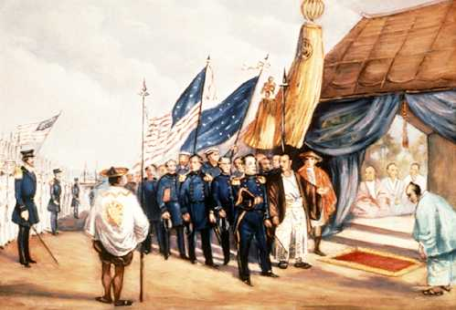
Treaty of Kanagawa: 1854

Slide 20
Alaska

Slide 21
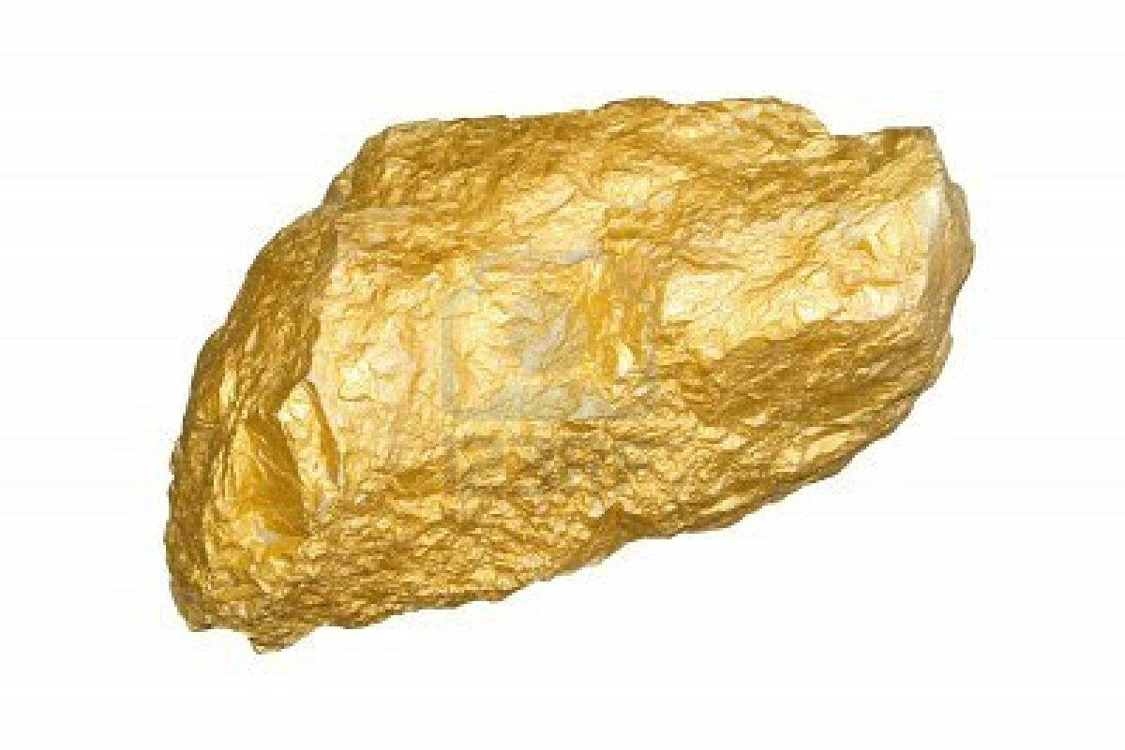
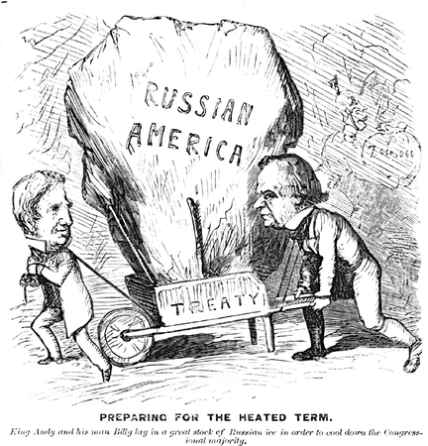
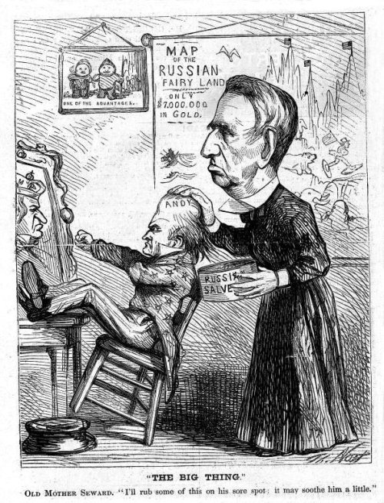
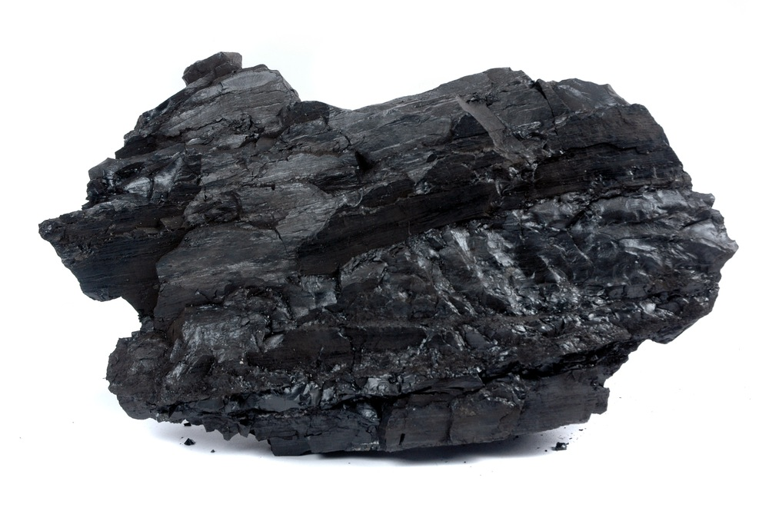


“Seward’s Icebox:” 1867
The U.S. bought Alaska for $7.2 million from Russia

Slide 22
Hawaii:
"Crossroads
of the
Pacific"

Slide 23
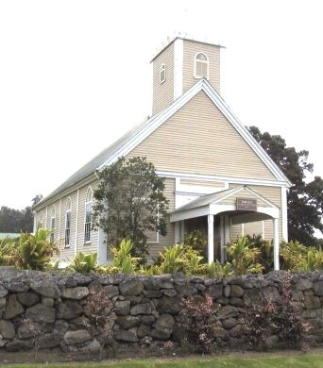
U.S. Missionaries in Hawaii
Imiola Church – first built in the late 1820s

Slide 24
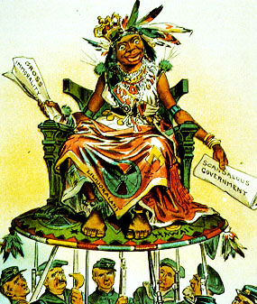

U.S. View of Hawaiians
Hawaii became a U.S. Protectorate in 1849 by virtue of economic treaties.

Slide 25
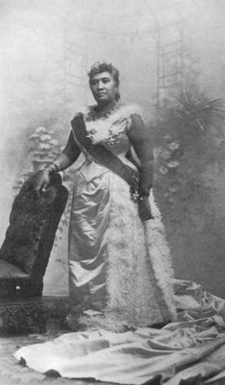
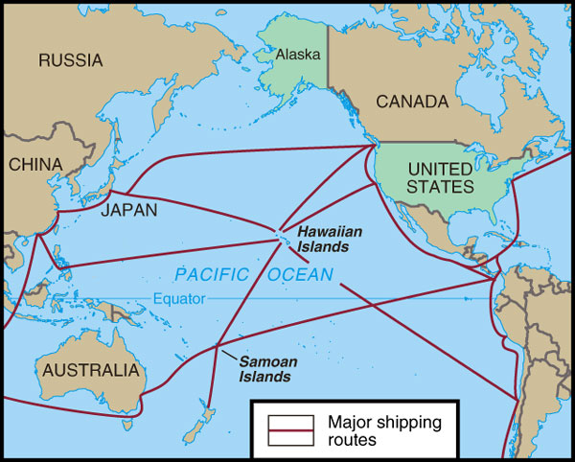
Hawaiian Queen Liliuokalani
Hawaii for the Hawaiians!

Slide 26
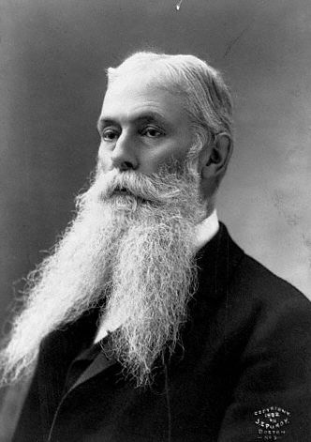
US Business Interests In Hawaii
1887- Hawaiians forced to sign a constitution which gave whites most of the power
1893 – American
businessmen backed an
uprising against Queen
Liliuokalani.
Sanford Ballard Dole
proclaims the Republic
of Hawaii in 1894, against the orders of Grover Cleveland

Slide 27
Cuba

Slide 28
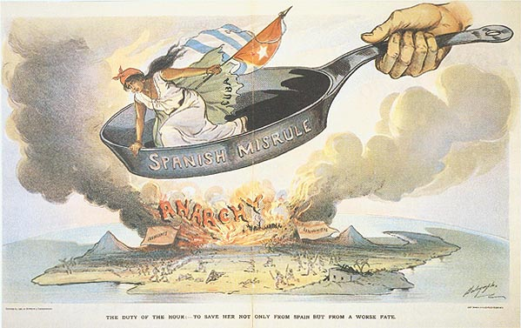
Spanish Misrule in Cuba

Slide 29
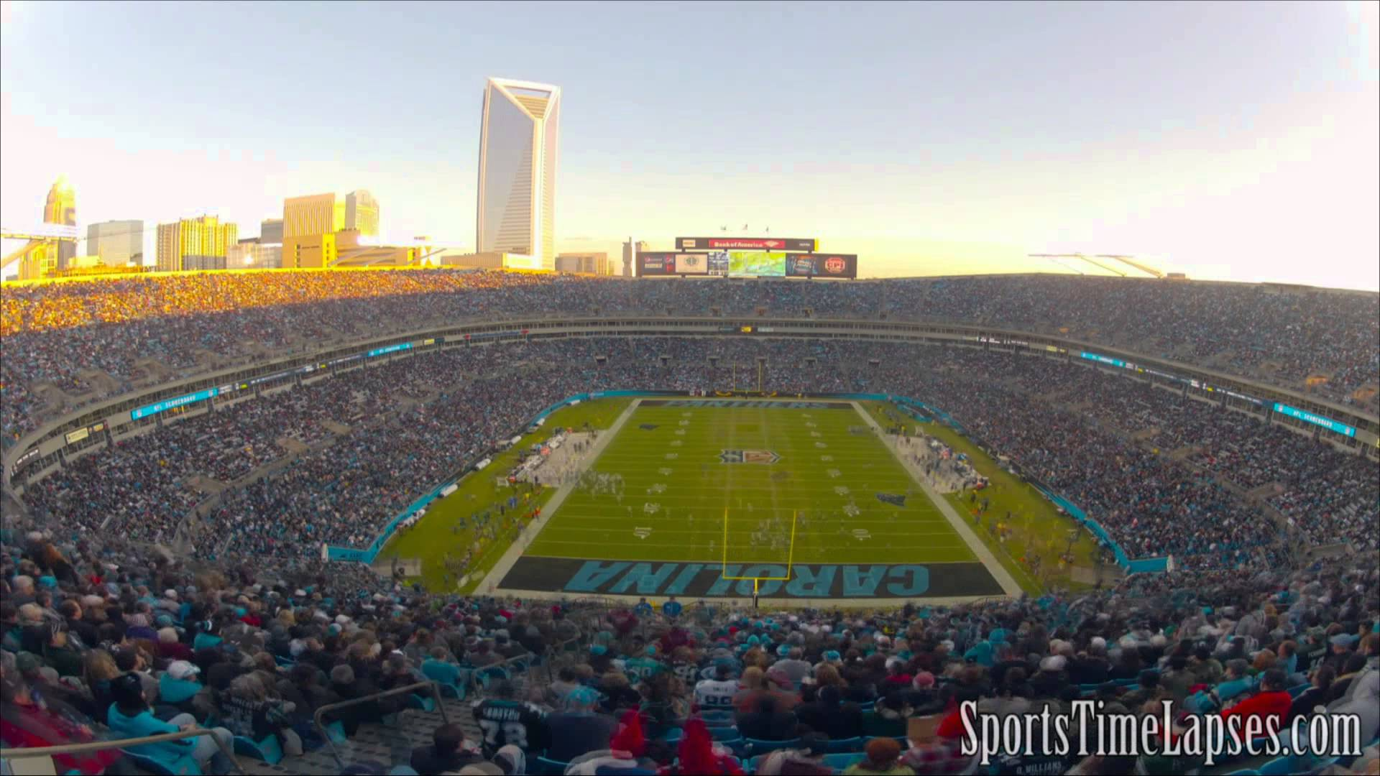
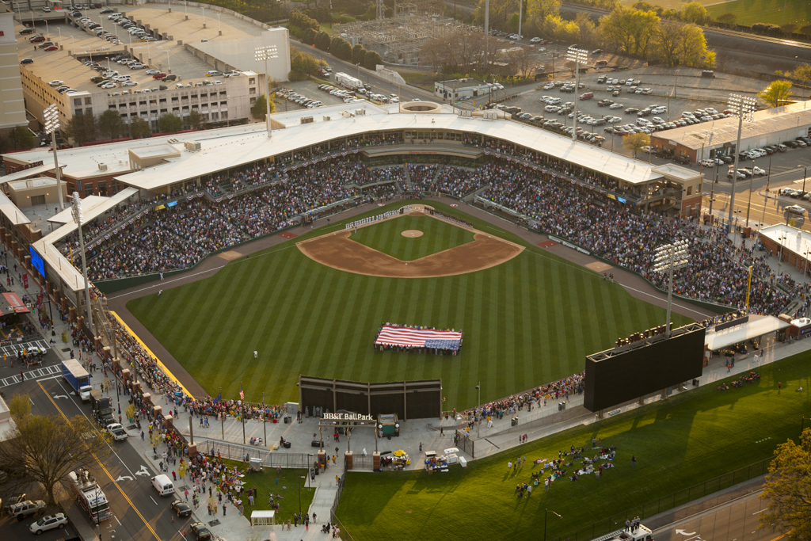
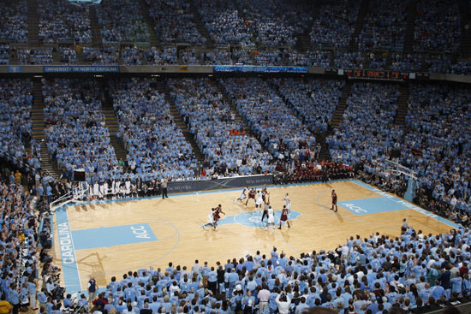
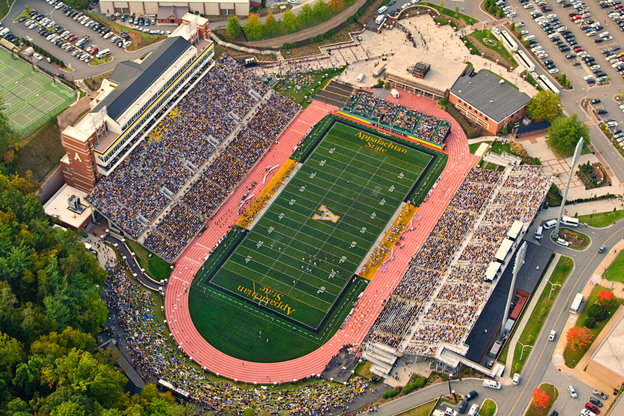
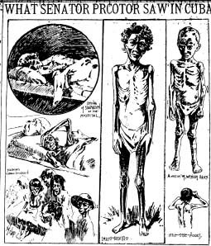
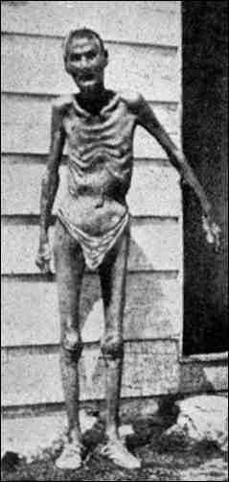
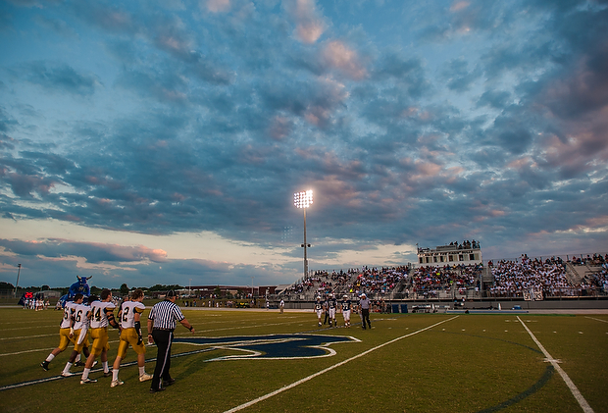
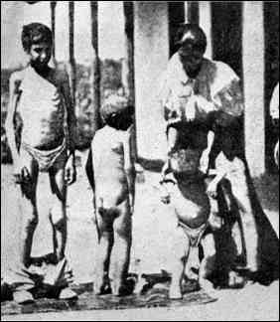
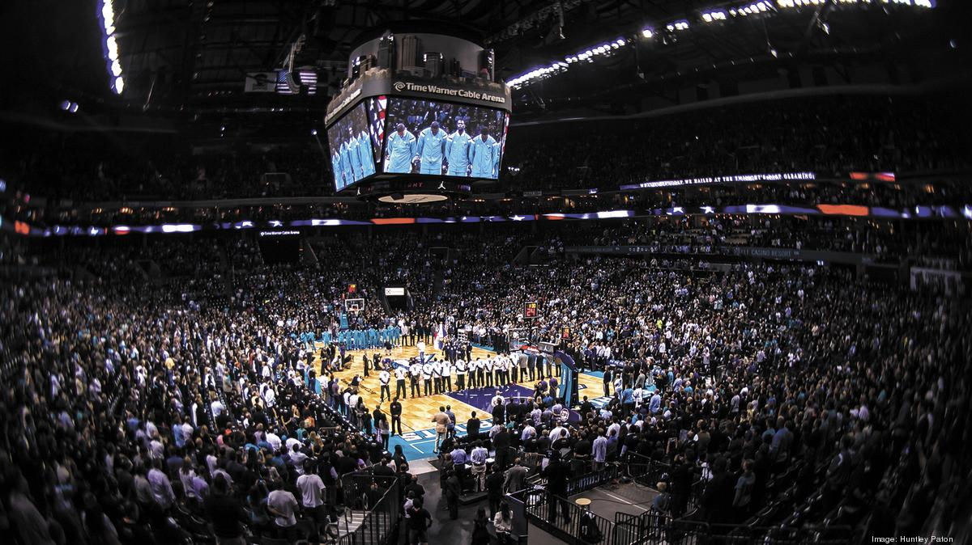
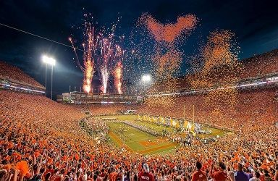
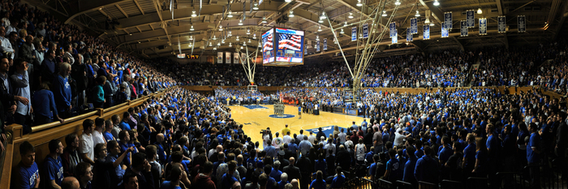
Valeriano Weyler’s “Reconcentration” Policy
170,000

Slide 30
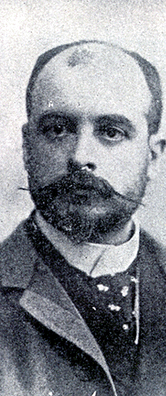
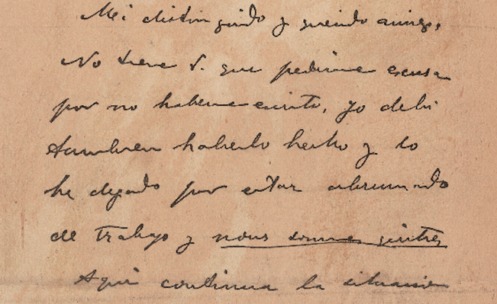
The De Lome Letter

Slide 31




Yellow journalism
“You furnish the pictures, and I’ll furnish the war!”

Slide 32



Remember the Maine!

Slide 33

U.S.S. Maine Mast Memorial – Arlington Cemetery

Slide 34

Yellow journalism

Slide 35

Yellow journalism

Slide 36


Slide 37

The Spanish-American war (1898): “that splendid little war”
How prepared was the US for war?

Slide 38

Theodore Roosevelt
Assistant Secretary of the Navy
Imperialist and Nationalist.
Criticized President
McKinley as having the backbone of a chocolate éclair!
Resigns his position to fight in Cuba.

Slide 39




The “rough riders”

Slide 40

Cuban independence?
Teller Amendment (1898)
Platt Amendment (1903)
  Cuba was not to enter into any agreements with foreign powers that would endanger its independence.
  The U.S. could intervene in Cuban affairs if necessary to maintain an efficient, independent gov’t.
  Cuba must lease Guantanamo Bay to the U.S. for naval and coaling station.

Slide 41

The Spanish-American war (1898): “that splendid little war”

Slide 42


Slide 43


Dewey captures manila

Slide 44

treaty of Paris - 1898
Cuba was freed from Spanish rule.
Spain gave up Puerto Rico and the island of
Guam.
The U.S. paid Spain
$20 mil. for the
Philippines.
The U.S. became
an imperial power!

Slide 45

Is He To Be a Despot?

Slide 46

Puerto rico
1900 - Foraker Act
US establishes official Colonial Government
  All federal laws were in effect.
  American government appoints governor and key legislators.
  Puerto Ricans were NOT American citizens

Slide 47

Puerto rico
1917 – Jones Act.
Puerto Rican’s ARE now citizens
Established Bill of Rights
PRs elected their own local legislators
President still appoints governor
PRs could NOT vote in US presidential elections.
A nonvoting commissioner is sent to represent PR in House of Reps
Puerto Ricans were drafted soon after the Jones Act was passed

Slide 48
America's
New
Role

Slide 49

America in the pacific

Slide 50

Big stick diplomacy
“Speak softly, and carry a big stick.”
-President Theodore Roosevelt

Slide 51
China

Slide 52


The open door policy
Gave ALL countries equal
access to trade in China.
Guaranteed that China would NOT be taken
over by any one European power.

Slide 53


The open door policy

Slide 54




The boxer rebellion - 1900

Slide 55

“Kill Foreign Devils”- The Boxer Rebellion
The Boxers
    A secret society determined to rid China of foreigners
Boxers killed hundreds of foreigners and Chinese Christians
Aug. 1900: Multinational force put down rebellion in two months
Notes:
Secret societies formed pledging to get rid of foreigners
Boxers most famous (practiced martial arts)
Killed missionaries
France, Britain, Germany, Japan and U.S. put down rebellion where thousands died

Slide 56

Constable of the World

Slide 57

Our “Sphere of Influence”

Slide 58

The Monroe doctrine
The US will use their military to enforce their right to “police” the Western Hemisphere

Slide 59
Panama

Slide 60

Originally French Idea
French abandon construction due to hazard conditions (40% complete)
Panama owned by Colombia
Roosevelt promises military support toward Panamanian Revolution in which they gained independence
Panama Canal

Slide 61


Slide 62

Taft’s Dollar diplomacy
“Dollar Diplomacy”
    Taft’s foreign policy
    Send money not Troops
Goal:
  Encourage American Businessmen to loan $ to Latin America
  The US could then use military force if debts were not paid (even to privately owned companies)

Slide 63

Dollar diplomacy
Improve financial
opportunities for American businesses.
Use private money to
further U.S. interests
overseas.
Therefore, the U.S.
should create stability and order abroad that would best promote America’s commercial interests.

Slide 64

us investments in Latin America, 1914

Slide 65

Nicaragua 1919-1919
Given US money to help fund banks and railroads
US ended up owning banks and railroads
This angered Nicaraguans
US sends in troops to prevent rebellion
Remained for 10 years

Slide 66
Wilson’s moral diplomacy
Dominican Republic (1916 – 1924)
  Installs Military government
Haiti (1915-1934)
  Military Occupation
  Creates new Haitian Constitution
Virgin Islands (1918)
  Purchased from Netherlands to prevent Germany from doing so first

Slide 67
Mexico

Slide 68

Mexican rebellion
Mexican Revolution
  Mexican government is very unstable
  Leader is assassinated
  Woodrow Wilson refuses to recognize “Government of Butchers”
American Involvement
  Wilson sends troops to intervene
    126 Mexicans Killed
  Wilson initially backs Pancho Villa to take over leadership but quickly changes his opinion
  Recognized Villa’s rival instead
Pancho Villa Raids
  Kills 16 Americans in Northern Mexico
  Kills 14 Americans in New Mexico
Francisco “Pancho” Villa

Slide 69

The chase for pancho
Wilson sent 15,000 under Gen. John Pershing to capture or kill Pancho Villa
Mexicans upset at US invasion
June 1916: Mexican army and US troops fought with deaths on both sides
1917: US ordered troops home due to World War I
  Never caught Pancho Villa
Gen. John Pershing

Slide 70

us interventions in Latin America: 1898-1920

Slide 71
The
Philippines

Slide 72

The anti-imperialist league
Founded in 1899.
Mark Twain, Andrew
Carnegie, William
James, and William
Jennings Bryan among
the leaders.
Campaigned against the annexation of the
Philippines and other
acts of imperialism.

Slide 73
Annexation debate – the Philippines
Pro-Annexation:
Educate
 Industrialize
 Civilize
 Close to China***
ANTI-Annexation:
Hypocritical – Violated the Declaration of Ind.
Denied Philippines right to self-government
Created racial problems

Slide 74


Emilio Aguinaldo
Leader of the Filipino
uprising
200,000+ dead
July 4, 1946:
Philippine independence

Slide 75

Philippine-American war
1899-1902: Filipinos rebel
Led by Emilio Aguinaldo
U.S put Filipinos in concentration camps
  Poor sanitation, starvation, mistreated and abused, and disease killed thousands
Took 3 years to end the revolt
  70,000 American troops - 4,000 KIA
  20,000 Filipino Soldiers KIA,
  30,000+ Civilians Killed (200k more Cholera)
  Cost US $400,000,000
Emilio Aguinaldo
Notes:
Led by Emilio Aguinaldo rose up against the U.S.
When Aguinaldo turned to guerrilla tactics, US forced Filipinos to live in designated zones, where poor sanitation, starvations and disease killed thousands
Many of 70K troops sent were African Americans. Af-Am newspapers asked them why were they spreading racial injustice.
Some joined other side because could not stand this.
20K rebels died and 4K Americans; costing $400 million 20x what the US paid to purchase the islands

Slide 76


Slide 77


Slide 78

“kill everyone over ten”
Notes:
General Jacob H. Smith's infamous order, “Kill everyone over ten,” was the caption in the New York Journal cartoon on May 5, 1902. The Old Glory draped an American shield on which a vulture replaced the bald eagle. Caption is: “Criminals because they were born ten years before we took the Philippines.”

Slide 79

Uncle Sam: One of the “Boys?”

Slide 80


