Slide 1
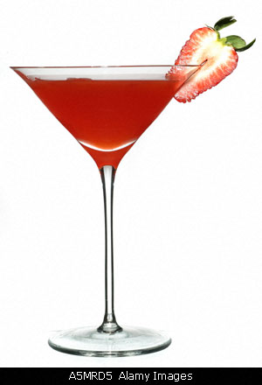
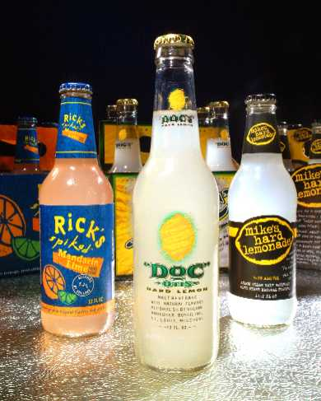
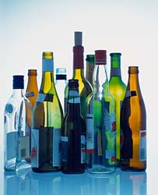
ALCOHOL
ALCOPOPS

Slide 2
75% of High School Students report having tried alcohol at least once.
28% reported having an alcoholic beverage in the last month
Male students more likely than female students to report episodic heavy drinking

Slide 3

What is Alcohol?
Depressant
Contains intoxicating substance called ethyl alcohol or ethanol
Slows down the functions of the brain and other parts of the nervous system

Slide 4
What is Alcohol?
Produced by a fermentation process
Proof is the amount of alcohol in the substance (ex. 100 proof bottle of vodka is 50% alcohol)
12 oz. Beer = 4 oz. Wine = 1 oz. liquor

Slide 5
Effects of Alcohol
Heart/Blood Vessels
  Short term
    Perspiration increases and skin becomes flushed
  Long Term
    High blood pressure and damage to the heart muscle; blood vessels harden and become less flexible

Slide 6

More Effects
Brain/Nervous System
  Short Term
    Speech is slurred and difficulty walking
  Long Term
    Brain cells are destroyed and unable to be replaced; damage to nerves in body resulting in numbness in hands and feet

Slide 7
…The Rest of Alcohol Effects
Liver
  Short Term
    Liver changes alcohol into water and carbon dioxide
  Long Term
    Liver is damaged possibly resulting in cirrhosis (scarring and destruction of the liver)

Slide 8
Liver
Can only oxidize about 1 serving of alcohol an hour
NO WAY to speed up this process
Until liver has had time to oxidize all of the alcohol ingested, it keeps circulating through the bloodstream

Slide 9
Liver Damage
FATTY LIVER
  alcohol interferes with body’s ability to break down fats.
    Excess fat blocks flow in liver resulting in reduced oxygen and cell death
    can be REVERSED when drinking stops

Slide 10
Liver Damage
CIRRHOSIS
  scarring of the liver
  no blood flow in scarred area
  liver cannot function
  symptoms: high blood pressure, abdominal swelling, jaundice
  IRREVERSIBLE

Slide 11
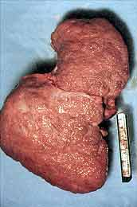
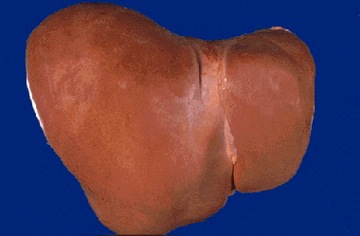
Healthy Liver
Alcoholic Liver

Slide 12
…The Rest of Alcohol Effects
Stomach/Pancreas
  Short Term
    Stomach acids increase, which often results in nausea and vomiting
  Long Term
    Irritation occurs in the stomach lining, causing open sores called ulcers; pancreas becomes inflamed

Slide 13
Binge Drinking
5 or more drinks in a sitting for men
4 or more drinks in a sitting for women
May lead to Alcohol Poisoning
May lead to unplanned unprotected sex
May lead to drug use
Many high school/college students die from alcohol poisoning from binge drinking on the weekends.

Slide 14
Dangers of Binge Drinking
Unintentional injuries (e.g. car crash, falls, burns, drowning).
Intentional injuries (e.g. firearm injuries, sexual assault, domestic violence).
Alcohol poisoning.
STD’s and/or Unintended pregnancy.
High blood pressure, stroke, and other cardiovascular diseases.
Liver Disease

Slide 15
Factors affecting the amount of alcohol in a person’s blood
Gender
Metabolism
Amount of Alcohol (not # of drinks)
How much they weigh
How much time elapses after or between drinks

Slide 16
Drinking and Driving
Drinking alcohol impairs vision, reaction time, and coordination.
DWI and DUI –leading cause of death among teens
Signs of intoxication can begin to appear as low as 0.02
There is no acceptable BAC level for anyone under 21

Slide 17
SAFEST AMOUNT OF DRINKS = 0!!!
This is at any age!!!!

Slide 18
Consequences of teen DUI
Harm to the driver and others
Severely restricted driving privileges
Alcohol related injuries, property damage, and death
Living with remorse

Slide 19
Blood Alcohol Concentration
Amount of alcohol in a person’s bloodstream
legal limit for IL is .08% for people 21 years old and older
legal limit for IL is zero for people under 21

Slide 20
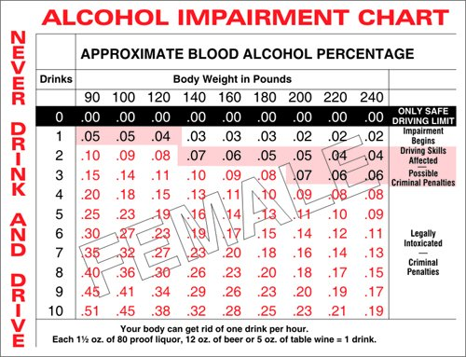

Slide 21
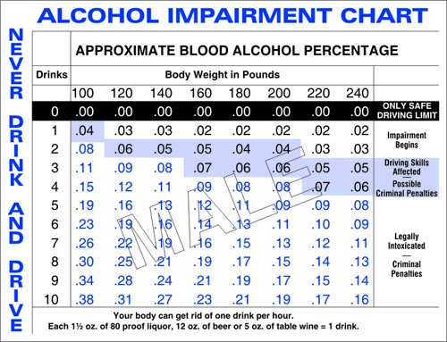

Slide 22
Alcohol Poisoning
Dangerous to just “sleep it off”
Signs
  Mental confusion, stupor, coma, inability to be excited, vomiting, and seizures
  Slow Respiration *Hypothermia *Dehydration *Irregular heartbeat
  CALL 911 immediately if suspicious of poisoning

Slide 23
What are some things that people do to ‘sober up’?

Slide 24
WHAT SOBERS A PERSON UP THE FASTEST????
TIME!!!

Slide 25
Alcoholism
A disease in which a person has a physical or psychological dependence on drinks that contain alcohol.
Characterized as an impaired ability to study, work, or socialize normally.

Slide 26
The 3 Stages of Alcoholism
Early Stage (Stage 1)
  to relax, relieve stress
  leads to necessity to manage stress
  begins to become intoxicated regularly
  makes excuses and tries to rationalize drinking behavior

Slide 27
Middle Stage (Stage 2)
  drinker denies or tries to hide problem
  body develops tolerance
  frequently absent from school or work
  drinking is central event in a persons life
  drinks when alone
  drinks first thing in the morning
  drinks daily

Slide 28
Final Stage (Stage 3)
  person becomes aggressive & isolated
  malnutrition occurs because drinker consumes alcohol and does not worry about food
  body is addicted
  try to quit=WITHDRAWAL
  Delirium Tremens-hot/cold flashes, tremors, nightmares, hallucinations, fear of people and animals
*****NO CURE---ONLY RECOVERY*****

Slide 29
Effects on Family and Society
40% of violent crimes annually are alcohol related
½ of all homicide victims have alcohol in their bloodstream

Slide 30
Treatment
Cannot be cured
Can be treated
Counseling
Medication

Slide 31
Where to go for help
Alcoholics Anonymous
National Association for children of alcoholics
National drug and treatment referral routing service.

Slide 32
This powerpoint was kindly donated to www.worldofteaching.com
http://www.worldofteaching.com is home to over a thousand powerpoints submitted by teachers. This is a completely free site and requires no registration. Please visit and I hope it will help in your teaching.

