Slide 1
Quote of the Day
“Educate and inform the whole mass of the people... They are the only sure reliance for the preservation of our liberty.”
-Thomas Jefferson

Slide 2
PRE-TEST
Who discovered America?
Think, Pair and Share. Where did you learn your information?

Slide 3
The Age of Exploration

Slide 4
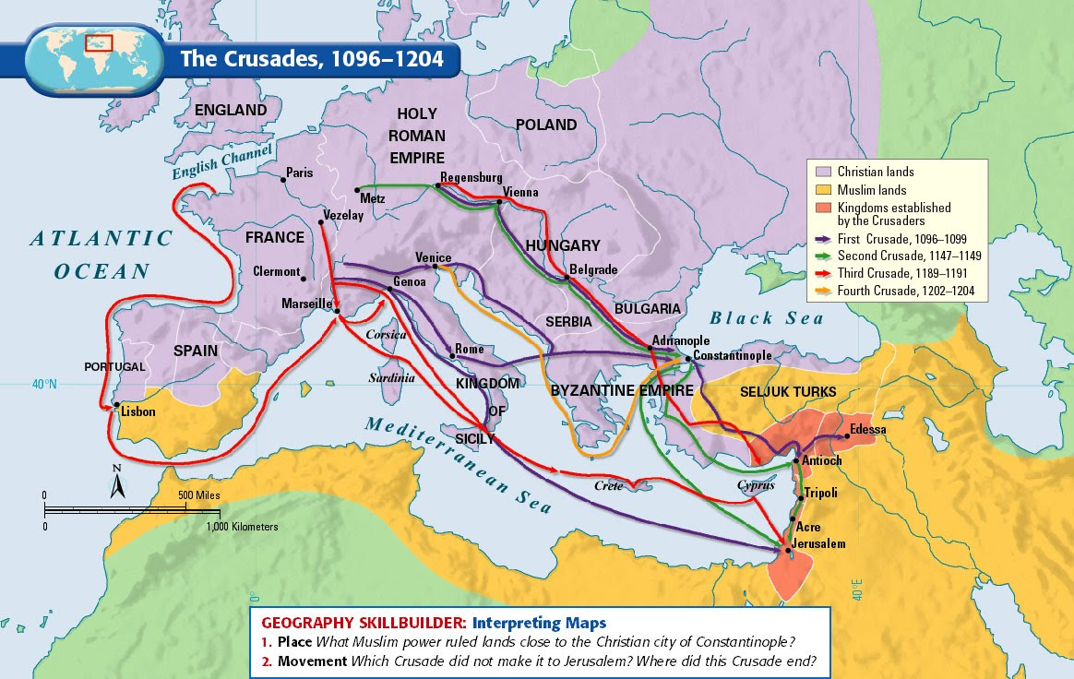

Slide 5
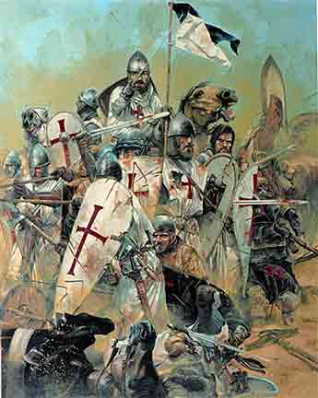
The Crusades & Trade
The Crusades of the 1100s exposed Europeans to an amazing variety of new trade goods, such as spices, tea and silk.
The problem for Europeans was that Muslim traders controlled access to those goods, which kept supplies limited and prices high
Europeans longed for a way to bypass these Muslim merchants and to develop a sea trade with India and China more directly

Slide 6
Why Not Explore Sooner?
The answer is the same as to why we didn’t go to the moon sooner….

Slide 7
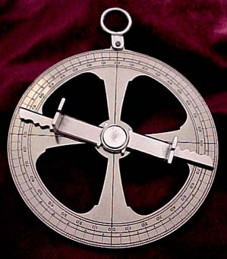
Why Not Explore Sooner?
Sea exploration only became possible in the mid-1400s thanks to new (ironically, mostly Muslim) technologies:
  Improved map-making methods
  The astrolabe, an instrument (invented by a Muslim) for determining latitude
  Better ship designs
  Better weapons for defense (naval cannons)

Slide 8
Which nation will be the first to reach ASIA by sea?
What route did they take?

Slide 9
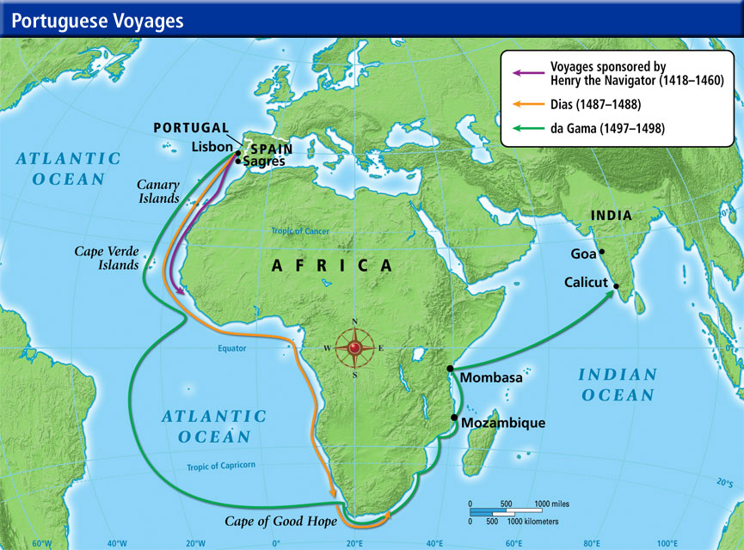

Slide 10
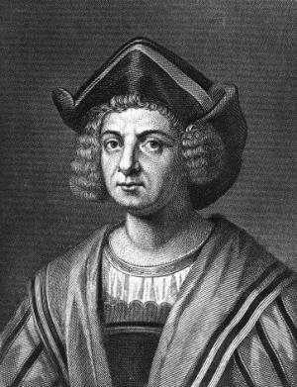

Slide 11
Cristoforo Colombo, Cristobal Colon, Christophorus Columbus

Slide 12
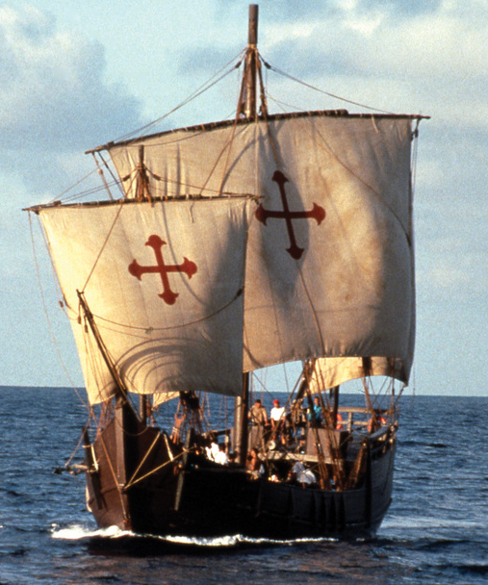
Spanish Exploration
The Portuguese eventually found success by sailing south around Africa and then to the east across the Indian Ocean
In 1492, Genoese explorer Cristoforo Colombo convinced Spain, however, to back his effort to reach Asia by sailing west across the Atlantic – a route he believed would be shorter and quicker
This route led to the discovery of the American continents and established Spain’s claim to a “new world”

Slide 13
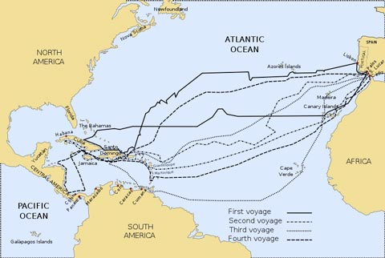

Slide 14
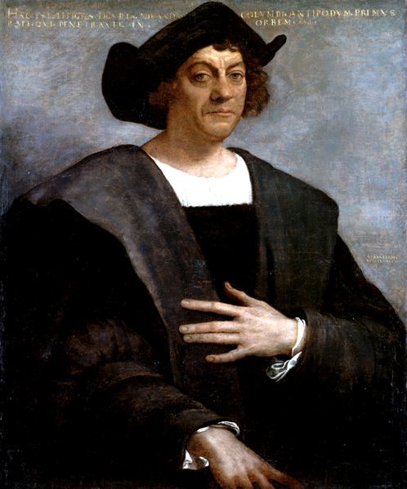
Christopher Columbus
Oct. 1492: Columbus landed in the West Indies
Columbus enslaved and tortured the natives and made them mine for gold
Named governor by the Spanish king, Columbus would later be removed from office due to corruption and abuse of power charges
Within 50 years of his arrival, 90% of the native Carib population had died from exposure to European diseases like smallpox, measles, and influenza

Slide 15
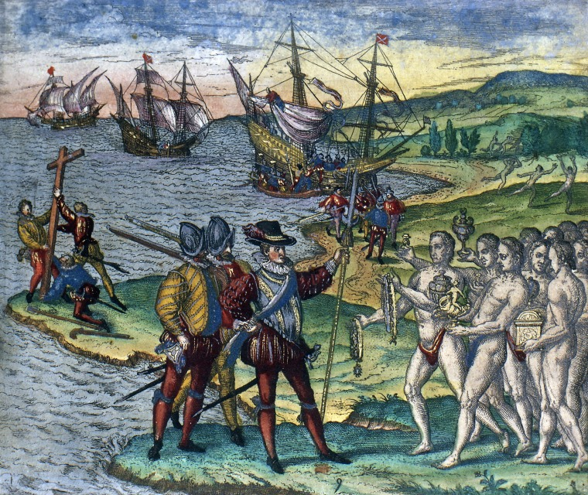

Slide 16
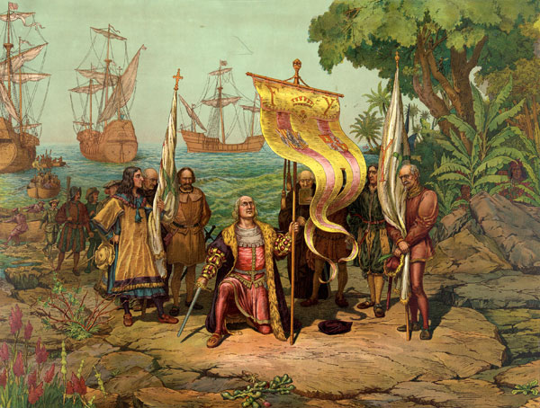

Slide 17
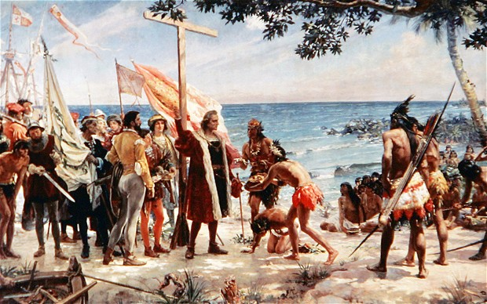

Slide 18
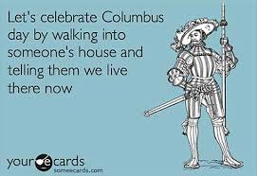

Slide 19
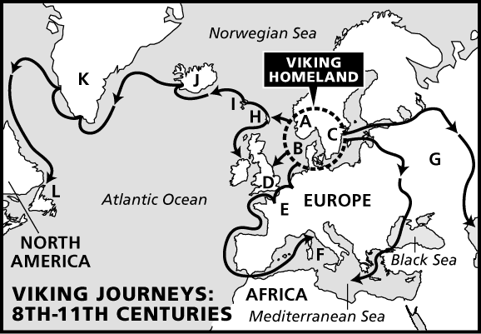
But Was Columbus First?
Asian nomads arrived between 10,000 and 30,000 years ago (the Native Americans)
The Vikings established trading outposts in Newfoundland (Canada) around 1000 AD
Plus, there is some limited evidence to support that the Chinese, Japanese, Africans, and/or Polynesians arrived in the Americas BEFORE Columbus

Slide 20
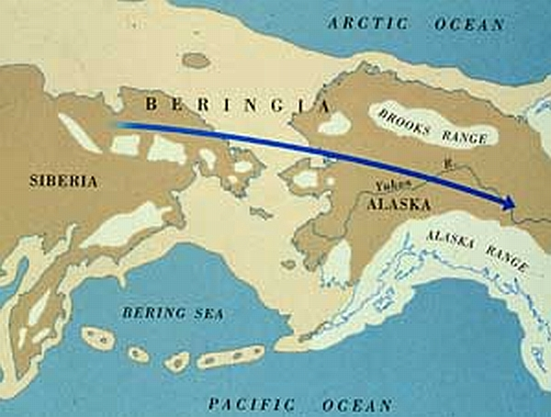

Slide 21
Lets distinguish Fact vs Myth
Native Americans had extremely complex societies

Slide 22
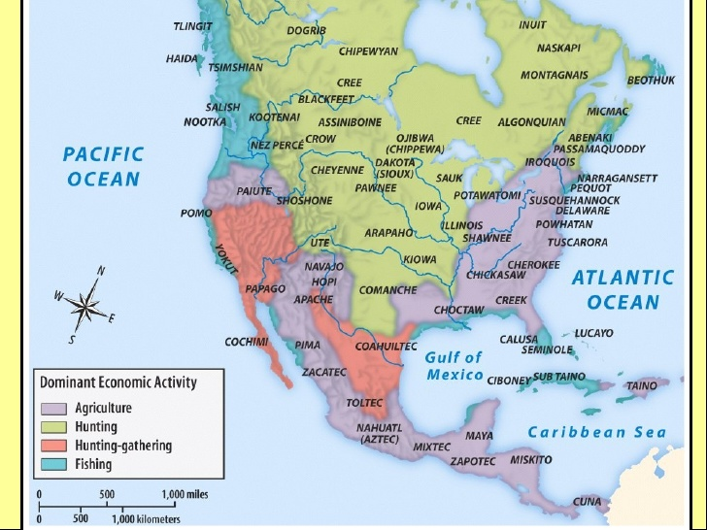

Slide 23
Why is America called America?

Slide 24


Slide 25
Which Nation Dominates the Early Period of Exploration?

Slide 26
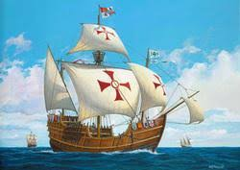
Warm-Up
European explorers during the 15th century could not have made their discoveries without being financed for their voyages. Like Columbus, other explorers had to ask their king and queens for support.
For you: Give an example of something you wanted badly and explain how you convinced, or failed to convince, someone to provide the means for you to get what you wanted? Did you go to multiple people?

Slide 27
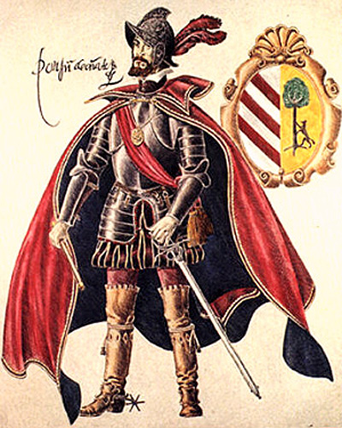
The Spanish Conquistadores
Following Columbus’ establishment of permanent Spanish settlements in the Caribbean, the Spanish sent military expeditions into the continental Americas to explore and conquer
Conquistadores, such as Hernan Cortes and Francisco Pizarro, quickly toppled the large Native empires of the Aztec and Inca peoples and expanded Spanish control of both the people and resources of the Americas

Slide 28
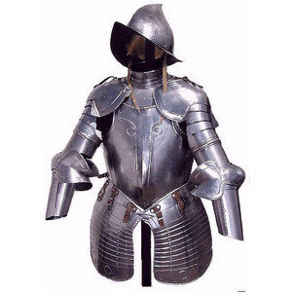
Spanish Advantages Over Natives
So how did a few hundred Spaniards defeat millions of natives?
  superior military technology
    horses
    armor
    Guns & cannons
  rivalries between native groups kept them from cooperating
  disease decimated the native population and destroyed their religious faith systems

Slide 29
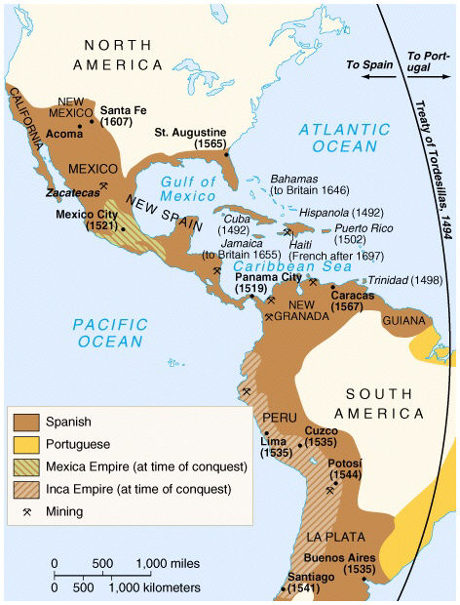
The Spanish Empire
Spain developed an American empire stretching from Northern California to South America
Spain’s rivals (primarily England and France, but also the Dutch Republic, Portugal, and even Sweden) began to show an interest in creating their own American empires

Slide 30
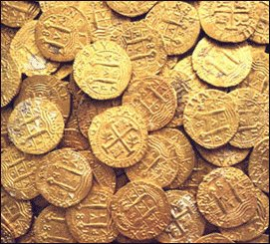
Spain Gets RICH!
Spain limited colonists to trading only with Spanish merchants
Colonists traded raw materials for Spanish manufactured goods
Spanish wealth came from exploiting American gold, silver, & sugar resources using slave labor

Slide 31
What were the primary motivations for the European Conquest of the America’s?
Why do countries conquer other nations?

Slide 32
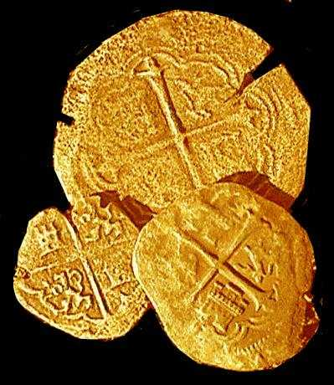
The Five G’s
What were the primary motivating forces that drew Europeans to the Americas?
  God: The opportunity for religious freedom, or to act as Christian missionaries to the Native Americans
  Glory: To build empires or to become famous
  Gold: To get rich
What primary advantages allowed them to reach these goals?
  Germs: Diseases wiped out much of the Native population
  Guns: Military advantage over the Natives

Slide 33
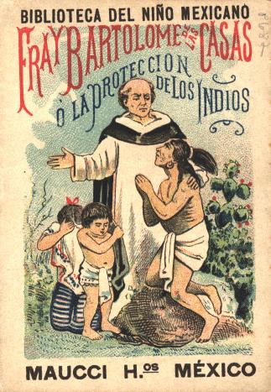

Slide 34
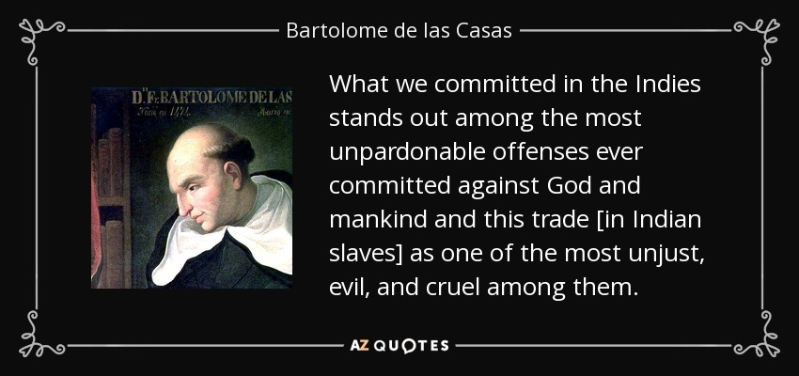

Slide 35
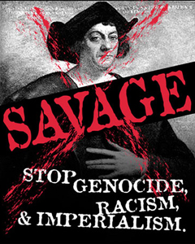

Short ESSAY Response
Read the article titled “Discovery Day, a national holiday reflecting America’s diversity.”
Who discovered America? Identify at least three groups that may have arrived before Columbus? Provide as much specific evidence as possible!
3. Based on what you've learned, do you believe we should celebrate Columbus Day as a national holiday? Did Columbus ultimately have a positive or negative impact on the world? Give me SPECIFIC evidence to corroborate your opinion.
Reg=100 Words, Honors=200 Words

