Slide 1
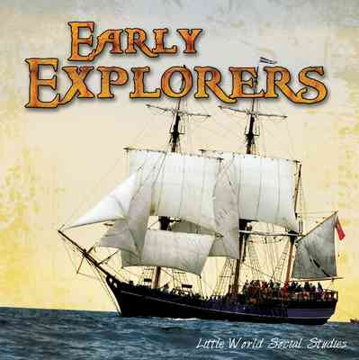
Age of Discovery 2
Early French and English Explorers

Slide 2
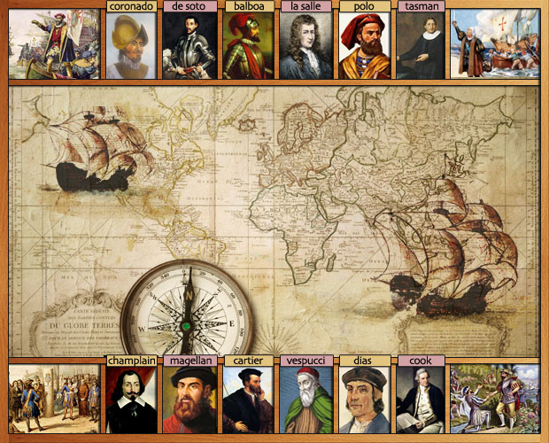
Conquering the New World
In the 1400’s and 1500’s, early European explorers from Spain, England and Portugal all vied (fought) for the title of the world’s richest and most powerful country of their time and were intent (focused) on conquering land and obtaining power in the New World.

Slide 3
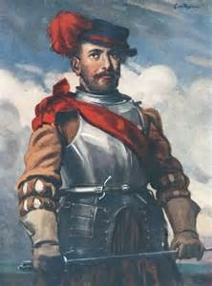
Sir Francis Drake
The Life of a Sea Dog
1540 Born in Tavistock, England
1577 Commissioned by England as a privateer to
raid (attack), plunder (rob) and claim Spanish
colonies in the Caribbean, South America, and
Fort of St. Augustine, Florida.
1580 Queen Elizabeth awarded Drake a jewel with
her portrait now known as the "Drake Jewel.”
1581 Queen Elizabeth knighted Drake for being
the 2nd explorer to successfully circumnavigate
(go around) the globe
1585 Fought with the English Navy and defeated
Spain making the New World safe for
English settlers. The English considered him a hero,
the Spanish called him a “Sea Dog”
1588 Named Vice-Admiral of the English fleet of
ships
1596 Died in Panama on January 27th

Slide 4
Francis Drake was…
An explorer-he sailed to the New World and returned with information about the people, places and cultures of the region to which they’d traveled.
A privateer-someone allowed by one country to attack and board the ship of another country (usually the enemy’s) to take what they found. They paid back the government who had sent them and kept a cut (portion) of the spoils (cargo) on an enemy ship.

Slide 5
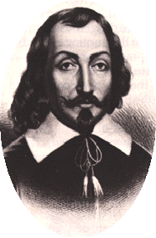
Samuel de Champlain
Father of
“New France”
August 13, 1567
Born in France
1603-1604
Explored and mapped North American Atlantic Coast and Great Lakes
1608
Founded and brought settlers to Quebec City, Canada
1609 Discovered Lake Champlain and traded furs with Huron Indians
1615 Helped Huron Indians battle Iroquois Indians
1620 Became Governor of Quebec
1629 Fought and surrendered to the English and returned to France
1629-1632 Wrote of his discoveries and drew maps of his discoveries because he was a skilled cartographer (mapmaker) and writer
1632 Returned to Quebec
December 25, 1635
Died in Quebec, Canada

Slide 6
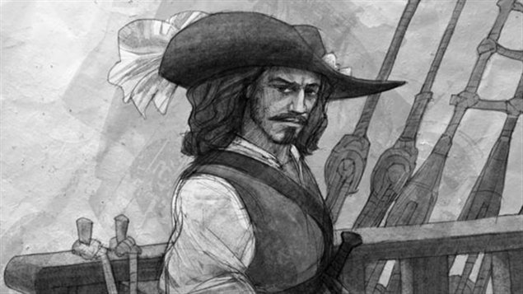
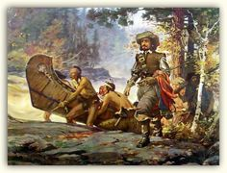
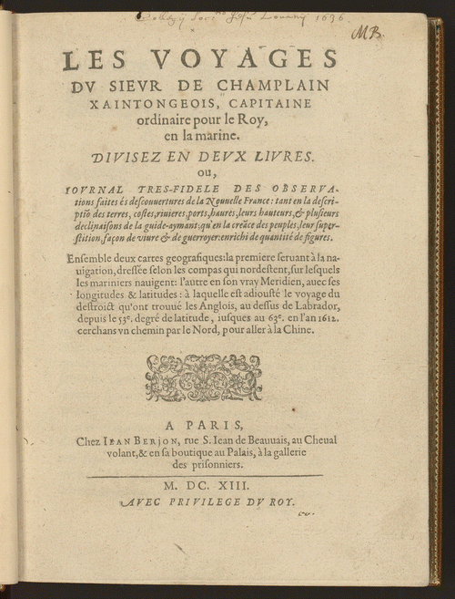
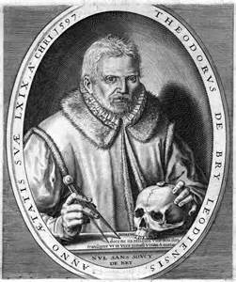

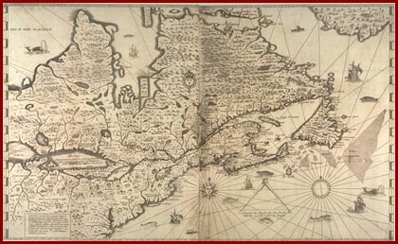
Samuel de Champlain was a
“Jack of All Trades”
(Someone skilled and able to do many different jobs well)
Navigator-a person who plans and directs a ship’s voyage or course
Explorer-someone who discovers and places no one has gone before
Draughtsman-someone who draws plans and makes models of machines, buildings, and other devices
Writer-someone who writes to persuade, inform, or entertain readers
Soldier-a person who fights to protect his country and most of the time paid for his service
Cartographer-someone who draws maps of places explored

Slide 7

Rene-Robert Cavelier, Sieur de La Salle
An Explorer and Entrepeneur
Born in France on November 21, 1643
Died in present-day Texas on March 19, 1687
Explored the Great Lakes and land along the banks of the Mississippi River, claimed the land and set up fur-trading posts (2/3 of what is now the U.S.) in April, 1682
Why didn’t anyone want to settle in New France? Convincing people to settle in New France was a challenge. They assumed the weather was cold and snowy as it was in Quebec, so they didn’t want to settle there
This land was later purchased by the U.S. in what was known as the Louisiana Purchase in 1803

Slide 8
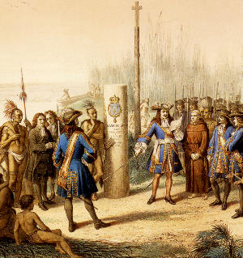
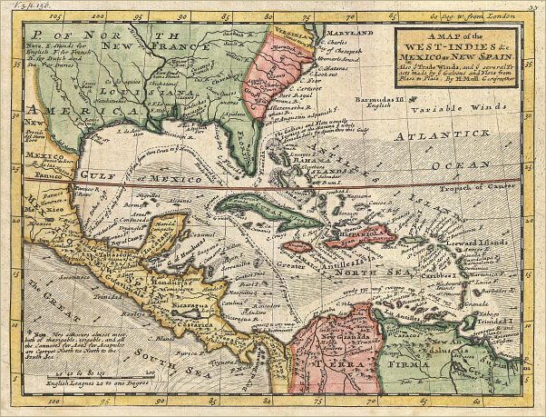
La Salle claims and names Louisiana territory after King Louis XV of France

Slide 9
Ferdinand Magellan
Born in Portugal in 1480
Died in the Philippines on April 21, 1521
1519-King Charles V of Spain provided funds for 5 ships for Magellan’s voyage when the king of Portugal didn’t help finance his trip. Magellan attempted to circumnavigate the globe, but died in 1521 during his voyage. His crew sailed on without him
1520-Magellan discovered a passage from the Atlantic Ocean to the Pacific Ocean which later became known as the Straits of Magellan.
1522-the Victoria was the only one of 5 ships to safely return to Spain that was provided for Magellan by King Charles V of Spain

Slide 10
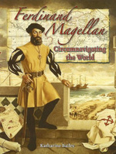
An International Date Line
http://www.kidsgeo.com/geography-for-kids/0023-the-international-dateline.php
The International Date Line (IDL) passes through the Pacific Ocean and is plotted on today’s charts and globes as the dividing line between ‘today’ and ‘tomorrow’.
When the 18 remaining crew members of Magellan’s expedition reached the Cape Verde Islands in July, 1522, they discovered their calendars were off by one day!
Magellan and his crew kept meticulous (accurate) records of their travels and realized the need for the international date line when they had crossed the equator.
Click on the link for an explanation of the International Date Line

Slide 11
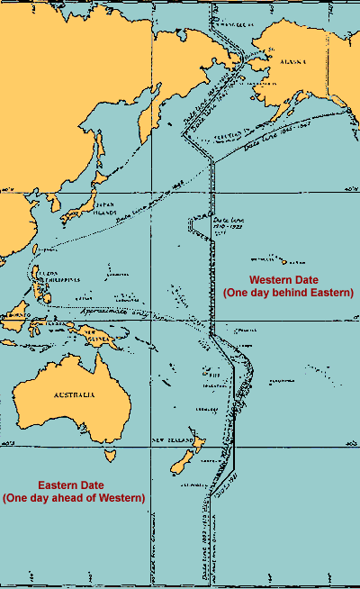
Does Anybody REALLY
know what time it is?
On July 9, 1522 Magellan’s crew landed on the Cape Verde Islands in the Pacific. A boat was sent ashore for supplies.
The crew wasn’t sure what day it was. The men were told it was Thursday, but based on their excellent ship’s log, they knew it was really Wednesday.
They could not explain the mistake.
But, as they sailed to the west and returned to the same place the sun sets, they had actually gained a whole day or 24 hours.

Slide 12
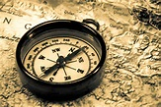
A Seaman’s Tool of the Trade:
The Magnetic Compass
How on earth did sailors find their way when it was cloudy or foggy? The magnetic compass was invented sometime around the 13th century making it easy for sailors to always find their way home.
A compass is powered (works) with a magnet and makes the compass point North.
The magnets inside compasses are drawn (or attracted) to the magnetic North Pole (about 1,000 miles south of the actual North Pole) because of the Earth’s magnetic field.
So, in North America, a magnetic compass will point north.

Slide 13

Words are Powerful! (Vocabulary study)
Choose 3 words listed below
Write a definition of the word
Write a sentence using the word in context (to understand the word’s meaning)
Part of Speech (Noun, Verb, Adjective)
Synonym(s)
Multiple Meanings
Create other forms (add a prefix and/or a suffix to create a new word and definition
Draw a picture of the word
Soldier
Navigator
Cartographer
Draughtsman
Explorer
Writer
Privateer

Slide 14
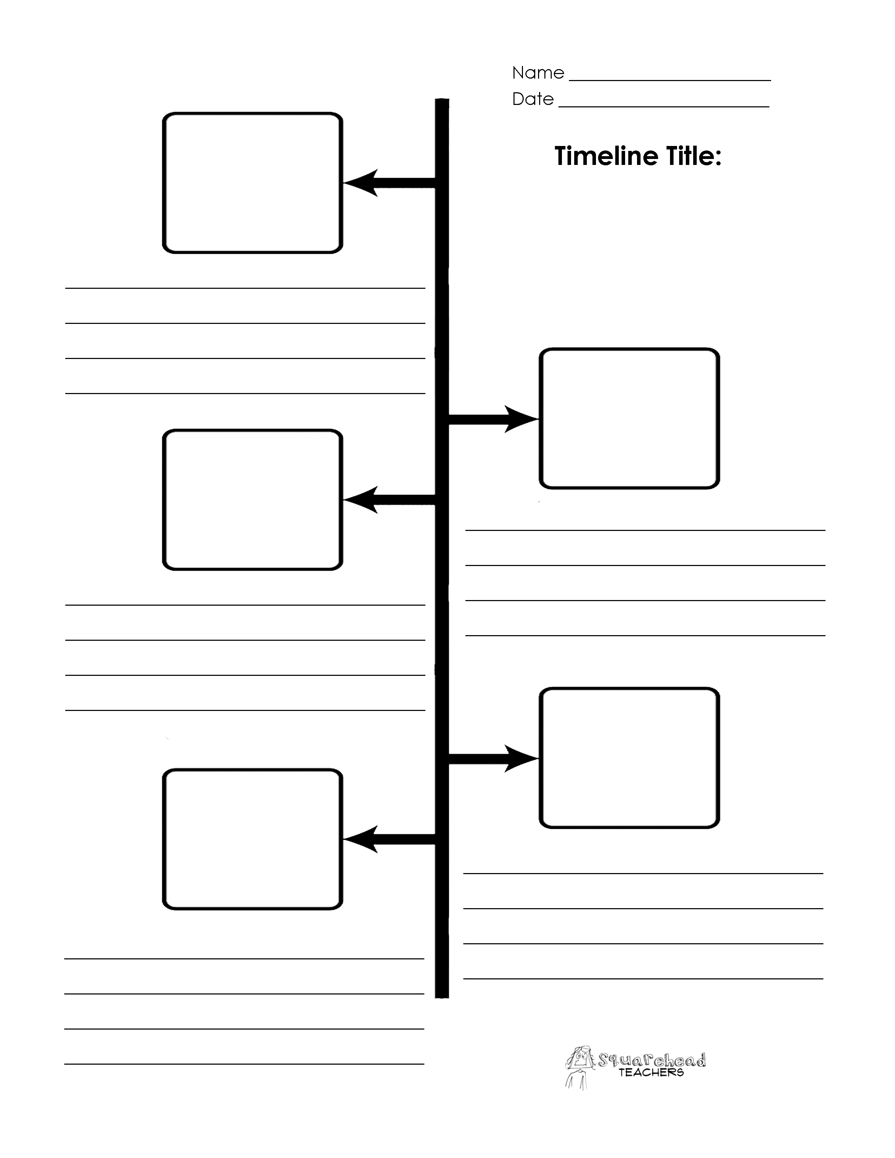
The Life and Times of…
Choose a famous explorer
Create a timeline (refer to Slides 4 and 5 on this
power point for a model)
Include the following information about your explorer:
Date and Place of Birth
Education (Where did they attend school)
Family (Wife, Children)
Voyages
Discoveries
Financial Support (country and name of monarch-king, queen, etc.)
Important Contributions to World History or Geography
Date and Place of Death

Slide 15

Summary-What do YOU think?
Write a summary describing good things that came as a result of Early European explorers and their discoveries
Be sure to include:
Names of important people
Minor characters
Important events and dates
Your thoughts and opinions on what you think about Early Explorers and their discoveries

