Slide 1
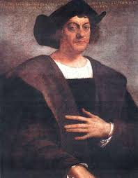
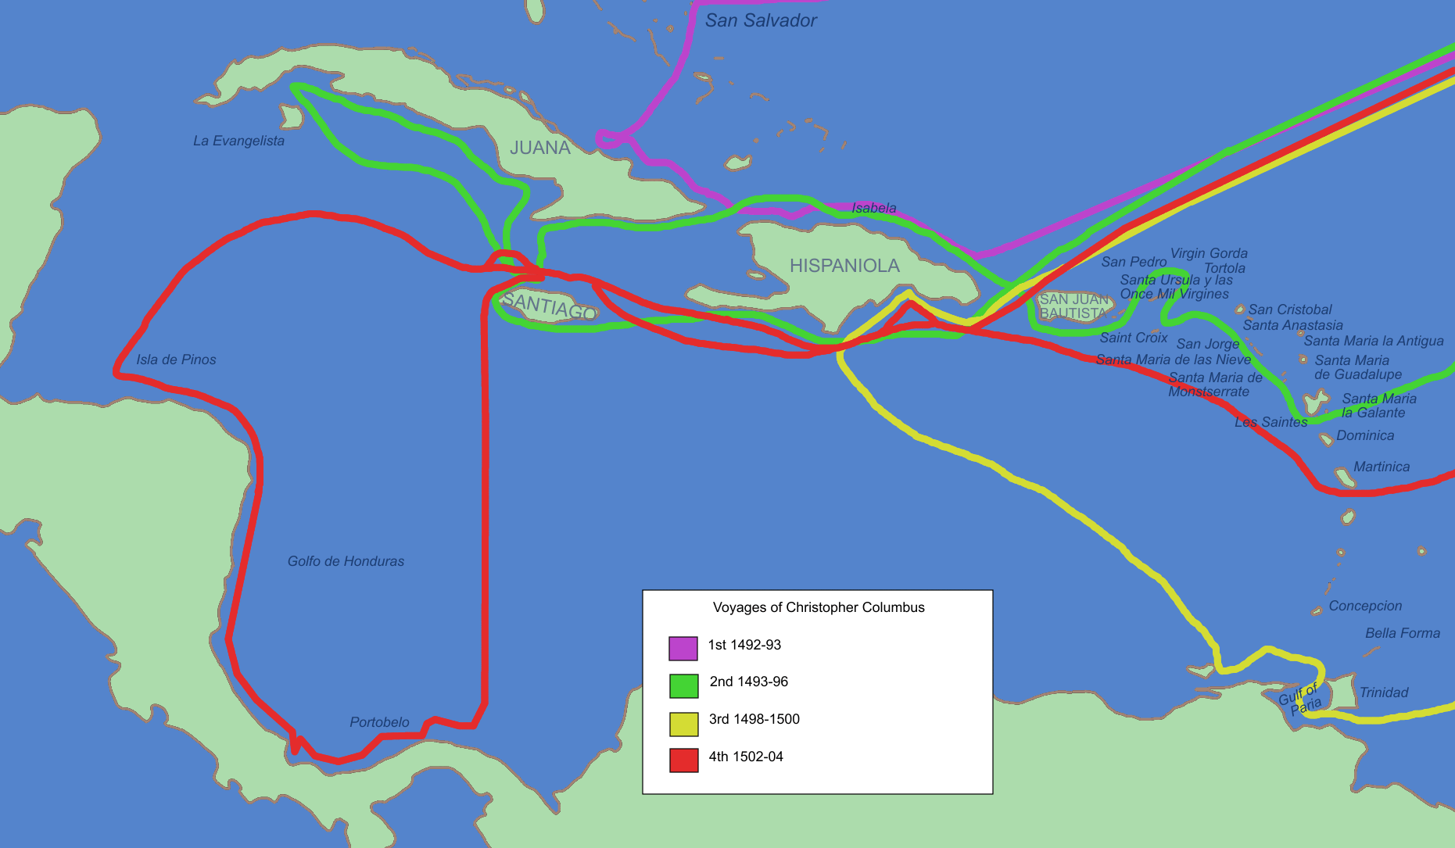
Christopher Columbus
Born: 1451 in Genoa, Italy
Died: May 20, 1506
Financial support from King Ferdinand and Queen Isabella of Spain
1st Voyage: 1492
Looking for a closer route between Europe and Asia to buy, sell, & trade silk and spices
Never reached Asia but arrived on what is today San Salvador
Claimed land for Spain, returned with Native Indians and gold
Spain sent more explorers to learn about the New World, became richer and more powerful

Slide 2
Impact on history of Columbus’s Discovery
Other countries (France and England) spent lots of money to send explorers
Explorers learned about the New World and settled “colonies”
Colony-area ruled by another country and not the people who live there
People from different parts of the world began communicating and sharing ideas with each other
Better transportation, mapmaking, and navigational equipment

Slide 3
Christopher Columbus was Curious and…
Brought horses to the new world on his second voyage.
Originally thought Asia was 2,400 miles from Portugal-it was really 5,625 miles
You can remember Columbus’s discovery of America with the rhyme: "In 1492 Columbus sailed the ocean blue".
The sailor who was first to spot land on the voyage would receive a reward. The winner was Rodrigo de Triana who spotted land from the crow's nest of the Pinta
was first buried in Spain, however his remains were later moved to Santo Domingo in the new world and then back, again, to Spain.
Married to Felipa Moniz Perestrelo in 1477 who died 2-3 years later giving birth to their son, Diego.

Slide 4
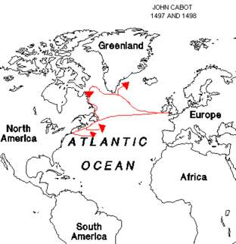
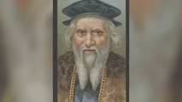
John Cabot
Born: 1450 in Genoa, Italy
Died: 1500 somewhere in the North
Atlantic Ocean
Financial support from King Henry VII of England
Explored what he thought was Asia in 1497
Claimed land what is today’s Canada
Explored parts of the United States
Ship sank and he drowned at sea and never knew what he’d discovered

Slide 5
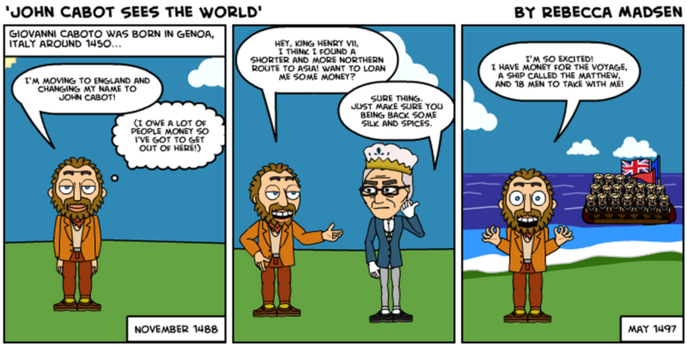
Facts about Cabot
Real name was Giovanni Caboto in Italy
became a Venetian citizen (resident of Venice) in 1476.
In 1480’s, married Mattea
Had 3 sons: Ludovico, Sancto and Sebastiano
Moved to Spain in 1490’s and then England because he owed a lot of money to people

Slide 6
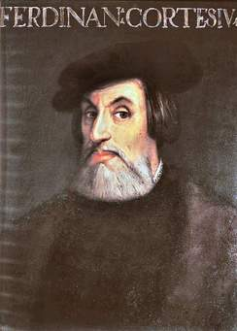
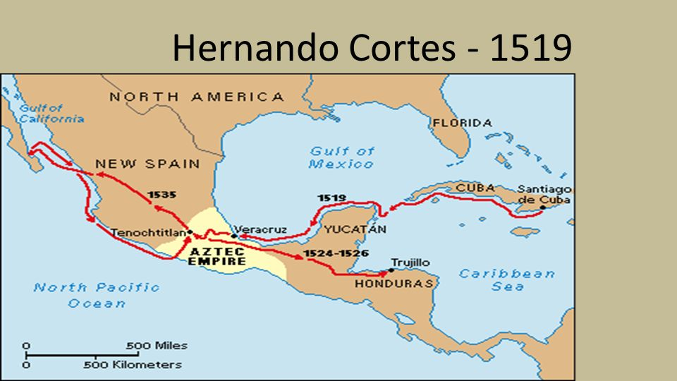
Hernando Cortes-Cities of Gold
Born: 1485 in Spain
Died: 1547 in Spain
Financial support from Spain
Sent to Cuba in 1511 with Diego Velazquez
Sailed to present day Mexico to find cities of gold and silver in the New World in 1519 without permission with 500 men and 11 ships
Fought with and conquered the Aztec people of Mexico in 1521
Spent last years of his life in Spain seeking recognition and support for his achievements

Slide 7
Facts about Cortes
Spanish conquistador and explorer
Very sick as a child
Parents wanted him to be a lawyer
Married twice and had 4 children
Owned a ranch & claimed Cuba as a Spanish colony
Discovered peninsula around California in 1536
People ignored him in his later life
Short tempered and arrogant

Slide 8
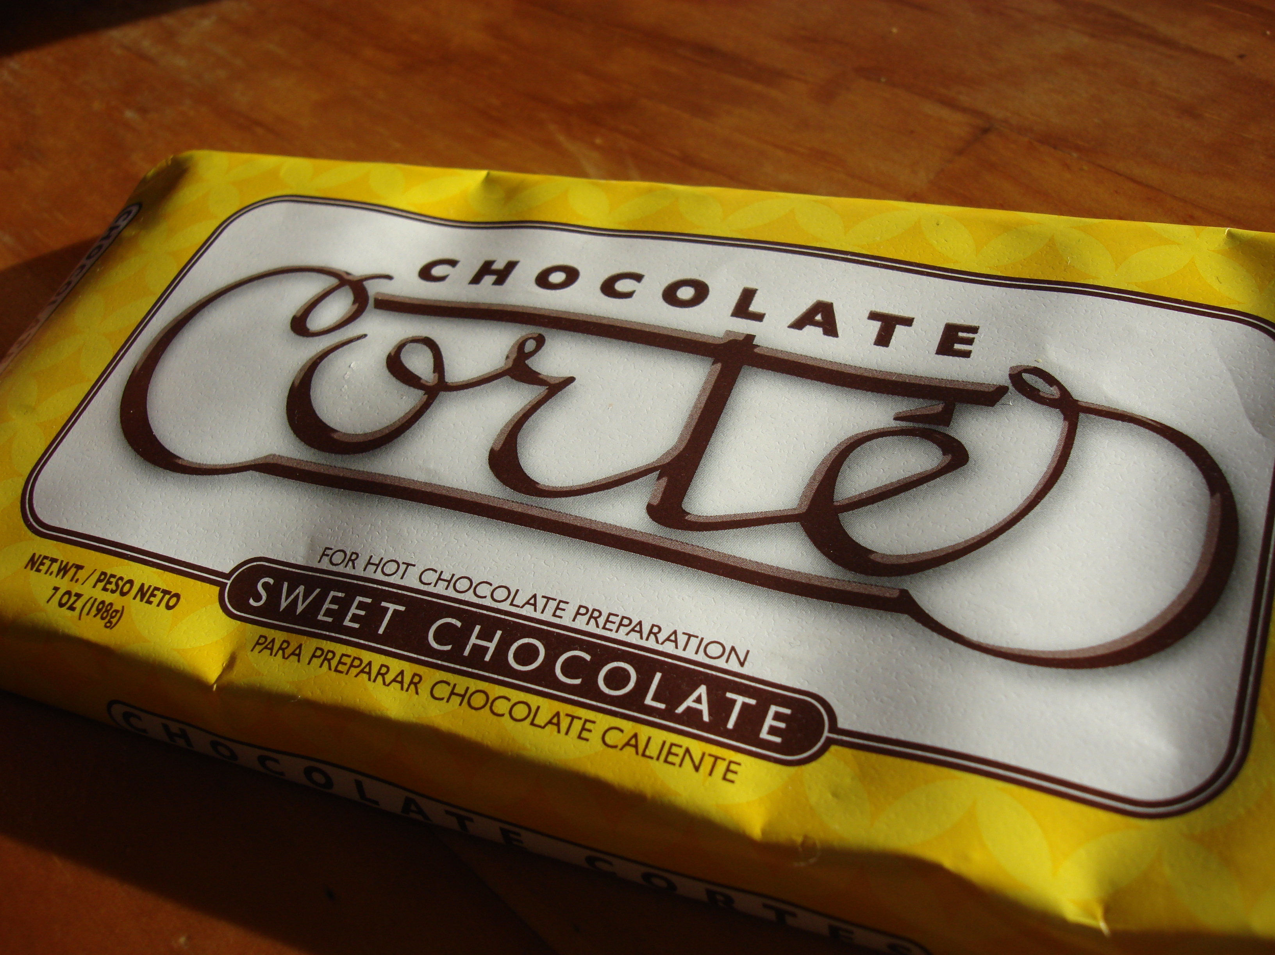
Cortes the Chocolatier
He was the first to taste Xocolatl-a chocolate drink
The beans were used as money and make a drink
Cortes returned to Spain with the beans and equipment for making Xoclatl for King Charles V of Spain. The drink wasn’t popular because it was strong and bitter.
Sugar & spices (like vanilla and cinnamon) were added to make cocoa powder delicious and made it popular.
It was expensive and only rich people could afford it.
Cortes started plantations in Mexico (and other places in the Caribbean).
The cocoa making process was left to monks who kept it top secret until 1580, when a chocolate production plant was built in Spain.

Slide 9
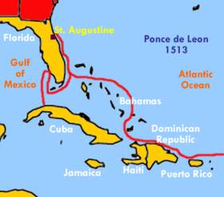
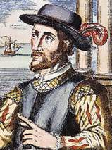
Juan Ponce de Leon
Magical Fountains of Youth
Born: 1460 in Santervas, Spain
Died: July 1521 in Cuba
Financial support from Spain
Traveled from present day Puerto Rico searching for a fountain of magical water that made old people young
Founded a settlement at Puerto Rico in 1508
Sailed around southern end and landed in present day Florida on Palm Sunday (Pascua Florida) 1513
King Charles V of Spain granted Ponce de Leon permission to explore the Bahamas.

Slide 10
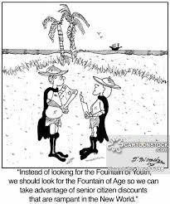
Facts about Ponce de Leon
Born to a wealthy, noble Spanish family
Well educated
He served as a page at the Spanish court
Was a privateer and attacked ships
In 1493, he sailed with Christopher Columbus‘s
2nd voyage to present day Hispaniola and Haiti
Thought Florida was an island
Died from a wound in Cuba in 1521
Buried in San Juan, Puerto Rico

Slide 11
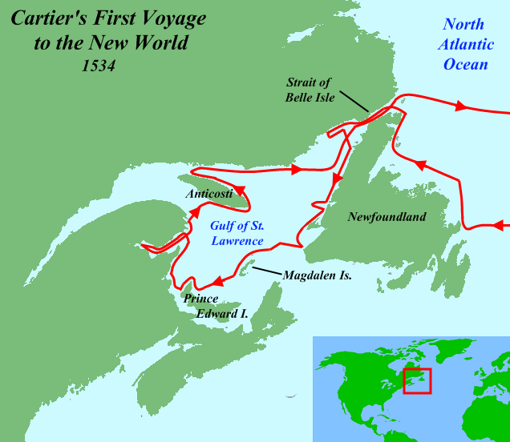
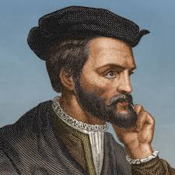
Jacques Cartier
Born: December 31, 1491 in Brittany, France
Died: September 1, 1557 in France
Financial support from King Francois I of France
Sent to find gold and other riches
Searched for (but didn’t find) a shortcut to Asia across North America
Explored parts of North America in 1524 with the explorer Verrazano
Discovered and claimed Newfoundland and the St. Lawrence River in Canada for France in 1534
Unsuccessfully attempted to create permanent settlement in Canada in 1545
Wrote about his expeditions and voyages of exploration to Canada after retiring in 1545

Slide 12
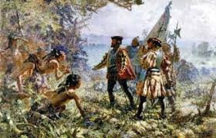
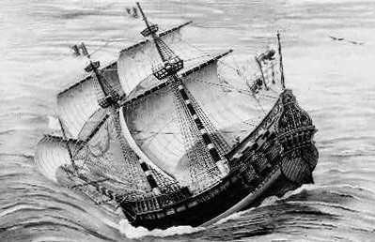
Facts about Cartier
The Grande Hermine - the ship of Jacques Cartier
Excellent reputation as a seaman and well-respected among France’s royalty
Found friendly Native Indian Villages near Montreal & Quebec
Made 3 voyages to the New World
Unsuccessfully tried to settle a French colony in Canada due to poor weather conditions
Married Catherine Des Granches in May 1520, but had no children

Slide 13
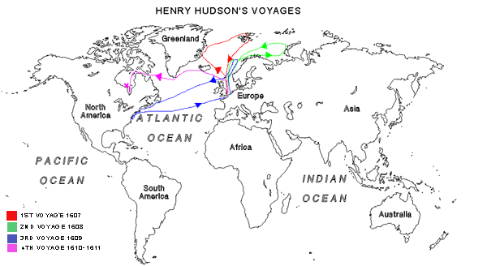
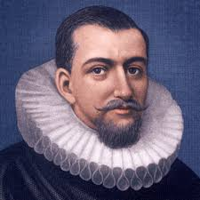
Henry Hudson
Born: between 1565 in London, England
Died: June 22, 1611 lost at sea
:
Financial support from England & the Dutch United East India Company
Unsuccessfully started as a sea captain and explorer
Looked for a Northeast water route to Asia in search of spices
Discovered the Hudson River, Hudson Bay, Hudson Strait in present day Manhattan in 1609
Dutch settlement that later became New York City
His last voyage ended in mutiny in 1611 when his crew took over his ship the “Discovery” and sent Hudson, his son John, and 8 crew members off to their death in a small boat

Slide 14
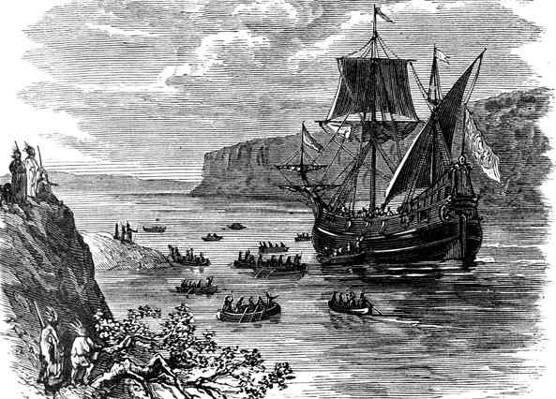
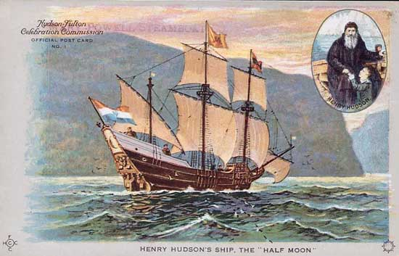
Facts about Hudson
Hudson’s ship
The Discovery
Married Katherine Hudson and had 3 sons: John, Richard and Oliver
Well educated and studied a variety of subjects including: cartography, navigation, astronomy, mathematics and seamanship
Dutch established a fur-trading post in1614 before the arrival of the Pilgrims in 1620
No attempt was made to search and rescue Hudson and the mutineers were never executed
Convinced the Dutch his experience and determination made him the best person for the job-even though he was an Englishman and not Dutch

Slide 15

Now it’s your turn…
Answer the following questions:
Why did early explorers want to find a faster way to Asia?
How did Columbus’s exploration have an impact on history?
Complete a Frayer Model for the following words:
-cartographer
-mutiny
-explorer
-colony

Slide 16
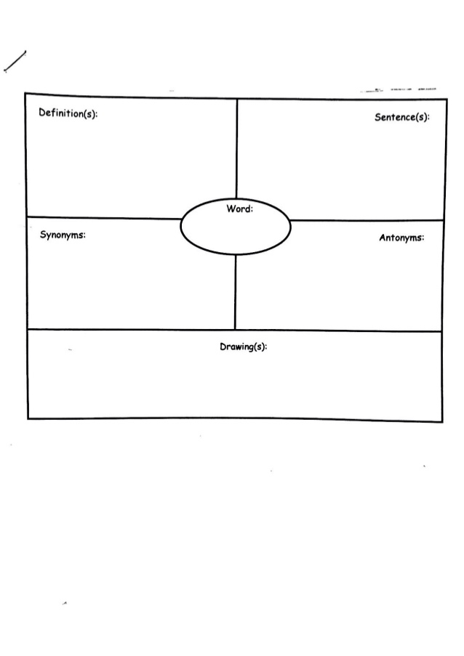
Frayer Model
(meaning of the word)
(same or similar)
Mutiny
(opposite)

