Slide 1

- Bantu were FARMERS (grains)
- Lived in SMALL COMMUNITIES
- Subsistence farming - growing just enough crops for personal use, not for sale
- Niger River and Congo River à East Africa
- Iron and Stone tools used for farming
Bantu-Speaking Peoples

Slide 2
- Muslims began coming to trade
- Result of Muslims: trading ports in Mogadishu, Mombasa, and Kilwa
- Intermarriage between Muslims and Africans
- A mixed African-Arabian culture emerged – known as Swahili
- Swahili is also applied to a language made up of Bantu words and Arabic words
- Swahili is now the language of Kenya and Tanzania
Muslims Come to Africa

Slide 3
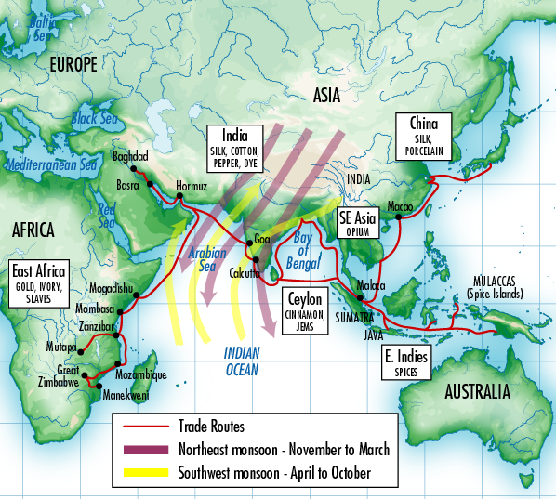
How did they come to Africa?

Slide 4
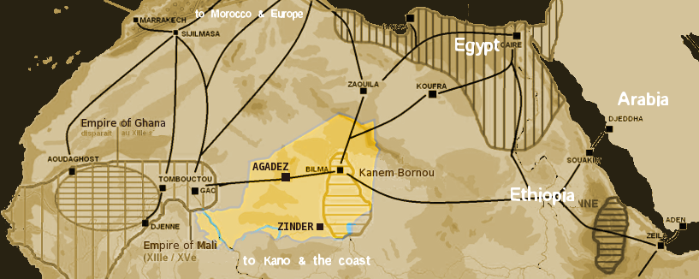
How did they come to Africa?
Gold Roads

Slide 5
- Stateless society – group of independent villages organized by clans and led by a local ruler or clan head
- Eventually, these independent villages started to consolidate and form states
- Zimbabwe – from 1300-1450 was the wealthiest and most powerful state in the region
- Why? Gold trade
- Great Zimbabwe – ruins of the capital – surrounded by stone walls – 18,000 people once lived inside the walls
- The land was eventually deserted because of overgrazing or natural disasters
Stateless Societies Become States

Slide 6
African Kingdoms Circle of Life
Use your textbook research and viable internet sources to complete your “Circle of Life” Poster for the African Kingdom you have been assigned. Include the following pieces of information in your “circle”:
What Time Period did your kingdom exist?
Location of your kingdom (Include a map)
What Major Cities developed in your kingdom?
What Products were traded by (and in) your kingdom?
What influenced the culture of your kingdom?
What is this kingdom famous for?
What reasons were there for the decline of your kingdom?

