Slide 1
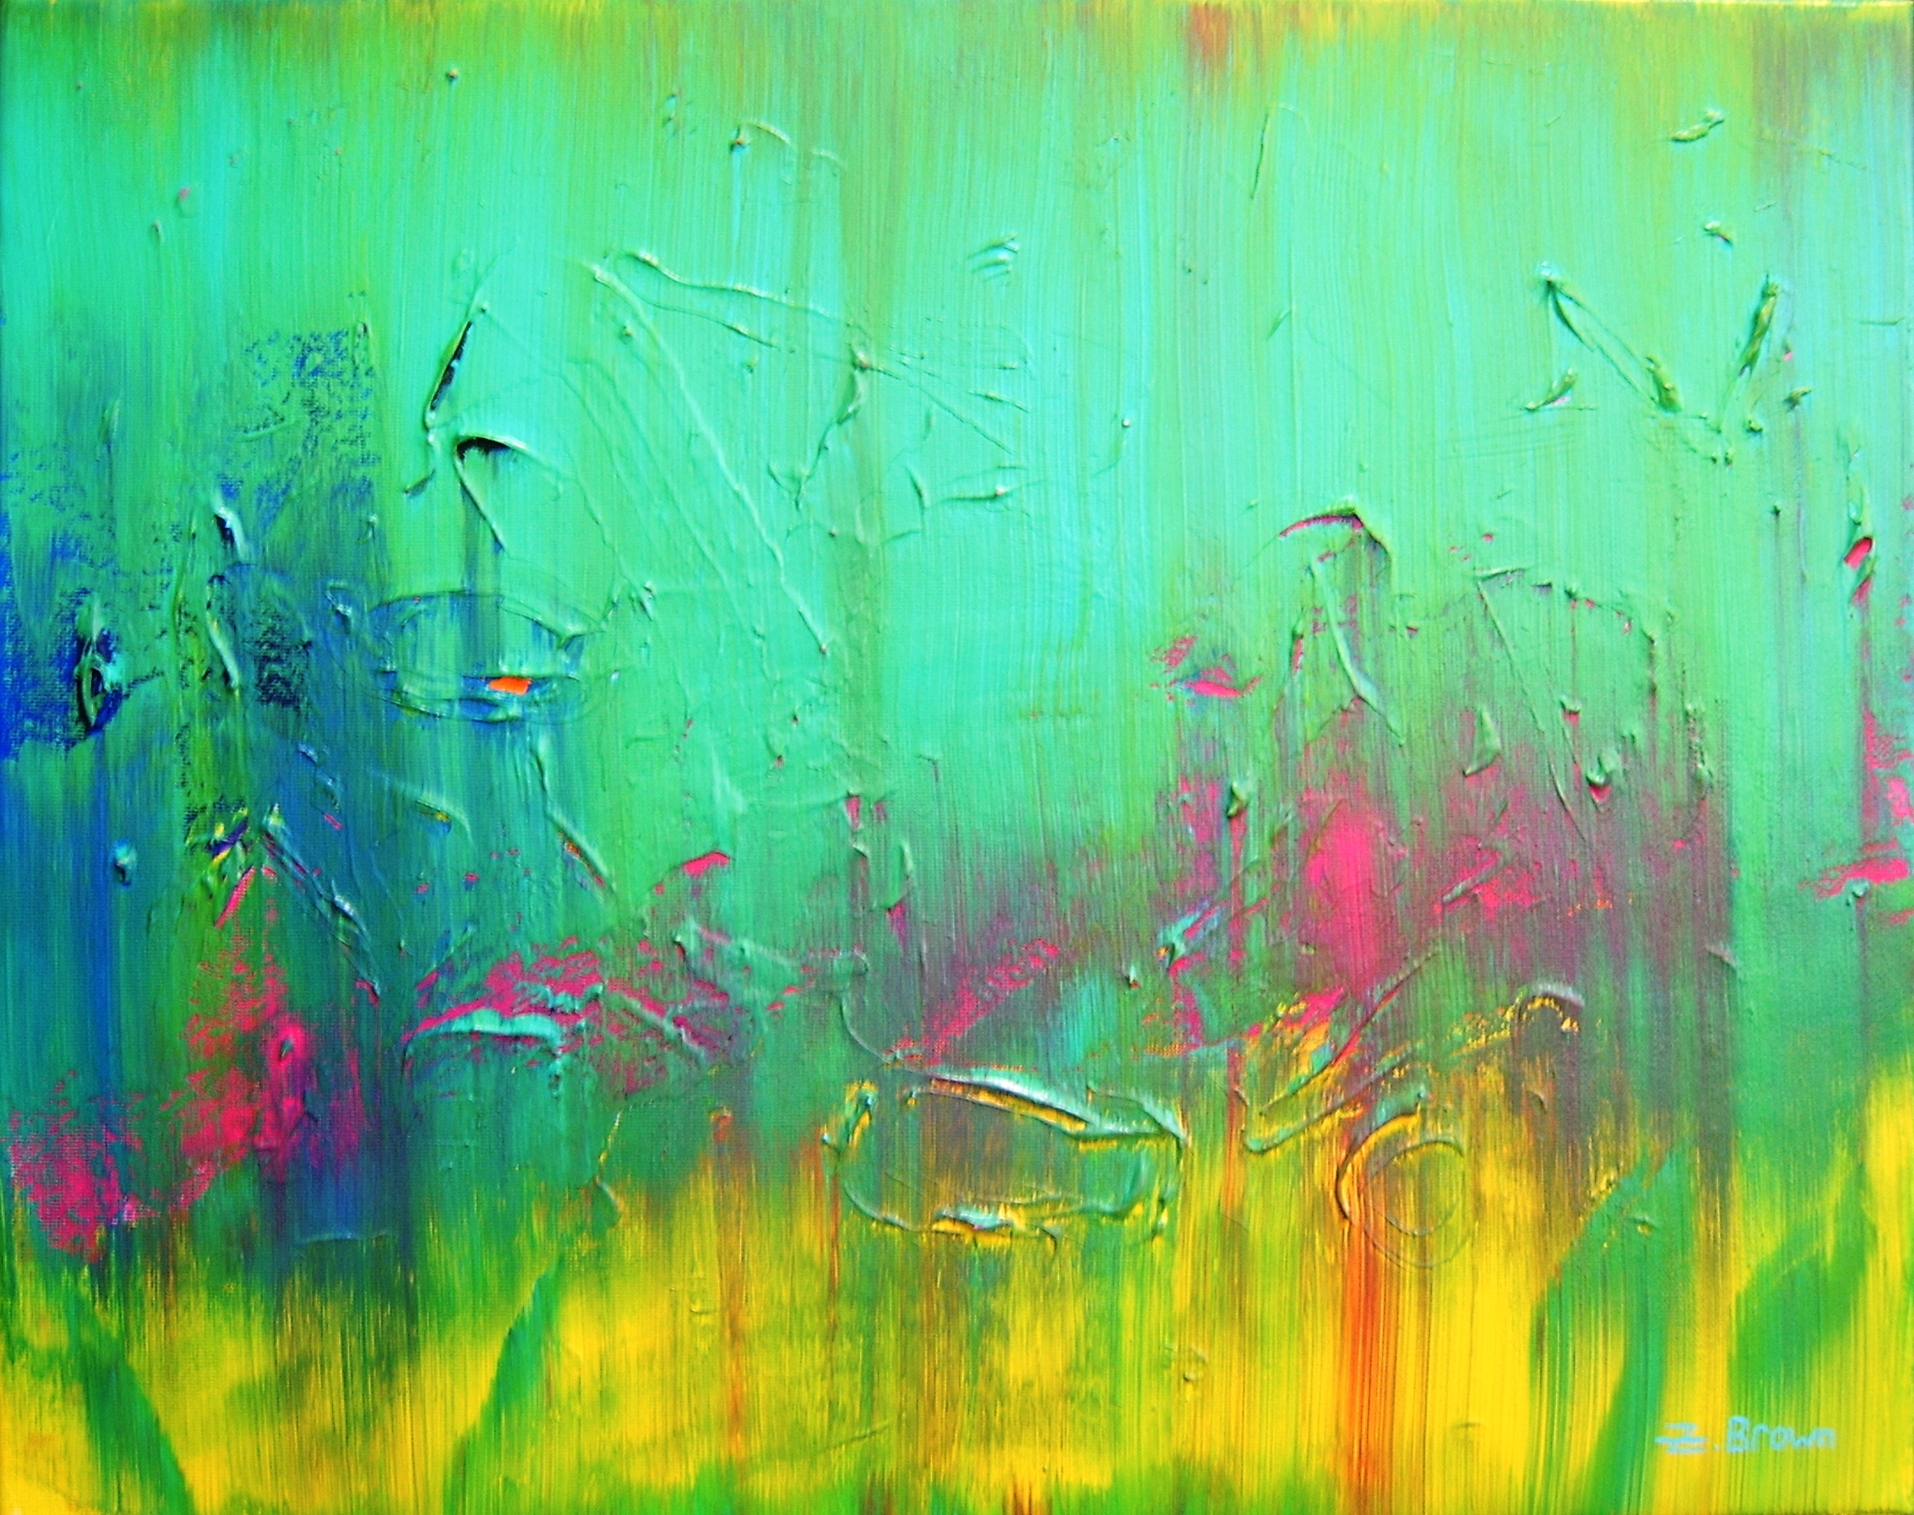
Abstract Painting
What is it?

Slide 2
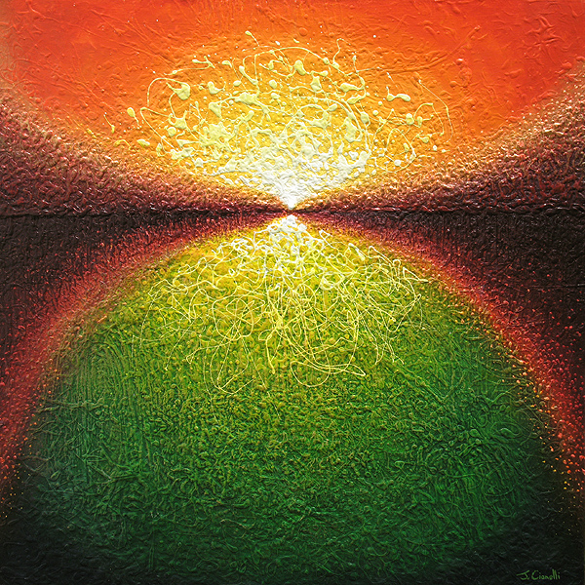
Abstract is…
Art that emphasizes design, or whose basic character has little visual reference to real or natural things.

Slide 3
Your Abstract Art
Step by Step
In your sketchbook, using a ruler, divide your paper into 4 equal sections.
A | B
C | D

Slide 4

Magazine Image
Take your magazine image and cut it into 4 equal pieces.
Mix them up.
Put a small piece of tape on the back of the small pieces and place one in the middle of each square in your sketchbook.
A | B
C | D

Slide 5
Next Step…
Once your pieces are in place start extending the lines from the magazine onto your sketchbook.
Lines that go to the edge of paper(section) need to continue somehow into the next section.
Feel free to alter what the lines look like but they must start from the magazine.
Once your lines are drawn, remove the magazine piece and draw the image from the magazine.
Transfer onto you final paper. Then paint!

Slide 6
Your Magazine Abstraction
Monochromatic
Complementary
Analogous
Warm or Cool

