Slide 1

Absolutism

Slide 2
What characteristics do you associate with an absolute ruler?

Slide 3
Definitions
1. Absolutism:
Belief that 1 ruler should hold power within a country
2. Divine Right:
The idea that God created the monarchy and monarchs act as representatives on Earth.

Slide 4
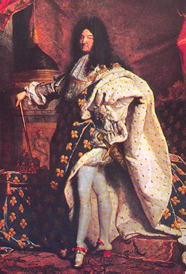
Causes of Absolutism
Decline of Feudalism
Growth of cities
Breakdown of Church authority
People wanted strong leadership

Slide 5
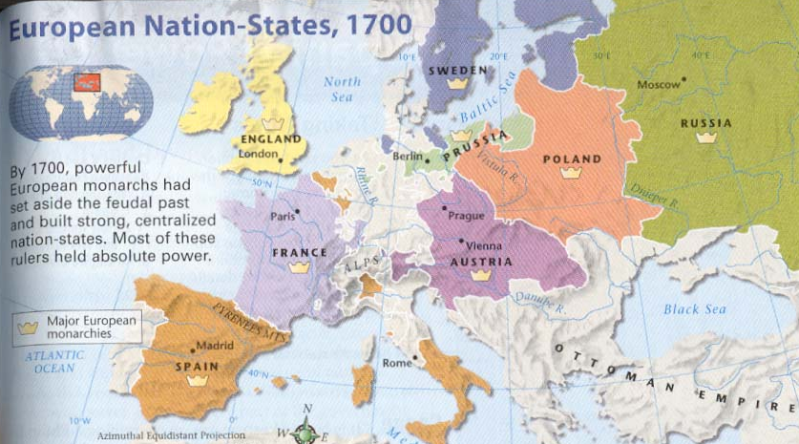
Absolute Monarchies in Europe
1550-1800
From World History: Connections to Today Prentice Hall, 2003

Slide 6
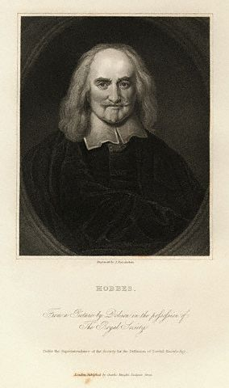
The Philosopher Behind the Age
Thomas Hobbes
1660 – Wrote the Leviathan (Giant)
Discussed the perfect government
People first lived in anarchy
Needed a “social contract”
Required an absolute monarch to maintain order
People retained the right only to maintain their lives.

Slide 7
What factors might weaken the power of an absolute monarch?

Slide 8
4 Major Features
1. Centralized political power
2. Pacified nobility
3. Increased revenue
4. New army

Slide 9
Louis XIV

Slide 10


Slide 11
Centralized Political Authority
    Use of propaganda, creation of political image
    “Divine right of kings” (Bossuet) = “L’etat c’est moi.”
    used intendants to administer the government = bureaucracy, councils, parlements
    chief foreign policy goal= secure international boundaries for France (prevent invasion) especially if he can expand the area of his rule
    revoked the Edict of Nantes (1685)- millions of Protestants emigrated or joined France’s enemies

Slide 12
Pacified Nobility
    Made sure nobility would benefit from his absolute authority by cooperation with regional parlements
Completed Versailles palace
      way of keeping an eye on nobility
      court life organized on his daily routine
      he was the source for most favors, patronage

Slide 13
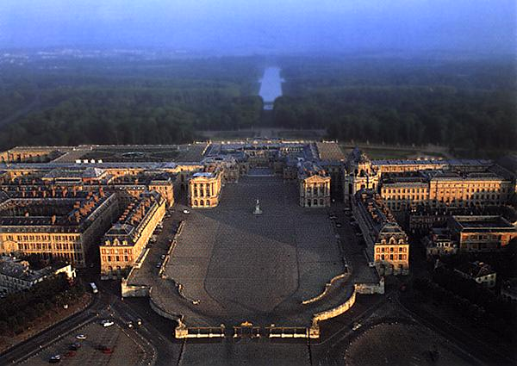
Louis XIV’s Grand Style

Slide 14
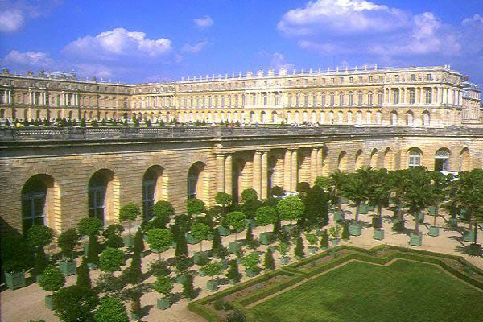
Louis XIV’s Grand Style

Slide 15
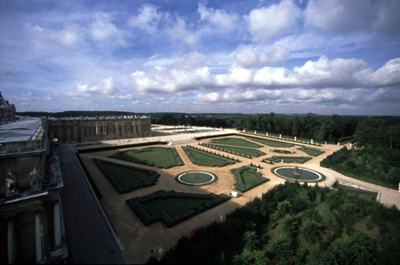
Louis XIV’s Grand Style

Slide 16
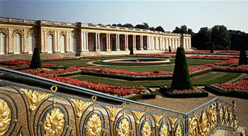
Louis XIV’s Grand Style

Slide 17
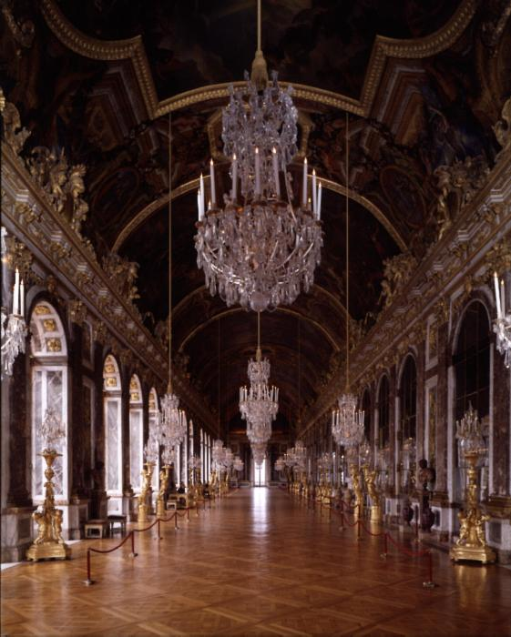
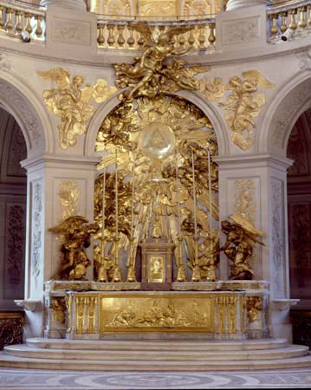
Louis XIV’s Grand Style

Slide 18
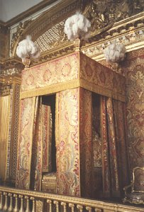
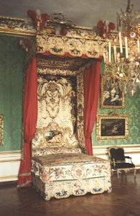
Louis XIV’s Grand Style
The King’s Bed
The Queen’s Bed

Slide 19
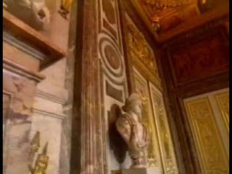

Slide 20
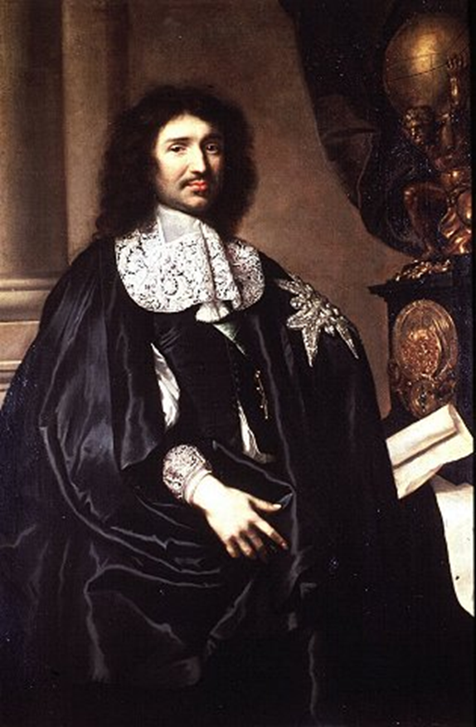
Increased Revenue
Finance Minister: Jean-Baptiste Colbert (1619-1683)
      regulated imports/exports
      created new nat’l industries and organized factories
      simplified administrative bureaucracy
      increased the taille (direct tax on peasantry) and reduced the number of tax-exempt nobles
      great practitioner of Mercantilism – transforms France into commercial power (colonies in Africa, India, Americas)
      began construction of navy

Slide 21
New Army
Military Advisors:
    Marquis de Louvois- Minister of War & military tactician: instituted salary pay, improved discipline, limited commissions, began merit system of promotion
    Sebastien Vauben – military engineer, devised system of trench warfare and concept of defensive frontiers

Slide 22
Wars of Expansion
War of Devolution: to acquire Spanish Belgium, won area of Lille (1668)
Invasion of Netherlands (1672)
Nine Years’ War (1689-1697): League of Augsburg (Eng., Sp., Sw.,U.P., Bavaria, Saxony, Palatinate) VS. France
War of Spanish Succession (1701-1713): Grand Alliance (Eng./Hol./HRE) VS. Fr./Sp./Bavaria
  throne of Spain went to Louis XIV’s grandson
  ended with the Treaty of Utrecht (1713) with Great Britain and Treaty of Rastatt (1714) wit Spain
        Sp. Loses Gibraltar
        Austrian gains Netherlands, Milan, Sicily, Naples
        Eng. Gets Newfoundland and control of slave trade

Slide 23
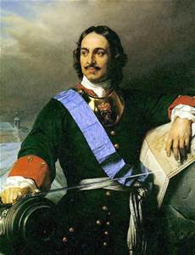
Peter The Great

Slide 24
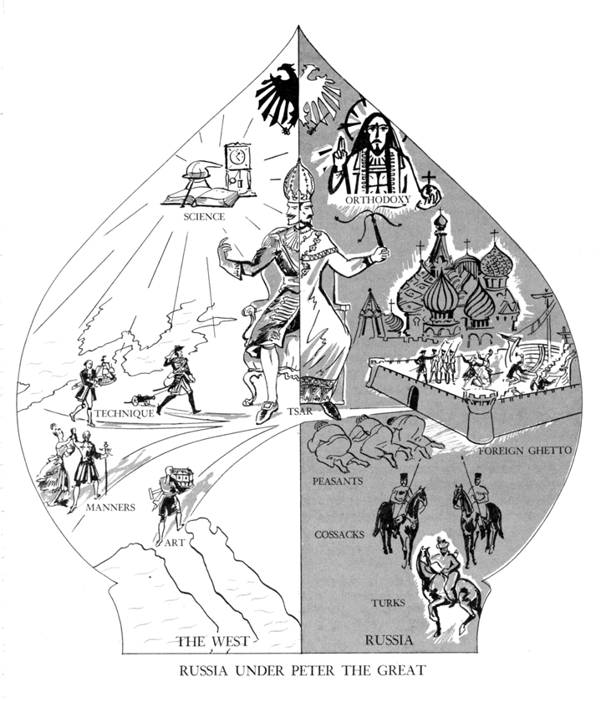
Westernization….
…Tradition

Slide 25
CenTralized Political power
Institutes Table of Ranks, making civil service a form of social status
Reorganized bureaucracy (“colleges”)
Classes of Ranks | Addressing Form
Classes I and II | Your High Excellency (Vashe vysokoprevoskhoditelstvo)
Classes III and IV | Your Excellency (Vashe prevoskhoditelstvo)
Class V | Your Highly Born (Vashe vysokorodie)
Classes VI, VII and VIII | Your Right Highly Born (Vashe vysokoblagorodie)
Classes XI, X, XI, XII, XIII and XIV | Your Wellborn (Vashe blagorodie)

Slide 26
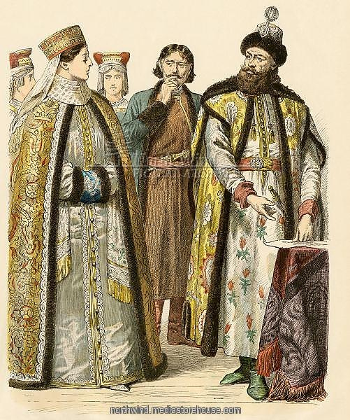
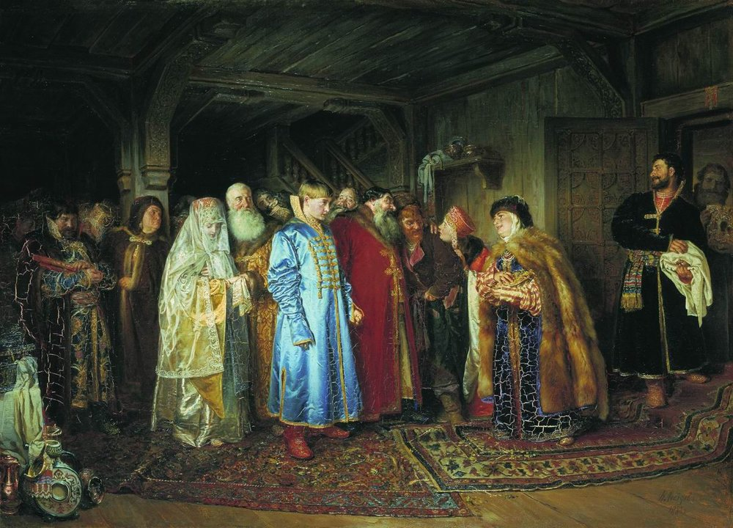
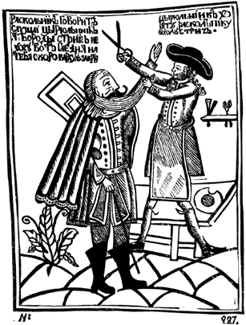
Pacified Nobility
    Westernizes Boyars by shaving beards, changing style of dress
    Sent young Boyars to study abroad in western Europe

Slide 27
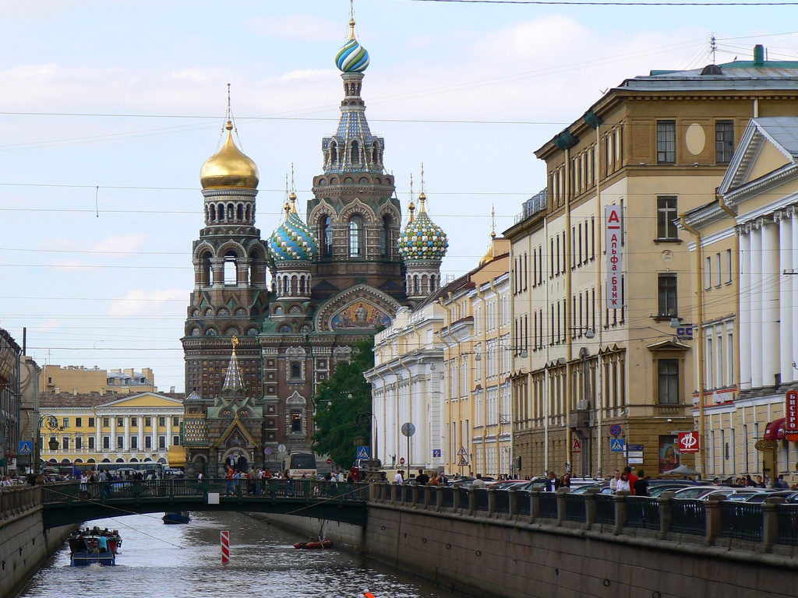
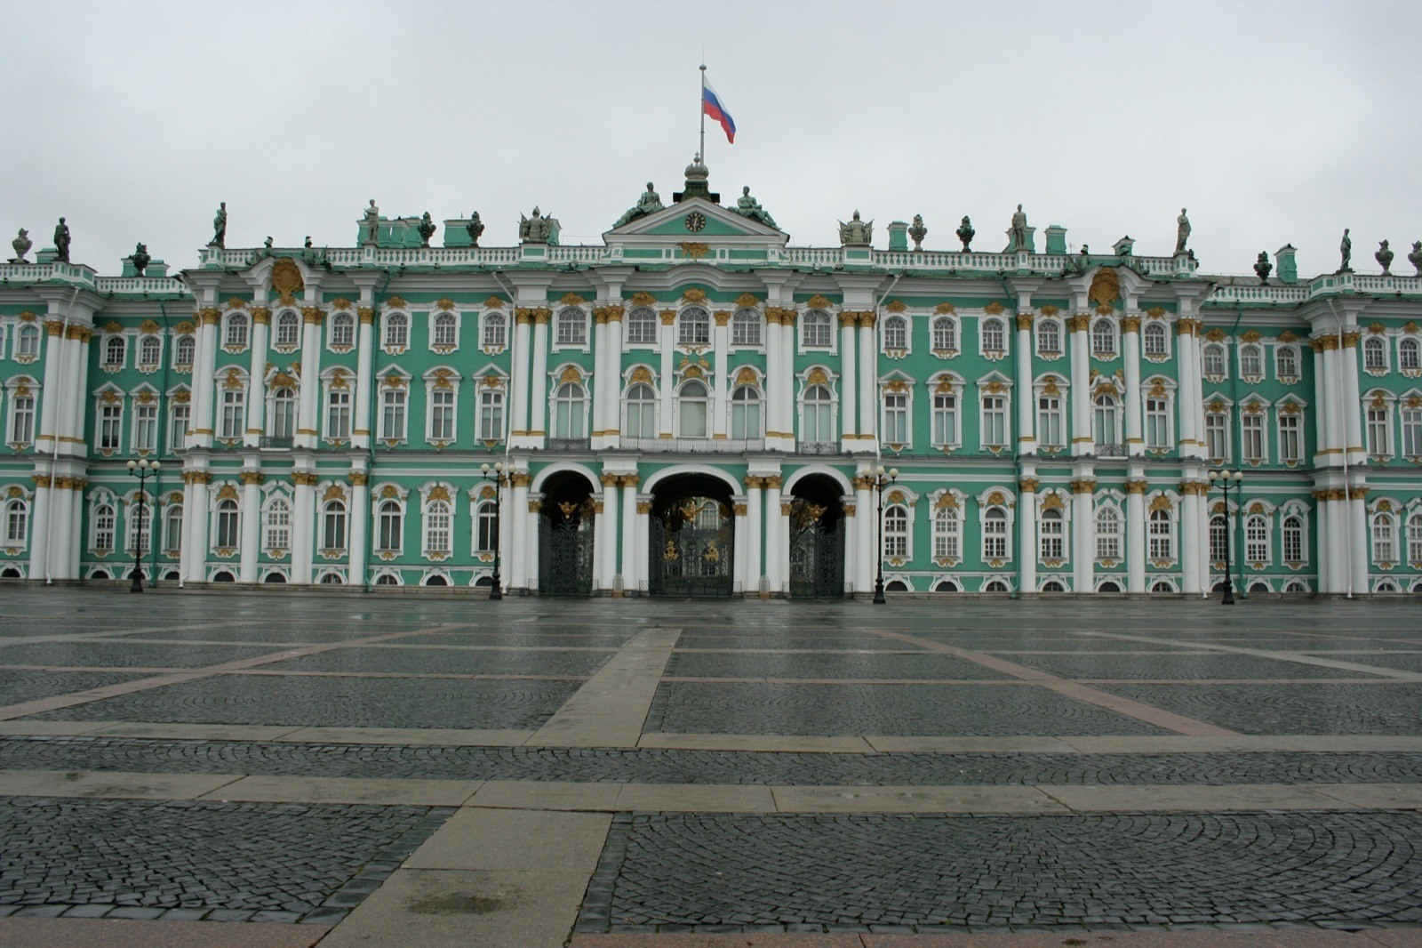
Increased Revenue
Builds St. Petersburg (like Versailles?) – Window to the West – warm water port
Conquers Baltic states – 1709 defeats Swedes at Poltava

Slide 28
New Army
Hires 1000 experts to create “Western” army
Gets rid of Streltsi (bodyguards) following revolt
Oversaw the construction of navy

Slide 29
Document Analysis: peter the Great
Source: General Alexander Gordon, History of Peter the Great, 1718.
This great emperor came in a few years to know to a farthing the amount of all his revenues, as also how they were laid out. He was at little or no expense about his person, and by living rather like a private gentleman than a prince he saved wholly that great expense which other monarchs are at in supporting the grandeur of their courts. …He had no letters; he could only read and write, but had a great regard for learning and was at much pains to introduce it into the country. He rose early; the morning he gave to business till ten or eleven o'clock at the farthest; all the rest of the day, and a great part of the night, to diversion and pleasure.
In the year 1703 the tsar took the field early, cantoned his troops in the month of March, and about the 20th of April brought the army together; then marched and invested another small but important place called Neva Chance…. The commodious situation of this place made the tsar resolve to erect on it a considerable town, with a strong citadel, consisting of six royal bastions, together with good out works; this he soon put into execution and called it St. Petersburg, which is now esteemed so strong that it will be scarcely possible for the Swedes ever to take it by force.

Slide 30
Constitutionalism
Characteristics:
  A written constitutional may or may not be present.
  Laws limit a ruler or government’s power.
  A Social Contract is the foundation for society
  The State creates a set of Laws that all must follow and the penalties are set by the state as well
Examples: England, Netherlands

Slide 31
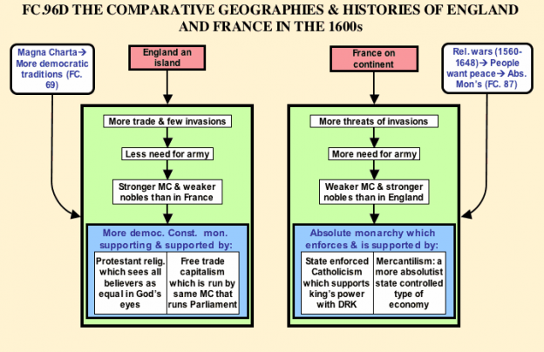
What would you consider the MOST important
step Britain made to create a Constitutional Monarchy?

