Slide 1
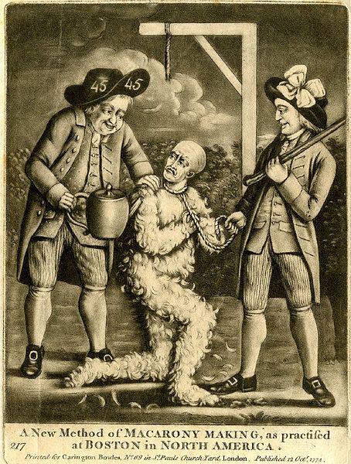

Slide 2
"The war is inevitable-and let it come! I repeat it, sir let it come! It is in vain, sir, to extenuate the matter. Gentleman may cry, Peace, peace; but there is no peace. The war is actually begun. The next gale that sweeps from the north will bring it our ears the clash of resounding arms. Our brethren are already in the field. Why stand we here idle? What would they have? If life so dear, or peace so sweet, as to be purchased at the price of chains and slavery? Forbid it, Almighty God! I know not what course other may take, but as for me-give me liberty, or give me death!“
-Patrick Henry

Slide 3
Quote of the Day
“The older I get, the more I doubt my own thoughts and value the opinions of others”
-Ben Franklin

Slide 4
A Revolution Begins

Slide 5
Shortly after the Boston Massacre……..

Slide 6
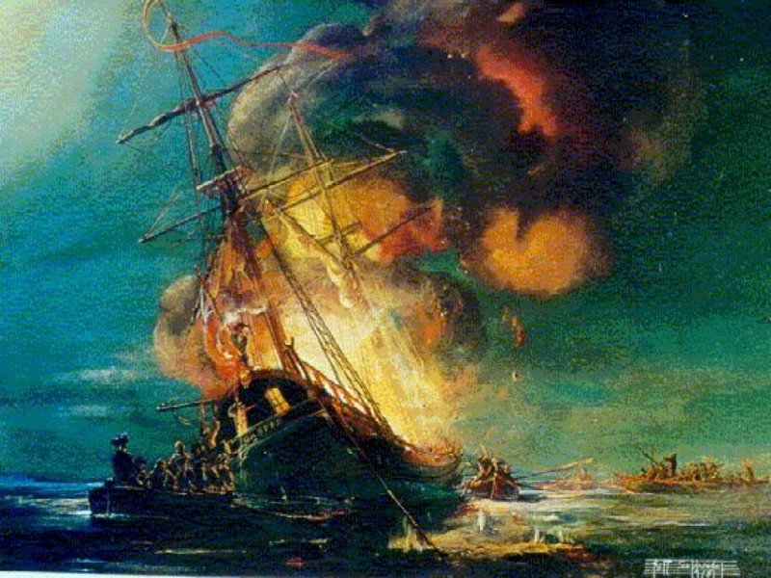

Slide 7
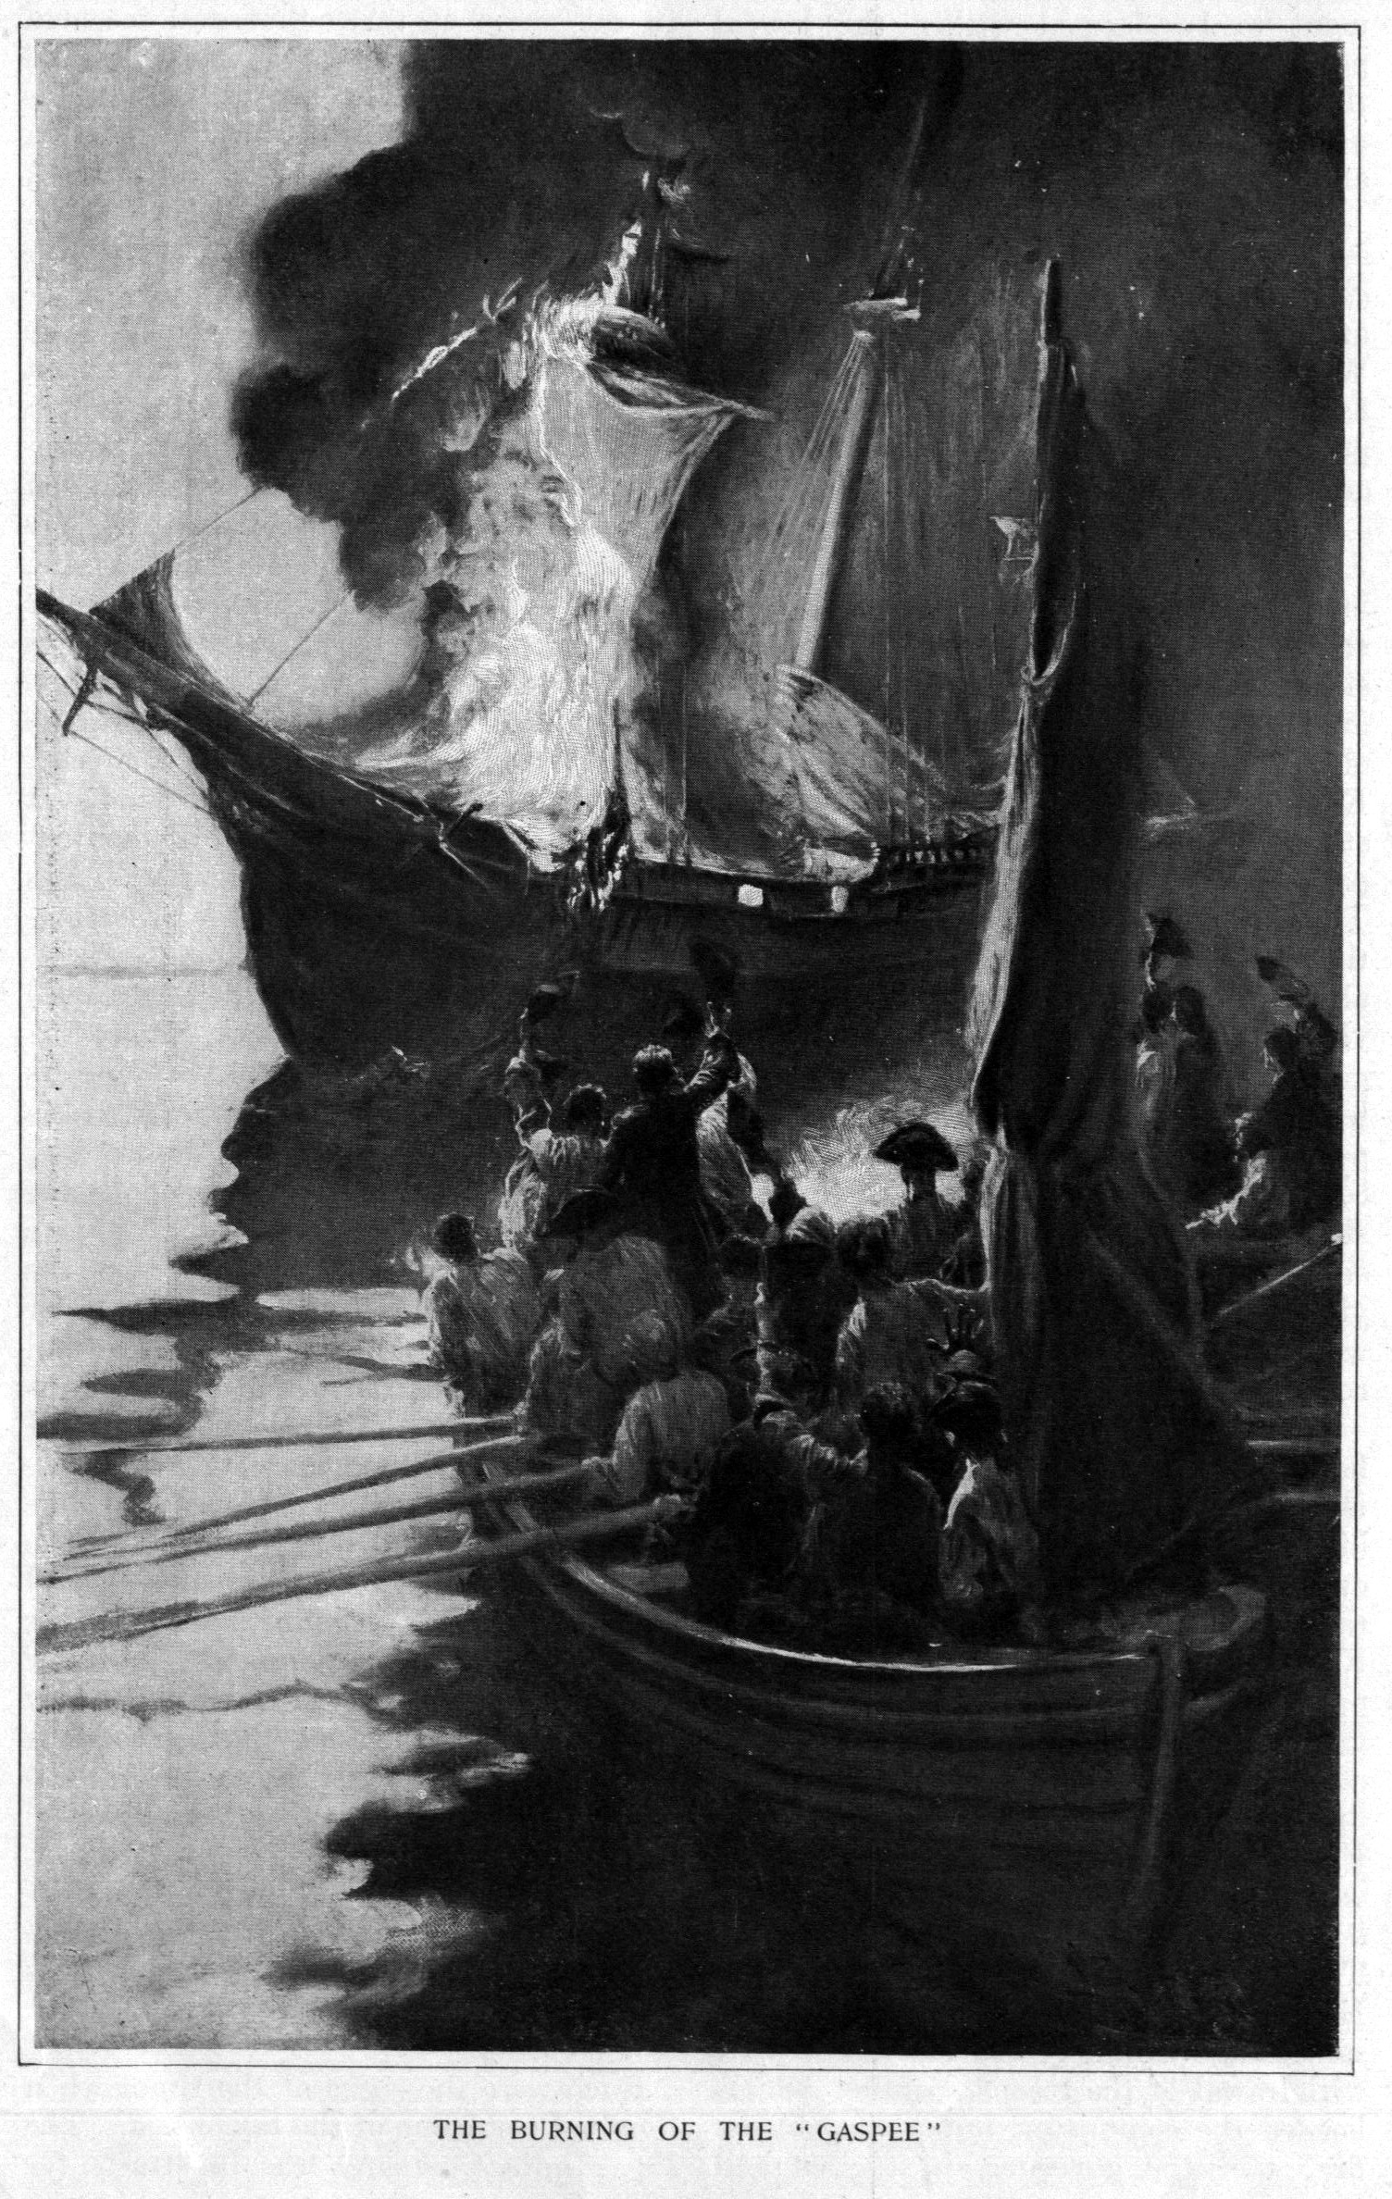
The Gaspee Affair
The British patrol ship HMS Gaspee had been stationed off the coast of Rhode Island to intercept smugglers
When it ran aground in June 1772, rather than help, angry colonists burned the ship

Slide 8
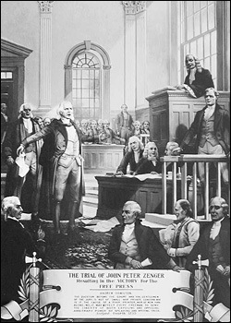
British Response
The British responded by ordering a special investigation and threatening to remove suspects for trial in England, rather than in Rhode Island
Rhode Island’s legislative assembly appealed to the other colonies for support

Slide 9
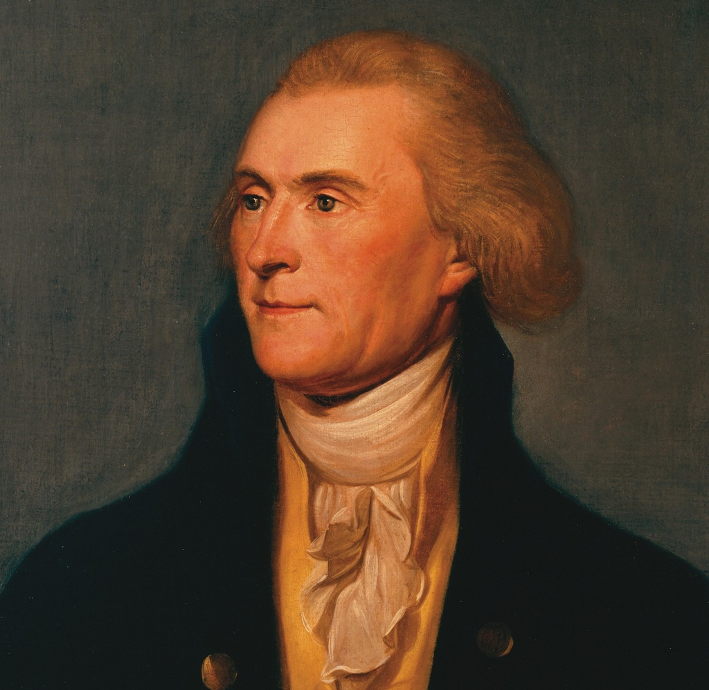
Committees of Correspondence
March 1773: Thomas Jefferson suggested that the individual colonies remain in constant communication with one another and debate how to react to British provocations through “committees of correspondence” (basically, that each colony regularly provide a report of British activities in their area to all of the other colonies so that responses could be unified)

Slide 10
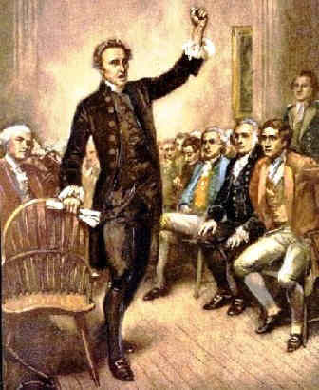
Committees of Correspondence
The Colonies would use committees of correspondence to coordinate plans for resisting British oppression right up to the American Revolution
In some ways, these committees can be seen as one of the first efforts to “unite” the American people

Slide 11
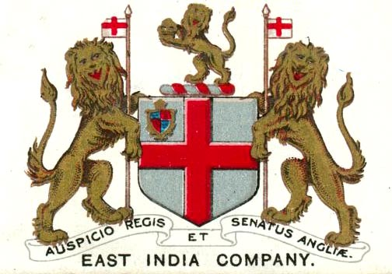
British East India Company
Thanks to war, corruption, mismanagement, and American boycotts against British tea, the British East India Company, one of the largest and most powerful companies in the world, was deeply in debt and on the brink of collapse
Parliament decided that it had to act to save the Company

Slide 12
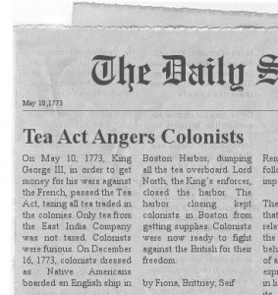
The Tea Act of 1773
Parliament allowed the East India Company to begin selling tea, almost completely tax free, directly to American shopkeepers
The elimination of the taxes, meant that the price of tea dropped, making British tea cheaper than smuggled in Dutch tea in the Colonies

Slide 13
At this point the British think that we will purchase their cheaper tea….

Slide 14
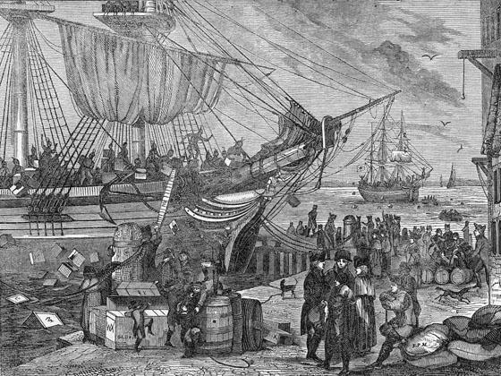
The Tea Boycott
The Non-Importation Agreement: When the East India Company shipped 1200+ chests of tea to American ports in October 1773, American merchants (coordinated by the committees of correspondence) refused to allow the ships to unload in New York or Philadelphia

Slide 15
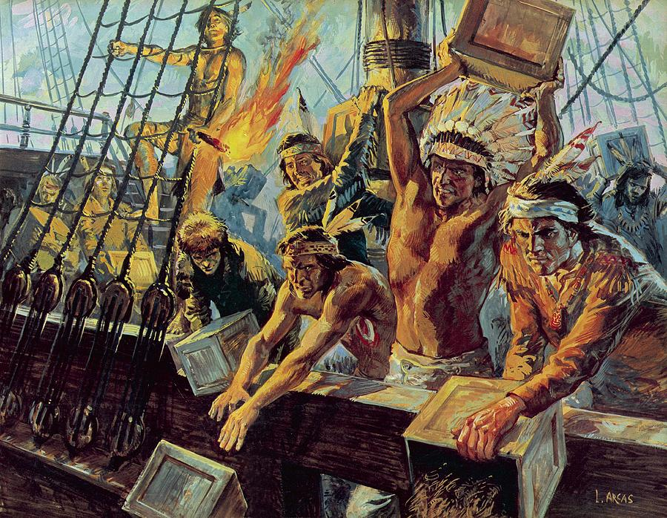
The Boston Tea Party
In Boston, however, the tea ships were raided in the night by colonists (poorly) disguised as Native Americans and the tea cargo was destroyed by throwing it into Boston Harbor
Despite there being hundreds of witnesses to the raid, no one offered to identify the raiders to the British

Slide 16
The Boston Tea Party shows us an Ideological shift in the colonies…..
Now it is about principle not prices, clearly there is no turning back now

Slide 17
How will the British respond?

Slide 18
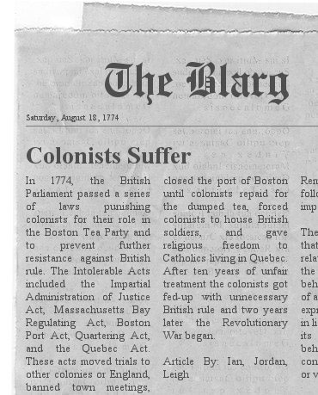
The Coercive Acts (1774)
Colonists referred to them as The Intolerable Acts
Parliament responded to the “tea party” by passing four punitive bills:
1. Boston Port Act: Boston’s port was closed until the city paid for the damages (about $2 million in today’s money)
2. Massachusetts Government Act: All elected officials in Massachusetts would now be appointed by the royal governor instead and all town meetings were banned

Slide 19
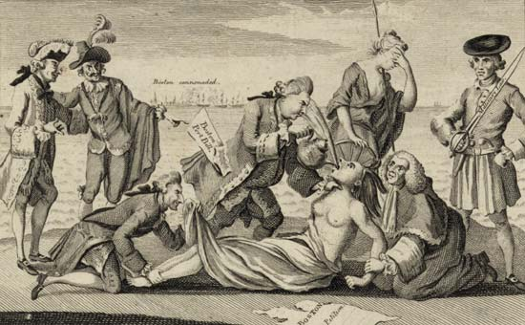
The Coercive Acts (1774)
3. Administration of Justice Act: British soldiers charged with crimes against colonists would be returned to England for trial rather than face trial in the Colonies
4. Quartering Act: Local officials would have to provide housing for British soldiers in areas of unrest, even if that meant housing them in people’s private homes

Slide 20
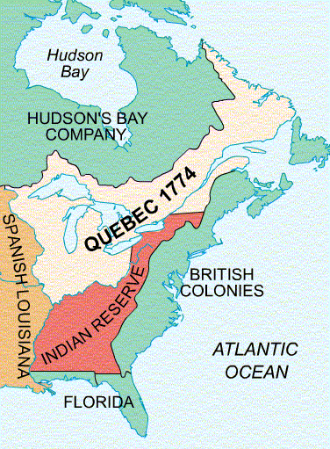
Gen. Gage & The Quebec Act
To enforce the Acts, General Thomas Gage was named military governor of Massachusetts and given 2000 extra soldiers to command
Parliament also passed the Quebec Act, expanding the colony of Quebec into the Ohio Valley, thereby taking away land that had historically been the territory of the American colonies

Slide 21
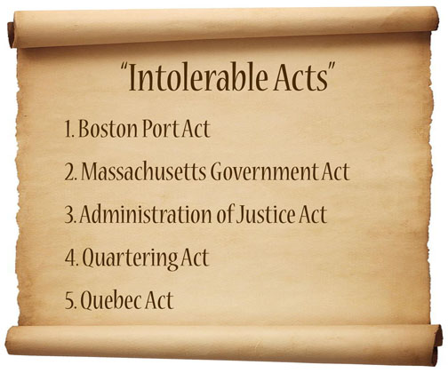
The Intolerable Acts
The Coercive Acts + the Quebec Act = what colonists began to cal “The Intolerable Acts”
While King George had meant for these acts to break the will of the American Colonies and bring them back in line, what they actually did was galvanize the Colonies against the British

Slide 22
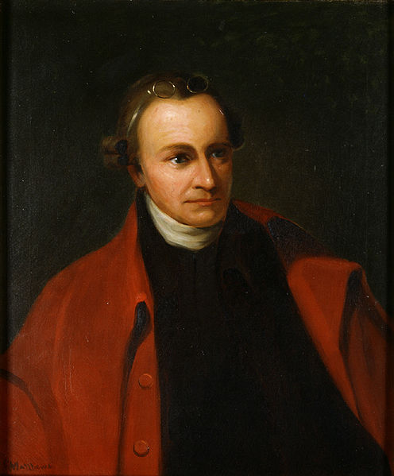
Virginia Sides With Boston
May 1774: The Virginia House of Burgesses, under the leadership of Thomas Jefferson and Patrick Henry, declared the placement of British soldiers in Boston to be an invasion
Virginia’s governor dissolved the House, but once again, they continued to meet and, through correspondence, called on other colonies to send delegates to create a colonial congress to decide the next course of action

Slide 23
A major event on the road to revolution…

Slide 24
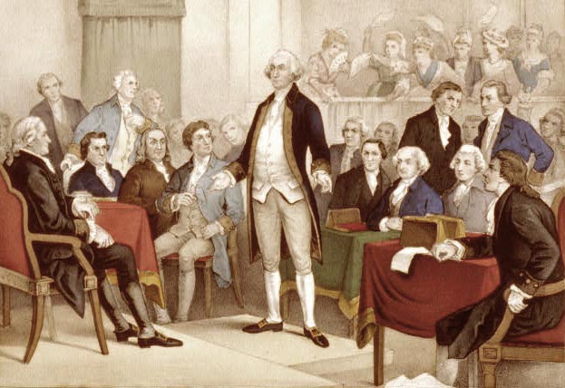
First Continental Congress
Sept. 5, 1774: The First Continental Congress met for the first time in Philadelphia
A heated debate followed, with some delegates demanding armed resistance to British rule and others arguing that the time had come to form a unified American government (akin to the Albany Plan of Union)

Slide 25
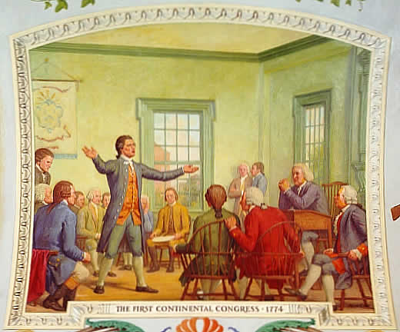
Declaration of Rights & Grievances
In the end, the Congress rejected both violent resistance and the creation of a central government in favor of a formal petition known as the Declaration of Rights and Grievances
The Declaration condemned the Intolerable Acts and announced an organized boycott of British goods, while still expressing loyalty to the King

Slide 26
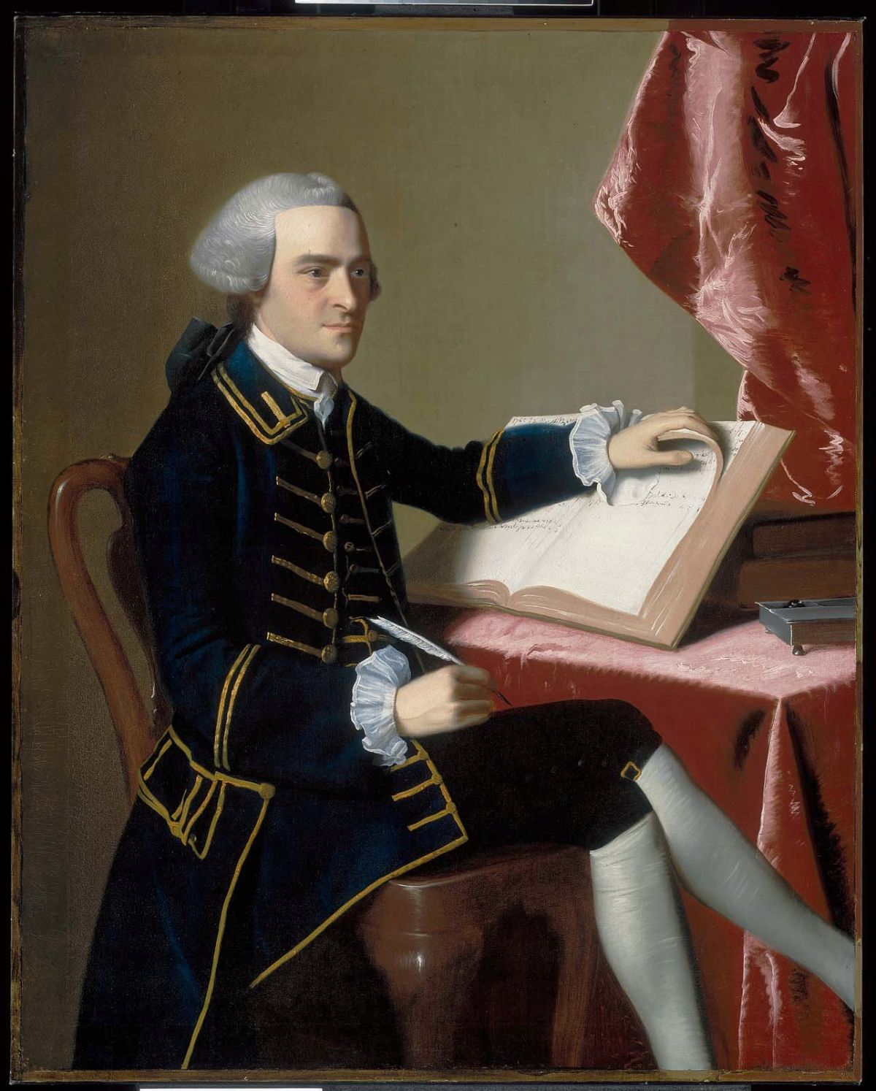
Massachusetts Rebels
Massachusetts, however, began openly defying the British by illegally creating their own Congress and electing John Hancock to be their head of state, even going so far as to authorizing him to raise an armed militia

Slide 27
The colonies prepare for War!

Slide 28
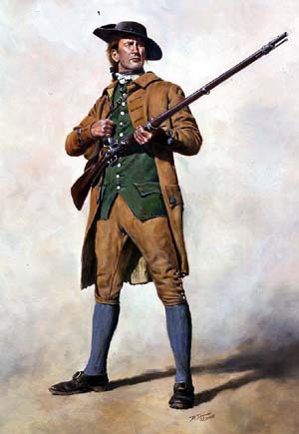
Minutemen
Across Massachusetts, militias began to drill and prepare to fight
The ideal was that these men should be ready to fight “at a minute’s notice,” earning them the nickname Minutemen
Other colonies, especially in New England, began to follow Massachusetts lead and defy English rule while preparing for war

Slide 29
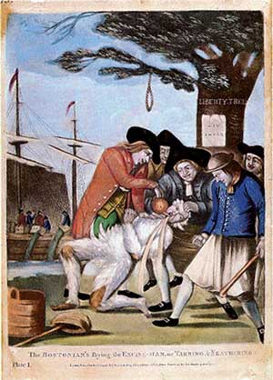
Loyalists
The move to throw off British rule was divisive, however – not every colonist supported independence and many remained loyal to the King
These came to be known as Loyalists or Tories, and came from all walks of life, but were especially strong amongst Anglican ministers, wealthy landowners, and frontier farmers (who needed British troops for protection from the Indians)
Loyalists were strongest in the South and in New York

Slide 30
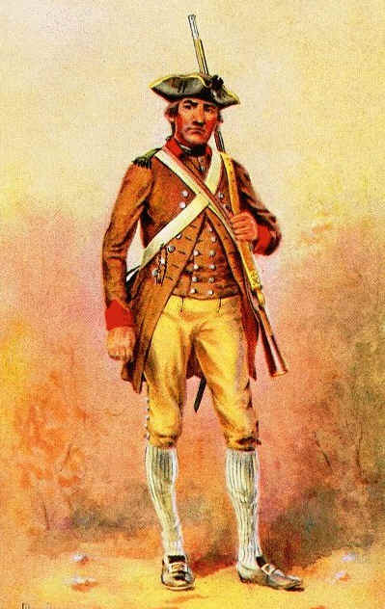
Patriots
Those who supported independence (or at least fighting for recognition of their rights as Englishmen) were called Patriots
Patriots were strongest in New England and Virginia and tended to come from the “middle class” background of artisans, urban workers, lawyers, and mid-size farmers

Slide 31
War begins…

Slide 32
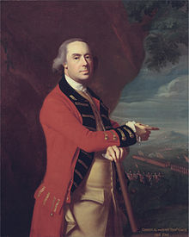
Gen. Gage Strikes
April 1775: Parliament ordered Gen. Gage to secure Massachusetts, even if it meant fighting, by arresting the Massachusetts Congress and securing all weapon and ammunition storage facilities used by the colonial militias
Redcoats began to march

Slide 33
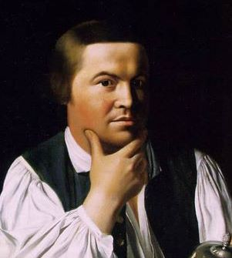

Slide 34
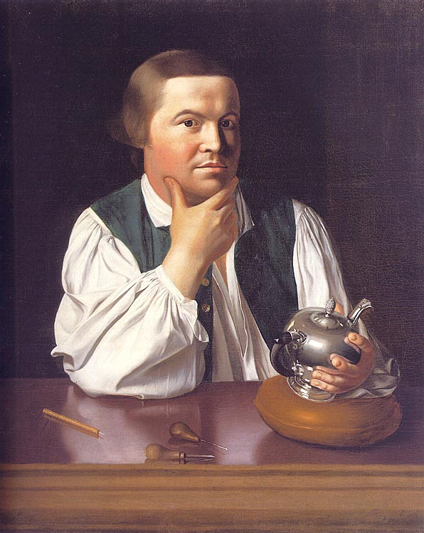
The British Are Coming?!
April 18, 1775: 700 British soldiers set out from Boston, under cover of darkness, to seize the weapons depots at Lexington and Concord, Mass.
Colonial sentries, including Paul Revere, who had been watching the British troops set out to warn the surrounding communities and to rouse the militias to action

Slide 35
Americans DO NOT like it when their right to arms is threatened!
“Guns are the teeth of liberty”
-Washington

Slide 36
“The Shot Heard Round ________?”

Slide 37
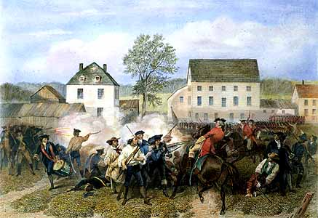
Battle of Lexington & Concord
April 19, 1775: British troops arrived in the town of Lexington and met 70 armed minutemen, leading to an exchange of gunfire; 8 minutemen were killed
Marching on to Concord, the British encountered a much larger force of 400+ minutemen and a larger battle ensued
Not expecting the amount of resistance, the British retreated back to Boston

Slide 38
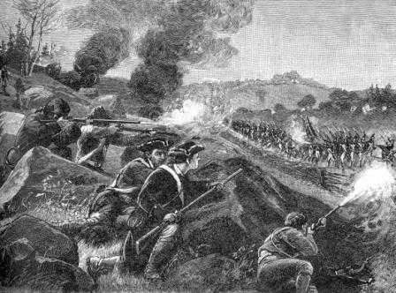
Battle of Lexington & Concord
During their retreat, the British were under constant fire, mostly from small pockets of militia they encountered, and lost 99 men with another 174 wounded before reaching the safety of Boston
Colonial dead totaled 49, with 46 more wounded

Slide 39
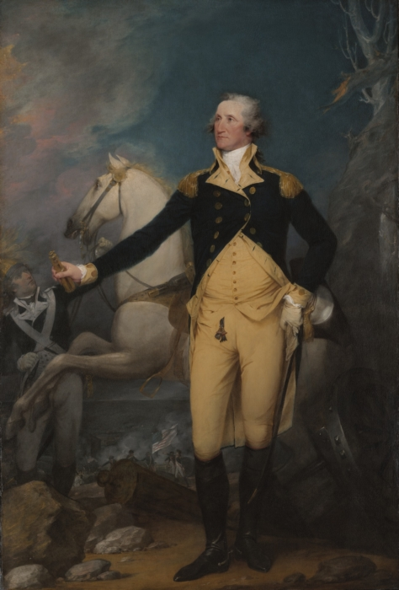
Second Continental Congress
Three weeks after the battles, the Second Continental Congress met in Philadelphia
The Congress voted to merge the various small militias into the Continental Army and to give command of that army to George Washington

Slide 40
The Revolutionary War has begun!

