Slide 1
A New Deal for America

Slide 2
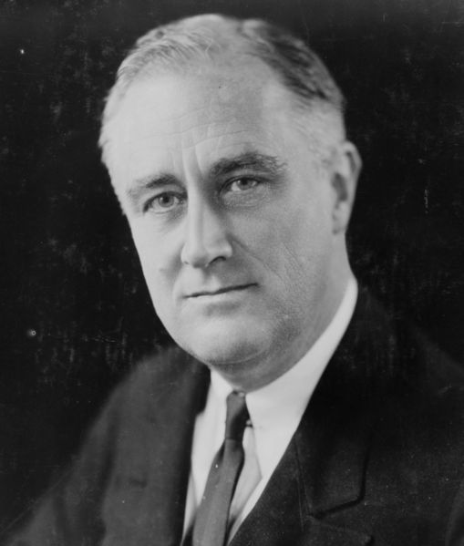
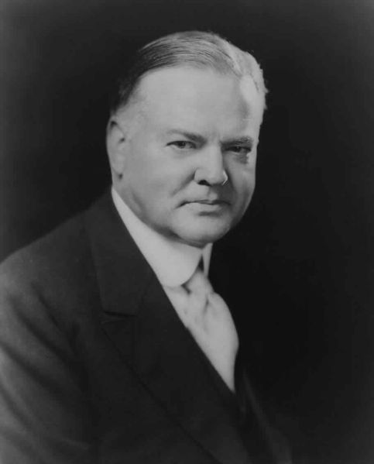
Election of 1932
Hoover vs. Roosevelt
FDR: 2-Term governor from New York
FDR wins in a landside
Notes:
2-Term governor from NY and distant cousin to TR
FDR: “Can Do” attitude
Roosevelt captured 23 million votes and Dems won nearly 2/3 of the Senate and ¾ of the House

Slide 3
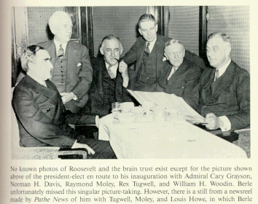
The Organizing of a Brain Trust
FDR had to wait 4 months to take office in March
  20th Amend. not until 1933
Selected a group of professionals (professors & lawyers) nicknamed the “Brain Trust”
Formulated the New Deal
3 Goals:
  Relief for the needy
  Economic recovery
  Financial reform
Notes:
Waited 4 months
20th Amendment not ratified until Feb ’33
Select group of lawyers, professors, journalists
Relief for the needy, economic recovery, and financial reform
Campaign Speech: “A New Deal for the American People”

Slide 4
The 1st New Deal
1933 & 1934

Slide 5
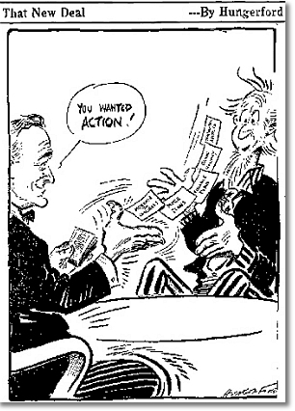
The First Hundred Days (March 9-June 16, 1933)
Passed 15 pieces of legislation
Declared a Bank Holiday
Emergency Banking Relief Act
  Allows Federal government to investigate banks
Helped to restore confidence in banks
Notes:
To prevent further withdrawals and failures
3 categories: those who were sound to reopen, those that were insolvent: those that could not pay their debts would remain closed and those that needed loans could get them
This restored confidence in the public that open banks were financially sound

Slide 6
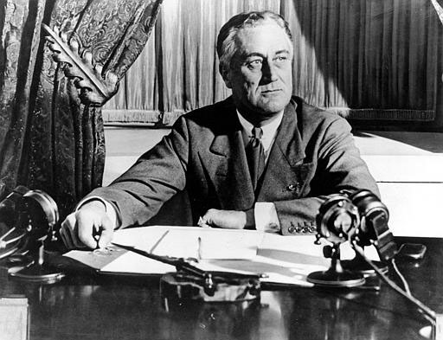
The Fireside Chat
March 12th First Fireside Chat
  A radio talk about public concern
He used clear, simple language
Restores confidence and optimism
Notes:
Done on March 12
for people to understand
Told them all cant demand savings in cash, not weak but cant handle that from everyone; many returned their savings in the following weeks

Slide 7

Regulating Banks
Glass-Stegal Act
  Creates the FDIC
  Insures bank accounts
    $5000
  Banks must follow guidelines setup by the government
Goal
  Prevent future “Bank Runs”

Slide 8

Regulating Stock Market
Federal Securities Act
  Creates the SEC
  Regulates stock market
  Makes Insider Trading illegal
Goal
  Prevent future crashes

Slide 9
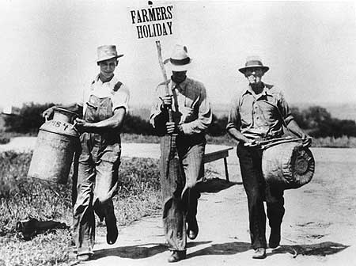
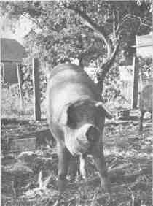

Rural Assistance:
Agriculture Adjustment Act (AAA)
AAA
  Government paid farmers to leave some land without crops
  Paid them to destroy their crops and slaughter their livestock
Goal
  Assist Farmers by increasing crop prices
Notes:
Agriculture Adjustment Act- paid farmers to leave amt of acres unseeded; $200million paid to plow 10million acres
Because too far along and many farmers were upset and people were starving;
Tennessee Valley Authority and and renovated 5 dams; gave jobs, flood control, and hydro power

Slide 10
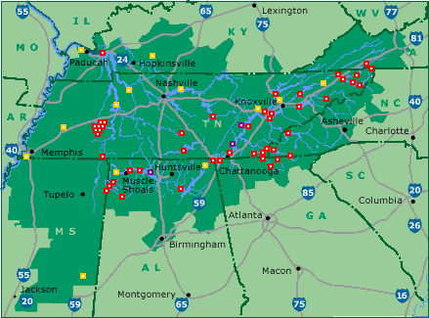
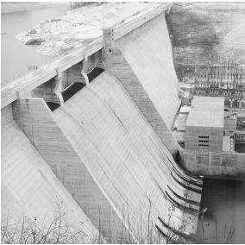
Rural Assistance:
Tennessee Valley Authority (TVA)
TVA
  Created to bring power to rural areas through building dams
Goal
  Create Jobs
Notes:
Tennessee Valley Authority and and renovated 5 dams; gave jobs, flood control, and hydro power

Slide 11

Providing Work Projects
Civilian Conservation Corps (CCC)
  “Unskilled” Men 17-28
  Worked to preserve natural resources and prevent erosion
    Paid $30 per month,
      $25 was sent home automatically
    Free food, lodging and uniform
  3 Million participants over 9 years
Notes:
Civilian Conservation Corp- Built parks, bridges, roads; sent $25 home
National Industrial Recovery Act- schools and community building construction
Civil Works Administration- claimed too many make work projects and a waste of money but built 40K schools and paid salaries of 500K rural school teachers and a half a million roads

Slide 12
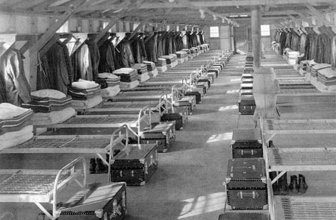
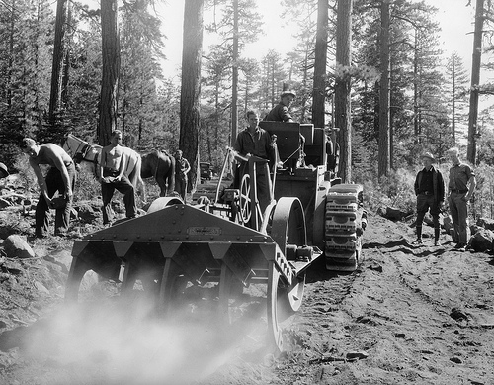


Slide 13
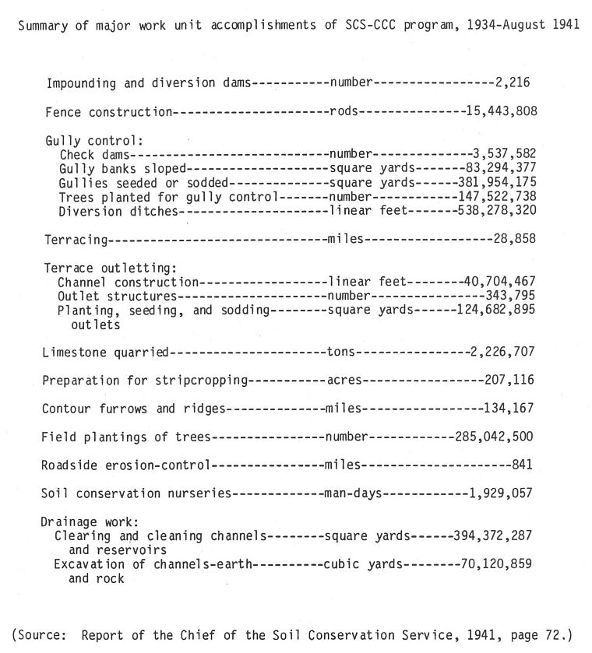

Slide 14
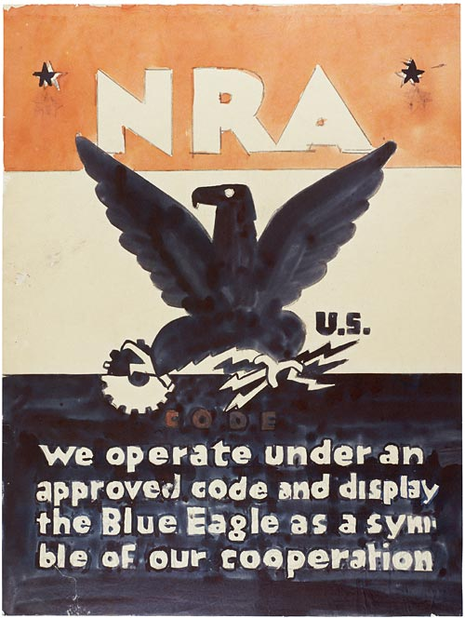
Promoting Fair Practices:
National Industrial Recovery Act (NIRA)
  Allows the Fed govt to regulate prices
  Goal: Prevent deflation
  Creates the…
    Nat. Recovery Admin
    Works Progress Admin
Notes:
National Recovery Administration- Set product prices and est. standards
Stop wage cuts, falling prices and layoffs
Set up by business and labor reps

Slide 15
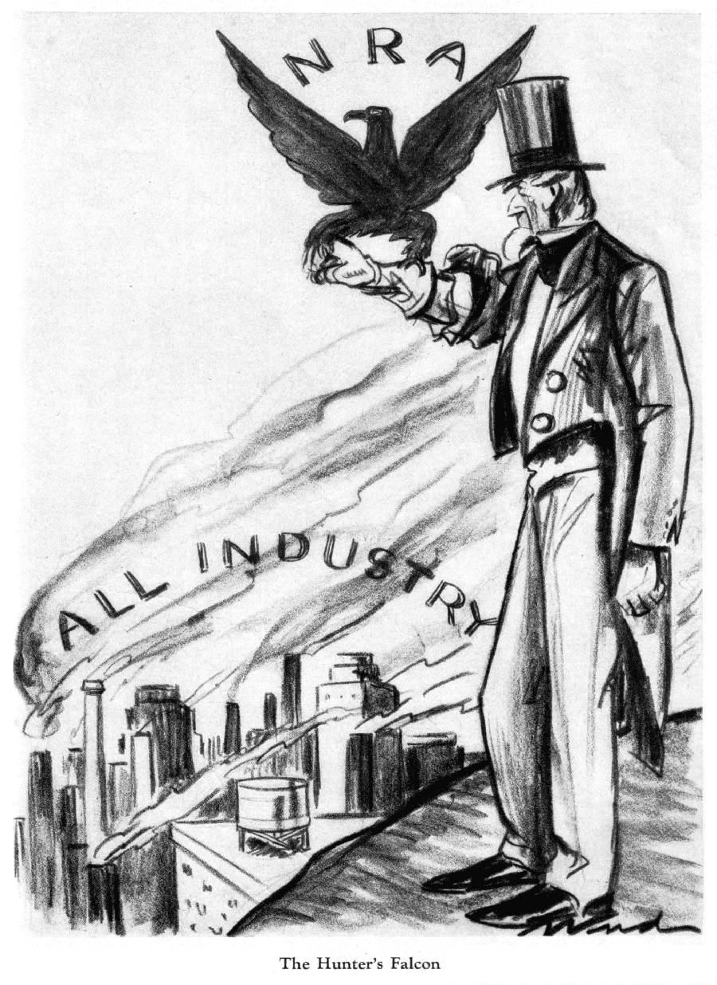
Promoting Fair Practices:
National Recovery Admin
  Goals:
    Protect right to Unionize
    Minimum wage laws
    Maximum work hours
    Minimum Prices for goods
  Declared Unconstitutional
    Regulating commerce that was not “interstate”
  Replaced by…
    Wagner Act 1935 - Unions
    Fair Labor Standards Act 1938 - Minimum Wage
Notes:
National Recovery Administration- Set product prices and est. standards
Stop wage cuts, falling prices and layoffs
Set up by business and labor reps

Slide 16
Date | Effective Date | Yrs w/o raise
1938 | $0.25
1939 | $0.30 | 0
1945 | $0.40 | 5
1950 | $0.75 | 4
1956 | $1.00 | 5
1961 | $1.15 | 4
1963 | $1.25 | 1
1967 | $1.40 | 3
1968 | $1.60 | 0
1974 | $2.00 | 5
1975 | $2.10 | 0
1976 | $2.30 | 0
1978 | $2.65 | 1
1979 | $2.90 | 0
1980 | $3.10 | 0
1981 | $3.35 | 0
1990 | $3.80 | 8
1991 | $4.25 | 0
1996 | $4.75 | 4
1997 | $5.15 | 0
2007 | $5.85 | 9
2008 | $6.55 | 0
2009 | $7.25 | 0
2017 | $7.25 | 7

Slide 17
The 2nd New Deal
1935 & 1936

Slide 18
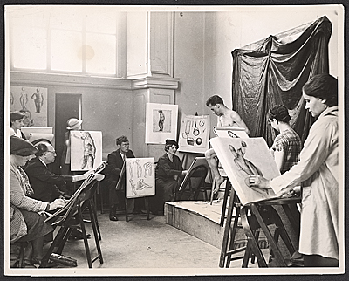

Works Progress Administration
Public Works
  Schools
  Buildings
  Parks
  Roads
Federal Project Number One
  Employed artists, musicians, actors, etc.

Slide 19
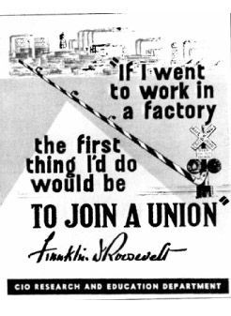
Wagner Act
The most important piece of labor legislation enacted in US History
Establishes the right of workers (in private companies) to unionize.

Slide 20
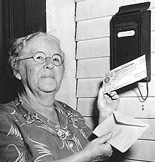
Social Security Act
Established a retirement program that would pay people after they stopped working
  Includes
    Elderly
    Unemployed
    Disabled
    Widows/Fatherless Children
he first monthly payment was issued on January 31, 1940 to Ida May Fuller of Ludlow, Vermont. In 1937, 1938 and 1939 she paid a total of $24.75 into the Social Security System. Her first check was for $22.54. After her second check, Fuller already had received more than she contributed over the three-year period. She lived to be 100 and collected a total of $22,888.92

Slide 21
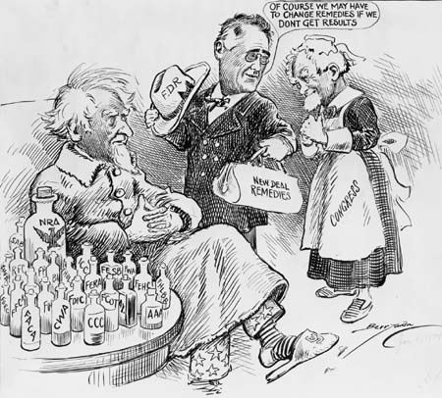

Slide 22
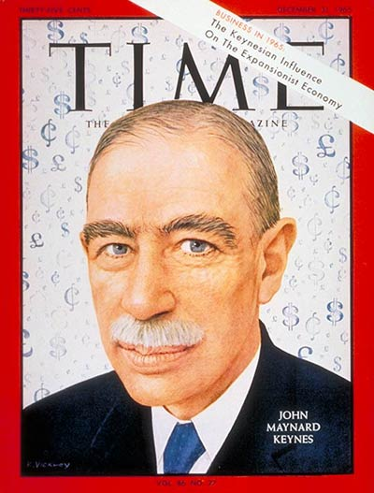
New Deal Under Attack
Policy of deficit spending was adopted to spend more money than the government receives in revenue developed by John Keynes
Liberal critics of the New Deal said it did not go far enough while Conservative critics said the programs spent too much

Slide 23
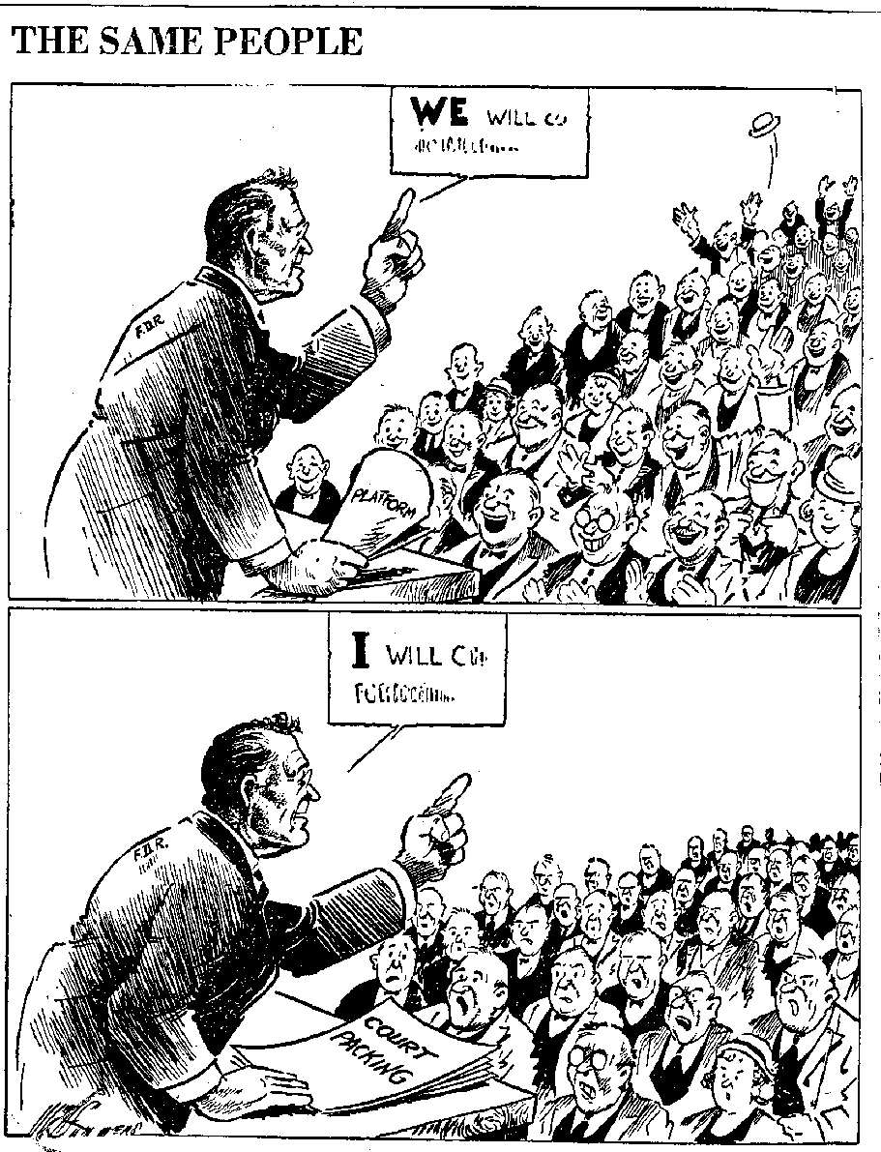
The Supreme Court Reacts
NIRA and AAA declared unconstitutional
In Response, FDR proposed a Bill to appoint 6 new Supreme Court justices
  AKA – “Court Packing”
The public and press turned against FDR with this scheme
The bill failed, but FDR appointed 7 justices because many began to retire
Notes:
Enforcement of industry codes in states went beyond the federal gov constitutional power to regulate interstate commerce; and agriculture a state matter
Retiring judges let him have his way in 4 years appointed 7 new justices

Slide 24
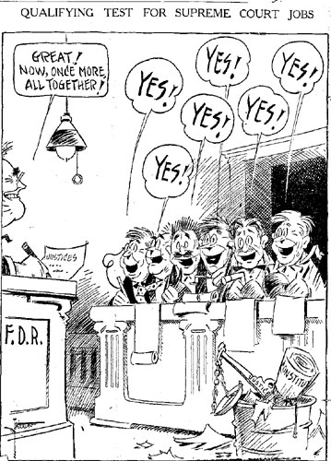

Slide 25
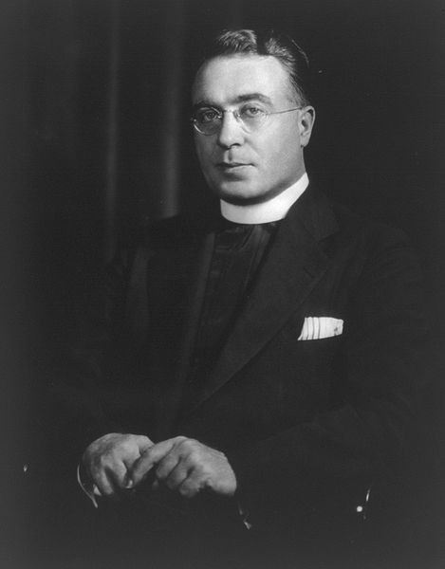
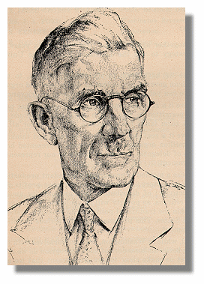
3 Fiery Critics
Father Charles Coughlin
  Initially supported FDR
  Later said FDR’s Reforms weren't enough
  Believed FDR was too easy on Bankers
  Favored guaranteed annual income and the nationalization of banks and railroads
Dr. Francis Townsend
  Promoted a plan to provide monthly benefits to the elderly
  His beliefs were eventually reflected by the Social Securities Act
Notes:
American Liberty League oppose New Deal Measures that violate rights of indiv and property
Caughlin supported then opposed the New Deal but became anti-semetic
Townend said not doing enough and got huge support

Slide 26
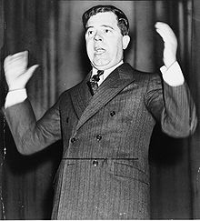
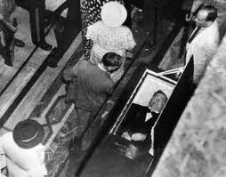
3 Fiery Critics
Huey Long (a.k.a. The Kingfish)
Louisiana Governor and Senator
Came up with a nationwide program called Share-Our-Wealth
Split from Dem Party and planned on running for President in 1936
Assassinated in ‘35
Notes:
Wanted to become president
Promised something for everyone
27K clubs with 7.5 million members; killed at height of popularity

Slide 27
Share-Our-Wealth
No person would be allowed to accumulate a personal net worth of more than 300 times the average family fortune, which would limit personal assets to between $5 million and $8 million. Annual incomes would be limited to $1 million and inheritances would be capped at $5 million.
Every family was to be guaranteed an annual family income of at least $2,000 to $2,500, or not less than one-third of the average annual family income in the United States. Yearly income, however, cannot exceed more than 300 times the size of the average family income.
An old-age pension would be made available for all persons over 60.
To balance agricultural production, the government would preserve/store surplus goods, abolishing the practice of destroying surplus food and other necessities due to lack of purchasing power.
Veterans would be paid what they were owed (a pension and healthcare benefits).
Free education and training for all students to have equal opportunities in all schools, colleges, universities, and other institutions for training in the professions and vocations of life.
The raising of revenue and taxes for the support of this program was to come from the reduction of swollen fortunes from the top, as well as for the support of public works to give employment whenever there may be any slackening necessary in private enterprise.

Slide 28
Effects of the New Deal
Many jobs are created
The banking system is stabilized
The Stock Market is regulated
Programs are created to help the elderly and the poor
Farmers are helped by the government
The government takes a more active role in the economy

Slide 29
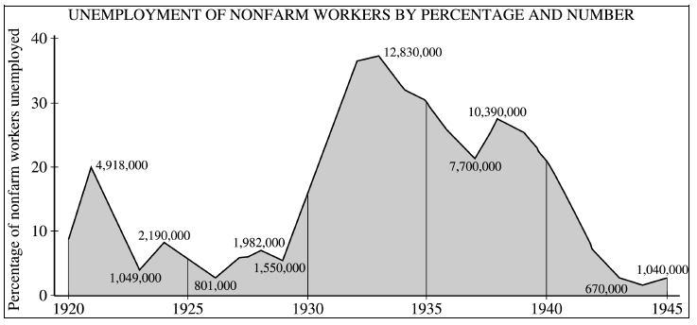
Did it work?
Recession of 1937
WWII
Recession of 37? WWII?

