Slide 1
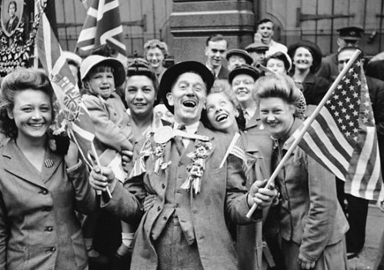
Post War America

Slide 2
Post WWII
Several new social issues emerge…
  Baby Boom
  Housing Crisis
  Economic Readjustment

Slide 3
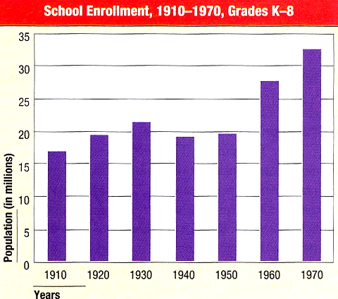
1. Baby Boom
- People born between 1945 and 1960
    Why did this happen?
Return of Soldiers from the War
End of the Great Depression
People have…
  More money
  More free time

Slide 4
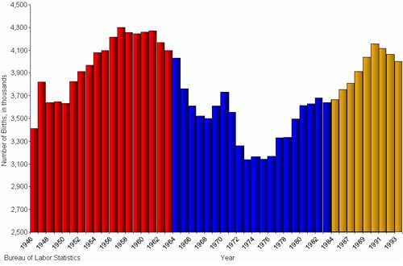

Slide 5

2. Housing Crisis
Causes
  Return of Soldiers
  Overcrowding cities
  Baby boomers
Solution:
  Rise of Suburbs
  William Levitt produced 150 houses per week
  $8000 or $60/month with no down payment
  All look the same

Slide 6
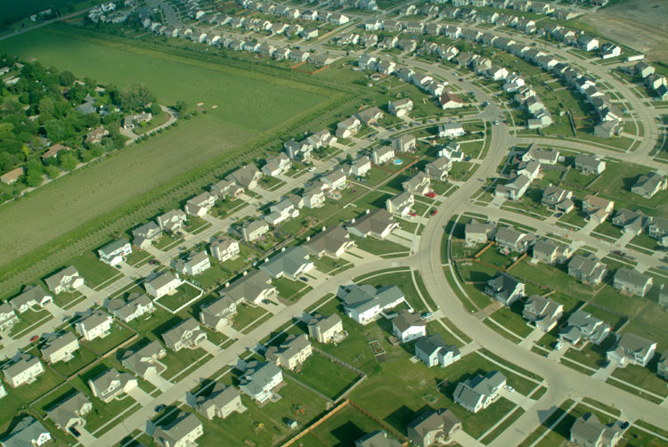
Housing Crisis
Levittown, L. I.: “The American Dream”

Slide 7
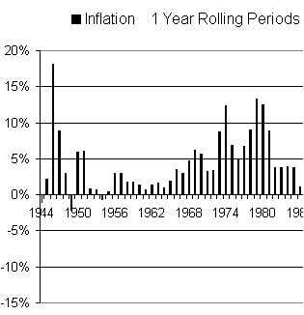
3. Economic Readjustment
Causes:
  Wartime to Peacetime Economy
  Accumulation of $ for the first time since 1920’s
  U.S. forced to lay off defense workers
  Rising unemployment
  Inflation
    Wages cant keep up
  Strikes
GI Bill 1944

Slide 8
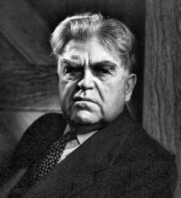
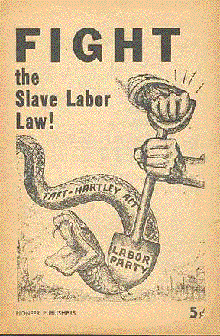
Labor Unrest
  United Mine Workers (John Lewis)
    40 day strike
    Truman orders govt seizure of mines
      Employers meet many of the demands
  The Rail Strike of 1946
    First ever complete shut down
    Strike ended 3 minutes before Truman orders army to seize railroads and to draft strikers
  Taft Hartley Act (a.k.a. “Slave Labor Bill”)
  Allows states to become “right to work states”
  Truman’s Veto overridden

Slide 9
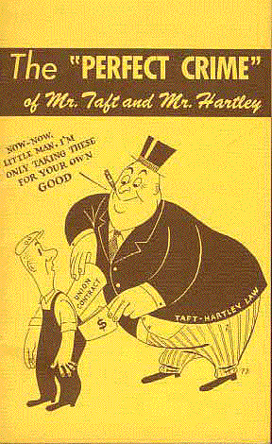
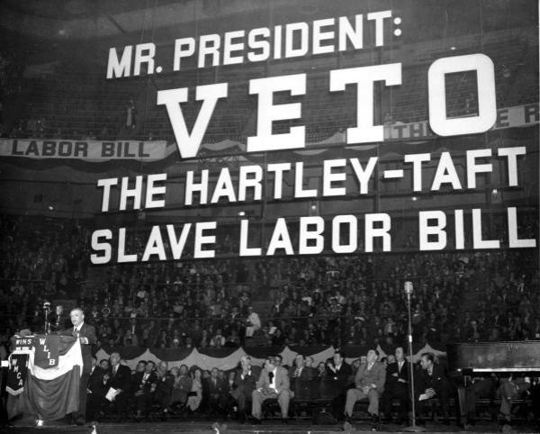

Slide 10
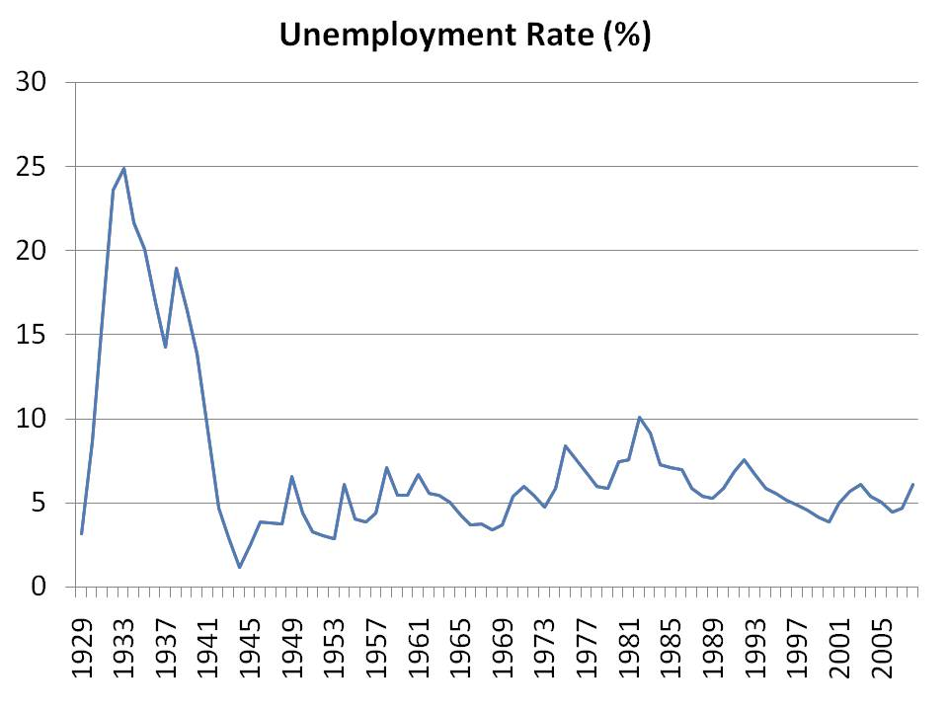

Slide 11
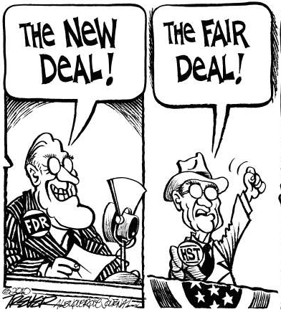
Truman’s Domestic Policy
Fair Deal:
- Extension of New Deal
Wanted to…
- Full Employment
- Raise Minimum Wage
  40 cents to 65 cents
- Create Public Housing
- Universal Healthcare
- Nationalize Atomic Energy
- Extend Social Security
- Aid to Education
-Aid to Scientific Research

Slide 12
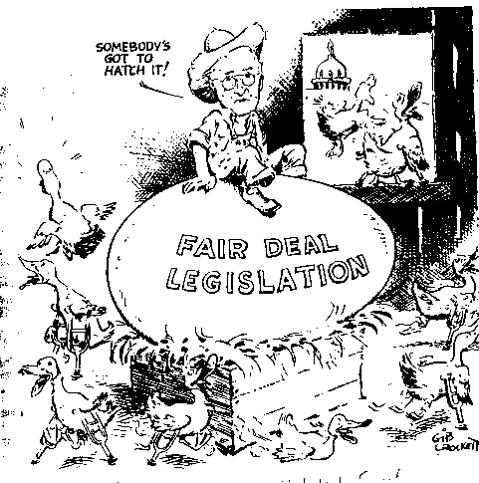
Fair Deal Rejected
Growing Conservative movement kills most of the plan
“Had Enough” midterm election
Alienates Southern Dems with proposal of Civil Rights Laws
Truman's popularity dropping quickly

Slide 13
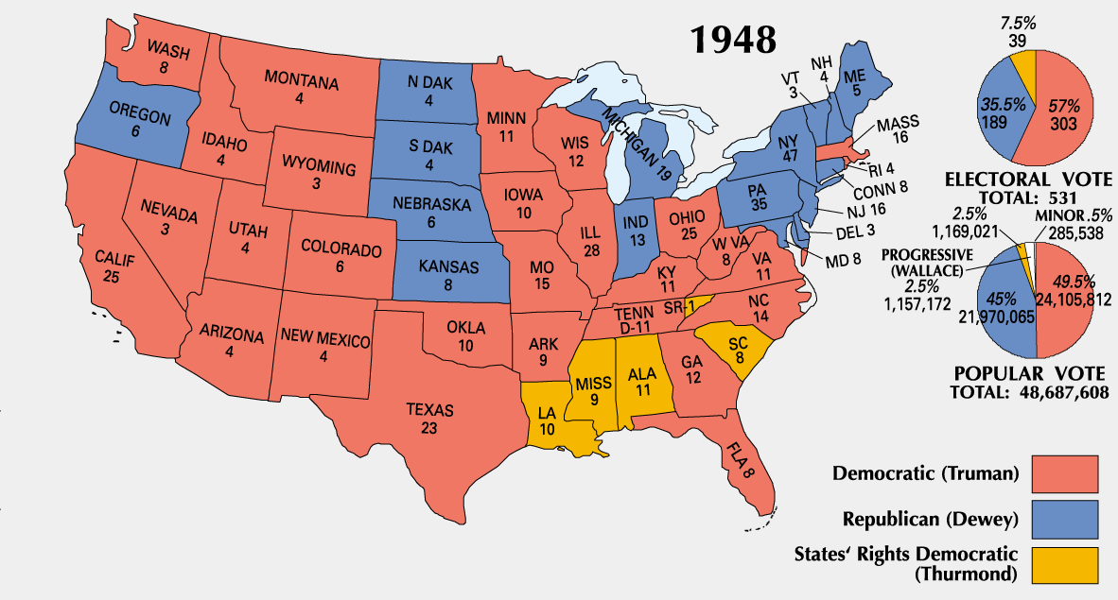
1948 Election
- Democrats (Truman) re-elected
- Dixiecrats (Strom Thurmond)
- Republican (Thomas Dewey)

Slide 14
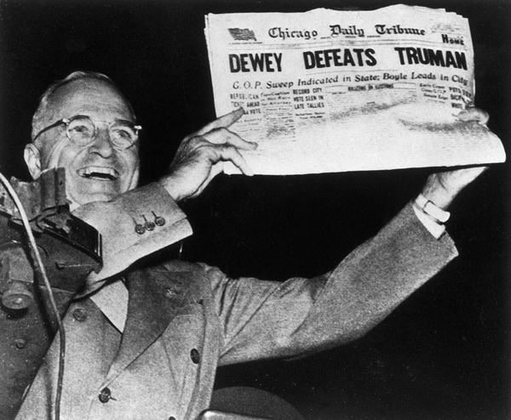

Slide 15
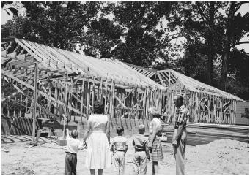
Fair Deal Revised
Minimum Raise
  Increased to 75 cents
Social Security
  Extended and Expanded
National Housing Act of 1949
  Provided 800,000 units of low income housing
Civil Rights
  Integrated Military
  Few significant Civil Rights laws passed, however change was clearly on the horizon

Slide 16
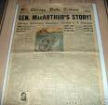
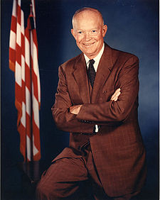
1951: Truman’s approval rate goes down
- Firing of 5 Star (Douglas MacArthur)
- Dwight D. Eisenhower elected President in 1953

Slide 17

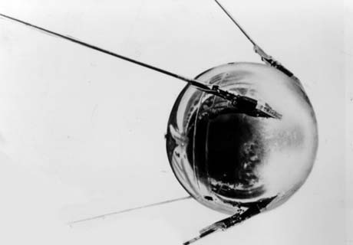
Progress Through Science
1957 → Russians launch SPUTNIK I
1958 → National Defense
Education Act

Slide 18
Progress Through Science
1951 -- First IBM Mainframe Computer
1952 -- Hydrogen Bomb Test
1953 -- DNA Structure Discovered
1954 -- Salk Vaccine Tested for Polio
1957 -- First Commercial U. S. Nuclear
Power Plant
1958 -- NASA Created
1959 -- Press Conference of the First 7
American Astronauts

Slide 19
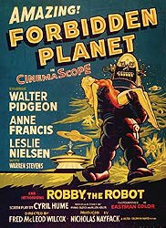
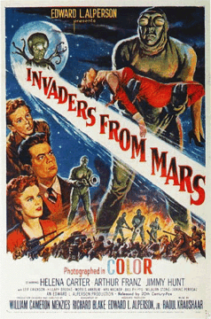
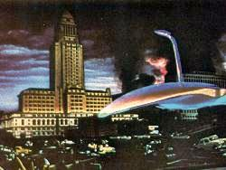
Progress Through Science
UFO Sightings skyrocketed in the 1950s.
War of the Worlds

Slide 20
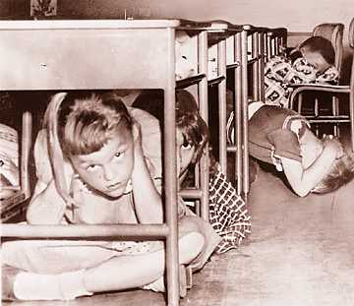

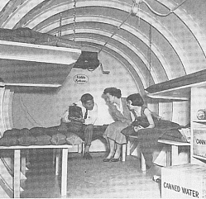
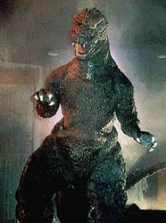
Progress Through Science
Atomic Anxieties:
  → “Duck-and-Cover
  Generation”
Atomic Testing:
  → 1946-1962 → U. S. exploded hundreds of nuclear weapons over the Pacific and in Nevada.

Slide 21
Consumerism: the buying of material goods = success
- $145 million on lawn/patio furniture
- planned obsolescence- products made with intention of becoming no good within a small amount of time.
- Diner’s Club –first credit card (1950)
- American Express (1958)
- Advertising: television becomes a powerful tool; symbol of popular culture

Slide 22
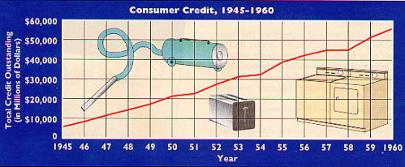
Consumerism
1950 → Introduction of the Diner’s Card
All babies were potential consumers who spearheaded a brand-new market for food, clothing, and shelter.
-- Life Magazine (May, 1958)

Slide 23
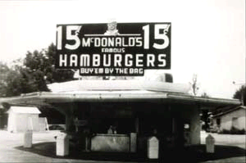
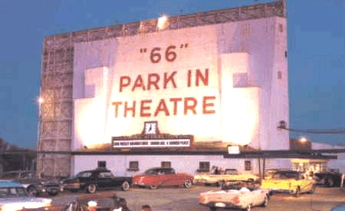
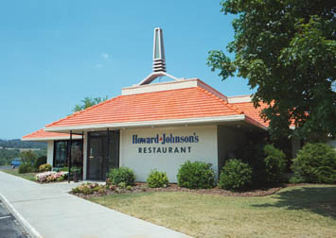
Suburban Lifestyle
1. Conglomerates: major corporation that has smaller unrelated industries.
2. Franchises: Company in different locations
First McDonald’s (1955- Ill.)
Drive-In Movies
Howard Johnson’s

Slide 24
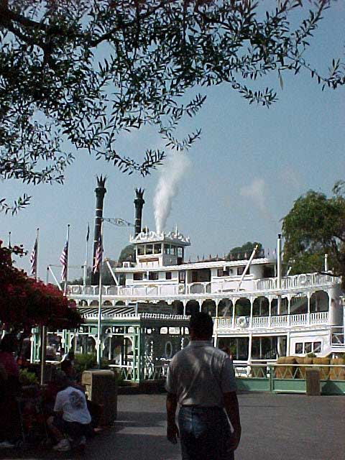
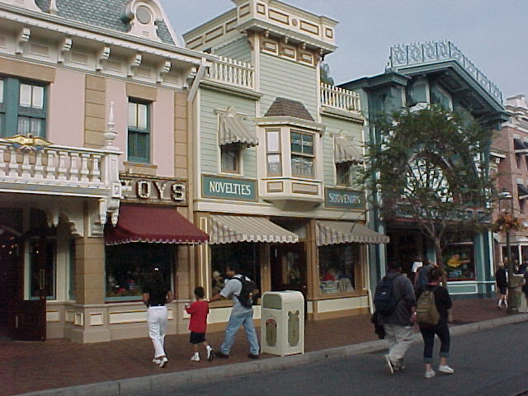
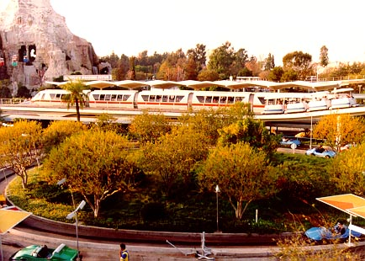
Suburban Lifestyle
The U. S. population was on the move in the 1950s.
NE & Mid-W → S & SW (“Sunbelt” states)
1955 → Disneyland opened in Southern California.
(40% of the guests came from outside
California, most by car.)
Frontier Land
Main Street
Tomorrow Land

Slide 25
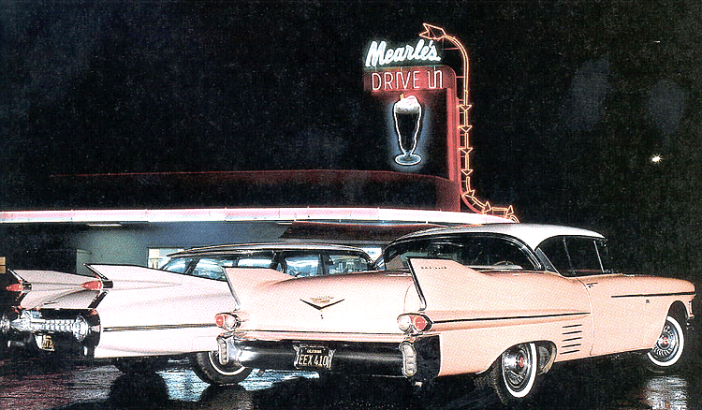
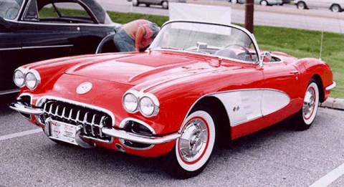
Suburban Lifestyle
Car registrations: 1945 → 25,000,000
1960 → 60,000,000
2-family cars doubles from 1951-1958
1958 Pink Cadillac
1959 Chevy Corvette
1956 → Interstate Highway Act → largest
public works project in American
history! Dwight D. Eisenhower
    → Cost $32 billion.
    → 41,000 miles of new highways built.

Slide 26
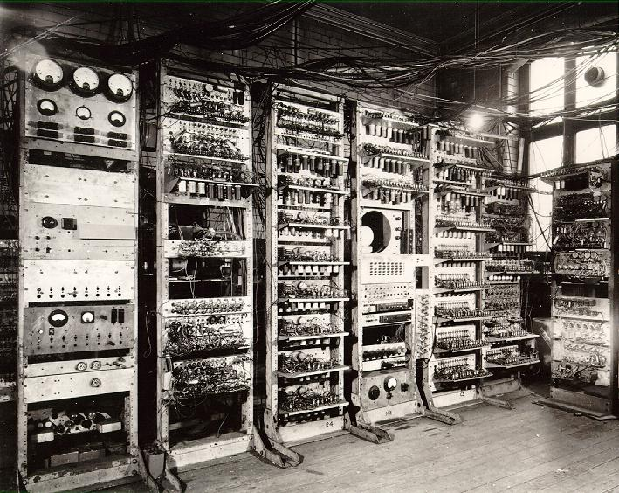
A Changing Workplace
Automation:
1947-1957 → factory workers decreased by
4.3%, eliminating 1.5 million
blue-collar jobs.
By 1956 → more white-collar than blue-collar
jobs in the U. S.
Computers → Mark I (1944). First IBM
mainframe computer (1951).

Slide 27
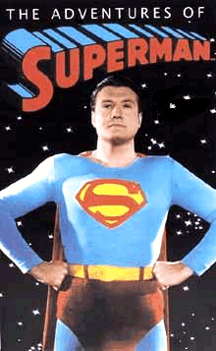
Mass Media
1939- Television available to general public
1946 → 7,000 TV sets in the U. S.
1950 → 50,000,000 TV sets in the U. S.
Television is a vast wasteland. → Newton Minnow, Chairman of the Federal Communications Commission, 1961
Mass Audience → TV celebrated traditional
American values.
Truth, Justice, and the American way!

Slide 28
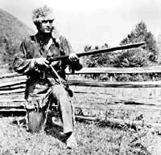
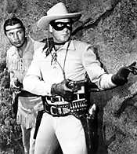
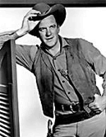
Mass Media
Davy Crockett
King of the Wild Frontier
Sheriff Matt Dillon, Gunsmoke
The Lone Ranger
(and his faithful
sidekick, Tonto):
Who is that masked man??

Slide 29
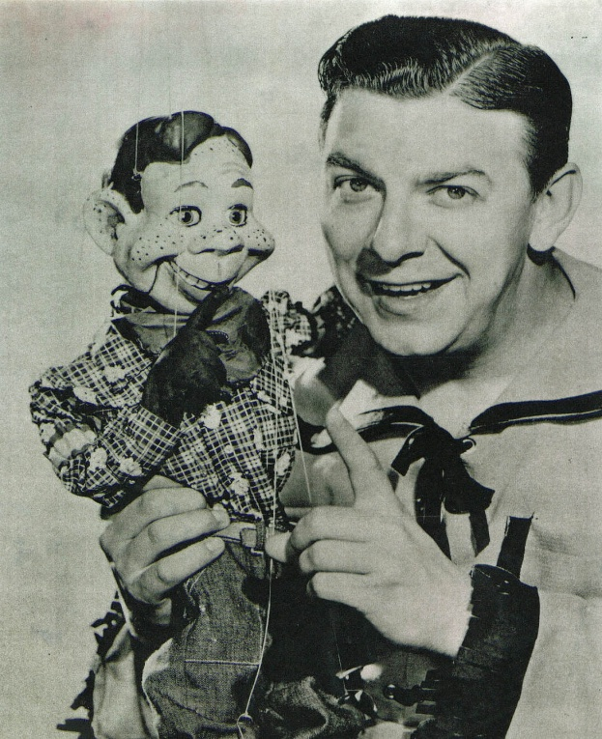
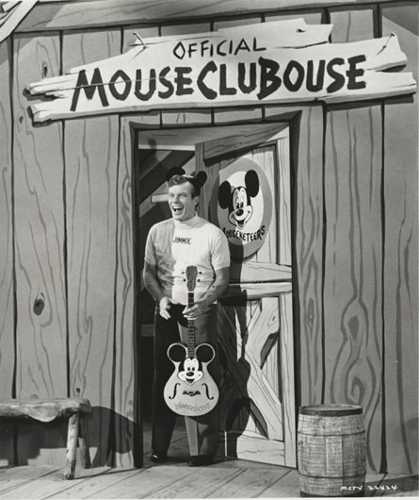
Mass Media
Children’s Programming
Mickey Mouse Club
Howdy Doody

Slide 30
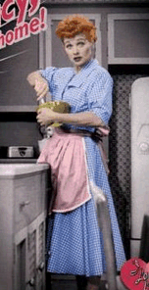
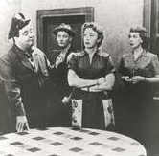
Mass Media
Glossy view of mostly
middle-class suburban life.
But...
I Love Lucy
The Honeymooners
Social Winners?... AND… Loosers?

Slide 31
Teen Culture
Behavioral Rules of the 1950s:
  → Obeyed Authority.
  → Control Your Emotions.
  → Don’t Make Waves → Fit in
  with the Group.

Slide 32
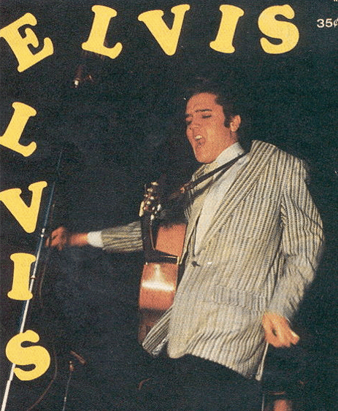
Teen Culture
In the 1950s → the word “teenager” entered
the American language.
By 1956 → 13 mil. teens with $7 bil. to spend
a year.
1951Alan Freed (Cleveland, Ohio)→ “ROCK ‘N ROLL”
Elvis Presley → “The King”

Slide 33
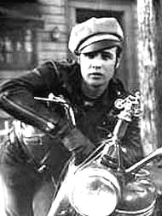
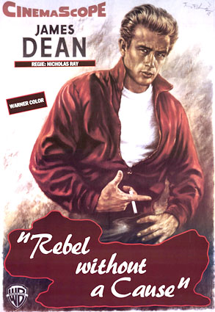
Teen Culture
“Juvenile Delinquency” ???
1951 → J. D. Salinger’s
A Catcher in the Rye
Marlon Brando in
The Wild One (1953)
James Dean in
Rebel Without a Cause (1955)

Slide 34
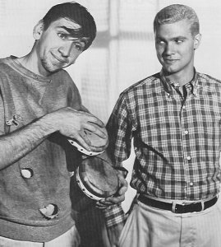
Teen Culture
The “Beat” Generation:
    Anti-Conformists
    “… the Beat Generation sold books, sold black turtleneck sweaters and bongos, berets and dark glasses, sold a way of life that seemed like dangerous fun—thus to be either condemned or imitated…”
“Beatnik”
“Clean” Teen

Slide 35
Religious Revival
Today in the U. S., the Christian faith is back in the center of things. -- Time magazine, 1954
Church membership: 1940 → 64,000,000
1960 → 114,000,000
Television Preachers:
1. Catholic Bishop Fulton J. Sheen → “Life is
Worth Living”
2. Methodist Minister Norman Vincent Peale →
The Power of Positive Thinking
3. Reverend Billy Graham → ecumenical message;
warned against the evils of Communism.

Slide 36
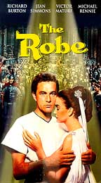
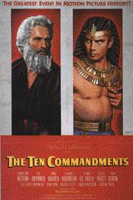
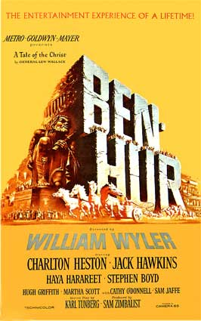
Religious Revival
Hollywood: apex of the biblical epics.
The Robe The Ten Commandments Ben Hur
1953 1956 1959
It’s un-American to be un-religious!
-- The Christian Century, 1954

Slide 37
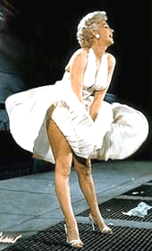

Well-Defined Gender Roles
The ideal modern woman married, cooked and
cared for her family, and kept herself busy by joining the local PTA and leading a troop of Campfire Girls. She entertained guests in her family’s suburban house and worked out on the trampoline to keep her size 12 figure.
-- Life magazine, 1956
Marilyn
Monroe
The ideal 1950s man was the provider, protector,
and the boss of the house. -- Life magazine, 1955
1956 → William H. Whyte, Jr. → The
Organization Man
    → a middle-class, white suburban
    male is the ideal.

Slide 38
The Other America
- Urban Poor
White flight: middle class America leaves cities for suburbs
1945-1960: 5 million African Americans move from rural South to urban areas
Growth of “inner cities” leads to Urban renewal: improved neighborhoods for minority groups

Slide 39

The Inner Cities

Slide 40



The 50s Come to a Close
Cold War ----->
Tensions
<----- Technology
& Affluence

