Slide 1
APA
7th Edition

Slide 2
What is APA?
American Psychological Association (APA) is a citation and formatting style for manuscripts in the Social Sciences
Most often used in:
  Psychology
  Linguistics
  Sociology
  Economics
  Criminology
  Nursing
  Business
APA Regulates:
  Stylistics
  In-text citations
  References

Slide 3
APA Point of View
First-person pronouns rather than third-person
  “We conducted an experiment…”
Active voice when stressing the actions of research
  “We asked participants questions…”
Passive voice when stressing the recipient or object of the action
  “The tests were inconclusive”
Language should be
  Clear: specific in description and explanations
  Concise: condense information when you can
  Plain: simple, descriptive adjectives and minimize figurative language

Slide 4
Types of APA Papers
Quantitative:
  Reports quantitative research, which uses empirical and numerical information often analyzed through statistical means.
  Includes:
    Title Page
    Abstract
    Introduction
    Method
    Results
    Discussion

Slide 5
Types of APA Papers
Qualitative:
  Reports qualitative research, which uses scientific practices to learn more about human experiences that cannot be numerically quantified.
  Includes:
    Title Page
    Abstract
    Introduction
    Method
    Findings/Results
    Discussion

Slide 6
Types of APA Papers
Literature Review:
  Summarizes scientific literature on a research topic
  A good literature review typically contains the following components:
    Introduction
    Thesis statement
    Summary and synthesis of sources
    List of References

Slide 7
APA General Format
An APA style paper should:
  Be typed on white 8.5“ x 11“ paper
  Double-space everything
  Use 10-12 pt. Times New Roman (or similar) font
  Set all margins to 1 inch on all sides

Slide 8
APA General Format
An APA style paper should include:
  The page number in the upper right
  Student papers do not require running headers
    A student paper is written for credit in a course

Slide 9
APA Paper Sections
An APA Style paper should include 4 major sections:
  Title Page
  Abstract
  Main Body
  References

Slide 10
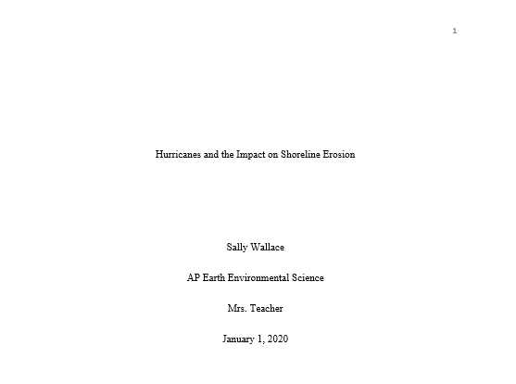
APA Title Page
Page number flush right
Title-Upper half of the page, centered
Name
Academic Department/Course Title
Instructor
Date

Slide 11
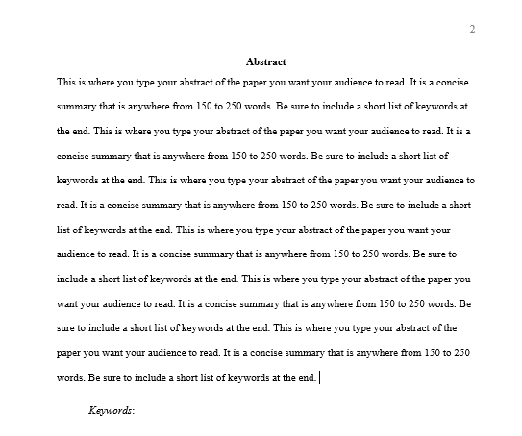
APA Abstract
Page number flush right
Double-space text
The word, Abstract, centered and bolded at the top of the page
Write a 150 - 250 word summary of the paper in a concise manner
  DO NOT indent the start of the paragraph
At the end of the abstract, provide a short list of keywords
  DO Indent the word, Keywords

Slide 12
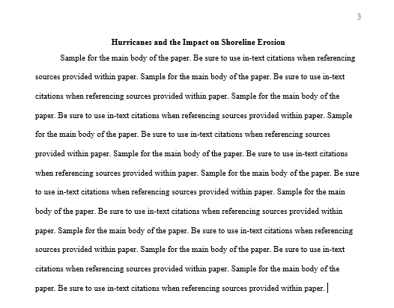
APA Main Body
Page number flush right
Center and bold the full title of the paper at the top of the page
DO indent the start of the paragraph
Double-space text
Identify sources used in the paper with in-text citations

Slide 13
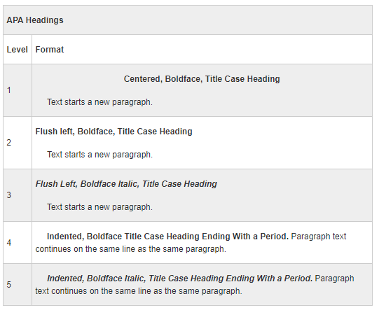
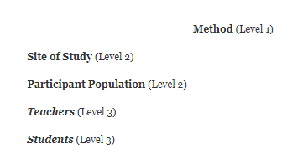
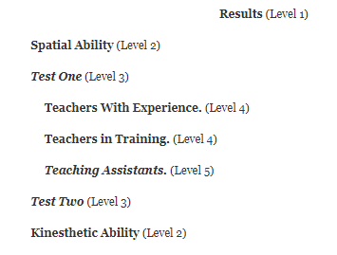
Formatting Section Headings Within Main Body
Example 1
Example 2

Slide 14
In-text
Citation

Slide 15
In-text Citation: The Basics
https://owl.purdue.edu/owl/research_and_citation/apa_style/apa_formatting_and_style_guide/in_text_citations_the_basics.html

Slide 16
In-text Citation: Author/Authors
https://owl.purdue.edu/owl/research_and_citation/apa_style/apa_formatting_and_style_guide/in_text_citations_author_authors.html

Slide 17
References

Slide 18
Reference Page
A Reference page is a list of the resources cited in the body of the paper
All in-text citations should be listed and match what is on the Reference page

Slide 19
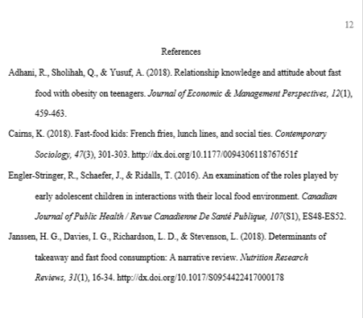
Reference Page
Start a new page
Center the title, References, at the top of the page. DO NOT bold it
Double-space reference entries
Flush left the first line of the entry and indent subsequent lines
Order entries alphabetically by the surname (last name) of the first author of each work

Slide 20
References: Basics
https://owl.purdue.edu/owl/research_and_citation/apa_style/apa_formatting_and_style_guide/reference_list_basic_rules.html

Slide 21
References: Author/Authors
https://owl.purdue.edu/owl/research_and_citation/apa_style/apa_formatting_and_style_guide/reference_list_author_authors.html

Slide 22
References: Periodicals
https://owl.purdue.edu/owl/research_and_citation/apa_style/apa_formatting_and_style_guide/reference_list_articles_in_periodicals.html

Slide 23
References: Books
https://owl.purdue.edu/owl/research_and_citation/apa_style/apa_formatting_and_style_guide/reference_list_books.html

Slide 24
References: Other Print Sources
https://owl.purdue.edu/owl/research_and_citation/apa_style/apa_formatting_and_style_guide/reference_list_other_print_sources.html

Slide 25
References: Electronic Sources
https://owl.purdue.edu/owl/research_and_citation/apa_style/apa_formatting_and_style_guide/reference_list_electronic_sources.html

Slide 26
References: Audiovisual Media
https://owl.purdue.edu/owl/research_and_citation/apa_style/apa_formatting_and_style_guide/reference_list_audiovisual_media.html

Slide 27
References: Other Non-Print Sources
https://owl.purdue.edu/owl/research_and_citation/apa_style/apa_formatting_and_style_guide/reference_list_other_non_print_sources.html

Slide 28
References: FAQs
https://owl.purdue.edu/owl/research_and_citation/apa_style/apa_formatting_and_style_guide/general_apa_faqs.html

Slide 29
SAMPLE APA PAPER
https://owl.purdue.edu/owl/research_and_citation/apa_style/apa_formatting_and_style_guide/apa_sample_paper.html

Slide 30
References
Perdue Online Writing Lab. (2020). APA formatting and style guide (7th Edition).
https://owl.purdue.edu/owl/research_and_citation/apa_style/apa_formatting_and_style_guide/general_format.html

