Slide 1
Practice Speaking Test

Slide 2
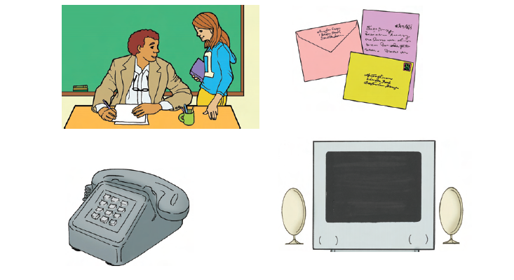
T1

Slide 3
Now its your turn.

Slide 4
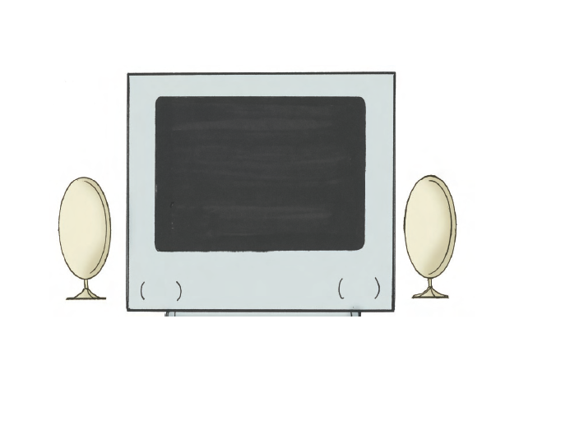
T2

Slide 5
T2—now it’s your turn.

Slide 6
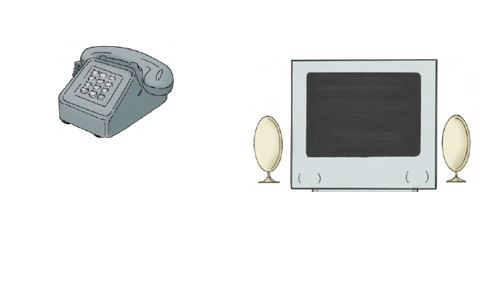
T3

Slide 7
T3—now it’s your turn.

Slide 8
T4

Slide 9
T4—Now it’s your turn.

Slide 10
T5

Slide 11
T5—Now it’s your turn.

