Slide 1
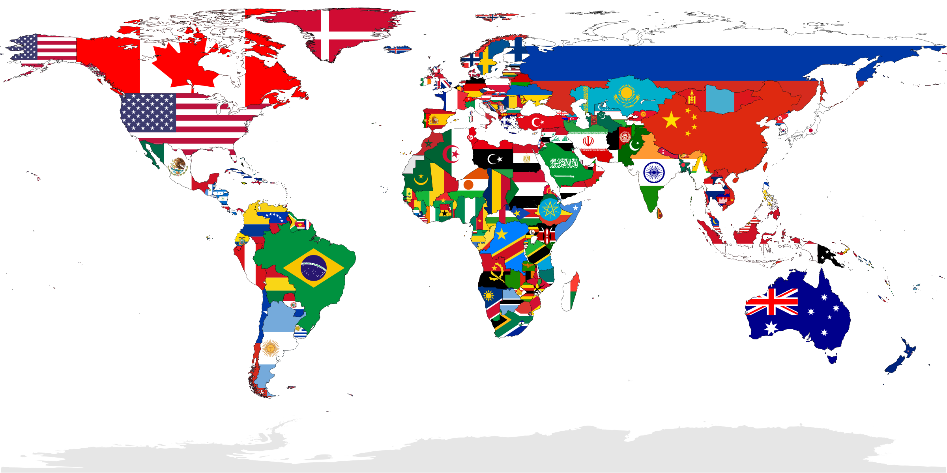
7th Grade Individuals and Socities
1400’s - Present Day

Slide 2
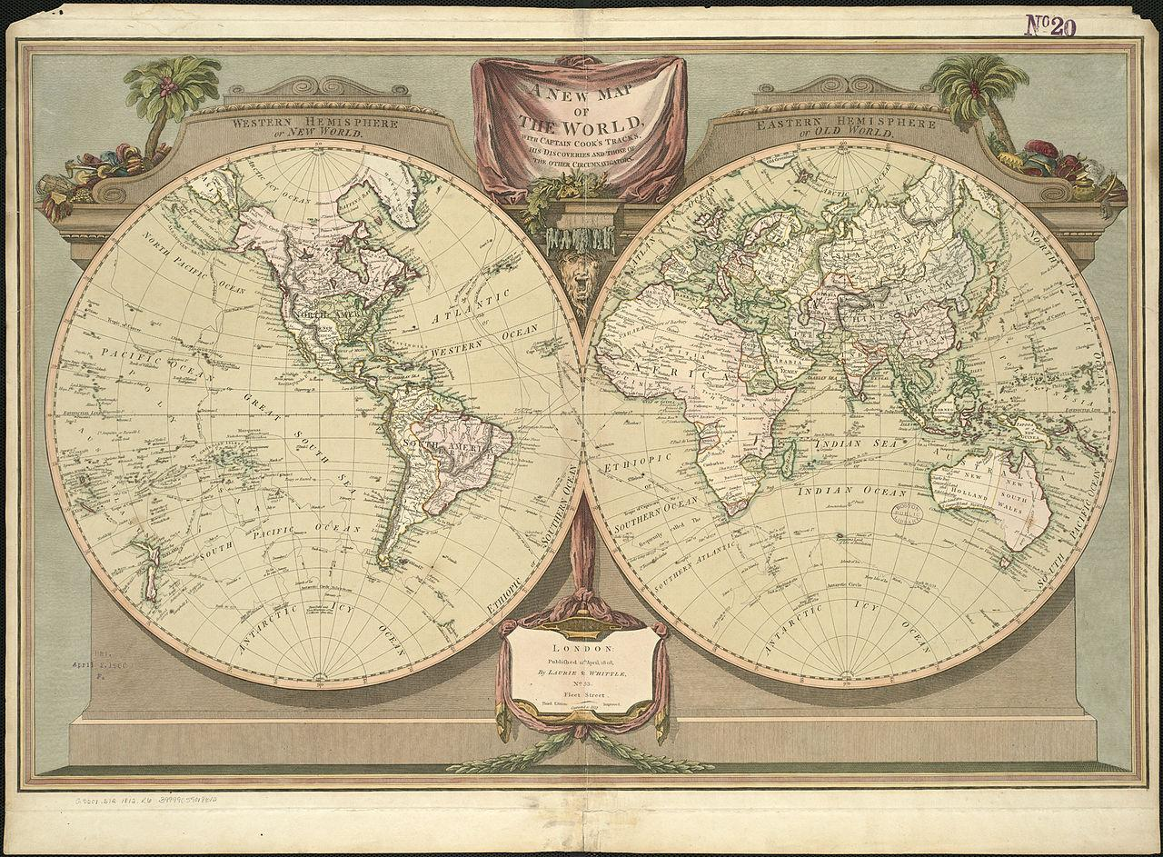
Unit 1 Interaction and Change
-Renaissance
-Scientific Revolution
-Age of Exploration
-Protestant Reformation

Slide 3
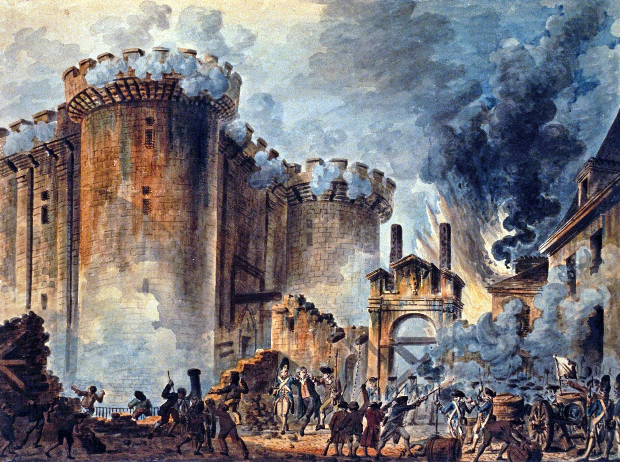
Unit 2 Revolution and Empire
-Absolutism
-Enlightenment
-Age of Revolution
(American,French,Russian,Latin American

Slide 4
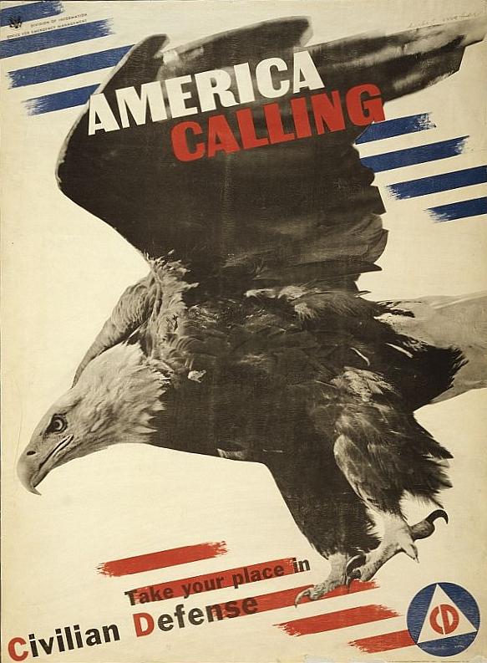
Unit 3 Global Conflict
-World War I
-Rise of Imperialism
-Rise of Dictators
-World War II

Slide 5
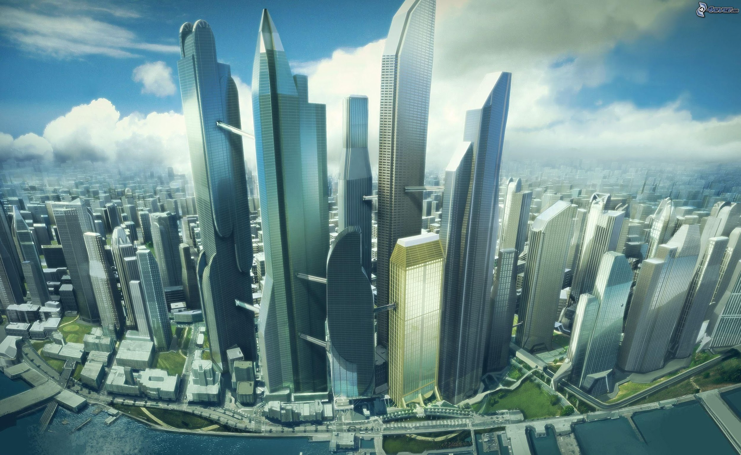
Unit 4 Emerging Modern World
-Cold War
-War on Terrorism
-Trade Policies
-Financial Literacy

