Slide 1
Relationships & Boundaries
4 types of relationships-Family- Friends-Casual-Romantic

Slide 2
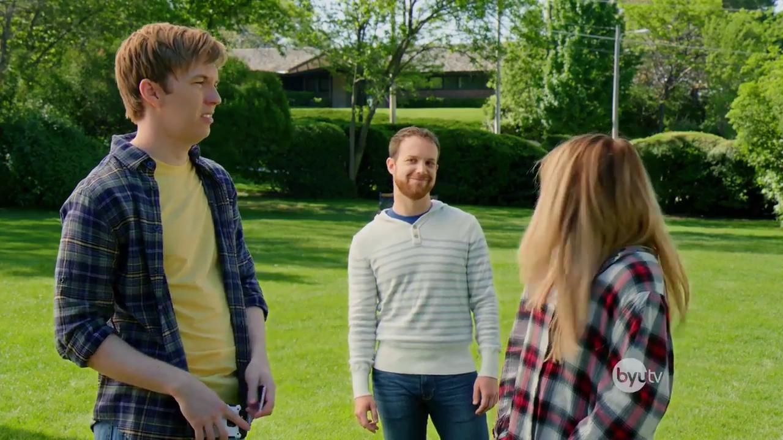
Sometimes relationships are complicated…..

Slide 3
Relationships
Think about what characteristics you want in a relationship.
What are your expectations?
Who do you want to spend time with?
How do you want them to treat you?

Slide 4
Healthy vs Unhealthy List 5 of each
In a HEALTHY relationship, you will feel
Secure
Loved
Safe
Free to be yourself
Valued
Acknowledged
Understood
Confident
In an UNHEALTHY relationship, you will feel
Anxious
Angry
Sad
Resentful
Pressured
Used
Ignored
Unsafe

Slide 5
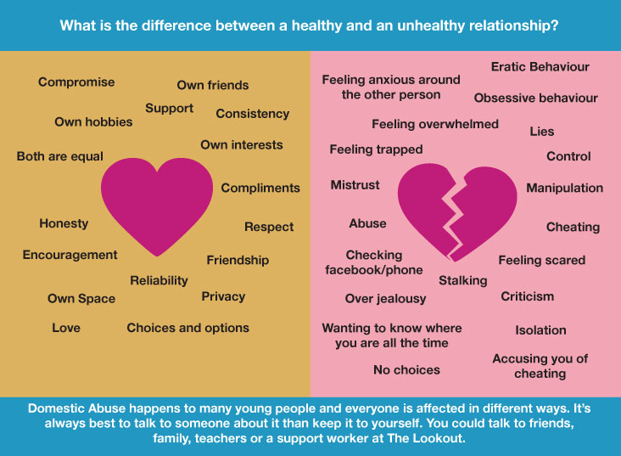
Healthy vs. Unhealthy

Slide 6
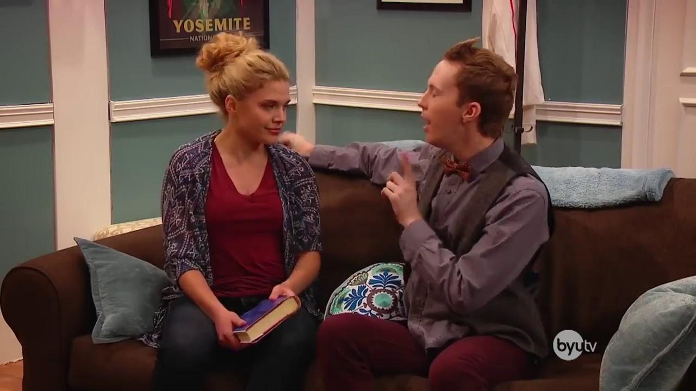
How tricky is it to understand boys/girls?

Slide 7
Keeping your relationships healthy?
List 3 ways you can damage a relationship.
List 3 ways you can strengthen a relationship.

Slide 8

Boundaries
Sometimes when we are “in love,” we make choices that we normally wouldn’t make.
This is why it is so important to establish your boundaries BEFORE you start dating.

Slide 9

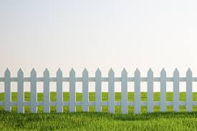
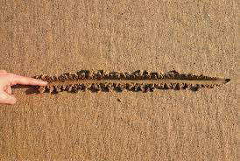

What is a boundary?
Guidelines, rules, or limits that a person sets in order to protect him or herself.
Think of them like laws - they are there to protect us, and keep us safe!

Slide 10
Why are boundaries important?
Here are some ideas:
They allow us privacy and comfort in our relationships.
They allow us to respect ourselves, and respect the rights of others
They allow us to develop healthy, strong and meaningful relationships

Slide 11
How do we set boundaries?
Talk to parents and family members about dating expectations, Talk about them.
Determine what is important to you
Decide now...
  What you will say
  How you will act
  What you will do

Slide 12
Respecting Boundaries
Consent is not... | Consent is...
Consent IS NOT the absence of, “No.” Consent IS NOT possible with the use of drugs or alcohol. Consent IS NOT valid if other cues are present that suggest, “No.” Consent IS NOT valid if coerced or manipulated | Permission for something to happen or agreement to do something. Consent IS the presence of a verbal, “Yes.”

Slide 13
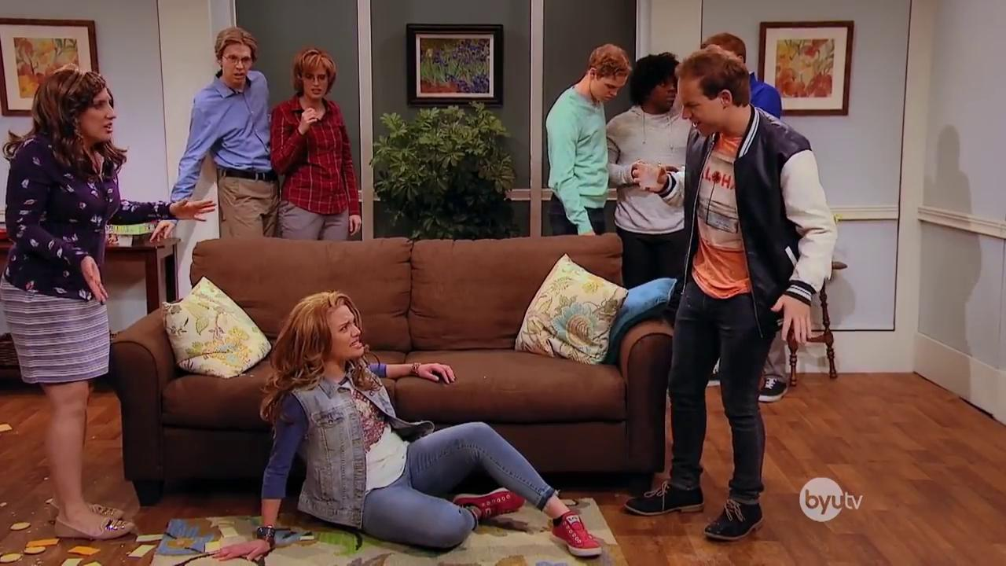
Make sure everyone is on the same page

Slide 14
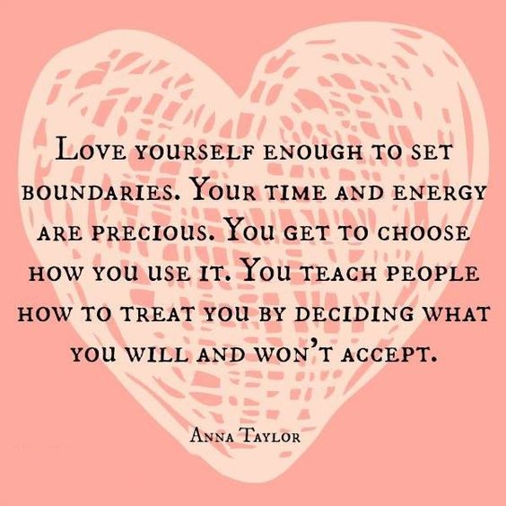
Love yourself!
Think of the 3 goals you have…write them down.
How might a unhealthy relationship impact you reaching your goals?
Don’t let anything stand in the way.

Slide 15
RelationSHIP Activity…..25 Min
Draw a picture of a ship in water.
ON YOUR SHIP: Write 4-5 things that make the relationship successful.
ON THE OUTSIDE OF YOUR SHIP: Write 4-5 things that can damage or destroy that relationship.
These should be colored neatly and your very best work.
WHEN FINISHED: Clean up your area and place your ship on your desk, face up.
Gallery Walk: You are going to walk around the room and look at other students ships. Notice 3 qualities for successful relationships and 3 qualities that damage relationships that you see are common among the ships or that stick out to you.

