Slide 1
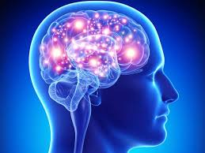
HL Topic 7
Further anatomy
Following on from SL Topic 1
Links to TOK:
Classical anatomical studies separate the human body into discrete systems. To what extent can separating components give us knowledge of the whole?
Links to Topic 12:
Genetics
Race
Suggested hours: 7
Leanne Farmer RCHK 2016

Slide 2
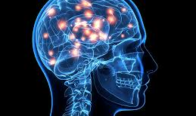
7.2 Structure and Function of the brain (obj 1)
https://www.theguardian.com/science/2016/apr/27/brain-atlas-showing-how-words-are-organised-neuroscience

Slide 3
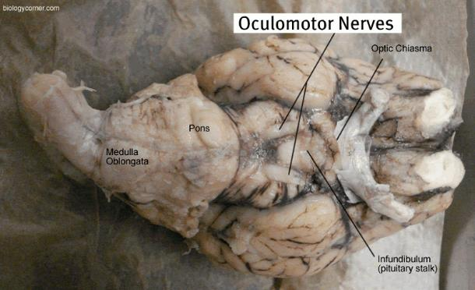
7.2.1 and 7.2.2 skills and practical
Skill: Be able to label a diagram of the brain.
Application: Brain dissection and locating the principal structures of the brain. (If possible, Pig?)

Slide 4
7.2.1 Label the following:
The brain stem
The diencephalon
The 2 hemispheres of the cerebrum
The cerebellum
https://www.youtube.com/results?search_query=cerebrum+within+brain
Skill: To build and label the different sections/lobes of the brain.
Application: Understand the principle lobes by using playdough / Play Doh to build a structure and label with toothpick flags.Application: Use website to see 3D view of the lobes and cerebrum. http://www.healthline.com/human-body-maps/brain

Slide 5
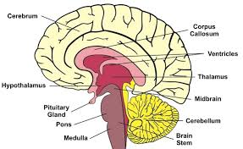
7.2.1 Label the location of the principal structures of the brain.

Slide 6
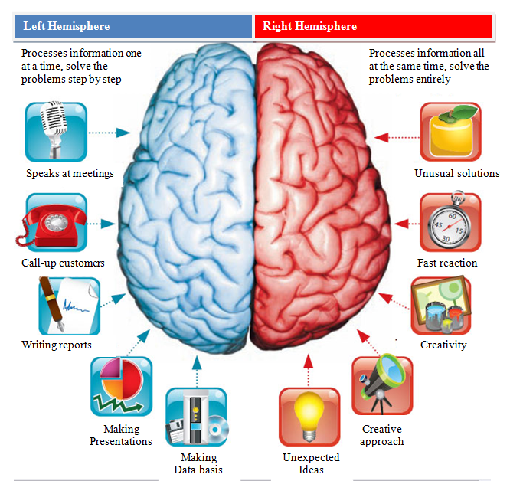
7.2.1 The 2 hemispheres of the cerebrum

Slide 7
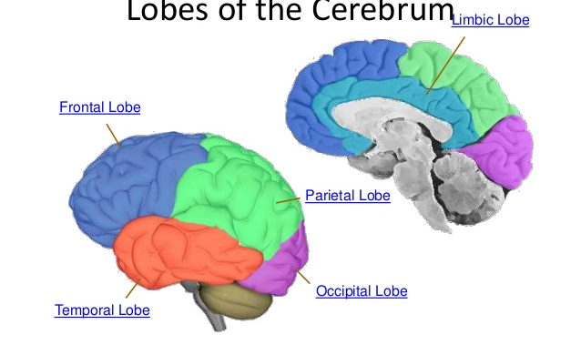
7.2.2 Principal lobes of the cerebrum. https://www.youtube.com/results?search_query=label+the+brain
(A bit corny but good explanation!)
Notes:
Application: Use website to see 3D view of the lobes and cerebrum. http://www.healthline.com/human-body-maps/brain

Slide 8
7.2.2 Label the following:
Frontal lobe
Parietal lobe
Occipital lobe
Temporal lobe
Limbic lobe
Skill: To build and label the different sections/lobes of the brain.
Application: Extension Task- With toothpick flags connect a photo to match the function of the brain e.g. occipital lobe has an attachment picture of a eye.

Slide 9
7.2.2 Label the lobes!
B
A
C
E
D
Notes:
A: Frontal Lobe. B: Limbic Lobe. C: Parietal Lobe. D: Temporal Lobe. E: Occipital Lobe.

Slide 10
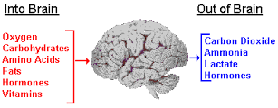
7.2.3 Outline blood supply to the brain
(obj 2)

Slide 11
7.2.3 Blood supply to the brain
For the brain to function it requires adequate supply of oxygen and nutrients.
These are supplied through a network of blood vessels.
Blood is supplied to the brain from 2 sets of vessels
1. Left and Right carotid arteries
2. Left and Right vertebral arteries
The Carotid arteries split in 2. External and Internal.
External – supply blood to face and scalp
Internal – supply blood to most of cerebrum

Slide 12
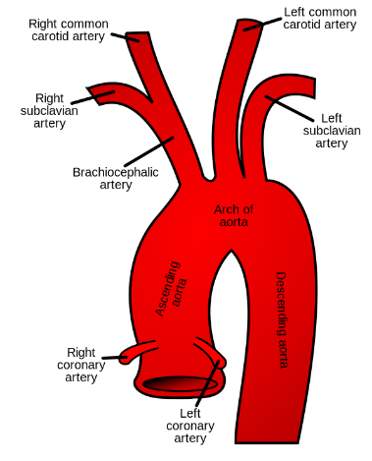
7.2.3 Blood supply to the brain
Brachiocephalic trunk
An artery that supplies blood to the right arm, head and neck.

Slide 13
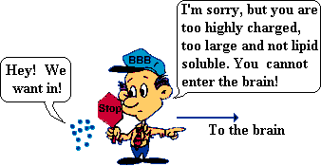
7.2.3 Blood supply to the brain
Blood-brain barrier (BBB)
This protects the brain from ‘foreign substances’ that may injure the brain.
Maintains a constant environment for the brain.
It is a highly selective barrier that separates the circulating blood from the brain extracellular fluid in the CNS.

Slide 14
7.2.4 Describe the principal source of energy for brain cells (obj 2)
Brain obtains energy using glucose and oxygen, which pass rapidly from the blood to the brain cells.
Aerobic respiration helps to make ATP within the brain.
CHO storage in the brain is limited, so the supply of glucose must be continuous.
If blood entering brain is low on glucose or oxygen,we can suffer:
mental confusion, dizziness, convulsions and loss of consciousness
https://www.youtube.com/watch?v=bTUGw9EzAX4
(Linked to Topic 3 Energy Systems)

Slide 15
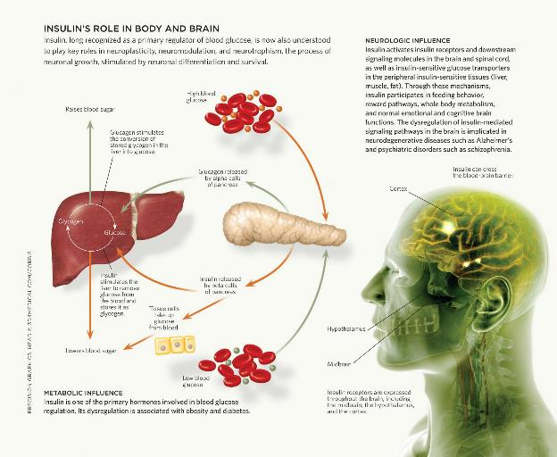
7.2.4 Energy to brain cells

Slide 16
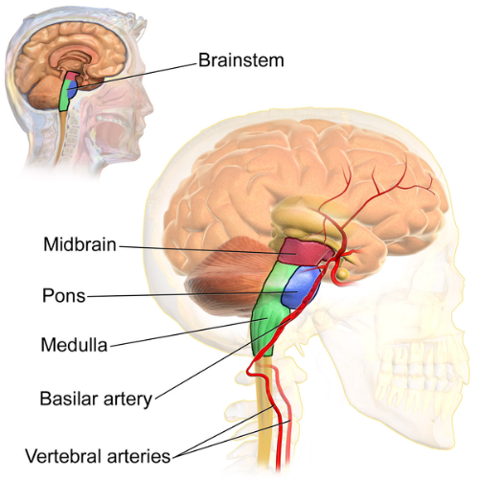
7.2.5 Explain the function of the principal parts of the brain (obj 3)
Brain stem:
Regulates vital body functions such as cardiac and respiratory functions and acts as a vehicle for sensory information.

Slide 17
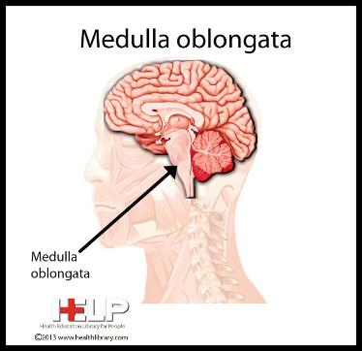
7.2.5 Brain Stem
Posterior part of the brain adjoining the spinal cord.
It is the control centre for the regulation of cardiac and respiratory function, consciousness and sleep cycle.
It is made up of MEDULLA OBLONGATA, PONS AND MIDBRAIN.
Medulla Oblongata regulates breathing, heart and blood vessel function.
It is the centre for respiration and circulation.

Slide 18
7.2.5 Brain Stem - Diencephalon
Diencephalon is located at the upper end of the brain stem.
Made up of 4 components but we will look at only 2:
THALAMUS
Sensations – pain, temperature, pressure, cognition.
HYPOTHALAMUS
Control of autonomic nervous system (ANS).
Heart rate, blood pressure, pituitary gland, body temp,appetite, thirst, fluid and electrolyte balance, circadian rhythms.

Slide 19
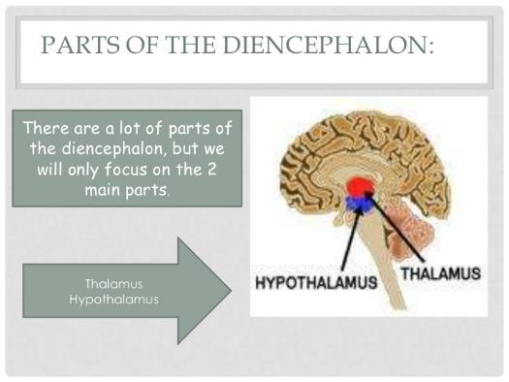
7.2.5 Diencephalon http://study.com/academy/lesson/diencephalon-definition-location-function.html (if have an account) https://www.youtube.com/watch?v=9jDBRpudd6U
Link to Topic 8

Slide 20
7.2.5 Cerebrum
The Cerebrum is responsible for high-level brain functions such as thinking, language, emotion and motivation.
The function has 3 broad processes:
1. Sensory (receiving sensory impulses
2. Association (interpreting and storing input and initiating a response)
3. Motor (transmitting impulses to effectors)
https://www.youtube.com/results?search_query=cerebrum

Slide 21
7.2.5 Cerebrum
Within the cerebrum, there are 5 lobes.
Although the lobes do not function independently, each lobe is associated with:
1. Frontal lobe
2. Parietal lobe
3. Occipital lobe
4. Temporal lobe
5. Limbic lobe

Slide 22
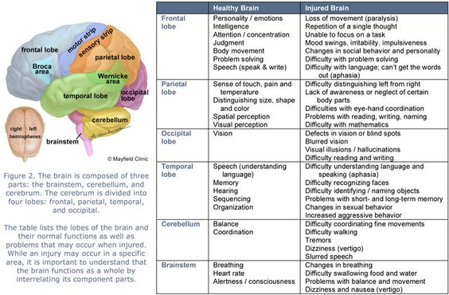
7.2.5 Cerebrum

Slide 23
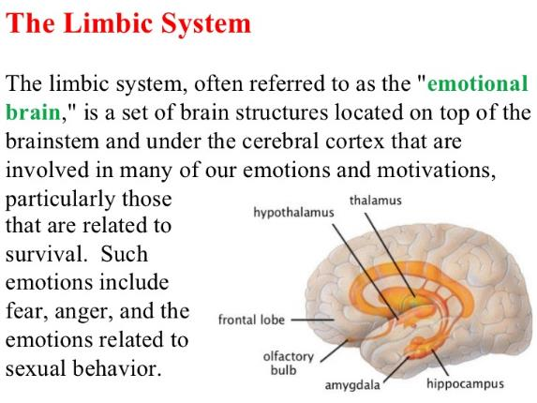
7.2.5 Cerebrum
…and Limbic lobe
Processes emotion, behaviour, motivation, long term memory.

Slide 24
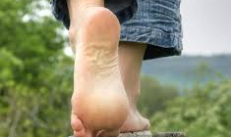
7.2.5 Cerebellum

Slide 25
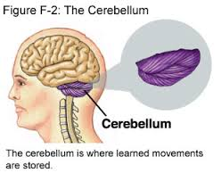
7.2.5 Cerebellum
The Cerebellum is responsible for coordinating movements, regulate balance, posture and helps skilled motor activities such as catching a ball to dancing.
Walnut shaped
Located at the top part of brain stem
It receives information from sensory systems, the spinal cord.
https://www.youtube.com/watch?v=FkJvl3qhDb4

