Slide 1

Statistical Analysis
Standard Level Diploma

Slide 2
What is statistics?
Even though you may not have realized it, you probably have made some statistical statements in your everyday conversation or thinking. Statements like "I sleep for about eight hours per night on average" and "You are more likely to pass the exam if you start preparing earlier" are actually statistical in nature.
Statistics is a discipline which is concerned with:
  designing experiments and other data collection,
  summarizing information to aid understanding,
  drawing conclusions from data, and
  estimating the present or predicting the future.

Slide 3

Why start with statistics?
You will need to design your own experiments and collect your own data
You need to know whether your data is ‘statistically significant’ and also whether is SPECIFIC, ACCURATE, RELIABLE and VALID.
Ideally you want to do the majority of this in year 12 so you can focus on your exams in year 13

Slide 4
Statistical Analysis
Sample = the world leading long jumps by men and women each year.
Calculate the mean (µ) =
add up all the numbers and divide by the population size

Slide 5
Statistical Analysis
Standard Deviation (∂)=
used to summarise the spread of values around the mean

Slide 6
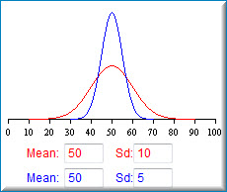

Slide 7
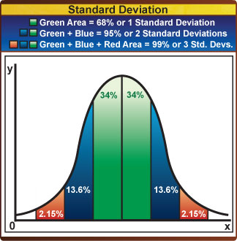
Statistical Analysis
Within a normal distribution approximately 68% and 95% of the values fall within plus or minus one or two standard deviations respectively.
World average for 100m

Slide 8
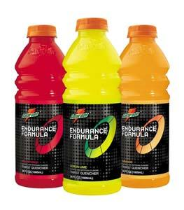
So why is SD important??
WHO CAN DRAW A SIMPLE
GRAPH WITH ERROR BARS
SHOWING THIS DATA?
2 Sports Drinks both claim to improve sprint performance on average by 10% (mean)
Q. What else do you notice about the number of tests??
A | 10 | 9.5 | 9 | 11 | 10.5 | 10.5 | 9.5 | 8 | 12 | 10 | 1.1
B | 10 | 2 | 18 | 19 | 1 | 17 | 3 | 19.8 | 0.2 | 10 | 8.5

Slide 9
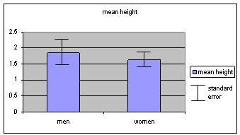
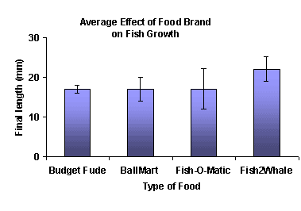
Error Bars

Slide 10
Can everyone now calculate their mean, standard deviation and co-efficient of variance for both sets of results
Co-efficient of variance (v)
The ratio of the standard deviation to the mean expressed as a percentage.
V= 100 x SD
Mean
What do you think the co-efficient of variance tells us??

Slide 11
We will now conduct a t-test in excel on our results.
The t-test tells us whether two sets of data are statistically significantly
We also need to work out the P value (probability that the results are caused by chance) needs to be less than 0.05 (5%). If they are <0.05 then they are thought to be statistically significant.
What type of t-test was this?
Why is it not an un-paired or independent t-test?
Lets watch this video

Slide 12
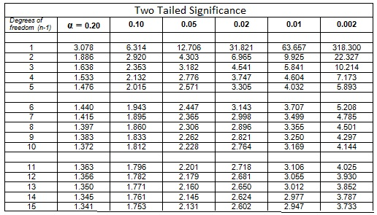

Slide 13
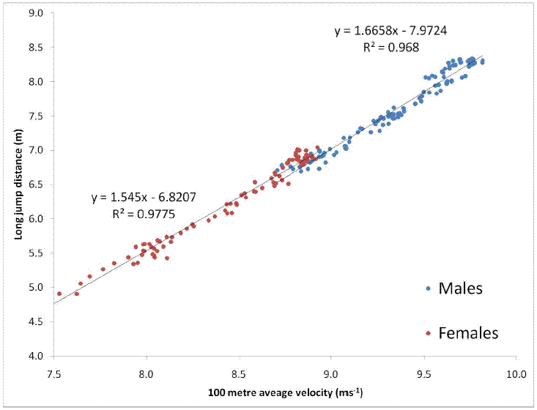
Correlation or cause?

Slide 14
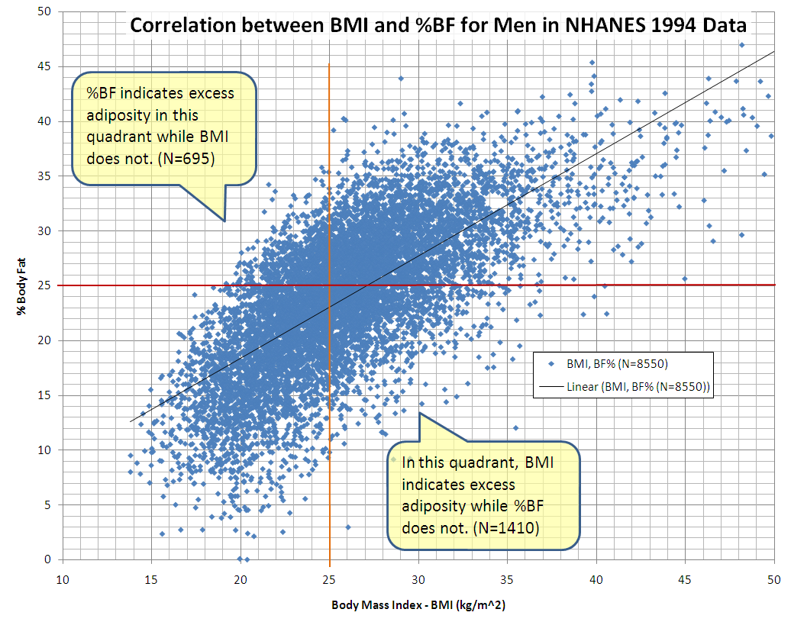
Correlation or cause?

Slide 15

Notes:
This website students need to be familiar with and they can use for their assessment for 6.2 and to develop ideas for their coursework.

Slide 16
Refers to how close a determined value is to the actual value and depends on the procedures and equipment used. |  | RELIABILITY
refers to the degree to which a test is consistent and stable in measuring what it is intended to measure. It will depend upon how strict the test is conducted and the individual's level of motivation to perform the test. |  | SPECIFICITY
refers to the degree to which the test actually measures what it claims to measure and the extent to which conclusions and decisions made on the basis of test scores are appropriate and meaningful. |  | ACCURACY
Refers to the ability of the test to correctly identify those parameters which are most important in regards to the claims of the study |  | VALIDITY

Slide 17
J Sports Med Phys Fitness. 1997 Dec;37(4):240-5.
An evaluation of the specificity, validity and reliability of jumping tests.
There were three objectives of this study: 1. To describe the influence of using a single and double leg take-off as a function of run-up length in jumping for height. 2. To determine if various types of jumps are specific in nature. 3. To evaluate two methods of assessing jumping height (a modified Vertec or Yardstick and a Board) for validity and inter-day reliability.
METHODS:
Seventeen male subjects were tested on jumps for height from a standing position and using a 1, 3, 5 and 7 stride run-up. These jumps were performed using a single and double leg take-off measured by the Yardstick. Selected jumps were also tested using a Board method and repeated for assessment of reliability.
RESULTS:
The single leg take-off produced significantly higher jumps when the run-up was three or more strides. The inter-relationships among jump conditions were generally high, however jump types could be considered as specific when the run-up length and number of legs used in the take-off were different. The Yardstick produced significantly greater jump heights than the Board method, which questions the validity of using a board for assessment of maximum jump performance. The reliability of both methods was generally high however the jumps performed from a run-up produced less reliable results than the standing jumps for the Yardstick.
CONCLUSIONS:
It was suggested that the design of tests to assess jumping ability should consider the specific jump type used in the sport of interest and that the Yardstick is the preferred mode of testing, provided that attempts are made to maximise reliability.

Slide 18
Sodium bicarbonate and sprint performance
The positive impact of sodium bicarbonate on sprint performance has been confirmed by a new study comparing its effects with those of two other potential ‘buffering’ agents.
In a double blind randomised crossover trial, 15 competitive male endurance runners, accustomed to brief intense efforts as part of their interval training, performed a run to exhaustion 90 minutes after ingestion of each of the agents and a placebo (sodium chloride) on separate days.
The mean run times to exhaustion were:
bicarbonate 82.3 seconds;
lactate 80.2s;
citrate 78.2s;
chloride 77.4s.
There were no substantial differences in gut discomfort between the buffer treatments.
The researchers conclude they have found ‘more evidence that ingestion of sodium bicarbonate is an effective strategy to enhance sprint performance. Sodium lactate is also likely to be effective, although possibly not as effective as sodium bicarbonate. Sodium citrate is probably not as effective as sodium bicarbonate.
‘We therefore recommend ingestion of sodium bicarbonate to enhance sprint performance.’

Slide 19
Notes:
What does this test mean in English?

