Slide 1
Personal Project:
WELCOME!
A General Introduction
Concord High School
2017-2018

Slide 2
THE BASICS…
-What is the Personal Project?
-What do I have to do?

Slide 3
What is the Personal Project?
An opportunity to demonstrate specific SKILLS students have gained in the IB programme as they end the last year of MYP.
Gives students the opportunity to engage in something they feel is valuable!
An independent assignment on ANY topic & can take on ANY form!

Slide 4
What sort of Personal Project CAN you do?
(What can you think of?)
Organize charity events
Create websites on topics you feel are significant
Design 3 D models / products (like building a violin)
Create a video to share information or help with an issue
Paint a mural to increase awareness of an issue
Create a cookbook designed to help people eat more fruits and vegetables
Create a collection of poems or short stories
Fix a problem or make something better

Slide 5
General Parameters of the Project
(What I HAVE to do…)
Expected to spend about 25 hours total (for ALL things related to the Project)
Demonstrate development in the ATL Skills
Document your experience in a PROCESS JOURNAL (ManageBac)
Collaborate with your SUPERVISOR
Have a GOAL, GLOBAL CONTEXT, and PRODUCT/OUTCOME
Conduct RESEARCH
Create your own CRITERIA
Develop a PLAN OF ACTION
Create a REFLECTIVE REPORT of your experiences
Meet expected deadlines; they will count for a grade (quarterly)

Slide 6
General Parameters of the Project
(What I HAVE to do…)
Please note that ALL STUDENTS WHO ARE ENROLLED IN MYP WILL COMPLETE A PERSONAL PROJECT, regardless if students plan to continue into DP
The IB programme REQUIRES at least 3 meetings with your supervisor (once at beginning of project, once near the mid-point, and once near the end). Students will record these meetings on the REQUIRED Academic Honesty Form and acquire the necessary signatures.
Attendance at Exhibition Night is MANDATORY for all students. For the 2017-2018 MYP Personal Project students, the date will be Monday, April 16.

Slide 7
GENERAL THINGS TO KEEP IN MIND…
-The IB Rubric
-ManageBac
-Your Supervisor

Slide 8
What Students Should Keep in Mind
Through the ENTIRE Project
  The IB Assessment Criteria/Rubric (You will need to write your project report using this rubric, since you will be assessed by it.)
      ATL Skills (In your project report, you’ll need to demonstrate development in all 10 areas.)
      The IB Learner Profile (In your project report, you’ll need to reflect on how you’ve developed as an IB Learner.)
  ManageBac / The Process Journal (You’ll need to consistently write in the journal to help you keep track of what you’ve accomplished and which ATL skills are addressed. You will write your report from these entries and can include UP TO 10.)
  A Supervisor (Will help guide you)

Slide 9
Assessment Criteria
Criterion A: Investigating
  Define a clear GOAL and GLOBAL CONTEXT
  Identify learning
  RESEARCH skills
Criterion B: Planning
  Develop your own assessment CRITERIA
  Record the development process in a PLAN OF ACTION
  Self-management skills
Criterion C: Taking Action
  Create a PRODUCT / OUTCOME
  Demonstrate thinking skills
  Demonstrate communication and social skills
Criterion D: Reflecting
  EVALUATE the product/outcome with your own criteria
  Reflect on how the project impacted your knowledge
  Reflect on how the project impacted you as an IB learner

Slide 10
ATL SKILLS (important!)
ATL Skill Categories | MYP ATL Skill Clusters
Communication | I. Communication
Social | II. Collaboration
Self-Management | III. Organization
 | IV. Affective
 | V. Reflection
Research | VI. Information Literacy
 | VII. Media Literacy
Thinking | VIII. Critical Thinking
 | IX. Creative Thinking
 | X. Transfer

Slide 11
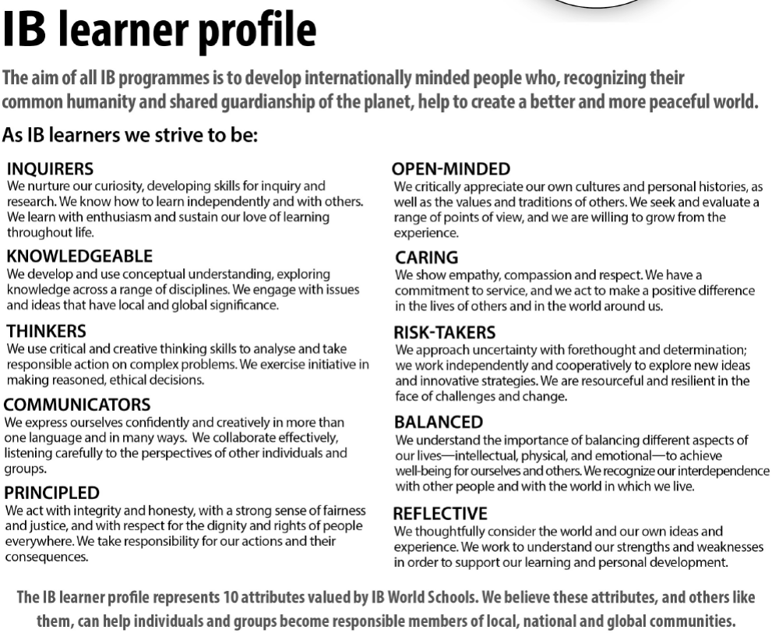
THE IB LEARNER PROFILE

Slide 12
What Students Should Keep in Mind
Through the ENTIRE Project
  The IB Assessment Criteria/Rubric (You will need to write your project report using this rubric, since you will be assessed by it.)
      ATL Skills (In your project report, you’ll need to demonstrate development in all 10 areas.)
      The IB Learner Profile (In your project report, you’ll need to reflect on how you’ve developed as an IB Learner.)
  ManageBac / The Process Journal (You’ll need to consistently write in the journal to help you keep track of what you’ve accomplished and which ATL skills are addressed. You will write your report from these entries and can include UP TO 10.)
  A Supervisor (Will help guide you)

Slide 13
The Process Journal
Use ManageBac - It’s a GREAT place to store everything – reflection, research, sources, etc. (No fear of losing your work!)
You can add journals entries, files, websites, photos, etc.
Consistent entries are an absolute necessity!
Use this as supporting evidence for development of ATL skills when writing your reflective report
Students can include up to 10 excerpts along with their report to support assertions made in the report

Slide 14
What Students Should Keep in Mind
Through the ENTIRE Project
  The IB Assessment Criteria/Rubric (You will need to write your project report using this rubric, since you will be assessed by it.)
      ATL Skills (In your project report, you’ll need to demonstrate development in all 10 areas.)
      The IB Learner Profile (In your project report, you’ll need to reflect on how you’ve developed as an IB Learner.)
  ManageBac / The Process Journal (You’ll need to consistently write in the journal to help you keep track of what you’ve accomplished and which ATL skills are addressed. You will write your report from these entries and can include UP TO 10.)
  A Supervisor (Will help guide you)

Slide 15
Supervisor
Each student will have a supervisor
  Staff member at CHS
  Not necessarily a teacher you have had!
This person will assist and guide students through the project
Supervisors will also assess projects
The IB requires at least 3 meetings with the supervisor: one at the beginning stages of the project, one at mid-point, and one near the end

Slide 16
THE PHASES OF THE PROJECT…

Slide 17
Phase 1: Topic, Goal, Product/ Outcome, Global Context, Begin Process Journal Entries, Supervisor
Choose a topic and develop a highly challenging goal! (See examples)
Develop a product/outcome based on that goal
Choose ONE Global Context to guide your project
Begin entries into ManageBac about the process, make references to the ATL skills
Meet your supervisor

Slide 18
Samples of highly challenging goals
Outline a BASIC & appropriate goal | Define a clear and CHALLENGING goal | Define a clear and HIGHLY CHALLENGING GOAL
To design my own electric violin | To research violin design and making, and then design my own electric violin | To research violin design and making, then design and produce my own 4 or 5 stringed electric violin
To design my own summer clothing collection | To research current fashion trends and then design my own summer clothing collection | To research current fashion trends and how to design patterns. Then design and create a summer clothing collection and then learn how to create a “template website” to market my designs
To raise $400 for the education of an Indonesian child | To sponsor an Indonesian child to university for 4 years by raising $1500 | To volunteer at the International Humanities Foundation over the Christmas holidays and then raise $1500 to sponsor an Indonesian child to university for 4 years
To donate money to a school in Bali | To raise money for a school in Bali and then donate the money raised for the school | To research schools in Bali and then raise money to purchase stationery for the school to support student education

Slide 19
Global Contexts: Choose only ONE!
Global Context | Examples of Personal Projects
Identities and relationships | • Two sides of social networking; an awareness campaign about digital citizenship and cyber bullying
Orientation in space and time | • Charting a family history through archives and a representational statue
Personal and cultural expression | • Video games as a form of cultural expression; a short film using five video games that shows how they are an expression of our culture
Scientific and technical innovation | • Can stem cells replace organ transplants?; an investigative report
Globalization and sustainability | • The struggle for water in developing countries; an awareness campaign
Fairness and development | • Open-market economies and their role in fair trade; a talk for students

Slide 20
Phase 2: The Plan of Action,
Begin the Research, Criteria
Students will develop a plan to complete the project (like a calendar)
Research resources should be of a “wide variety”; the topic/goal/global context will drive your research
Students will develop their own rigorous criteria to assess the quality of their product/outcome

Slide 21
Phase 3: Product / Outcome
& Project Report
Students should continue research on their project
Students will complete their product/outcome, then they will use their own criteria to evaluate their project
Students will complete their Project Reports

Slide 22
Your Report Will Consist Of:
(1)Personal Project Cover Sheet
(2)Academic Honesty Form
(3)The Project Report (1,500 to 3,500 words)
(4)Bibliography
(5)Evidence of Your Product/Outcome – can be pictures or your actual product
(6)Appendices – up to 10 pages of excerpts from ManageBac can be included (such as journal entries, your criteria, a sample of your plan of action, excerpt of an annotated bibliography); these ARE NOT scored, but they are SUPPORTING EVIDENCE and should be utilized!

Slide 23
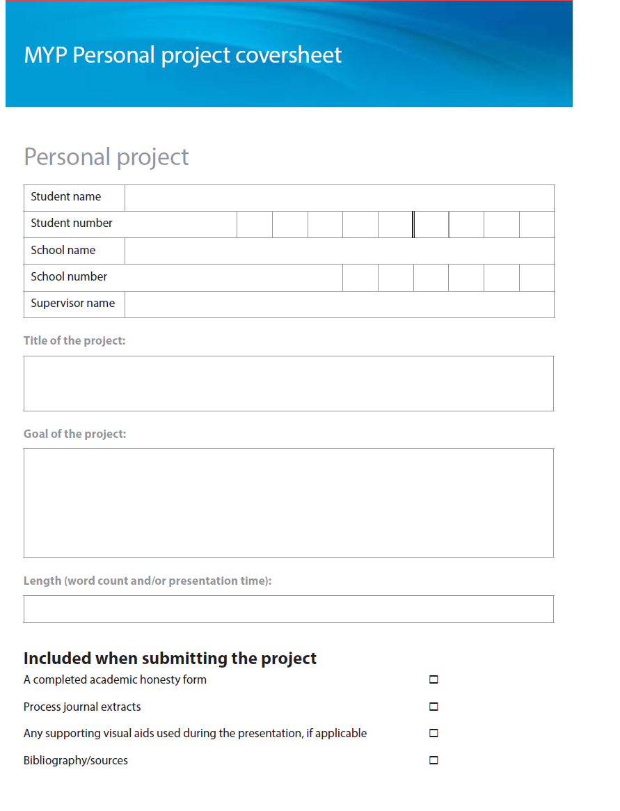
COVER SHEET

Slide 24
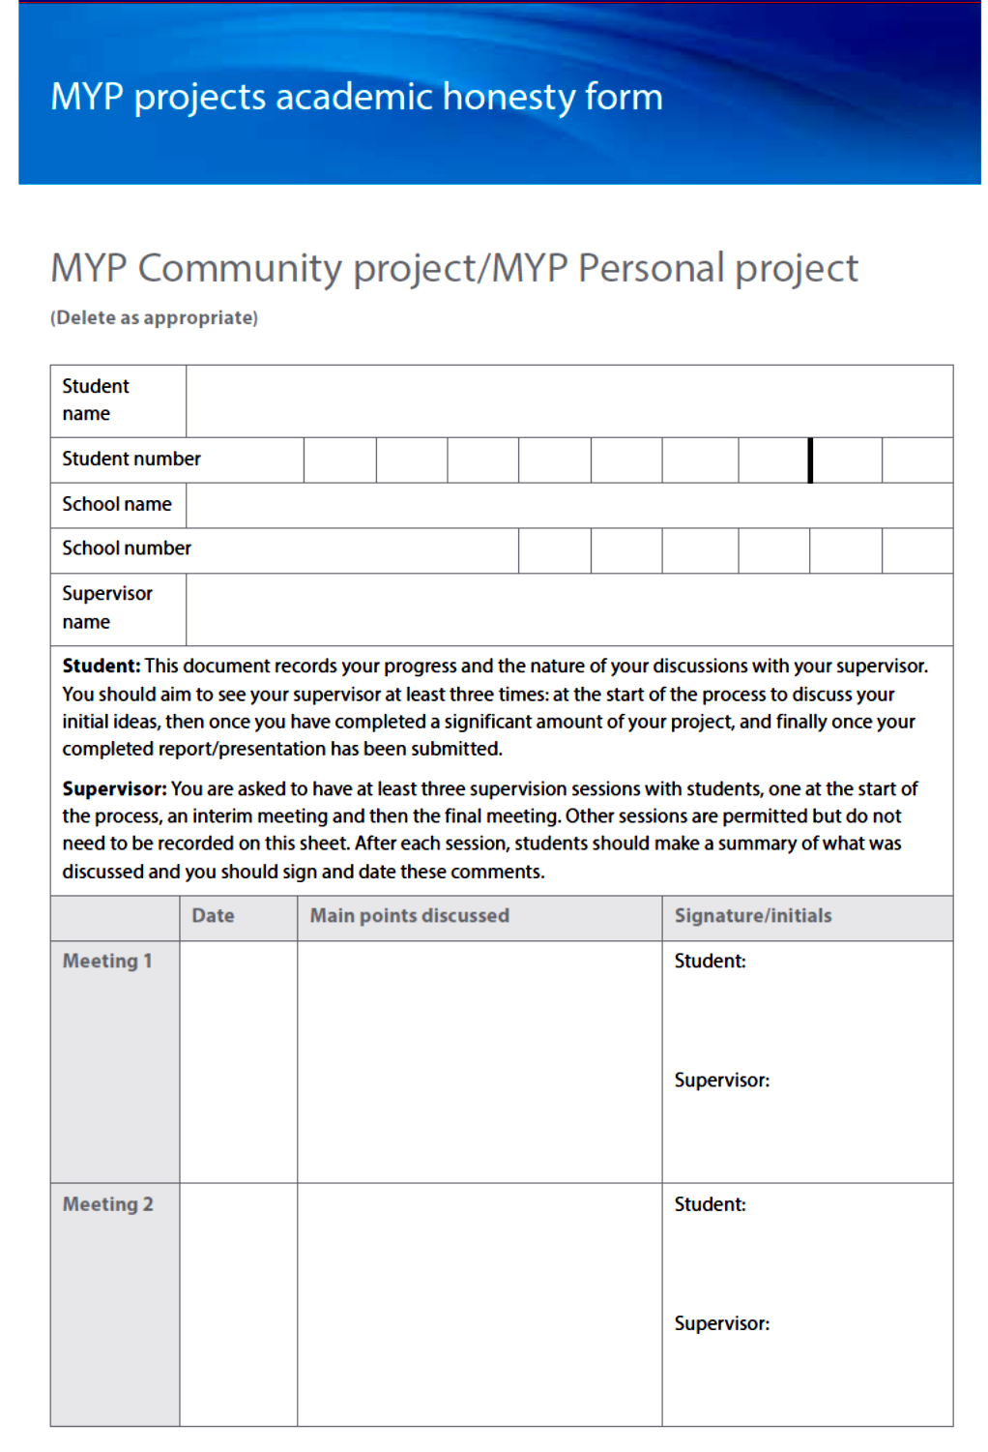
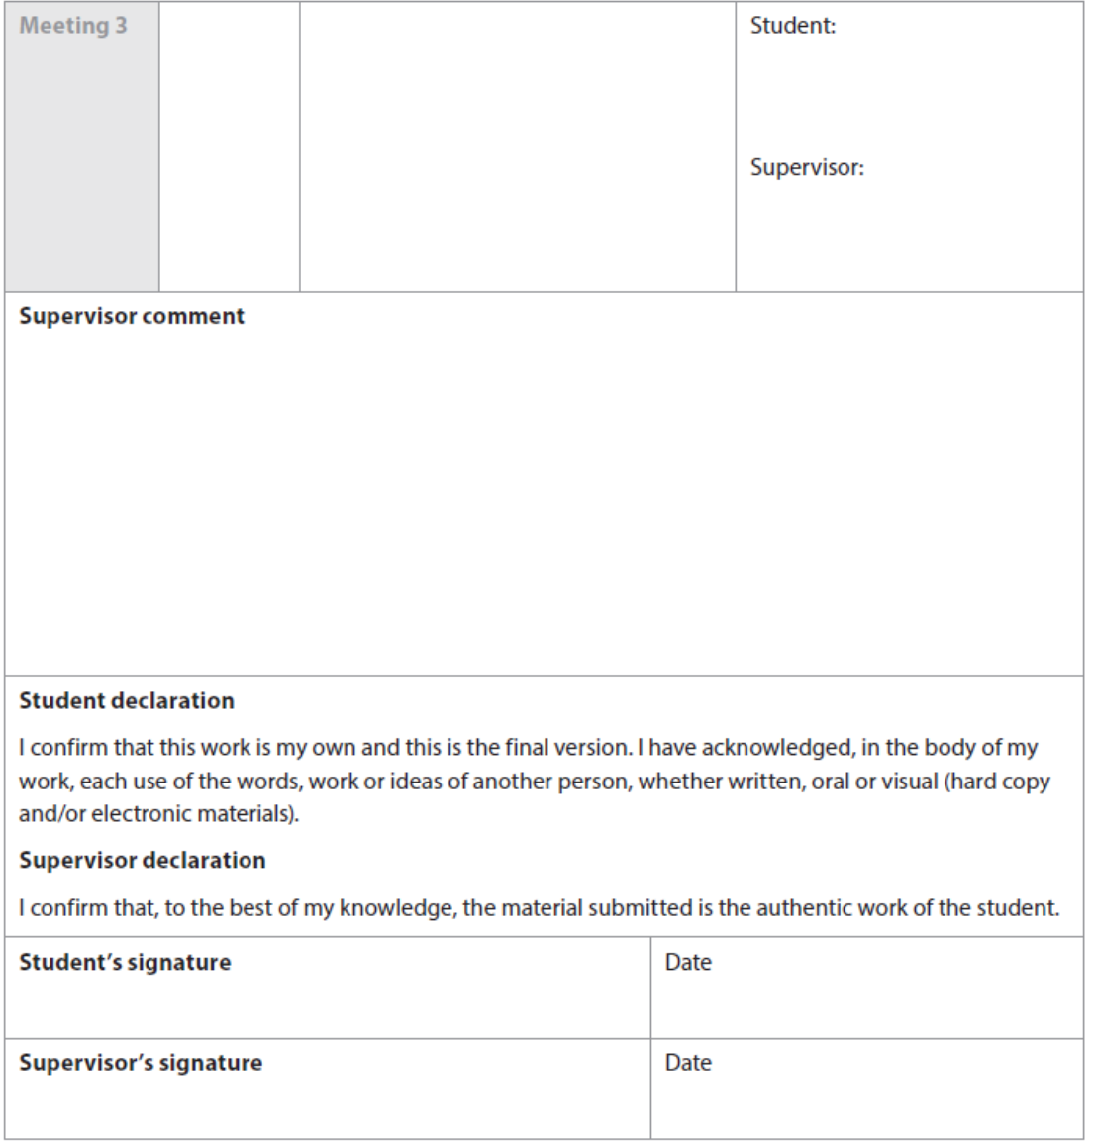
ACADEMIC HONESTY FORM

Slide 25
Personal Project Report Sample
This Project scored an 8 in all 4 Criteria:
“Rockets”

Slide 26
Phase 4: The Assessment
Supervisors will meet to internally standardize the criteria (agree on what it means) and assess student projects
Assessment scores will be shared and discussed with students

Slide 27
How will the project be scored?
Criteria | Description | Maximum Score
Criterion A | Investigating | 8
Criterion B | Planning | 8
Criterion C | Taking Action | 8
Criterion D | Reflecting | 8
Students can have a maximum score of 32 points.

Slide 28
Score Guidelines
MYP General Grade Descriptors
To arrive at a criterion levels total for each student, teachers add together student’s final achievement levels in all criteria.
Grade | Boundary Guidelines | Descriptor
1 | 1-5 | Produces work of very limited quality. Conveys many significant misunderstandings or lacks understanding of most concepts and contexts. Very rarely demonstrates crucial or creative thinking. Very inflexible, rarely using knowledge or skills.
2 | 6-9 | Produces work of limited quality. Expresses misunderstandings or significant gaps in understanding for many concepts and contexts. Infrequently demonstrates critical or creative thinking. Generally inflexible in the use of knowledge and skills, infrequently applying knowledge and skills.
3 | 10-14 | Produces work of an acceptable quality. Communicates basic understanding of many concepts and contexts, with occasionally significant misunderstandings or gaps. Begins to demonstrate some basic critical and creative thinking. Is often inflexible in the use of knowledge and skills, requiring support even in familiar classroom situations.
4 | 15-18 | Produces good-quality work. Communicates basic understanding of most concepts and contexts with few misunderstandings and minor gaps. Often demonstrates basic critical and creative thinking. Uses knowledge and skills with some flexibility in familiar classroom situations, but requires support in unfamiliar situations.
5 | 19-23 | Produces generally high-quality work. Communicates secure understanding of concepts and contexts. Demonstrates critical and creative thinking, sometimes with sophistication. Uses knowledge and skills in familiar and unfamiliar classroom and real-world situations.
6 | 24-27 | Produces high-quality, occasionally innovative work. Communicates extensive understanding of concepts and contexts. Demonstrates critical and creative thinking, frequently with sophistication. Uses knowledge and skills in familiar and unfamiliar classroom and real-world situations, often with independence.
7 | 28-32 | Produces high-quality, frequently innovative work. Communicates comprehensive, nuanced understanding of concepts and contexts. Consistently demonstrates sophisticated critical and creative thinking. Frequently transfers knowledge and skills with independence and expertise in a variety of complex classroom and real-world situations.

Slide 29
Phase 5: Exhibition Night
This is an opportunity for students to show off their accomplishments to their friends, family, and community!
Invite all of those involved!
Celebrate your accomplishments in MYP!
Attendance is mandatory! You should want to show off your work!

Slide 30
SAVE THE DATE!
Exhibition Night will be:
Monday, April 16, 2018

Slide 31
What can students do RIGHT NOW?
Think wisely about choosing a topic and goal! You will be overwhelmed with EIGHT classes (perhaps some are AP), extra-curricular activities, and finding time to spend with your family, friends, eating, and sleeping! It should be challenging, but…
a time consuming project ≠ a better project
Contact anyone you want to be a part of your project
Know emails, in case you have questions over the summer
    Marie.Deal@Cabarrus.k12.nc.us
    Jennifer.Drake@Cabarrus.k12.nc.us
Last year’s handbook can be located on Mrs. Drake’s webpage: http://www.cabarrus.k12.nc.us/Page/52195

Slide 32
TENTATIVELY
Completed Project Report Due:
Thursday, February 15, 2018
by 2:30 pm
ONCE MORE,
CHS Personal Project Exhibition:
Monday, April 16th, 2018
in CHS Media Center
Please mark this date; students are required to attend

Slide 33
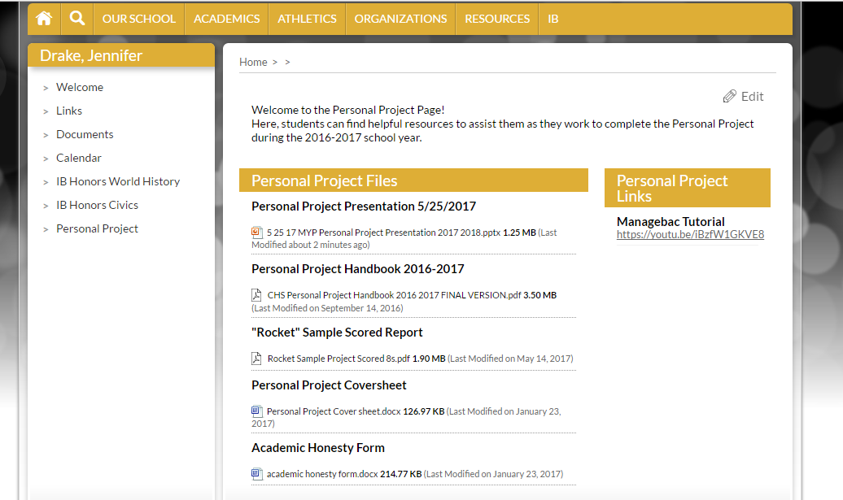
This presentation (and other helpful items) can be found on Mrs. Drake’s CHS webpage at: http://www.cabarrus.k12.nc.us/Page/52195

Slide 34
Questions????

