Slide 1
Life at the turn of the Century

Slide 2
Science and Urban Life

Slide 3
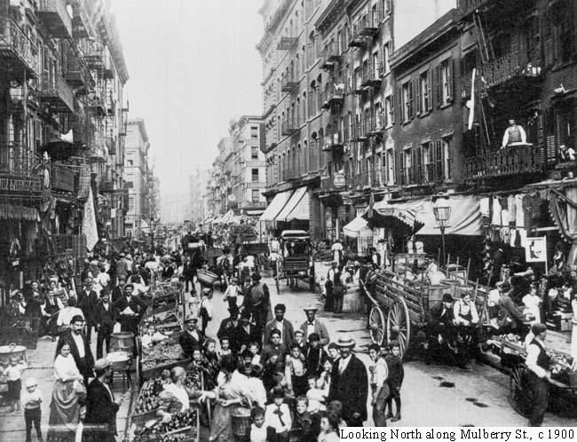
Continued Rise of Urbanization
The number of people living in cities and suburbs continues to increase.
4 out of 10
Why?
How?

Slide 4
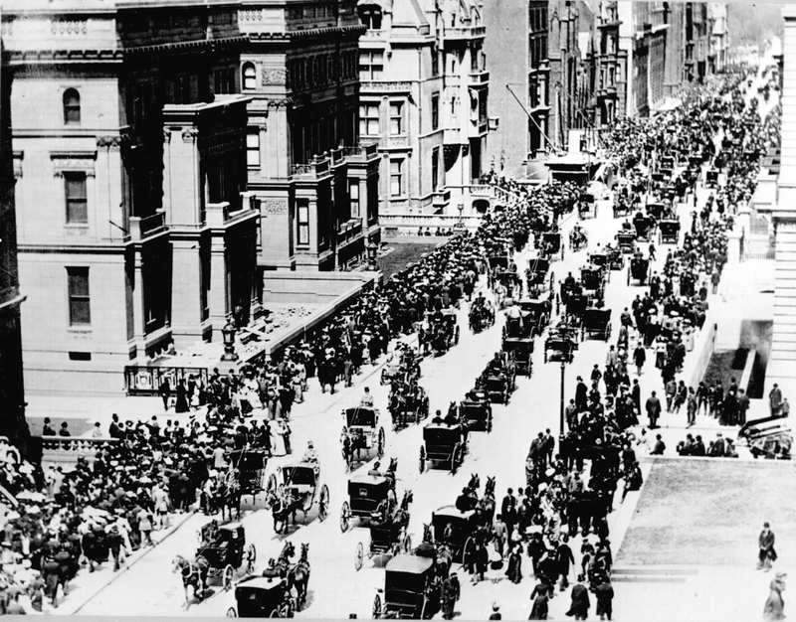

Slide 5
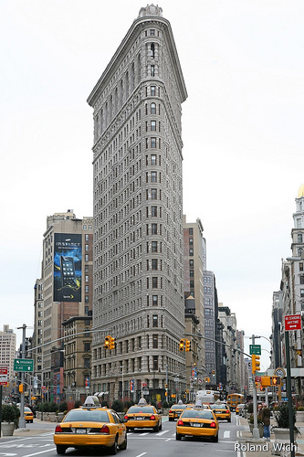
How are cities Handling the People?
Skyscrapers
  what made these possible?
    Steel and Elevators
Louis Sullivan
  Designed “first” skyscraper
  Wainwright Building in St Louis
Daniel Burnham
  Designed Flatiron Building in New York City
* Skyscrapers allowed cities to make better use of space

Slide 6
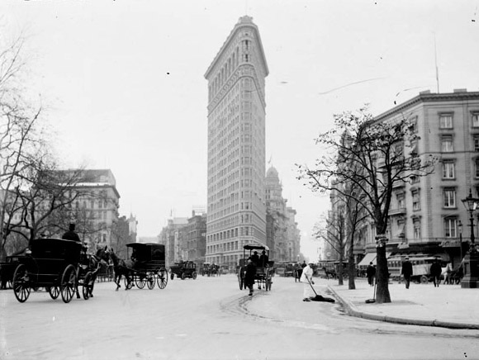

Slide 7
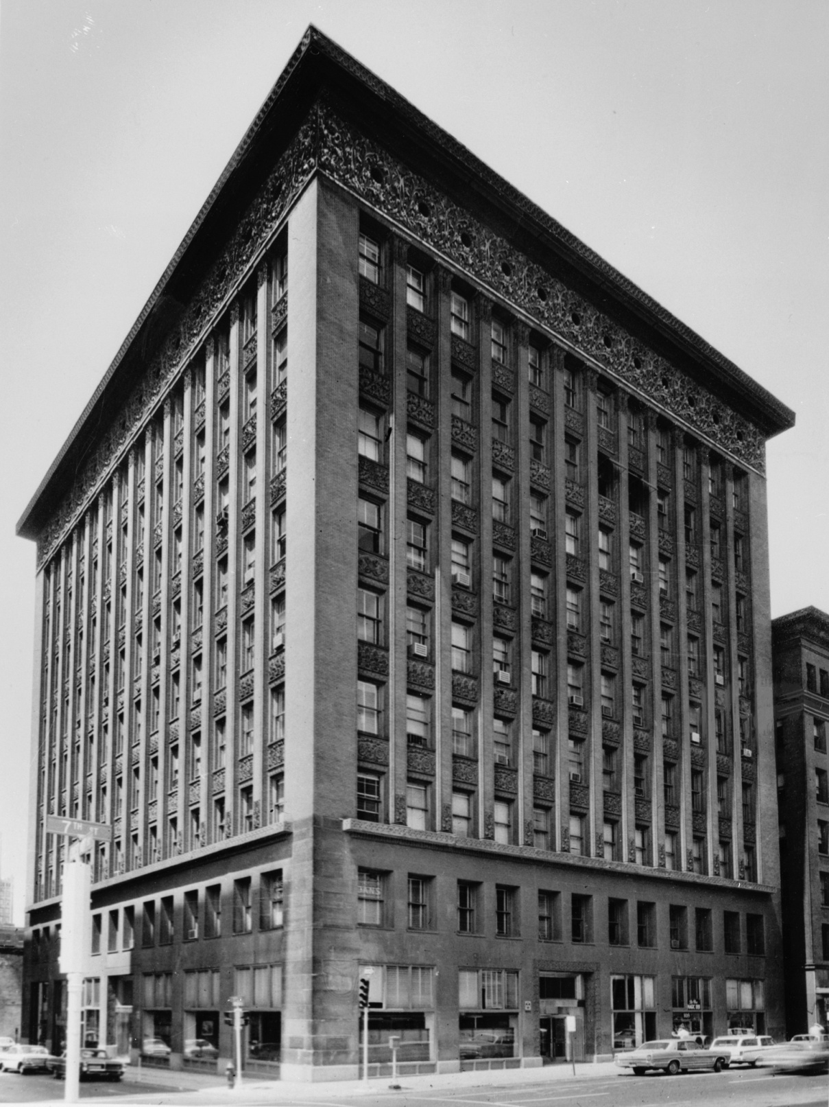

Slide 8
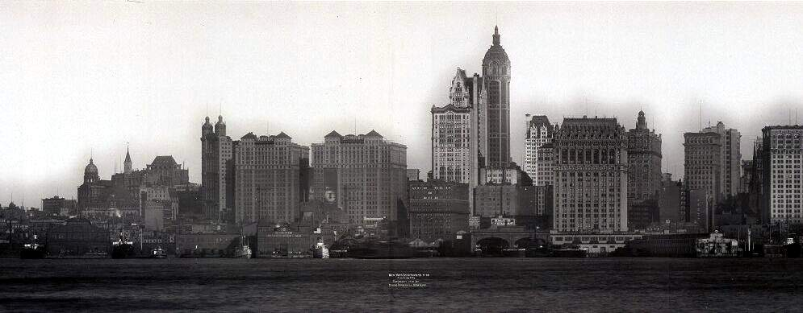

Slide 9
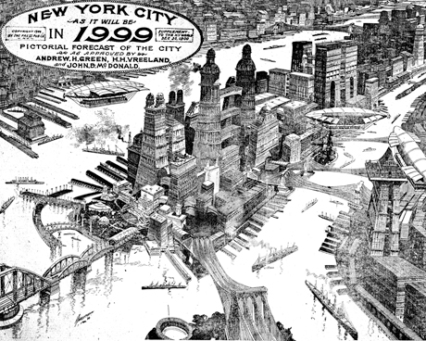

Slide 10
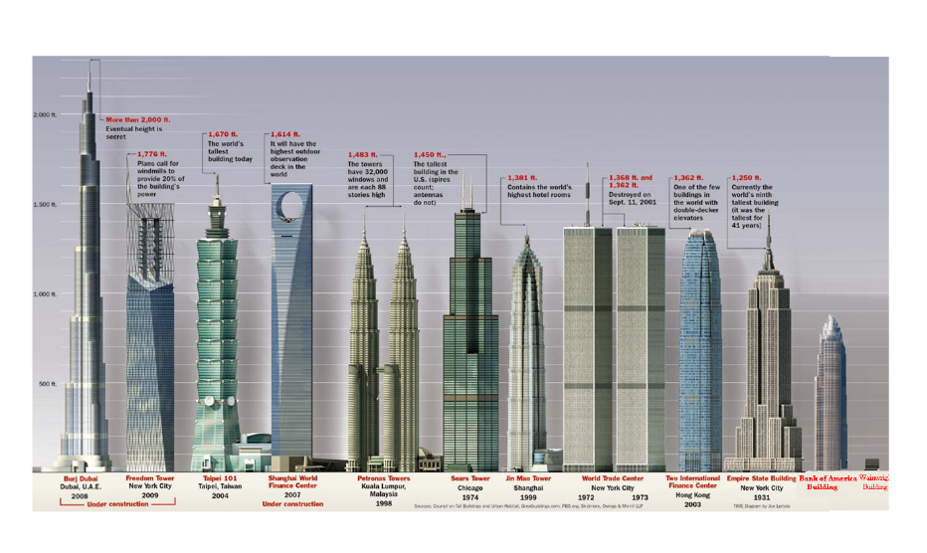

Slide 11
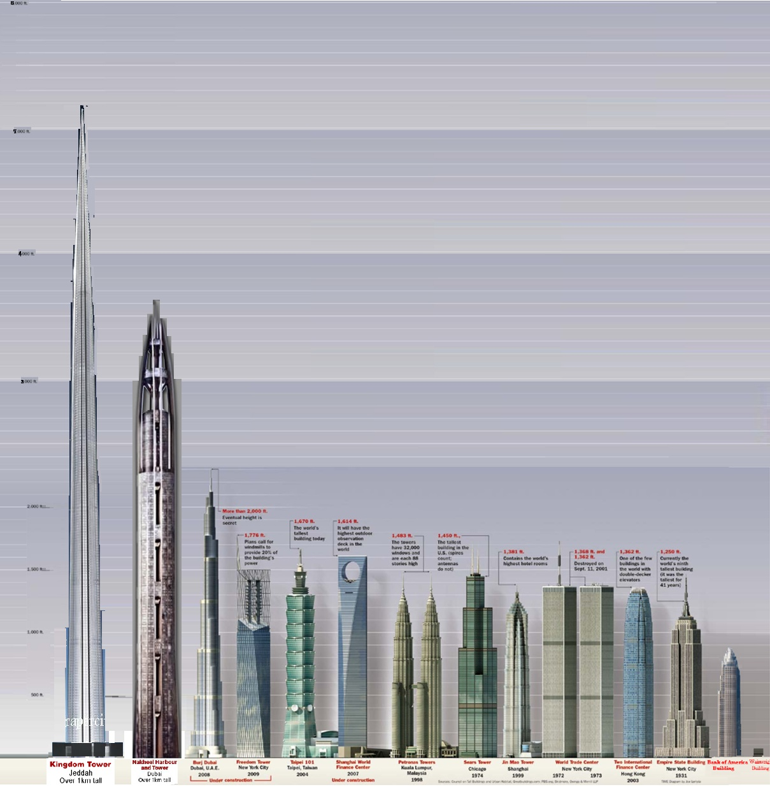

Slide 12
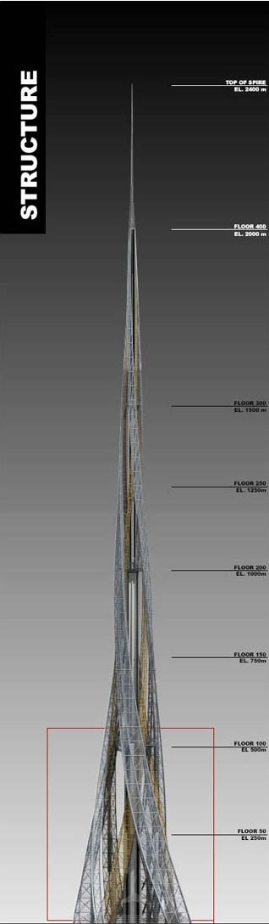


Slide 13
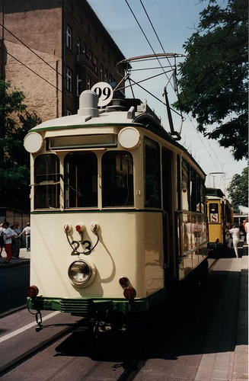
How are these people getting around?
Mass Transit
  Subways
  Trolleys
  Streetcars
  “el trains”
*allows suburbs to pop up around the cities

Slide 14
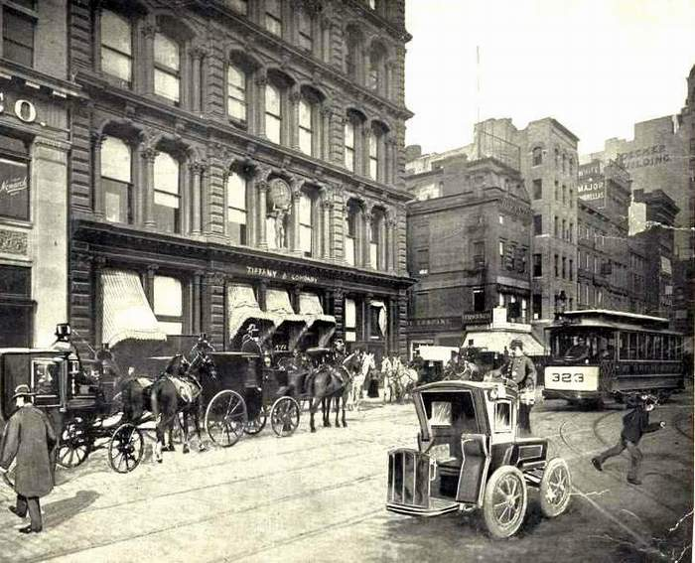

Slide 15
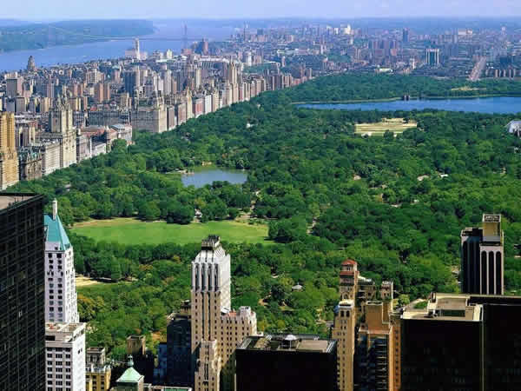
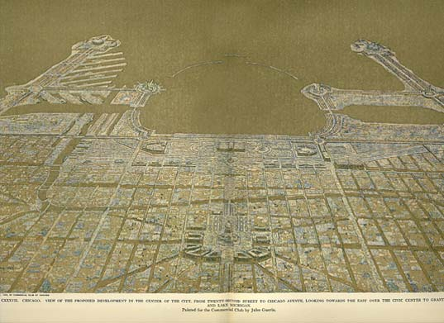
Engineering and Urban Planning
Bridges
  Many had sidewalks and promenades
Parks
    Fredrick Law Olmstead
      Central Park
Future expansion was now taken into consideration
*Brought cities together and made them more enjoyable.

Slide 16
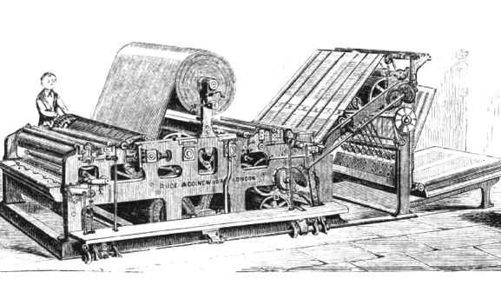
New Technologies
Printing
  Literacy Rate now near 90%
  Magazines, Books, Newspapers more popular
  Cheap, Durable paper now available
  Perfecting Press- prints on both sides of paper, cuts, folds and sorts
* News and Books now available and affordable

Slide 17

Wright Brothers
First to develop a motor light enough to get airborne.
  1903-Kitty Hawk, NC
    120 feet, 12 seconds
  1905
    30 minutes
  1908
    U.S. Military contract
  1920
    Transcontinental Flight
* First used for Mail Service

Slide 18
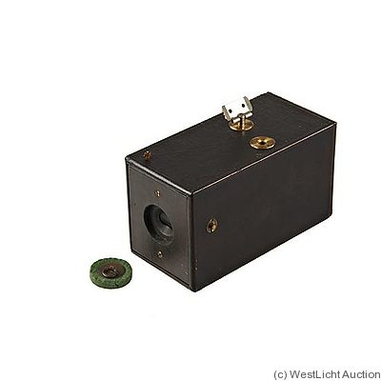
Photography
Early Photography
  Heavy equipment
  Had to develop immediately
  Stationary
Photography in 1900
  Film created
  George Eastman- Kodak Camera
    Affordable camera with reloadable film
*Made photography possible for everyone. Photojournalism

Slide 19
Dawn of Mass Culture

Slide 20
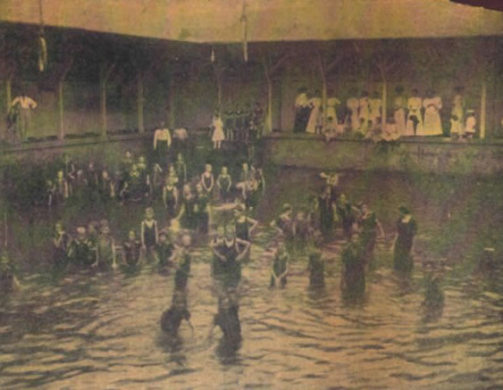
American Leisure
People in the early 1900’s had more free time
  Why?
Shorter Hours
Weekends
More Money
Electric Transit

Slide 21
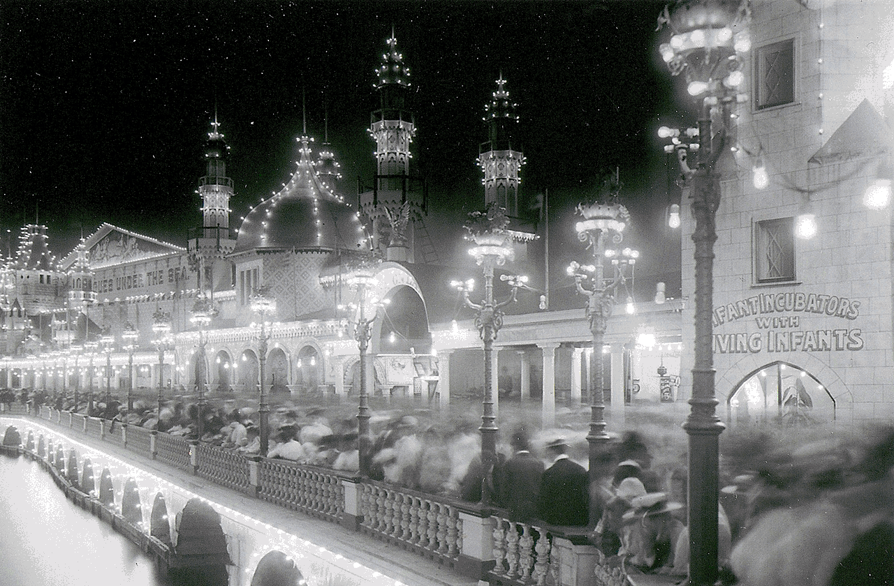
Amusement Parks
Some of the first Amusement parks were built in big cities
Accessible by electric transit
Coney Island was one of the first parks
Coney Island

Slide 22
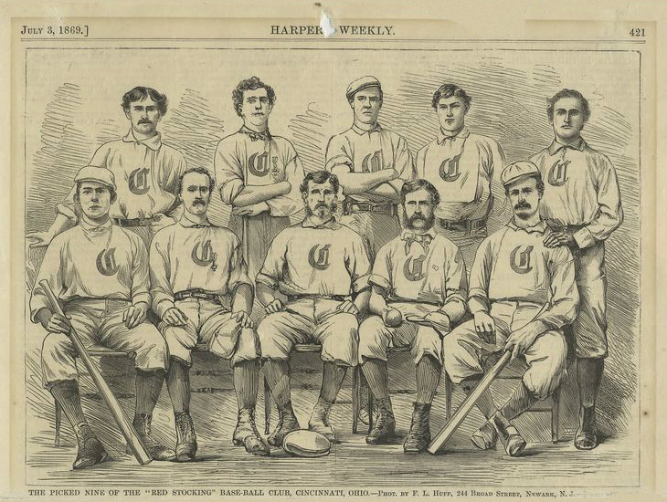
Spectator Sports
Although sports had been around for years, they became a profitable business
  Baseball
    1830s - Began in U.S.
    1869 - First pro team
    1903 - First World Series
  Football
    1869 – First College Game
  Basketball
    1891 – Invented
  Boxing
    1880 – Becomes repudable

Slide 23
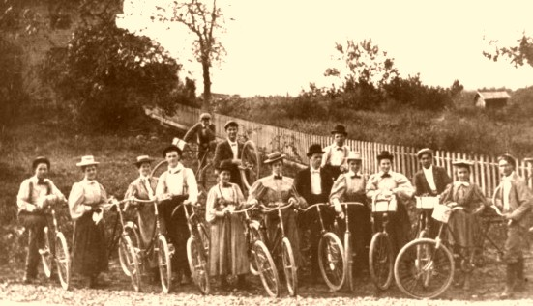
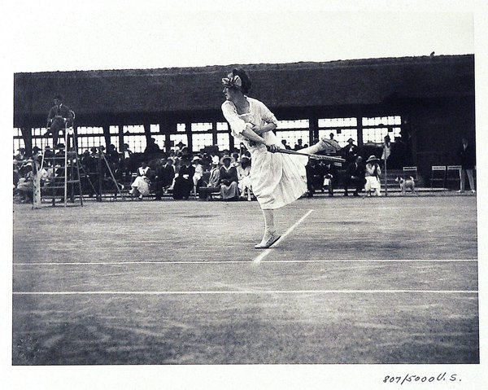
Leisure Sports
Biking
Golf
Croquet
Tennis

Slide 24
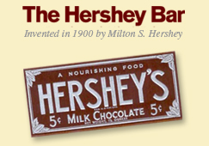

Coke and Candy
Hershey’s chocolate Bar
  First sold in 1900
  Factory located in Hershey Pennsylvania
Coca cola
  Originally created to cure headaches
  Originally contained small amounts of cocaine

Slide 25
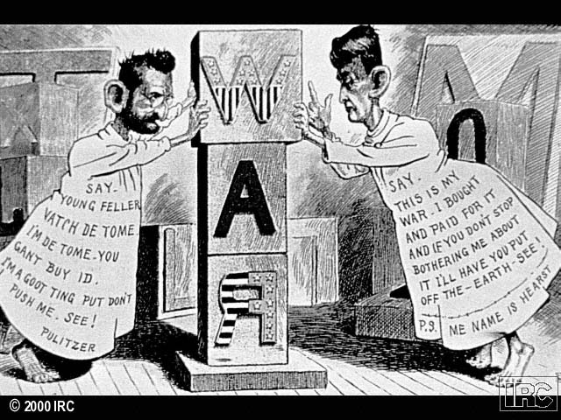
Newspapers
First Mass Circulation
  Joseph Pulitzer
    New York World
  William Randolph Hearst
    New York Morning Journal
  Pulitzer and Hearst in a constant competition to out-do competition
    Both sold over one million copies per day

Slide 26
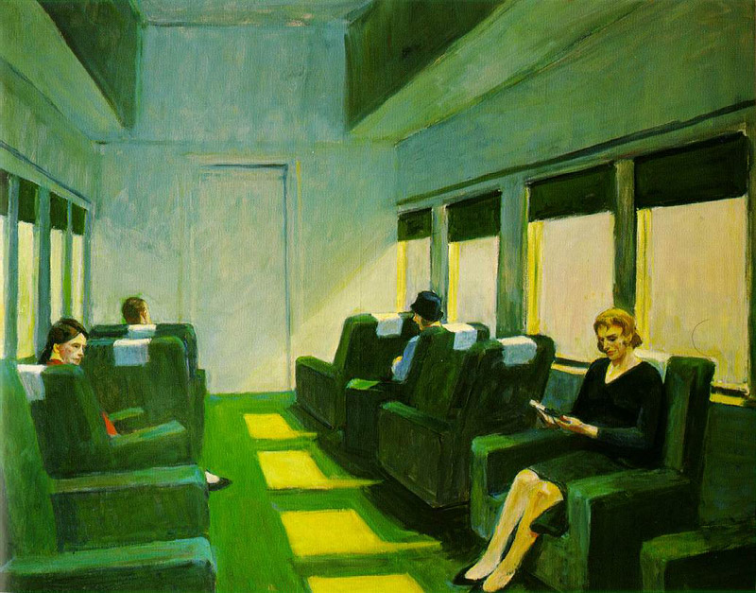
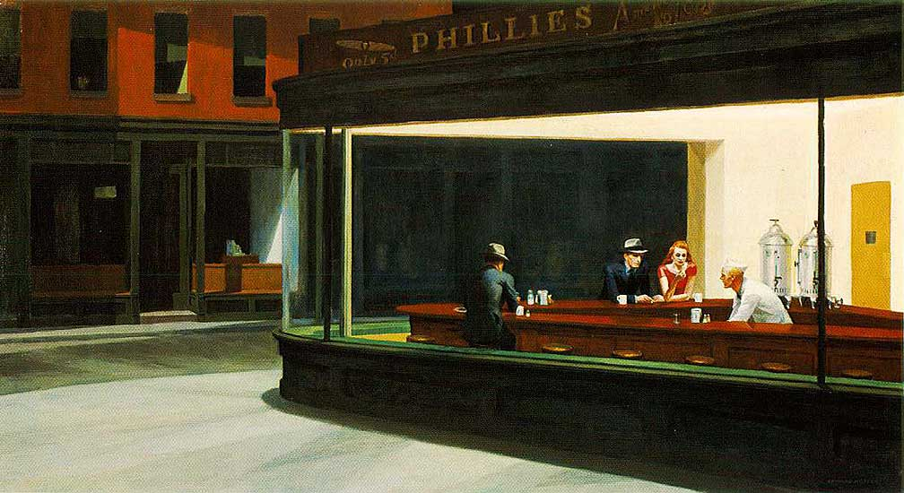
Art
Ashcan School
  Focused on Realism
  American Life in the city
* Edward Hopper

Slide 27
Intellectual Movements
Darwinism
Evolution
Fundamentalism
Pragmatism

Slide 28
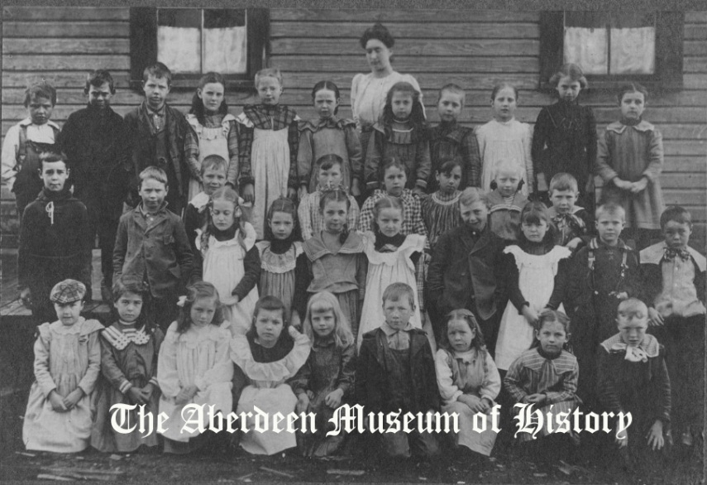
Education
Public Schools
  Rapidly growing in cities
  1900 - Attendance laws in 31 states
  Slow progress in rural areas
  Segregation and Discrimination
Universities
  Growth of state universities
    Morrill Land Grant
  Agriculture, Technology, Medicine
  Rise of Women’s Universities

Slide 29
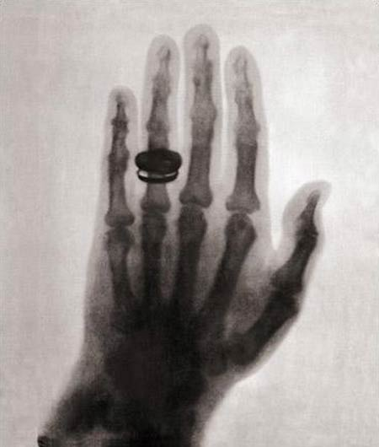
Medicine
Medical Advancements
  X-Ray
  Improved microscopes
  Aspirin
  Early Chemotherapy
  Blood Transfusions
  Germ Theory Accepted

Slide 30
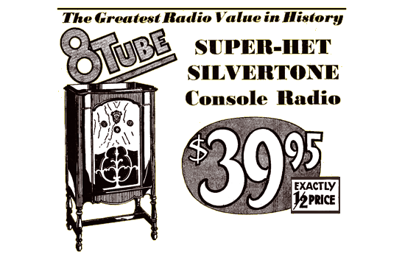
Shopping
Easier transportation=Changes in shopping
  Chain stores
    A&P Grocery
    F.W. Woolworth
  Dept. Stores
    Marshalls
    Montgomery Wards
  Mail Order
    Sears and Roebuck
Women as consumers
  National Consumers League
  Encourage women to only buy “white label” goods

