Slide 1
Landscape Design
Essential Standard 5.00: Understand landscape design

Slide 2
Principles of Design
Balance- materials are distributed evenly on opposite sides of a central axis
  3 types of balance
    Symmetric- one side is a reflective mirror image of the opposite side, most formal type of balance
    Asymmetric- each side has as much interest as the other, but not a mirror image
    Proximal/distal- balances right and left as well as near and far

Slide 3
Principles of Design
Macro-range- the viewer sees the landscape from the most distant point
Micro-range- the views from other locations not as distant

Slide 4
Principles of Design
Focalization- selects and positions visually strong items in the landscape composition to create focal points. It draws the eye of the viewer to one major feature in each use area such as a corner planting
Simplicity- seeks to make viewers comfortable within the landscape. It excludes and unnecessary changes in shape, color, direction, etc.

Slide 5
Principles of Design
Rhythm and line- repeating something at a standard interval or pattern creates rhythm and lines. It establishes the shape and form of the landscape replicating strong exisiting lines such as the lines of a house or pool. Functions of line plantings include foundation plantings, block a view, frame a view and provide privacy

Slide 6
Principles of Design
Proportion- the size relationships between all the features of the landscape including vertical, horizontal and spatial relationships. It will maintain proper proportional relationships in a landscape between:
  Buildings and people Masses and soils
  Buildings and plants
  Plants and people
  Plants and plants

Slide 7
Principles of Design
Unity- all the separate parts contribute to the creation of the total design. It ties together the individual parts of each use area by:
  Repeated prominent colors
  Repeated construction materials
  Continued interior design themes to outdoor rooms
  Repeated plant species
  Raised patios, decks and porches to door level

Slide 8
Types of Plans Used in Landscaping
Sequential- each is increasingly more specific and details
  Functional diagrams- begins the arrangement of the client’s program on the site. Bubble diagrams (thumbnail sketch) are loosely drawn from freeform shapes to represent areas or spaces. They help the designer make decisions concerning layout, sizes and the use of each area

Slide 9
Types of Plans Used in Landscaping
  Outdoor room concept moves the indoor out for a continuous flow
    Public area- usually the front yard portion of the landscape
    Private area- a secluded area, patio or screened porch
    Utility area- recycle, garbage, storage
    Family/play area- pools, open areas, play structures

Slide 10
Types of Plans Used in Landscaping
  Preliminary designs- breaks the bubble diagram down to show first draft vision of how each landscape area will be shaped. The landscape is given its form, type of materials to be used and application of landscape design principles. A number of preliminary designs may be shown to a client before the final plans are made.

Slide 11
Types of Plans Used in Landscaping
  Final plans- suggestions and reactions of the client to make a master drawing that is graphically detailed and completely specific in its intent for the landscape. They include precisely identified plants and other materials, paving patterns and other specific detailed information such as constructions drawings for the landscape contractor and subcontractors. Graphics are designed to impress.

Slide 12
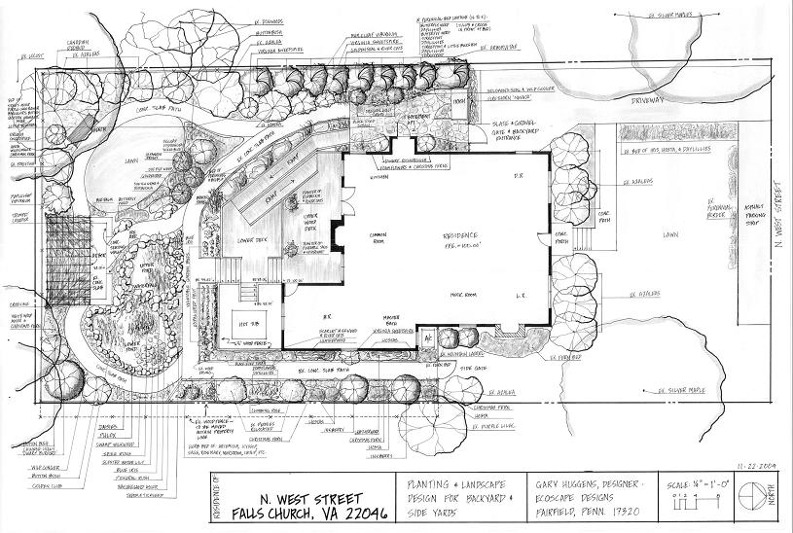
Landscape Design-Final

Slide 13
Types of Plans Used in Landscaping
Computer Assisted or drawing board
  Computer aided design or design programs
  Hand drawn. Many professionals choose to hand draw their designs

Slide 14
Types of Plans Used in Landscaping
Graphics
  Free-hand lettering
  Mechanical
  Computer

Slide 15

Drawing Instruments
Pencil
  Mechanical pencils
    Lead sizes- 0.2, 0.3, 0.5, 0.7, 0.9 mm in thickness
    Uses a lead holder
    Does not require sharpening
  Drawing pencils
    Varying degree of hardness in mechanical and drawing pencils- 2B,B, HB, F, 2H-9H
    H is a harder lead and produces lighter lines and is less likely to smear
    B is a softer lead and produces darker lines and will smear
    A good choice for landscape designer is HB-2H

Slide 16
Drawing Instruments
Eraser- a vinyl eraser will erase pencil marks without damaging the paper. Magic Rub is a good eraser
Compass- adjustable instrument used to draw circles or arcs
T square- used for drawing vertical or horizontal lines that are parallel to the edge of the drawing board

Slide 17
Drawing Instruments
Scale
  Architect
    Contains scales of ½, ¼, ⅛, 1/16, ¾ 3/16
    Most commonly used by landscape designer is ⅛
  Engineer
    Contains scales of 1/10 (one inch= 10 feet), 1/20, 1/30, 1/40, 1/50, 1/60
    Most commonly used by landscape designers is 1/10

Slide 18
Drawing Instruments
Templates- used to draw circles and landscape features such as fences, hedges, etc.
Protractors- used to measure the angle of any two joining lines from 0-180 degrees
Triangles
  Used to draw angled lines
  Most common angles are 45 and 90 degree
  Other angles are 30, 45, 60 or 90 degree

Slide 19
Drawing Instruments
Drawing board- gives smooth surface for drafting paper
Drafting paper
  Available as opaque or transparent in a wide variety of sizes
  Vellum paper (100% cotton) is commonly used for hand drawings
  Gridded paper is also popular to use in landscape design. Grid size available are ¼”=1’, 1/10”= 1’

Slide 20
Landscape Process
Process is a sequence of steps to reach a goal
Project development process
  Needs or objectives
  Design process
  Accepting the design
  Contracting
  Subcontracting
  Actual landscaping acceptance
  Billing and payment

Slide 21
Landscape Process
Project maintenance process
  Need or desire
  Selecting a landscape maintenance company which assesses the needs and presents a proposal
  If the proposal is accepted, the company schedules and does the work
  After work is complete, bill the customer
Design process includes site analysis and program analysis

Slide 22
Landscape Occupations
Landscaping- profession that includes designing installing and maintaining the outdoor human environment
The 3 branches of the landscaping industry are:
  Landscape architects- licensed professionals who conceptualize and plan the outdoor environment or landscape for both residential and commercial clients (customers). Landscape designers usually do actual drawings for residential and commercial landscapes.

Slide 23
Landscape Occupations
Landscape contractors- must pass a licensing exam. They are professionals who carry out the installation or actual construction of the landscape plan. Landscape contractors hire subcontractors to do special work such as pools, electrical work, stonework, outdoor features such as kitchens. Landscapers are not licensed but can do the same work but cannot use the title “Landscape Contractor”.

Slide 24
Landscape Occupations
  Landscape maintenance- the care of newly installed and existing landscapes.
Design-build firms- landscape businesses that handle everything from the initial contact with the client, the design, construction process, long term care and maintenance. They may hire subcontractors for specific jobs.

Slide 25
Landscape Occupations
Other occupations in the landscape industry:
  Landscape nursery worker- a professional who sells and installs landscape plants and related materials.
  Landscape sales- works directly with clients to develop creative design solutions.
  Arborist- specialist in the care, treatment, trimming and/or removal of trees.
  Irrigation specialist- designs, installs and maintains irrigation systems

Slide 26
Landscape Occupations
  Seasonal color specialist- works directly with clients, possesses a thorough knowledge of seasonal color in both design and maintenance along with a strong understanding of plant materials.
  IPM specialist- inspects and diagnoses insect and disease issues, develops treatment plans, applies treatments effectively and safely, performs necessary record keeping duties, maintains supplies and equipment.

Slide 27
Planting and Maintenance

Slide 28
Planting
Balled and burlapped (B&B) plants
  Plant in a flat bottomed, straight-sided hole twice the width of the root ball
  Backfill soil should fill the hole enough to raise the plant slightly above the soil line
  Loosen the burlap around the top of the plant and tuck it down a few inches below the soil level
  After backfilling the hole, the soil should be mounded in a circle around the newly planted trees and shrubs to catch and hold water
  Handle B&B plants by the root ball

Slide 29
Planting
Bareroot plants
  Mound or dome is left in the bottom of the hol
  Roots should be spread over the mound so roots will grow downward in the soil
  Backfill with soil
  After backfilling the hole, the soil should be mounded in a circle around newly planted trees and shrubs to catch and hold water.

Slide 30
Planting
Container plants may need to have the roots cut of unwound before planting. This prevents the roots from continuing to grow in a circle pattern
Newly planted trees should be staked to keep trees growing straight
Careful observation of newly planted shrubs, trees, annuals, and perennials on a regular basis, will determine the time and amount of maintenance needed

Slide 31
Watering
Should be done at planting and frequently for a few days to prevent roots from drying out and the plant wilting. Water to a depth of 12-16” initially. This helps the plant ot develop a deep root system.
Then less often is needed
Different plants have different water requirements and watering should be adjusted to meet the needs of the individual plants

Slide 32
Fertilizing
Trees- drill holes or use a soil tube 12” deep at 24” intervals around the tree at the canopy drip line (tips of outer branches).
Shrubs- hand apply small amounts of low analysis fertilizer but not too late in the growing season.
Fertilizer should be mixed in back fill soil at planting for trees and shrubs and in soil beds during prep for annuals and perennials.
Lawns- need regular fertilizing. A fertilizing schedule should be established for lawn care.

Slide 33
Mulching
Suppresses weeds, retain soil moisture and equalize soil temperature.
May need to be refreshed or replaced yearly.
Mulch depths vary depending on type of material used and the moisture holding capacity of the soil. 2”-4” (after settling) is commonly recommended, add an inch more for sandy soils

Slide 34
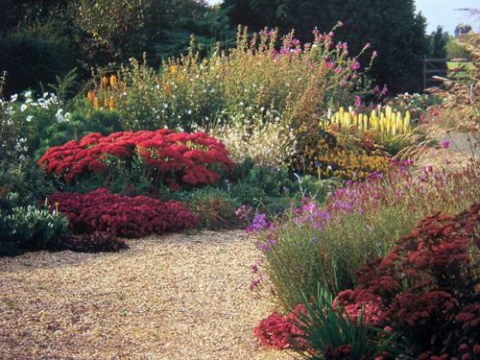
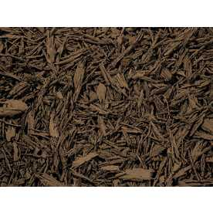
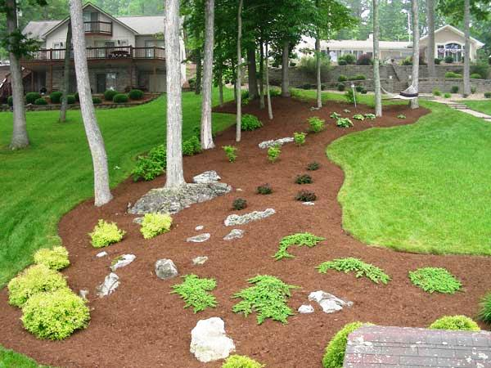
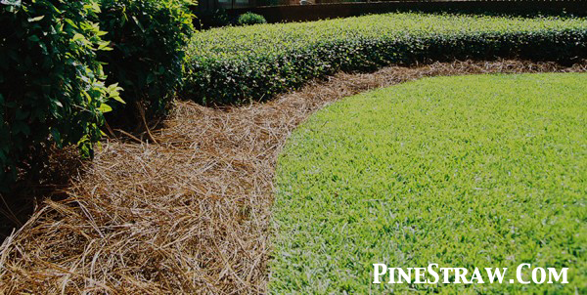
Mulching
Types of Mulch
  Shredded or ground bark- hardwood, cypress, pine
  Pine needles
  Stone
  Shredded rubber

Slide 35
Pest
Pest control is necessary to control damage from insects, diseases, weeds and rodents.
Prevent pest problems by planting pest resistant varieties, keeping the landscape free of debris and watering efficiently
Monitor landscapes for pest problem.
Set up a pest maintenance schedule if necessary.

Slide 36
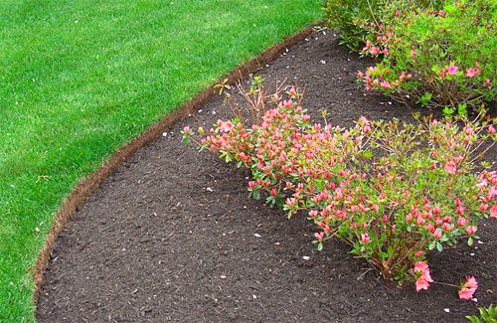
Mowing and Edging
Mow lawns at correct heights based on the type of grass.
Edging makes a sharp line of separation between plantings and the lawn.

Slide 37
Winterizing
Treat wintertime weeds such as chickweed and henbit
Remove leaves and other debris from lawns. It can smother grass, promote diseases and invite pests.
Drain your irrigation systems.
Mulch beds if mulch is thin.

Slide 38
Principles of Pruning
Shrubs that produce flowers on wood grown the previous season should be pruned immediately after flowers fall off.
  Forsythia
  Azaleas
  Spirea

Slide 39
Principles of Pruning
Shrubs that bloom on current year’s growth should be pruned in fall or early spring.
  Rose
  Butterfly bush
  Crape Myrtle

Slide 40
Types or Methods of Pruning
Thinning- removes certain branches to open up the plant allowing light through to keep the natural shape.
Heading back- removes the end section of branches at the same height so that new shoots make a plant thicker
Renewal- removes old branches that are large and unproductive by cutting them back to ground level.

Slide 41
Types or Methods of Pruning
Root- usually done one growing season prior to transplanting. The general rule is that one inch of stem diameter equals 10” of circle diameter for pruning roots around the plant.

Slide 42
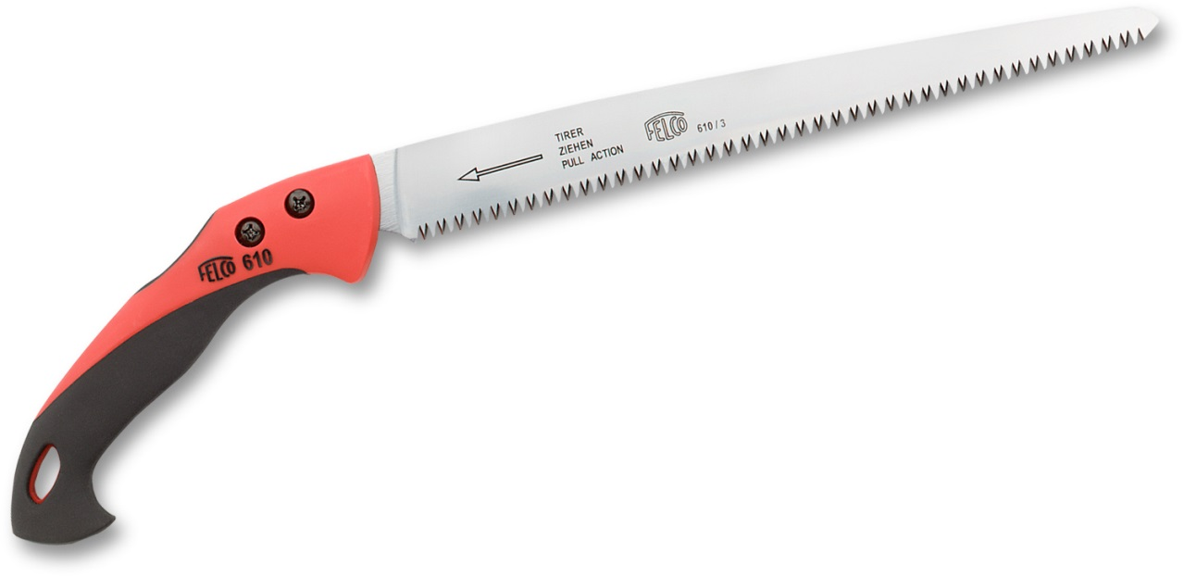
Pruning Tools
Pruning saw
  Will cut live or dead limbs
  Has coarse teeth
  Blade may or may not fold into the handle

Slide 43
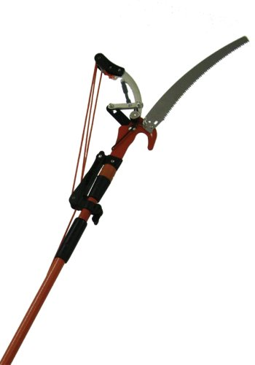
Pruning Tools
Pole pruner
  Has a saw and pruning tool on a pole to remove branches that are up to 12 feet overhead
  Non-powered or gas powered

Slide 44
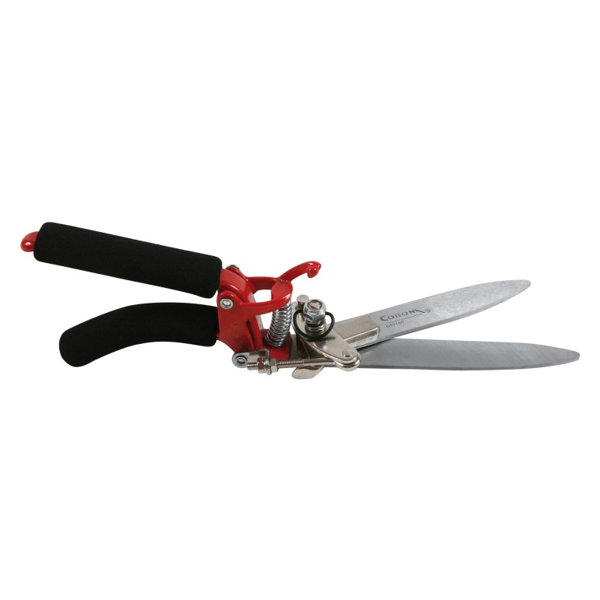
Pruning Tools
Grass shears
  Has 2 blades designed to cut grass around edges of walks or flower beds
  Non-powered or battery powered

Slide 45
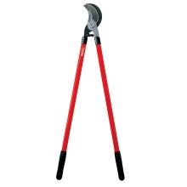
Pruning Tools
Lopping shears
  Long handled, bypass cut (scissor type blade that overlap each other)
  Cuts limbs from 1” to 1 ½”

Slide 46
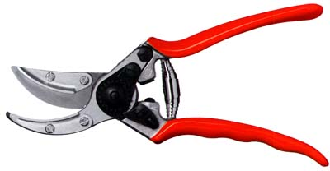
Pruning Tools
Hand shears or pruning shears
  Bypass shears- scissor type blade that overlap each other
  Anvil shears- a single blade that strikes against a flat metal plate.
  Removes branches ¼”-½”.

Slide 47
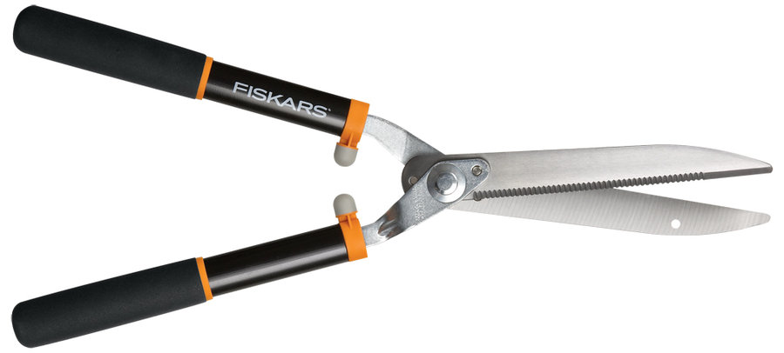
Pruning Tools
Hedge shears.
  Has long blades.
  Trim hedges or shape shrubs
  Non-powered, gas or electric powered

Slide 48
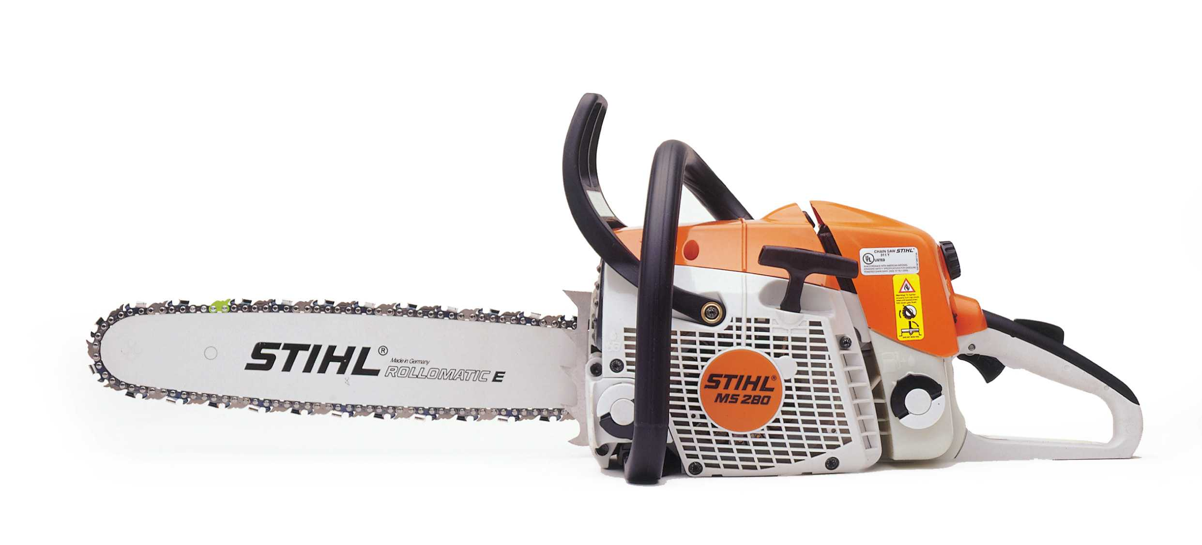
Pruning Tools
Chain saw
  Cuts limbs from 3” up to the blade length
  Gas, electric or battery powered

