Slide 1

Program Overview for Parents
Notes:
*

Slide 2


Slide 3

Academically gifted: student performs well above grade level in one or more academic areas. “Strong student”
Intellectually gifted: student possesses a high I.Q./ aptitude score in comparison to peers. Has the ability to learn new information quickly.
Gifted programs VARY by county/state. Each has unique placement criteria.
“One program does not fit all”
Notes:
*

Slide 4
The Powerschool Identifiers
AIG Academically & Intellectually Gifted | Student has high aptitude and math and elevated reading achievement
AM Academically Intellectually Gifted Math Only | Student has high aptitude and elevated math achievement
AR Academically Intellectually Gifted Reading Only | Student has high aptitude and elevated reading achievement
IG Intellectually Gifted | Student has extremely high aptitude (98-99%ile)
Notes:
Talking Points: Students may not have demonstrated high achievement in the missing area at this point- but they will have chances each year on the EOG. Sometimes students are truly only gifted in only one academic area- and parents and teachers need to be aware of that and accommodate accordingly. Students may also be gifted in areas like science, history, or arts but these are not measured on standardized tests
IG- students may not have had a chance yet to demonstrate high achievement (particularly in 3rd grade after NNAT, before EOGs) or the student may be underachieving compared to their demonstrated achievement. This should be monitored carefully and goals need to be set to improve academic achievement.

Slide 5
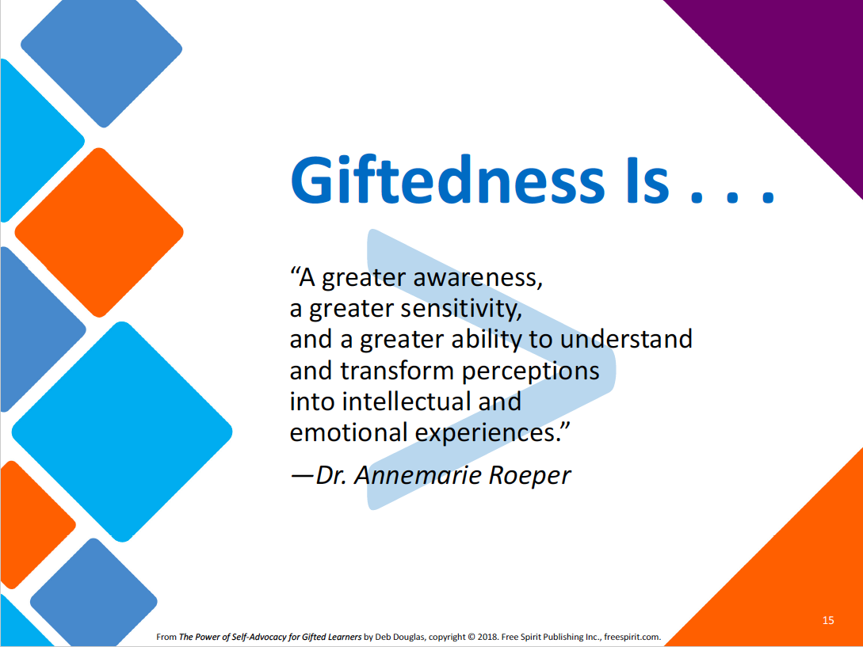
Screen Shot 2017-11-14 at 1.28.20 PM
Notes:
A reminder that being gifted is about MORE than just academics- it is WHO a person is

Slide 6
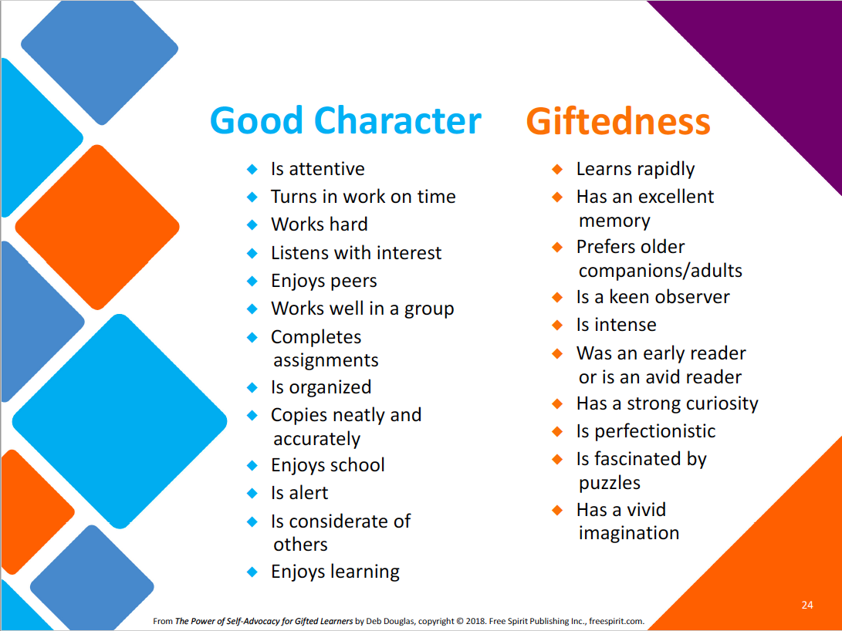
Notes:
While gifted students can often tend to demonstrate good character traits and behaviors- these should not be confused with the true characteristics of GIFTED learners.

Slide 7
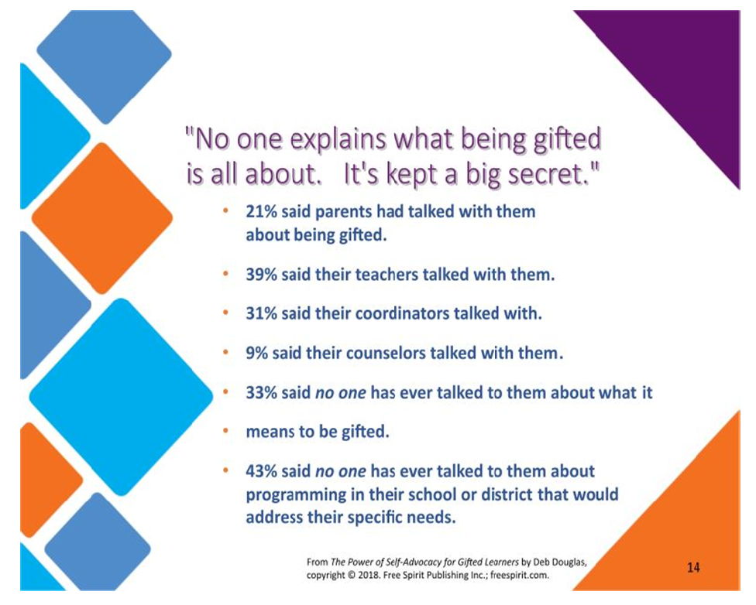

Slide 8
I wish someone had told me...
In surveys of gifted adults.. Many wish they had been better informed about their giftedness as a child.
“Why are my inner experiences and perceptions so different from the “norm?”
“Why do I have such heightened sensitivity and emotion?”
CCS is working to change this!
Notes:
Next slides will show families how CCS AIG Program is working to educate parents, teachers and students about what it really means to be gifted and everything that might come with that.

Slide 9

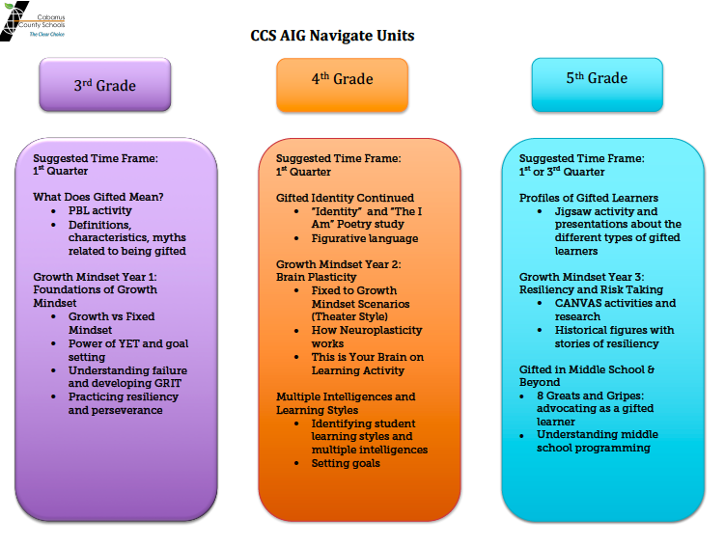
Navigate units are being added to 3rd, 4th and 5th grade AIG curriculum
Notes:
One of the great advantages to being able to meet with AIG students in SOAR resource class is the direct focus we can put on developing social and emotional skills, advocacy skills and help the gifted students understand what it really MEANS to be a gifted person.

Slide 10

A Gifted Local Endorsement course is now in ALL schools (K-12) for teachers to learn more about these unique needs.
Our GLEE teachers at Coltrane-Webb:
  Ms. Henry
  Mrs. Walters
  Mrs. Beaver
  Ms. Espinoza
  Mrs. Brooks
  Ms. Henderson
  Mrs. Thaxton
  Ms. Boone
Teacher who are completing GLEE this year:
  Mrs. Wells-Zeigler
  Mrs. Wallace
  Mrs. Archambault
  Mrs. Auerbach

Slide 11
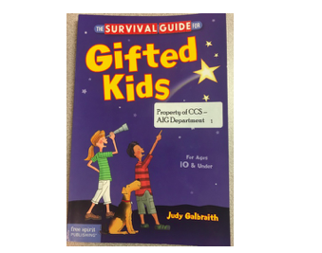
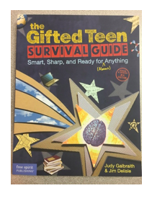
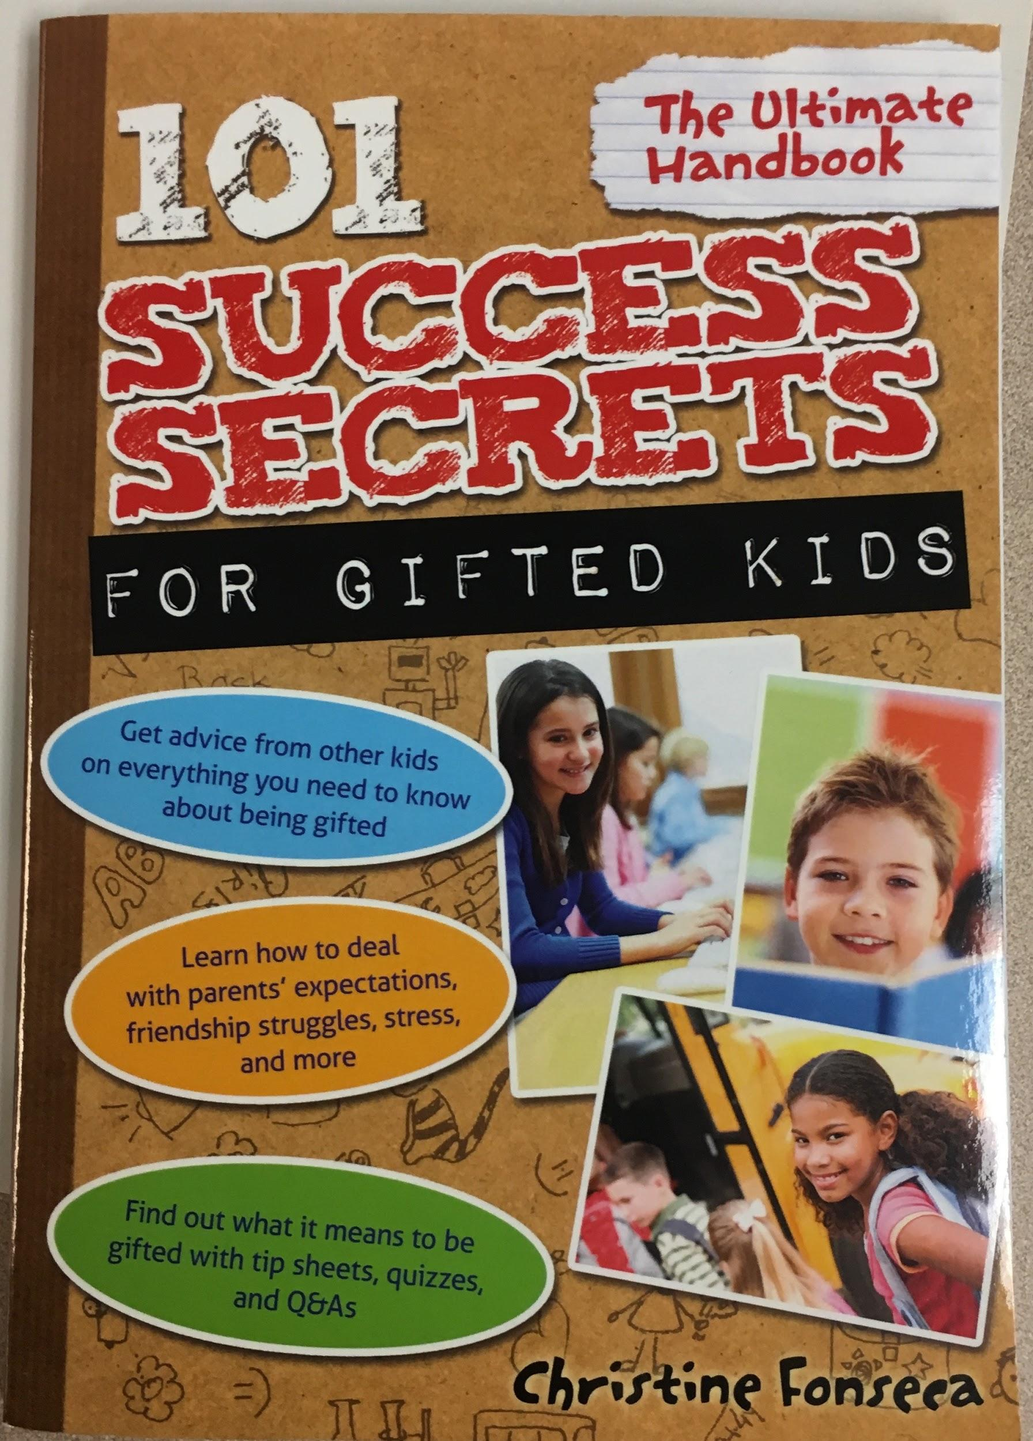
Gifted Survival guides and other reading materials are suggested to CCS AIG students.
Survival Guides for Gifted Kids and Teens
Notes:
Good reads for parents too!

Slide 12

Common Academic, Social & Emotional Issues for Gifted Children
Click for a great article
Source: Ian Byrd
byrdseed.com
Notes:
Ian Byrd is one of the big gurus in Gifted Education- parents can subscribe to his website to get interesting resources and articles. The next 2 slides are from one of his articles.

Slide 13
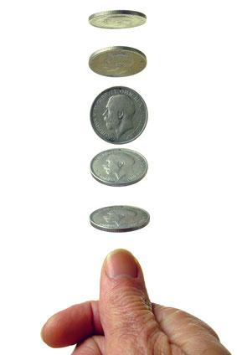
2 sides of the Coin
The very STRENGTHS that make a child gifted ….
can be the very CAUSE of potential problems the child faces in school, at home, and in the social arena.

Slide 14
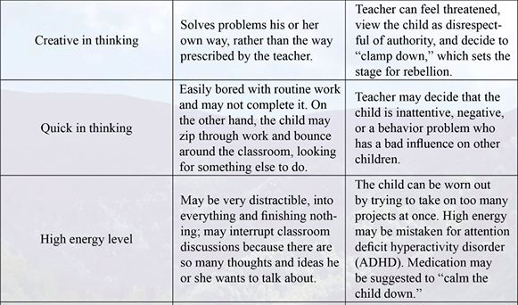
Strength Flip Side Possible Consequences
See full list at : http://www.greatpotentialpress.com/living-with-the-ups-and-downs

Slide 15
So…
What is the answer?
Notes:
CCS AIG believes one of the STRONGEST answers we have to the needs of gifted learners is the development of Growth Mindset thinking and strategies. Let me tell you a bit about this school of thinking and how YOU can begin to support your child at home.

Slide 16
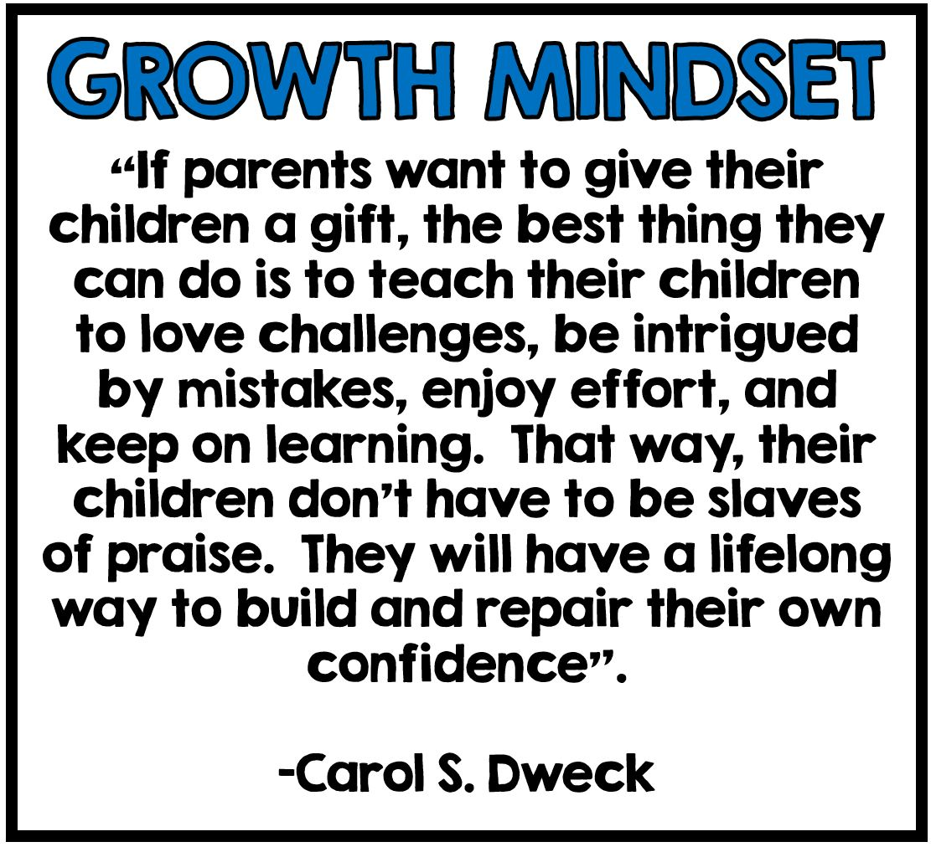
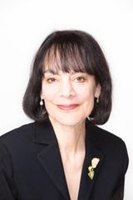
Notes:
This is the author and creator of the Growth Mindset unit- you can read detailed information in her book.

Slide 17
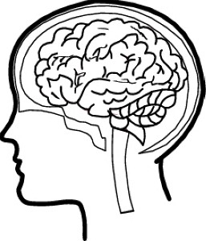

Fixed Mindset – A belief system that suggests that a person has a predetermined amount of intelligence, skills, or talents
Growth Mindset – A belief system that suggests that one’s intelligence can be grown or developed with persistence, effort, and a focus on learning

Slide 18
When do children develop fixed mindsets?
Grade | Fixed Mindset | Growth Mindset
K | n/a | 100%
1 | 10% | 90%
2 | 18% | 82%
3 | 42% | 58%
In one middle school in suburban Washington D.C., 60% of students entering 6th grade indicated they believed they were born with specific academic strengths and weaknesses they could not change

Slide 19
Changing the way we praise
It’s okay. When I was in school, I wasn’t good at math either
You’re so smart!
You’re a natural!
You’re so good at that
Math is your thing
You’ve always been the best at ______

Slide 20
Changing the way we praise
It’s okay. When I was in school, I wasn’t good at math either
You’re so smart!
You’re a natural!
You’re so good at that
Math is your thing
You’ve always been the best at ______

Slide 21
Growth Mindset Praise
I can tell you studied very hard!
You never gave up, even when it was hard
You tried really hard on that
That was a very responsible thing you did
What a creative solution to that problem!
I like the way you are doing __________
You have such a positive attitude
I can tell you tried your best because __________
What a great friend you are
You worked very well with your classmates
I appreciate how helpful you were when you ________
You really handled that situation well because _____
I’m so proud that you made that choice
I love how you took ownership of that
You are not afraid of a challenge! I like that
You have really improved on ______
You thought of that all by yourself!

Slide 22
Dweck’s Cautions
Praising effort alone is not helpful if the child is not making progress
  Praise the process and strategies the child used and tie those to the outcome
  “See, you studied more and your grade on this test is higher” and “you tried different strategies and you figured out how to solve the problem”
Talking about growth mindsets is not enough, we need to alter our teaching and parenting strategies to align with the belief
  How we respond to our children’s and our own failure or errors
  Treat mistakes as learning opportunities and not as damaging or harmful

Slide 23

Merging Gifted Education and Growth Mindset
Does telling a child that he or she is “gifted” manifest a fixed mindset?
Too much emphasis on who is gifted creates kids who think they have to be infallible. -Carol Dweck
Encourage children to enjoy learning rather than “live up to expectations.”

Slide 24
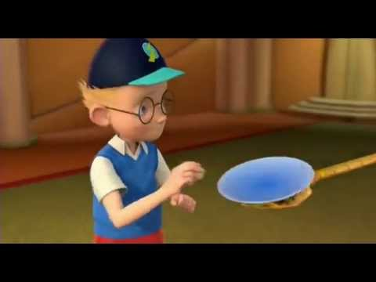
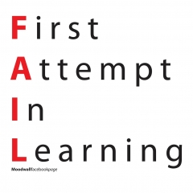
Change the narrative about FAILURE
FAILURE = Keep Moving Forward!
Disney’s “Meet The Robinson’s”
Notes:
Video Link to Meet the Robinsons- a movie that CELEBRATES failure as a chance to grow and improve.

Slide 25
How to Build a Resilient Home
Help Children Find Their Own NICHE
Adopt a glass half-full mentality in the home - find HOPE and POSITIVITY
Model Flexibility (they’re watching!!!)
Use Growth Mindset Praise
(praise a child’s effort, patience, and practice)
(Ricci, Mindset in the Classroom)
Notes:
Growth Mindset Praise - always praise a child’s willingness to try, their effort, patiencee, and practice. Don’t attribute success to being smart or the best
Flexibility - children watch you to see how you expeirence setback. When you plan a trip to a museum and find it’s closed on Monday, you can model flexibility by brainstorming other alternatives for the day. Model how to problem-solve when failure or frustration sets in
Glass half full mentality - even during a hardship, we need to find positivity. A child with hope believes there can be a positive side to most situations. Parents need to model a positive attitude both verbally and nonverbally when faced with setbacks.
Niche - a successful child is a confident child. This doesn’t mean signing kids up for every lesson, sport, or club that comes along. It means providing opportunities for kids to experience a variety of things to find what intrinsically motivates them.

Slide 26
Harnessing the power of “YET”
Notes:
Hopefully you will begin to hear this word from your gifted child at home- we will use it over the years in AIG class. Consider posting the word on your refrigerator as a reminder to the family…

Slide 27
YET. . .
Confidence
Persistence
Resilience
Notes:
The true power of YET can be life-changing and lead to many great qualities and skills - remember CPR - Confidence, Persistence, and Resilience

Slide 28


Great Books to Promote Growth Mindset and Risk Taking
Walk On! A Guide for Babies of All Ages
Rosie Revere Engineer
The Most Magnificent Thing
What Do You Do With An Idea?
The Girl Who Never Made Mistakes
Beautiful OOPS
The Fantastic Elastic Brain
Mistakes That Worked
the dot
ish

Slide 29

Gifted programming in
Cabarrus County Schools
What to expect?

Slide 30
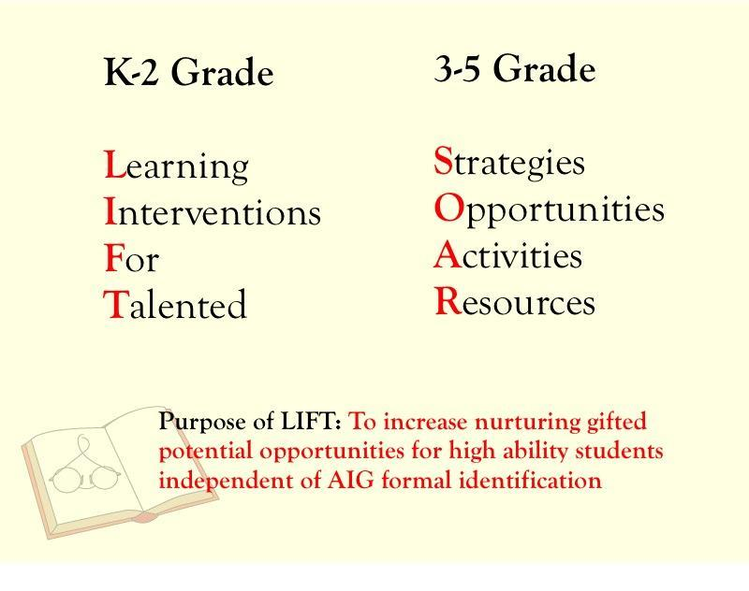
CCS Elementary AIG Programming
1st & 2nd
3rd, 4th, 5th

Slide 31
A Few FYI’s ….
Once a student qualifies for AIG Resource, he/she is served without further testing until the end of 5th grade.
Students should continue to perform at an elevated level in the classroom to be pulled out for AIG services.
AIG students will receive Progress Reports from the SOAR teacher at the end of each SEMESTER.
Meetings will be held at the beginning of each new school year for parents of current AIG Students, as well as NEW AIG students, to discuss the AIG plans for the year.

Slide 32
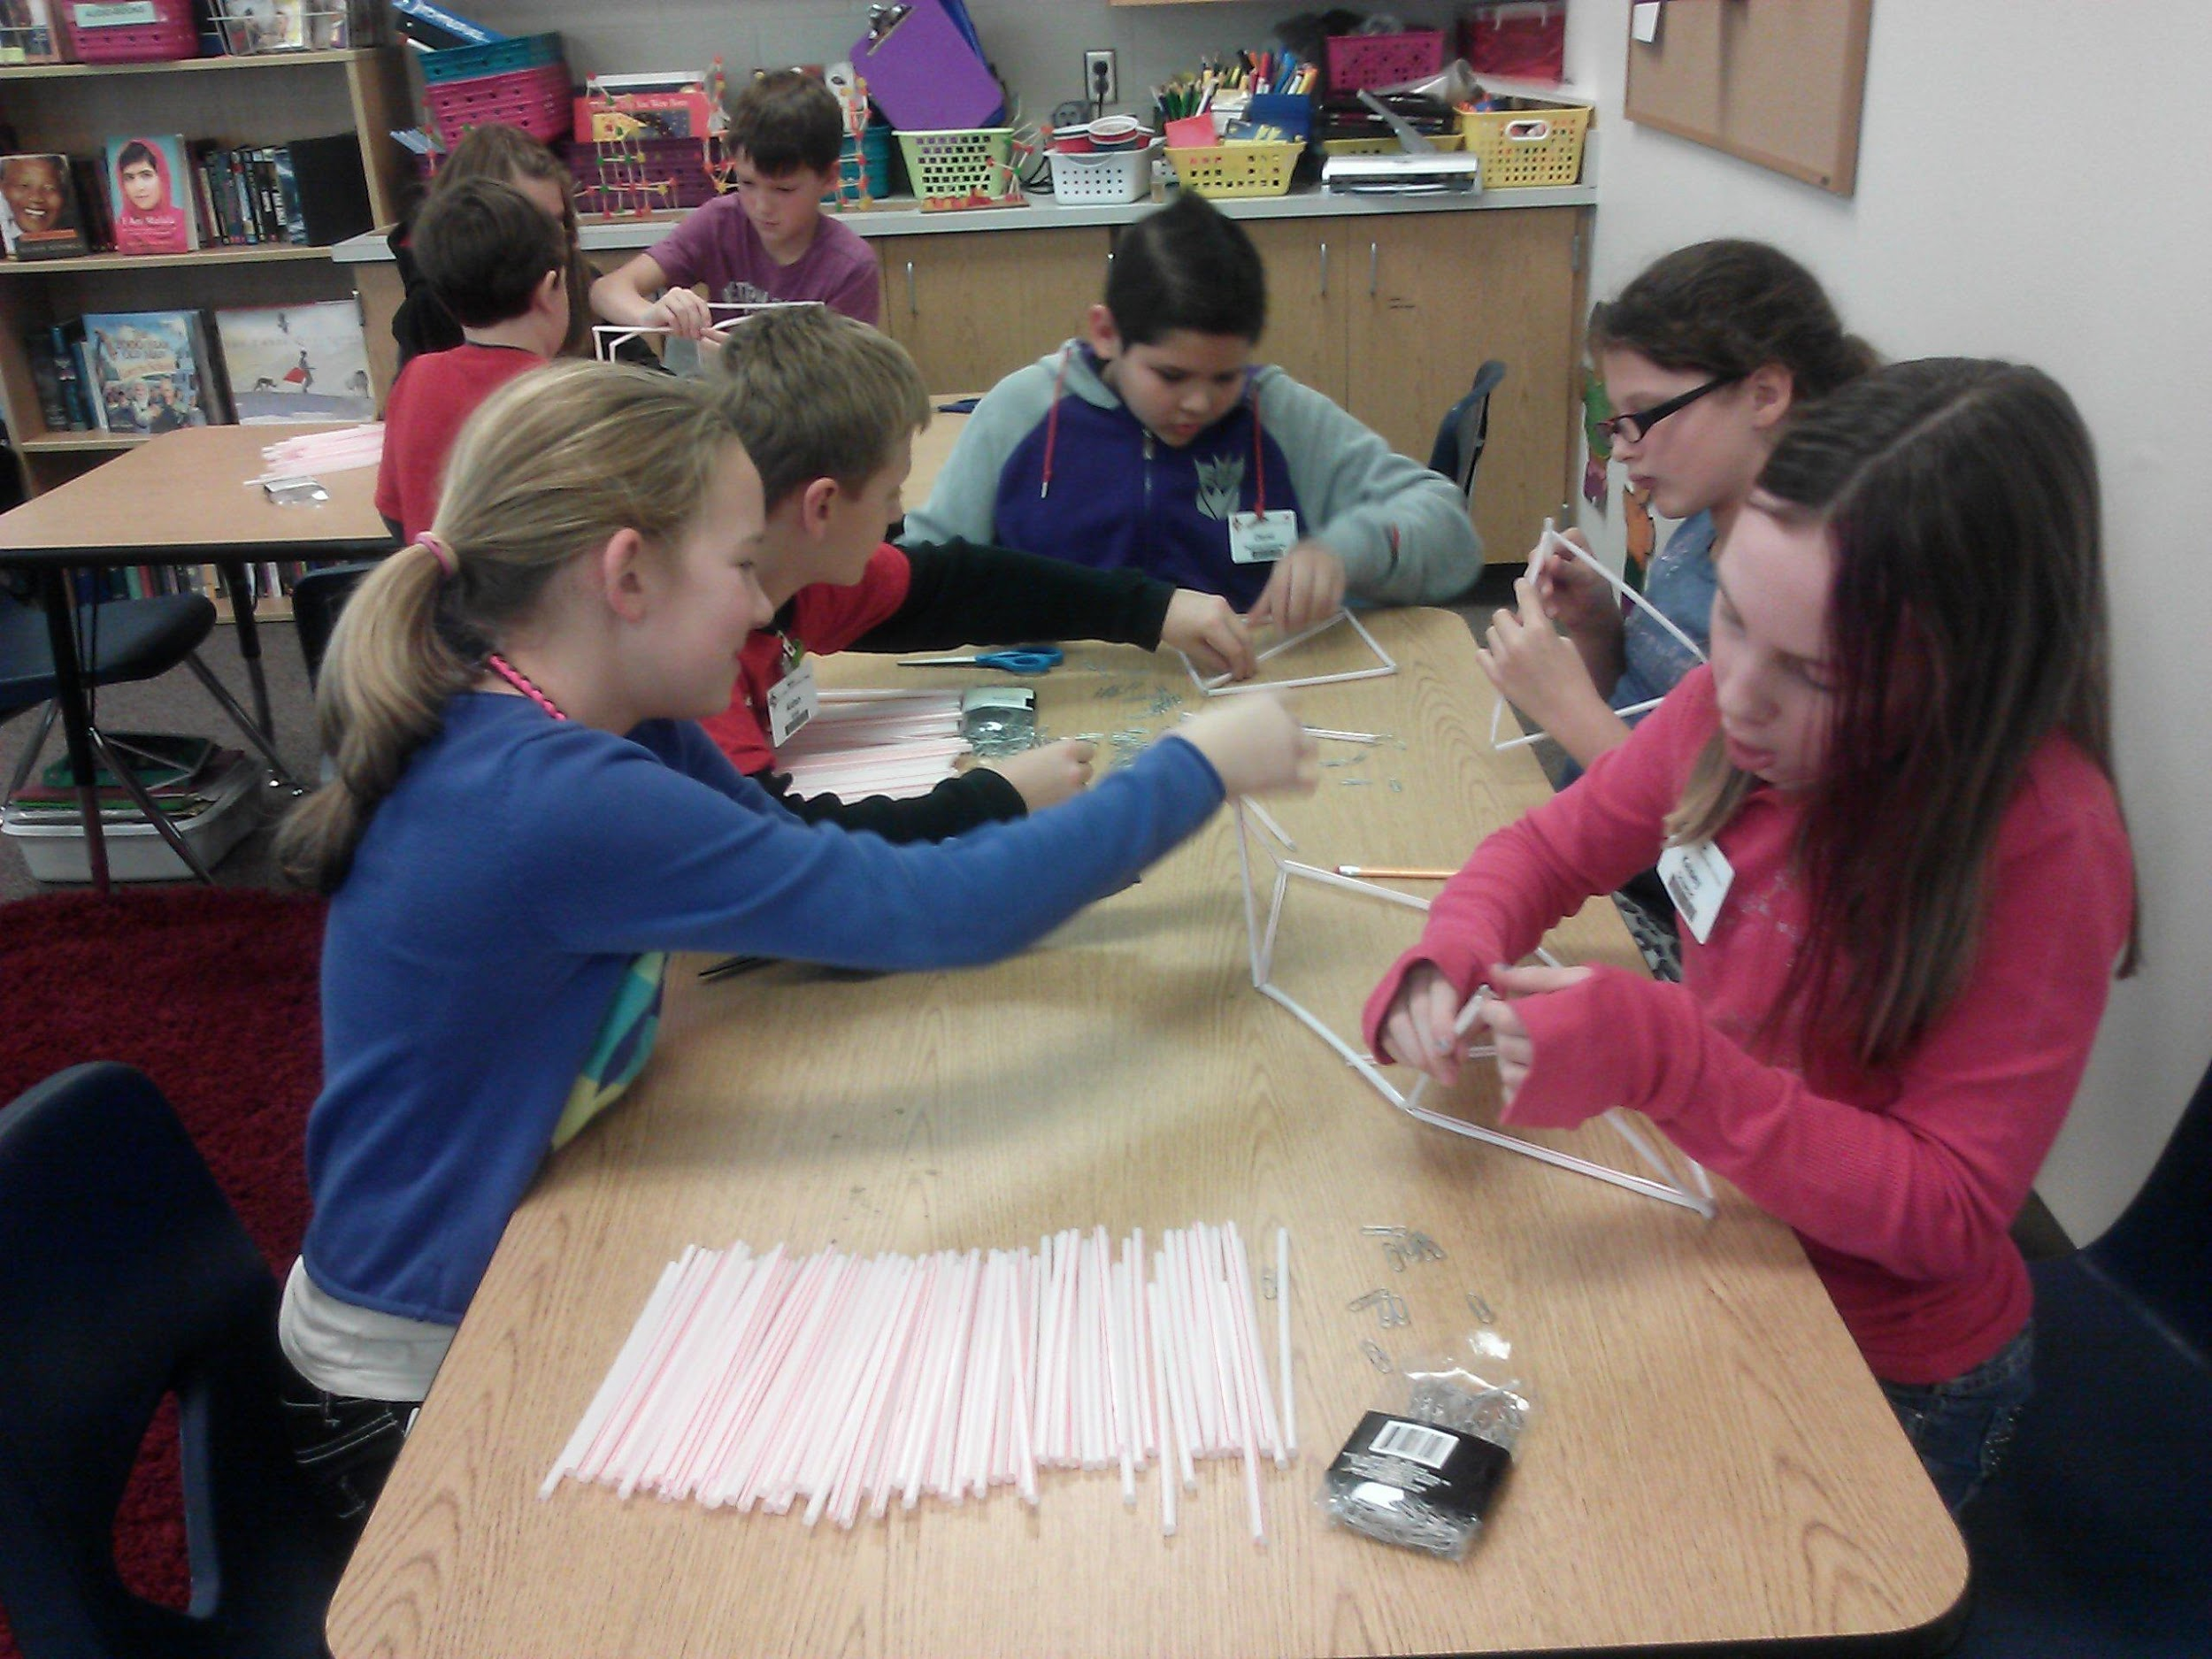
3-5 SOAR Service Details
Students attend resource class in the AIG classroom with other AIG peers and a certified AIG teacher
2 hours/week
Project Based and/or Interdisciplinary units of study that extend/enrich the curriculum
Focus on the CCS AIG Curriculum goals and objectives
Notes:
*

Slide 33
What are the Implications for my child??
Curriculum
AIG program encourages…
AIG Resource classes do NOT instruct math or reading at an advanced level.
Skills that will prepare gifted learners for a globally competitive world
Develops career awareness
Directly addresses the implication of being a gifted learner, as well as related social and emotional issues.
A love of learning
Creativity
Innovativeness
Goal setting
Responsibility
Time management
Technology
Social interaction
Teamwork
Career readiness

Slide 34
A.I.G. Warm-ups
Math Olympiad
Greek & Latin Word Roots
Weekly math warm-up from retired Math Olympiad Contest problems
5th grade students can choose to participate in Math Olympiad Contests--- starting mid-October.
Weekly word root to expand vocabulary building through 3 years.
“Hot Seat” game to review words and word roots

Slide 35
What will my child study in AIG?
Units
nAvIGate- 3rd grade curriculumm
EV-3 Robotics level 1
CSI: Mysteries

Slide 36
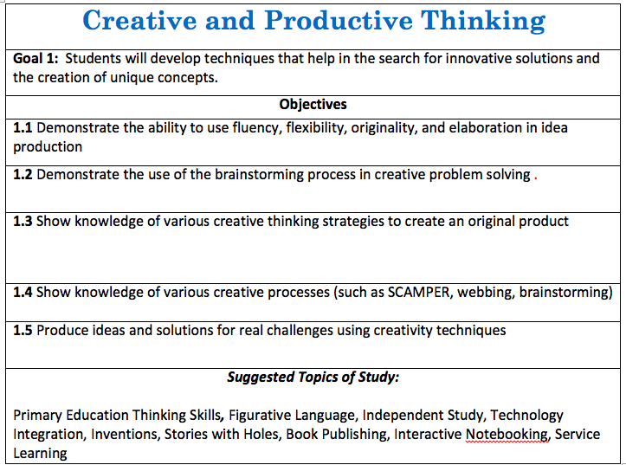

Slide 37
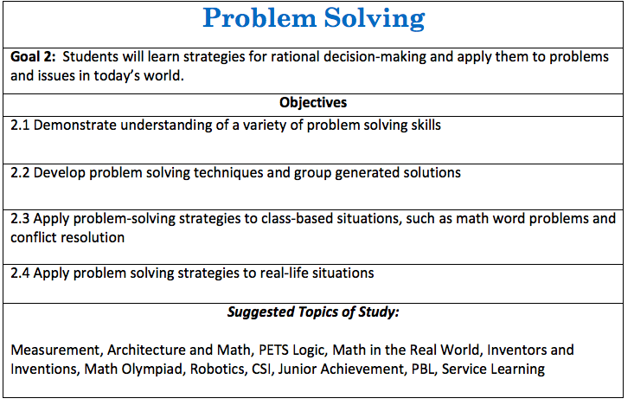

Slide 38
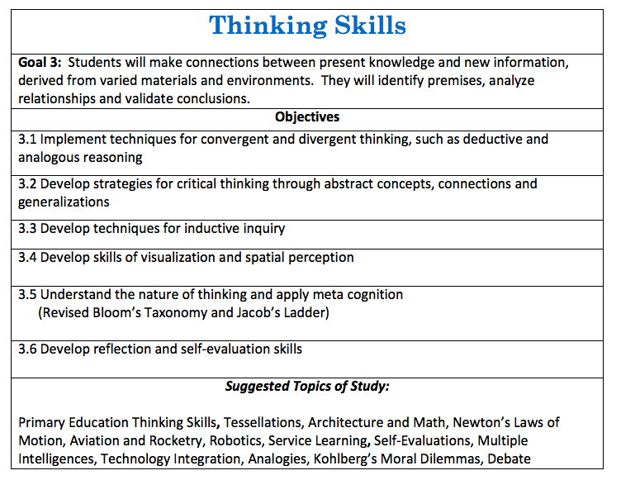

Slide 39
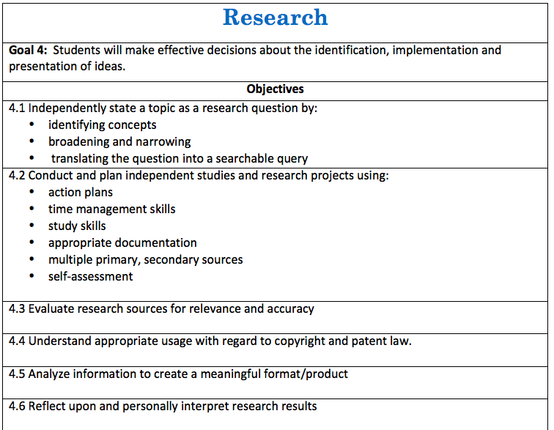

Slide 40
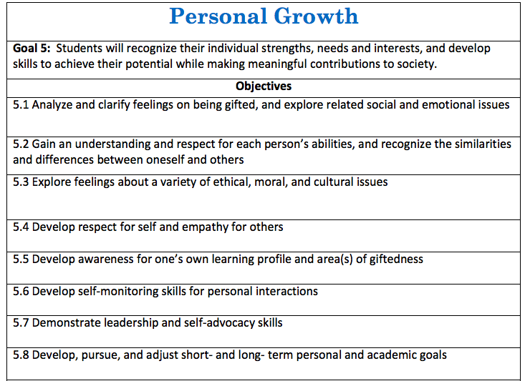

Slide 41
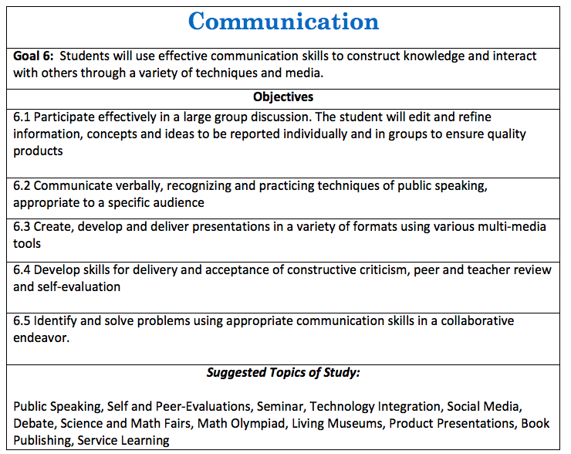

Slide 42
AIG Program Best Practices
Staggered Scheduling
AIG teachers will try to pull students out of the regular classroom from 2 different subjects if possible
Our students are pulled during their I.E. block
Missed Classwork
While many classroom teachers do not give AIG students work from time missed, if they do, we must encourage our students to make up this work. The teacher may feel the missed work is an essential concept that needs to be practiced/reviewed.
Classroom work is #1 Priority
Emphasize to students that their performance on regular classroom tests and assignments is critical to their continued participation in AIG Resource. They need to show they can handle it.

Slide 43
AIG Differentiated Education Plan
(D.E.P)
Indicates the special options for learning IN THE REGULAR CLASSROOM available to AIG identified students.
Your child will have a new DEP completed each school year, filled out by the new classroom teacher. This will “flag” the teacher about your child’s learning needs in certain academic areas.
The AIG DEP is to be signed each year by the parent and the classroom teacher. Copies will be provided to parents, and a copy will remain in the student AIG File.
Let’s take a look at the DEP.

Slide 44
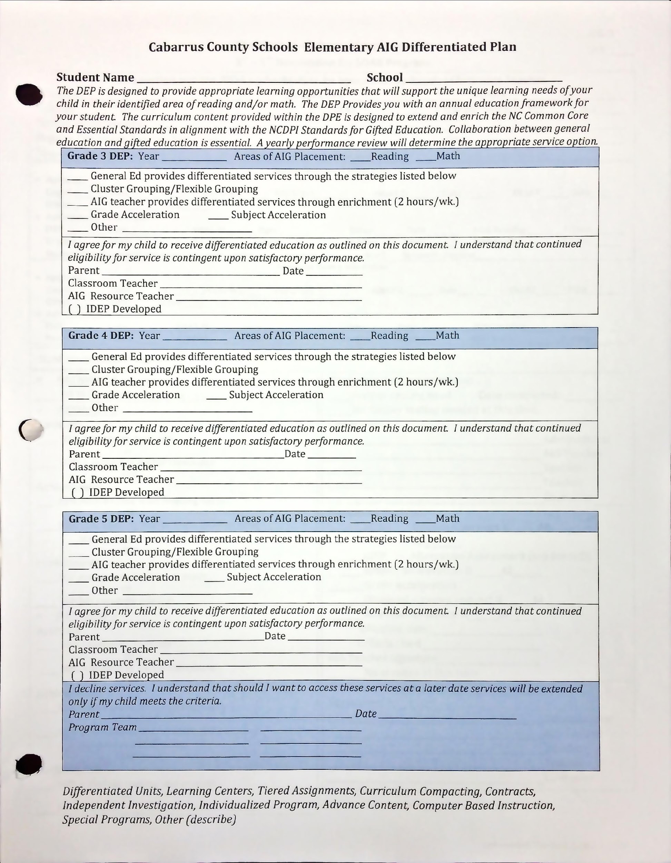
Areas of identification MAY be updated year to year based on EOG scores.
These are some of the strategies classroom teachers may use when working with gifted students. Ask your child’s teacher about specifics related to these strategies.

Slide 45
For more information about gifted education….
Check out the Cabarrus County Gifted Education Webpage: http://www.cabarrus.k12.nc.us/Page/4272
Like the CCS AIG Facebook page to get tips from district psychologists about strategies to work with your gifted learner at home!
Check out your AIG Teacher’s webpage
SENG Parent Group Information located on CCS Gifted Webpage.

Slide 46

THANK YOU!!!
QUESTION/COMMENTS

