Slide 1
Mongols
“The Mongols made no technological breakthroughs, founded no new religions, wrote few books or dramas”
Why historically significant?

Slide 2
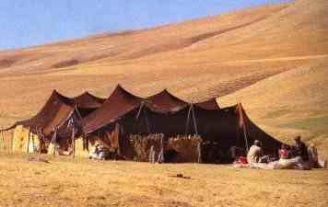
A Quick Background…
Nomads
Genghis Khan was the chosen leader
Need for water leads to conquest - Central Asia lacked rain for agriculture
Greatest Opportunity was trade – horses!

Slide 3
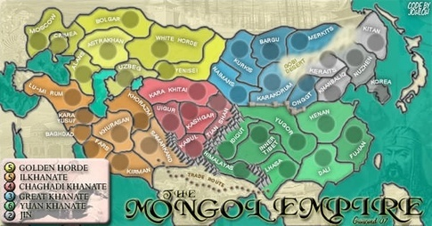
What were the key factors that allowed fewer than 125,000 nomadic warriors to build the largest empire in world history?
Military Power
Adapting to conquered lands cultures/talents
Timing: conquering lands one by one (think of puzzle pieces being put together)

Slide 4
Impact of the Mongols
“The Mongols created a single economic, cultural, and epidemiological world system”
  Mongol Exchange
  New methods of warfare
  Trade from Venice to Beijing and beyond
  Demographic change via the plague and major population shifts
  Altered the political histories of Russia, China, Europe
  Unparalleled cultural diffusion

Slide 5
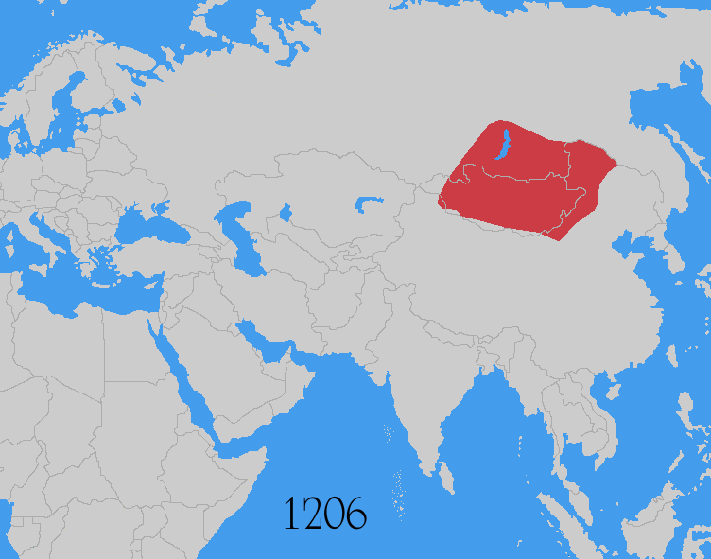

Slide 6
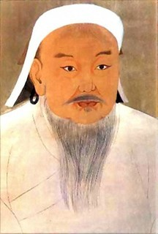
Genghis Khan: Leader of the Mongols
Genghis Khan
Mastered the art of steppe diplomacy which called for:
  displays of personal courage in battle
  combined with intense loyalty to allies
  a willingness to betray others to improve one’s position
  the ability to entice other tribes into cooperative relationships
Was responsible for bringing together all Mongol tribes into a single confederation

Slide 7
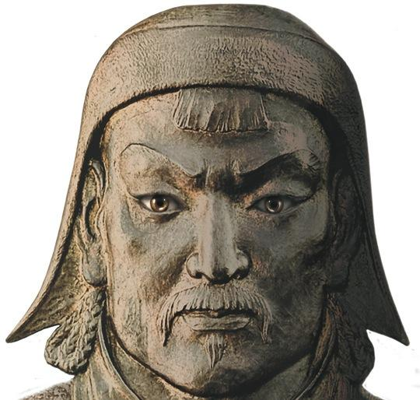
Genghis Khan
In 25 years, subjugated more land & people than the Romans did in 400 years.
Destroyed LOTS of ‘less important’ cities – often along less accessible trade routes – to funnel commerce into routes that his army could more easily supervise and control.

Slide 8
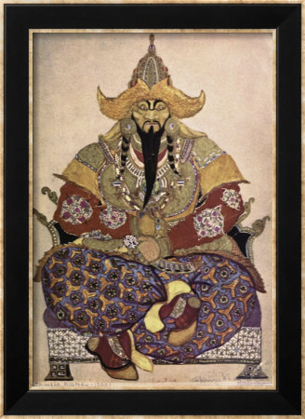
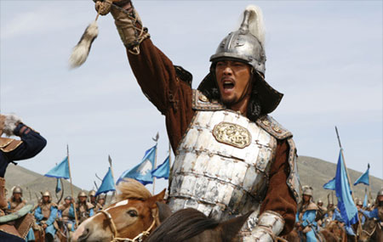
Genghis Khan
Valued individual merit & loyalty
Fighting wasn’t honorable; winning was. So, used any means necessary to win (trickery, etc.)
Conscripted peasants: Mongols just didn’t understand peasants who seemed like grazing animals rather than real humans who ate meat. “They used same terms, precision, & emotion in rounding up yaks as peasants.”
Refugees preceded Mongol attack as people from outlying areas fled to cities for protection but overwhelmed the cities & spread fear
LOVED negative PR: allowed & encouraged true or false stories to be circulated in order instill fear.
Fought on the move: didn’t care if chased or fled (unlike sedentary soldier-farmer), just wanted to kill the enemy.

Slide 9
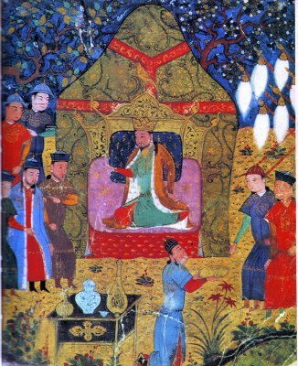
Genghis Khan – innovations
Relied on speed & surprise and perfected siege warfare (not relied on defensive fortifications)
Used resources of land instead of relying on supply train
Allocated fallen soldiers’ share of loot to widow/children (ensured support)
Reorganized army so each unit had a mix of tribal/ethnic peoples and they had to live & fight together ---transcend kinship, ethnicity, & religion.
Religious tolerance ☺
Instituted postal system for communication
Ordered writing system created
Abolished torture & insisted on rule of law (to which even the khan was accountable)

Slide 10
Overland Trade and Plague
  1. Mongol conquests opened overland trade routes and brought commercial integration of Eurasia.
  2. Disease including the bubonic plague spread among the world.

Slide 11
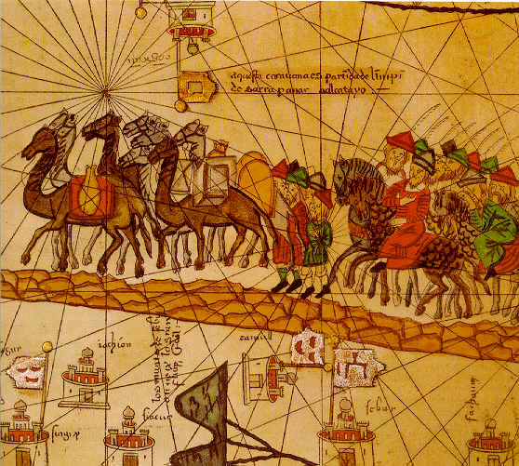
“Pax Mongolica”
Under the Mongols, there was unprecedented long-distance trade
Mongols encouraged the exchange of people, technology, and information across their empire
Weatherford: the Mongols were “civilization’s unrivaled cultural carriers…”
Marco Polo en route to China

Slide 12
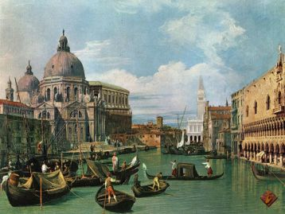
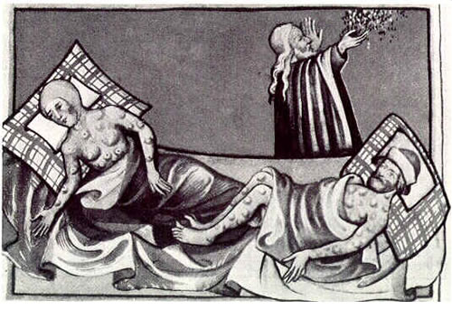
More Effects on Europe
Disappointed with loot from European invasions, Mongols allowed Italian merchants to take many of their European prisoners to sell as slaves (esp. to Egypt) in exchange for large amounts of trade goods.
This began a long & profitable relationship between Mongols & merchants of Venice & Genoa who set up trading posts in Black Sea: Italians supplied Mongols with manufactured goods in return for the right to sell the Slavs as slaves in the Mediterranean market
Silk routes opened … & then spread PLAGUE to Europe.

Slide 13
The Mongols
The Good, the Bad & the Ugly

Slide 14

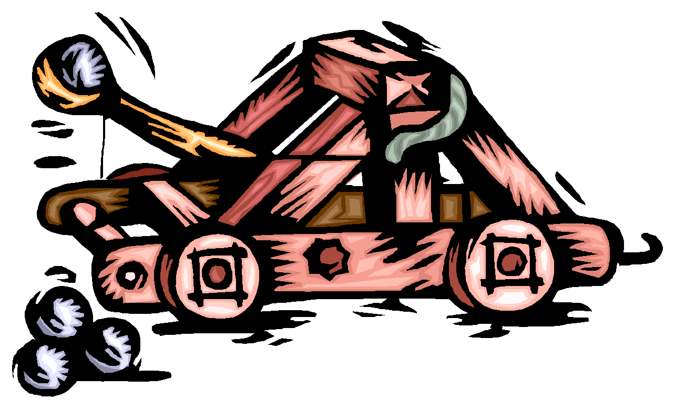
THE GOOD (accomplishments & contributions)
Military Strategy & Innovation – Cavalry, Horse Archers, surprise attacks, sieges - Genghis first needed to disband tribal loyalties
Religious Tolerance (converted to all faiths in region except Hinduism)
Common Legal Code
Utilized skills of conquered peoples – artisans, soldiers

Slide 15
THE GOOD (accomplishments & contributions)
Discipline, obedience to own laws
Sense of honor and loyalty, respect for these qualities in others, even opponents
High status of women
These qualities attested to even by European observers who generally detested the Mongols

Slide 16

THE GOOD, cont…
Golden Horde was the only group to successfully conquer Russia
Created largest continental empire in history
TRADE – source of diffusion – goods, ideas & people - under Mongol rule it was less risky → Pax Mongolica

Slide 17
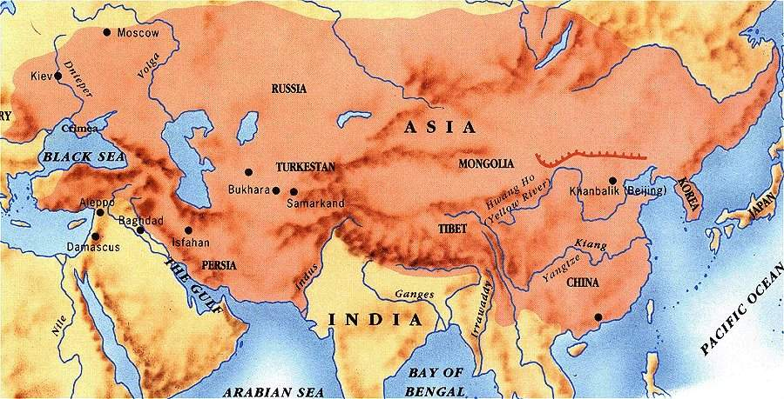
The Mongol Empire at its height

Slide 18
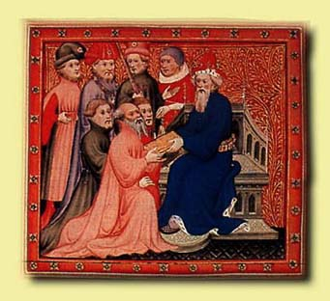
THE BAD – (failures & struggles)
Constant in-fighting for power – “Khan”
Genghis never setup centralized rule, Kublai struggled with it (Yuan Dynasty)
Kublai failed to conquer Vietnam, Burma, Cambodia & Japan
Inability to control China without considerable force
Over-spending

Slide 19
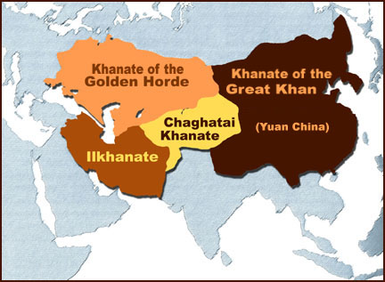
Shortly after Chinggis Khan’s death, his empire split
into four Khanates

Slide 20
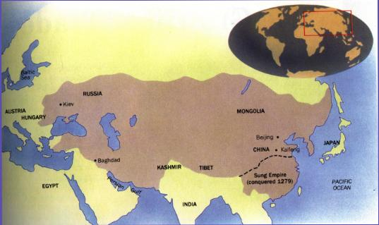

THE BAD, cont…
THE PLAGUE!!!
Over-extension – loss of control in Persia
Struggle between nomadic lifestyle and need to settle (centralized government)

Slide 21
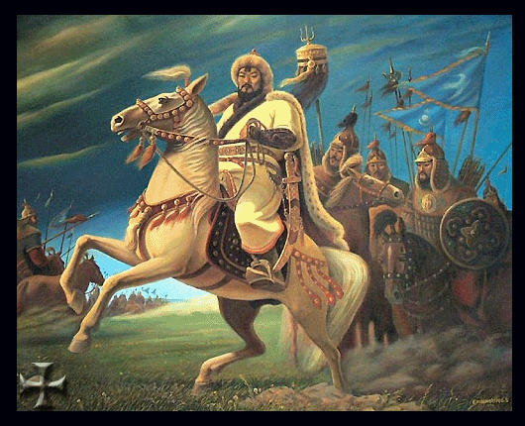
THE UGLY – (What!?! Those Mongols were CRAZY!!)
Surrender or Die
Looting & Destruction of Cities
Massacres (1.6 Million in 1 Afghan city, as many as 18.4 Million total killed)
Use of organized tactical terror
All exemplified by the Ilkhanate’s conquering of Middle East (Persia)

Slide 22
Fall of the Mongols
The large amounts of money spent on public works projects greatly weakened the economy of the Mongol Empire.
A failed conquest of Japan also weakened the military presence of the Mongols in China. This left the empire in a state that was ripe for rebellion.
Following the death of Kublai Khan, power struggles emerged throughout the Mongol Empire regarding who would rule. Because of the empire's large size, centralized leadership was hard to maintain.

Slide 23
Fall of the Mongol Empire
In China, a series of floods and increases in taxes in the early 1300s further stressed the Chinese, and rebellions broke out against the Yuan Dynasty.
In 1368, Zhu Yuanzhang led Chinese forces against the Yuan Dynasty and overthrew the Mongol emperor. The Mongols fled to Mongolia and foreign rule of China came to an end.

Slide 24
The Impact of the Mongols
POLITICAL
Mongol conquest left Russia more divided culturally & less developed than Western European nations
Descendants of Genghis Khan & Timur established the Mughal Empire in India
Introduced new military techniques & organization to Turks & Europeans – such as small organized units, the use of cavalry & the effective use of gunpowder
Mongol defeat of the Seljuk Turks in 1243 CE allowed for the later rise of the Ottoman Turks in the Middle East

Slide 25
The Impact of the Mongols
ECONOMIC
Global trade expanded dramatically under Mongol control – Italians were the primary beneficiaries in Europe; security, use of paper currency, control & management of Silk Road all increased trade in the Eastern Hemisphere
Europeans were exposed to a much greater number of Chinese goods on a large scale – gunpowder & printing being among the most influential
The global trade network became more intertwined
Mongol decline made land travel more dangerous & a shift to seafaring occurred in Europe & China after 1400 CE
Mongol conquest likely spread the Black Plague to the Europe which would have devastating economic effects

Slide 26
The Impact of the Mongols
SOCIAL
Mongols practiced religious toleration in the Middle East & Europe and often converted to local religions – allowed Islam & Orthodox Christianity to continue to thrive
Russia became isolated from European trends like the Renaissance – continued the split between Eastern & Western Europe started w/ the Byzantine Empire
The Black Plague devastated Europe in the 14th C
Mongol expansion & control of the Silk Road allowed for cultural diffusion & exploration on an unprecedented scale – including the journey of Marco Polo

Slide 27
Global Connections – The Mongol Linkages
Mongols brought the Muslim and European worlds new military knowledge, especially the use of gunpowder
Trade and cultural contact between different civilizations throughout Eurasia became much easier
Trading empires established in their dominions by Venetians and Genoese provided experiences for later European expansion
An unintended consequence was the transmitting of the fleas carrying the bubonic plague (black death) from China to central Asia to the Middle East to Europe

