Slide 1

Senior Meeting
College Application Season
Class of 2022

Slide 2

Transcripts
Transcript Audit:
Review your transcript to ensure all classes (including Summer classes) are listed
Make sure you received credit (1 or .5) for each class you passed
Make sure you received the added points (.5 or 1) for Honors and College classes
Check for classes that should be suppressed
Requesting Transcripts:
Use this link to request High School Transcript: High School Transcript
Use this link to request College Transcript: College Transcript

Slide 3
Transcripts
Sending Transcripts:
**There are 3 options to send transcripts**
Through CFNC (You can do this on your own without my assistance)
  CFNC Application Hub
Request electronically through Common App, Send EDU, Coalition...
By Mail (Takes the longest)
  It usually takes 3 weeks for the admissions department to process your transcripts, so don’t procrastinate.

Slide 4

Residency Determination Services
Use this link to establish NC Residency so you can receive in-state tuition: RDS
This must be completed and approved in order to receive in-state tuition

Slide 5

Scholarship Offerings
Use this link to record ALL scholarships, grants, or other FREE money you receive, even if you don’t plan to attend the school: Scholarship Awards
Update this form each time you receive free money for college.
The school reports the final amount to the district. In an effort to report accuracy, we request that you report all offers.

Slide 6

Requesting Recommendations
Requesting Recommendations:
Use this form to request recommendations:
Letter of Recommendation Request
Make sure you submit the Letter of Recommendation Request Form, Student Information Sheet, and Resume to each person you select to write your recommendation.

Slide 7

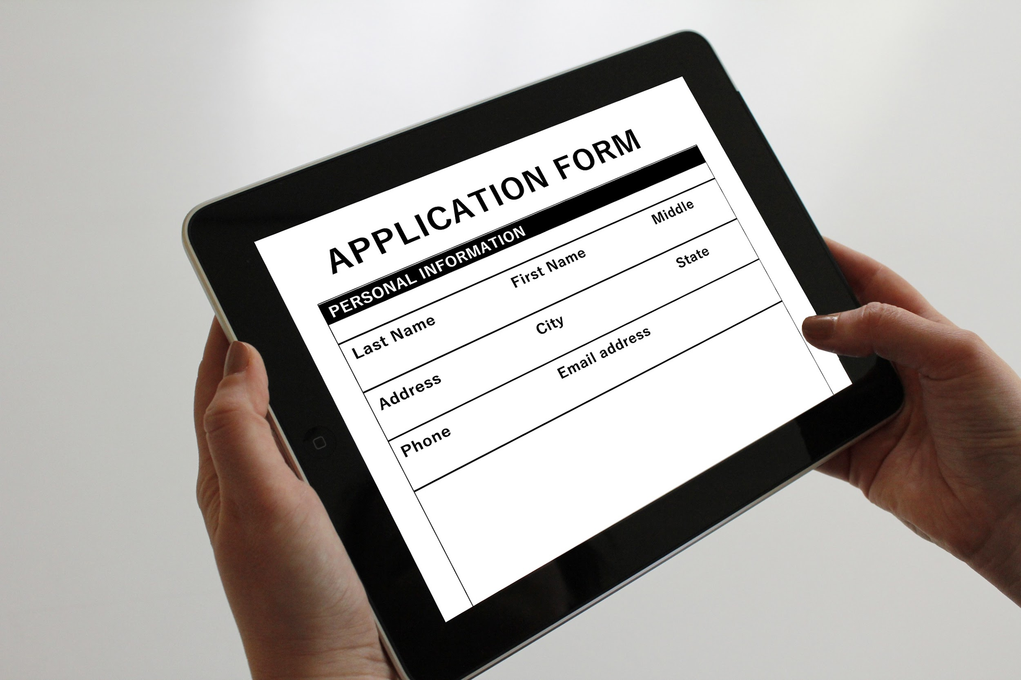
Helpful Information for College App
Senior Class Size- 55
Counselor Name: Ge’Vora Crews
Counselor Email address: gevora.crews@cabarrus.k12.nc.us
Counselor Phone Number: (704) 216- 3872
Grading Scale: 4.0
CEEB (School Code): 340877
Apply as “First Year Student”
Enrollment Type: Dual Enrollment

Slide 8

College Application Week:
Oct 18-22
During this week, many North Carolina colleges and universities waive their application fees (ncccountdowntocollege.org). Qualifying students can use the College Board, ACT, and NACAC fee waivers for institutions not waiving their application fees.

Slide 9

Open House & Admissions Deadlines
NC College Admissions Deadline and Open House Dates

Slide 10
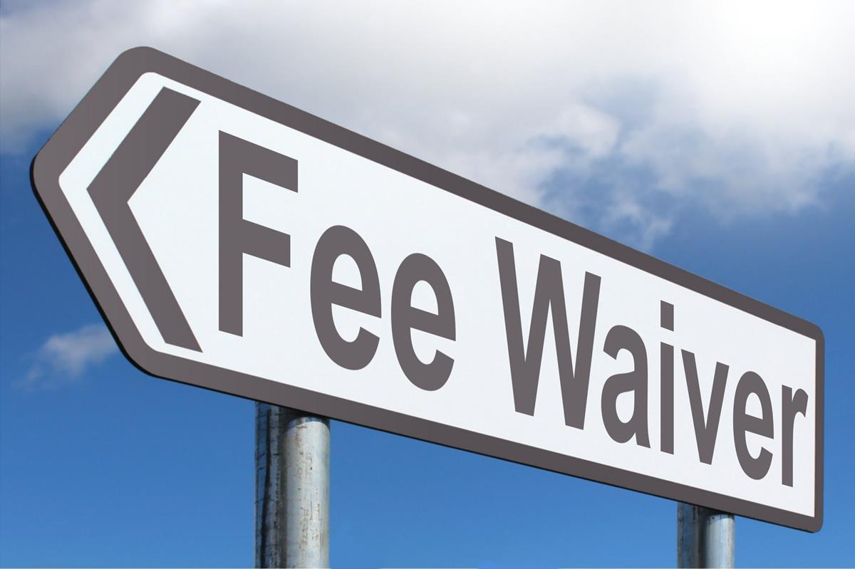
Fee Waivers
SAT /ACT Waivers: Email me if you need a waiver
You must be eligible to receive free/reduced lunch or experience a financial hardship that prevents you from paying the fees.
College Application Fee Waivers are also available. Same eligibility applies!

Slide 11

Ways to Pay For College
Apply for Financial Aid
  (FAFSA) Free Application for Federal Student Aid
Grants & Scholarships
  Sometimes referred to as 'gift-aid', grants and scholarships are types of financial aid that you typically do not have to repay. They are provided by the federal government, state government, colleges, and private organizations.
Work Study Programs:
  This program allows students to work part-time jobs to help pay for their education expenses. Students who are interested in work-study should contact the financial aid office at their school to find out what positions are available, how to apply and how their process works.
Student Loans:
  Loans always require repayment, so never borrow more than is needed or can be reasonably repaid
NC Assist Loans:
  NC Student Assist Loan and the NC Parent Assist Loan to help bridge the gap between college costs and financial aid. With no fees and competitive, low fixed interest rates, these may be the right fit for your college financial needs.

Slide 12
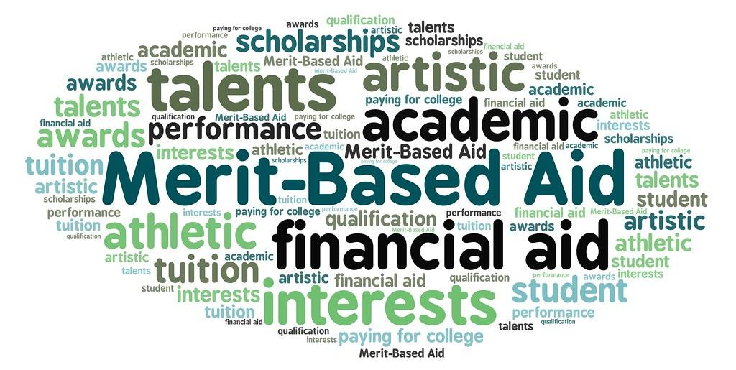
Scholarships
Some Merit and Need-Based Scholarships require a separate application. Check your college of interest to determine how to apply for scholarships. Many full-ride scholarships have deadlines before Winter Break! Check my website for a list of scholarships
Morehead- Cain Pre Nomination Form
Complete this form if you would like to be nominated for UNC-Chapel Hill’s Morehead-Cain Scholarship
Return to Mrs. Crews by September 12th.
Park Scholarship Pre-Nomination Form
Complete this form if you would like to be nominated for N.C. State’s Park Scholarship
Return to Mrs.Crews by September 27th
Davidson's Belk Scholarship
Let me know if you’re applying to Davidson and would like to be nominated
Levine Scholars Program
Let me know if you’re applying to UNCC and would like a nomination for the program

Slide 13

FAFSA NEWS
Free Application for Federal Student Aid
The Free Application for Federal Student Aid, opens Oct 1st.
The FAFSA Process
  Walks through the process of preparing for, completing, and submitting a FAFSA form
20202-2021 FAFSA Worksheet
  You can print and fill out the FAFSA on the Web Worksheet prior to completing FAFSA on the Web. This worksheet will help you collect and organize your and your parents' financial information needed for FAFSA on the Web (parent information is only required if you are dependent). The FAFSA on the Web Worksheet is not the financial aid application, nor is it part of the application. It is merely a guide to help you complete FAFSA on the Web, and should not be submitted to Federal Student Aid.
fafsa4caster
  Gives you a free early estimate of your eligibility for federal student aid. This information helps families plan ahead for college. You must use the Free Application for Federal Student Aid (FAFSA®) form to apply for aid once you’ve decided to apply for admission and attend college.

Slide 14

Exploring Careers/Apprenticeships
Alternative Pathways to Careers:
Use this link to search for Apprenticeships and Careers

Slide 15

Money Management
Skills
Money Management Tools
Learning how to manage your money wisely provides you with valuable skills that can be beneficial in many parts of your life.
Being in college allows most students to be in control of their finances. It also presents moments where students can be tempted to overspend and possibly get into debt.
The sooner you start practicing good money management, the better your financial outcomes will be in the future. So let's get started.

Slide 16


ACT/SAT Test Dates
ACT Dates:
Registration/Test Dates
SAT Dates:
Registration/Test Dates

Slide 17

College Application Checklist
College Application Checklist:
Use this checklist to make sure you’re on track!

Slide 18

Q & A

