Slide 1


Kindergarten Curriculum Night
2020

Slide 2


Transportation
Please send all same day transportation changes in writing in the daily folder.
Be sure to communicate with your child and the teacher.
Car riders – Please help your child learn their number.
Stay in your car. If you need extra time, please pull up to the flag poles so the line can keep moving. NEVER go around a stopped car. ALWAYS go down to the ball fields and get in line down there.

Slide 3
Student ID Numbers
You need your student’s ID # to:
  Login to their lunch account to add money
  To login into iReady
  To pay student fees etc. online.
  Contact your child’s teacher to get your #.
  Teachers may not email the #s home. They have to be sent home in the daily folders.

Slide 4

In School Housekeeping Items
Names on all items (bookbags, water bottles, lunch boxes, and jackets)
Student supply fee – Different from Supply Lists
Eating with your child at lunch begins the first week in October
Label all money sent in with the name and purpose
All transportation changes need to be known by 2:00. Be sure to call the front office as we do not check email throughout the day
All checkouts need to be done before 2:30
All absences need to have a note/email the day of the absence. Only have 3 days to code an absence.
Return red Comet Folders every Monday
Pack snack in a separate container/bag
Have your child practice opening snack and lunch items on their own
Wear appropriate shoes for school and on gym days
Do your background check!!
You can eat lunch with your child in October

Slide 5
Virtual Housekeeping Items
Students Will
Log into MS Teams every Monday – Thursday 8:30-10:15
Attend individual/small group instruction weekly according to the schedule provided by the teacher
Log into CANVAS Monday – Friday and complete the daily assignments
Students Need
They need a designated work space.
They need headphones with a built-in microphone.
They should already have a composition book that is their daybook for sorts and other assignments.
The parents will
Help students log into their meetings
Allow the student to attend class independently
Allow students to cut, glue, color, write and complete their assignments on their own
Allow students to complete assessments (IReady, Istation, teacher assessments) independently– this includes not explaining the questions. Explaining is helping and they cannot have any help on these assessments

Slide 6



Student Online Platforms
CANVAS
Everyday for homeroom as well as encore classes
One-stop shop for MS Teams, Seesaw, Bookflix and Epic!
Seesaw
For doing online assignments
For turning in paper assignments
Flipgrid
Mostly for encore classes

Slide 7

Reading
Reader's workshop
  Is used in all Kindergarten classrooms and consists of the following:
    Guided Reading: small group instruction for children at the same reading level
    Learning Centers: phonics or literacy based reading practice
    Shared Reading: whole group print concept
    Independent/Partner Reading: children read at their individual reading levels
    Conferencing: Teacher meets with individual students to assess their current reading level/skills
    I Station computer program used weekly

Slide 8
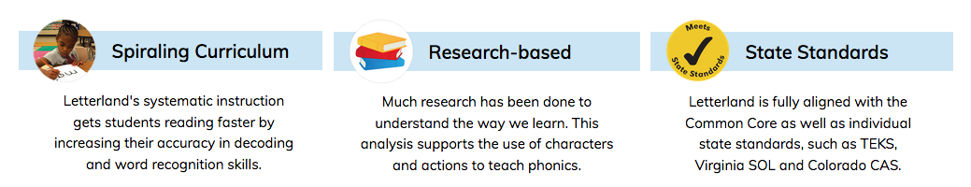
Phonics
Letterland is our new phonics/phonemic awareness program.
Letterland was created to teach phonics using a story-based approach. The story logic engages students leading to long term retention of concepts. What's more, Letterland is wonderfully multi-sensory. It activates every learning channel through music, actions, alliteration, movement, song, art, games and role-play.

Slide 9
Reading Assessments
  Through Istation
  From the state – 3 times a year (September, January & May)
Daily/Weekly
  Conferencing
  Guided Reading Groups
  Classroom Observations
  Center work

Slide 10

Writing
Writer's Workshop
  Is used in all Kindergarten classrooms and consists of the following:
    Mini lesson taught whole group every day
    Children work on writing at their own pace and writing stage
    Children monitor/assess their own writing
  Units for the year include: Small Moments, Informational Writing (How-To and All About Books) and Persuasive Writing.
  Writing celebrations occur at the end of most units

Slide 11

Writing Assessments
Throughout the year
  Writing prompts
  Word study inventories
Daily/Weekly
  Conferencing
  Classroom observations

Slide 12
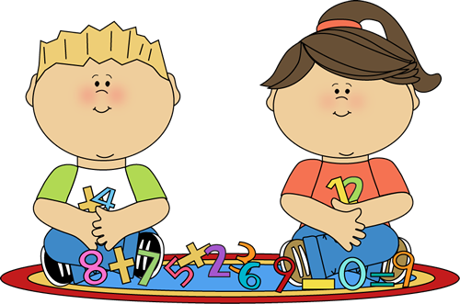
Math
Math Workshop
  Is used in all Kindergarten classrooms and consists of the following:
    Mini lesson taught whole group daily
    Math stations done daily (in school)
    Small groups are pulled by the teacher
    iReady Math

Slide 13
Math Assessments
Created by teachers that correlate with each unit
Assessments are given throughout the year to help guide instruction
Teacher uses classroom observations from groups or center work
iReady Math - Beginning of the year assessment has been administered.

Slide 14

Social Studies/Science
Social Studies
Integrated throughout the curriculum
Family, community helpers, holidays and seasonal themes
Science
Integrated throughout the curriculum
Science kits are done each 9 weeks (Force and Motion, Animals, Properties, and Measuring)
Weather changes and seasonal topics

Slide 15

Important to remember that although you may receive a brief note or picture from us in Dojo, any further communication needs to be through our CCS email.
Meant for positive reinforcement.

Slide 16

Report Card/Progress Reports
Progress Reports go home 4 times a year
Report cards go home at the end of every 9 weeks
Parent/teacher conference is included/required with the first report card
Additional conferences are on an as needed basis

Slide 17
Standards Based Report Cards
Report a student's level of end of the year grade level standards
Aligned with Common Core
Special area scores for music, art and PE given twice a year
Social/learning skills are recorded separate
Scoring seen as a 1, 2, 3, or 4 (above grade level)
Children may receive 1's or 2's 1st and 2nd quarter because they are "making progress" towards end of year goal
Goal is have a 3 in all areas by the end of the year

Slide 18
Homework
Starting January, homework will be weekly. More information will come closer to the time.
For now, you should be reading with your child every night and they can be working on writing their name, recognizing letters, writing upper and lowercase letters, letter sounds, writing numerals, counting to 100 by ones and 10s, following directions and being independent.

Slide 19
Tips for success!
Nutrition
Sleep
Limit screen time and anything that promotes aggression
Play outside

Slide 20
Thanks for coming!
If you have individual teacher/classroom questions please email your teacher!

