Slide 1
HUMANITARIAN SOCIETY
Interest Meeting

Slide 2
Attendance
http://bit.ly/humso920
Notes:
Nandika

Slide 3
What are we about?
“Service Above Self”
Volunteering in the community
Developing leadership skills
Notes:
Darby

Slide 4
Meet the Officers!
Darby Taylor- President
Jaidan Rubinstein- Vice President
Shaista Sayeed- Public Relations
Nandika Komirisetti- Secretary
Protima Mukherjee- Secretary
Maya Stang- Volunteer Coordinator
Notes:
All

Slide 5


Join our Remind!
Text @cmhum to 81010
Follow us on Twitter!
@CMHShumanitary
Notes:
Shaista

Slide 6

T-SHIRTS!
$12, cash only!
Bring money before Wednesday, September 26th to Mrs. Fontan’s room.
http://bit.ly/humsoshirt
Notes:
Jaidan

Slide 7
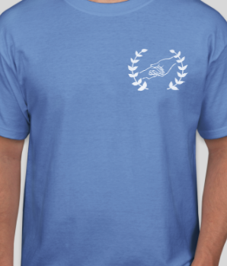

http://bit.ly/humsoshirt
Thank you
Gigi and Melody!
Notes:
Maya
*what designs are projected to look like
*members will have purple shirts

Slide 8

Walk to End Alzheimer’s
When: Saturday, October 13th *times will vary!
Where: BB&T Ballpark - Downtown Charlotte
Walk Day Volunteer
12-16 years old: guardian*
Register as an individual.
If you sign up, show up.
More info later, keep eye on email.
Pictures? Share them with us!
  cmumanitarianclub@gmail.com
Notes:
Protima (there is a semi-script bc i was being a bit extra)
First Volunteer Opportunity of the School Year:
-Walk to End Alzheimer’s on Saturday, October 13th -> specific times will be on sign up
-BB&T Ballpark -> downtown CLT -> carpool?
-sign up through link as a walk day volunteer -> scroll down page
-we all surpass the minimum age requirement, but if under 16 or younger need guardian -> difficult but can always contact coordinator
-register as an individual -> opportunity is optional, we won’t know how many actually go
-if you sign up, show up. Conflict -> contact coordinator -> info on sign up
-hopefully more information will be sent to you individually via email once it gets closer to the time
-take pictures, wear CMHS shirts/colors there -> you will get a shirt there
-keep eye out for officers, say hi if you see us -> all in different areas, can’t really meet up

Slide 9
Thank you for coming!
Next Meeting - October 18th*
Notes:
Darby
*subject to change, hoping to meet on third thursday of every month

