Slide 1
Cabarrus County Schools
Administrator’s Tips
for Financial Success

Slide 2
Principal’s Fiscal Responsibility
The principal is the fiscal manager of the school. It is essential to follow the law and accepted practices. The principal is held accountable for all school related expenditures. It is the principal’s responsibility to establish sound bookkeeping and business practices for all receipts and expenditures regardless of the source of funds. This includes proper accounting of funds by organizations sponsored by the school (clubs, camps, etc.). Administering funds will require the principal to make decisions regarding which programs and activities are the most important.
The principal should assume the responsibility for financial planning, as well as protecting school funds. He / she should develop a school budget to be used during the school year. Knowledge of the laws regarding the handling of school funds is essential. Principals would not intentionally misuse school funds. However, ignorance of the law is no excuse.
Your School Treasurer will serve as your greatest resource for helping with your fiscal management.

Slide 3
Treasurers
General Statute 115C-448(a) of the School Budget and Fiscal Control Act states that the school treasurer “shall keep a complete record of all moneys in his / her charge in such form and detail as may be prescribed by the Finance Officer of the administrative unit, and shall make such reports to the Superintendent and the finance officer of the administrative unit as they or the Board of Education may prescribe.”

Slide 4
Treasurer Duties / Responsibilities
Receive all monies collected, write receipts, prepare timely deposits, and deposit funds in bank.
Process purchase orders, invoices, write checks for items received and paid for at the school level.
Work with Finance Office for expenditures relating to non-school funds.
Keep all books and accounting records.
Daily monitoring of timekeeper and related reporting.
Meet all deadlines required for payroll reporting.
Close out all accounting records as of June 30.
Any and all other responsibilities prescribed by the principal and the Finance Officer.

Slide 5
Funding levels
County Managed
  Instructional Allotment or “ADM”
  Teacher Allotment
  Clerical/Custodial Allotment
  Local Travel Allotment
  Grants $5,000 or more
School Managed
  Revenue from fundraising activities (pictures, prom, parking passes, etc.)
  Grants under $5,000
  Instructional Fees
  Revenue from vending, concessions
Outside Sources
  PTA/PTO
  Boosters

Slide 6
Allotments
County Managed
Each year, Cabarrus County Schools has limited resources to fund and support four essential school related areas in our system; Teachers, Teacher Assistants, instructional supplies, and clerical / custodial staffing.
Instructional Supplies: There are a fixed amount of funds available for instructional supplies each year. At the start of each fiscal year, funds are allocated to each school based on ADM.

Slide 7
Allotments cont.
County Managed
Items considered instructional supplies or materials include:
Items consumed in use.
Items which lose their original shape or appearance with use.
Items which are expendable (that is, if damaged or if some of their parts are lost or worn out, it is usually more feasible to replace them rather than repair them).
Items which are inexpensive (cost does not exceed $5,000) with the characteristics of equipment, or items which are a service (such as the rental of instructional equipment used as part of the instructional program).
Library books for the school media center.
Textbooks in excess of the state’s provision of adopted textbooks.
It is impossible to provide a comprehensive list to address all situations if you have a question or are unsure please speak with your Treasurer or Finance Department.

Slide 8
Allotments Cont.
County Managed
Teachers:
There are a fixed number of teacher positions to allocate within our system. Generally the number of teacher positions at each school is determined by the school’s projected Average Daily Membership (ADM). There are some differences based on school level as follows:
Elementary – Based on ADM with consideration given to target class size.
Middle School – Based on ADM with consideration given to target class size. Allotment may be adjusted based on current “at risk” population. Free and reduced lunch percentage is currently used as an indicator of risk.
High School - Number of teachers determined based on ADM. Allotment may be adjusted based on current “at risk” student population. Free and reduced lunch percentage is currently used as an indicator of risk. High Schools may also receive additional positions for specific areas such as AP courses.

Slide 9
Allotments Cont.
County Managed
Classroom Teacher – Coded 121
  To qualify, an individual must spend the major portion of the school day doing any of the following or any combination of the following:
    Provides classroom instruction to students
    Provides direct instruction via pull out sessions
    Works in the classroom with the teacher of record to implement effective strategies which align to required content standards
    Subs are allowed
    Earns personal leave
    May Not take leave on student days
    Lead Teacher – Coded 135 (limited funding)
      Title 1 – can’t switch out
      DOES NOT GET SUB
      Does not earn personal leave
      May take annual leave on student days

Slide 10
Allotments Cont.
County Managed
Clerical and Custodial:
Funding for clerical and custodial positions in our system is set amount each year. Clerical and Custodial allotments are calculated separately, but can be used interchangeably at the discretion of each school’s administration. Clerical and Custodial staffing is allotted in terms of Months of Employment (MOE). There are 172 hours allowed for each month of employment. Example - For a ten month full time clerical staff, the school is allowed 1,720 hours during the fiscal year.
Clerical – Allotments are Based on ADM
Custodial – Allotments are Based on a combination of ADM and Facility Square Footage

Slide 11
Allotments Cont.
County Managed
Travel Allotment

Slide 12
What’s the difference?
“ADM” vs. School Funds
Instructional Allotment “ADM” = instructional supply funds
ADM allocations are funds you can access with a purchase requisition but are held at the central office. The system finance officer signs the purchase order and the check.
School funds = pictures, field trip, athletics tickets, supply fees, parking lot fees, etc.
School funds are in the school checking account. The principal signs the purchase order. The principal and the school treasurer signs the check.
ALL of the above are PUBLIC FUNDS.
Anything you use public funds for can (and will) show up in the newspaper. Be sure you are proud of your purchases.

Slide 13

Anatomy of an Account Code
County Managed
Fund = where the money comes from
1 = State
2 = Local
3 = Federal
4 = Capital
5 = Child Nutrition

Slide 14
Anatomy of an Account Code Cont’d
County Managed
Purpose = the reason for which something exists or is used
5110 = Regular Instruction
5210 = Special Instruction
5330 = Remedial & Supplemental K-12 (Title 1)
9000 = Furniture & Equipment
The Board of Education must approve all budget amendments if moved between function

Slide 15
Anatomy of an Account Code cont’d
County Managed
PRC = Program Report Code
050 – Title I
060 – Exceptional Children
061 – Instructional Supply
069 – At-Risk
897 - Technology
999 – Capital Outlay

Slide 16
Anatomy of an Account Code cont’d
County Managed
Object = the service or commodity obtained as a result of the expenditure
121 – Teacher Salary
199 - Overtime
163 – Substitute Pay
196 – Stipend
143 – Salary for Contracted Duties
311 – Contracted Services
411 – Instructional Supplies
418 – Software
461 – Furniture & Equipment
(less than $5,000 per item)
462 – Computer Equipment
(less than $5,000 per item)

Slide 17
Accounts Payable
Applicable to both County and School Managed funds
Public school funds should not be committed without getting an approved purchase order first.
Requisition – Request to spend funds.
Purchase Order – Approval to spend funds.
Timing is everything. An approved purchase order (not requisition) must be received before any goods are purchased or any services rendered.
If you do not have a purchase order in place before obligating public funds – we appreciate your financial contribution to your school from your personal funds.

Slide 18
Accounts Payable- Cont’d
Applicable to both County and School Managed funds
Purchases
A purchase order must be prepared and approved before any order is authorized. Any order placed or services received prior to approval will be the responsibility of the individual who placed the order. This includes reimbursements to staff members. Only principals can approve purchase orders with the exception of the treasurer when the principal is absent.
Reimbursements
Items purchased for reimbursement must be presented for payment with valid receipts and a signed copy of the purchase order. Purchases should be on separate receipts and not combined with personal purchases. Receipts should be reviewed by the treasurer to determine if purchase is appropriate for use of public funds.
Payments to School Personnel other than reimbursements must be processed through payroll.
Reimbursements to employees should only occur in cases where the vendor does not accept a school purchase order; no check should be issued in payment of any item for which an invoice would normally be furnished.
A purchase made by a staff member to be reimbursed in order to circumvent policy is unacceptable. Any staff member making that purchase will be responsible for payment.

Slide 19
Accounts Payable
Applicable to both County and School Managed funds
Travel
Prior approval form for any travel outside of Cabarrus County must be signed by the claimant, and their principal or supervisor. Out of state and overnight travel must also be signed by the Superintendent. Be sure to fill out the form in its entirety.
Meals (require overnight stay) are paid at per diem and do not require receipts.
All other expenses require receipts. (e.g. Registration, hotel expense, parking, taxi cabs, car rental, and airline luggage fees).
Travel forms auto calculate and are available on Finance website.

Slide 20
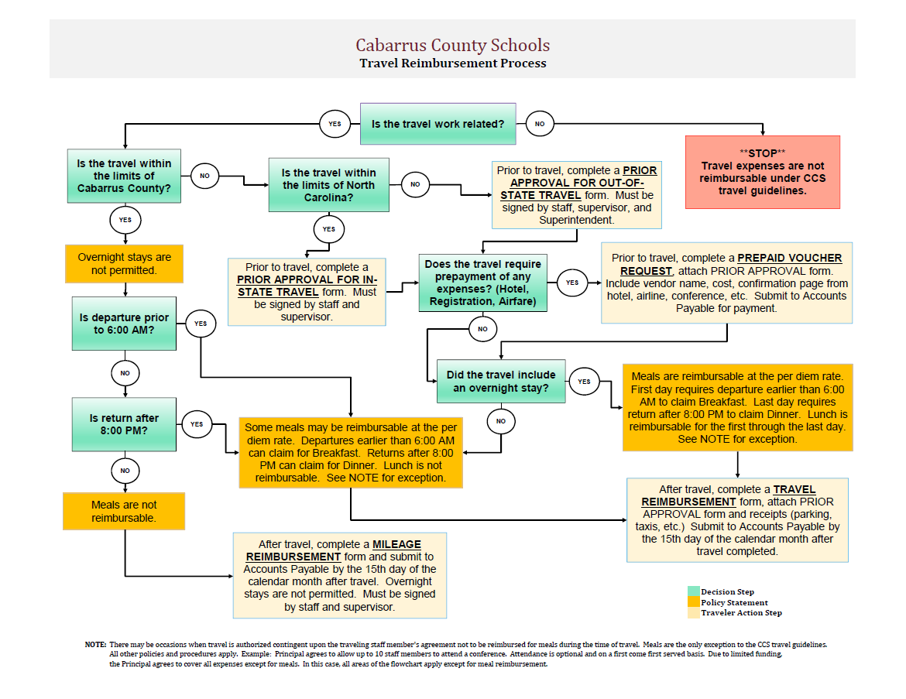
Accounts Payable
Travel Flowchart

Slide 21
Accounts Payable
Applicable to both County and School Managed funds
Prepaid Vouchers
Prepaid Vouchers can be used for registration/conferences, stamps, hotel reservations, membership fees, annual dues, copier contract costs, utilities/telephone, or reimbursements under $25.00.
Proper and complete backup is required, including:
prior approval forms
completed registration forms
hotel confirmations
contract copy
invoices
original receipts
Postage requires original receipt to be returned to Accounts Payable after purchase(County Managed Only).

Slide 22
Accounts Payable
Applicable to both County and School Managed funds
Tipping Policy
The Board recognizes that some incidental expenses can be incurred during the process of handling official district business. Tips and gratuities can be paid for normal services associated with travel and food services with proper documentation.
It is expected that CCS employees exercise prudence in all financial matters. Tips should be reasonable and customary. Anything in excess of reasonable and customary will be an individual expense and will not be reimbursed by CCS.
Meals are reimbursed per our travel policy at the per diem rate. For overnight travel, this rate is inclusive of tip amounts paid. Tips should not be entered separately on the travel reimbursement request form, this should be included in the cost of the meals. Receipts are not required to claim per diem meal reimbursement.
Non-travel related food purchases are when food is catered or delivered to a CCS event. Reasonable and customary tips are an allowable expense. Tip amounts must be included on the invoice or original receipt. For reimbursements, the payment of gratuity must be supported with proper documentation; proper documentation includes a receipt showing tip amount as a separate line and copy of credit card statement or checking account statement.
  Gratuity should not exceed 15% of the bill for dine in meals.
  For Parties of 6 or more, the gratuity should not exceed 18% of the bill for dine in meals.
  Gratuity should not exceed 5% of the bill for delivered meals and catering.
  Gratuity for other travel services are not permitted except for the following: baggage handling/skycaps, shuttle drivers, valets, and taxi drivers.
  Airports: Baggage handling/skycaps and shuttle drivers = no more than $2 per bag
  Parking/Auto Related: Valets = $2 per car when collecting the car;
    Taxi Drivers = no more than 15% of the fare and $2 per bag

Slide 23
Accounts Payable
Applicable to both County and School Managed funds
  Gratuity for charter bus drivers is allowed provided the following requirements are met:
      The field trip form that goes home to parents must clearly state that funds collected include a $50 tip to be given to drivers.
      The gratuity should not exceed $50 per driver for the total trip.
        If the service provided is not satisfactory, then a tip should not be given.
Example:
  7th grade class of Dean Smith High School will going to Washington D.C
    3 charter buses are needed
    The potential tip would be $150, $50 per driver
      Provided the field trip form includes information about the tip and the service is satisfactory.
Remember we are spending taxpayer money, we should always practice prudence and good financial stewardship.
Pursuant to Section 3.4 Travel, Mileage, and Meal reimbursement of the Finance Manual, requests for reimbursements shall be filed within 30 days after the travel period ends for which the reimbursement is being requested. Failure to adhere to all policy and procedures expressed will render amounts ineligible for reimbursement.

Slide 24
Accounts Payable
County Managed
School Managed
Purchase Orders
Requisitions are to be entered into financial software before purchases have been made and will not be approved until proper documentation has been received.
A copy of the requisition and three bids are required for any item over $5,000 or multiple items totaling $5,000 if all components are required to complete usage of the items. (e.g. Smart Boards).
Technology requisition approval number is required on electronics and software purchases.
A copy of the requisition and list of items are required for orders over 25 items that are not individually typed on the requisition.
Dell requires quote numbers to be typed on requisitions.
Purchase Orders
Purchase orders must be approved by the Principal and entered into SFO(School Funds Online) before any purchases are made.
A copy of the requisition and three bids are required for any item over $5,000 or multiple items totaling $5,000 if all components are required to complete
usage of the items. (e.g. Smart Boards).
Technology requisition approval number is required on electronics and software purchases.
A list of items are required for orders over 25 items that are not individually typed on the purchase order.
Dell requires quote numbers to be typed on purchase orders.

Slide 25
Checklist for disbursing funds
School Managed
Approval obtained before purchase was made?
Is purchase reasonable and appropriate for school use?
Audit trail? Does your documentation tell the story?
Are school level checks signed by principal and treasurer?
Are bids secured for purchases over $5,000?

Slide 26
School Funds
School level funds are accessed through School Funds Online (SFO); SFO is a web based accounting software system.
Type of Accounts
100 Series – Athletic Accounts
200 Series – Fine Art Accounts
300 Series – Class Accounts
400-500 Series – Club Accounts
600 Series - Scholarship Accounts
700 Series - General Accounts
900 Series - Fundraising Accounts

Slide 27
School Funds Cont’d
Important Accounts to Note
General Fund
School Support Fund
Faculty/Social Fund

Slide 28
School Funds Cont’d
Allowable General Fund Expenditures
Are “limited to such expenditures that benefit the students or school as an entity, support the goals and strategies of the School Improvement Plan, and/or accomplish expectations set forth by the superintendent.”
Some examples include:
Student materials and supplies
Teacher needs (file folders, markers, pens, etc.)
School Improvement
Mileage reimbursement for school related travel
Hotel and workshop expenses for staff development

Slide 29
School Funds Cont’d
Allowable School Support Expenditures
This is not an anything and everything account
Items purchased from this fund must be appropriate for school use and related to school activities.
Food can only be provided as part of a meeting or staff development activity. We cannot buy biscuits for breakfast because it’s payday, we can buy biscuits for a staff development meeting.
The staff development activity should have prior notice, sign-in sheet/list of attendees and a formal agenda reflecting staff development activity.
Excessive usage will be monitored
Incentives may be purchased for a job well done, if it is an educational tool to be used in the performance of the job. Day planners, calendars, pens, etc. are fine. It cannot be strictly for personal use. Flowers for students in the hospital or loss of parent is fine. Flowers for staff members should come from faculty funds.

Slide 30
School Funds Cont’d
Allowable Faculty Fund Expenditures
Faculty funds are contributed by staff with the intent to be used to purchase items approved by the group.
This fund can be used to purchase flowers, celebrations such as baby showers, holidays, weddings, or other personal events.
This fund should never be in the negative i.e., if the funds are not available you cannot purchase.

Slide 31
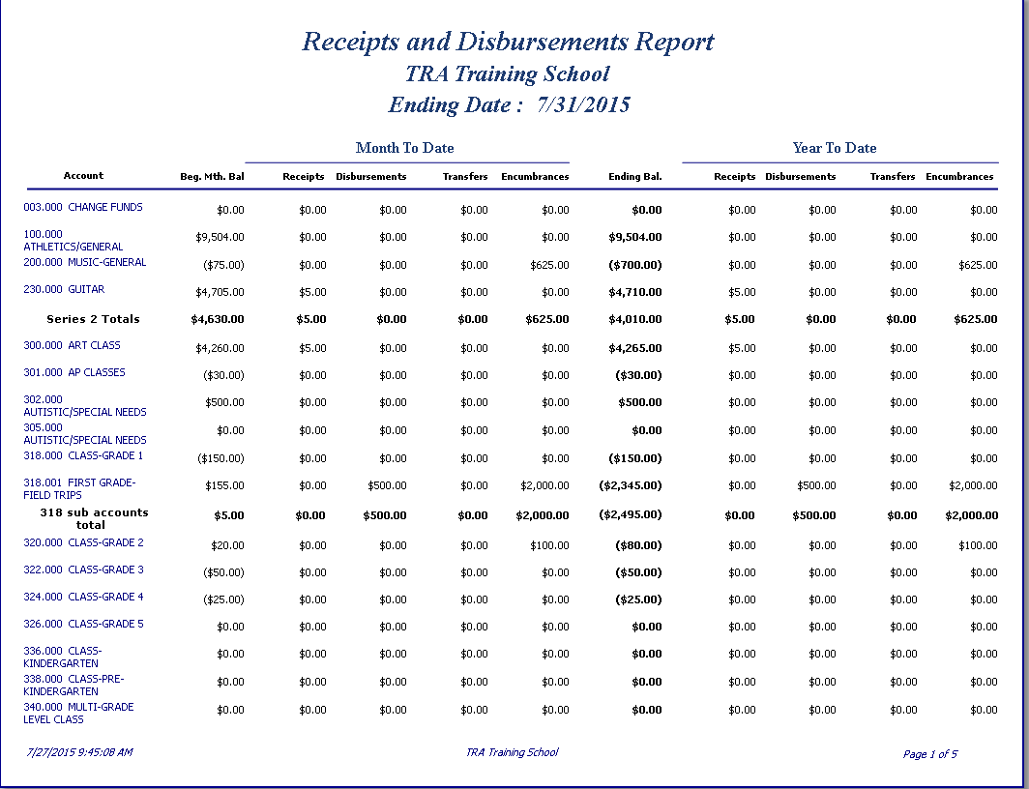
School Funds Cont’d
Reporting

Slide 32
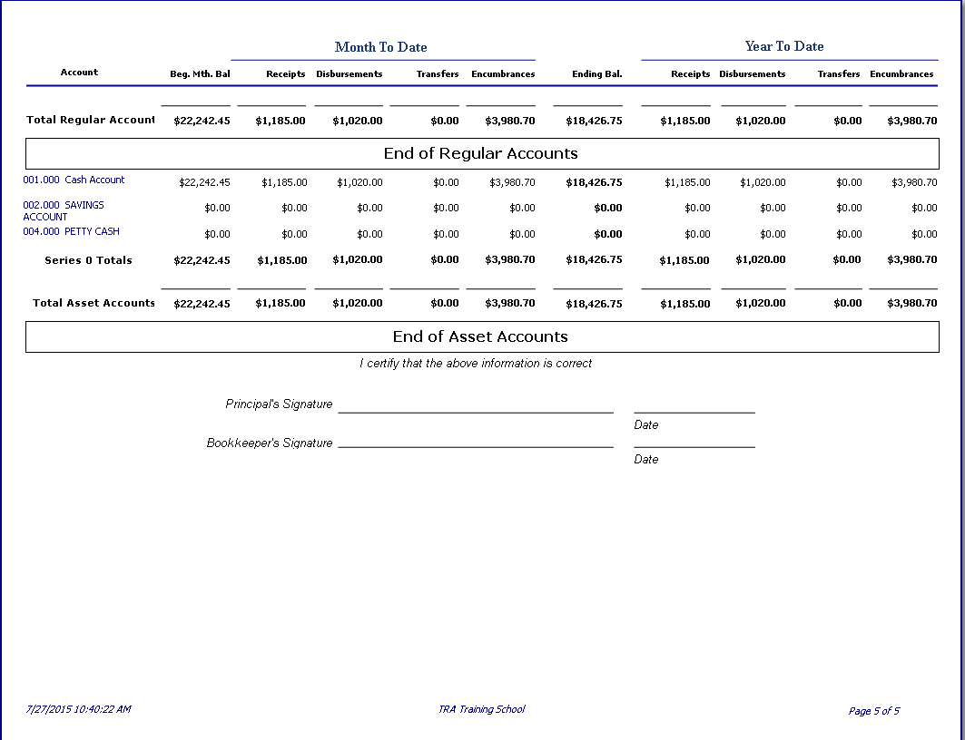
School Funds Cont’d
Reporting

Slide 33
Cash, Gift Cards, Gift Certificates
Applicable to both County and School Managed funds
Cash payments, gift cards, or gift certificates are not allowed.
IRS deems cash or cash equivalents as taxable wages. Gift cards circumvent policies, procedures and laws. Use of gift cards opens the door to embezzlement and fraud.
ONLY allowable exception: Exceptional Children Occupational Course of Study Program – for student instructional need.
Loans, personal or otherwise, are strictly prohibited.

Slide 34
Daily Deposit of Funds
Applicable to both County and School Managed funds
Board of Education policy 8325 states:
Except as otherwise provided by law, all monies collected or received by an officer, employee or agent of the school system or an individual school will be deposited in accordance with this policy. Each officer, employee and agent of the school system or individual school whose duty it is to collect or receive any taxes or other monies will deposit daily his or her collections and receipts. However, if the amount on hand is less than $250, daily deposits are encouraged but are not required. Regardless of the amount on hand, all funds will be deposited at the end of each school week and on the last business day of each month. All deposits will be made with the finance officer or designee or in an official depository. Deposits in an official depository will be reported immediately to the finance officer or individual school treasurer by means of a duplicate deposit ticket..
Cash receipts:
  Verify teachers/staff are turning in money timely.
  Verify treasurers are depositing funds securely in bank daily.
  Athletic/special event/ parking pass receipting according to guidelines.

Slide 35
Daily Deposit of Funds
Applicable to both County and School Managed funds
All funds received should be recorded one of two ways
Receipt (Teacher Receipt, Receipted at County Office)
      Bulk Receipt excludes board approved fees
Ticket Sales
This is applicable for athletic events, dances, movie night or any other event where a receipt is not issued.

Slide 36
Ticket Sale Procedures
School Managed
These procedures are to be used for any school event that requires payment to attend the event. Hand stamps may not be used in the place of tickets.
The Athletic Director is responsible for gate money at athletic events.
For other events (ex: dance) the staff member in charge of the event will be in charge of the sale of tickets and money box.
Athletic Director/Staff Member will prepare a cash box for each gate.
A record sheet for each box should be prepared; each gate box should be
maintained under dual control.
At the end of ticket sales, money should be counted by the two people at that gate and reconciled back to the number of tickets sold.

Slide 37
Ticket Sale Procedures cont’d
School Managed
Any variance should be adequately documented to explain reason for overage or shortage. The Treasurer will inform Principal of any overages/shortages in a timely manner so it can be addressed with employee.
Any variances over $5 must be signed off by the Principal.
Cash box is turned back in to the Athletic Director/Staff member.
Athletic Director/Staff member will verify that each cash box is counted and reconciled.
Receipt is prepared for total money collected and turned in to Treasurer with Financial Recap of sales.

Slide 38
Fundraisers - School Managed
School sponsored fund raisers are not an exception to Board policy and must follow the same guidelines for the receipt of money.
A purchase order must be in place before items to sell are purchased.
As money is turned in, it must be receipted in the teacher receipt book.
PTSO/PTA fundraisers are not part of school funds and should be handled solely by the PTSO/PTA.

Slide 39
Miscellaneous- School Managed
Grants received $5,000 and over, are to be sent to the Finance office. The grantee and finance will work together to create the accounts to be used when spending the money. Grants less than $5,000 can be deposited into school funds.
Financial Reporting - Each school shall file a monthly financial report with the Finance Department by the tenth of the following month as per North Carolina General Statute 115-100.31.
  Are monthly reports sent to finance timely?
  Are they reconciled and accurate?
  Did the principal and treasurer sign the report?

Slide 40
Miscellaneous- Cont’d
Applicable to both County and School Managed funds
Raffles
Are not authorized per CCS policy due to severe limitations on usage per North Carolina statue (GS 14-309.15).
Raffles are to be handled by PTO/PTA or boosters.

Slide 41
Miscellaneous- Cont’d
Applicable to both County and School Managed funds
A Petty cash fund should not be utilized.
Expenditures should be made in the form of check or store purchasing account and adhere to CCS expenditure policy.
Change Fund
It is permitted if start-up cash is needed for an event.
A purchase order must first be approved and signed by Principal.
The purchase order and check should be made payable to the athletic director, club advisor, or Treasurer.
The check should be charged to the appropriate fund.
After the event, the change fund/start-up cash should be separated from the proceeds of the event and deposited separately.
The bank deposit ticket should be marked “Redeposit of Change Fund”.
The proceeds from the event should be receipted in a teacher receipt book and deposited separately from the change fund redeposit.
.

Slide 42
Miscellaneous- School Managed
Transfers
A transfer occurs when an amount is subtracted from one account and added to another account.
All transfers should be approved by the Principal.
Transfers should only be used on rare occasions; each transfer should be adequately explained as to the justification of the transfer.
  Stating the transfer was to clear year end negative accounts is not considered adequate documentation

Slide 43
Miscellaneous – Cont’d
Applicable to both County and School Managed funds
Board Policy: 5030 Community Use of Facilities
The use of school facilities by community groups should be consistent with the education program and the goals and objectives of the board and school system.
Any individual or group that wishes to use a school facility must execute a written agreement regarding the use of the facility.
Costs for using designated facilities will be calculated in accordance with the fee schedule.
Non-Profit Organizations receive a 25% discount off the facility fee
Youth Organizations receive a 50% discount off the facility fee
In-kind contributions that goes toward the cost of facility rentals are allowed. The three most common examples, are service labor hours being provided to repair school fields or grounds, donated equipment or materials, and monetary contributions. For these situations, in-kind contributions have to be clearly noted, in the appropriate place, on the application for Community Use of School Facilities.

Slide 44
Miscellaneous – Cont’d
Applicable to both County and School Managed funds
Board Policy: 5030 Community Use of Facilities
All facility use applications with in-kind contributions should be send to Finance.
The eligibility of in-kind contributions depends on the following conditions being met:
In-kind contributions of materials, equipment, or monetary donations must be accompanied by receipts or documentation of value.
  A spreadsheet must be created to track total rental charges and deductions for monetary contributions, contributed services, and donated materials. A running total should be kept until it is used up (template attached).
  This documentation should be kept at the school but a copy must also be sent to Finance attached to the application for community use of school facilities.
  Evidence of monetary contributions require both of the following:
    Copy of the check from the donor
    Receipt from the school or parent organization that received the donation
    All fees must be collected two weeks prior to the scheduled event and if payment is not received the participants should not be allowed to use the facility.

Slide 45
Miscellaneous – Cont’d
Applicable to both County and School Managed funds
Board Policy : 7730 Conflict of Interest
Employees are expected to avoid engaging in any conduct that creates, or gives the appearance to the public of creating a conflict of interest with job responsibilities with the school system. While there may be other conflicts of interest, employees must follow board directives in the following areas.
Financial Interests: An employee or their spouse will not engage in selling goods or services to the board and will not engage in or have a financial interest, directly, or indirectly in any activity that conflicts with duties and responsibilities in the school system.

Slide 46
Personal Purchases and Checks
Applicable to both County and School Managed funds
No employee shall charge personal items to any account with intentions of paying the school/county office when the items are received. Funds may not be obligated for personal purposes.
Personal checks should not be cashed from school or county managed funds.

Slide 47
Authorized Check Signers
School Managed funds
The principal and school treasurer are the primary check signers. In cases of emergencies, the principal and treasurer should have backup personnel authorized to sign checks when the principal or treasurer is unavailable.
Checks should not be signed by two people of the same job “area”. (ex. Principal and assistant principal should not sign together nor should treasurer and treasurer back-up. Signature should be by administrator and treasurer or administrator and the treasurer back-up position.)
Finance must be notified of any changes in banking intuitions or changes to the signature card.
Signature stamps are not permitted on any financial or payroll documentation

Slide 48
Theft
In the event that money is stolen at the school, the Finance and Human Resources Department should be notified in writing immediately as well as a police report filed.
The principal and the Finance Department will decide whether the theft could have been avoided if all local school fund account procedures contained in the manual had been followed.
If procedures were not followed and the theft was a result of this negligence, then the negligent person will be held responsible for repaying the missing funds. If the Finance Procedures Manual was followed, and all necessary precautions were taken to safeguard the funds, then the principal would likely deem it appropriate that the missing funds be replaced out of the school’s General Fund. The Finance Department would assist the treasurer with this process. The principal should also consult with Finance Department as to what steps will be taken to avoid a recurrence.

Slide 49
School Audits
By law, by the end of the fiscal year, all accounting records of the school system, including the school funds, must be audited by a Certified Public Accountant. The Cabarrus County Board of Education selects the auditing firm. The auditing firm, selects a sample of the schools, performs audits, and issues a report as a part of the financial statements of the system.
All accounting records of each school must be closed out and in good order prior to the final independent audit. Each year, the schools are informed by the finance department of all year-end cut-off dates and audit procedures.
The finance department performs internal audits of each school, issues a report covering the financial standing of the school funds and expresses an opinion. The principal and the treasurer share responsibility of the school’s financial records and audit results. Audit results are reported to the Principal, the Treasurer, and the Superintendent for the principal’s evaluation file.

Slide 50
School Audits – cont’d
Audit results are communicated through an audit results letter the rankings are as follows:
  Blue (Excellent Job)
  Red (Good Job)
  Yellow (Needs Improvement)
  Caution
During the course of the audit areas for improvement are noted and addressed in a management letter which goes to the principal and treasurer only.

Slide 51
Ownership & Responsibility of School Audit
Whose audit is this?
  School’s audit
Who is responsible?
  Principal and Treasurer jointly
If it happened and it is not in compliance, it’s an audit exception.
It does not matter who is at fault!
Audit results get reported to:
  Principal
  Treasurer
  Superintendent (for principal’s evaluation file)

Slide 52
Payroll
Timekeeper Administrative approval:
Timekeeper is the system wide computer software we use to track employee time. Exempt employees are required to sign in daily but are not required to sign out for payroll, however hourly (non-exempt) employees are required to sign in and out.
Administrators are responsible for reviewing employees previous weeks’ time to ensure accuracy and must approve time every Monday by 1:00pm.
Each school must have at least one trained back up to guarantee employee time is approved by the weekly deadline.
Your staff can not be paid without timekeeper approval. It is imperative that you have a back up and a plan to ensure approval EVERY Monday by 1pm.
Regardless of rain, sleet, snow, holiday, or vacation, your staff has a zero tolerance for a late pay check.

Slide 53
Fair Labor Standards Act
FLSA overtime rules are an important aspect of workplace knowledge for both employers and employees. As a general rule, the Fair Labor Standards Act (FLSA) requires an employer to pay a non-exempt employee overtime pay at the rate of one and one-half times the employee’s regular rate of pay for any hours worked over 40 in a given workweek. The FLSA overtime rules clearly state that all time spent by an employee performing activities which are job-related is potentially “work time.” This includes the employee’s regular “on the clock” work time, plus “off the clock” time spent performing job-related activities (which benefit the employer). Potential work is actual work if the employer “suffered or permitted” the employee to do it. An employer suffers or permits work if it knows the employee is doing the work (or could have found out by looking), and lets the employee do it.

Slide 54
Your responsibility
All non-exempt staff MUST be paid for hours worked.
Non-exempt staff may NOT work off the clock.
If you know of a non-exempt staff member working off the clock – it must be reported.
Look around you – Is someone there when you get in and still there when you leave? You know you worked more than 8 hours. When you approve time – is there overtime? If not, ask questions.
It is a Principal’s responsibility to make sure time is recorded accurately.

Slide 55
Monthly vs. Bi-weekly pay
All hourly nonexempt employees are paid bi-weekly. (Every other Tuesday)
All certified and exempt employees are paid monthly at the end of the month.
10 Month Certified Staff are prepaid for a portion of their wages (paid in advance of work) every month
It is IMPERATIVE you communicate with payroll and HR as quickly as you know someone is leaving the system so they will not be overpaid.

Slide 56

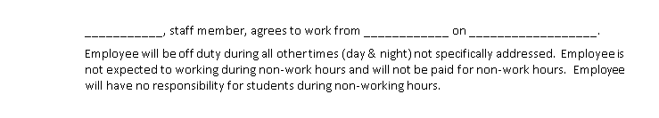
Overnight field trips
Exempt employees should be used for overnight field trips.
In rare instances where there is no other option, non-exempt staff may be used provided the following guidelines are followed:
  Non exempt staff must be given the option to decline.
  Non exempt staff is only paid for “working hours”.
  An “on duty- off duty” agreement must be signed by principal and employee clearly defining work hours prior to the field trip.

Slide 57
Teacher prepayment of salary
Background:
  During the 2004 Legislative session, House Bill 1464 (Session Law 2004-180) was passed and put into effect as of July 1, 2005.
  The bill required that the opening date of school for students “shall not be prior to August 25th and the closing date should not be after June 10th”.
  At the same time, existing legislature mandated teachers be paid a full months pay not later than August 31st.
  This initiated the beginning of Prepayment of salaries for teachers.
  This same bill also changed the school calendar from 220 days to 215 days

Slide 58
Period worked VS. When Paid
Month | Pay Period (21.5 Days) |  | Absence Period (Mon - Sun) *Sub Pay Period |  | Weeks in Absence Period | Pay Date
August | 08/17/16 | 09/15/16* | 07/18/16 | 08/21/16 | 5 | Wed, Aug 31, 2016
September | 09/15/16* | 10/14/16 | 08/22/16 | 09/18/16 | 4 | Fri, Sep 30, 2016
October | 10/17/16 | 11/15/16* | 09/19/16 | 10/16/16 | 4 | Mon, Oct 31, 2016
November | 11/15/16* | 12/14/16 | 10/17/16 | 11/20/16 | 5 | Wed, Nov 30, 2016
December | 12/15/16 | 01/13/17* | 11/21/16 | 12/18/16 | 4 | Wed, Dec 21, 2016
January 2017 | 01/13/17* | 02/13/17 | 12/19/16 | 01/22/17 | 5 | Tue, Jan 31, 2017
February | 02/14/17 | 3/15/17* | 01/23/17 | 02/19/17 | 4 | Tue, Feb 28, 2017
March | 03/15/17* | 04/13/17 | 02/20/17 | 03/19/17 | 4 | Fri, Mar 31, 2017
April | 04/14/17 | 05/15/17* | 03/20/17 | 04/16/17 | 4 | Fri, Apr 28, 2017
May | 05/15/17* | 06/13/17 | 04/17/17 | 05/21/17 | 5 | Wed, May 31, 2017
 | Total 215 Days
- TimeKeeper is pulled weekly. All absences, corrections, etc. must be completed and approved for the prior week by 1:00 pm each Monday for prior week time records.
- Each pay period has a half - day. (21.50 Days). * Denotes half day

Slide 59
Teacher Prepayment Continued
Prepayment has raised many issues for both administrators and teachers
  When you receive a check at the end of the month you are being prepaid through approximately the middle of the next month. For example in August the teachers will be paid on August 31st and it prepays them through September 15th. Refer to the previous slide for the remaining pay dates and pay periods.
  When a teacher leaves after the monthly check, but before the pay period ends the district is mandated to enforce collection of the over payment.
  Teachers are confused when they are not paid in June.
    The pay check in May pays through the end of the school year.
  Another time of confusion is retirement or other separation.

Slide 60
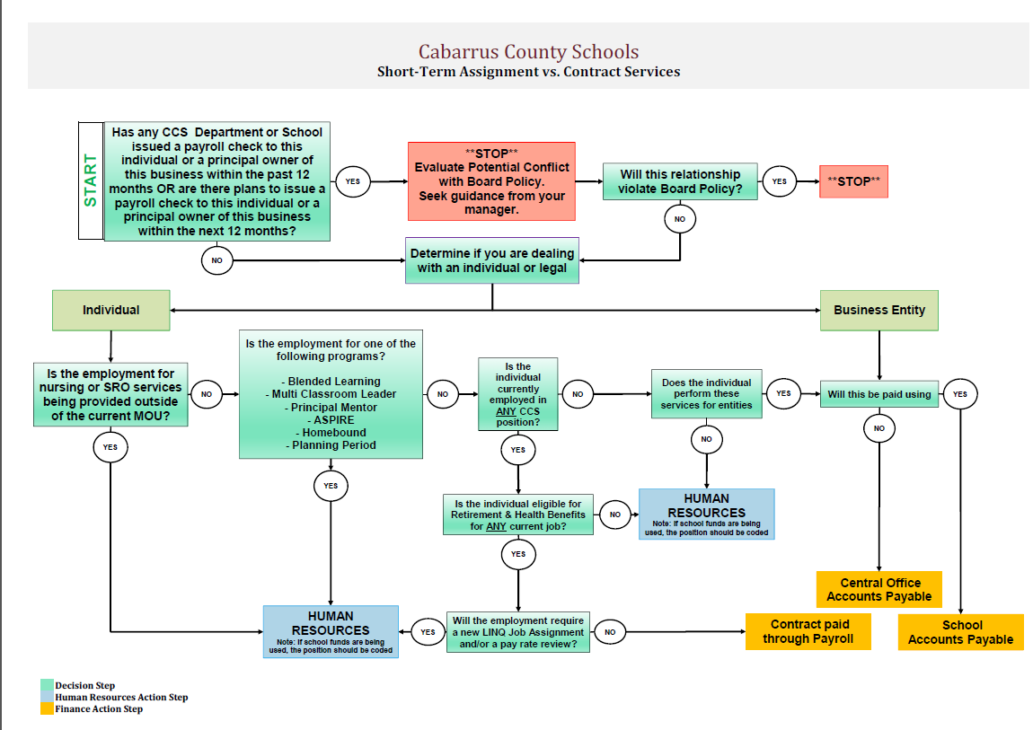
Contracts

Slide 61
Employee Payments
Employee Payments - No payments shall be made from school funds for personal services to any person currently in the employment of the school administrative unit. Compensation for services rendered must be paid through the Payroll Department.
**Reimbursement through Accounts payable is the only exception.
Please refer back to the conflict of interest policy

Slide 62
Stipend vs Supplement
Stipends are processed and paid through payroll for attendance of a staff development activity that occurs outside a regular workday.
Full day stipend rate for certified employee is $100
Full day stipend rate for non-certified employee is $70
Local Supplements are paid in addition to the state legislated certified salary.
Supplement | Month Paid
Athletic & Band | September
Certified Supplement | November & June
Academic Supplement/CTE | April
Athletic, Band, Chorus, Media Facilitator, Travel, ROTC | December & April
Administrators/Assistant Principals(School) | Monthly

Slide 63
Flex time - exempt
Due to the Fair Labor Standards Act (FLSA), non-exempt (hourly) employees cannot be awarded flex time. Exempt (salaried) employees are expected to fulfill all job duties; however, there may be circumstances where the awarding of flex time is appropriate.
A maximum of 5 days of flex time can be accrued each year. **
Flex time can only be accrued outside the regular workday.
Flex time may not be taken on student days.
The awarding of and use of flex time must be pre-approved by the principal.
Flex time must be tracked at each school (each school can determine the method best for them).
Flex time must be used by August 30th of the school year earned.
All flex time balances must be zeroed out at as of September 1 (flex time cannot rollover).

Slide 64
Flex time - exempt
Flex time can be awarded for the following:
Staff development offered in the summer or a Saturday for school or system issues (When a stipend is not paid).
Club and activities which improve the lives and climate of the school when a stipend or supplement is not paid. (A maximum or 1 flex day per club/activity).
Teachers who come to work before teacher workdays begin to setup classrooms. (A maximum of 2 flex days can be given).
Saturday functions at the school.
Working athletic events and after school events above and beyond the expected duties of a teacher.
Flex time cannot be awarded for the following:
  Teachers who are asked to cover other classes during planning periods.

Slide 65
School Nutrition
Account Charges:
Under Federal law, School Nutrition cannot incur a loss due to non-payment of a cafeteria account. All charges on accounts at the end of the school year are the responsibility of the school to pay for. School Nutrition will bill the school for any unpaid charges prior to June 30. The School Nutrition bookkeeper will notify the principal quarterly of the charges that are due. A report of charges can be obtained from the cafeteria manager at any time. The principal should work with the cafeteria manager during the year to keep charges at a minimum but at the same time ensure that children are getting the proper meals that they need.
The school should only be covering student charges; faculty charges should be recouped from the applicable staff members.

Slide 66
School Nutrition cont.
Dish Loss:
Cabarrus County Schools along with School Nutrition have agreed that schools will help cover the cost of dishes, bowls, silverware, and trays that are missing from the cafeteria each year. These items are inventoried quarterly and the principal is notified of any discrepancies. The School Nutrition bookkeeper will bill the losses back to the school prior to June 30. The principal should work with the cafeteria manager to ensure that there are minimal losses during the year. The most common causes for loss are students throwing the items in the trash and teachers/staff taking items back to their classrooms and not returning them.

Slide 67
School Nutrition
School Nutrition Statements should be reviewed monthly by the Treasurer and approved by the Principal
This statement should be reviewed for accuracy, reasonableness, repetitive student charges and any staff charges. The school should investigate these charges to determine the reason for nonpayment and also document the action taken regarding the outstanding charges. It is the school’s responsibility to monitor these charges on a monthly basis to prevent the accumulation of excessive charges. It is also the school’s responsibility to collect any outstanding charges.
Every effort should be made to collect these charges or determine if the student qualifies for free or reduced lunch or other alternative remedies. There may be rare extreme situations where charges may accumulate prior to qualifying for free or reduced lunch but this should be the exception to the rule and these charges should be minimal.
Staff is no longer allowed to accumulate any SNP charges. All charges must be cleared by the end of the school year either by the student or the school.
Under no circumstances should the school pay staff charges, these charges should be paid directly to SNP by the applicable staff member.

Slide 68
Budget changes & Entries
Applicable to County Managed funds
Proper planning and ensuring that budget amounts are set appropriately at the beginning of the year will prevent the need for Budget Journal Entries (BJE). BJE’s are used to set up budgets or transfer funds between accounts and should rarely be used.
BJE’s cannot cross funds or PRC’s, and only whole dollars can be moved (no cents). Please include an explanation as to why the funds need to be moved. BJE’s will not be processed without an explanation.
Forms should be submitted to Finance for approval 3 days in advance of needing to use the funds for purchases. Do not enter a requisition until the budget amendment has been processed.
A BJE form (link) must be printed, signed by the appropriate personnel, approved and keyed by the Finance department and maintained on file in Finance.

Slide 69
Sales Tax
CCS is required to pay sales tax on retail purchases or leases of tangible personal property and certain digital property.
Some services may also be taxable.
Sales tax is also applicable on receipts. This includes fundraisers, vending machine sales, concession sales, yearbook sales, etc.
  Basically, any time the school is making a profit sales tax will be due to the state of NC except for certain circumstances.
So, how do we handle?
  Ask questions of vendor and staff – they could have vital information that will affect how sales tax is handled. Make sure your treasurer is kept in the loop---we have discussed sales tax at length with them, they know all the guidelines and will be able to advise you.
  Use PTO/PTA and booster clubs where possible—these organizations are tax exempt and can avoid the difficulties with reporting sales tax.

Slide 70
Crowdsourcing and fundraising do’s and don’ts

Slide 71
Who to know!
Budget Audit & Compliance Financial Policies and Procedures Board Inquiries Public Requests for Data | Kelly Klutz, CPA Chief Financial Officer Kelly.kluttz@Cabarrus.k12.nc.us | 704.262.6144 704.467.1990(cell)
Instructional Supply Allotments Construction Projects Federal Programs Budget Audit & Compliance | Ed Emery, CPA Assistant Finance Officer edward.emery@cabarrus.k12.nc.us | 704.262.6137 704.792.5116(cell)
School Finance Policies School Internal Audits Treasurer Support Department Support Clerical/Custodial Allotments K12 Payments | Katrina Myers-Arnold Accountant Katrina.myers-arnold@Cabarrus.k12.nc.us | 704.262.6204 704.794.3164(cell)

