Slide 1
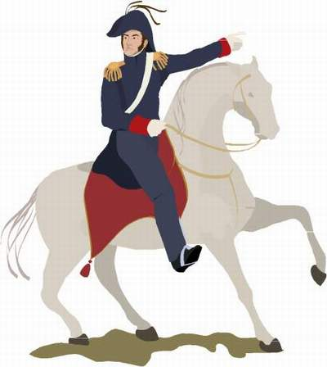
Revolutions in
Latin America
(19c - Early 20c)

Slide 2
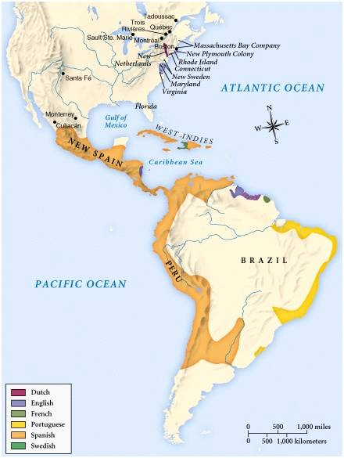
European Empires: 1660s

Slide 3
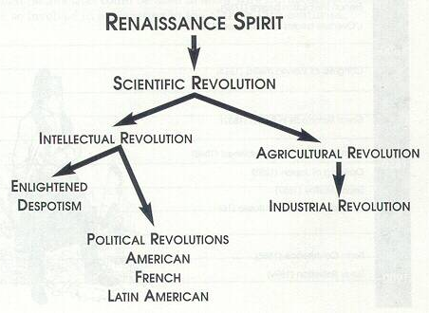
16c-18c:
New Ideas Brewing in Europe

Slide 4
Causes of Latin American
Revolutions
Enlightenment Ideas → writings of John Locke, Voltaire, & Jean Rousseau; Thomas Jefferson and Thomas Paine.
Creole discontent at being left out of government jobs and trade concessions.
Inspiration of American and French Revolutions.
Preoccupation of Spain & Portugal in fighting the Napoleonic Wars.

Slide 5
1. Enlightenment Ideas
Laws of nature [NATURAL LAWS] govern natural science and human society.
Give people rights → life, liberty, property!
Make fair societies based on reason possible.
Challenged the theory of “Divine Right” monarchy.

Slide 6
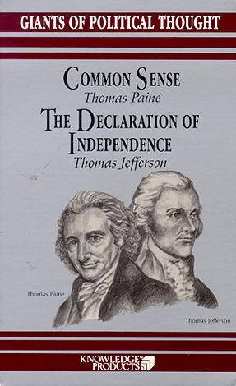
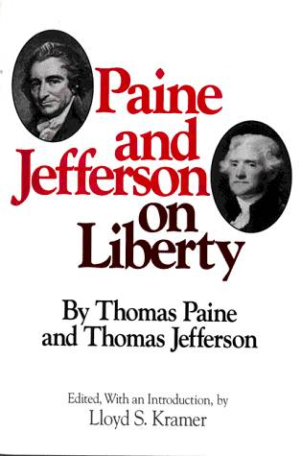
Enlightenment
Thinkers

Slide 7
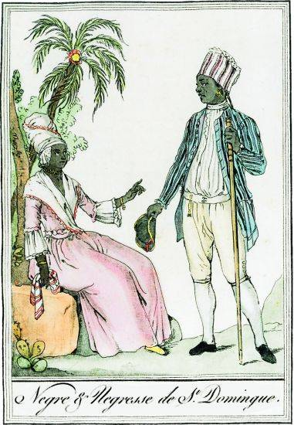
2. Creole Discontent

Slide 8
The Colonial Class System
Peninsulares
Creoles
Mestizos
Mulattos
Native Indians
Black Slaves

Slide 9
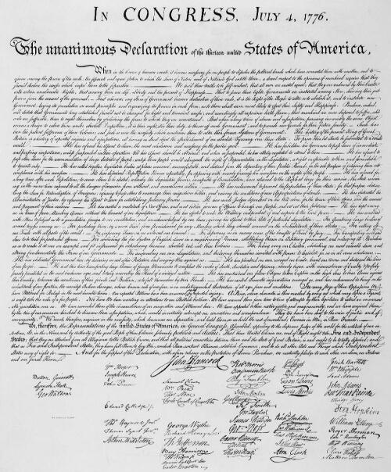
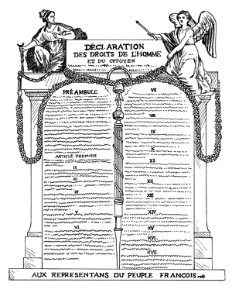
3. Inspiration of American & French Revolutions
Declaration of the Rights of Man & of the Citizen, 1789
Declaration of Independence, 1776

Slide 10
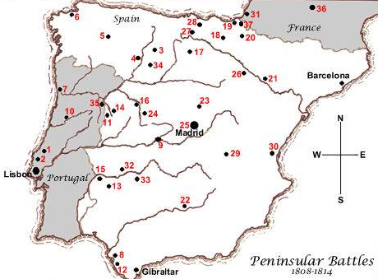
4. Preoccupation of Spain & Portugal In Fighting Napoleonic Wars

Slide 11
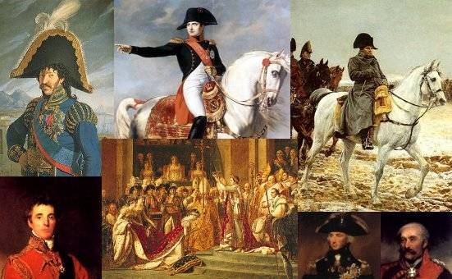
Napoleon on the March
Provides a model & a diversion!

Slide 12
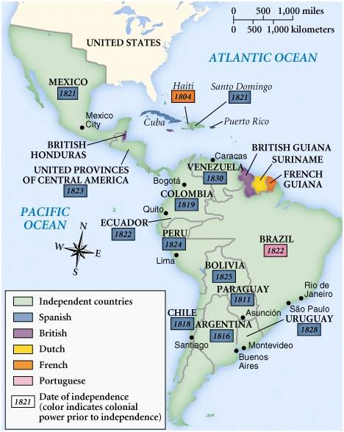
Latin American Revolutions!

Slide 13
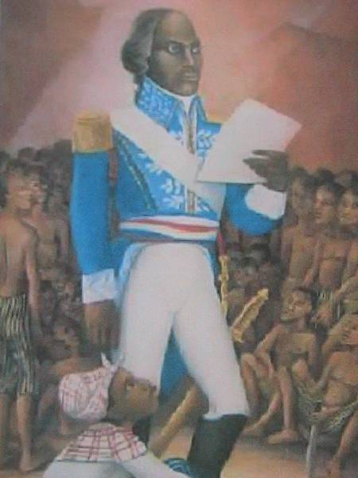
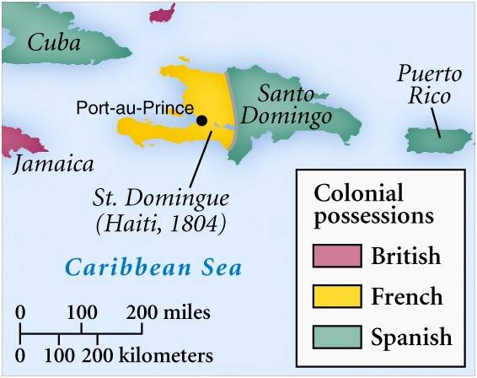
Toussaint L’Ouveture
Leads a Revolution
in Haiti
(1804)

Slide 14
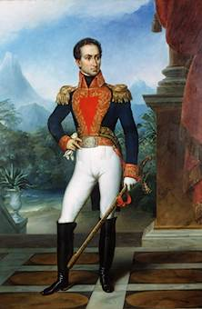
Simón Bolivar:
The “Brains”
of the
Revolution
Creole leader of the revolutions in Venezuela.
Spent time in Europe and the newly-independent United States.

Slide 15
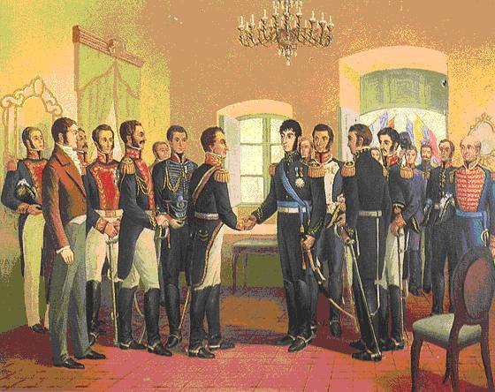
Simón Bolivar Meets José de San Martin

Slide 16
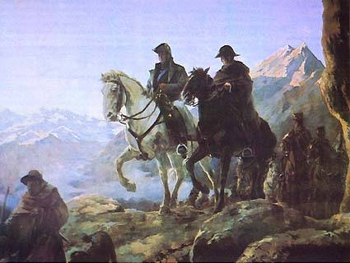
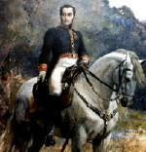
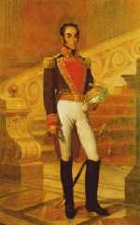
The “Muscle” of the Revolution
Bolivar coming from the North.
José de St. Martín and Bernard O’Higgins cross the Andes Mountains.

Slide 17
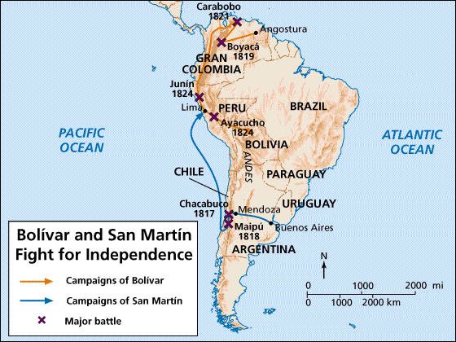
Bolivar & San Martin Fight for Independence!

Slide 18
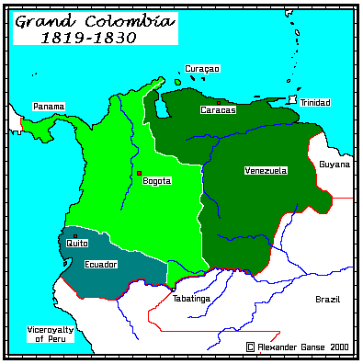
Bolivar’s Accomplishment

Slide 19
Bolivar’s Failure
After uniting Venezuela, Columbia, & Ecuador into Gran Columbia, he left to help free the rest of Latin America.
He died a year later, with his goal of uniting all of South America unfulfilled!

Slide 20
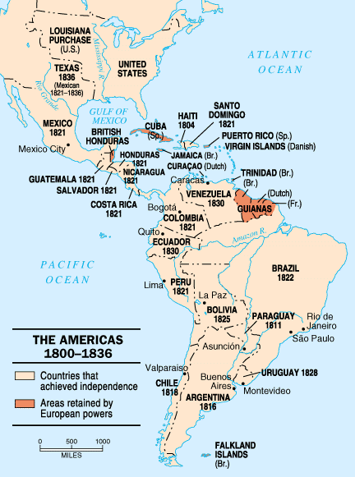
Latin
American
States
After the
Revolutions

Slide 21
Results
of the
Latin American
Revolutions

Slide 22
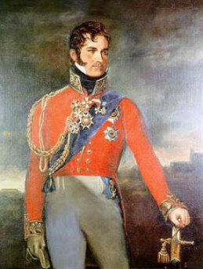
1. Brazil Freed from Portugal
The Portuguese royal family escaped Napoleon by fleeing to Brazil.
Pedro I set up a new, independent kingdom in 1821 when his father returned to Portugal.
Pedro II assumed full power after Pedro I abdicated his throne.

Slide 23
2. Independence
for Spanish & Portuguese Latin America
By the mid-1820s, revolts create many newly-independent nations.
  Toussaint L’Ouveture – Haiti
  Bolívar, San Martín, & O’Higgins in: Paraguay, Argentina, Chile, Uruguay, Peru, Bolivia, the United Provinces of Central America, and Gran Columbia!

Slide 24
3. No Unity!
Failure of Bolivar’s dream for a united South America:
  Many newly independent countries struggle with civil wars.
By 1830s, geographic factors (mts., the Amazon, etc.) plus cultural differences defeated attempts at unification.
  Gran Columbia.
  United Provinces of Central America.

Slide 25
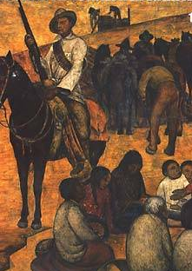
4. Independence Brought More Poverty
The wars disrupted trade.
The wars devastated the cities and the countryside.

Slide 26
5. Left Many Countries in the Control of Caudillos
WHO WERE THEY?:
  Mid-19c dictators → military authoritarianism.
  Mostly wealthy creole aristocrats.
  Immediately followed the fight for independence.
  Posed as reformers with goals to improve the economy and better the lives of the common people.

Slide 27
5. Left Many Countries in the Control of Caudillos
WHO WERE THEY?:
  BUT…Overthrew governments and took away basic human rights.
  Some attempted to make improvements, but most just cared about themselves and their families and friends [nepotism].
  Power changes usually occurred at bayonet-point [coup d’etats!]

Slide 28
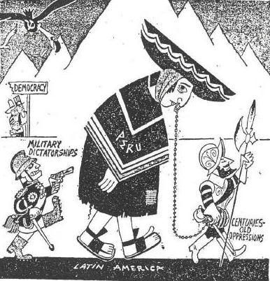
What is the Message?

Slide 29
Additional Problems
Feuds among leaders.
Geographic barriers.
The social hierarchy continued from the past.
Conservatives favored the old social order.
Liberals wanted land reform.
Dependence on foreign nations for capital and for economic investments.

Slide 30
United States Involvement

Slide 31
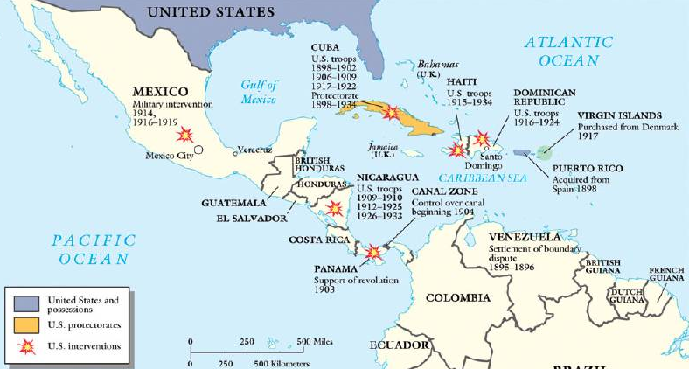
The Caribbean:
An “American Lake”

Slide 32
“The Colossus of the North”
US dominated affairs in the Americas.
1823 – Monroe Doctrine.
US takes Texas (1836) and Mexican Cession (1848).
US gains independence for Cuba (1898) in the Spanish-American War.
Roosevelt Corollary – US will police
the Americas.
US sent troops to Cuba, Haiti,
Mexico, Honduras, Nicaragua.
US built Panama Canal (1913)– “Yankee
imperialism.”- US troops aid Panamanian revolt against Colombia.

Slide 33
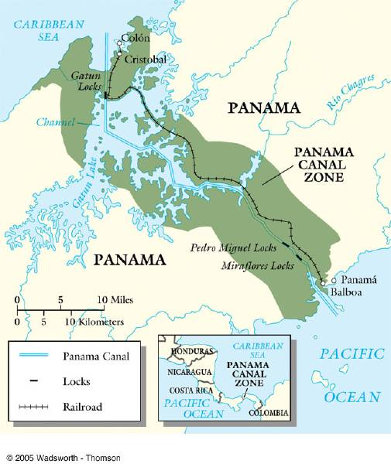
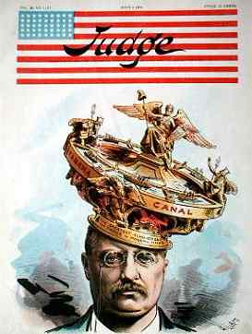
The Panama Canal
1904-1913

Slide 34
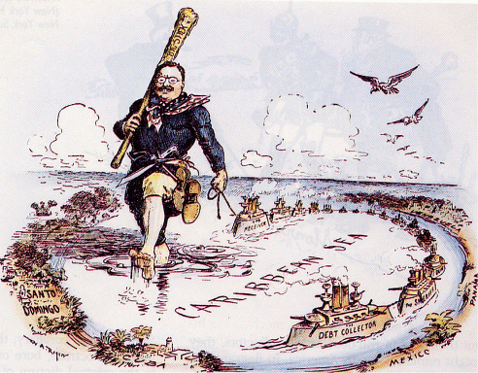
“Big Stick” Foreign Policy

Slide 35
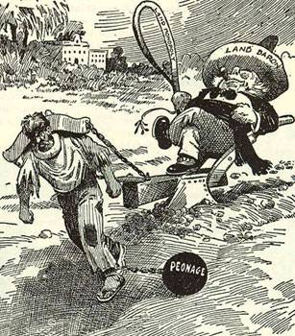
Cause of the Mexican Revolution of 1910?

Slide 36
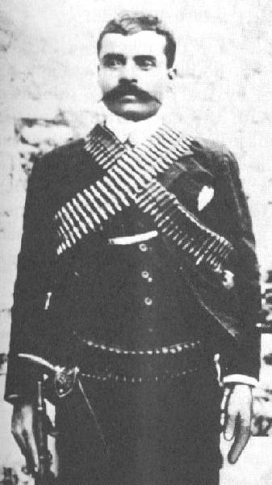
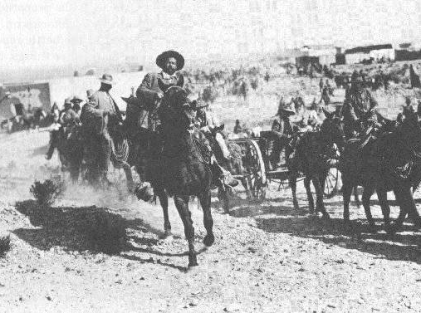
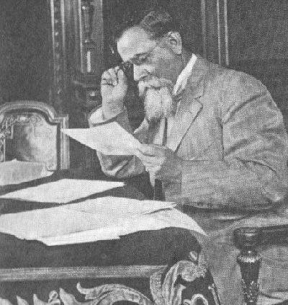
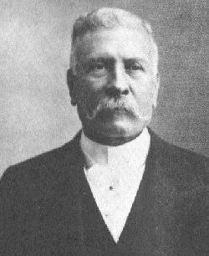
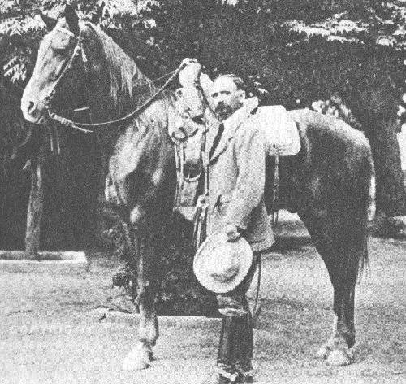
Mexican Revolutionaries
Emiliano
Zapata
Pancho Villa
Venustiano
Carranza
Francisco I Madero
Porfirio Diaz

Slide 37
The Mexican Revolution
Victoriano Huerta seizes control of Mexico and puts Madero in prison where he was murdered.
Venustiano Carranza, Pancho Villa, Emiliano Zapata, and Alvaro Obregon fought against Huerta.
The U.S. also got involved by occupying Veracruz and Huerta fled the country.
Eventually Carranza would gain power in Mexico.

Slide 38
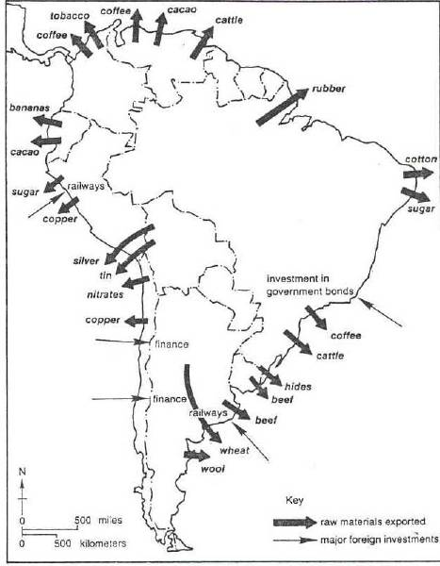
1913: Economic Imperialism?
US is a major investor in Latin America

Slide 39
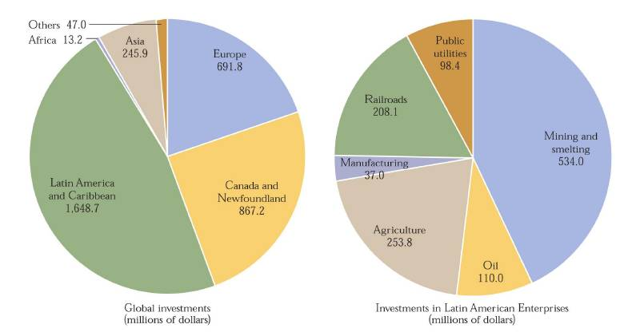
U. S. Global Investments
in 1914

Slide 40
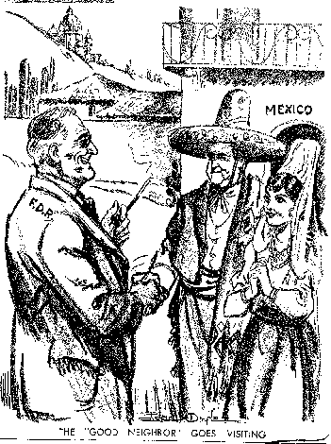
U. S. Good Neighbor Policy
1933, US President Franklin Roosevelt
Rejected use of military force in Latin America
1st time in 30 years
1934 – US withdraws Marines from Haiti

Slide 41
U. S. Great Depression Felt Across Latin America
Negative Effects:
Decreased demand for Latin American products
50 % decrease in exports
Positive Effects:
Developed their own industries
Eventually multinational corporations would form

Slide 42
Government & Political Development Mid-20th Century
Argentina:
Oligarchy: a government where a select group of people exercise control
Juan Peron set up labor unions and implemented Fascist policies
- government ruled by a dictator controls the lives of the people and in which people are not allowed to disagree with the government
Brazil:
Had an authoritarian government until 1985 it turned democratic

Slide 43
Government & Political Development Mid-20th Century
Mexico:
PRI (Industrial Revolutionary Party)
Student protests would lead to reform and increase in political parties
Privatization: sell of government-owned companies to private firms
Cuba:
Fidel Castro: est. Communist dictatorship (1959)
Guerrilla warfare
US declared trade embargo and broke diplomatic ties

Slide 44
Latin America Today
Population growth
Rise of cities and shantytowns which create a wealth gap between the rich and poor
Rise of drug trafficking in areas like Bolivia, Panama, and Colombia
Increased US investment since Congress passed the North American Free Trade Agreement (1994).

Slide 45
Resources
World History Glencoe
Jennifer Orr
Hickory Ridge High School
Harrisburg, NC
Ms. Susan M. Pojer & Ms. Lisbeth Rath
Horace Greeley HS Chappaqua, NY

