Slide 1
Skeletal System
IB Sport, Exercise and Health Science

Slide 2
Critical Thinking
Activity: Skeleton Observation
Consider the following definitions from the Collins Concise Dictionary Plus:
  Axis: a real or imaginary line about which an object, form, composition, or geometrical construction is symmetrical.
  Append: to add as a supplement; to attach; hang on.
  How does this relate to your observations of the skeleton? List the features you believe would be classified as axial and appendicular skeleton.

Slide 3
Axial vs. Appendicular
The skeleton can be thought of as 2 main divisions.
  The axial skeleton as the name implies, consisting of of those parts near the skeletal axis (the skull, the vertebral column, the ribs and sternum).
  The appendicular skeleton, consisting of the upper and lower extremities, the pelvic bone with the exception of the sacrum), and the shoulder girdle.

Slide 4
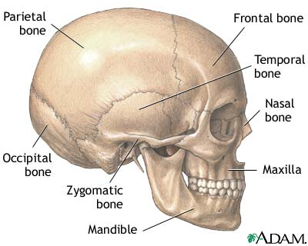
The Skull
There are 22 Bones that make up the skull
  8 bones in the brain case protect the brain and 14 facial bones form the structure of the face
  - Facial bones also provide attachment for muscles involved in chewing

Slide 5
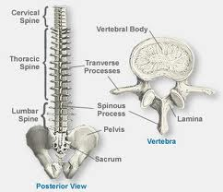
Vertebral Column
Extends from base of the skull to the pelvis and consists of 26 bones in 5 regions
5 Main functions
  Supports weight of head and trunk
  Protects the spinal cord
  Allows spinal nerve to exit
  Provides site for muscle attachment
  Permits movement of the head and trunk
Intervertabral Discs are pads are fibrocartilage located between the vertebrae
  Act as shock absorbers and allow for movement in the spine

Slide 6
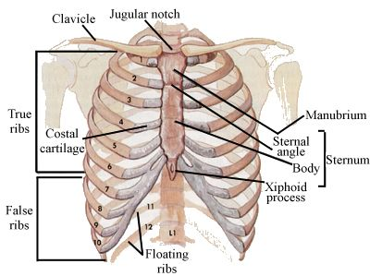
Thoracic Cage (Rib Cage)
Protects vital organs and forms chamber that can increase and decrease during breathing.
First seven ribs are called true ribs and attach directly to the Sternum
Inferior three ribs are false ribs and join to common cartilage
Bottom two ribs are floating ribs and do not attach to the sternum

Slide 7
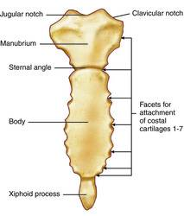
Sternum
Attachment for the ribs and help protect vital organs within the thorax
Broken into three parts
  Manubrium
  Body
  Xiphoid Process

Slide 8
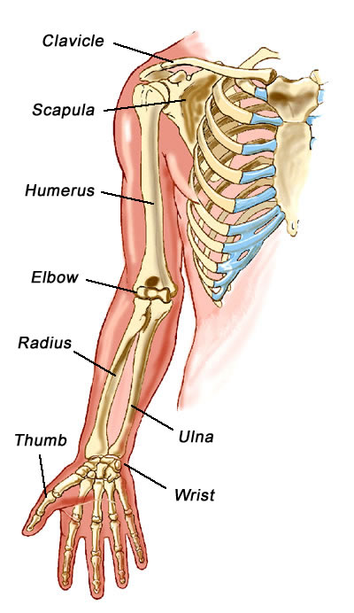
Upper Limb
One bone, the Humerus, goes from the shoulder to the elbow
  Attachment for muscles in the upper arm (biceps, triceps, deltoids)
Forearm made up of two bones
  Ulna on the medial side
  Radius on the lateral (thumb) side

Slide 9
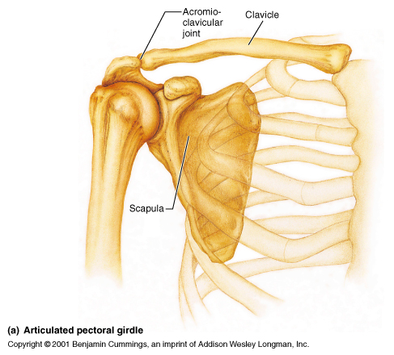
Pectoral Girdle
Consists of two scapulas and two clavicles
Scapula has attachment for humorous and numerous muscles
Clavicles attach to the acromion process on the scapula and to the axial skeleton on the sternum
Both enhance mobility of the upper limbs

Slide 10
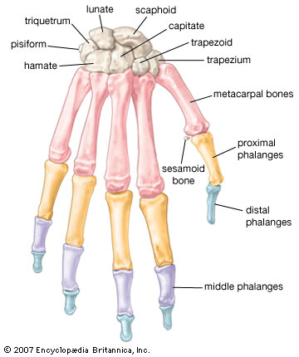
Wrist and Hand
Composed of eight carpal bones.
Metacarpal bones attach to the carpal bones and form the framework for the hand
Proximal, middle and distal phalanges make up the 4 fingers while thumb consists of just two (proximal and distal)

Slide 11
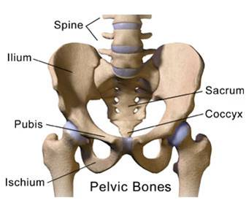
Pelvic Girdle
Attachment for lower limbs, supports weight of the body, attachment for thigh muscles and protects internal organs
Formed by three bones (ilium, ishium and pubis) fused together.

Slide 12
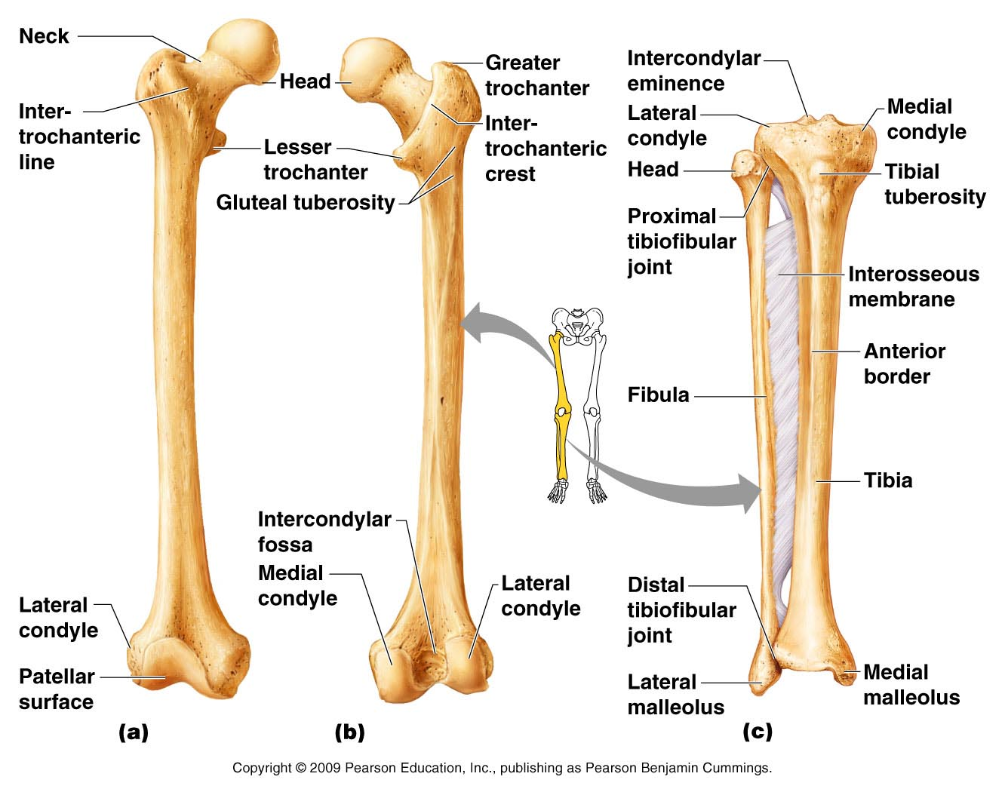
Lower Limb
Thigh consist of one bone- the femur
Lower leg includes two bones- Tibia and the fibula
All bones offer many sites for muscle attachments in the lower leg

Slide 13
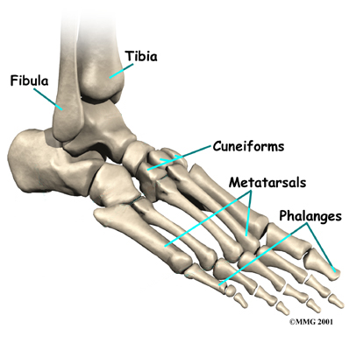
Foot
Consists of seven tarsal bones including the Calcaneus (heel) and the Talus (attach to tibia)
Metatarsals form the arch of the foot with phalanges similar to the structure of the hand making up the toes

Slide 14
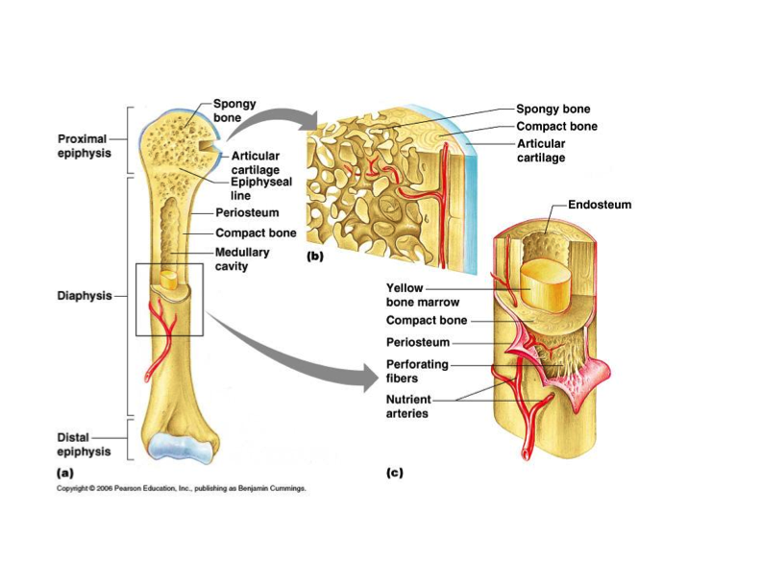
Structure of a Long Bone

Slide 15
Structure of a Long Bone
Diaphysis- shaft of a long bone consisitng of mostly compact bone
Spongy Bone- Located near the end of a long bone, has many spaces
Articular Cartilage- hyaline cartilage at the end of a long bone within a joint
Periosteum- connective tissue membrane that covers outer surface, contains blood vessels and nerves
Endosteum- single layer of cells lining the internal cavities within bones
Epiphyseal plate- growth plate between diaphysis and end of bone called epiphysis
Epiphyseal Line- Cartilage of plate replaced with bone when growing stops
Marrow Cavity- large internal space in diaphysis that contains marrow
Red Bone Marrow- site of blood cell formation, turns to yellow marrow (adipose tissue) as one ages

Slide 16
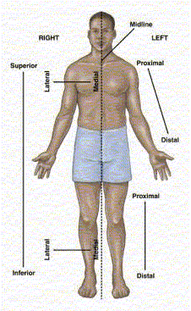
Anatomical Positions
Anatomical position refers to a person standing erect with the face directly forward, the upper limb hanging to the sides and the palms of the hands facing forward

Slide 17
Anatomical Directions
Superior- Nearer to the head, a structure above another
Inferior- Nearer to the feet, A structure below another
Anterior- Nearer to the front, the front of the body
Posterior- Nearer to the back, the back of the body

Slide 18
Anatomical Directions Cont.
Proximal- Nearer to the trunk, Closer to the point of attachment to the body than another structure
Distal- Farther from the trunk, Farther from the point of attachment to the body than another structure
Medial- Nearer to the media plane, toward the midline of the body
Lateral- Farther from the medial plane, Away from the midline of the body

Slide 19
Connective Tissue
Cartilage- Cartilage provides support and cushioning. It is found between the discs of the vertebrae in the spine, surrounding the ends of joints such as knees, and in the nose and ears
Ligament- connective tissue that attach two or more bones together. Ex. Glenohumeral Ligament, Anterior Cruciate Ligament
Tendon- Connective tissue that attach muscle to bone. Ex. Achilles Tendon

Slide 20
Joints
Joints is a place where two or more bones come together or articulate
  Some joints permit no movement , some small amounts and some large amount of movement depending on the structure.

Slide 21
Activity 1.3
Using the computers complete the worksheets 1.3 – Types of Joints in the Human Body

Slide 22
Joint
3 Types of Joints
      Fibrous Joints
      Cartilaginous Joints
      Synovial Joints

Slide 23
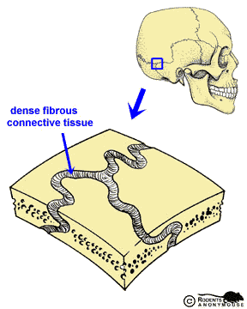
Fibrous Joints
Consist of two bones joined by fibrous connective tissue
Have no joint cavity, and allow little or no movement
Classified as sutures, syndesmoses, or gomophoses

Slide 24
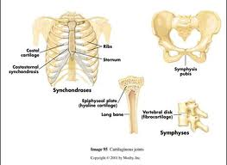
Cartilaginous Joints
Unite two bones using either hyaline cartilage or fibrocartilage
Synchondroses consist of two bones joined by hyaline cartilage and allow little or no movement
Symphyses unite two bones using fibrocartilage and allow for some movement. Ex. Intervertebral Discs

Slide 25
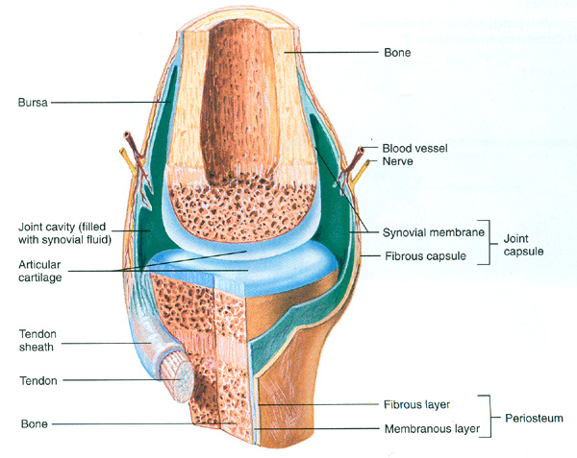
Synovial Joints
Freely moving joints that contain synovial fluid in a cavity around articulating bones
Most joints that unite the appendicular skeleton are large synovial joints

Slide 26
Parts and Functions of Synovial Joints
Articular Cartilage- thin line of hyaline cartilage providing smooth surface where the bones meet
Synovial Membrane- delicate membrane of connective tissue cells that line the joint cavity. Produces synovial fluid
Synovial Fluid- coats and lubricates articular cartilage preventing friction damage during movement
Ligament- join bone strengthening connection while limiting movement in some direction
Bursae- pocket above the synovial membrane. Contains synovial fluid and prevent structures (tendons) from rubbing
Meniscus- a fibrocartilage pad which absorb and distribute force
Articular Capsule- surrounds the ends of bones of synovial joints and contain a fibrous capsule and the synovial membrane

Slide 27
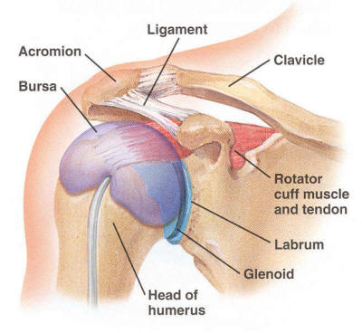
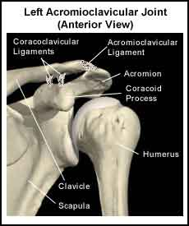
Shoulder Joint

Slide 28
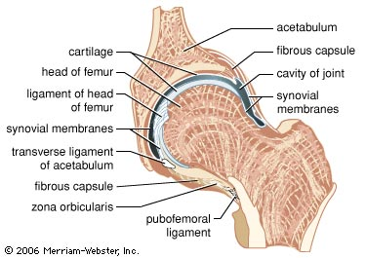
Hip Joint

Slide 29
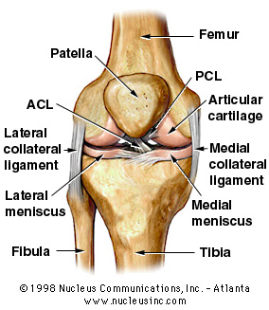
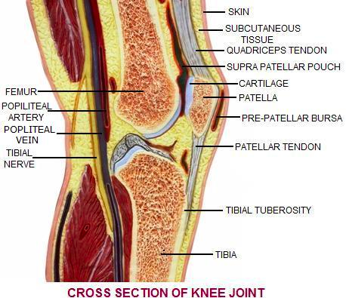
Knee Joint

Slide 30
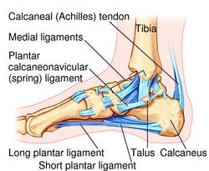
Ankle Joint

Slide 31
Types of Joint Movement in Synovial Joints
Adduction- movement toward the medial plane (to bring together)
Abduction- is movement away from the medial plane (to take away)
Flexion- is movement of a body part in the anterior direction, towards the coronal plane
Extension- is movement of a body part in the posterior direction, posterior to coronal plane

Slide 32
Types of Joint Movement in Synovial Joints
Pronation- rotation of the forearm so that the palms face inferiorly
Supination- rotation of the forearm so that the palms face superiorly
Elevation- moves a structure superiorly
Depression- moves a structure inferiorly
Rotation- turning of a structure around its long axis

Slide 33
Types of Joint Movement in Synovial Joints
Circumduction- combination of flexion, extension, abduction and addiction
Eversion- turning the ankle so the plantar surface faces laterally
Inversion- turning the ankle so the plantar surface faces medially
Plantar Flexion- Movement of foot towards the plantar surface (standing on toes)
Dorsi Flexion- movement of the foot towards the shin (walking on heel)

