Slide 1
Earths Movement

Slide 2
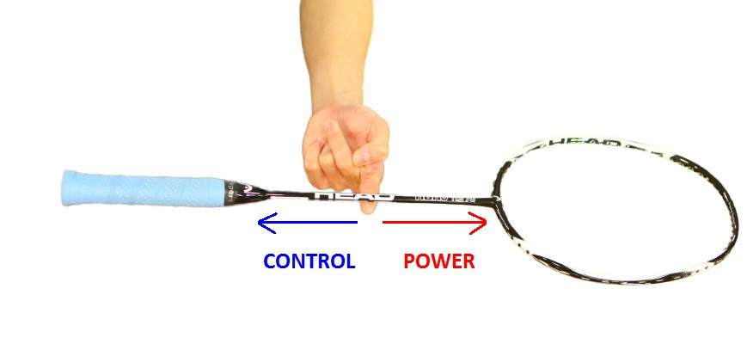
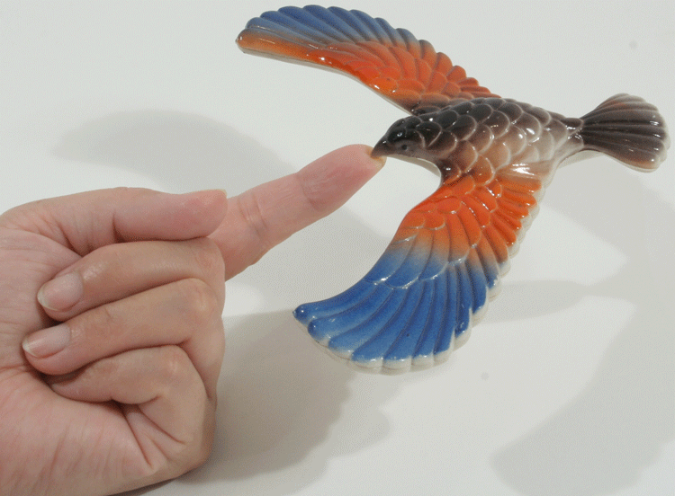
Barycenter
The point between two objects where they balance each other
  The center of mass where two or more celestial bodies orbit each other.
  When a moon orbits a planet, or a planet orbits a star, both bodies are actually orbiting around a point that lies outside the center of the larger body. (1,710 km)
Notes:
http://ecx.images-amazon.com/images/I/71PWRTtmO8L.gif

Slide 3
The Sun is not stationary in our solar system.
It actually moves as the planets tug on it, causing it to orbit the solar system’s barycenter.
The sun never strays too far from the solar system barycenter.
http://www.youtube.com/watch?v=1iSR3Yw6FXo

Slide 4
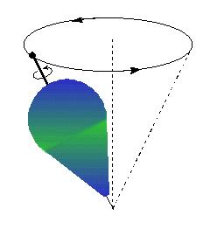
Precession
Change in the direction of the axis of the Earth, but without any change in tilt
This changes the stars near (or not near) the Pole, but does not affect the seasons
The Earth’s axis currently points at Polaris as the “Northern Star”, but it wont always be..
Each gyration around the cone takes 26,000 years

Slide 5
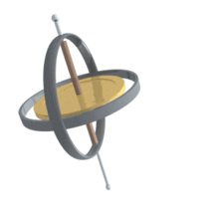

Slide 6
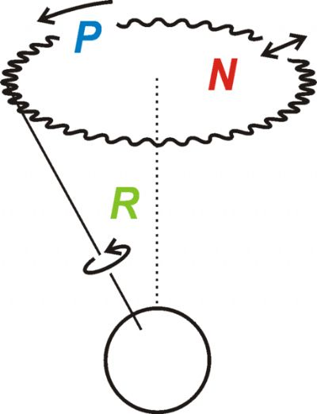
Nutation
Wobbling around the precessional axis
Change in the angle: ½ degree one way or the other
Occurs over an 18 year period and is due to the Moon
Very slightly increases or decreases seasonal effects

